Slide 1

Promotion and Tenure
Kevin A. Morano, Ph.D.
Professor, Microbiology & Molecular Genetics
Associate Dean for Faculty Affairs. McGovern Medical School
Associate Vice President of Faculty Affairs and Development, UTHealth

Slide 2
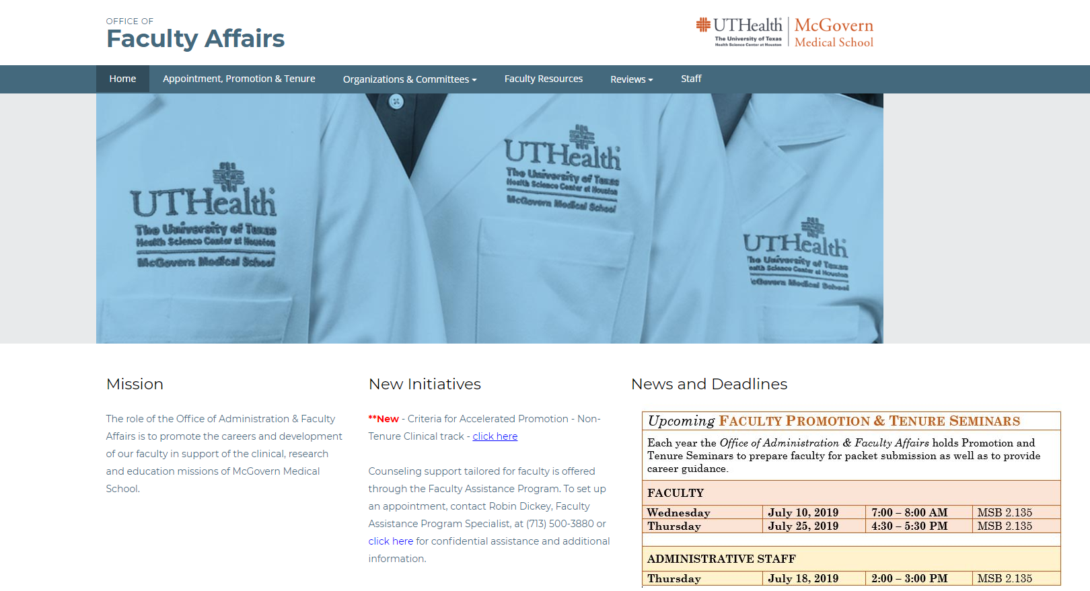

Slide 3
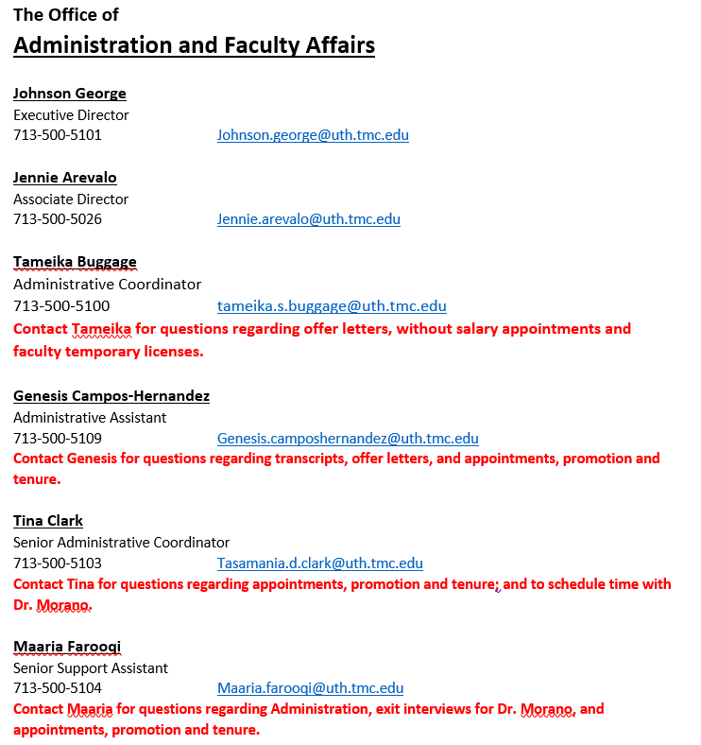

Slide 4
Academic Tracks
Clinical, non-tenure track
Research, non-tenure track
Tenure track
Clinician/Educator pathway
Scientist/Educator pathway
Faculty whose primary function is education can be promoted on the clinical or research non-tenure track

Slide 5
Ranks, Tracks, and Pathways to Promotion and/or Tenure via FAPTC
(tenure must be awarded before 9th year)
____________________________
Tenure track
clinician/educator
scientist/educator
FAPTC
3 yr min*
FAPTC
3 yr min*
Assistant
Professor
Associate
Professor
Professor
(-/+ tenure)
UAPTC
(-/+ tenure)
UAPTC
Track change **
(2 allowed)
Instructor
(not reviewed by FAPTC)
Non-tenure
clinical track
Assistant
Professor
FAPTC
3 yr min*
Associate
Professor
FAPTC
3 yr min*
Professor
FAPTC
3 yr min*
FAPTC
3 yr min*
Non-tenure
research track
Assistant
Professor
Associate
Professor
Professor
*Minimum of 3 years in rank is required for promotion (HOOP); however, less than
5 years at time of submission is considered accelerated.
** Requested by faculty member and approved by Dept. Chair and Dean, effective 9/1.
Time off the tenure track does not count toward the 9-year tenure probationary period.
5

Slide 6
Role and Philosophy of the FAPTC
Advisory to the Dean
“Gatekeepers”
Quality of the faculty
Reputation and future
of the institution

Slide 7
Readiness for Promotion
Purpose of the Annual Faculty Review
determine if the candidate is on track for promotion
give guidance and plan for the upcoming year.
The Department (Internal) Review Committee
reviews the candidate’s credentials with CV and 3 internal reference letters.
advises the Department Chair regarding the candidate’s promotion.
The Office of Faculty Affairs can review a candidate’s CV (in the UT format) in advance.
Associate Dean Morano will hold a 30 min. consultation session (Individual Promotion Plan; IPP) upon request with updated CV

Slide 8
Time Table
May 1 to August 31 – Department (Internal) Review Committee reviews recommendations
September 1 - Proposals due to the Dean, c/o Office of Faculty Affairs, ELECTRONIC SUBMISSION
March/April - Health Science Center - University Appointments, Promotions and Tenure Committee meets
May/June - Health Science Center report due in Austin
August - Board of Regents meet (re: tenure actions)
September 1 - Promotion and/or Tenure becomes effective

Slide 9
The Parts of Your Promotion Package
The Chair’s letter of nomination
CV in UT format
Promotion Narrative (required)
Letters of support (3) from colleagues within UTHealth but outside your department
List of 6 external references outside UTHealth* (“Department letters”)
Tenure track only: Faculty Affairs obtains references and letters from an additional 6 colleagues (“Dean’s letters”), who are nominated by those on your external reference list

Slide 10
Rules for External Letters
For tenure track candidates
at least 3 of the 6 external references submitted by the department should be from individuals outside of Houston who did not have personal contact with the candidate during training. Should demonstrate national/international peer esteem.
For non-tenure track candidates
at least 3 of the 6 external references submitted by the department should be from individuals who did not have personal contact with the candidate during training. External letters must be from various institutions outside of UTHealth and should demonstrate regional peer esteem.
External referees should be peers who know the candidate through professional accomplishments and not from a personal relationship.

Slide 11
A Comparison of Promotion on the Tenure and Non-Tenure Tracks
Tenure Track
“Department letters”
“Dean’s letters”
Must show a national or international reputation for focused scholarship; must be original, directed work
Requires a broader contribution to university (e.g., in more areas of endeavor)
Non-Tenure Track
“Department letters”
Must show a local/regional reputation in a focused area; need not be fully independent work
May have a narrower contribution to university (e.g., less teaching, committee service or research)

Slide 12
Review Process by FAPTC
For promotion to Associate Professor:
Primary and secondary FAPTC reviewers
assigned
Reviewers present dossier at FAPTC meeting with recommendations
FAPTC discusses and votes on recommendation,
which is forwarded to the Dean

Slide 13
Review Process by FAPTC
For promotion to Professor:
Ad hoc committee of 3 professors (FAPTC member as Chair and 2 MMS Professors)
Ad hoc committee reviews the dossier and prepares a report to FAPTC
The ad hoc committee chair presents the report at FAPTC meeting with recommendation
After discussion, the FAPTC votes on recommendation, which is forwarded to the Dean.

Slide 14
Dean’s Actions
Dean reviews the FAPTC recommendations and decides to endorse or not endorse them
The Dean notifies the candidate’s Department Chair of her decision
A copy of this letter is provided to the candidate

Slide 15
UTHealth Actions
The endorsed tenure track dossiers are forwarded to the EVP/CAO for the University Appointments, Promotions and Tenure Committee (UAPTC).
The outcome of the UAPTC action is conveyed to the Dean, who notifies the candidate via the Department Chair.

Slide 16
Expectations
Planning for Promotion and Tenure

Slide 17
Qualifying for Promotion: “Clinical Activities”
Clinical service is highly valued for its role in education and discovery
Volume, quality and impact
Quality improvement projects
Developing or expanding clinical programs
Innovation in techniques, instrumentation, procedures
Document all of your clinical obligations and expand on their impact

Slide 18
Qualifying for Promotion: “Scholarly Activities”
Evidence of scholarly activity can be in many forms, e.g., peer-publications, invited articles, awards and honors, participation on grants, patents issued/licensed, etc.
Presentations, case studies, speaking invitations
In general, the scholarly activity must be documentable and must demonstrate some impact on the candidate’s field.
Disseminated/adopted QI programs

Slide 19
Qualifying for Promotion: “Teaching Activities”
Many types of teaching/educational activities
Didactic, classroom teaching
PBL/TBL
One-on-one mentoring/training of undergraduates, graduate students (MS/PhD), medical students, postdocs, residents, fellows
Loosely interpreted – rounds, workshops, M&M discussions
Teaching effectiveness, evaluation and assessment should be included in Chair’s letter of nomination
Patient/community outreach and education

Slide 20
Qualifying for Promotion: “Service/Admin Activities”
Administrative activity is important to the institution, but it is rarely by itself the basis for promotion. Expected of all faculty at some level.
Committee work: division, department, school, university, hospital, society
Grant/guideline/paper reviewing
Leadership/admin examples: division director, medical director, etc.
Leadership roles important for promotion to senior ranks.

Slide 21
Non-tenure Clinical Track Revision Working Group
Joseph L. Alcorn, Ph.D., Associate Professor, Pediatrics (Neonatology)
Patricia M. Butler, M.B., Ch.B., Vice Dean, Educational Programs & Professor, Psychiatry
Semhar J. Ghebremichael, M.D., Assistant Professor, Anesthesiology
Mark J. Hobeika, M.D., Assistant Professor, Surgery (Immunology & Organ Transplantation)
Susan D. John, M.D., Chair & Professor, Diagnostic & Interventional Imaging
James J. McCarthy, M.D., Chair & Associate Professor, Emergency Medicine
Nancy O. McNiel, Ph.D., Associate Dean, Administrative Affairs
Philip R. Orlander, M.D., Associate Dean, Educational Programs & Professor, Internal Medicine (Endocrinology)
Nahid J. Rianon, M.B.B.S., Dr.P.H., Associate Professor, Internal Medicine (Geriatric & Palliative Medicine)
Mya C. Schiess, M.D., Professor, Neurology
Jennifer L. Swails, M.D., Assistant Professor, Internal Medicine (General Medicine)

Slide 22
Revised NTC Promotion Criteria
Four Domains of Achievement
Clinical/Patient Care
Research/Scholarship
Education
Service/Administration
Activity in any domain that only meets basic employment expectations will be described as Acceptable and will not contribute toward consideration for promotion.
Performance above and beyond this level will be described as Commendable and will count toward promotion.
A second level of extraordinarily high performance will be described as Exceptional.
Quantitatively, these levels of achievement will be given point values of 0, 1 and 2, respectively.

Slide 23
Revised NTC Promotion Criteria
For promotion to Associate Professor
1. Exceptional (2) in at least one domain.
2. At least a 1 in clinical.
3. Total of 4 points.
For promotion to Professor
1. Exceptional (2) in at least two domains.
2. At least a 1 in clinical.
3. Total of 5 points.
Chair’s letter and faculty narrative will build the case for proposed achievement levels and areas of focus

Slide 24
Revised NTC Promotion Criteria
Example A: An innovative clinician with high clinical productivity and quality, significant committee service and activity in resident education with little to no published research seeking promotion to Associate Professor might claim Clinical: 2, Service: 1, Education: 1.
Example B: A strong clinician with moderate clinical productivity and quality, multi-year appointment as Medical Director, and several published research papers or quality project reports seeking promotion to Associate Professor might claim Clinical: 1, Service: 2, Research: 1.
Example C: An innovative clinician with high clinical productivity and quality, bedside supervision of multiple trainees and additional didactic teaching, multi-year appointment as Residency Director, several case studies and one or two peer-reviewed publications and a strong record of hospital committee service, seeking promotion to Professor might claim Clinical: 2, Education: 2, Research: 1, Service: 1.
Example D: A strong clinician with moderate clinical productivity and quality, little to no exposure to trainees, no publications and service on several committees in the last five years would be scored Clinical: 1, Education: 0, Research: 0, Service: 1, and would not yet be competitive for promotion. (This last case may also represent a faculty better suited to move to a Staff Physician appointment).

Slide 25
Qualifying for Promotion: “Peer Esteem”
Reflects regional, national, international reputation
Clinical referrals, invited seminars/talks/meeting presentations
Grant review, journal review, invited reviews and book chapters
Overlaps with scholarship
Takes time and effort

Slide 26
Some Strategies for Getting Known Outside Your Institution
** Publish and present your work**
Join professional societies, go to meetings
Correspond with people whose work interests you
Agree to review grants, journal articles
Speak to the media, local and national organizations
Join large (national) collaborative research studies

Slide 27
Take Away Messages…
Know what is expected of you
Actively guide your career path
Assess your readiness for promotion
Make a timeline
Decide how best to direct your efforts in the time you have
Revisit your plan and make mid-course corrections as needed
Document your achievements carefully
Seek professional visibility
Be flexible!

Slide 28
Need A Hand?
Office of Administration and Faculty Affairs
713-500-5020
MSB G.420
Consultation
Information
Assistance

