Slide 1
UT FORMAT
MCGOVERN MEDICAL SCHOOL
CV FORMAT
FORMAT FOR CURRICULUM VITAE AND BIBLIOGRAPHY
NAME: Date
Number all pages at bottom right
PRESENT TITLE:
Assistant Professor of Pediatrics
or Clinical Assistant Professor of Pediatrics (part-time)
or Visiting Associate Professor of Pediatrics
ADDRESS:
McGovern Medical School at UTHealth
Department of ____, Division _____
6431 Fannin St., MSB _____, Houston, TX 77030
CITIZENSHIP: Do not include your social security #
UNDERGRADUATE EDUCATION: Do not include high school
GRADUATE EDUCATION:
POSTGRADUATE TRAINING: Internship, residency, fellowship

Slide 2
UT FORMAT
MCGOVERN MEDICAL SCHOOL
CV FORMAT
MILITARY SERVICE:
ACADEMIC APPOINTMENTS:
- Include current faculty rank and department
- List your appointment as McGovern Medical School at UTHealth and not HSC-Houston, unless you have an
appointment there
ADMINISTRATIVE AND HOSPITAL APPOINTMENTS:
Include your current appointment and the name of the hospital. For Memorial Hermann Hospital, list which location
LICENSURE: Lic. # _____, State
CERTIFICATION:
PROFESSIONAL ORGANIZATIONS: Local, Regional, National
HONORS AND AWARDS: List multiple awards once with inclusive dates
EDITORIAL POSITIONS:

Slide 3
UT FORMAT
MCGOVERN MEDICAL SCHOOL
CV FORMAT
SERVICE ON NATIONAL GRANT REVIEW PANELS, STUDY SECTIONS, COMMITTEES:
SERVICE ON THE UNIVERSITY OF TEXAS HEALTH SCIENCE CENTER AT HOUSTON COMMITTEES:
SERVICE ON THE MCGOVERN MEDICAL SCHOOL AT UTHEALTH COMMITTEES:
Examples: Curriculum Committee
Committee on Committees
Create a separate heading for DEPARTMENTAL COMMITTEES
SERVICE ON UT GRADUATE SCHOOL COMMITTEES:
SERVICE ON MCGOVERN MEDICAL SCHOOL AFFILIATED HOSPITAL COMMITTEES:
- Memorial Hermann Hospital
- Lyndon B. Johnson General Hospital
SERVICE TO THE COMMUNITY:
Internal and external to McGovern

Slide 4
UT FORMAT
MCGOVERN MEDICAL SCHOOL
CV FORMAT
SPONSORSHIP OF CANDIDATES FOR POSTGRADUATE DEGREE:
Names and years sponsored
SPONSORSHIP OF POSTDOCTORAL FELLOWS:
Names and years sponsored
CURRENT TEACHING RESPONSIBILITIES:
- # of students, residents, fellows
- Frequency
- List your role, the number of years and type of activity
you have been teaching
CURRENT CLINICAL AND SERVICE RESPONSIBILITIES:
List locations, frequency, clinic vs. hospital
CURRENT GRANT SUPPORT:
Project title, P.I., funding agency, award period and amount; a brief description is helpful
PAST GRANT SUPPORT:
Project title, P.I., funding agency, award period and amount; a brief description is helpful

Slide 5
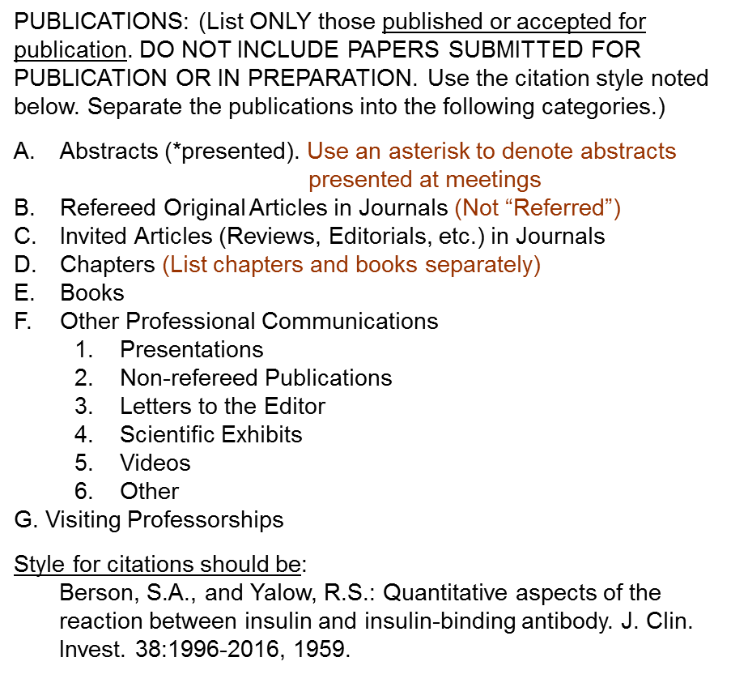
UT FORMAT
MCGOVERN MEDICAL SCHOOL
CV FORMAT

Slide 6
MCGOVERN MEDICAL SCHOOL
CV FORMAT
FONTS AND WHITE SPACE
To improve readability of your CV, we suggest that you use an easy-to-read 11pt or 12pt font size, i.e., Arial, Calibri, etc.
Times New Roman
or
Batang
Garamond
-vs.-
Arial
or
Calibri
Gulim

Slide 7
MCGOVERN MEDICAL SCHOOL
CV FORMAT
DO’s & DON’Ts
List items in chronological order beginning with the oldest at the beginning to the most recent at the end
The information in parentheses throughout the CV format is to help with CV content, so do not include on your CV
Use an 11pt. or 12 pt. font to improve readability of your CV
Delete categories that do not apply
List a multiple award only once with inclusive dates (Not a separate entry for each year)
The first time you use an abbreviation (MHH, LBJ, UTMS), spell it out and add the abbreviation after it. Thereafter, you may use the abbreviation
Do not duplicate entries
The bibliography should be lettered and numbered consecutively
Do not include publications submitted or in preparation

Slide 8
MCGOVERN MEDICAL SCHOOL
CV FORMAT
Need help with your CV?
Contact the Office of Faculty Affairs…..
To schedule an appointment with Dr. Morano to discuss CV content, please contact:
Tina Clark
713/500-5103
Tasamania.D.Clark@uth.tmc.edu
For questions regarding CV format, please contact:
Tina Clark
713/500-5103
Tasamania.D.Clark@uth.tmc.edu
- or -
Johnson George
713/500-5101
Johnson.George@uth.tmc.edu

