Slide 1


The Office of Administration & Faculty Affairs
invites McGovern Medical School Faculty appointed in the past year to
New Faculty Orientation
OCTOBER 21st, 2020 | 8 – 9:30 AM
WebEx

Slide 2

NEW FACULTY ORIENTATION
October 21.2020 | 8:00 – 9:30 AM
P r o g r a m
Welcome ( 8: 0 5 – 8: 1 0 )
Richard Andrassy, MD | Executive Dean ad interim, McGovern Medical School |
H. Wayne Hightower Distinguished Professor in the Medical Sciences
Richard.Andrassy@uth.tmc.edu
Academic Life | Promotion & Tenure | Grants 1 0 1 & 1 0 2 ( 8: 1 0 – 8: 25 )
Kevin A. Morano, PhD | Kevin.A.Morano@uth.tmc.edu
Associate Vice President | Faculty Affairs & Development
Associate Dean | Faculty Affairs
Director | New Investigator Development Program
Graduate Student Training ( 8: 25 – 8 :3 0)
William W. Mattox, PhD | Senior Associate Dean - Graduate School of Biomedical Sciences | William.Mattox@uth.tmc.edu
Office of Diversity & Inclusion ( 8 : 30 – 8 :3 5)
Pedro Mancias, MD | Assistant Dean - Diversity & Inclusion | Pedro.Mancias@uth.tmc.edu
Faculty & Educational Development ( 8: 35 – 8 :4 0 )
Allison Ownby, PhD | Assistant Dean for Faculty and Educational Development | Allison.R.Ownby@uth.tmc.edu
Women Faculty Forum ( 8 :40 – 8 :4 5 )
Mandy Hill, DrPH | Co-Chair | Mandy.J.Hill@uth.tmc.edu
Suur Biliciler, MD | Co-Chair | Suur.Biliciler@uth.tmc.edu
Office of Communications ( 8: 45 – 8 : 50 )
Darla Brown | Director | M.Darla.Brown@uth.tmc.edu
UTHealth Faculty Assistance Program| Academic Ombuds ( 8 :5 0 – 9 :0 0)
Robin Dickey, PhD, MA, LPC | Faculty Assistance Specialist | Academic Ombuds | Robin.Dickey@uth.tmc.edu
Intellectual Property and Commercialization ( 9 :0 0 – 9: 05)
Christine Flynn, PhD | Associate Director - Office of Technology Management | Christine.Flynn@uth.tmc.edu
Collaborative Research ( 9 : 05 – 9: 1 0)
Amy Hazen, PhD | Associate Director, Shared Research Resources | Amy.Hazen@uth.tmc.edu
Valerie Bomben, PhD | Supervisor, Specialized & Collaborative Research Agreements | Valerie.C.Bomben@uth.tmc.edu
Office of Postdoctoral Affairs ( 9 : 10 – 9 :1 5)
Leslie S. Beckman | Assistant Director | Leslie.Beckman@uth.tmc.edu
Secured Text Messaging ( 9 :1 5 – 9 : 2 0 )
Christina F. Solis, JD, MPH | Senior Legal Officer & Privacy Officer - Office of Legal Affairs | Christina.F.Solis@uth.tmc.edu
Salman Khan | Manager – IT Security | Salman.Khan@uth.tmc.edu
Questions / Answers ( 9 : 20 – 9 :3 0)

Slide 3
The Office of Administration & Faculty Affairs
Counseling and mentoring of faculty about their academic careers (i.e., offering comprehensive reviews of a faculty member’s curriculum vitae to enhance career advancement opportunities)
Promoting salary equity and equal opportunities for faculty
Seminars on the promotion and tenure process
New faculty orientation programs
Counseling of faculty regarding employment-related issues
Manage and coordinate Annual Faculty Reviews and Six-Year (post-tenure) Faculty Reviews
Serving as a liaison with the Texas Medical Board for institutional permits for faculty licensing and for permanent licensure problems
Assisting with faculty recruitment and retention
Identifying and offering programs to improve faculty skills (faculty development)
Conducting exit interviews with faculty leaving MMS

Slide 4

Promotion and Tenure
Kevin A. Morano, Ph.D.
Professor, Microbiology & Molecular Genetics
Associate Dean for Faculty Affairs, McGovern Medical School
Associate VP, Faculty Affairs and Development, UTHealth

Slide 5

Need A Hand?
Office of Administration and Faculty Affairs
713-500-5103 MSB G.420
Tina Clark: tasamania.d.clark@uth.tmc.edu
Consultation
Information
Assistance
CV Evaluation
Website: https://med.uth.edu/administration/

Slide 6




Academic Tracks
Clinical, non-tenure track
Research, non-tenure track
Instructor, non-tenure track
Tenure track
Clinician/Educator pathway
Scientist/Educator pathway

Slide 7

Expectations
Planning for Promotion and Tenure

Slide 8

Qualifying for Promotion: ‘Clinical Activities’
Clinical service is highly valued for its role in education and discovery.
Money generated is important to your department but not to your promotion
However, excellence in a clinical specialty DOES contribute to faculty promotion
Document all of your clinical obligations and expand on their impact
Highlight new services, clinics, any other innovations you have implemented
Highlight any clinical leadership roles

Slide 9
NTC Promotion Criteria
Four Domains of Achievement
Clinical/Patient Care
Research/Scholarship
Education
Service/Administration
Activity in any domain that only meets basic employment expectations will be described as Acceptable and will not contribute toward consideration for promotion.
Performance above and beyond this level will be described as Commendable and will count toward promotion.
A second level of extraordinarily high performance will be described as Exceptional.
Quantitatively, these levels of achievement will be given point values of 0, 1 and 2, respectively.

Slide 10
NTC Promotion Criteria
For promotion to Associate Professor
1. Exceptional (2) in at least one domain.
2. At least a 1 in clinical.
3. Total of 4 points.
For promotion to Professor
1. Exceptional (2) in at least two domains.
2. At least a 1 in clinical.
3. Total of 5 points.
*Chair’s letter and faculty narrative will build the case for proposed achievement levels and areas of focus*

Slide 11

Qualifying for Promotion: ‘Scholarly Activities’
Evidence of scholarly activity can be in many forms, e.g., publications, presentations, invited professorships, awards and honors, grants, etc.
In general, the scholarly activity must be documentable and must demonstrate some impact on the candidate's field.
Not only researchers, but also clinicians and educators are expected to have documentable scholarly work, although the evidence of scholarship may be different.

Slide 12


Qualifying for Promotion: ‘Teaching Activities’
Types of teaching/educational activities:
Didactic, classroom teaching
PBL
One-on-one mentoring/training of undergraduates, graduate students (MS/PhD), medical students, postdocs, residents, fellows
Loosely interpreted – rounds, workshops, M&M discussions
*Teaching effectiveness, evaluation and assessment should be included in Chair’s letter of nomination*

Slide 13
Qualifying for Promotion: ‘Service/Admin Activities’
Administrative activity is important to the institution, but it is rarely by itself the basis for promotion. Expected of all faculty.
Service to the university in the form of committees or other responsibilities is expected in those who gain promotion.
Consider carefully when is the right time for you to take on administrative duties since these take time and effort.
Leadership roles important for promotion to senior ranks.

Slide 14


Qualifying for Promotion: ‘Peer Esteem’
Reflects regional, national, international reputation
Clinical referrals, invited seminars/talks/meeting presentations
Grant review, journal review, invited reviews and book chapters
Overlaps with scholarship
“Visibility” – Does anyone know who you are?

Slide 15
Mentoring: Opportunities and Pitfalls
A good mentor can:
Direct you to opportunities
Open doors
Help you avoid problems
Share wisdom
Help you assess progress
Impart specific skills and knowledge

Slide 16

New Investigator Development Program
Grants 101: Overview of UTHealth policies/procedures
Grants 102: In-depth 6-month grant-writing workshop with mentored review process. Goal to submit grant application must be met!
Workbook: Grant Writers’ Seminars and Workshops, LLC (GWSW)

Slide 17

Grants 102
Mentored preparation of a research grant
Step-by-step advice from experienced and FUNDED faculty
Assembly, editing, streamlining
Logistics: budgets, staffing
Responding to critiques
SUCCESS!: 31% funding rate from over 275 graduates,
> $85M in funding

Slide 18
NEW FACULTY ORIENTATION
October 21.2020 | 8:00 – 9:30 AM
P r o g r a m
Welcome ( 8: 0 5 – 8: 1 0 )
Richard Andrassy, MD | Executive Dean ad interim, McGovern Medical School |
H. Wayne Hightower Distinguished Professor in the Medical Sciences
Richard.Andrassy@uth.tmc.edu
Academic Life | Promotion & Tenure | Grants 1 0 1 & 1 0 2 ( 8: 1 0 – 8: 25 )
Kevin A. Morano, PhD | Kevin.A.Morano@uth.tmc.edu
Associate Vice President | Faculty Affairs & Development
Associate Dean | Faculty Affairs
Director | New Investigator Development Program
Graduate Student Training ( 8: 25 – 8 :3 0)
William W. Mattox, PhD | Senior Associate Dean - Graduate School of Biomedical Sciences | William.Mattox@uth.tmc.edu
Office of Diversity & Inclusion ( 8 : 30 – 8 :3 5)
Pedro Mancias, MD | Assistant Dean - Diversity & Inclusion | Pedro.Mancias@uth.tmc.edu
Faculty & Educational Development ( 8: 35 – 8 :4 0 )
Allison Ownby, PhD | Assistant Dean for Faculty and Educational Development | Allison.R.Ownby@uth.tmc.edu
Women Faculty Forum ( 8 :40 – 8 :4 5 )
Mandy Hill, DrPH | Co-Chair | Mandy.J.Hill@uth.tmc.edu
Suur Biliciler, MD | Co-Chair | Suur.Biliciler@uth.tmc.edu
Office of Communications ( 8: 45 – 8 : 50 )
Darla Brown | Director | M.Darla.Brown@uth.tmc.edu
UTHealth Faculty Assistance Program| Academic Ombuds ( 8 :5 0 – 9 :0 0)
Robin Dickey, PhD, MA, LPC | Faculty Assistance Specialist | Academic Ombuds | Robin.Dickey@uth.tmc.edu
Intellectual Property and Commercialization ( 9 :0 0 – 9: 05)
Christine Flynn, PhD | Associate Director - Office of Technology Management | Christine.Flynn@uth.tmc.edu
Collaborative Research ( 9 : 05 – 9: 1 0)
Amy Hazen, PhD | Associate Director, Shared Research Resources | Amy.Hazen@uth.tmc.edu
Valerie Bomben, PhD | Supervisor, Specialized & Collaborative Research Agreements | Valerie.C.Bomben@uth.tmc.edu
Office of Postdoctoral Affairs ( 9 : 10 – 9 :1 5)
Leslie S. Beckman | Assistant Director | Leslie.Beckman@uth.tmc.edu
Secured Text Messaging ( 9 :1 5 – 9 : 2 0 )
Christina F. Solis, JD, MPH | Senior Legal Officer & Privacy Officer - Office of Legal Affairs | Christina.F.Solis@uth.tmc.edu
Salman Khan | Manager – IT Security | Salman.Khan@uth.tmc.edu
Questions / Answers ( 9 : 20 – 9 :3 0)

Slide 19

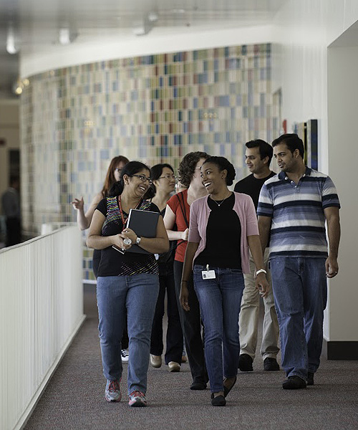

Degree Programs: PhD, MS and MD/PhD
Research Areas (PhD/MS)
Biochemistry and Cell Biology
Cancer Biology
Immunology
Genetics and Epigenetics
Medical Physics
Microbiology and Infectious Disease
Neuroscience
Quantitative Sciences
Therapeutics and Pharmacology
Specialized Master of Science (SMS)
Genetic Counseling
Medical Physics
Umbrella
Admissions

Slide 20
GSBS Faculty Membership
Degree Programs: PhD, MS and MD/PhD
Joining GSBS - faculty must apply for membership
Any UTHealth faculty member may apply
New Faculty are welcome!
Membership Categories
Associate Member – MS student advisor only
Regular Member – PhD or MS student advisor
More information
gsbs.uth.edu/faculty
william.mattox@uth.tmc.edu

Slide 21
NEW FACULTY ORIENTATION
October 21.2020 | 8:00 – 9:30 AM
P r o g r a m
Welcome ( 8: 0 5 – 8: 1 0 )
Richard Andrassy, MD | Executive Dean ad interim, McGovern Medical School |
H. Wayne Hightower Distinguished Professor in the Medical Sciences
Richard.Andrassy@uth.tmc.edu
Academic Life | Promotion & Tenure | Grants 1 0 1 & 1 0 2 ( 8: 1 0 – 8: 25 )
Kevin A. Morano, PhD | Kevin.A.Morano@uth.tmc.edu
Associate Vice President | Faculty Affairs & Development
Associate Dean | Faculty Affairs
Director | New Investigator Development Program
Graduate Student Training ( 8: 25 – 8 :3 0)
William W. Mattox, PhD | Senior Associate Dean - Graduate School of Biomedical Sciences | William.Mattox@uth.tmc.edu
Office of Diversity & Inclusion ( 8 : 30 – 8 :3 5)
Pedro Mancias, MD | Assistant Dean - Diversity & Inclusion | Pedro.Mancias@uth.tmc.edu
Faculty & Educational Development ( 8: 35 – 8 :4 0 )
Allison Ownby, PhD | Assistant Dean for Faculty and Educational Development | Allison.R.Ownby@uth.tmc.edu
Women Faculty Forum ( 8 :40 – 8 :4 5 )
Mandy Hill, DrPH | Co-Chair | Mandy.J.Hill@uth.tmc.edu
Suur Biliciler, MD | Co-Chair | Suur.Biliciler@uth.tmc.edu
Office of Communications ( 8: 45 – 8 : 50 )
Darla Brown | Director | M.Darla.Brown@uth.tmc.edu
UTHealth Faculty Assistance Program| Academic Ombuds ( 8 :5 0 – 9 :0 0)
Robin Dickey, PhD, MA, LPC | Faculty Assistance Specialist | Academic Ombuds | Robin.Dickey@uth.tmc.edu
Intellectual Property and Commercialization ( 9 :0 0 – 9: 05)
Christine Flynn, PhD | Associate Director - Office of Technology Management | Christine.Flynn@uth.tmc.edu
Collaborative Research ( 9 : 05 – 9: 1 0)
Amy Hazen, PhD | Associate Director, Shared Research Resources | Amy.Hazen@uth.tmc.edu
Valerie Bomben, PhD | Supervisor, Specialized & Collaborative Research Agreements | Valerie.C.Bomben@uth.tmc.edu
Office of Postdoctoral Affairs ( 9 : 10 – 9 :1 5)
Leslie S. Beckman | Assistant Director | Leslie.Beckman@uth.tmc.edu
Secured Text Messaging ( 9 :1 5 – 9 : 2 0 )
Christina F. Solis, JD, MPH | Senior Legal Officer & Privacy Officer - Office of Legal Affairs | Christina.F.Solis@uth.tmc.edu
Salman Khan | Manager – IT Security | Salman.Khan@uth.tmc.edu
Questions / Answers ( 9 : 20 – 9 :3 0)

Slide 22
Office of Diversity and Inclusion
Pedro Mancias, MD

Slide 23
Who we are…
Dr. LaTanya Love
Executive Vice President for Student Affairs and Diversity at UTHealth
Dr. Pedro Mancias
Assistant Dean of Diversity and Inclusion
Dr. Asia McCleary-Gaddy
Ms. Luna Hernandez
Director of Diversity and Inclusion
Sr. Administrative Assistant
Associate Professor, Department of Pediatrics (Med-Peds)
Dean of Education ad interim, McGovern Medical School
Professor, Department of Pediatrics

Slide 24
Diversity is…..
Gender
Generation
Religion
LGBT
Ethnicity
Physical
Abilities
Language
Homogeneity does not foster innovation!
Notes:
Ethnicity is last on this list..

Slide 25
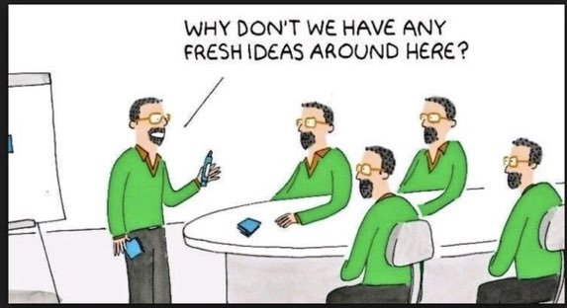
https://twitter.com/CurtisSChin/status/1090782460386848768

Slide 26
What is Inclusion?
The state of being valued, supported, and heard
The overall feeling of being a part of the community

Slide 27

Inclusion means you!

Slide 28
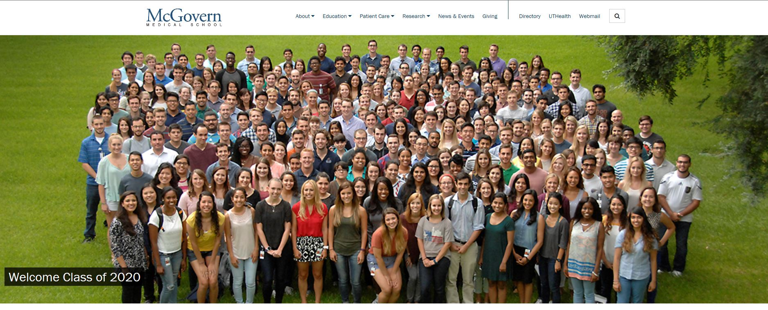

Slide 29
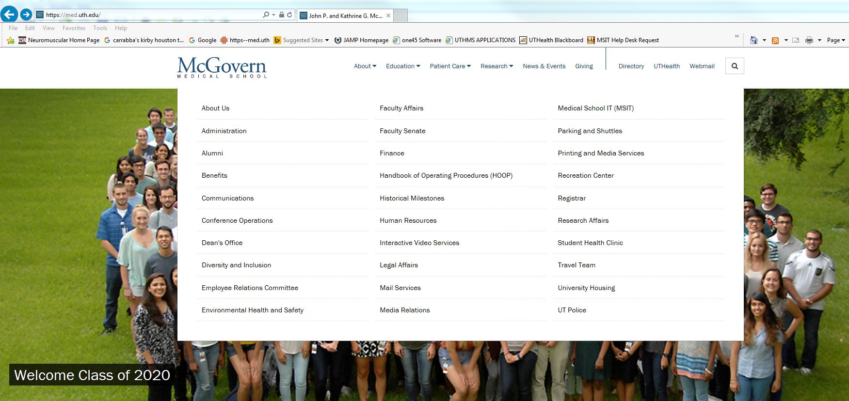

Slide 30
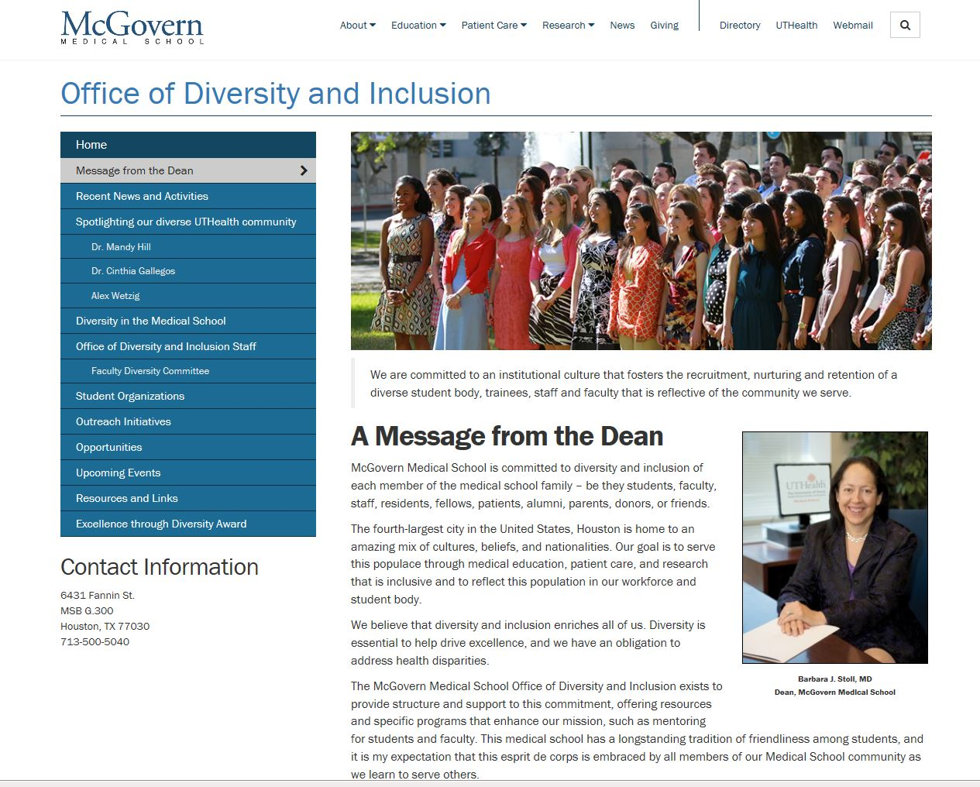

Slide 31
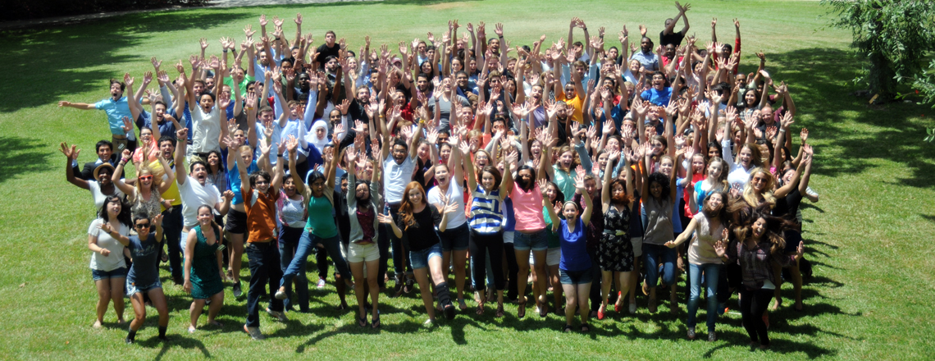
Who do we serve?
McGovern Medical School!

Slide 32
What we do…
Climate surveys
Diversity Weeks
Bulletin board of opportunities for research, funding or training
Workshops on cultural competency

Slide 33
Other…
Outreach programs for area grade school students
JAMP
Walk-in advising/mentoring for students

Slide 34
Also…
Mentoring for junior faculty members
Needs assessments for MMS overall and for individual departments
Present inclusion in search committees
Support faculty for promotion and tenure
Highlight faculty members on our webpage
Mixers for faculty members
Help sponsor faculty to attend AAMC early and mid-career faculty developmental conferences

Slide 35
What can you do?
Respond to our surveys and emails
Come to our events
Submit suggestions for more programs
We are here for you!

Slide 36
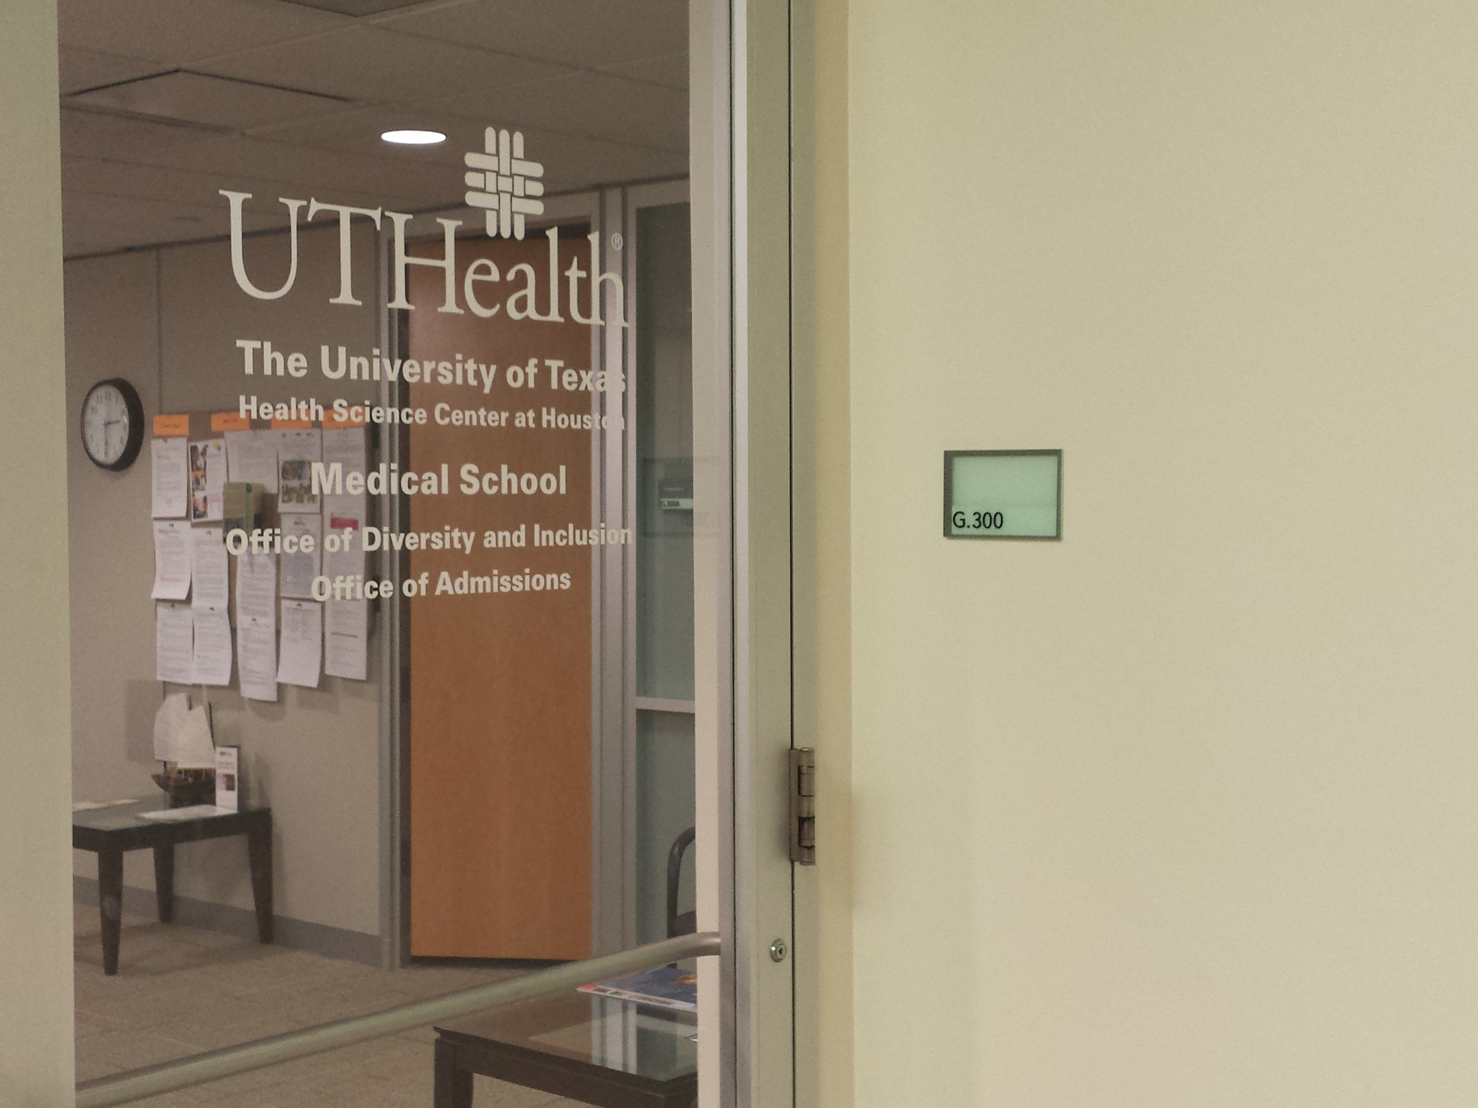
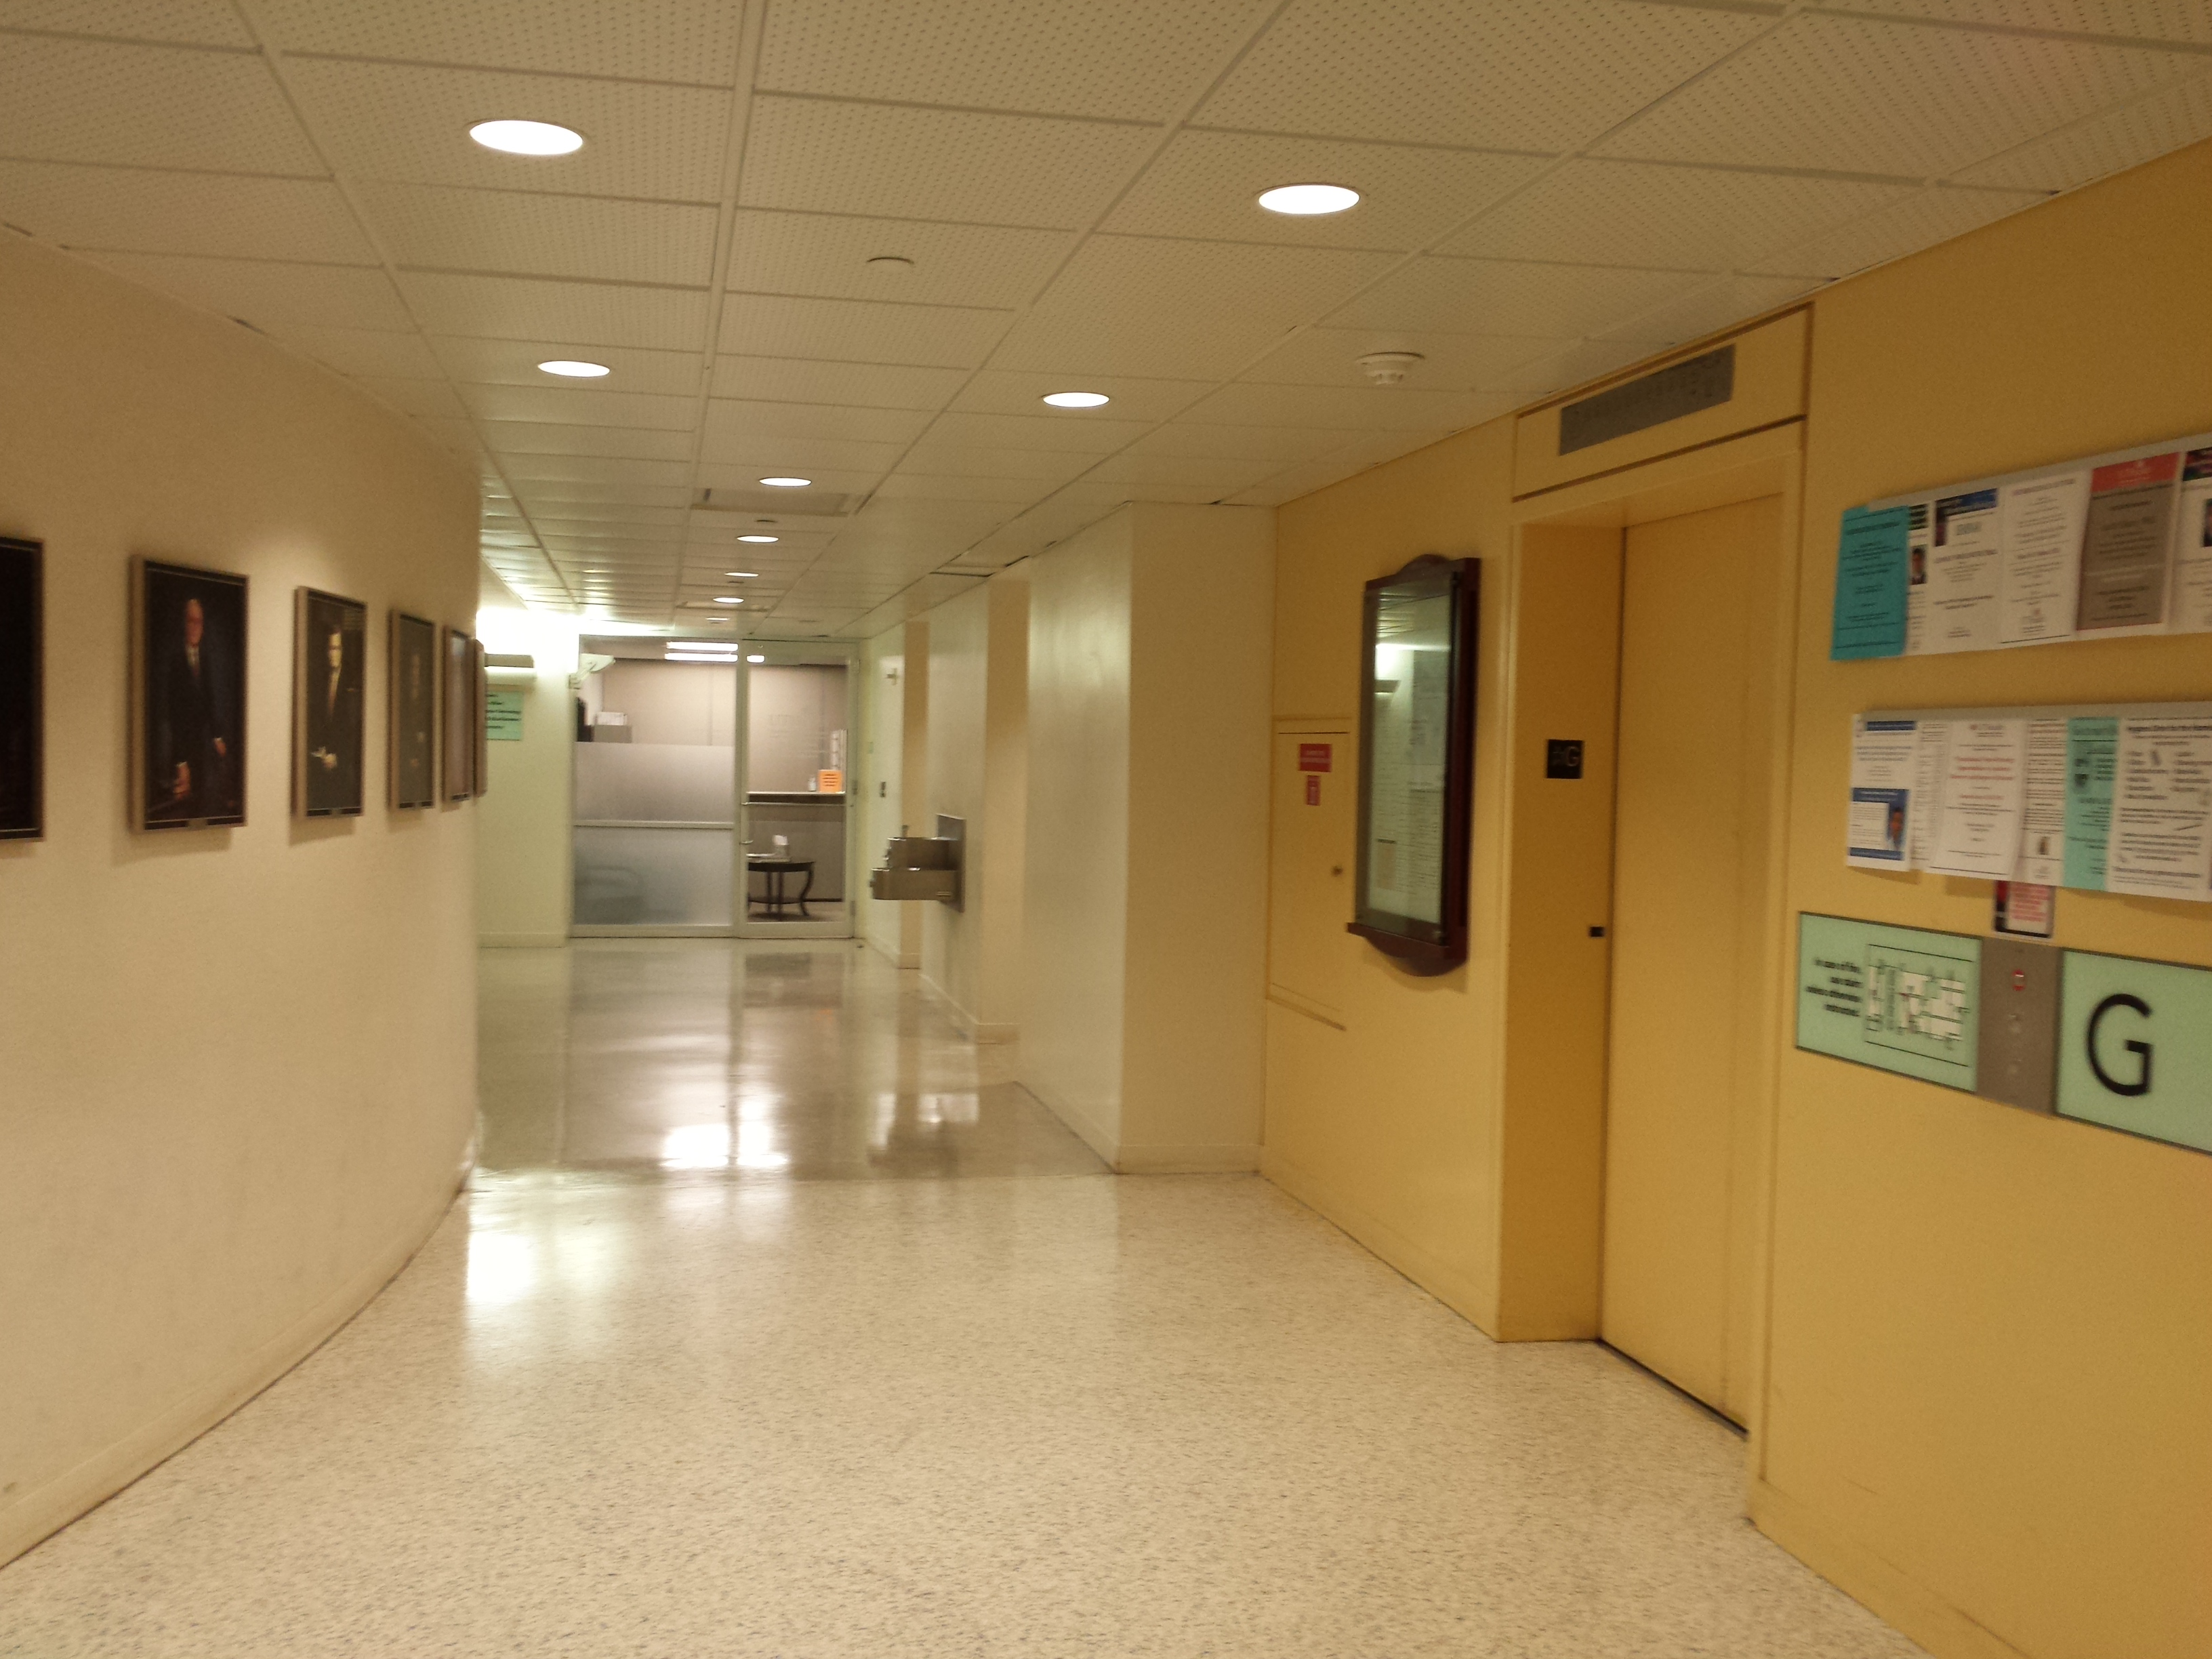
Our office…..
Come see us!
ODI

Slide 37
NEW FACULTY ORIENTATION
October 21.2020 | 8:00 – 9:30 AM
P r o g r a m
Welcome ( 8: 0 5 – 8: 1 0 )
Richard Andrassy, MD | Executive Dean ad interim, McGovern Medical School |
H. Wayne Hightower Distinguished Professor in the Medical Sciences
Richard.Andrassy@uth.tmc.edu
Academic Life | Promotion & Tenure | Grants 1 0 1 & 1 0 2 ( 8: 1 0 – 8: 25 )
Kevin A. Morano, PhD | Kevin.A.Morano@uth.tmc.edu
Associate Vice President | Faculty Affairs & Development
Associate Dean | Faculty Affairs
Director | New Investigator Development Program
Graduate Student Training ( 8: 25 – 8 :3 0)
William W. Mattox, PhD | Senior Associate Dean - Graduate School of Biomedical Sciences | William.Mattox@uth.tmc.edu
Office of Diversity & Inclusion ( 8 : 30 – 8 :3 5)
Pedro Mancias, MD | Assistant Dean - Diversity & Inclusion | Pedro.Mancias@uth.tmc.edu
Faculty & Educational Development ( 8: 35 – 8 :4 0 )
Allison Ownby, PhD | Assistant Dean for Faculty and Educational Development | Allison.R.Ownby@uth.tmc.edu
Women Faculty Forum ( 8 :40 – 8 :4 5 )
Mandy Hill, DrPH | Co-Chair | Mandy.J.Hill@uth.tmc.edu
Suur Biliciler, MD | Co-Chair | Suur.Biliciler@uth.tmc.edu
Office of Communications ( 8: 45 – 8 : 50 )
Darla Brown | Director | M.Darla.Brown@uth.tmc.edu
UTHealth Faculty Assistance Program| Academic Ombuds ( 8 :5 0 – 9 :0 0)
Robin Dickey, PhD, MA, LPC | Faculty Assistance Specialist | Academic Ombuds | Robin.Dickey@uth.tmc.edu
Intellectual Property and Commercialization ( 9 :0 0 – 9: 05)
Christine Flynn, PhD | Associate Director - Office of Technology Management | Christine.Flynn@uth.tmc.edu
Collaborative Research ( 9 : 05 – 9: 1 0)
Amy Hazen, PhD | Associate Director, Shared Research Resources | Amy.Hazen@uth.tmc.edu
Valerie Bomben, PhD | Supervisor, Specialized & Collaborative Research Agreements | Valerie.C.Bomben@uth.tmc.edu
Office of Postdoctoral Affairs ( 9 : 10 – 9 :1 5)
Leslie S. Beckman | Assistant Director | Leslie.Beckman@uth.tmc.edu
Secured Text Messaging ( 9 :1 5 – 9 : 2 0 )
Christina F. Solis, JD, MPH | Senior Legal Officer & Privacy Officer - Office of Legal Affairs | Christina.F.Solis@uth.tmc.edu
Salman Khan | Manager – IT Security | Salman.Khan@uth.tmc.edu
Questions / Answers ( 9 : 20 – 9 :3 0)

Slide 38
Educator Development Activities
The Office of Educational Programs
2020

Slide 39
Educator Development Activities
Educational Development Workshops*
Monthly sessions at noon
Educator Retreat – Fall and Spring
Educator Development Certificate
Online modules
Educational Technology Training and Consultations
Online Resources – 20 Minute Mentor (Canvas)
*CME credit available

Slide 40
Educator Development Activities
Health Educators Fellowship Program
Current cohort graduates in June 2021
Recruiting Fall of 2021 for next cohort (2022-2023)
Academy of Master Educators
Hot Topics in Medical Education
Networking and Mentorship opportunities
Membership is based on teaching excellence

Slide 41
Opportunities for Involvement
Committee Membership
Curriculum Committee
Graduate Medical Education Committee
Continuing Medical Education

Slide 42
Opportunities for Involvement
Curriculum Participation
Pre-clerkship
Problem-based learning facilitator
Preceptors (longitudinal clinical experience)
Clinical Years
Clerkships
Career Focus Tracks
Research
Scholarly Concentrations
Summer Research Program
Courses and modules
Selectives
Electives

Slide 43
Interested in improving your teaching?
Academy of Master Educators-Peer Coaching Group (AME-PCG)
Peer coaching is available to all MMS faculty members who wish to have their educational activities reviewed
Request a peer observation:
https://med.uth.edu/oep/educational-development/peer-coaching-group/

Slide 44
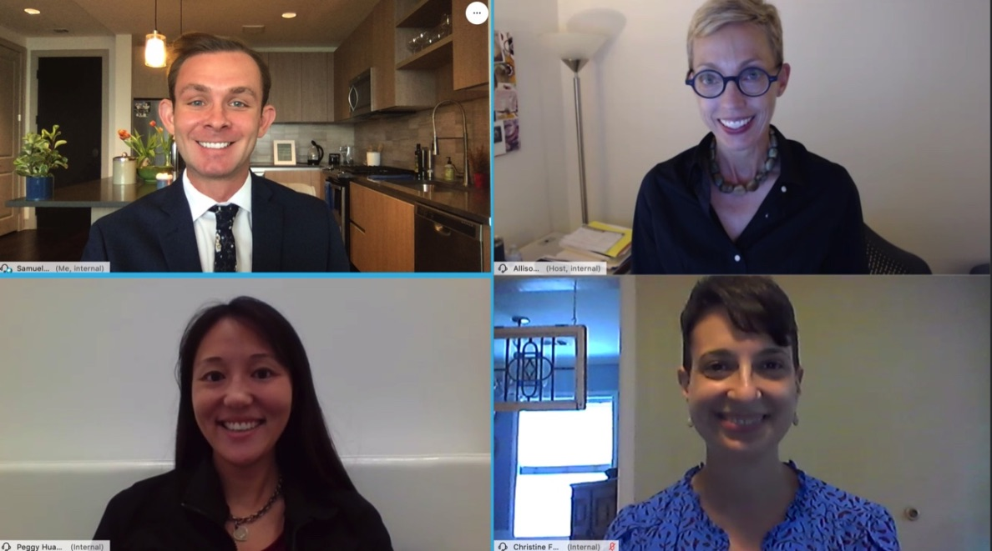
Welcome!

Slide 45
Office of Educational Programs / 713-500-5140
https://med.uth.edu/oep/
Patricia Butler, MD
Vice Dean for Educational Programs
patricia.butler@uth.tmc.edu
Allison Ownby, PhD, MEd
Assistant Dean for Faculty and Educational Development
allison.r.ownby@uth.tmc.edu
Peggy Hsieh, MEd, PhD
Director of Educational Development
peggy.h.huang@uth.tmc.edu
Christine Ford, EdD
Education Specialist
christine.d.ford@uth.tmc.edu
Samuel Neher, EdD
Education Specialist
samuel.e.neher@uth.tmc.edu

Slide 46
NEW FACULTY ORIENTATION
October 21.2020 | 8:00 – 9:30 AM
P r o g r a m
Welcome ( 8: 0 5 – 8: 1 0 )
Richard Andrassy, MD | Executive Dean ad interim, McGovern Medical School |
H. Wayne Hightower Distinguished Professor in the Medical Sciences
Richard.Andrassy@uth.tmc.edu
Academic Life | Promotion & Tenure | Grants 1 0 1 & 1 0 2 ( 8: 1 0 – 8: 25 )
Kevin A. Morano, PhD | Kevin.A.Morano@uth.tmc.edu
Associate Vice President | Faculty Affairs & Development
Associate Dean | Faculty Affairs
Director | New Investigator Development Program
Graduate Student Training ( 8: 25 – 8 :3 0)
William W. Mattox, PhD | Senior Associate Dean - Graduate School of Biomedical Sciences | William.Mattox@uth.tmc.edu
Office of Diversity & Inclusion ( 8 : 30 – 8 :3 5)
Pedro Mancias, MD | Assistant Dean - Diversity & Inclusion | Pedro.Mancias@uth.tmc.edu
Faculty & Educational Development ( 8: 35 – 8 :4 0 )
Allison Ownby, PhD | Assistant Dean for Faculty and Educational Development | Allison.R.Ownby@uth.tmc.edu
Women Faculty Forum ( 8 :40 – 8 :4 5 )
Mandy Hill, DrPH | Co-Chair | Mandy.J.Hill@uth.tmc.edu
Suur Biliciler, MD | Co-Chair | Suur.Biliciler@uth.tmc.edu
Office of Communications ( 8: 45 – 8 : 50 )
Darla Brown | Director | M.Darla.Brown@uth.tmc.edu
UTHealth Faculty Assistance Program| Academic Ombuds ( 8 :5 0 – 9 :0 0)
Robin Dickey, PhD, MA, LPC | Faculty Assistance Specialist | Academic Ombuds | Robin.Dickey@uth.tmc.edu
Intellectual Property and Commercialization ( 9 :0 0 – 9: 05)
Christine Flynn, PhD | Associate Director - Office of Technology Management | Christine.Flynn@uth.tmc.edu
Collaborative Research ( 9 : 05 – 9: 1 0)
Amy Hazen, PhD | Associate Director, Shared Research Resources | Amy.Hazen@uth.tmc.edu
Valerie Bomben, PhD | Supervisor, Specialized & Collaborative Research Agreements | Valerie.C.Bomben@uth.tmc.edu
Office of Postdoctoral Affairs ( 9 : 10 – 9 :1 5)
Leslie S. Beckman | Assistant Director | Leslie.Beckman@uth.tmc.edu
Secured Text Messaging ( 9 :1 5 – 9 : 2 0 )
Christina F. Solis, JD, MPH | Senior Legal Officer & Privacy Officer - Office of Legal Affairs | Christina.F.Solis@uth.tmc.edu
Salman Khan | Manager – IT Security | Salman.Khan@uth.tmc.edu
Questions / Answers ( 9 : 20 – 9 :3 0)

Slide 47

Women Faculty Forum

Slide 48
MISSION
The mission of the Women Faculty Forum (WFF) is to:
Advocate on behalf of women faculty at McGovern Medical School at UTHealth.
Create and deliver opportunities for professional development for women faculty at McGovern Medical School at UTHealth.
Offer events aimed at encouraging networking among the women faculty, as well as with the leaders in academic science and medicine within and beyond the institution.

Slide 49
VISION
The vision of the Women Faculty Forum is to positively influence the academic experience of Women Faculty at our institution.
Through this vision, our goal is to increase retention of Women Faculty in Academic Medicine.

Slide 50
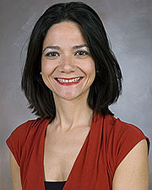
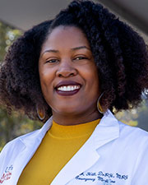
Woman Faculty Forum Co-Chairs
Suur Biliciler, M.D.
Clinical Co-Chair
Associate Professor
Director, Neurology Residency Program
Neurology
Mandy Hill, DrPH, MPH
Basic Sciences Co-Chair
Associate Professor
Director, Population Health in
Emergency Medicine
Emergency Medicine

Slide 51
Woman Faculty Forum Council
Susan H. Wootton, M.D.
Associate Professor Pediatrics
Amber Zulfiqar, M.D.
Assistant Professor
Family And Community Medicine
Bindu Akkanti, MD CMQ FCCP
Associate Professor Medicine- Pulmonary Rehabilitation
Heidi B. Kaplan, Ph.D.
Associate Professor
Microbiology & Molecular Genetics

Slide 52
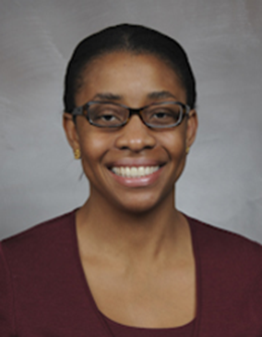
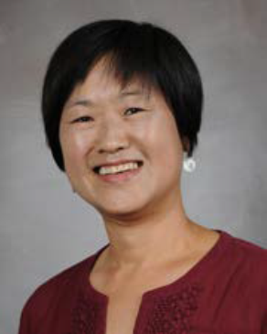
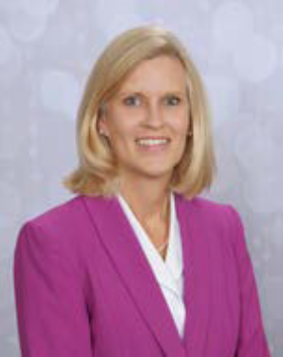
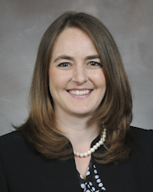
Woman Faculty Forum Council
Chiamaka N. Aneji, MD, MPH
Associate Professor Pediatrics
Nayun Kim, Ph.D.
Assistant Professor
Microbiology & Molecular Genetics
Melissa B. Aldrich, Ph.D.
Assistant Professor
Institute of Molecular Medicine
Rachel K. Miller, Ph.D.
Assistant Professor
Pediatrics

Slide 53
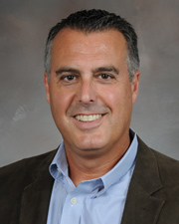
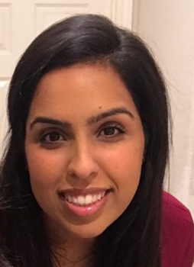
Woman Faculty Forum Administration
Kevin A. Morano, Ph.D. Associate Dean for Faculty Affairs
Maaria Farooqi Office of Administration & Faculty Affairs

Slide 54
Women Faculty Forum (Annual Events)
Annual Fall event
Roundtable Discussions
Annual Spring Event: International Day of Women and Girls in Science Symposium
Annual Excellence Awards

Slide 55
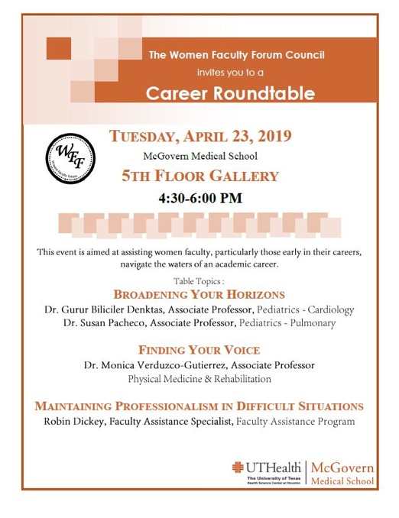
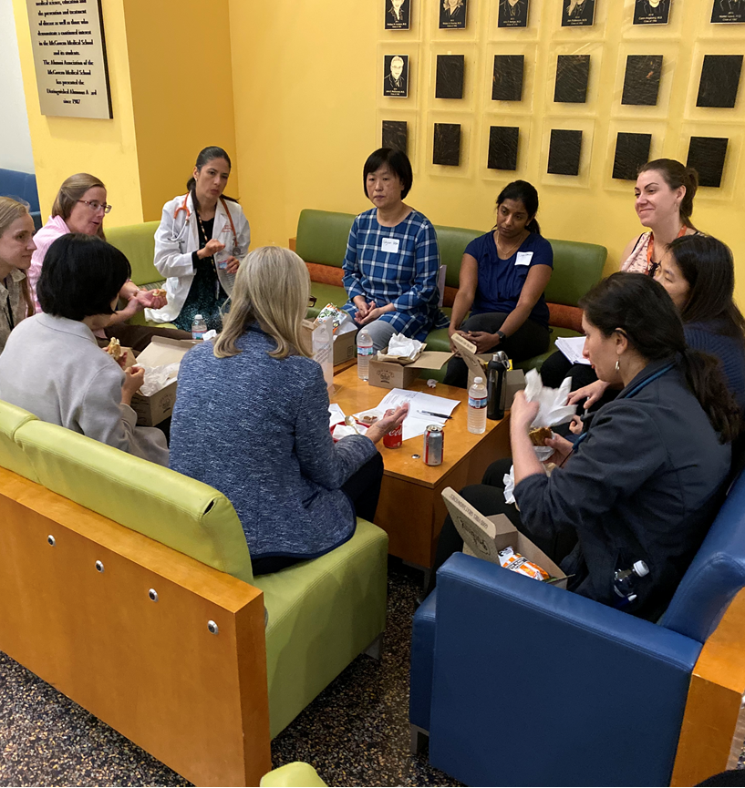
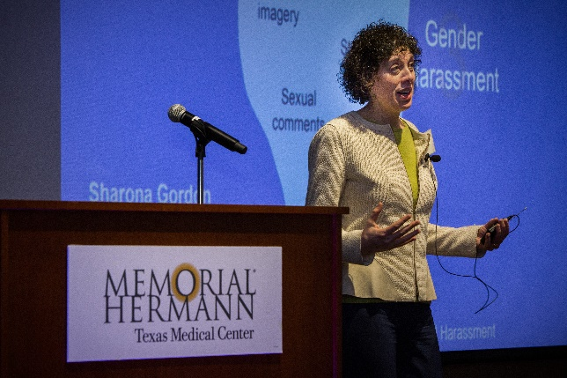
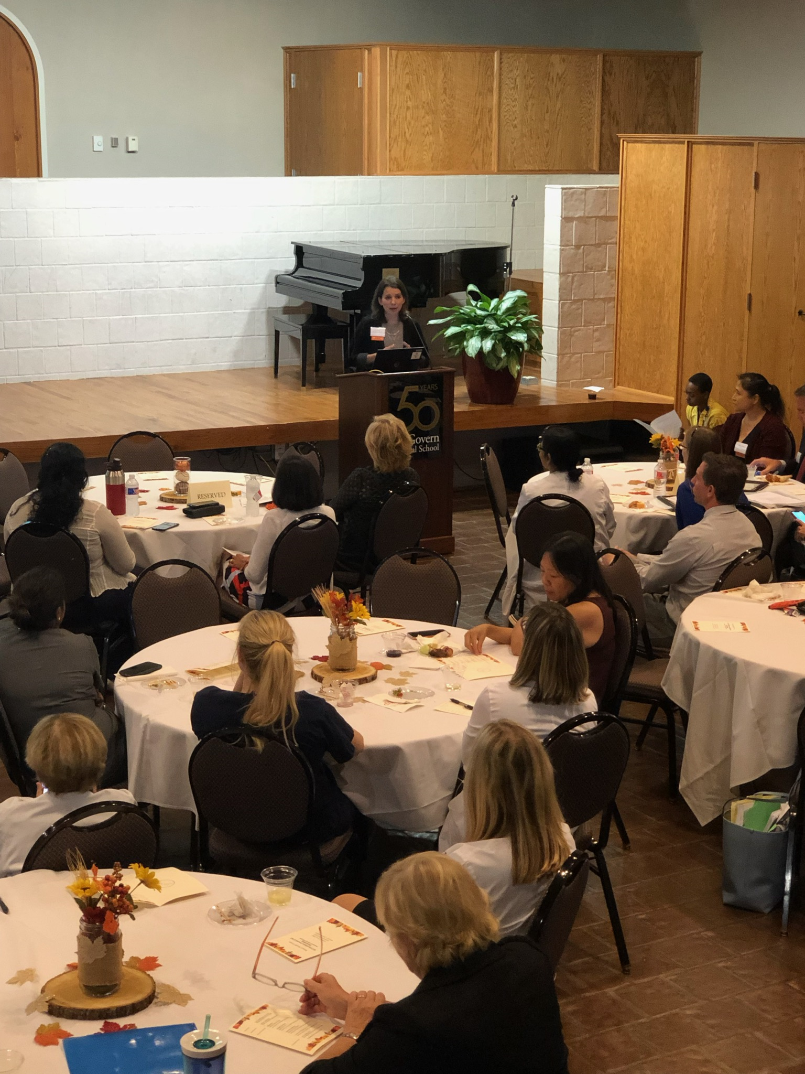

Slide 56
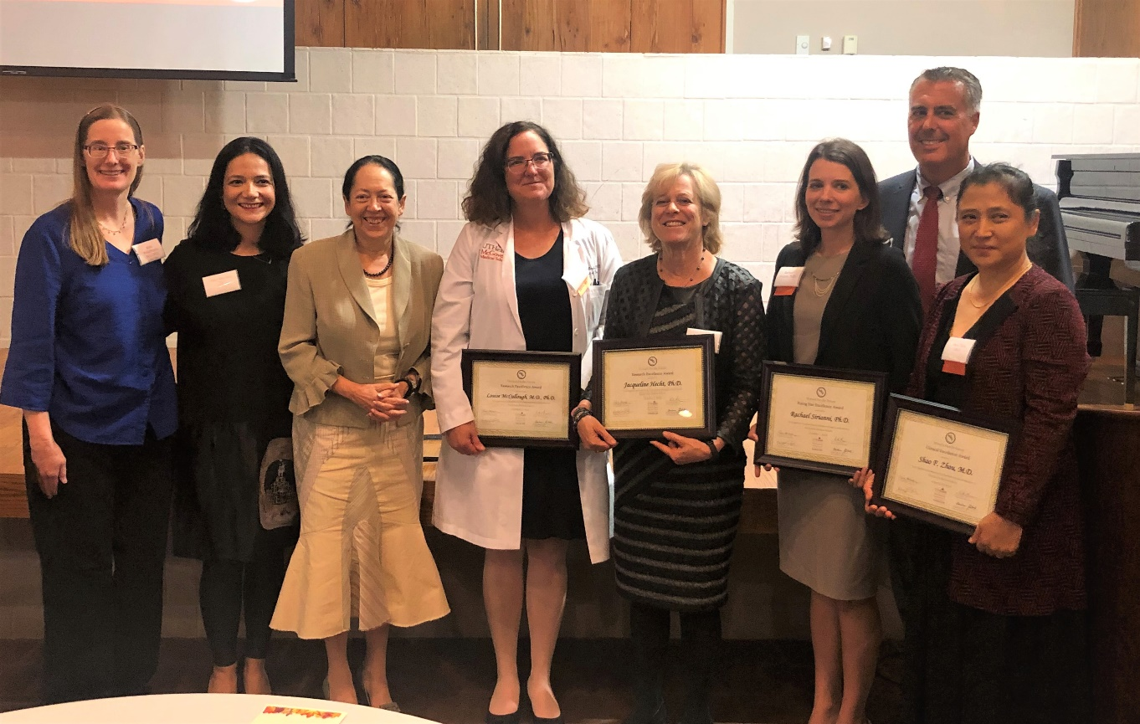
Women Faculty Forum Excellence Awards 2019

Slide 57
Women Faculty Forum Opportunities
Mentoring
Get connected
AAMC Faculty Development Meetings
Book club

Slide 58



Connect with us! Stay up to date with the WFF:
Women Faculty Forum McGovern Medical School at UTHealth
wff_uthealth
@FacultyWomen

Slide 59

Helpful Links
Women Faculty Forum Website:
https://med.uth.edu/administration/women-faculty-forum/
Http://tinyurl.com/utwff

Slide 60
NEW FACULTY ORIENTATION
October 21.2020 | 8:00 – 9:30 AM
P r o g r a m
Welcome ( 8: 0 5 – 8: 1 0 )
Richard Andrassy, MD | Executive Dean ad interim, McGovern Medical School |
H. Wayne Hightower Distinguished Professor in the Medical Sciences
Richard.Andrassy@uth.tmc.edu
Academic Life | Promotion & Tenure | Grants 1 0 1 & 1 0 2 ( 8: 1 0 – 8: 25 )
Kevin A. Morano, PhD | Kevin.A.Morano@uth.tmc.edu
Associate Vice President | Faculty Affairs & Development
Associate Dean | Faculty Affairs
Director | New Investigator Development Program
Graduate Student Training ( 8: 25 – 8 :3 0)
William W. Mattox, PhD | Senior Associate Dean - Graduate School of Biomedical Sciences | William.Mattox@uth.tmc.edu
Office of Diversity & Inclusion ( 8 : 30 – 8 :3 5)
Pedro Mancias, MD | Assistant Dean - Diversity & Inclusion | Pedro.Mancias@uth.tmc.edu
Faculty & Educational Development ( 8: 35 – 8 :4 0 )
Allison Ownby, PhD | Assistant Dean for Faculty and Educational Development | Allison.R.Ownby@uth.tmc.edu
Women Faculty Forum ( 8 :40 – 8 :4 5 )
Mandy Hill, DrPH | Co-Chair | Mandy.J.Hill@uth.tmc.edu
Suur Biliciler, MD | Co-Chair | Suur.Biliciler@uth.tmc.edu
Office of Communications ( 8: 45 – 8 : 50 )
Darla Brown | Director | M.Darla.Brown@uth.tmc.edu
UTHealth Faculty Assistance Program| Academic Ombuds ( 8 :5 0 – 9 :0 0)
Robin Dickey, PhD, MA, LPC | Faculty Assistance Specialist | Academic Ombuds | Robin.Dickey@uth.tmc.edu
Intellectual Property and Commercialization ( 9 :0 0 – 9: 05)
Christine Flynn, PhD | Associate Director - Office of Technology Management | Christine.Flynn@uth.tmc.edu
Collaborative Research ( 9 : 05 – 9: 1 0)
Amy Hazen, PhD | Associate Director, Shared Research Resources | Amy.Hazen@uth.tmc.edu
Valerie Bomben, PhD | Supervisor, Specialized & Collaborative Research Agreements | Valerie.C.Bomben@uth.tmc.edu
Office of Postdoctoral Affairs ( 9 : 10 – 9 :1 5)
Leslie S. Beckman | Assistant Director | Leslie.Beckman@uth.tmc.edu
Secured Text Messaging ( 9 :1 5 – 9 : 2 0 )
Christina F. Solis, JD, MPH | Senior Legal Officer & Privacy Officer - Office of Legal Affairs | Christina.F.Solis@uth.tmc.edu
Salman Khan | Manager – IT Security | Salman.Khan@uth.tmc.edu
Questions / Answers ( 9 : 20 – 9 :3 0)

Slide 61
Office of Communications, A Faculty Resource
October 2020

Slide 62

How we can help
https://youtu.be/uowDI6OInnw

Slide 63
What the Office of Communications provides
Internal Communications
Creative Services
Weekly e-newsletters (Scoop, Spotlight)
Daily curated e-newsletter – News of Note
Online calendar
Medical School website
Templates
Social media: Facebook, Twitter, YouTube, Instagram
Photography and video coverage of school events
Annual report
Fact book
TV monitors – DNA (daily news access)
Faculty bookcase
Website training
Web communicators meetings
Photography (studio and on location)
Graphic design
Website design, e-newsletters
Video
Writing/editing
Poster printing and design

Slide 64

Website
med.uth.edu/ooc

Slide 65
About our Name
McGovern Medical School at UTHealth
McGovern Medical School at The University of Texas Health Science Center at Houston (UTHealth)
McGovern Medical School, a part of UTHealth
med.uth.edu/faq

Slide 66
NEW FACULTY ORIENTATION
October 21.2020 | 8:00 – 9:30 AM
P r o g r a m
Welcome ( 8: 0 5 – 8: 1 0 )
Richard Andrassy, MD | Executive Dean ad interim, McGovern Medical School |
H. Wayne Hightower Distinguished Professor in the Medical Sciences
Richard.Andrassy@uth.tmc.edu
Academic Life | Promotion & Tenure | Grants 1 0 1 & 1 0 2 ( 8: 1 0 – 8: 25 )
Kevin A. Morano, PhD | Kevin.A.Morano@uth.tmc.edu
Associate Vice President | Faculty Affairs & Development
Associate Dean | Faculty Affairs
Director | New Investigator Development Program
Graduate Student Training ( 8: 25 – 8 :3 0)
William W. Mattox, PhD | Senior Associate Dean - Graduate School of Biomedical Sciences | William.Mattox@uth.tmc.edu
Office of Diversity & Inclusion ( 8 : 30 – 8 :3 5)
Pedro Mancias, MD | Assistant Dean - Diversity & Inclusion | Pedro.Mancias@uth.tmc.edu
Faculty & Educational Development ( 8: 35 – 8 :4 0 )
Allison Ownby, PhD | Assistant Dean for Faculty and Educational Development | Allison.R.Ownby@uth.tmc.edu
Women Faculty Forum ( 8 :40 – 8 :4 5 )
Mandy Hill, DrPH | Co-Chair | Mandy.J.Hill@uth.tmc.edu
Suur Biliciler, MD | Co-Chair | Suur.Biliciler@uth.tmc.edu
Office of Communications ( 8: 45 – 8 : 50 )
Darla Brown | Director | M.Darla.Brown@uth.tmc.edu
UTHealth Faculty Assistance Program| Academic Ombuds ( 8 :5 0 – 9 :0 0)
Robin Dickey, PhD, MA, LPC | Faculty Assistance Specialist | Academic Ombuds | Robin.Dickey@uth.tmc.edu
Intellectual Property and Commercialization ( 9 :0 0 – 9: 05)
Christine Flynn, PhD | Associate Director - Office of Technology Management | Christine.Flynn@uth.tmc.edu
Collaborative Research ( 9 : 05 – 9: 1 0)
Amy Hazen, PhD | Associate Director, Shared Research Resources | Amy.Hazen@uth.tmc.edu
Valerie Bomben, PhD | Supervisor, Specialized & Collaborative Research Agreements | Valerie.C.Bomben@uth.tmc.edu
Office of Postdoctoral Affairs ( 9 : 10 – 9 :1 5)
Leslie S. Beckman | Assistant Director | Leslie.Beckman@uth.tmc.edu
Secured Text Messaging ( 9 :1 5 – 9 : 2 0 )
Christina F. Solis, JD, MPH | Senior Legal Officer & Privacy Officer - Office of Legal Affairs | Christina.F.Solis@uth.tmc.edu
Salman Khan | Manager – IT Security | Salman.Khan@uth.tmc.edu
Questions / Answers ( 9 : 20 – 9 :3 0)

Slide 67
Office of Academic Ombuds
Phone: Confidential mobile: 713-705-5005
Email: ombuds@uth.tmc.edu
Web: www.go.uth.edu/ombuds
Faculty, students, residents, fellows, and postdocs
Express and discuss concerns regarding your educational and workplace experiences at UTHealth
Get assistance navigating institutional information, policies, resources, and other offices to which you may formally express your concerns, resolve disputes, manage conflicts, and improve communication
Neutral, informal, confidential, impartial

Slide 68
Faculty Assistance Program (FAP)
Available to faculty members as well as your family members.
Convenient and confidential mental health counseling and consultation services with a licensed mental health professional at no cost to you. 5 sessions per issue.
Integrative Wellness Coaching-uniquely catered for faculty!
The FAP offers a variety of additional services including legal and financial resources, childcare and eldercare resources, and coping through COVID resources just to name a few.
Websites:
http://go.uth.edu/fap
www.mylifevalues.com (username and password both: uth)
Phone Contact:
713-500-3880 (FAP)
Contact Robin directly at:
Phone: 713-500-3358
Email: Robin.dickey@uth.tmc.edu

Slide 69
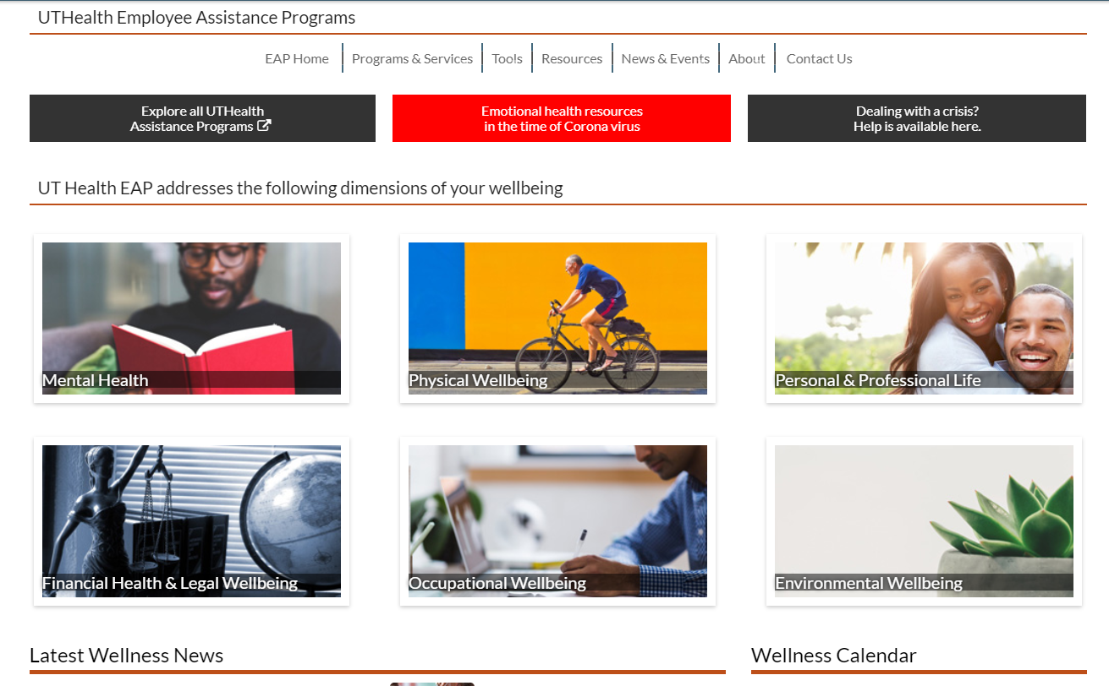

Slide 70
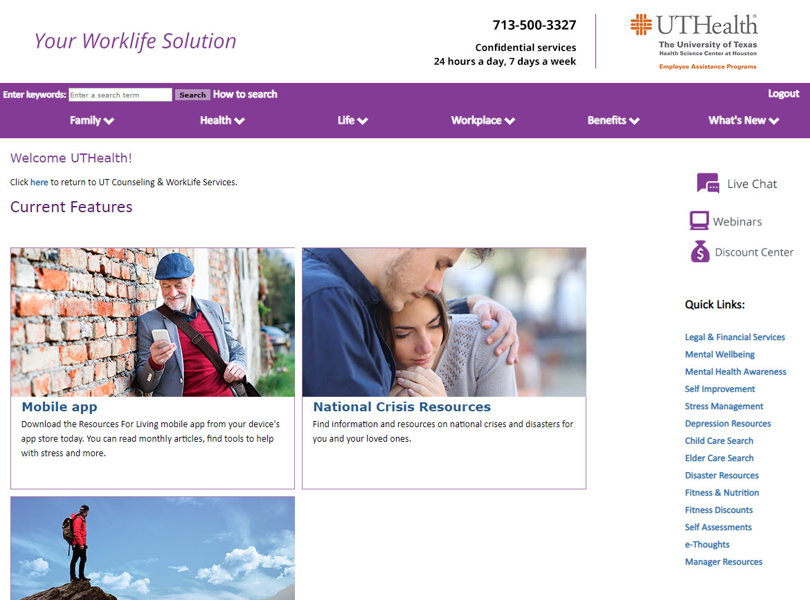

Slide 71
NEW FACULTY ORIENTATION
October 21.2020 | 8:00 – 9:30 AM
P r o g r a m
Welcome ( 8: 0 5 – 8: 1 0 )
Richard Andrassy, MD | Executive Dean ad interim, McGovern Medical School |
H. Wayne Hightower Distinguished Professor in the Medical Sciences
Richard.Andrassy@uth.tmc.edu
Academic Life | Promotion & Tenure | Grants 1 0 1 & 1 0 2 ( 8: 1 0 – 8: 25 )
Kevin A. Morano, PhD | Kevin.A.Morano@uth.tmc.edu
Associate Vice President | Faculty Affairs & Development
Associate Dean | Faculty Affairs
Director | New Investigator Development Program
Graduate Student Training ( 8: 25 – 8 :3 0)
William W. Mattox, PhD | Senior Associate Dean - Graduate School of Biomedical Sciences | William.Mattox@uth.tmc.edu
Office of Diversity & Inclusion ( 8 : 30 – 8 :3 5)
Pedro Mancias, MD | Assistant Dean - Diversity & Inclusion | Pedro.Mancias@uth.tmc.edu
Faculty & Educational Development ( 8: 35 – 8 :4 0 )
Allison Ownby, PhD | Assistant Dean for Faculty and Educational Development | Allison.R.Ownby@uth.tmc.edu
Women Faculty Forum ( 8 :40 – 8 :4 5 )
Mandy Hill, DrPH | Co-Chair | Mandy.J.Hill@uth.tmc.edu
Suur Biliciler, MD | Co-Chair | Suur.Biliciler@uth.tmc.edu
Office of Communications ( 8: 45 – 8 : 50 )
Darla Brown | Director | M.Darla.Brown@uth.tmc.edu
UTHealth Faculty Assistance Program| Academic Ombuds ( 8 :5 0 – 9 :0 0)
Robin Dickey, PhD, MA, LPC | Faculty Assistance Specialist | Academic Ombuds | Robin.Dickey@uth.tmc.edu
Intellectual Property and Commercialization ( 9 :0 0 – 9: 05)
Christine Flynn, PhD | Associate Director - Office of Technology Management | Christine.Flynn@uth.tmc.edu
Collaborative Research ( 9 : 05 – 9: 1 0)
Amy Hazen, PhD | Associate Director, Shared Research Resources | Amy.Hazen@uth.tmc.edu
Valerie Bomben, PhD | Supervisor, Specialized & Collaborative Research Agreements | Valerie.C.Bomben@uth.tmc.edu
Office of Postdoctoral Affairs ( 9 : 10 – 9 :1 5)
Leslie S. Beckman | Assistant Director | Leslie.Beckman@uth.tmc.edu
Secured Text Messaging ( 9 :1 5 – 9 : 2 0 )
Christina F. Solis, JD, MPH | Senior Legal Officer & Privacy Officer - Office of Legal Affairs | Christina.F.Solis@uth.tmc.edu
Salman Khan | Manager – IT Security | Salman.Khan@uth.tmc.edu
Questions / Answers ( 9 : 20 – 9 :3 0)

Slide 72

Intellectual Property & Commercialization
Office of Technology Management
Christine E. Flynn, Ph.D.
Associate Director, Licensing & New Venture Development

Slide 73

^{ABOUT}
^{Innovation}
^{WHAT IS INTELECTUAL PROPERTY?}
^{Patents}
A government granted right to exclusively exclude others from making, using, or selling an invention. Patented items include a processes or method, a machine, a manufacture, a composition of matter, a plant not occurring in nature, or a design.
^{Copyrights}
The exclusive legal right of an author or owner to print, publish, perform, film, or record artistic, literary, and musical works.
^{Trade secrets}
A secret device, method, formula, process, or strategy used in
business to obtain an economic advantage over competitors.
^{Trademarks}
A word, phrase, symbol, design, or
^{combination thereof, which}
^{identifies and distinguishes}
^{a source of goods.}
Intellectual property refers to creations of the mind, such as inventions, discoveries, trade secrets, technology, scientific or technological developments, research data, computer software, or original works of authorship fixed in a tangible medium of expression.
Intellectual property rights are rights that allow the inventors, creators, or owners of such property to exclude others from practicing, using, making, selling, reproducing, marketing, performing, displaying, and distributing their technologies, brands, or works covered by patents, copyrights, trademarks, or trade secrets, without permission.
Intellectual property and the rights associated with them can be protected in a number of ways, including patents, trademarks, copyright, and/or by maintaining them as a trade secret.

Slide 74




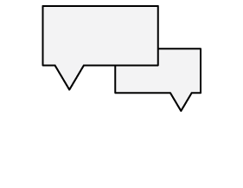


^{ABOUT}
^{Innovation}
^{THE COMMERCIALIZATION PATH}
^{Discover}
^{Disclose}
^{Search}
^{Protect}
^{Market}
^{License}
^{Manage}

Slide 75



















OTM By The Numbers
Selected Portfolio Companies:
$4+ million Annual Gross Revenue
$83+ million Licensing Revenue (cumulative)
25+ New License/Option Agreements per Year
475+ Total License/Option Agreements (cumulative)
1700+ Patents/Patent Applications (cumulative)
45 New Patent Applications Filed Each Year
100+ Products on the Market
Portfolio Companies (UTHealth)
56 portfolio companies (cumulative); 31 active
More than $250 M in capital raised to date
3 companies IPO/acquired with market cap >$3B : Volcano, LifeCell; PLx Pharma
More than >1300 jobs created in private and 3 public companies

Slide 76




^{Information}
^{MORE}
^{otm@uth.tmc.edu}
^{uth.tmc.edu/otm}
^{@UTHealth_OTM}
UTHealth Office of Technology Management

Slide 77
Contact Us: We are here to help YOU!
Bruce D. Butler, Ph.D.
Vice President for Research and Technology
(713) 500-3369
Bruce.D.Butler@uth.tmc.edu
Christine E. Flynn, Ph.D.
Associate Director, Licensing & New Ventures
Director, Biotechnology Commercialization Center
713-500-3383 direct
Christine.Flynn@uth.tmc.edu
Peter G. Seferian, Ph.D. Senior Patent Manager 713-500-3377 direct Peter.Seferian@uth.tmc.edu
Hannah Marman Nelson, Ph.D.
Sr. Technology Licensing Associate
713-500-3399 direct
Hannah.M.Nelson@uth.tmc.edu
Chuan-Yar “Yaya” Lai, Ph.D.
Technology Licensing Associate
713-500-3384 direct
Chuan-Yar.Lai@uth.tmc.edu

Slide 78
NEW FACULTY ORIENTATION
October 21.2020 | 8:00 – 9:30 AM
P r o g r a m
Welcome ( 8: 0 5 – 8: 1 0 )
Richard Andrassy, MD | Executive Dean ad interim, McGovern Medical School |
H. Wayne Hightower Distinguished Professor in the Medical Sciences
Richard.Andrassy@uth.tmc.edu
Academic Life | Promotion & Tenure | Grants 1 0 1 & 1 0 2 ( 8: 1 0 – 8: 25 )
Kevin A. Morano, PhD | Kevin.A.Morano@uth.tmc.edu
Associate Vice President | Faculty Affairs & Development
Associate Dean | Faculty Affairs
Director | New Investigator Development Program
Graduate Student Training ( 8: 25 – 8 :3 0)
William W. Mattox, PhD | Senior Associate Dean - Graduate School of Biomedical Sciences | William.Mattox@uth.tmc.edu
Office of Diversity & Inclusion ( 8 : 30 – 8 :3 5)
Pedro Mancias, MD | Assistant Dean - Diversity & Inclusion | Pedro.Mancias@uth.tmc.edu
Faculty & Educational Development ( 8: 35 – 8 :4 0 )
Allison Ownby, PhD | Assistant Dean for Faculty and Educational Development | Allison.R.Ownby@uth.tmc.edu
Women Faculty Forum ( 8 :40 – 8 :4 5 )
Mandy Hill, DrPH | Co-Chair | Mandy.J.Hill@uth.tmc.edu
Suur Biliciler, MD | Co-Chair | Suur.Biliciler@uth.tmc.edu
Office of Communications ( 8: 45 – 8 : 50 )
Darla Brown | Director | M.Darla.Brown@uth.tmc.edu
UTHealth Faculty Assistance Program| Academic Ombuds ( 8 :5 0 – 9 :0 0)
Robin Dickey, PhD, MA, LPC | Faculty Assistance Specialist | Academic Ombuds | Robin.Dickey@uth.tmc.edu
Intellectual Property and Commercialization ( 9 :0 0 – 9: 05)
Christine Flynn, PhD | Associate Director - Office of Technology Management | Christine.Flynn@uth.tmc.edu
Collaborative Research ( 9 : 05 – 9: 1 0)
Amy Hazen, PhD | Associate Director, Shared Research Resources | Amy.Hazen@uth.tmc.edu
Valerie Bomben, PhD | Supervisor, Specialized & Collaborative Research Agreements | Valerie.C.Bomben@uth.tmc.edu
Office of Postdoctoral Affairs ( 9 : 10 – 9 :1 5)
Leslie S. Beckman | Assistant Director | Leslie.Beckman@uth.tmc.edu
Secured Text Messaging ( 9 :1 5 – 9 : 2 0 )
Christina F. Solis, JD, MPH | Senior Legal Officer & Privacy Officer - Office of Legal Affairs | Christina.F.Solis@uth.tmc.edu
Salman Khan | Manager – IT Security | Salman.Khan@uth.tmc.edu
Questions / Answers ( 9 : 20 – 9 :3 0)

Slide 79
Collaborative Research
Amy Hazen, PhD | Associate Director, Shared Research Resources
Valerie Bomben, PhD | Supervisor, Specialized & Collaborative Research Agreements, Sponsored Projects Administration

Slide 80
Shared Research Resources
Research Service Centers
Staffed by technical experts, can assist with protocol development, training, data analysis, letters of support for grants, fee for service
iLab Core Management System
MOU with GCC and across UTSystem (most on iLab platform)
Collaborative Research Centers
Collaboration with a PI with expertise in specific technology/area, shared authorship, shared expenses
https://www.uth.edu/research/

Slide 81
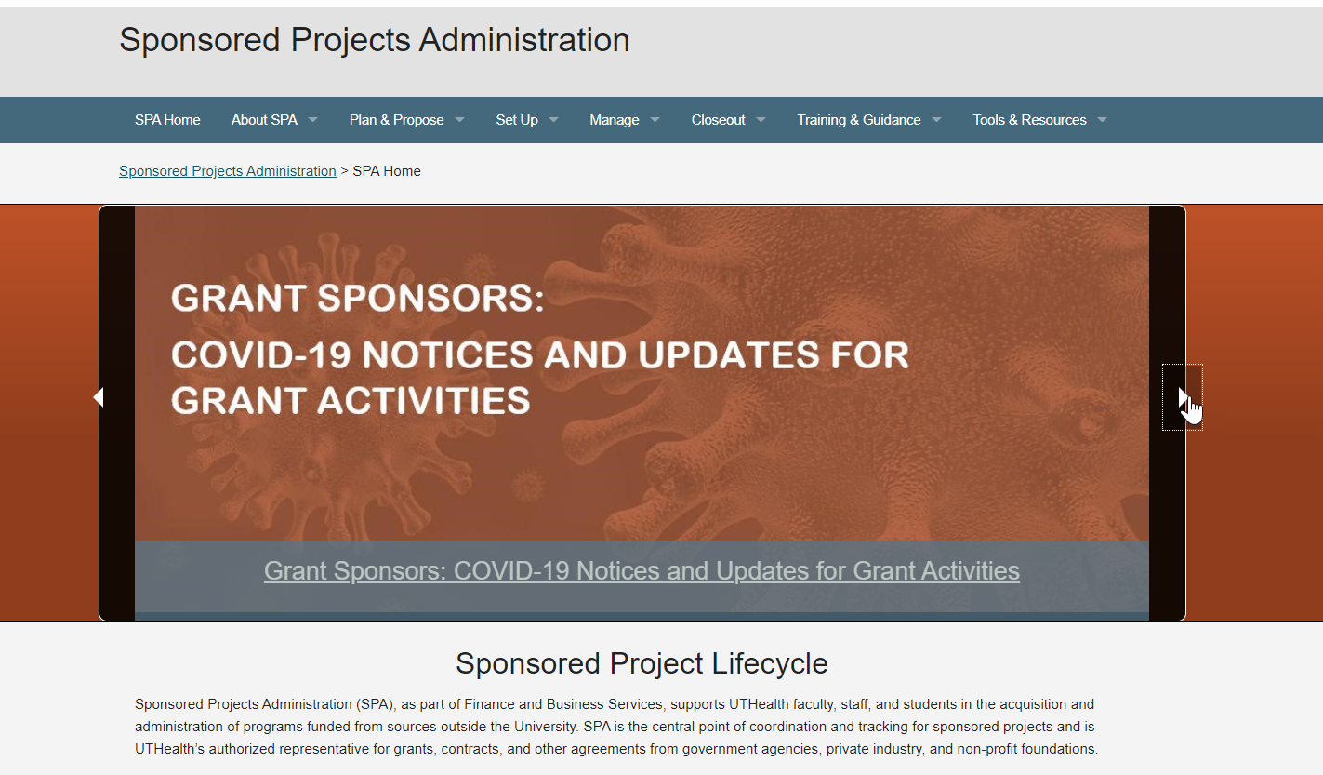
Sponsored Projects Administration
https://www.uth.edu/sponsored-projects-administration/

Slide 82

Specialized & Collaborative Research Agreements Team
Investigator initiated studies with industry & other funding entities
In coordination with PIs, departments, Technology Management, Office of Research, we support the negotiations of contracts for the University and the set-up of the projects for the Sponsored Projects lifecycle
uthealthstart.uth.tmc.edu
go.uth.edu/start
One stop Sponsored Projects System
Project lifecycle: (Proposal Development, Award Management, Subaward and Contract management, Financial Tracking, and Closeout)

Slide 83
Contact Information
Valerie.C.Bomben@uth.tmc.edu
713-500-3174
Amy.Hazen@uth.tmc.edu
713-500-3612

Slide 84
NEW FACULTY ORIENTATION
October 21.2020 | 8:00 – 9:30 AM
P r o g r a m
Welcome ( 8: 0 5 – 8: 1 0 )
Richard Andrassy, MD | Executive Dean ad interim, McGovern Medical School |
H. Wayne Hightower Distinguished Professor in the Medical Sciences
Richard.Andrassy@uth.tmc.edu
Academic Life | Promotion & Tenure | Grants 1 0 1 & 1 0 2 ( 8: 1 0 – 8: 25 )
Kevin A. Morano, PhD | Kevin.A.Morano@uth.tmc.edu
Associate Vice President | Faculty Affairs & Development
Associate Dean | Faculty Affairs
Director | New Investigator Development Program
Graduate Student Training ( 8: 25 – 8 :3 0)
William W. Mattox, PhD | Senior Associate Dean - Graduate School of Biomedical Sciences | William.Mattox@uth.tmc.edu
Office of Diversity & Inclusion ( 8 : 30 – 8 :3 5)
Pedro Mancias, MD | Assistant Dean - Diversity & Inclusion | Pedro.Mancias@uth.tmc.edu
Faculty & Educational Development ( 8: 35 – 8 :4 0 )
Allison Ownby, PhD | Assistant Dean for Faculty and Educational Development | Allison.R.Ownby@uth.tmc.edu
Women Faculty Forum ( 8 :40 – 8 :4 5 )
Mandy Hill, DrPH | Co-Chair | Mandy.J.Hill@uth.tmc.edu
Suur Biliciler, MD | Co-Chair | Suur.Biliciler@uth.tmc.edu
Office of Communications ( 8: 45 – 8 : 50 )
Darla Brown | Director | M.Darla.Brown@uth.tmc.edu
UTHealth Faculty Assistance Program| Academic Ombuds ( 8 :5 0 – 9 :0 0)
Robin Dickey, PhD, MA, LPC | Faculty Assistance Specialist | Academic Ombuds | Robin.Dickey@uth.tmc.edu
Intellectual Property and Commercialization ( 9 :0 0 – 9: 05)
Christine Flynn, PhD | Associate Director - Office of Technology Management | Christine.Flynn@uth.tmc.edu
Collaborative Research ( 9 : 05 – 9: 1 0)
Amy Hazen, PhD | Associate Director, Shared Research Resources | Amy.Hazen@uth.tmc.edu
Valerie Bomben, PhD | Supervisor, Specialized & Collaborative Research Agreements | Valerie.C.Bomben@uth.tmc.edu
Office of Postdoctoral Affairs ( 9 : 10 – 9 :1 5)
Leslie S. Beckman | Assistant Director | Leslie.Beckman@uth.tmc.edu
Secured Text Messaging ( 9 :1 5 – 9 : 2 0 )
Christina F. Solis, JD, MPH | Senior Legal Officer & Privacy Officer - Office of Legal Affairs | Christina.F.Solis@uth.tmc.edu
Salman Khan | Manager – IT Security | Salman.Khan@uth.tmc.edu
Questions / Answers ( 9 : 20 – 9 :3 0)

Slide 85
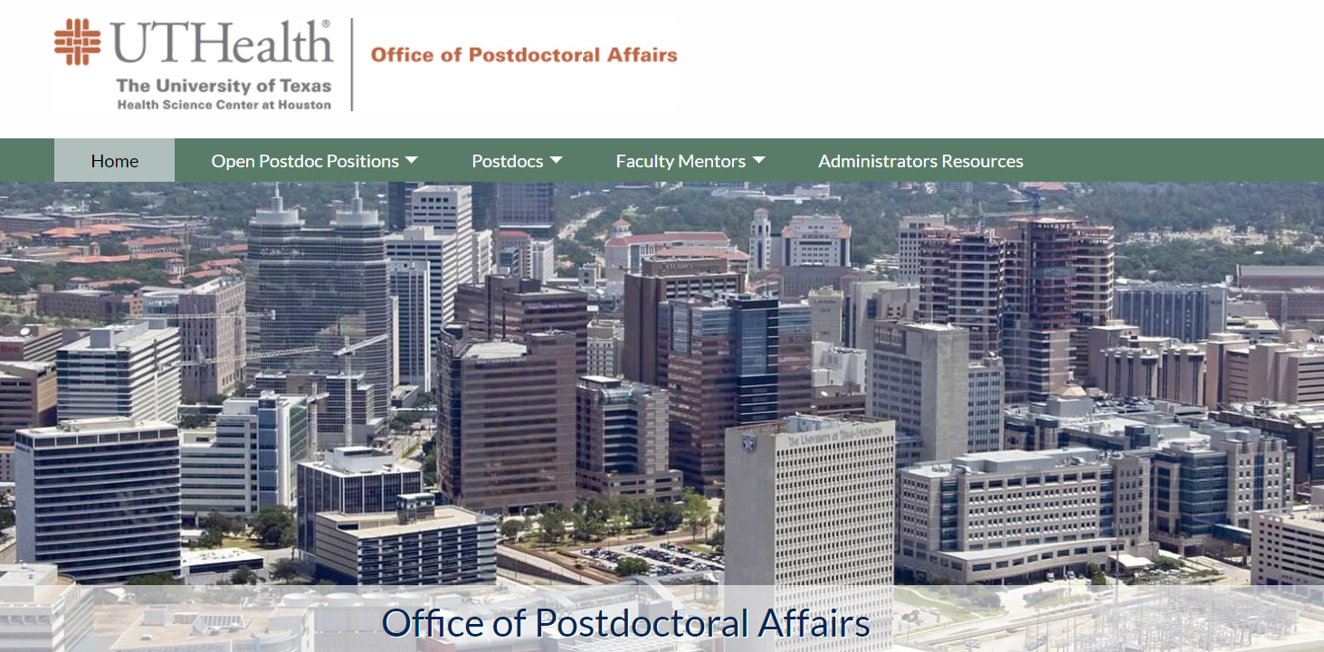

Slide 86
Faculty Support
15 years experience
Recruitment assistance / appointment approval
Career development training program
Communication channels
Postdoctoral tracking database
Financial award programs
Open door / confidentiality policy
Everything postdoc!
Notes:
From day one we are here – we post your position / have templates for offer letters/ interview if you would like / approve position prior to hiring through HR / or visa processing.
Program – numerous class Difference between Research staff and postdoc – is the requires commitment to training – cannot all be done in the lab – we are here to augment the training and not only provide excellence in career development – but also meet the needs of what is REQUIRED to train postdocs – either mandated by funding agencies – or implicit in career directions…… not all faculty anymore…….
We address comprehensive training – transferable skills
Support – play up on the support we offer faculty! Faculty here know that we are here for them. I get several emails each week from very serious issues to minor question
See Yamins’ email from OPA Oregon State – that is a good transition to our faculty support tool including the database, assistance with IDP and annual reviews. (Possibility annual requirement soon to visit OPA in person each year) ns. -

Slide 87
OPA Personnel
Kevin Morano, PhD
AVP Faculty Affairs and Development
Leslie S. Beckman
Assistant Director
Yasmin Chebaro, PhD
Program Manager
Notes:
I started the office 15 years ago. Two years ago, I approached Kevin to partner with our office to be of better service to faculty and postdocs alike.
His position – we have accomplished many changes never thought would make its way – longer visa sponsorship, relocation payments for postdocs, mandated orientations, annual reviews and much more.
Yasmin – former UTH postdoc – did an internship in our office and found her talents added greatly to the offerings not only of our office, but to her growth in a new career trajectory. Huge asset to us to have a postdoc in the postdoc office.

Slide 88
NEW FACULTY ORIENTATION
October 21.2020 | 8:00 – 9:30 AM
P r o g r a m
Welcome ( 8: 0 5 – 8: 1 0 )
Richard Andrassy, MD | Executive Dean ad interim, McGovern Medical School |
H. Wayne Hightower Distinguished Professor in the Medical Sciences
Richard.Andrassy@uth.tmc.edu
Academic Life | Promotion & Tenure | Grants 1 0 1 & 1 0 2 ( 8: 1 0 – 8: 25 )
Kevin A. Morano, PhD | Kevin.A.Morano@uth.tmc.edu
Associate Vice President | Faculty Affairs & Development
Associate Dean | Faculty Affairs
Director | New Investigator Development Program
Graduate Student Training ( 8: 25 – 8 :3 0)
William W. Mattox, PhD | Senior Associate Dean - Graduate School of Biomedical Sciences | William.Mattox@uth.tmc.edu
Office of Diversity & Inclusion ( 8 : 30 – 8 :3 5)
Pedro Mancias, MD | Assistant Dean - Diversity & Inclusion | Pedro.Mancias@uth.tmc.edu
Faculty & Educational Development ( 8: 35 – 8 :4 0 )
Allison Ownby, PhD | Assistant Dean for Faculty and Educational Development | Allison.R.Ownby@uth.tmc.edu
Women Faculty Forum ( 8 :40 – 8 :4 5 )
Mandy Hill, DrPH | Co-Chair | Mandy.J.Hill@uth.tmc.edu
Suur Biliciler, MD | Co-Chair | Suur.Biliciler@uth.tmc.edu
Office of Communications ( 8: 45 – 8 : 50 )
Darla Brown | Director | M.Darla.Brown@uth.tmc.edu
UTHealth Faculty Assistance Program| Academic Ombuds ( 8 :5 0 – 9 :0 0)
Robin Dickey, PhD, MA, LPC | Faculty Assistance Specialist | Academic Ombuds | Robin.Dickey@uth.tmc.edu
Intellectual Property and Commercialization ( 9 :0 0 – 9: 05)
Christine Flynn, PhD | Associate Director - Office of Technology Management | Christine.Flynn@uth.tmc.edu
Collaborative Research ( 9 : 05 – 9: 1 0)
Amy Hazen, PhD | Associate Director, Shared Research Resources | Amy.Hazen@uth.tmc.edu
Valerie Bomben, PhD | Supervisor, Specialized & Collaborative Research Agreements | Valerie.C.Bomben@uth.tmc.edu
Office of Postdoctoral Affairs ( 9 : 10 – 9 :1 5)
Leslie S. Beckman | Assistant Director | Leslie.Beckman@uth.tmc.edu
Secured Text Messaging ( 9 :1 5 – 9 : 2 0 )
Christina F. Solis, JD, MPH | Senior Legal Officer & Privacy Officer - Office of Legal Affairs | Christina.F.Solis@uth.tmc.edu
Salman Khan | Manager – IT Security | Salman.Khan@uth.tmc.edu
Questions / Answers ( 9 : 20 – 9 :3 0)

Slide 89

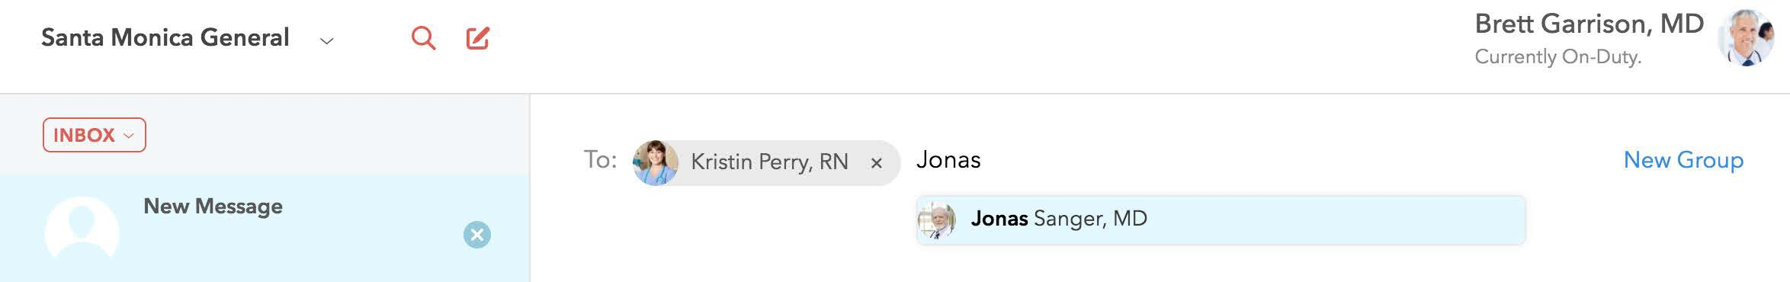

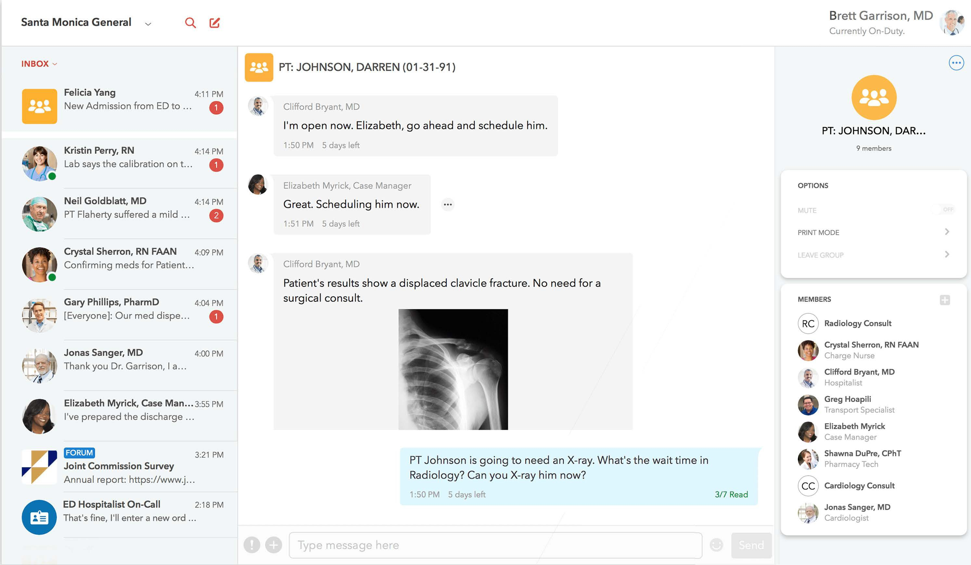






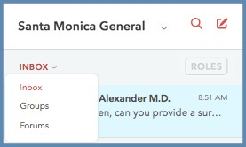


Quick Reference Guide
Getting to Know the TigerConnect Desktop App/
Web Messenger
Creating Patient-Centered Care Groups:
Click Compose (pen and paper icon) to create a Group with multiple colleagues. Alternatively, click the New Group button (far-right) to set up a group based on a specific location or by a patient's name.
Click your avatar to edit your Profile or sign out of your account.
1
Log In
Go to Desktop App or https:// login.tigerconnect.com and log in with your username and password.
Organizations
Need to update a Group name, Print a Conversation, or Mute a Conversation's notifications? Click
Santa Monica General
1
the Conversations Settings in the upper right (circle with three horizontal dots).
2
Find a Co-Worker
Search by first or last name in the directory (magnifying glass) or Compose a new message directly (pad and pen icon - right).
3
Send a Message
Type your message in
the box below and click Send.
Need to Recall or Resend a message? Click here.
Filtering
In TigerConnect, you have the ability to filter Groups and Forums and access your organization's Roles. To do so, simply click on the ‘Inbox’ dropdown, just above your Inbox conversations or click the 'Roles' section to access your organization's Roles. Simply select the message type you wish to view and select the conversation.
Questions?
Contact Salman Khan in IT Security: salman.khan@uth.tmc.edu
9

Slide 90


Thank you!
Questions?

