Slide 1
pathology of aortic diseases subject to open surgical repair: two decades experience
L. Maximilian Buja, MD
Professor of Pathology and Laboratory Medicine
Distinguished Teaching Professor
McGovern Medical School
Chief, Cardiovascular Pathology
Texas Heart Institute

Slide 2
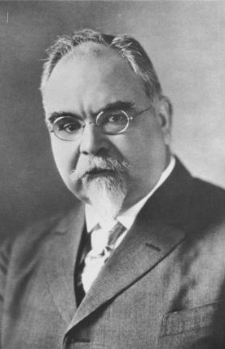
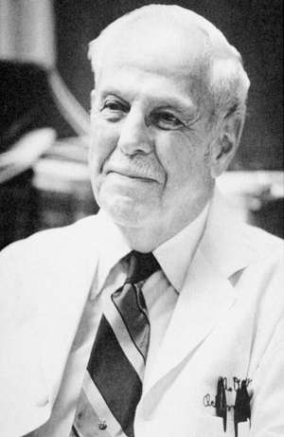
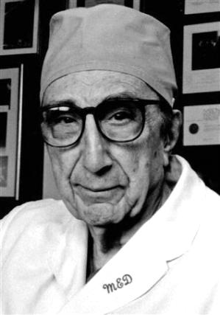
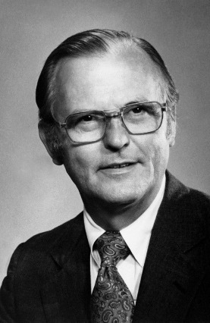
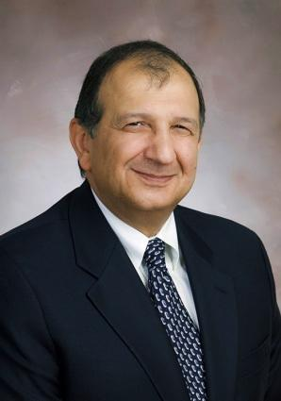
Genealogy of Innovators in Cardiothoracic and Vascular Surgery
Rudolph Mattas
(1860 - 1957)
Tulane University
Alton Ochsner, Sr.
(1896 - 1981)
Tulane University
Michael DeBakey
(1908 - 2008)
Tulane University
Baylor College of Medicine
Stanley Crawford
(1922 - 1992)
Baylor College of Medicine
Hazim Safi
(???? - ????)
Baylor College of Medicine
UTHSCH (UT Health)

Slide 3
The Safi Chairmanship at UTH and MHH-TMC 1999-2019
Establishment of the Department of CTVS
Recruitment and Mentoring of Faculty and Fellows
Leadership of a Premier CTVS Service
Important Contributions to the Scientific Literature

Slide 4
Open Surgical Procedures on the CTVS Service at MHH-TMC

Slide 5
Trends in Open Versus Endovascular (EVAR) Repair of Aortic Aneurysms
EVAR Adoption Trends for Non-ruptured AAA repairs
EVAR Adoption Trends for AAA repairs – Non-ruptured and Ruptured
Sethi RKV et al. J Vasc Surgery
2013;58:596-606

Slide 6
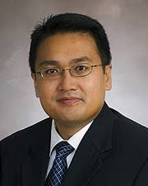
Center for Aortic Diseases
Hazim Safi, MD
CTV Surgery
Dianna Milewicz, MD, PhD
Medical Genetics
Anthony Estrera, MD
CTV Surgery
L. Max Buja, MD
CV Pathology

Slide 7
Schematic representation of thoracic aortic aneurysms and aortic dissections
D Milewicz

Slide 8
Pathology of Aortic Diseases
Functional Histology and Architecture of th Aorta
Focused Review of Surgical Pathology Cases from 2010 and 2019
Pathogenesis of Aortic Dissection
Pathology and Pathogenesis of Genetic Aortopathies

Slide 9
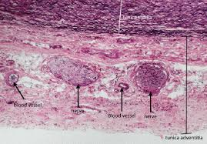
Functional Histology of Normal Aorta

Slide 10
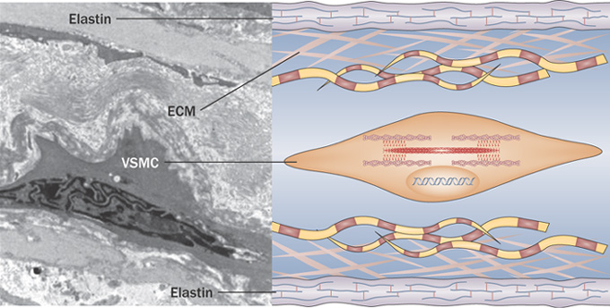
The Lamellar Unit
El-Hamamsy I and Yacoub M H (2009) Cellular and molecular mechanisms of thoracic aortic aneurysms
Nat Rev Cardiol doi:10.1038/nrcardio.2009.191

Slide 11
Classification of Aortic Surgical Cases Yielding Surgical Pathology Specimens for 2010 and 2019
Year 2010 2019
Category Pathology
Coarctation 12 0 Intimal/medial invagination (shelf)
ATAA 61 104 Primary medial degeneration; aortitis
Root 2 33
AVR 1 11
Dissection 15 28
DTAA 13 8 Primary med deg; atherosclerosis
TAAA 9 13 Atherosclerosis
AAA 7 6 Atheroslerosis
Totals 102 121
AAA = abdominal aortic aneurysm; ATAA = ascending thoracic aortic aneurysm; DTAA = descending thoracic aortic aneurysm; TAAA = thoracoabdominal aortic aneurysm

Slide 12
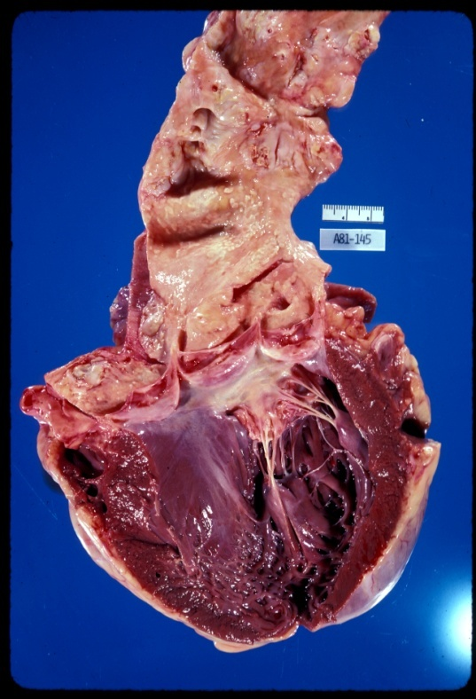
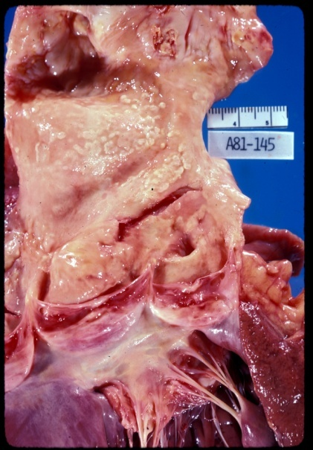
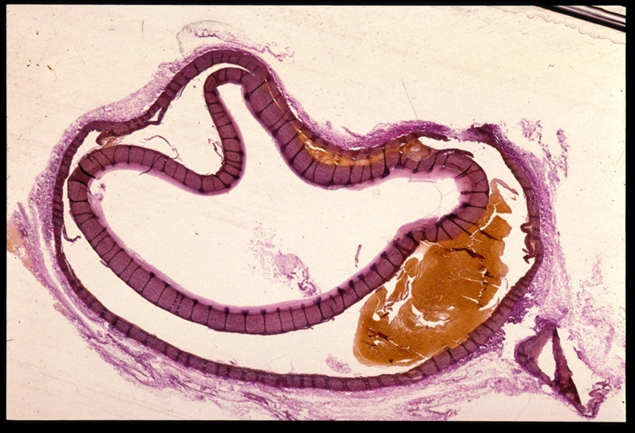
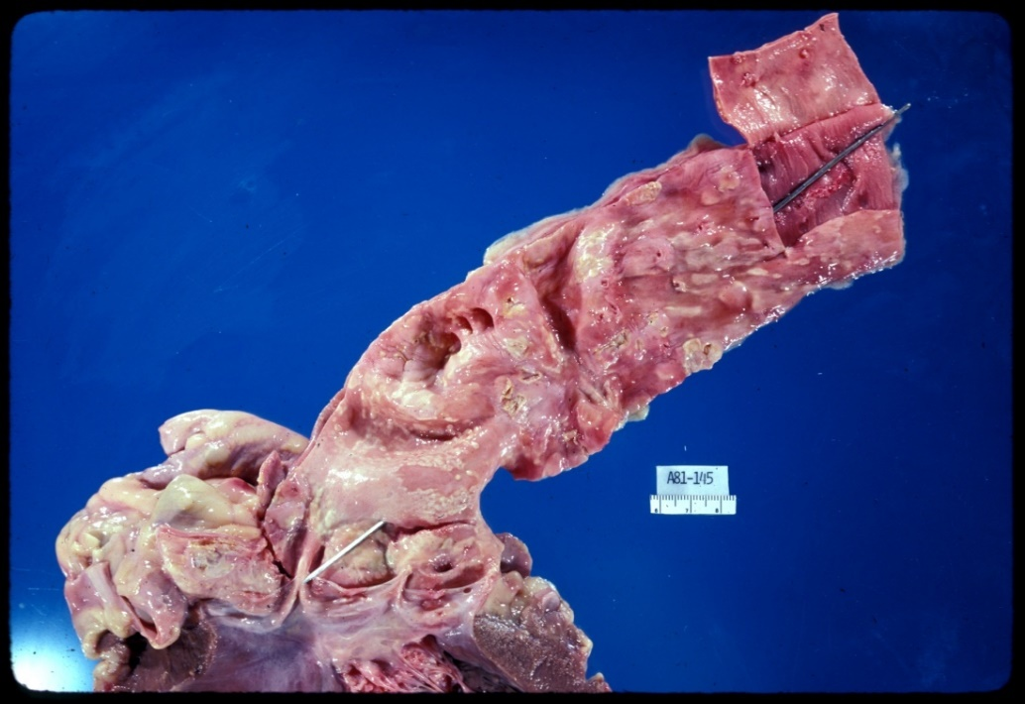
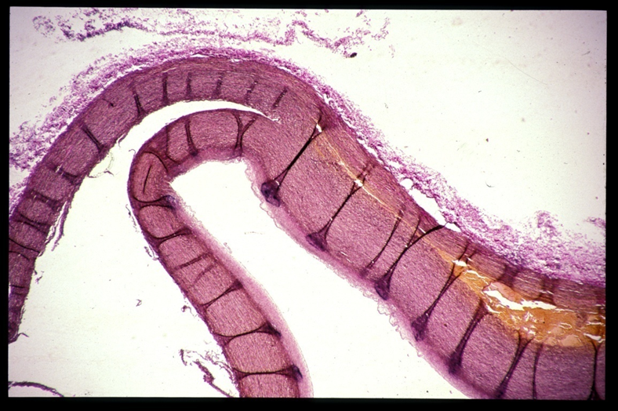
Type A Aortic Dissection

Slide 13
Aortic Size and Yearly Rates of Morbidity and Mortality (Parve S, Ziganshin BA, Elefteriades JA. J CV Surg (Torino) 2017;58:238-51)
Rupture
Dissection
More than 50% of AD involve aortas less than 5.5 cm diameter (IRAD data)
Rupture, Dissection or Death
Rupture or Dissection

Slide 14
Medial Degeneration of the Aortic Wall: Elastic Fiber Abnormalities and Aortic Dissection
intima
intima
Elastic fiber (EF) loss obvious in AD (right) versus a control (left) – extent is variable
media
Elastic fiber
media
adventitia
adventitia
The loss of interconnecting elastic fibers (IEF) is more obvious in the external media in AD (right) versus a control (left)
Akutsu K. Etiology of aortic dissection. Gen Thoracic Cardiovasc Surg 2019;67:271-276

Slide 15
Quantitation of Interlaminar Elastic Fibers (IEF) Values for Control Cases (Nakashima Y, Shiokawa Y, Sueishi K. Lab Invest 1990;62:751-760)
NUMBER OF INTERLAMINAR ELASTIC FIBERS (IEF) IN CONTROL CASES
Age in Decade Number of IEF of the Inner and Outer Media
(mean +/- SD, n=54)
40 105.4 +/- 22.1
104.9 +/- 21.8
50 105.7 +/- 21.1
98.2 +/- 20.4
60 105.1 +/- 22.8
99.4 +/- 21.4
70 117.5 +/- 23.9
93.5 +/- 24.9
80 118.0 +/- 25.8
95.6 +/- 27.9
Formic acid digestion
Scanning EM
Point counting method. Details of the counting method are described in the "Methods" section. The number of points overlying the fractured lines of interlaminar elastic fibers, represented as black points in the figure, were counted. The figure is the same as that of Figure lB. Bar represents 50 µm.

Slide 16
Aortic Dissection Cases
Inner Media
Outer Media
Elastic architecture in cases of dissecting aneurysm. A, B, and C, The inner media of case No. 4 was demonstrated in A and the outer media in B and C. D and E, Outer media of case No. 10. F and G, The outer media of case No. 9. A, B, D, and G, Figures of scanning electron microscopy. C, E, and F, Weigert's elastic fiber staining. Bars represent 50 µm.
Outer Media
#4(55F) – IM 125.2 +/- 15.3;
OM 45.9 +/- 9.8
# 9(79F) – IM 94.4 +/- 34.8;
OM 34.8 +/- 9.9
#10(84F) – IM 119.7 +/- 21.6
OM 44.9 +/- 15.1
Outer Media
Outer Media
6/10 cases – significant irregular arrangement and focal decrease of IEL
3/10 cases – CMN

Slide 17
Pathogenesis of Aortic Dissection (Akutsu K. Etiology of aortic dissection. Gen Thoracic Cardiovasc Surg 2019;67: 271-276)
AD has requirement for two pathological conditions:
Medial degeneration
Facilitative genetic profile
Damage to vasa vasorum from hypertension
Loss of interlaminar elastic fibers (IEF) in outer media
Mechanical shear stress of the aortic wall
Vertical swinging motion of the aorta at the aortic root: upward movement of heart with contraction plus tethering of aorta at isthmus
Hypertension
Forceful dp/dt

Slide 18
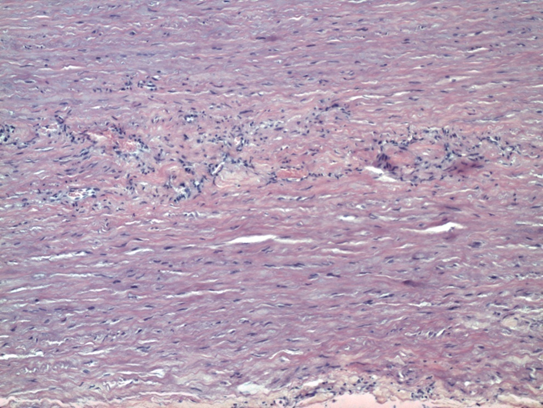
Heritable Thoracic Aortic Disease (HTAAD) (Renaud M et al. JACC 2018;72:605-616)

Slide 19
Heritable Thoracic Aortic Disease (HTAD): Cases and Methods
Review of histopathology of aortic specimens from 42 patients who underwent surgical aneurysm or dissection repair.
These individuals (n) harbored pathogenic variants in the following 11 genes: FBN1 (13), ACTA2 (6), TGFBR1 (7), TGFBR2 (3), TGFβ2 (3), SMAD3 (3), LOX (1), MYLK (1), PRKG1 (1), and COL3A1 (4); total 42.
The 42 specimens included 17 with medial dissection and 25 non-dissected aneurysms.
Arterial specimens were evaluated using histopathology consensus criteria (Halushka MK et al. Cardiovasc Pathol 2016;25:247-257).

Slide 20
Consensus grading scheme to evaluate aortic medial degeneration (Halushka MK et al. Cardiovasc Pathol 2016;25:247-257)
MEMA – mucoid extracellular matrix accumulation

Slide 21
Heritable Thoracic Aortic Disease (HTAD): Findings
By LM, specimens were graded (0 – 3+) for mucoid extracellular matrix accumulation (MEMA), elastic fiber fragmentation and/or loss (EFFL), SMC nuclear loss/laminar medial collapse (SMCNL/LMC), and overall medial degeneration (A 1-2, B 3-4, C 5-6, D 7-9);
Intimal lesions (0-3+) and medial dissection (+/-) also were noted.
Electron microscopy was used to further evaluate two cases (Davis EC. Lab Invest 1993;68:89-99).
By LM, cases showed a spectrum of extent and severity of medial degenerative changes: A mild 8 cases, B moderate 18 cases, C moderately severe 14 cases, and D severe 2 cases.

Slide 22
Two Cases of HTAAD
R.B.
D.S.
64 year old man with vascular Ehlers Danlos Syndrome
Mutated gene in vEDS/EDS-IV - COL3A1
Ascending Aortic Aneurysm
Underwent surgery on 9/4/2018
31 year old man with Loeys-Dietz Syndrome
Mutated genes in LDS -TGFBR1,TGFBR2,TGFB2, SMAD3
Ascending aortic aneurysm
Underwent surgery on 8/14/2018 for aneurysm repair and aortic root procedure

Slide 23
Two Cases of HTAAD
R.B. (HS18-11161) – Aorta with mild focal medial degeneration with minimal loss of elastic fibers
D.S. (HS18-10257) – Medial degeneration with marked fragmentation and loss of elastic fibers

Slide 24
Two Cases of HTAAD
R.B. - Abundant SMCs and elastin fibers; deficient collagen fibers
D.S. - Abundant SMC and collagen fibers; deficient elastin fibers

Slide 25
Two Cases of HTAAD
R.B. - Variation in range of diameters of residual collagen fibers
D.S. - Abundant normal collagen fibers

Slide 26
Two Cases of HTAAD
R.B.Close apposition of elastin fibers with SMC; deficient collagen fibers
D.S. Residual elastin fiber lacks close contact with SMC

Slide 27
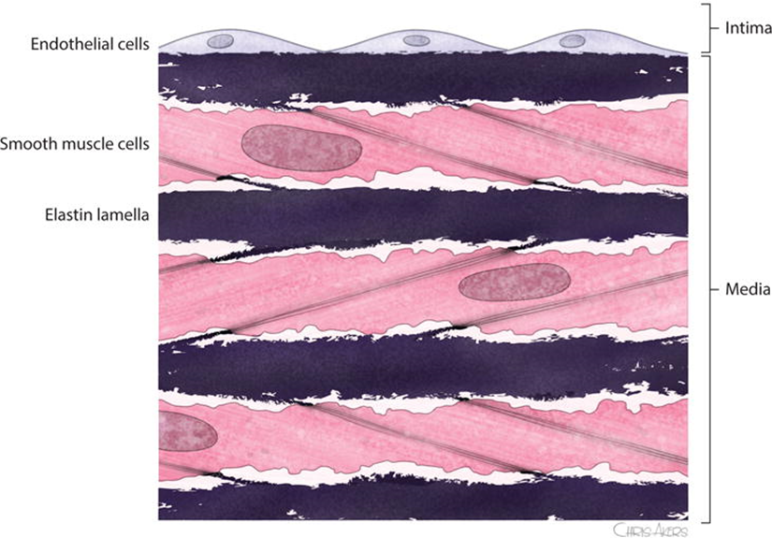
Comment
Our findings:
1) demonstrate that the pathology of the genetic vasculopathies involves structural defects in the interaction of ECM components and SMCs, with impairment of the elastin-contractile unit directly or through loss of structural support provided by collagen, and
2) support the altered mechano-transduction hypothesis for pathogenesis of aortopathy.
.
Humphrey JD et al. Circ Res 2015;116:1448-1461;
Pinard A, Jones GT, Milewicz DM. Circ Res 2019;124:588-606

Slide 28
Colleagues and Friends of Longstanding

