Slide 1
Hazim J. Safi, MD
Observations From a Remarkable Career
Charles C Miller, PhD

Slide 2
JVS Article:
The Challenges and Pitfalls of Survival Curves and Propensity Scores in Vascular Publications
What Dr. Safi Made Me Learn about Survival Analysis

Slide 3
Why are Competing Risks Important?
Amputation Rate
100
80
60
40
20
0
0
5
10

Slide 4
Why are Competing Risks Important?
Mortality Rate
100
80
60
40
20
0
0
5
10

Slide 5
Why are Competing Risks Important?
Individual Rates
100
80
60
40
20
0
0
5
10

Slide 6
Why are Competing Risks Important?
Limbs with no People
100
80
60
40
20
0
0
5
10

Slide 7
Why are Competing Risks Important?
Amputation-Free Survival
100
80
60
40
20
0
0
5
10

Slide 8
More Interesting Part:
What Dr. Safi’s Career has Meant to the Field

Slide 9
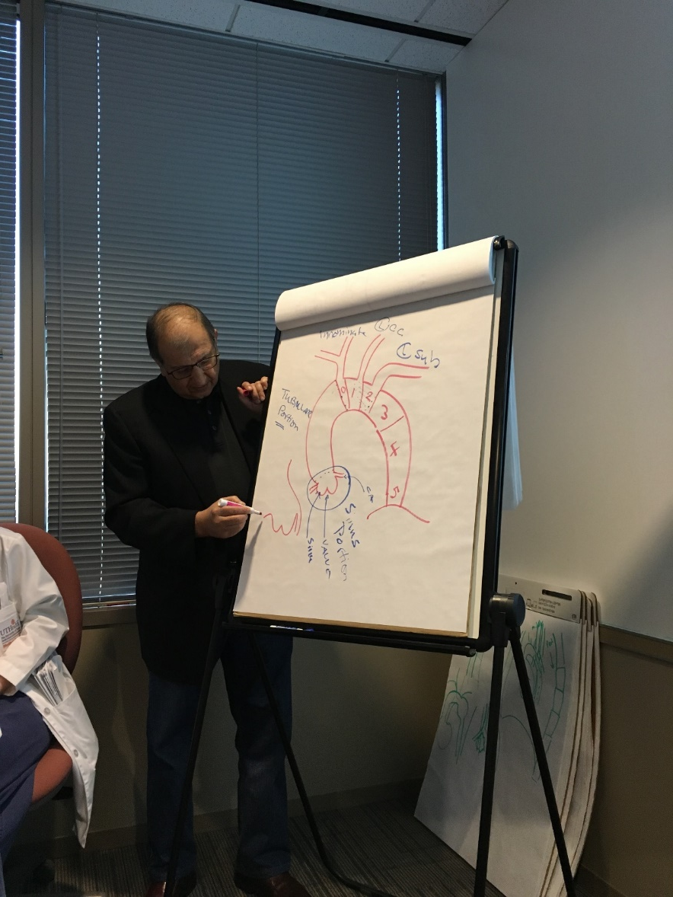
Teaching

Slide 10
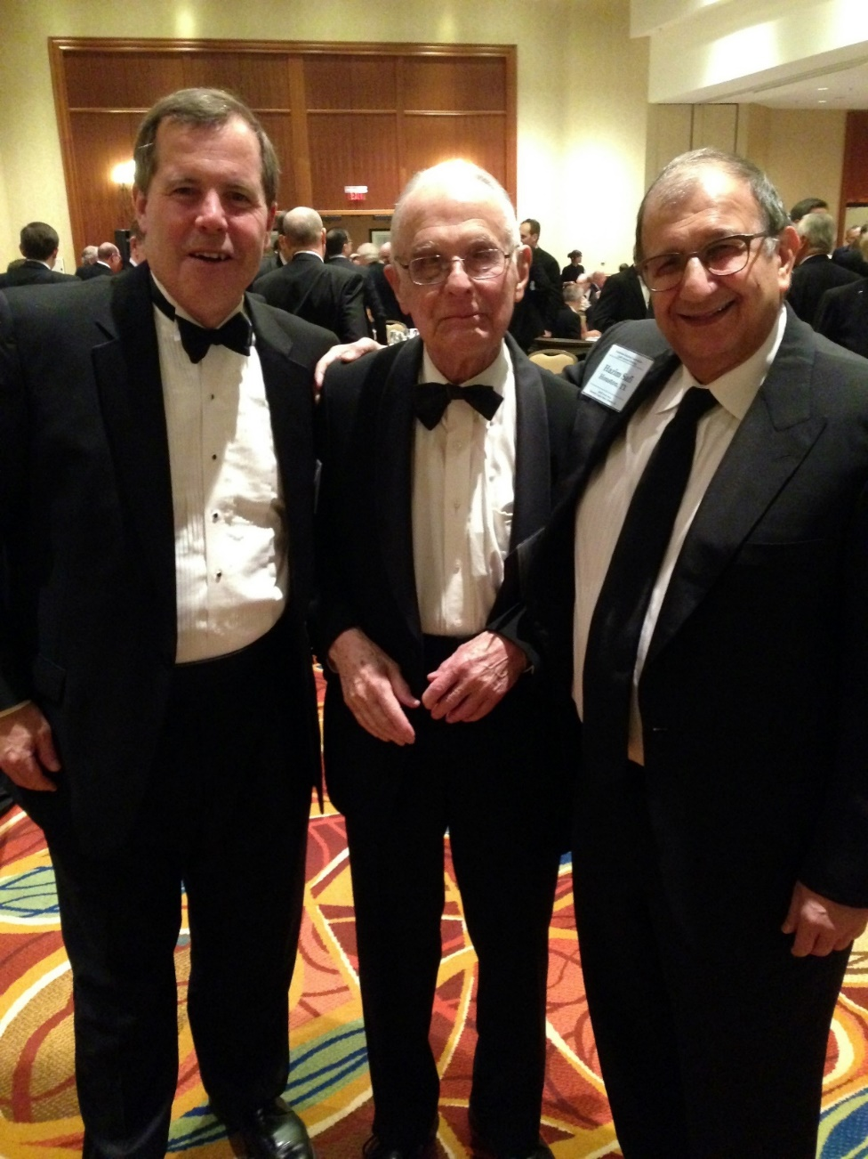
Peer Influence

Slide 11
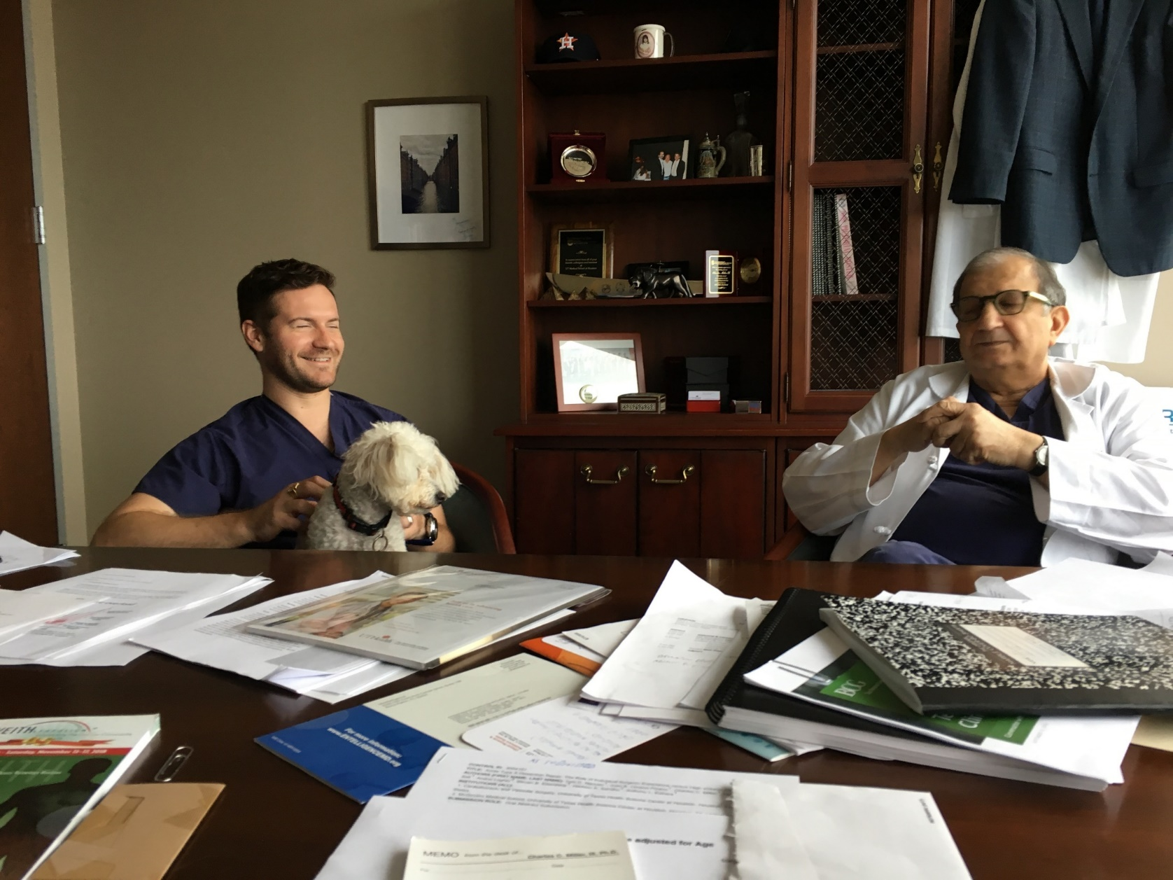
Mentoring Staff

Slide 12
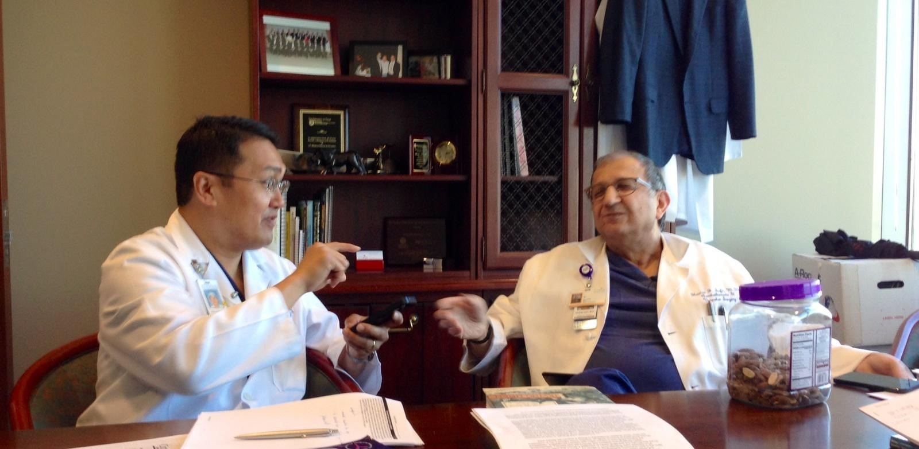
Tormentoring Associates

Slide 13
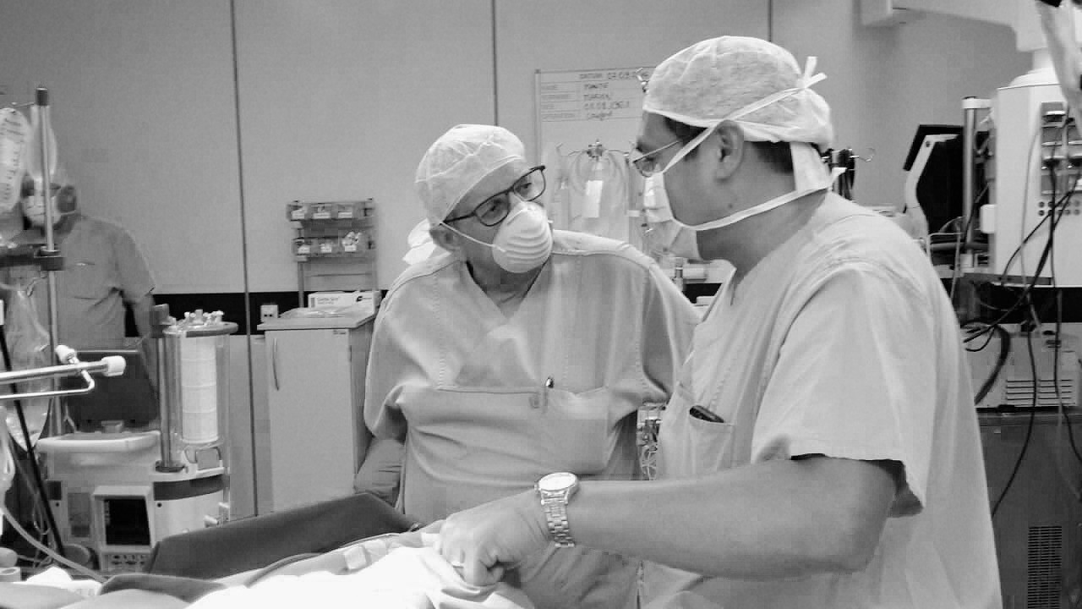
Conferring

Slide 14
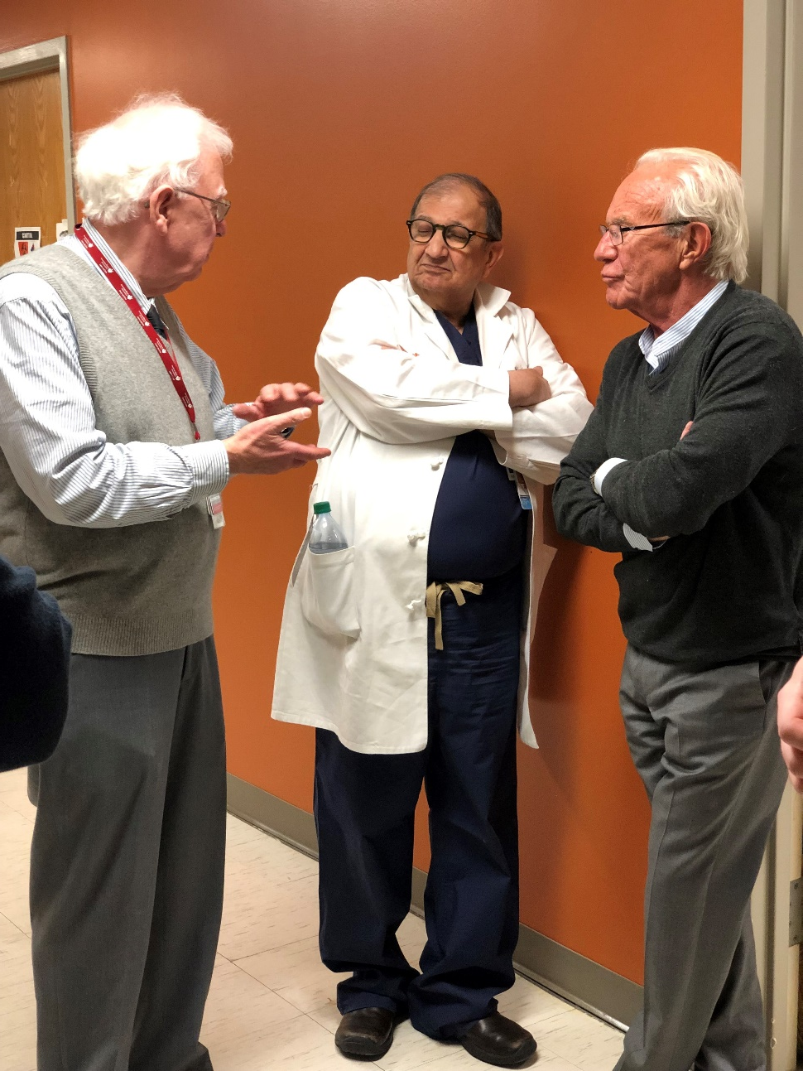
Skeptical Consumer of Data

Slide 15
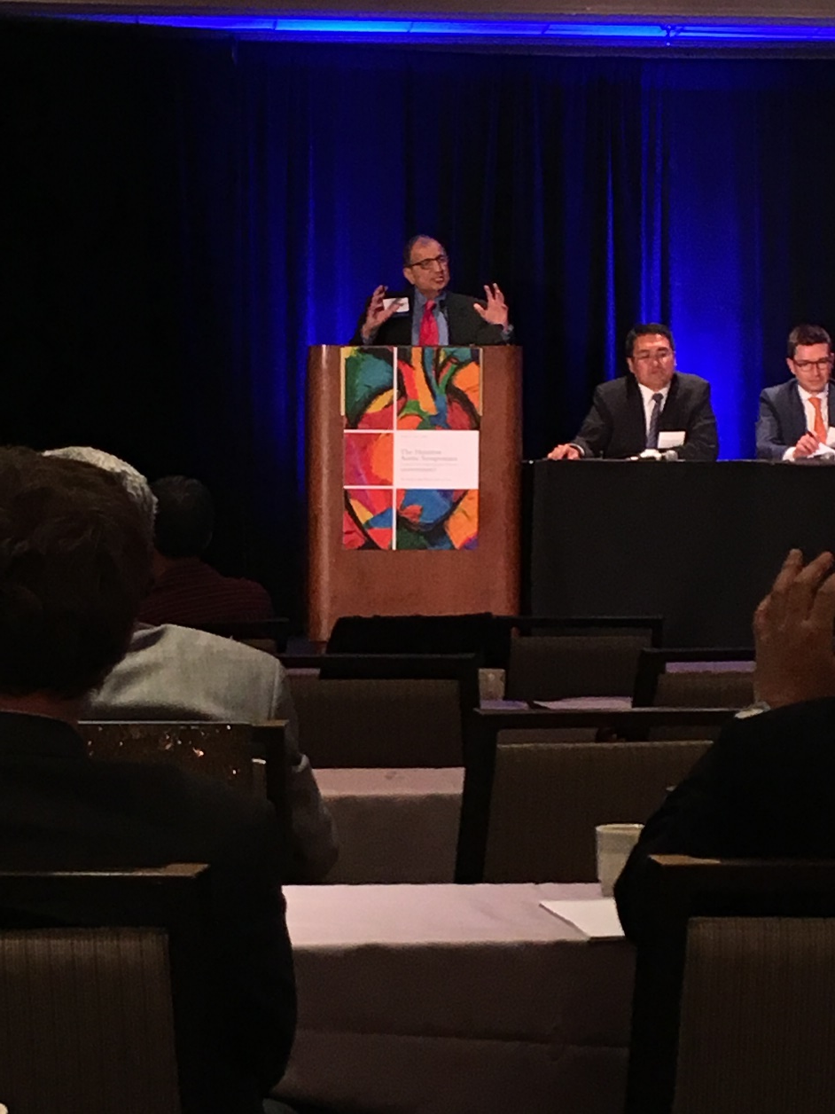
13 Years of Symposium

Slide 16
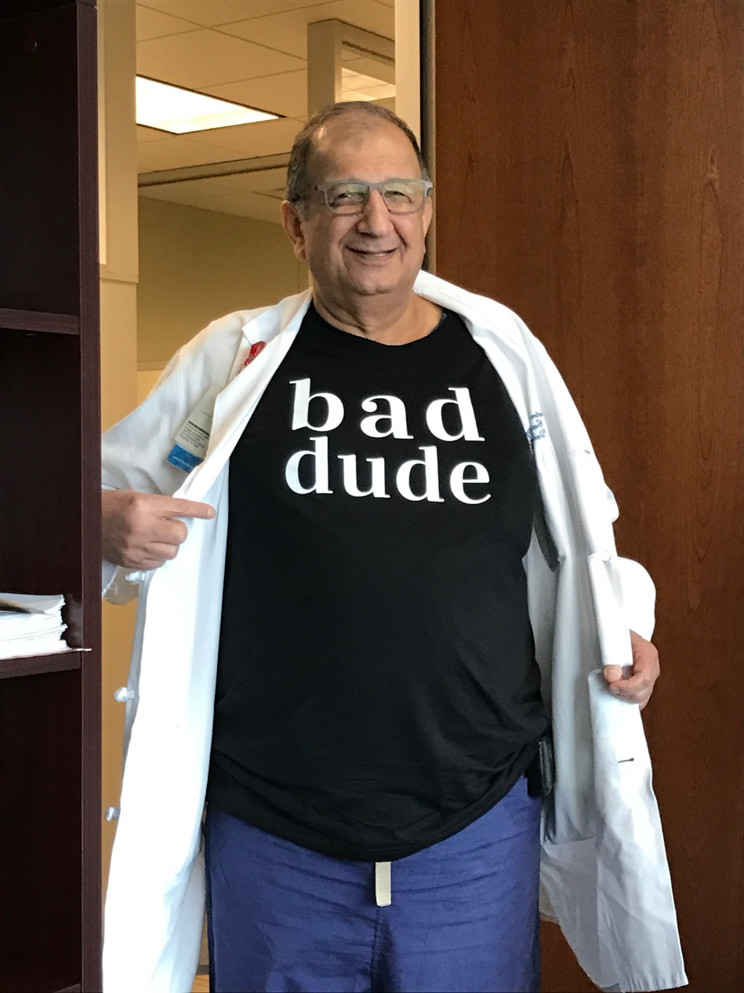
Still a Bad Hombre

Slide 17
Recognition:
What Dr. Safi’s Career has Meant to the Field
The Academy of Athens

Slide 19
Academy of Athens
Plato – 387 BC
Some Wars
Modern Academy - 1926
Dr. Safi

Slide 20
Notable Members
Albert Einstein
Alexander Fleming
Max Planck
Eric Kandel
Michael DeBakey
Lukas Papademos
Hazim J. Safi

Slide 22
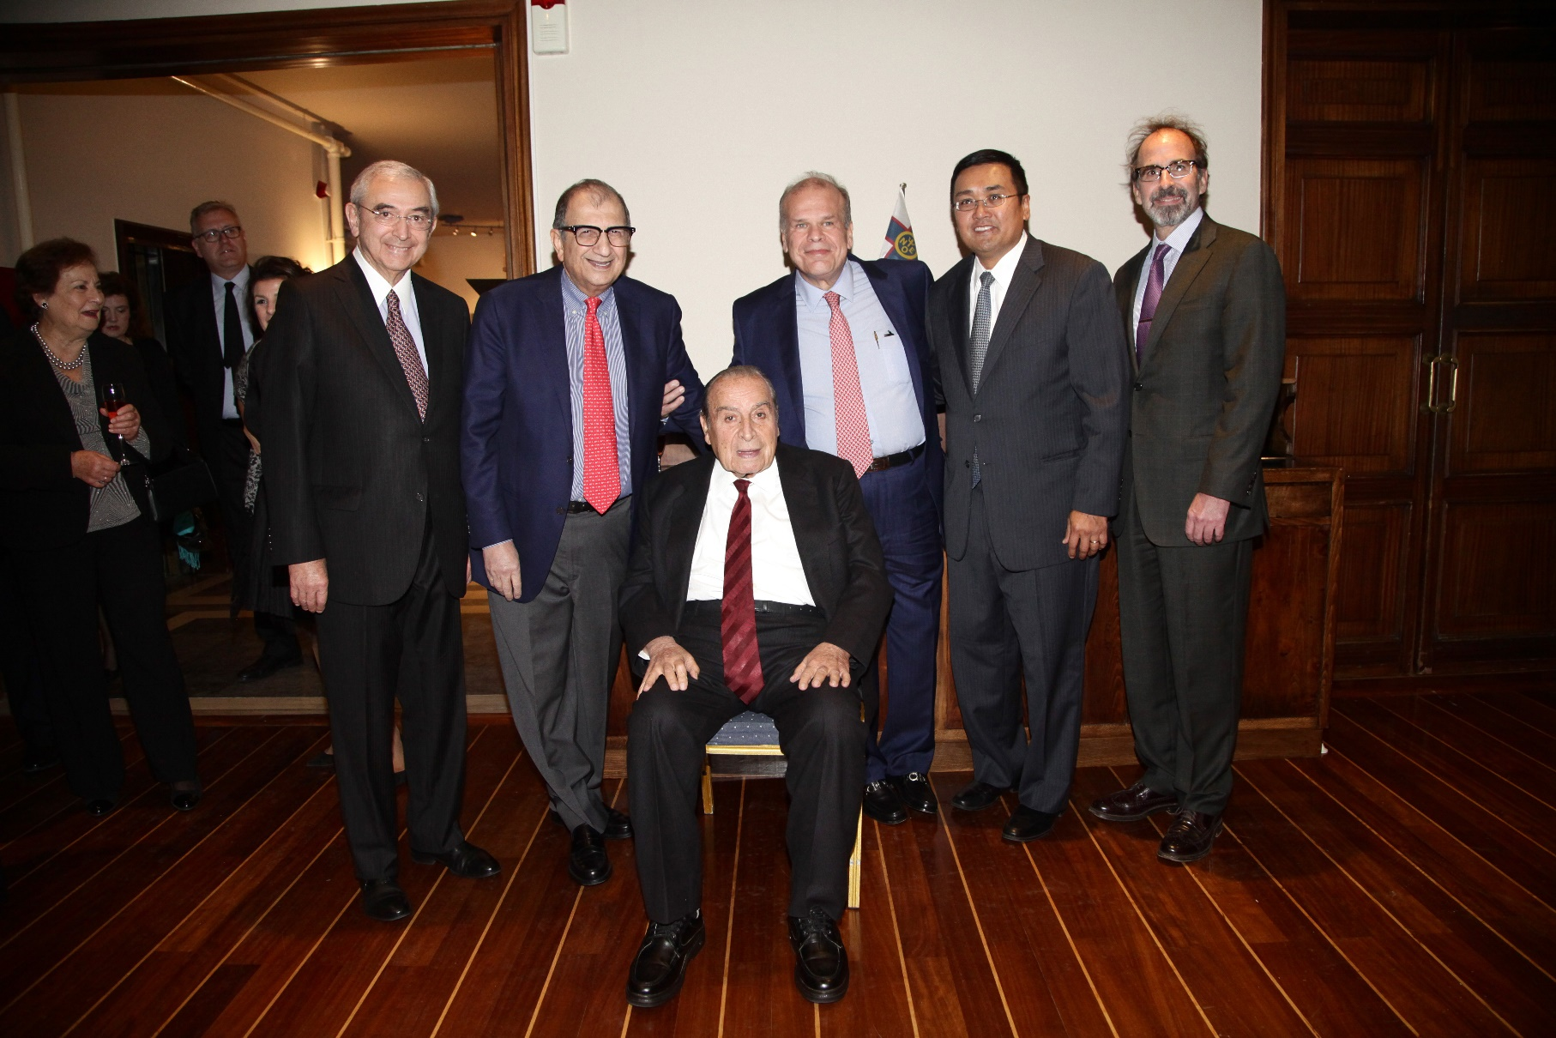
Proposed by Dr. Skalkeas
Hosted by Dr. Iliopoulos

Slide 23
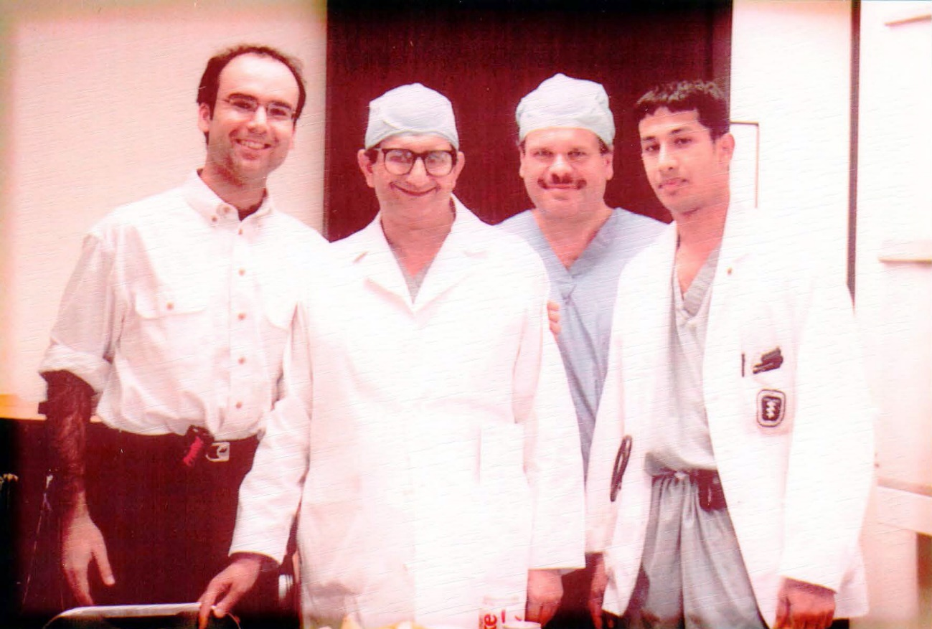
Dr. Iliopoulos

Slide 24
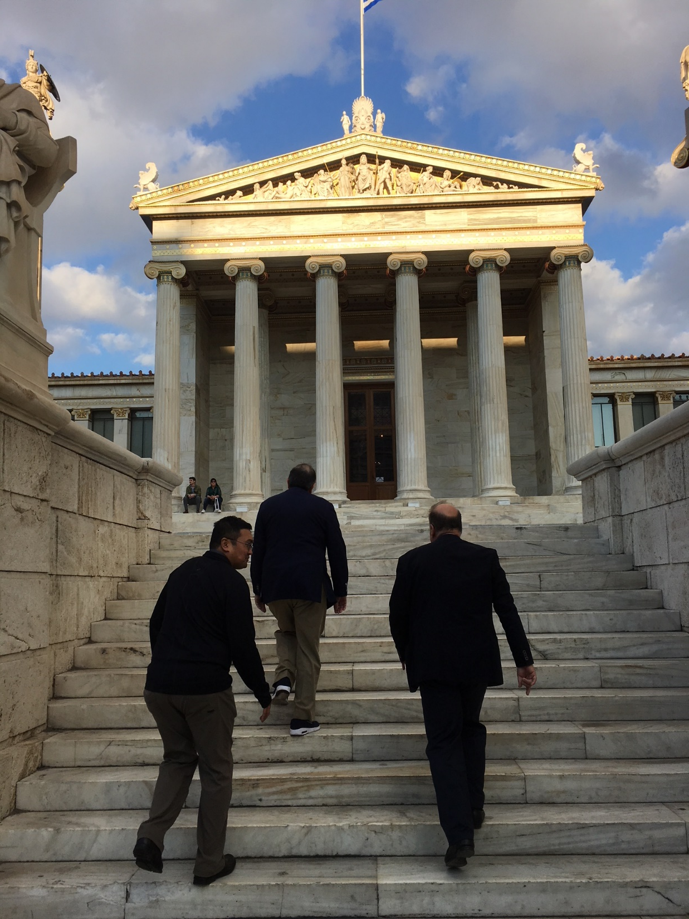

Slide 25
Athens Navy Club

Slide 26
November 7, 2017

Slide 27
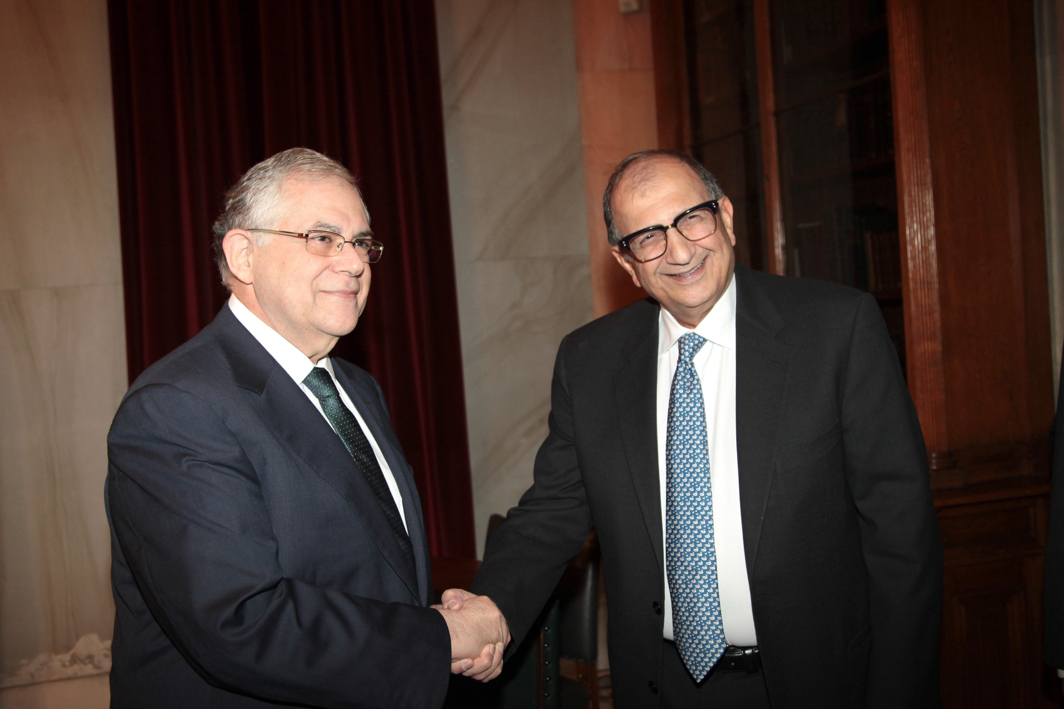
Academy of Athens

Slide 28
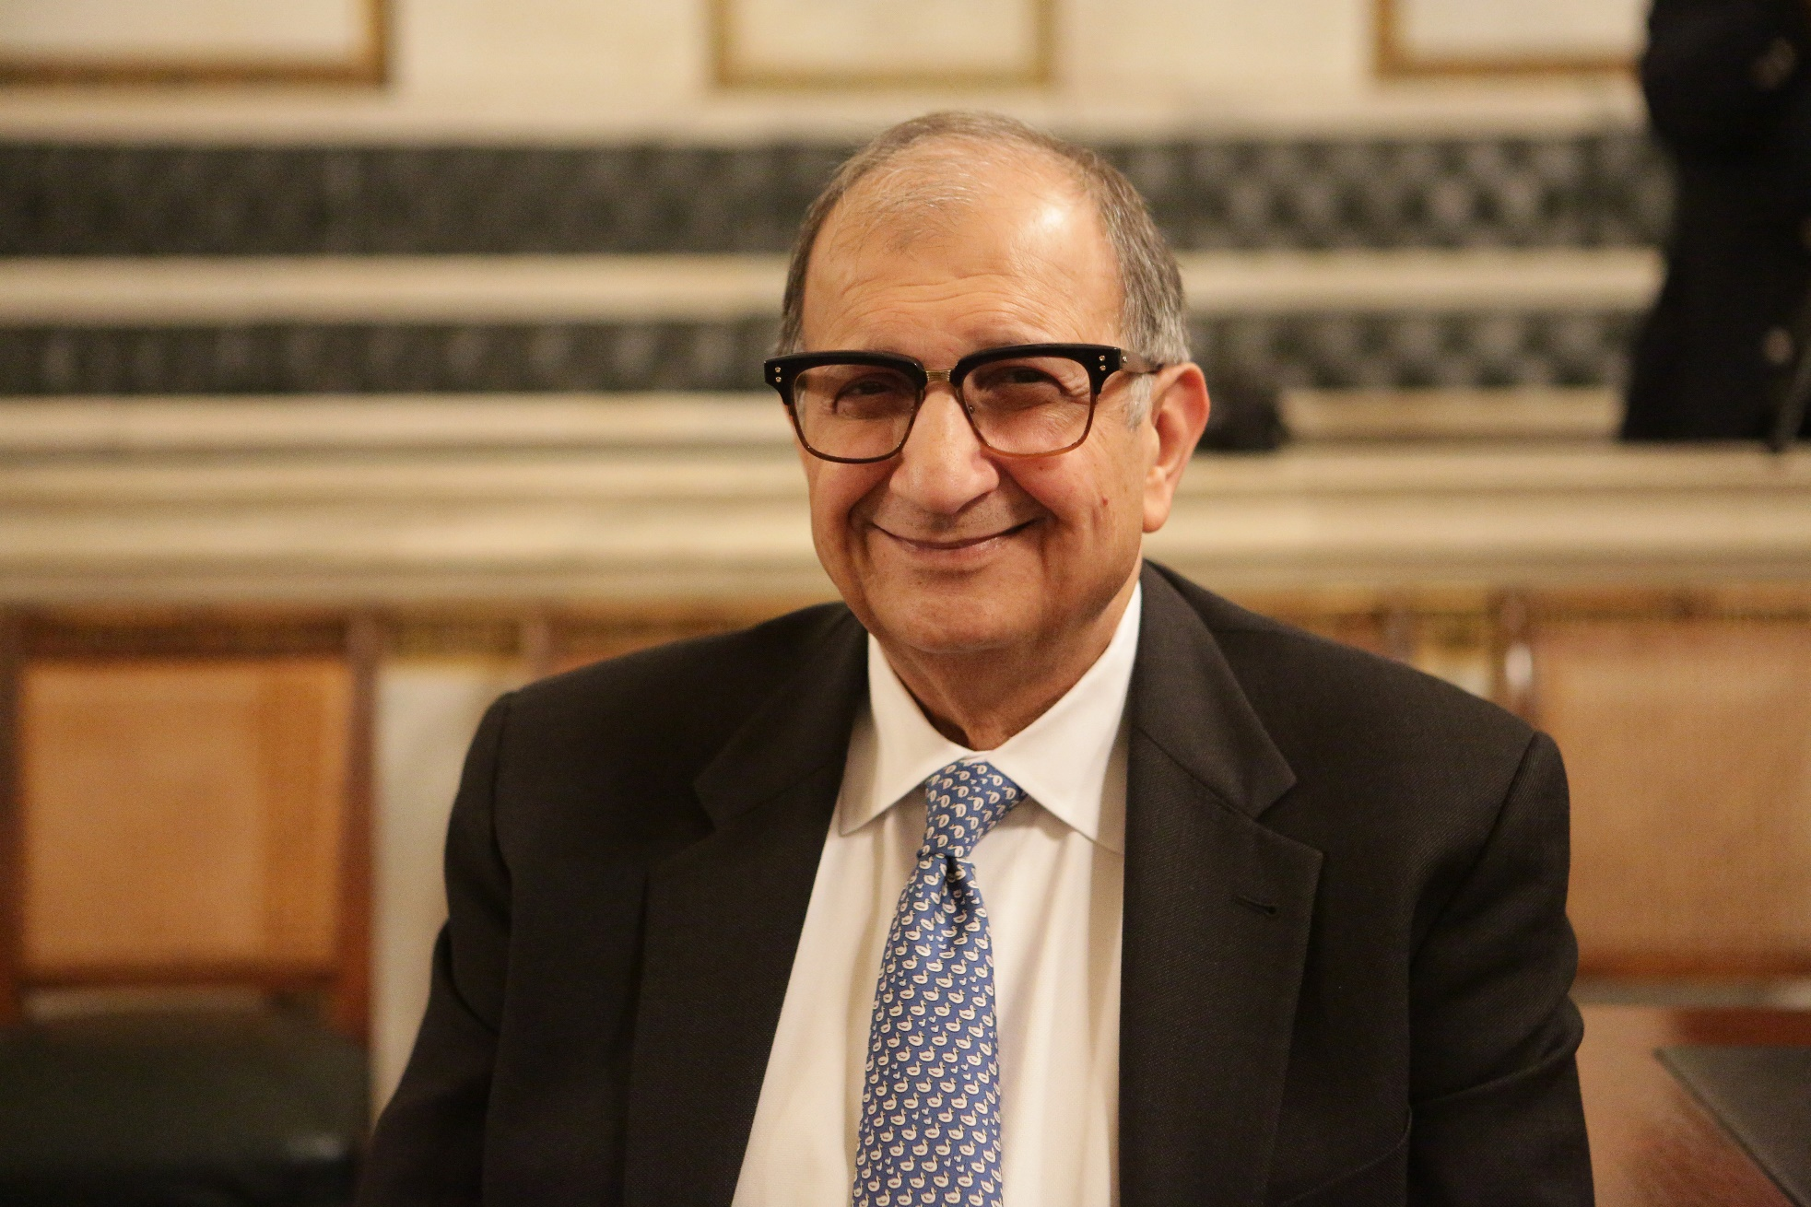
Academy of Athens

Slide 29
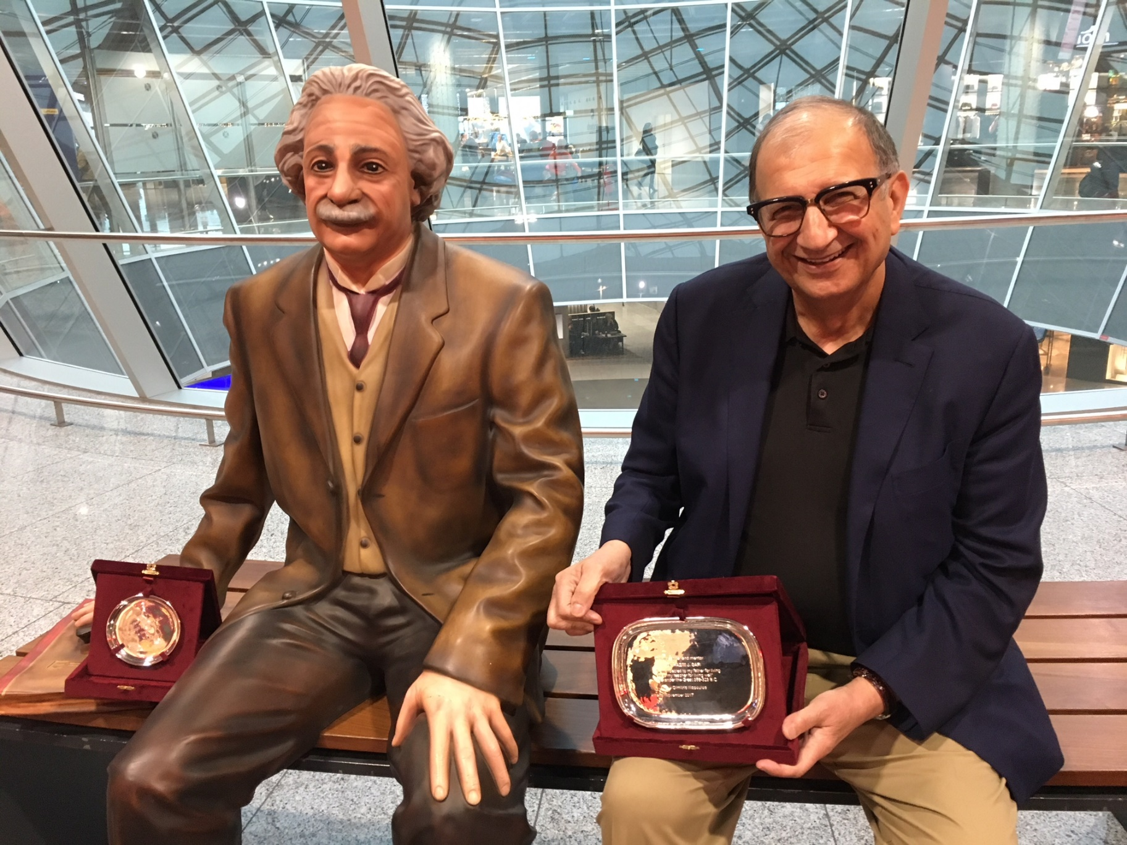
Frankfurt – The Honorees

