Slide 1
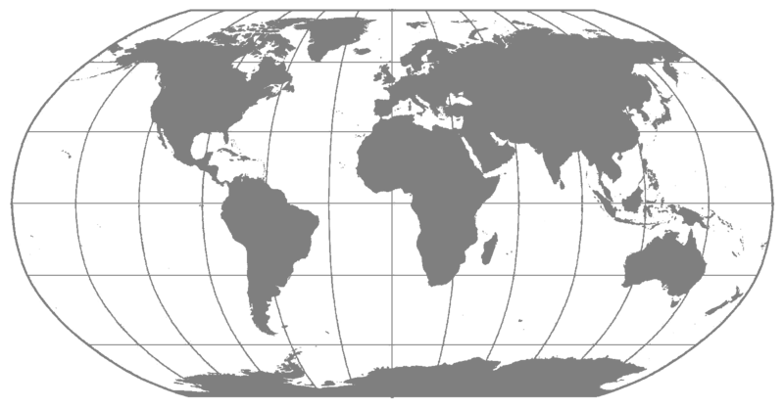
Center for Global Health at McGovern presents Travel Safety Information
2019

Slide 2
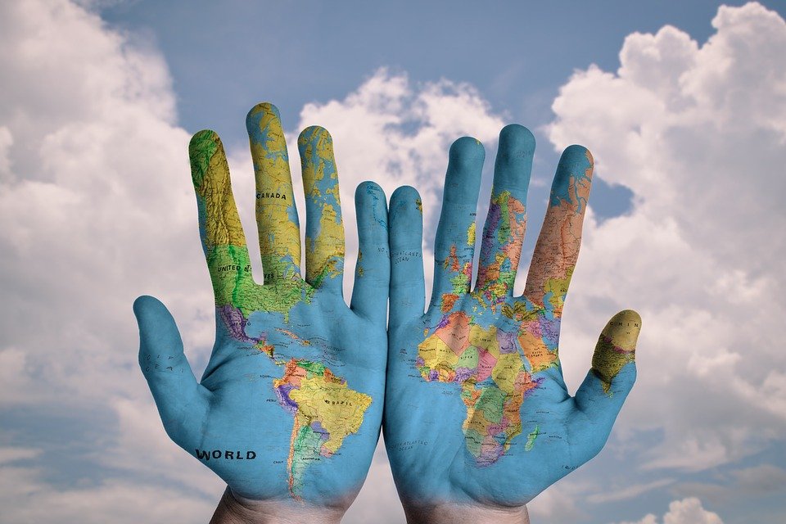
Travel at McGovern General Process
Verify with your faculty mentor/supervisor of trip approval
Follow all McGovern & UTHealth procedures for travel including completing the Student Travel Portal (well in advance) on med.uth.edu/globalhealth
Get International SOS
Check your travel destination is Govt. Level 1 or 2 (3 or 4 will be denied) travel.state.gov
Complete travel plans
Prepare for trip with itinerary, safety plans, etc.
Upon return, complete any requirements from your faculty mentor, course, etc.

Slide 3
Before Your Trip: Health
Check your destination for health concerns
Make an appointment with your healthcare provider well in advance
Pack a travel health kit with:
Your health insurance card
Your ISOS insurance info
All prescription & OTC meds you will need for trip (plus extra)
Make sure these are LEGAL in the area you are traveling
First aid supplies
Enroll in International SOS

Slide 4
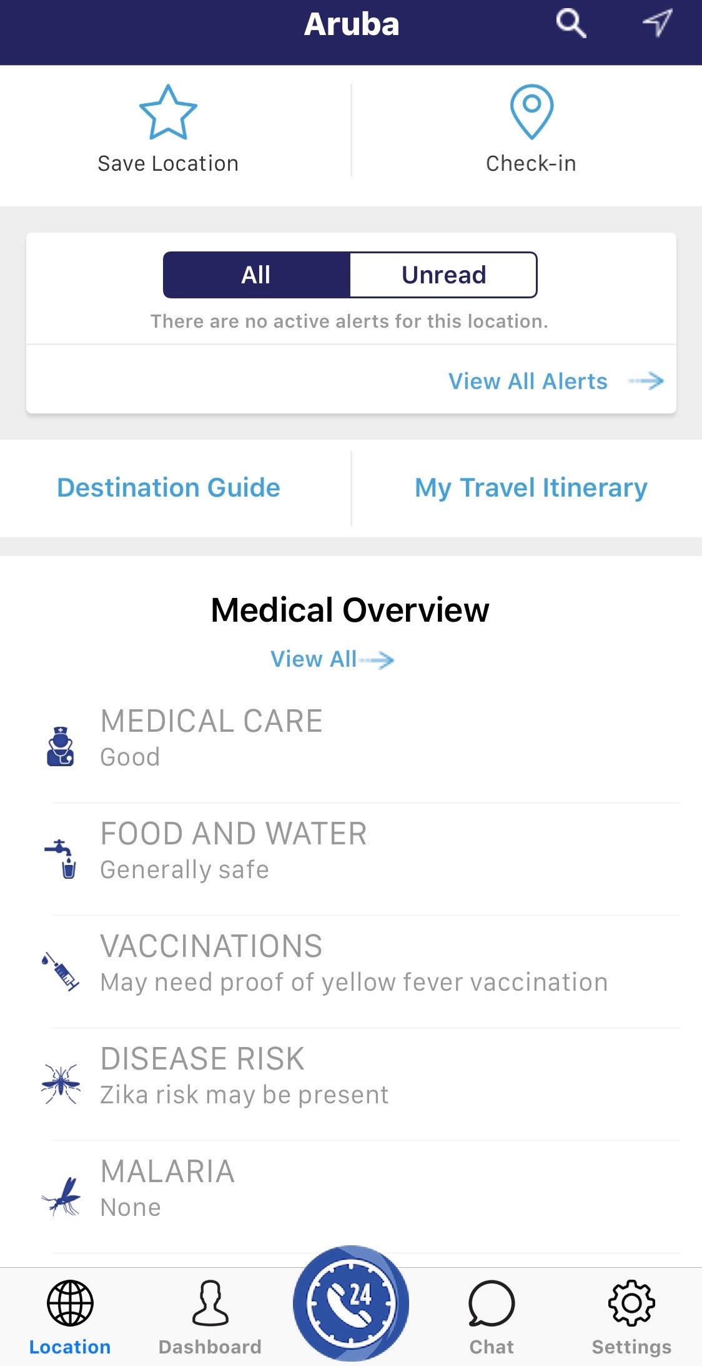
Before Your Trip: International SOS
*MANDITORY*
For UTH related travel
+1-215-942-8059 24/7 Emergency Assistance before & DURING your travel
Create an ISOS account; membership ID: 11BSGC000037
Add your trip; make sure you include emergency contact(s) NOT traveling with you
Get the ISOS App
save the ISOS number in your phone
print the ISOS travel card to keep in your purse/wallet

Slide 5
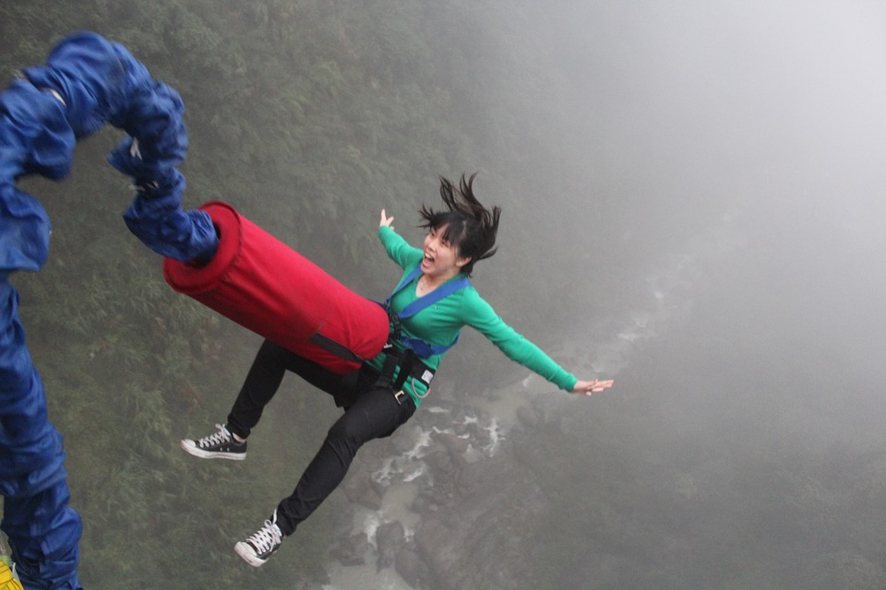
Before Your Trip: International SOS
+1-215-942-8059 24/7 Emergency Assistance before & DURING your travel
Some benefits: clinic/hospital referrals, security & medical advice, legal referrals, emotional support
Review benefits policy: https://www.utsystem.edu/offices/risk-management/student-international-travel-accident-sickness-policy
Insurance does not cover high risk activities, sports, or routine care
Maintain primary health coverage while abroad
No cost to students if policy guidelines are followed*
*Subject to change. Does not cover high risk activities/locations, routine care, elective procedures, unofficial/unapproved travel; contact ISOS with questions

Slide 6
Before Your Trip: Safety
Check your destination for safety concerns travel.state.gov
Keep in mind these levels can change quickly
Enroll in the State Department’s Smart Traveler Enrollment Program (STEP)
https://step.state.gov/
Latest safety info
Provide your emergency contact(s) with your itinerary and copies of your important docs (i.e. passport)
Keep an additional copy with you in case of loss or theft of originals

Slide 7
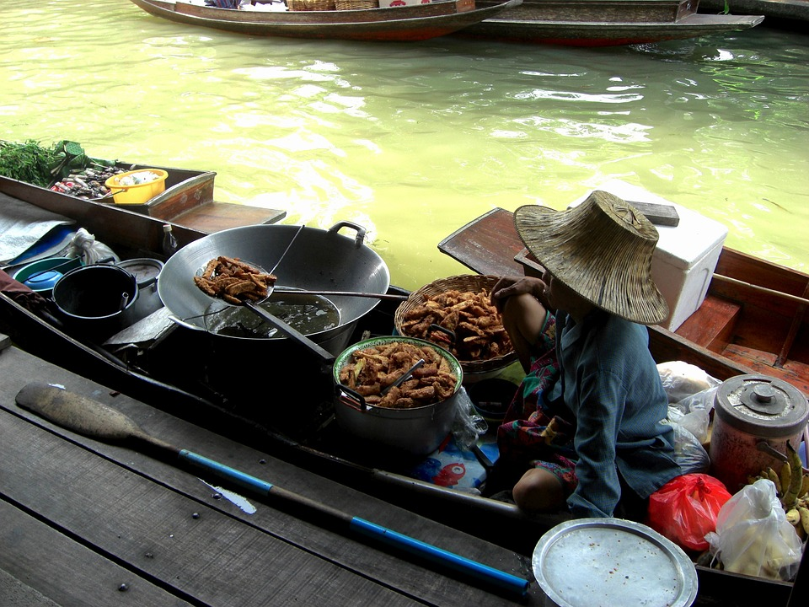
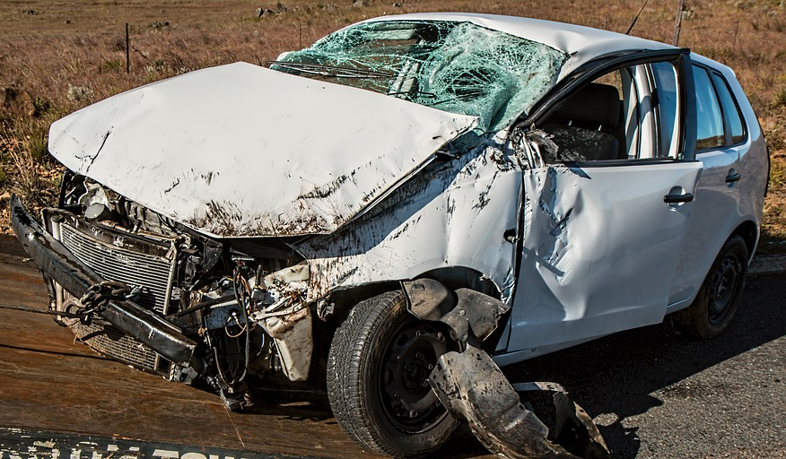
During Your Trip
REMEMBER: food & safety standards vary greatly country-to-country
Always wear seat belts & choose safe transportation
Eat and drink safely
Food should be kept at safe temps & handled hygienically
Drink responsibly (open own drink, know your limits, abstain)
Even ice in your drink may be contaminated
Protect yourself from hot temps & sun exposure
Prevent insect bites, bring DEET with you
Avoid animals
#1 Killer of healthy US citizens in foreign countries:
motor vehicle crashes
Most common travel-related illness: travelers’ diarrhea

Slide 8
During Your Trip: Safety outside of the global Health assignments
Keep safe around bodies of water
Use a flotation device if needed, know your limits
Avoid rip tides & live/washed up animals
Avoid areas without many people and follow warning signs
Safety during social outings
Make a plan for “going out” – identify a non-drinker or low-drinker to be “in charge”
Have check-in plan and let someone know where you’ll be
Meet in public place and/or with others
Known risks include being in unfamiliar location, STIs, etc.
Honor a “leave no man or woman behind” code of community responsibility when heading back for the night

Slide 9
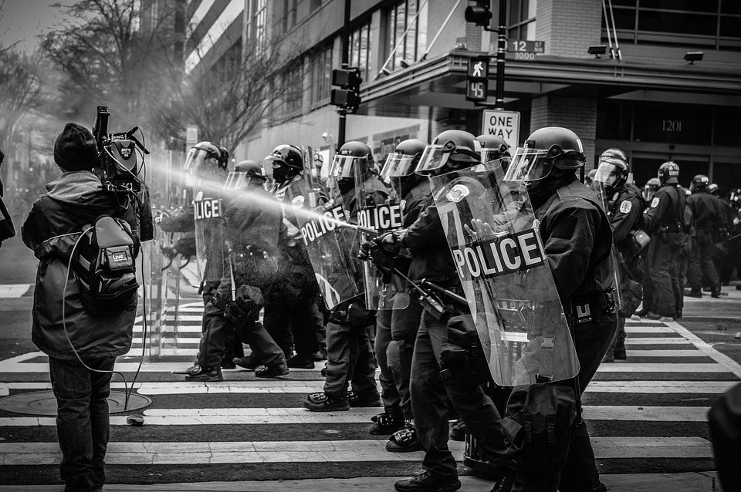
During Your Trip: Streetwise
Keep a low profile & dress to local social norms
Follow all local laws
Avoid protests & overcrowded infrastructures
Know where emergency exits are
Know when it is appropriate (and safe) to take a photo
Pay attention to your surroundings and NOT your phone
Some buildings/areas are illegal to photograph; do not take photos that risk your safety for a good shot

Slide 10
During Your Trip: Streetwise
Petty theft is common especially in tourist areas
Keep valuables hidden and in a safe spot where you can see them
Vary your routes around to be less predictable and less of a target for theft/stalking

Slide 11
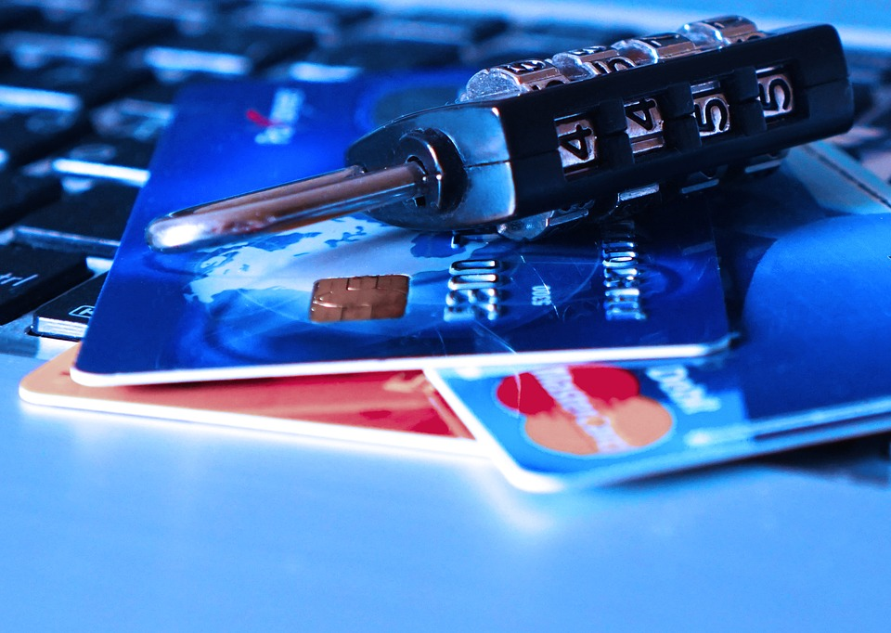
During Your Trip: Technology & Finance Safety
Keep sensitive documents/research secure
Clean devices of what you do not need (save on drive/device leaving behind)
Check with Information Security at McGovern
Change passwords before/after travel
Turn Bluetooth off and do NOT connect to public Wi-Fi
ATM skimming is common everywhere
Use ATMs in a safe location in the daylight
Monitor your bank account
Limit the amount of money you have at one time or in one place
Never resist theft – your life is more valuable

Slide 12
During Your Trip: Research & Devices
Research data must ONLY be saved on the UTHealth shared drive. Research staff and IT will provide a secure path for data to be saved and accessed.
NEVER save data on a flash drive or portable device.
Please contact you advisor:
To get guidance on where to store data
What devices are encrypted and shared prior to your travel
On correct protocols to follow
About if you need to complete the Human Subjects (CITI) Training*
*Training guide can be found at med.uth.edu/globalhealth/resources

Slide 13
During Your Trip: Self Care
Take time for yourself
Maintain normal hobbies & exercise as appropriate for your travel location
Remote areas with a language barrier can be a particular challenge with loneliness/homesickness
In whatever communications are available to your area, regularly contact family/friends from home
Call International SOS if you need to talk with someone (they will arrange)
If you are unwell in any way, contact ISOS

Slide 14
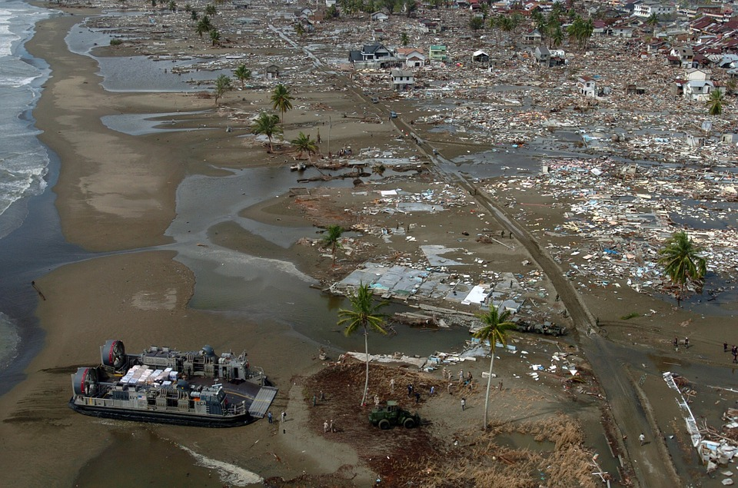
Emergency Response
HAVE AN EMERGENCY/SAFETY PLAN
Emergency contacts
ISOS
U.S. Embassy
Assess the situation during a crisis (safest place to be, help if needed, monitor alerts/progression of the situation)
CONTACT all emergency contacts (family/friends, school, local partners, etc.) once it is SAFE to do so
Keep your phone charged at all times
Networks may be temporarily down but KEEP TRYING (call, text, apps, etc.)

Slide 15
References & Resources
LGBTQ+ Traveler Safety info: https://ilga.org/resources
https://inside.uth.edu/travel/international/sos.htm
https://www.internationalsos.com/
https://wwwnc.cdc.gov/travel/page/summer-travel-abroad
https://travel.state.gov/content/travel/en/traveladvisories/traveladvisories.html/
https://www.utsystem.edu/offices/risk-management/student-international-travel-accident-sickness-policy
https://pixabay.com/

