Slide 1
Human Subjects Training
Do I need to complete Human Subjects (CITI) Training?
If you’re submitting to the Committee for the Protection of Human Subjects (CPHS/IRB) – YES!
If you’re submitting as Quality Improvement (QI) – NO
Unsure? Contact your mentor/faculty contact.

Slide 2
Human Subjects Training
https://about.citiprogram.org/en/homepage/
Select “Register”
Under “select your organization affiliation”, search for “Houston”, and select The University of Texas Health Science Center at Houston
Click “continue” to create your username and password
Complete:
Human Subjects Research (Group 1 for biomedical research OR Group 2 for social and behavioral research)
Good Clinical Practice

Slide 3
Human Subjects Training
You can expect to spend around five hours completing this training.
Once you have completed the two modules, save your completion certificates.
Training must be renewed every three years.

Slide 4
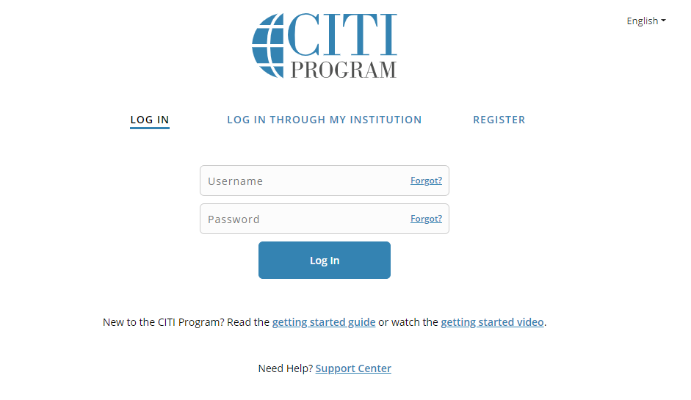

Slide 5
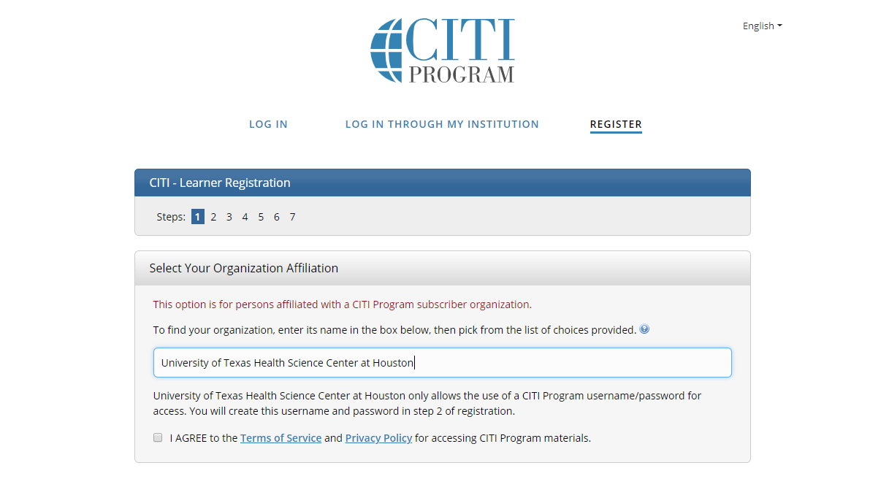

Slide 6
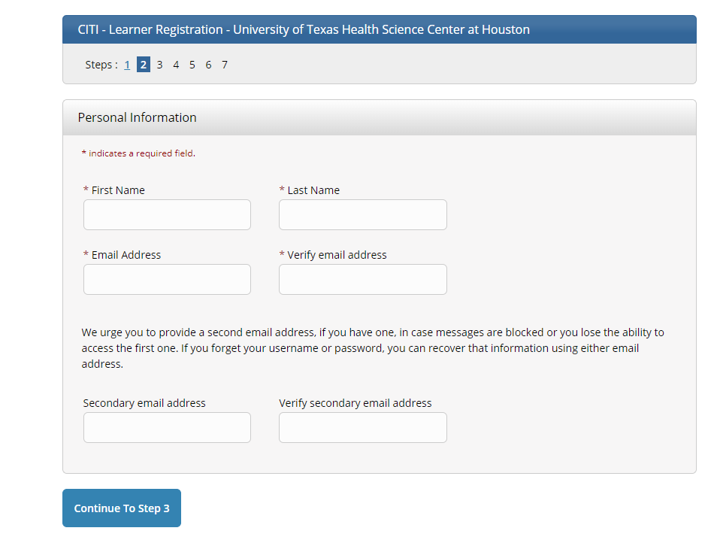

Slide 7
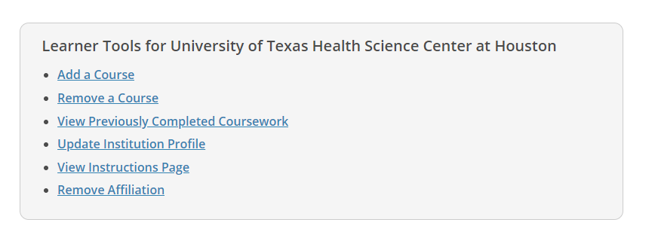

Slide 8
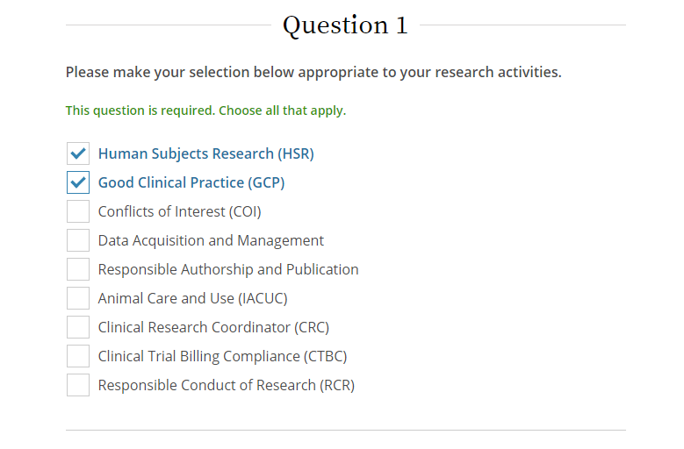

Slide 9
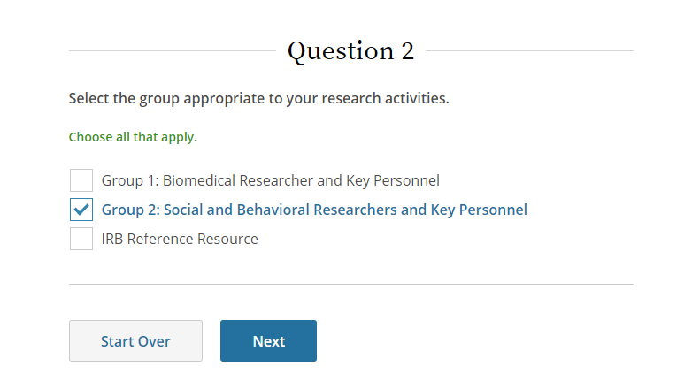

Slide 10
