Slide 1
Internal Medicine Abstracts

Slide 2
Increasing Herpes Zoster Vaccination Rates in a High Risk IBD population Ryan Goldstein M.D., Asmeen Bhatt M.D., Ph.D.
Overview/Problem Statement:
To increase Herpes Zoster Vaccination rates in patients with IBD age ≥50 from 4.8% to >75% over a 1-year period by June 2021.
Previously, Zostavax was the only option available for herpes zoster vaccination but had a limitation of being a live attenuated vaccine and since a majority of patients with inflammatory bowel disease (IBD) are on immunosuppression, Zostavax was contraindicated, and these patients were unable to receive vaccination.
However, a recently approved drug called Shingrix, a recombinant zoster vaccine that is safe in patients with immunosuppression, has been made available to our LBJ community hospital. Shingrix is administered as a 2-dose series with the second dose given 2 to 6 months after the first dose.
Results:
During the past 10 months, 55 patients have met the vaccination criteria.
76.4 % (42/55) received either their 1st or 2nd vaccinations, while 12.7% (7/55) did not receive immunizations and 10.9% declined immunizations (6/55) when offered.
At this time, 50.0% (21/42) patients have received their second Shingrix dose.
No recorded side effects to date.
Methods:
We performed a retrospective analysis of all patients age greater than 50 that have been seen in the LBJ Gastroenterology clinic over a 2-month period and found that only 4.8% (1/21) of patients with IBD were vaccinated for Herpes Zoster (HZ).
Over a 5-year period there have been 15 patients with a major herpes zoster flare with 3 patients (20% having repeated flares). 20% of which had a potentially life threating or sight-threatening condition, like Herpes Zoster Opthalmicus (HZO) defined as herpes zoster involvement of the ophthalmic division of the fifth cranial nerve.
We aimed to increase HZ vaccinations through a series of QI interventions focused on education, awareness and a step wise algorithm with an EPIC IBD template and hard prompts.
Conclusions:
Through our QI implementation, we are successfully meeting our aim to increase HZ Vaccination rates from 4.8% to 76.4%.
Vaccination have largely been impacted by a decrease in inpatient clinic visits due to COVID-19 and patients holding off their 1st or 2nd Shingrix vaccination until after their COVID-19 vaccination series.
Although, current guidelines recommend vaccination after the age of 50, our retrospective analysis suggests that maybe patients before the age of 45 would benefit from earlier herpes zoster vaccination, especially if those patients are to receive a more aggressive immunosuppressive treatment for their underlying IBD.
01

Slide 3
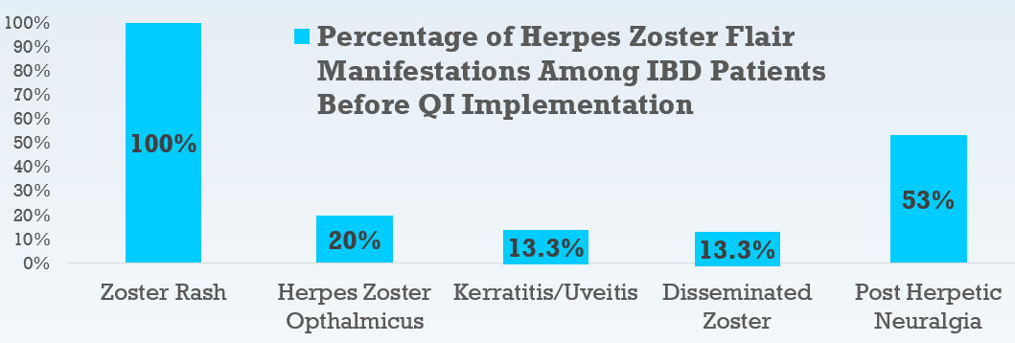
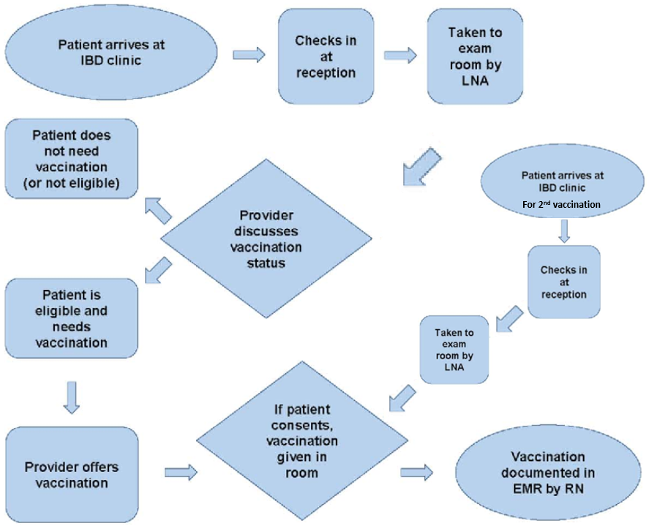
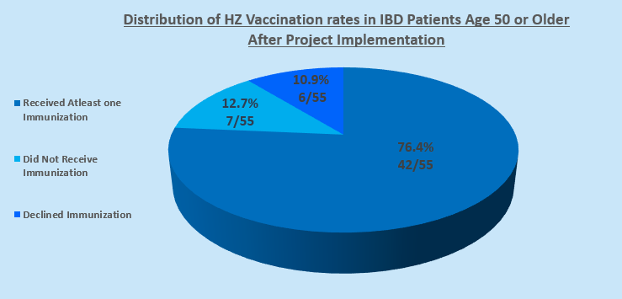
Increasing Herpes Zoster Vaccination Rates in a High Risk IBD population Ryan Goldstein M.D., Asmeen Bhatt M.D., Ph.D.
Figures (if any):

Slide 4
Examining Factors Related to CHF Readmission Rates at Memorial Hermann Hospital
Ijele Adimora MD, Steffi Hu MD, Annie Janise MD, Kalyn Mosely MD, Vivian Okirie MD,
Vi Pham MD, Stephan Reyes MD, Siddharth Karanth MBBS, MPH, DRPH
Overview/Problem Statement
Congestive heart failure (CHF) is the leading cause of hospitalization among adults in the United States. Nearly 50% of all CHF patients discharged from a hospitalization will be readmitted within 6 months.
The purpose of our research is to elucidate the risk factors driving CHF readmission at our institution, in order to more effectively implement a prevention strategy for management of heart failure readmissions.
Results
Of the 148 patients who were readmitted within 30 days:
61% had low health literacy
69% had scheduled outpatient follow up
67% had documented medication compliance
48% had physical limitation
25% had neuropsychiatric barriers
34% readmitted with non CHF exacerbation related problems
See Figure 1
Methods
We examined the medical records of 148 patients who had CHF as their primary diagnosis and were readmitted to our institution within 30 days from 9/2015-9/2019
Reason for readmission was documented as either related to or unrelated to CHF exacerbation.
Multiple risk factors related to hospital readmission were examined including: availability of home ancillary services, patient neuropsychiatric barriers, patient health literacy, scheduled outpatient follow-up, medication availability and compliance, and patient physical limitations.
Conclusion
Low health literacy appears to be a large contributor to CHF readmissions. The majority of patients readmitted for CHF exacerbation had scheduled outpatient follow up and were documented as medication compliant.
More analyses remains to be done about the particular root causes for readmission in the setting of appropriate adherence and outpatient attention.
03

Slide 5
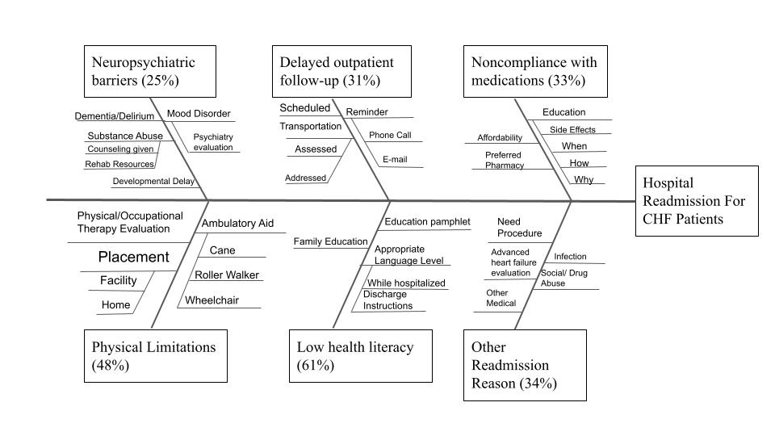
Examining Factors Related to CHF Readmission Rates at Memorial Hermann Hospital
Ijele Adimora MD, Steffi Hu MD, Annie Janise MD, Kalyn Mosely MD, Vivian Okirie MD,
Vi Pham MD, Stephan Reyes MD, Siddharth Karanth MBBS, MPH, DRPH
Figure 1.
Cause and Effect Diagram for 30-day readmissions in CHF patients

Slide 6
Bridging the Gap: A palliative care-modeled goals of care curriculum for in-person Spanish interpreters providing language services to patients with limited English proficiency Adrienne Baksh MD, Halyna Ivashchuk MD, Soraira Pacheco DO, Ana Leech MD, Rex Paulino MD
Introduction:
More than 60 million Americans speak a second language at home, Spanish being the most common second language. Our project aims to bridge the gap in communication between Spanish-speaking patients and Palliative Care (PC) providers by teaching in-person Spanish interpreters (SI) key communication concepts.
Results:
In-person SI feel comfortable discussing GOC 100% (Figure B) of the time. Since participating in the goals of care training, SI reported initiating pre-meetings 89% (Figure C) and debriefs 78% (Figure D) of the time. They also reported feeling more comfortable speaking with patients and families regarding Palliative Care and hospice (89%). Overall, 100% of participants felt the training equipped with them with skills to better serve as a patient liaison/advocate in their role as an interpreter. Majority of the SI had a correct response to core PC topics of at least 50% (Figure A).
Methods:
A needs assessment was done to determine curriculum content. A multiple-choice pre-test was used to establish SI’ attitude in rendering goals of care (GOC) discussions. SI attended communication skills training sessions commonly provided to palliative care providers. The content included core PC topics (days 1 and 2), interpreting exercises (day 1), and role-play (day 2). Post-tests were distributed immediately, at 2-, and 4-months after intervention. Outcomes measured include SI’ knowledge and attitude in communicating serious news and/or end-of-life issues using a multiple-choice exam and self-efficacy scale.
Conclusion:
The palliative care-modeled goals of care curriculum increased the SI’ level of comfort communicating serious news and initiating pre-meetings and debriefs.
04

Slide 7
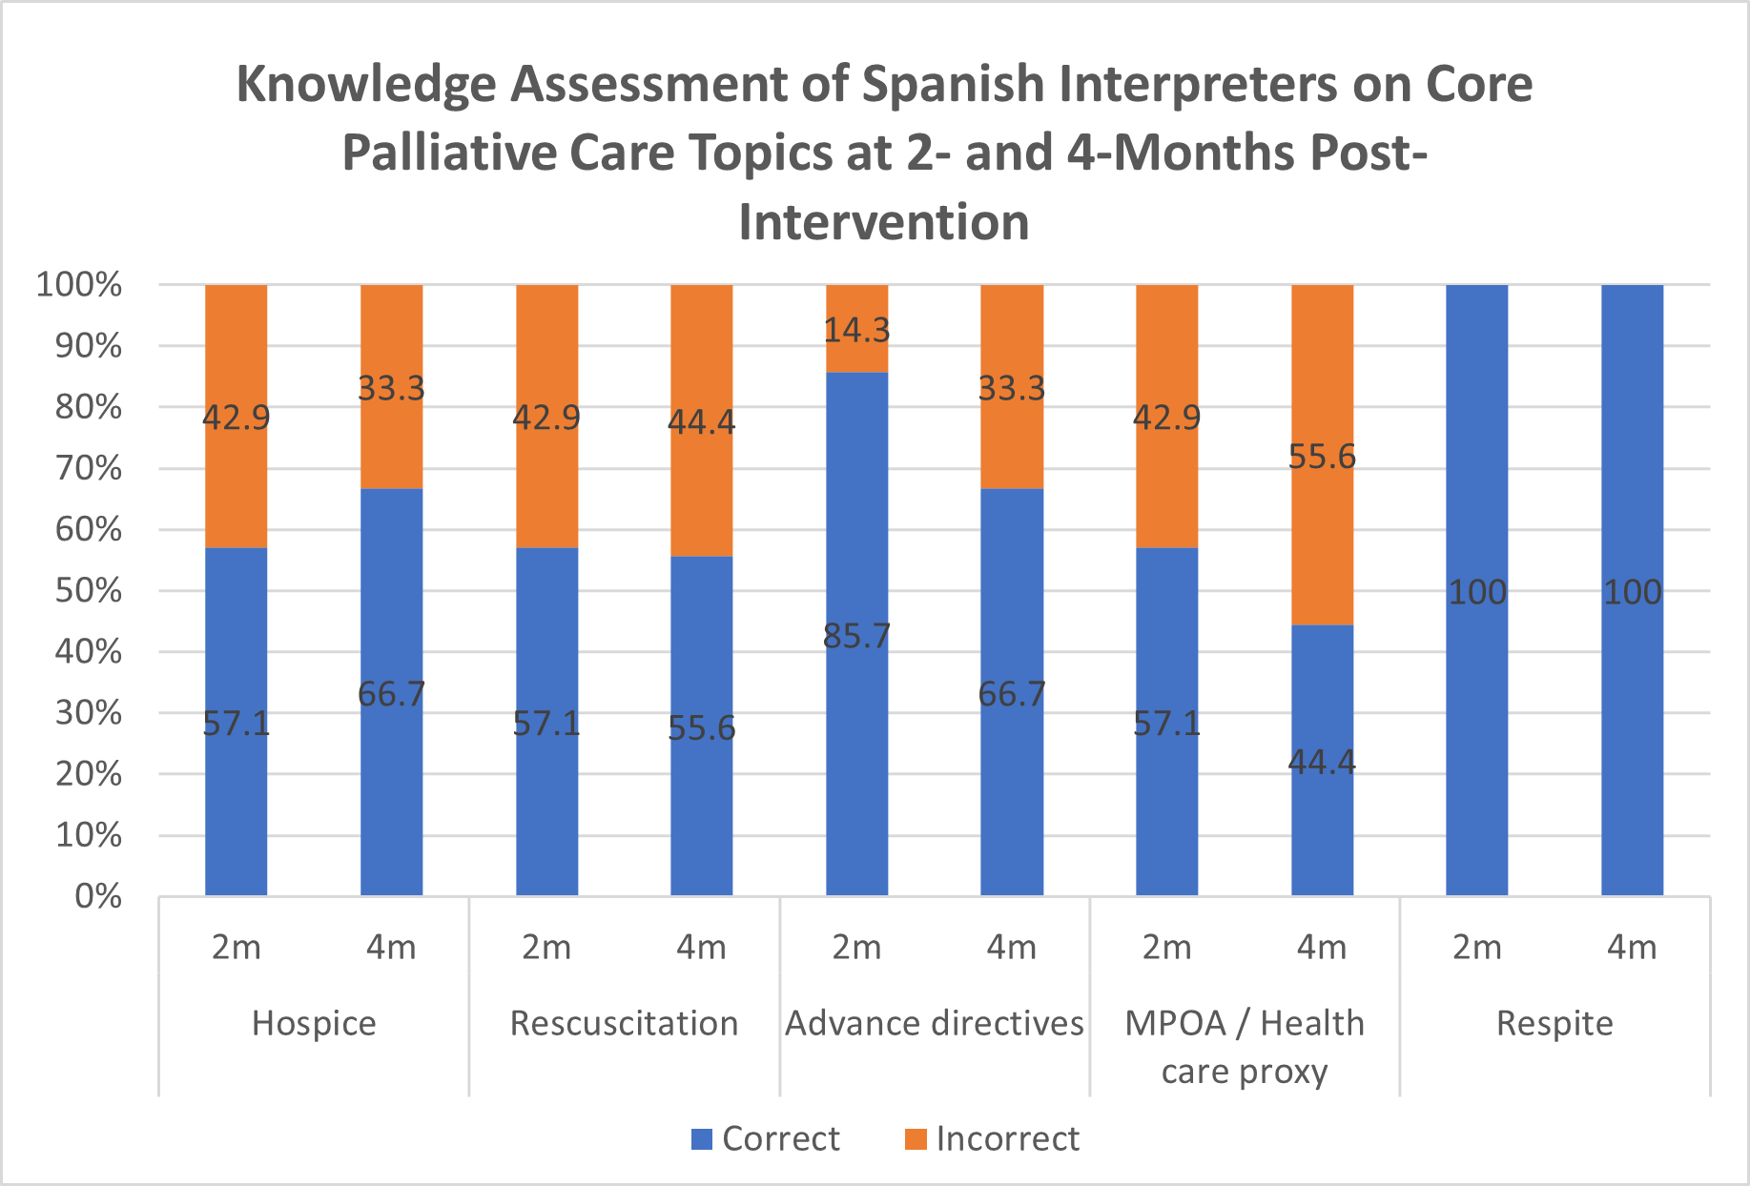
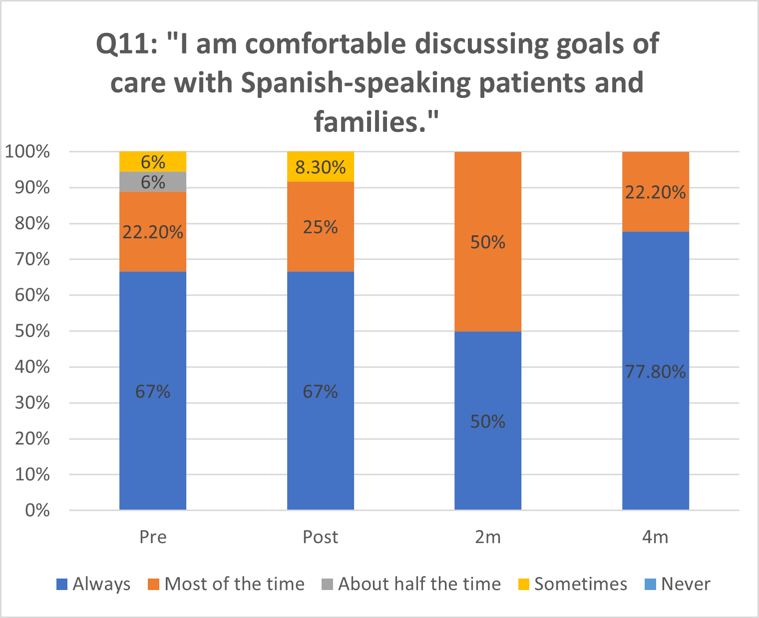
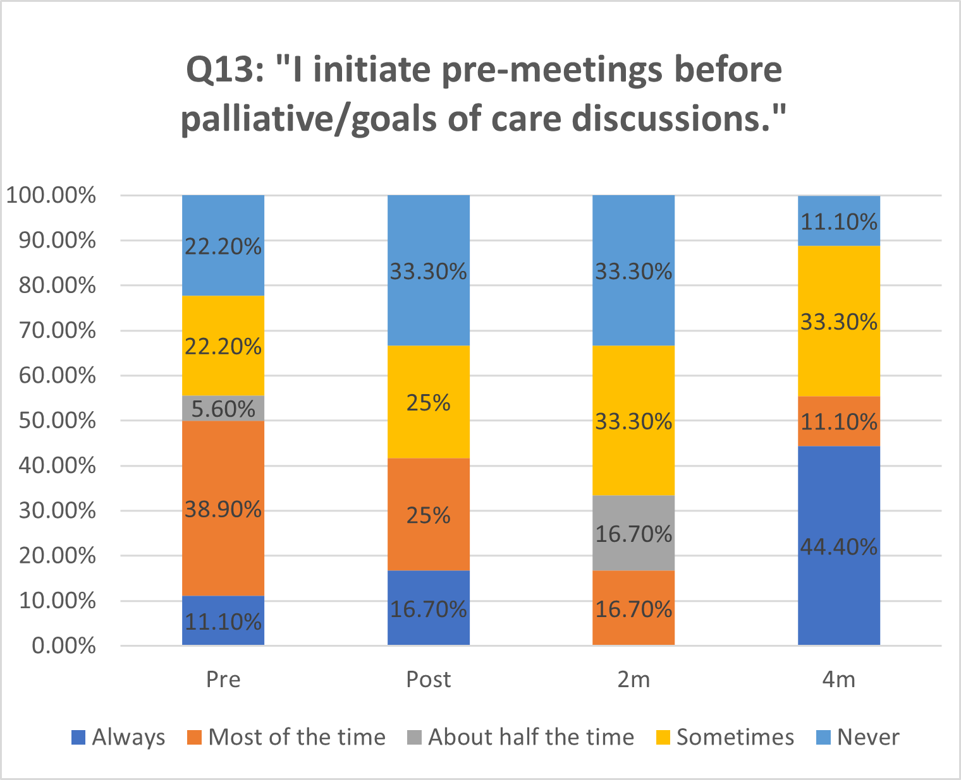
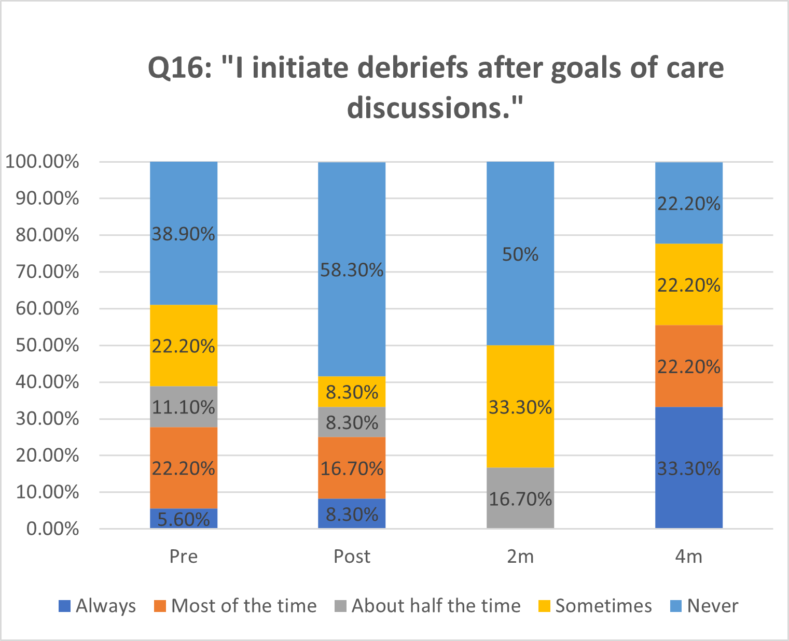
Bridging the Gap: A palliative care-modeled goals of care curriculum for in-person Spanish interpreters providing language services to patients with limited English proficiency Adrienne Baksh MD, Halyna Ivashchuk MD, Soraira Pacheco DO, Ana Leech MD, Rex Paulino MD
Figures:
A. B.
C. D.

Slide 8
The potential impact of a multiplex meningitis and encephalitis PCR in the management of CNS infections in adults and children at MHH
Elizabeth Aguilera, Shelby Simar, Susan H Wootton, Rodrigo Hasbun
Overview/Problem Statement:
The majority of adults and children with meningitis and encephalitis have unknown etiologies fostering universal admission, prolonged length of stay, empirical antibiotic and antiviral therapies.
Results:
A total of 5291 CSF specimens were screened, 285 (5.3%) met the criteria for meningitis or encephalitis and underwent testing. (84.2%) were adults and (74.3%) had meningitis presentation. (99.6%) were admitted to the hospital. FAME panel was positive in 101 patients (35.4%) for all etiologies, 74.2% of patients were positive for a viral pathogen. A total of 165 (57.8%) patients were discharged from MHH with an unknown etiology of whom FAME was positive in 25 (15%) [VZV (36%), HSV2 (20%), Enterovirus (16%), Haemophilus influenzae (8%), HHV6 (8), Streptococcus pneumoniae (8%) and HSV1 (4%)]. 52 patients (18.2%) underwent a repeat LP with main reason to obtain additional testing. Empirical antibiotic and antiviral therapy was given to 89% and 63% of patients, respectively.
Methods:
Patients admitted to MHH system between July 5, 2018, to April 26, 2021 with meningitis or encephalitis, cerebrospinal fluid (CSF) with WBC >5 cells/mm³ and leftover CSF were available for testing. All CSF specimens underwent testing with the Biofire® Film Array Meningitis Encephalitis (FAME) panel. This is a multiplex PCR tool that utilizes a sample of 0.2cc of CSF to identify in 1 hour the presence of 14 viral, bacterial and fungal pathogens.
Conclusions:
A rapid multiplex PCR decreases the proportion of unknown etiologies and has the potential to decrease length of stay and the use of empirical antibiotic and antiviral therapies.
10

Slide 9
A Surveillance Tool for Staff and Patient Safety at Vaccine Mega-Sites Fozia Steinkuller MPH, CIC, Karen J. Vigil MD, Stephanie Villarreal MA, CIC,
Olasunkanmi W. Adeyinka MD, George L. Delclos MD, MPH, PhD, Luis Ostrosky-Zeichner MD
Overview/Problem Statement:
Vaccine mega sites are new and could potentially negatively affect staff and patients if they are not monitored. We created a surveillance tool to audit staff and patient safety at vaccine mega sites. We aimed to achieve a score above 90% with the implementation of the surveillance tool.
Results:
The vaccination site surveillance tool score overall average at baseline was 77% and increased to above 90% for subsequent visits. The audit tool provided feedback which guided tailored education and interventions which improved compliance. Just in time education as well as reeducation during noon huddles closed knowledge gaps. The increase in scores from the baseline was sustained ( >90%) and indicates the use of this audit tool was successful in improving infection prevention and patient safety measures.
Methods:`
We developed a vaccination site surveillance tool adapted from the Guide to Infection Prevention for Outpatient Settings: Minimum Expectations for Safe Care. Our tool examines appropriate personal protection equipment (PPE), hand hygiene, injection safety practices, and additional measures tailored to vaccinations centers not encompassed in the first three domains.
Conclusions:
The vaccination site surveillance tool provides an organized infection prevention assessment of vaccination sites.
11

Slide 10
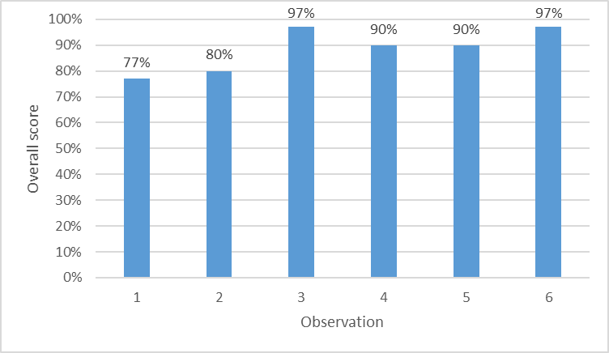
A Surveillance Tool for Staff and Patient Safety at Vaccine Mega-Sites Fozia Steinkuller MPH, CIC, Karen J. Vigil MD, Stephanie Villarreal MA, CIC,
Olasunkanmi W. Adeyinka MD, George L. Delclos MD, MPH, PhD, Luis Ostrosky-Zeichner MD
Fig 1. Cooley Vaccine Center Observations

Slide 11
Cardiovascular Risk in Rheumatoid Arthritis Patients at LBJ Rheumatology Clinic Katherine Terracina, Austin Armstrong, Raman Bamidele, Arpita Beechar, Karim Doughem, Yvette Farran, Yllen Hernandez Blanco, Lakshmi Konduru, Brian Lam, Huong Le, Connor Vershel
Overview/Problem Statement: Cardiovascular disease is the leading cause of death worldwide.¹ In rheumatoid arthritis (RA), cardiovascular disease accounts for the largest proportion of excess mortality with a 48% increased risk for cardiovascular event (RR 1.48, 95% CI 1.36-1.62).² The European League Against Rheumatism (EULAR) published guidelines in 2015/2016 recommending rheumatologists use a 1.5 multiplier to the cardiovascular risk model to account for increased cardiovascular risk.³ With this project, we sought to assess how well patients seen in the LBJ Rheumatology Clinic were screened for cardiovascular risk, and introduce a screening tool to remind rheumatologists to screen for cardiovascular risk in RA.
Results: 247 patients were identified, ages 27 to 87 (mean 55.7, SD 11.6). 91.5% female, 73.3% Hispanic, 24.7% diabetic, 48.2% on antihypertensives, and 30.4% on statin. In the last 5 years, 212 (85.8%) patients had a lipid panel. The ASCVD≥7.5 in 64 (30.2%) patients and 37 (57.8%) of these patients were on a statin. When using the risk modifier, the ASCVD-RA≥7.5 in 98 (46.2%) patients and 51 (52.0%) of these patients were on a statin. The intervention was used in 61(76%) patients in April 2021. 15 (19%) patients were identified to need a lipid panel and it was ordered in 12 (15%). Only 3 (4%) patients needed a lipid panel but did not have it ordered.
Methods: A retrospective chart review of patients with RA seen at LBJ Rheumatology Clinic from 11/1/2020 to 2/28/2021. Data was collected including demographics, comorbidities, medications, blood pressure, and lipid panel if done within the last five years. The ASCVD risk was calculated as well as the increased risk from RA using the 1.5 risk modifier (ASCVD-RA). In April 2021, a smartphrase was introduced in clinic to prompt residents and fellows to obtain lipid screening if not done within the last five years.
Conclusions: Lipid screening is a vital part of cardiovascular risk assessment in RA. Given the frequency that a rheumatologist sees their patients, they have a unique opportunity to educate patients and other providers about the increased risk associated with RA and the need for proper screening. Through a simple smartphrase incorporated into the note template, lipid screening can be improved.
References
1.World Health Organization. (17 May 2017). Cardiovascular diseases (CVDs). World Health Organization. Access 3 Dec 2020. https://www.who.int/news-room/fact-sheets/detail/cardiovascular-diseases-(cvds).
2.Sokka T, Abelson B, Pincus T. Mortality in rheumatoid arthritis: 2008 update. Clin Exp Rheumatol. 2008 Sep-Oct;26(5 Suppl 51):S35-61.
3.Agca R, Heslinga SC, Rollefstad S, et al. EULAR recommendations for cardiovascular disease risk management in patients with rheumatoid arthritis and other forms of inflammatory joint disorders: 2015/2016 update. Annals of the Rheumatic Diseases 2017;76:17-28.
14

Slide 12
Cardiovascular Risk in Rheumatoid Arthritis Patients at LBJ Rheumatology Clinic Katherine Terracina, Austin Armstrong, Raman Bamidele, Arpita Beechar, Karim Doughem, Yvette Farran, Yllen Hernandez Blanco, Lakshmi Konduru, Brian Lam, Huong Le, Connor Vershel
Figures:
Charts reviewed
n=683
Patients seen in clinic
n=208
Patients with RA
n=255
Patients with RA
n=255 (37.3%)
Repeat visits excluded
n=8
Patients with RA
n=80 (38.5%)
Patients included
n=247
Patients included
n=247 (36.1%)
Intervention used?
Lipid panel in 1 yr
n=152 (61.5%)
No lipid panel
n=35 (14.2%)
Lipid panel in 5 yrs n=212 (85.8%)
Yes
n=61 (76.3%)
No
n=19 (23.8%)
ASCVD ≥ 7.5
n=44 (29.0%)
ASCVD ≥ 7.5
n=64 (30.2%)
Lipid panel in 5 yrs
n=49
No lipid panel in 5 yrs n=12
Lipid panel in 5 yrs
n=16
No lipid panel in 5 yrs n=3
ASCVD-RA ≥ 7.5 n=70 (46.1%)
ASCVD-RA ≥ 7.5 n=98 (46.2%)
Lipids ordered
n=12 (100%)
“Missed Opportunity”
n=3 (4%)
On statin
n=27 (61.4%)
On statin
n=40 (57.1%)
On statin
n=37 (57.8%)
On statin
n=51 (52.0%)
Figure 1: Lipid screening, ASCVD, and statin use in RA patients seen in LBJ Rheumatology Clinic from November 1, 2020 to February 28, 2021.
Figure 2: Results of intervention in LBJ Rheumatology Clinic in April 2021.

Slide 13
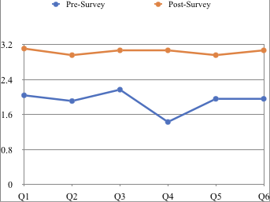
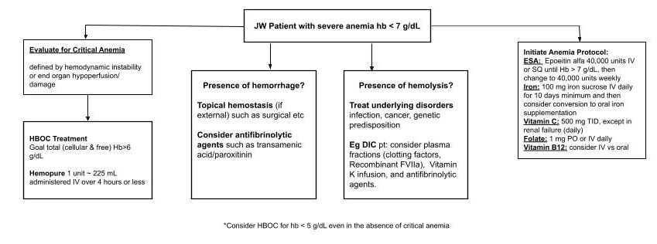
Approach to Anemia in the Jehovah Witness Patient Laurent Ehrlich, Athira Jayan, Julia Chernis, Ariana McClendon, Ashlyn Parkhurst, Jeffrey Chen, Samir Mazharuddin
Overview/Problem Statement:
There is currently no practice guidelines in place at MHH to address acute anemia in JW patients. While blood products are absolutely contraindicated in JW patients, blood product “fractions” are not. The goal of this project is to understand the principles underlying JW beliefs towards blood products as well as to develop an organized and tested clinical algorithm to anemia in the JW patient. In the process, we will review new and emerging technologies regarded as blood product “fractions.”
Results:
Pre-presentation mean scores:
2.04, 1.91, 2.17,
1.43, 1.96, and 1.96
(23 responses)
Post-presentation mean scores:
3.11, 2.96, 3.07,
3.07, 2.96, and 3.07
(27 responses)
Methods:
We surveyed our own colleagues on a scale of 1-4 of how comfortable they were treating anemia in JW patients (1 least and 4 most comfortable). Six categories were addressed: understanding JW belief system, acute anemia, chronic anemia, blood product alternatives, discussion with staff and patients. We then presented educational material describing the above material and created an algorithm describing the clinical approach to the JW patient with anemia. We then conducted a post intervention survey to determine the effectiveness of our algorithm and education strategy. Mean scores for each question were tabulated between pre- and post- intervention.
Conclusions:
An educational physician campaign increased levels of confidence and knowledge in UT physicians about managing anemia in JW patients. Our intervention will increase positive outcomes in JW patients with anemia.
17

Slide 14
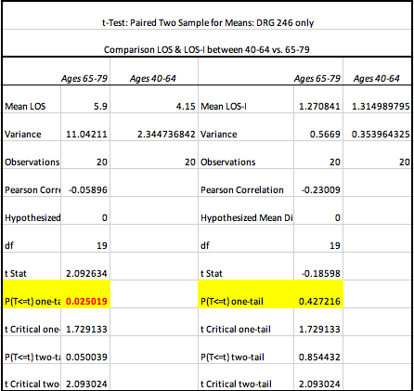
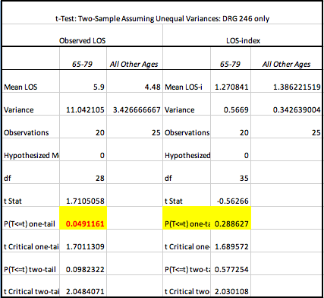
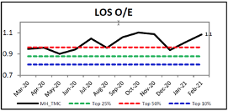
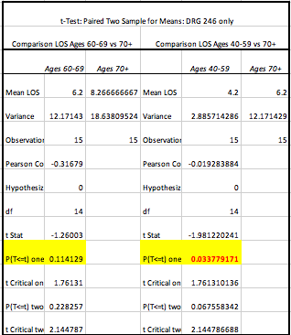
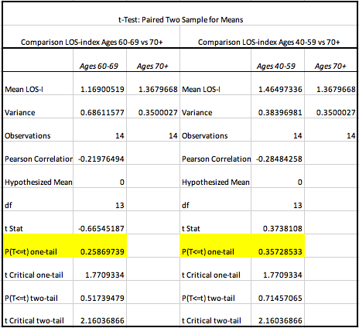
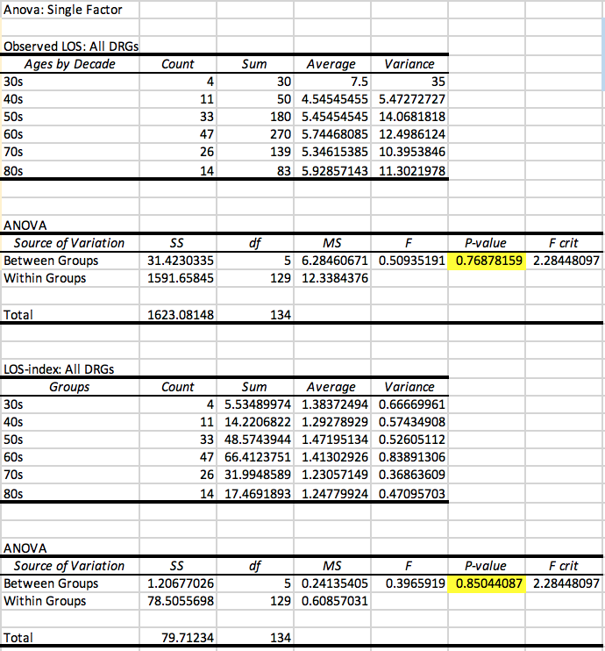
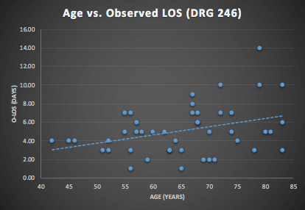
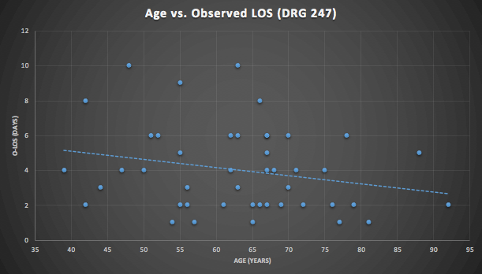
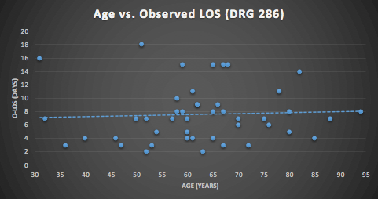
The Impact of Patient Age on Cardiac Catherization Length of Stay at Memorial Hermann Heart & Vascular Institute Honan, K. A., Hanna, A., Fossas-Espinosa, J., Box, N., Thanikachalam, S., Amatullah, A., Kim, J. W., Chen, J. W., Anderson, H. V.
Overview/Problem Statement:
Results:
Fig. 5
Fig. 6
Cumulative DRG analysis with single factor ANOVA showed LOS/LOS-i did not significantly vary between ages by decade (Figure 2, 3; scatter plots [Figures 8-10])
DRG 246 carried significantly higher LOS/LOS-i when compared to other DRGs (p=.0429 vs. 247, p=.0002 vs. 286), also showing ages 65-79 had a sharp demarcation in LOS compared to ages 40-64, and to [40-64]+[≥80]; LOS-i in this age was not significant (Figures 5,6)
The eldest half of DRG 246 was further split into ages 60-69 and 70+; surprisingly, patients in their 60’s did not have significantly increased LOS/LOS-i compared to oldest patients (Figure 7a, 7b)
Healthcare systems worldwide are struggling with length-of-stay (LOS) and LOS-index issues
We observed patients undergoing cardiac catheterization procedures at our hospital had LOS/LOS-indices higher-than-expected and up-trending over the past year. Also, 3 of the top 4 DRG codes with highest LOS-indices were codes involving coronary stent procedures (Figure 1)
We sought out to identify patient characteristics tied to increased LOS/LOS-i: we analyzed trends such as distinct age differences, sex, admit source, etc.
Fig. 1
Fig. 7a
Fig. 7b
Fig. 8-10
Conclusions:
Methods:
Fig. 2
135 patient charts came from 3 DRG codes of interest
ANOVA single factor and t-test statistics (paired two sample) were used to interrogate specific age delineations amongst the different cohorts
t-test with unequal variances was used sparingly
Certain ages carry higher LOS/LOS-indices. Anticipation of age ranges carrying lengthier hospital stays will benefit all parties, by setting forth realistic expected time courses while demanding vigilance in monitoring for prolonging events close to time of cardiac catherization. Additional in-depth root cause analyses of these patients would be fruitful.
Appendix:
Length of Stay Index: LOS-i= [Observed LOS] / [Expected LOS]
DRG code 246: PCI w/ DES, with major complication or comorbidity (MCC) or 4+ vessels or stents
DRG code 247: PCI w/ drug-eluting stent without major complication or comorbidity (MCC)
DRG code 286: Circulatory disorders except A-MI, with cardiac catheterization with major complication or comorbidity (MCC)
Fig. 3
19

Slide 15
Prevalence and factors associated with mental health symptoms in adults undergoing Covid-19 testing Osaghae, Ikponmwosa, MD, MPH; Nguyen, Linh, PhD; Chung, Tong Han, PhD, MPH; Moffitt, Olivia, MD; Le, Yen-Chi, PhD; Suh, Mark, MD; Prasad, Pooja, BS; Thomas, Eric J, MD, MPH; Gordon, Christine, MD; Hwang, Kevin O, MD, MPH
Overview/Problem Statement: The burden of mental health symptoms have been shown to be on the rise since the COVID-19 pandemic began. Little is known about the mental and psychological sequelae among a segment of the population who were tested for COVID-19 relatively early in the pandemic. This study aims to assess the association between sociodemographic factors and mental health symptoms at 8 weeks (baseline) after a COVID-19 test and at 16 weeks follow-up, and compare the prevalence of mental health symptoms at baseline to those at follow-up.
Results: At baseline, a total of 124 (47.51%) participants reported at least mild depressive symptoms, 110 (42.15%) endorsed at least mild anxiety symptoms, and 94 (35.21%) endorsed hazardous alcohol use. Compared to males, females were at increased risk of having at least mild depressive symptoms at baseline (Adjusted OR (AOR): 2.08; 95% CI: 1.14-3.79). The odds of having at least mild depressive symptoms was significantly lower among those residing in zip codes within the highest quartile compared to lowest quartile of household income (AOR: 0.37; 95% CI: 0.17-0.81). Also, non-Hispanic Whites had significantly higher odds of reporting hazardous alcohol use compared to non-Whites at baseline (AOR: 1.94; 95% CI: 1.05-3.57). The prevalence of mental health symptoms remained elevated after 16 weeks.
Methods: Prospective cohort study of adults who received outpatient COVID-19 testing at UT Physicians. Depression was assessed using PHQ-9 Questionnaire, anxiety was assessed using GAD-7 Questionnaire, and hazardous alcohol use was assessed using AUDIT-C Questionnaire. Logistic regression analyses were conducted to assess the association between sociodemographic characteristics and COVID-19 test results and mental health symptoms. McNemar’s test was used to compare the prevalence of mental health symptoms at baseline with those at 16 weeks follow-up.
Conclusions: There is a high burden of symptoms of depression and anxiety as well as hazardous alcohol use in a diverse population who received COVID-19 testing. These findings highlight the need for screening for symptoms of mental health disorders in patients tested for COVID-19 well after initial testing.
25

Slide 16
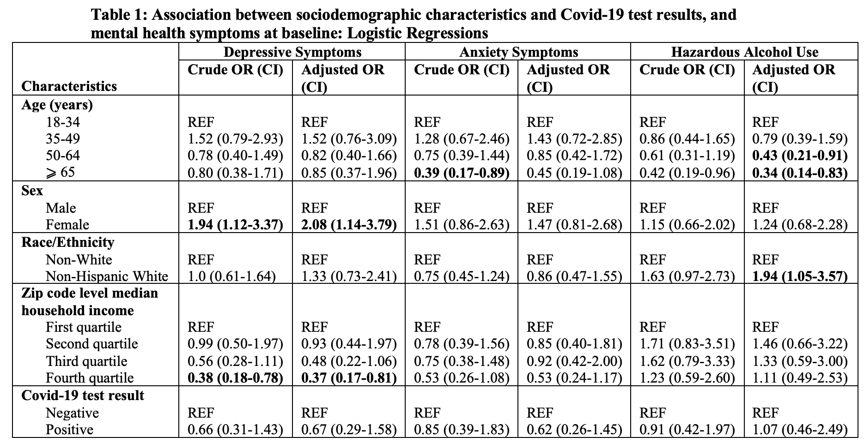
Prevalence and factors associated with mental health symptoms in adults undergoing Covid-19 testing Osaghae, Ikponmwosa, MD, MPH; Nguyen, Linh, PhD; Chung, Tong Han, PhD, MPH; Moffitt, Olivia, MD; Le, Yen-Chi, PhD; Suh, Mark, MD; Prasad, Pooja, BS; Thomas, Eric J, MD, MPH; Gordon, Christine, MD; Hwang, Kevin O, MD, MPH
Boldface indicates statistical significance (p < 0.05). REF: Reference category.
OR: Odds ratio; CI: 95% confidence interval. Age, sex, race/ethnicity, median household income, and covid-19 test result were adjusted for each other in a multivariable logistic regression analysis.

Slide 17
Implementing Risk-Based Candida Prophylaxis Protocol to Decrease Cases of Candidemia During the COVID-19 pandemic in the Medical Intensive Care Unit Dr. Logan Hostetter, Dr. Jinesh Gheeya, Dr. Jeffrey Chen, Dr. Rajan Amin, Dr. Julio Rodarte, Dr. Jordan Graham, Dr. Akshitha Yarrabothula, Dr. Dan Rongo, Barbara Dutra, Jennifer Cortes, Dr. Brandy McKelvy, Dr. Luis Ostrosky
Overview/Problem Statement:
Candidemia is a nosocomial infection associated with higher costs of care and increased length of stay with an estimated mortality as high as 40%. During the COVID-19 pandemic there was an increase in ICU admissions, length of stay, and central line usage. This project aimed to implement a Candida prophylaxis protocol in response to increased candidemia cases per year in the MICU during the covid pandemic.
Results:
Number of candidemia cases per year in the MICU increased from 5 pre-pandemic to 14 during the pandemic (Figure 1). This led to the implementation of a risk-based fluconazole prophylaxis protocol in March 2021 to prevent candidemia in the MICU. To qualify for Candida prophylaxis, patients must meet all three major criteria: ICU stay length > 7 days, exposure to broad spectrum antibiotics, and central venous access. They must also meet at least two of the following minor criteria: mechanical ventilation for at least 48h, any type of dialysis, systemic corticosteroids, systemic immunosuppressive therapy, pancreatitis, or use of total parenteral nutrition.
Methods:
This is a retrospective and prospective single center study of patients in the MICU. Cases of candidemia in the MICU between March 2019 and February 2020 was obtained as a baseline comparison prior to the COVID-19 pandemic. Cases of candidemia were then collected from April 2020 to March 2021 during the COVID-19 pandemic.
Conclusions:
We implemented a risk-based Fluconazole prophylaxis protocol aimed at reducing cases of candidemia in the MICU. If successful, we intend to implement the protocol to additional ICUs.
28

Slide 18
Implementing Risk-Based Candida Prophylaxis Protocol to Decrease Cases of Candidemia During the COVID-19 pandemic in the Medical Intensive Care Unit Dr. Logan Hostetter, Dr. Jinesh Gheeya, Dr. Jeffrey Chen, Dr. Rajan Amin, Dr. Julio Rodarte, Dr. Jordan Graham, Dr. Akshitha Yarrabothula, Dr. Dan Rongo, Barbara Dutra, Jennifer Cortes, Dr. Brandy McKelvy, Dr. Luis Ostrosky
Figure 1: Cases of Candidemia Per Month in the MICU Pre-Covid vs Post-Covid

Slide 19
Memorial Hermann-TMC Abstracts

Slide 20
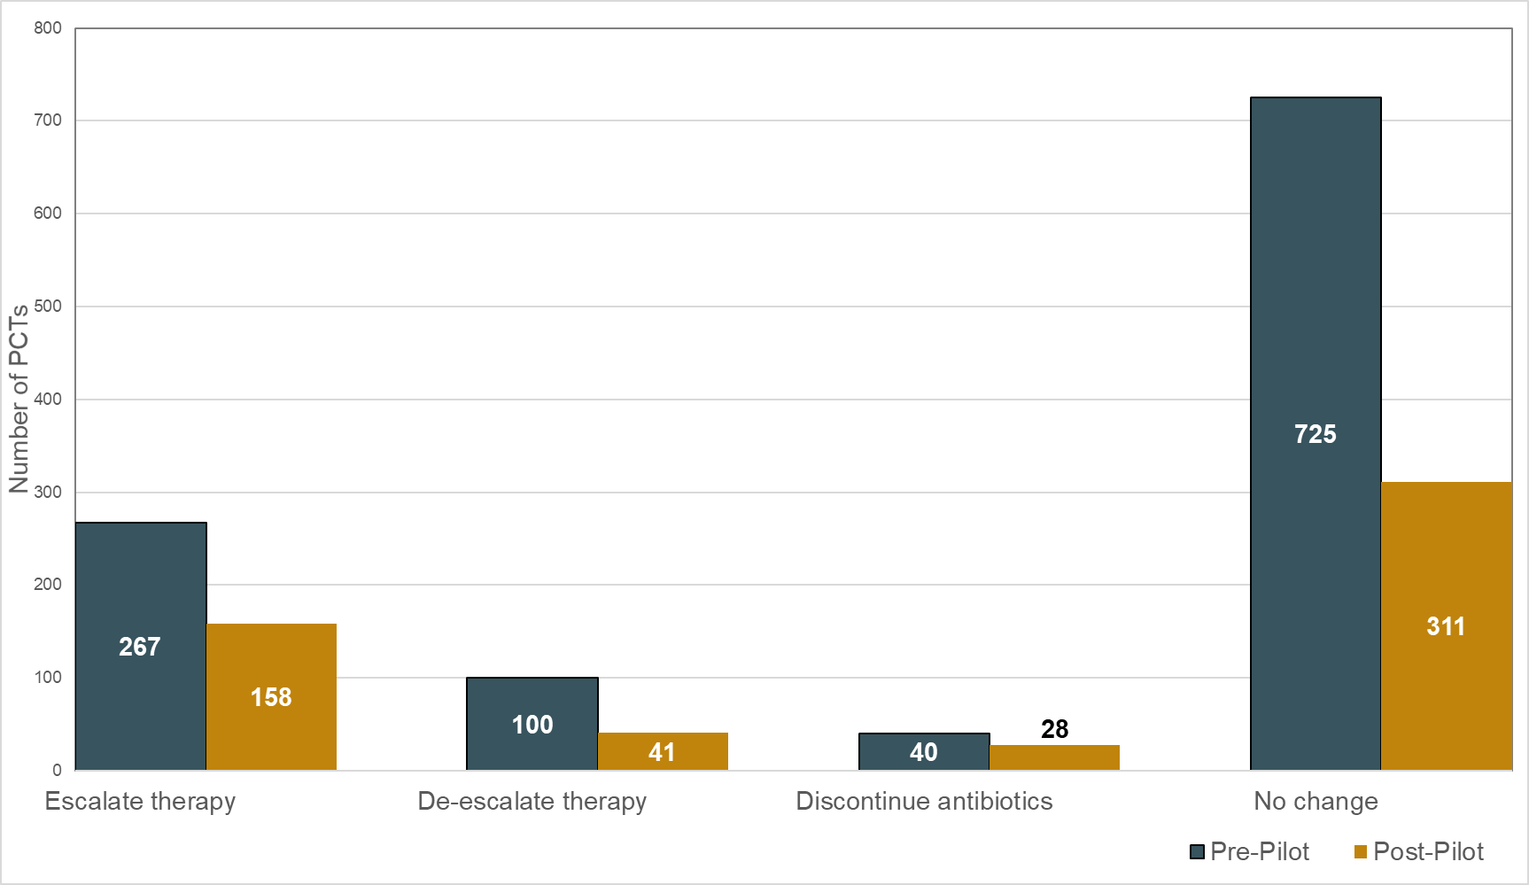
Reducing the number of procalcitonin lab draws in critically ill patients, a quality improvement project Sarah Brinson, PharmD, MBA; Jennifer Cortes, PharmD, BCPS, BCCCP, FCCM; Megan Hooven, PharmD; Bethany Kummer, PharmD; Brittany Pelsue, PharmD, BCPS, BCCCP
Background:
Procalcitonin (PCT) is released during an inflammatory response
PCT becomes elevated within 2-6 hours, then peaks at 24 hours following insult
PCT is cleared by the kidneys at about 50% every 1-1.5 days
PCT level trends can be monitored to escalate or de-escalate antibiotics
At MH-TMC, PCT labs are ordered routinely, and often more frequently than clinically necessary, leading to increased costs, unnecessary labs and waste of resources
Objective: To evaluate and reduce the use of PCT lab draws by at least 10% in adult patients in the medical (MICU), transplant surgical (TSICU), and Sarofim heart (SHIC) intensive care units at MH-TMC
Results:
Figure 1. Response to PCT result
Table 1. Evaluation of institutional impact
 | Pre-Pilot (n=1215) | Post-Pilot (n=567) | p-value
Hours between PCTs, median (IQR) | 35.2 (23.5-74.9) | 58.5 (26.4-128.1) | <0.001
Appropriate n (%) | 466 (38) | 402 (71) | <0.001
Cost of PCT during study period | $23,760 | $10,608 | -
Conclusions:
Pre-pilot:
PCT labs were repeatedly drawn <48 hours apart
Thousands of dollars were spent annually on PCT labs with nearly 2/3 that did not result in a change to therapy
Post-pilot:
PCT labs were drawn less frequently and >48 hours apart
Exceeded goal reducing PCT use by >50%
Reduction in number of PCT lab draws resulting in no change to therapy
Increased PCT labs considered appropriate
Significant cost reduction
Methods:
Single-center quality improvement project
Created & implemented an algorithm to guide PCT lab draws
Inclusion criteria:
Admitted to MH-TMC MICU, SHIC, TSICU
Adult patients ≥ 18 years of age
≥1 PCT level
Pre-intervention period: 12/1/2019 to 1/31/2020 and 5/1/2020 to 6/30/2020
Post-intervention period: 10/5/2020 to 12/31/2020
Discontinue

Slide 21
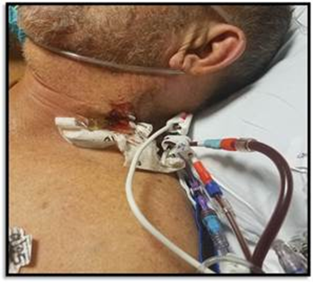
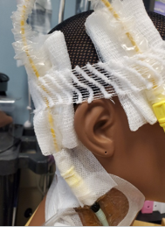
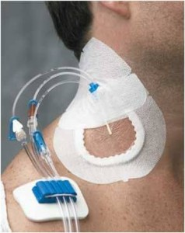
Problem solving CLABSI prevention: Front Line Engagement & Solutions to Improve Central Line Dressing Integrity Yvana Rivera, MPH, CIC; Kelsey Schneider, BSN, RN, CCRN; Dana Kunkel, BSN, RN, CCRN; Kimberly York Thompson, BSN, RN, CCRN; Kelley Boston, MPH, CIC, CPHQ, FAPIC; Luis Ostrosky-Zeichner, MD, FACP, FIDSA, FSHEA, FECMM, CMQ; Mark Warner, MD, FCCP, CMQ; Konstantinos Charitakis, MD, FACC, FSCAI
Overview/Problem Statement:
Central line-associated bloodstream infections (CLABSIs) each have an estimated attributable mortality of 12%-25% and cost approximately $25, 000 per infection². “The most common route of infection for short-term catheters is migration of skin organisms at the insertion site.” ¹. Maintaining central line (CL) dressing integrity reduces a patient’s risk of device-associated infection^{3,4} by protecting the insertion site from introduction of microorganisms that can cause infection.
In a cardiac care unit (CCU), low CLABSI bundle compliance led to
identifying decreased staff engagement in CLABSI prevention as well
as a knowledge deficit of available resources and lack of integration
into practice contributing to ~50% more CLABSIs than predicted during
FY19-20 (Standardized Infection Ratio: 1.50; 1.52).
Results:
Data review: >70% of CLABSIs among IJ CLs involving skin organisms
Oct 2020-Feb 2021 bundle rounding: On average 77% of all CL dressings were occlusive and intact
PPS Nov 2020: 62% of all CL dressings were clean, dry and intact. Internal jugular CL dressing integrity challenges identified: position and size of line in the neck, patient movement, line weight and tubing manipulation.
Process owner engagement which led to innovative solutions to address IJ dressing challenges
April 2021: IJ project launched intervention to support dressing integrity
Pre intervention
Methods:
Multidisciplinary review of CLABSIs during July 2018 -October 2020
Ongoing CLABSI prevention bundle rounding with the infection preventionist (IP) and CCU team including quality coordinator, unit manager, educator, and medical directors
Point prevalence study (PPS) in November 2020 with diverse team: bedside nurses, unit manager, quality coordinator, unit educator, and CL dressing manufacturer representative
Mandatory education completed by 100% nursing staff on bundle compliance, available dressing aids, and internal jugular (IJ) project aims
Weekly/monthly bundle compliance feedback, stakeholder meetings, and just in time education during rounds with nursing staff
Conclusions:
“The first step toward successful reduction of CLABSIs is to engage both frontline and senior leadership champions in the process and outcome improvement plan” ³. Multidisciplinary CLABSI data review and bundle rounding with data monitoring and feedback fostered unit teamwork and engagement in prevention efforts resulting in frontline solutions for central line dressing integrity challenges. These are valuable tools that can be used to increase engagement and identify and target specific challenges to prevent CLABSIs in the high risk intensive care unit setting ultimately working towards the goal of zero patient harm.
Notes:
FY19 CCU CLABSI SIR: 1.50
FY20 CCU CLABSI SIR: 1.52
Kelsey – Conclusion
Dana – Methods?
Yvana - Introduction
Kim – Results?
IJ CL Dressing Occ/Intact Scores:
Feb: 40%
April: 71%
Percent increase: 77.5%
Days from insertion to infection for CLABSIs during July 2018 -October 2020: Range 3-13 days; Average: 6 days
Short term catheter use is defined as usually less than 3 weeks
References:
¹Association for Professionals in Infection Control and Epidemiology. Vascular Access Device-Associated Infections. Retrieved May 5, 2021, from https://text.apic.org/toc/prevention-measures-for-healthcare-associated-infections/vascular-access-device-associated-infections
²Centers for Disease Control and Prevention. Reduction in Central Line--Associated Bloodstream Infections Among Patients in Intensive Care Units --- Pennsylvania, April 2001--March 2005. Retrieved May 5, 2021, from https://www.cdc.gov/MMWR/preview/mmwrhtml/mm5440a2.htm
³Marschall, J., Mermel, L., Fakih, M., Hadaway, L., Kallen, A., O’Grady, N., . . . Yokoe, D. (2014). Strategies to Prevent Central Line-Associated Bloodstream Infections in Acute Care Hospitals: 2014 Update. Infection Control & Hospital Epidemiology, 35(S2), S89-S107. doi:10.1017/S0899823X00193870
⁴O’Grady et al. (2017). Guidelines for the Prevention of Intravascular Catheter-Related Infections, 2011. Retrieved May 4, 2021, from https://www.cdc.gov/infectioncontrol/pdf/guidelines/bsi-guidelines-H.pdf

Slide 22
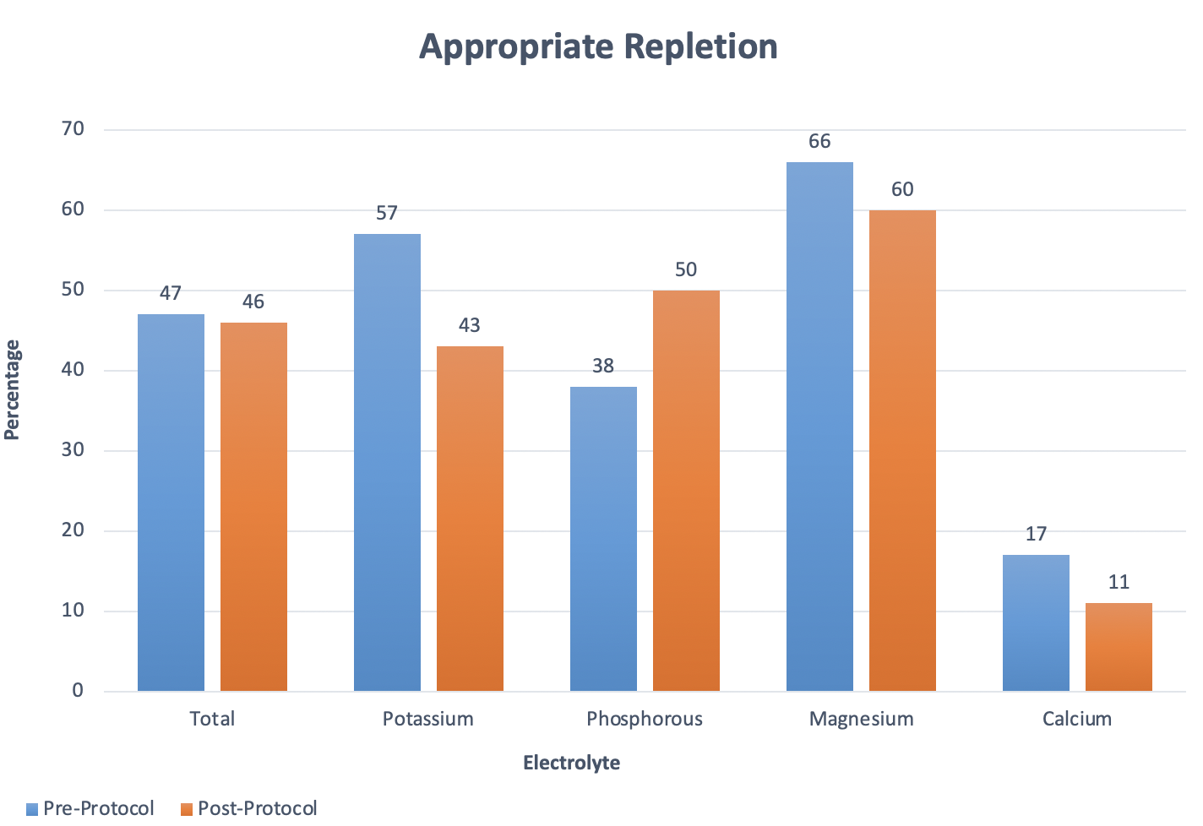
Evaluation of electrolyte replacement in the Medical Intensive Care Unit Diana Charles PharmD, Eric Dalton, PharmD, Jill Davenport, PharmD, Jennifer Cortes, PharmD, BCPS, BCCCP, FCCM, Brittany Pelsue, PharmD, BCPS, BCCCP
Overview/Problem Statement:
In the medical intensive care unit (MICU) at Memorial Hermann–TMC (MH-TMC), critically ill patients often experience significant electrolyte abnormalities which require correction
However, the complexity of the current nurse-driven electrolyte repletion order set may cause confusion and lead to suboptimal or delays in therapy
This can lead to waste of ordered products, and excess lab draws increasing healthcare costs
Results:
Methods:
Single center, quasi-experimental study
Pre-Intervention time period: December 1, 2019 - June 30, 2020
Post-intervention time period: October 10, 2020-January 31, 2020
Inclusion Criteria: Admitted to MH-TMC MICU, Adult Patients > 18 years of age, ordered to receive the ICU electrolyte replacement order set
Exclusion Criteria: Weight < 40 kg, pregnancy, serum creatinine > 2.0 mg/dL or creatinine clearance < 30 mL/min, temperature < 35° Celsius, patients on dialysis (HD, PD, CRRT)
Dose to Goal, median, dose (IQR)
Electrolyte | Pre-protocol | Post-protocol | p-value
Potassium, mEq | 40 (40-100) | 60 (40-100) | 0.09
Phosphorous, mmol | 42 (16-61) | 61 (45-96) | < 0.01
Magnesium, grams | 1.8 (0.8-1.4) | 2 (2-4) | 0.18
Calcium, grams | 3 (2-3) | 2 (1-4) | 0.5
Replacement Thresholds
Electrolyte | Pre-protocol | Post-protocol
Potassium, mg/dL | 3.9 | 3.4
Phosphorous, mg/dL | 2.4 | 2.9
Magnesium, mg/dL | 2.0 | 1.7
Calcium, mmol/L | 1.03 | 0.89
Conclusions:
Effective and safe adjustments to electrolyte replacements
Expect appropriateness to be higher with new thresholds of replacement secondary to nurse driven replacement with less variation
There were no difference in adverse reactions between the groups
HD= hemodialysis
PD= peritoneal dialysis
CRRT= continuous renal replacement therapy

Slide 23
UTHealth Abstracts

Slide 24
Improving Accuracy of Linear Growth Measurements in the Neonatal ICU
Polina Gelfer, M.D.; Jenifer Davis RD; Megan Forbes, RD; Kendall McLean, RD
Overview/Problem Statement:
Preterm infants are at risk for disproportional growth and many remain underweight and short during childhood. Improved postnatal linear growth was associated with improved cognitive and motor scores. Close monitoring of linear growth allows necessary adjustments in nutritional plans and better outcomes. The American Academy of Pediatrics recommends length board measurements performed by 2 trained professionals. Our unit’s routine length measurement practice was done by obtaining tape measurements by one nurse. During random audits only 60% of infants were measured within 1 cm of differences. We aimed to increase this rate to 80% by implementing length board measurement practices.
Results:
This pilot included 25 before and 22 after intervention audit measurements. The length board intervention improved accuracy of measurements to ≤1cm difference from 60% to 73% and to >1≤2 cm from 20% to 23%. Measurement discrepancy of > 2cm difference decreased from 24% to 4%. Out of 92 post procedure surveys, 99% stated that the length boards were easy to use and measurement time was <5 min.
Methods:
A before-after intervention comparison design was used. The following interventions were implemented: nursing education curriculum, measurement steps card, champion team, nursing questionnaire to elicit feedback, bedside rounds. The audits were performed within 24-48h of the original measurement.
Conclusions:
There is a need for uniformity and accuracy of length measurements. Many challenges were identified, including needs for additional nursing support and time, purchase and maintenance of the equipment and the safety of procedure for sick infants. Appropriate staffing and continued educational efforts can alleviate these concerns.

Slide 25
A Novel Telemedicine Intervention to Decrease Avoidable Emergency Department (ED) Visits
Zheng Ben Ma, MD MHCM; Jonathan Rogg, MD MBA; Kunal Sharma, MD CMQ
Overview/Problem Statement:
To decrease avoidable ED visits, this study aimed to examine the impact of using an emergency physician (EP) telemedicine visit to assist the ask-my-nurse line at Harris Health System for patients who would otherwise be referred to the ED. The primary goal was to assess the reduction in referred patient visits to the ED. Patient satisfaction and accessibility were additionally measured.
Results:
During the study period, 1351 patients called ask-my-nurse and met criteria for ED evaluation. 102 patients declined to be seen virtually or were unable to connect. 1249 patients had a telehealth visit with an EP; 74% were video visits. 894 patients (72%) successfully avoided the ED. Overall satisfaction measured by post-visit survey was 77.9%.
Methods:
This was a four-month pilot study that includes patients who called the Harris Health ask-my-nurse line Monday-Friday, 8AM-5PM between November 2020 and March 2021. Patients who would by protocol be sent to the ED were instead routed to an EP on-call for telemedicine. The EP would then either definitively address the patient’s concern or refer to the appropriate care setting.
Conclusions:
This study examines a novel role of emergency physicians in telemedicine, where EPs enhance an ask-my-nurse line to avoid ED visits. Most patients (72%) successfully avoided the ED and were definitively treated or referred to less intensive sites of care. EPs are perfectly suited to judiciously determine the best use of precious and costly emergency care resources. Importantly, health systems that wish to reduce ED visits should consider investment in tele-triage systems staffed by emergency physicians.

Slide 26
Using Patient Data to Transform Care and Improve Outcomes in Pediatric Inflammatory Bowel Disease
Fernando Navarro, M.D, Jon Marc Rhoads, M.D, Amanda Schuck-Phan, D.O, Melissa Van Arsdall, M.D., Supriya Nair, M.D., Jane Alookaran, M.D
Overview/Problem Statement:
Children’s Memorial Hermann Hospital (CMHH) and the University of Texas McGovern Medical School pediatric gastroenterology division (UTPGI) are part of the national Improve Care Now (ICN) network. This national quality improvement network focuses in improving the health care delivery for pediatric patients with inflammatory bowel disease (IBD).
Results:
Increased percentage of patients registered (Figure 1). Increased percentage of patients on prednisone-free remission (Figure 2). Data quality score (the lower the better) improving (Figure 3). CMHH/UTPGI team compared to ICN network targets (Figure 4).
Methods:
The network assigns teams to learning labs to guide and support QI projects. These assignments are based on where the teams are in their QI journey within the network. The learning labs meet monthly with a QI coach from ICN to share each team progress.
The clinical remission and data completeness were tracked and compared to the network targets. PLAN-DO-STUDY-ADAPT cycles were done to optimize the maintenance of the patient master list, weekly review of UTPGI providers’ schedule and monthly pre-visit planning visits to improve the consent, registration and timely input of clinical/lab data processes.
Conclusions:
Our overall goal of increasing the percentage of prednisone-free clinical remission (US news and world report measure for hospital national rankings) met network target.

Slide 27
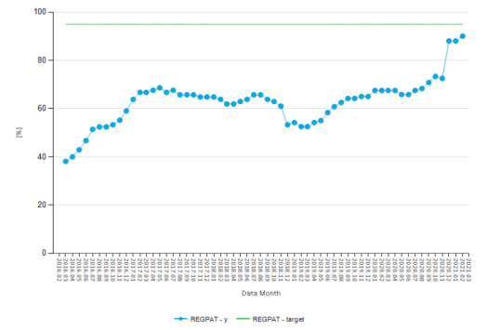
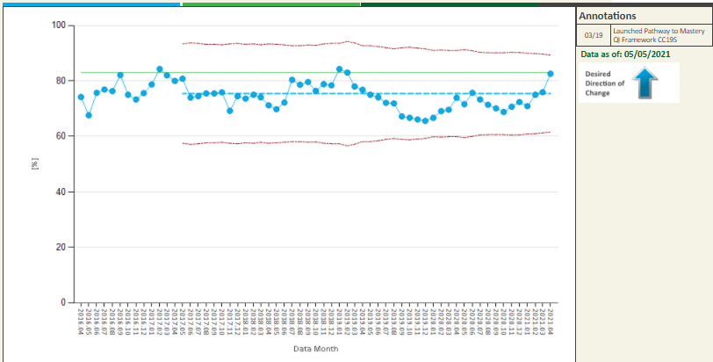
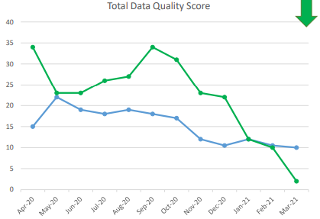
Using Patient Data to Transform Care and Improve Outcomes in Pediatric Inflammatory Bowel Disease
Fernando Navarro, M.D, Jon Marc Rhoads, M.D, Amanda Schuck-Phan, D.O, Melissa Van Arsdall, M.D., Supriya Nair, M.D., Jane Alookaran, M.D
Figure 1: Percentage of Registrable Population
Figure 2: Patients on Prednisone-free remission
Figure 3: Data quality score card for CMHH/UTPGI (in green)
Figure 4: CMHH/UTPGI team performance and ICN targets

Slide 28
Improve Parental awareness and knowledge about Newborn Screening
Marta Frigeni, Katherine Leach, Matthew Wright, Jeremy Hill, John Patton, Abigail Kacpura, Agata Migut, Prajakta Yeragi
Overview/Problem Statement:
Every child born in Texas receives two newborn screening blood tests to screen for rare genetic, metabolic, immunologic, and hematologic disorders. The goal of the screening is to identify children with serious but treatable diseases in order to reduce morbidity and mortality associated with these conditions. Despite the screening being a routine component of newborn care, there is no standardized method of educating parents about the significance of the screen.
Objective: This project aims to improve parental knowledge about newborn screening.
Results:
To date, 41 pre-intervention surveys and 38 post-intervention surveys have been completed at two pediatric clinics. After receiving the education, 95% of parents reported knowing why newborn screening is performed, compared to 20% of parents prior to the intervention. After intervention, 95% of parents said they knew what to do if their child’s newborn screen is abnormal, compared to 5% pre-intervention.
Methods:
Questionnaires were provided to parents to assess understanding of newborn screening at the 2 weeks well child visit, and then parents were counseled and given an education pamphlet. A repeat questionnaire was given to parents at the 2 months visit to assess retention of information post-counseling.
Discussion & Conclusion:
The education provided to parents about newborn screening was well-received. Survey results indicate that the education improved parental understanding of the purpose of newborn screening as well as the implications for their children.
This standardized method of parental education about newborn screening is effective and can be a valuable contribution to routine newborn care.

Slide 29
Post-Operative Atrial Fibrillation Prevention in patients receiving isolated Coronary Artery Bypass Grafting—MHH-TMC
Steven B. Eisenberg MD, Helene Weideman, Ijeoma A. Ekeruo MD, Mark T. Warner MD, Jill A. Bennett NP, Rana O. Afifi MD, Brian E. Gulbis PharmD
Overview/Problem Statement:
Post-operative atrial fibrillation (POAF) in patients undergoing isolated coronary bypass grafting is common (historical incidence 33-35%/STS data) and has been associated with multiple complications including significant increases in ICU and total length of stay. Previously published studies have suggested reduction in POAF utilizing pharmacologic, pulmonary, and mechanical interventions. This study was designed to develop a PROTOCOL integrating these modalities to potentially improve Hospital metrics.
Results:
49/69 patients receiving isolated CABG were started on the POAF protocol.
Incidence of post-operative AF in protocol vs non protocol group was 14.286% vs 50.0% (x2, p= 0.0018). POAF incidence Protocol vs Historical/STS incidence 35% (x2, p=0.0188), NNT = 4.8. Median post-operative length of stay between protocol and non-protocol patients was 6 vs 7 days (IQR=2.0,4.25) and median post-operative ICU time 3
vs 3.5 days respectively (IQR=2.0,2.25).
Methods:
The POAF protocol was developed and approved by MHH/TMC QIIRB to reduce the incidence of POAF. Protocol elements include pre-operative screening for obstructive sleep apnea, intra-operative administration of 2gm Magnesium IV and Amiodarone 0.75 mg/min IV continuing for 72 hours post-op, early post-operative initiation of beta blocker and Colchicine BID at 72 hours post-op. Protocol was initiated or withheld from patients
based on individual surgeon preference. Patients were monitored in real time for POAF.
Conclusions:
In patients receiving an isolated CABG, initiation of the POAF protocol significantly reduces incidence of POAF, post-op ICU time, and post-op hospital length of stay.

Slide 30
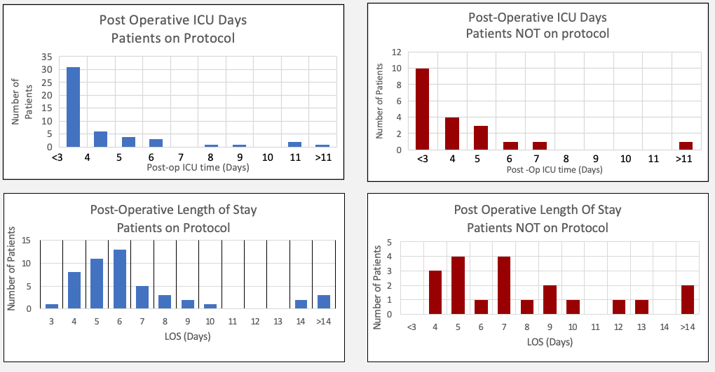
Post-Operative Atrial Fibrillation Prevention in patients receiving isolated Coronary Artery Bypass Grafting—MHH-TMC
Steven B. Eisenberg MD, Helene Weideman, Ijeoma A. Ekeruo MD, Mark T. Warner MD, Jill A. Bennett NP, Rana O. Afifi MD, Brian E. Gulbis PharmD
Figures:
Metric | Protocol | No Protocol
median ICU time | 3 | 3.5
median LOS | 6 | 7
IQR ICU time | 2 | 2.25
IQR LOS | 2 | 4.25
mean ICU time | 4 | 4
mean LOS | 7 | 9
SD ICU time | 3 | 3
SD LOS | 4 | 6

Slide 31
Standardization of Pediatric Non-cardiac Operating Room to Intensive Care Unit Handoffs Improves Communication and Outcomes
Nutan B Hebballi BDS, MPH, Vikas Gupta MD, Kyle Sheppard, BS, Ann Kubanda RN, Danielle Salley RN, Tiffany Ostovar-Kermani MD, MPH, Christina Bryndzia DO, Amir Khan, MD, Nitin Wadhwa MD, KuoJen Tsao, MD, Ranu Jain MBBS, Akemi L Kawaguchi, MD, MS
Overview/Problem Statement:
Handoffs are critical points in transitioning care between multidisciplinary teams, yet data regarding intensive care unit (ICU) handoffs in pediatric non-cardiac surgical patients are lacking. We hypothesized that standardized handoffs from the pediatric operating room (OR) to the ICU would improve physician presence, communication, and patient care parameters.
Results:
After phase 1, surgery and ICU physician attendance increased significantly, distractions decreased, and communication of essential patient data improved. In phase 2 (scripted handoff), attendance continued to rise, distractions remained decreased, and transfer of essential information was still improved compared to baseline. Mean handoff duration did not significantly change throughout the study. Certain patient-care parameters (escalation of respiratory support, additional laboratory studies, vasopressor administration, antibiotic administration and timing) remained unchanged compared to baseline. However, the need for resuscitative fluid bolus or blood products significantly decreased in phase 2.
Methods:
This quality improvement initiative was performed at a tertiary children’s hospital. Stakeholders (anesthesiologists, nurses, intensivists, and surgeons) developed a standardized OR to pediatric and neonatal ICU handoff process based on common goals and outcomes of interest. Baseline data were collected and the implementation was carried out in two phases, Phase 1 with a written handoff, and Phase 2 with a scripted handoff process. Data collected by trained observers included handoff attendance, distractions, and transfer of essential patient information. As a surrogate for outcomes, patient-care parameter data were collected for six hours post-transfer.
Conclusions:
Standardized handoffs for pediatric non-cardiac surgical patients from the OR to ICU can improve provider attendance and communication.

Slide 32
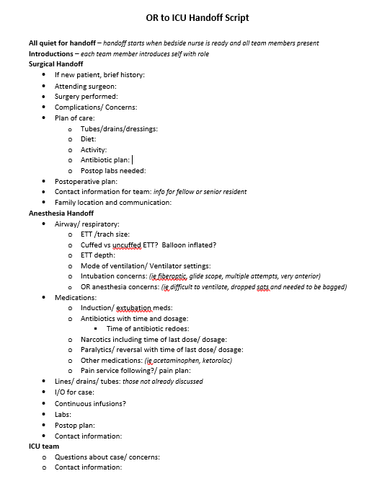
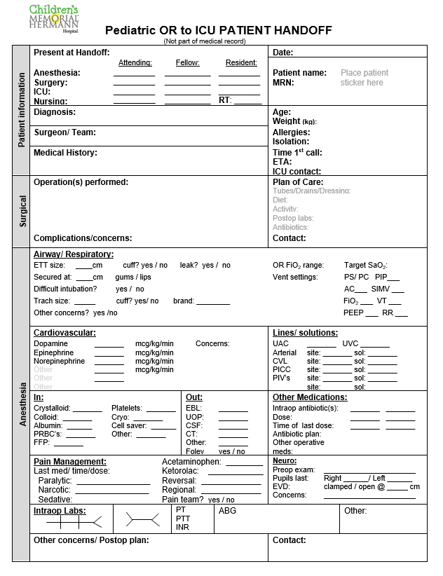
Standardization of Pediatric Non-cardiac Operating Room to Intensive Care Unit Handoffs Improves Communication and Outcomes
Nutan B Hebballi BDS, MPH, Vikas Gupta MD, Kyle Sheppard, BS, Ann Kubanda RN, Danielle Salley RN, Tiffany Ostovar-Kermani MD, MPH, Christina Bryndzia DO, Amir Khan, MD, Nitin Wadhwa MD, KuoJen Tsao, MD, Ranu Jain MBBS, Akemi L Kawaguchi, MD, MS
Figure 1: Quality Improvement (QI) Initiative – Written handoff form
Figure 2: Quality Improvement (QI) Initiative – Handoff Script

Slide 33
Early Discharge after Enema Reduction of Pediatric Intussusception is Cost-Effective and Safe
Nutan Hebballi BDS MPH, Seyed Arshad MD, Elenir Avritscher MD PhD MBA/MHA, Susan John, MD, Robert Lapus MD, KuoJen Tsao MD, Akemi Kawaguchi MD MS
Overview/Problem Statement:
We implemented a quality improvement (QI) initiative to safely reduce post-reduction monitoring for pediatric patients with ileocolic intussusception, hypothesizing that there would be decreased length of stay (LOS) and hospital costs, without change in intussusception recurrence rates.
Results:
Of 90 patients, 37(41%) were pre-QI and 53(59%) were post-QI. Age, sex, race, insurance status, transfer status, and imaging performed were similar. Patients had a median LOS of 23.4 hours pre-QI (IQR: 16.1-34.6), versus 9.3 hours (IQR 7.4-14.2) post-QI , P<0.001 (Figure). Mean total costs per patient were $3,231 (95% CI, $2,442 to $4,020) pre-QI, versus $1,861 (95% CI, $1,481 to $2,240) post-QI (Figure). The mean absolute cost difference was $1,370 less per patient post-QI (95% CI, [-$2,251]-[-$490]). Five patients had an additional encounter within 24 hours of discharge [Pre-QI: 1 (3%) versus post-QI: 4 (8%), p=0.7] with four recurrences [pre-QI: 1 (3%) versus post-QI: 3 (6%), p=0.6].
Methods:
A retrospective cohort study was conducted of pediatric ileocolic intussusception patients who underwent successful air enema reduction between January 2015- June 2020. Our QI protocol allowed discharge from the emergency department after reduction. Pre- and post-QI outcomes were compared for index encounters and encounters within 24 hours of discharge. An economic evaluation was performed with hospital costs inflation-adjusted to 2020 United States Dollars ($). Cost differences between groups were assessed using multivariable regression, P<0.05 significant.
Conclusions:
Implementation of a QI initiative for the treatment of pediatric intussusception reduced hospital length of stay and costs without negatively affecting post-discharge encounters or recurrence rates.

Slide 34
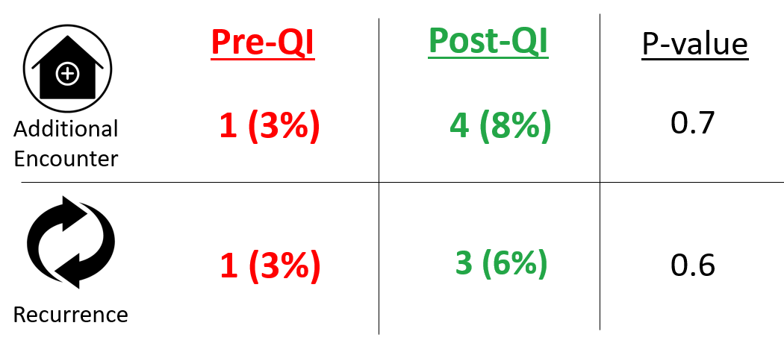
Early Discharge after Enema Reduction of Pediatric Intussusception is Cost-Effective and Safe
Nutan Hebballi BDS MPH, Seyed Arshad MD, Elenir Avritscher MD PhD MBA/MHA, Susan John, MD, Robert Lapus MD, KuoJen Tsao MD, Akemi Kawaguchi MD MS
Figure 1: Additional Encounters and Recurrence

