Slide 1
Cardiac Electrophysiology Fellowship Program A Virtual Tour
McGovern Medical School
2023

Slide 4
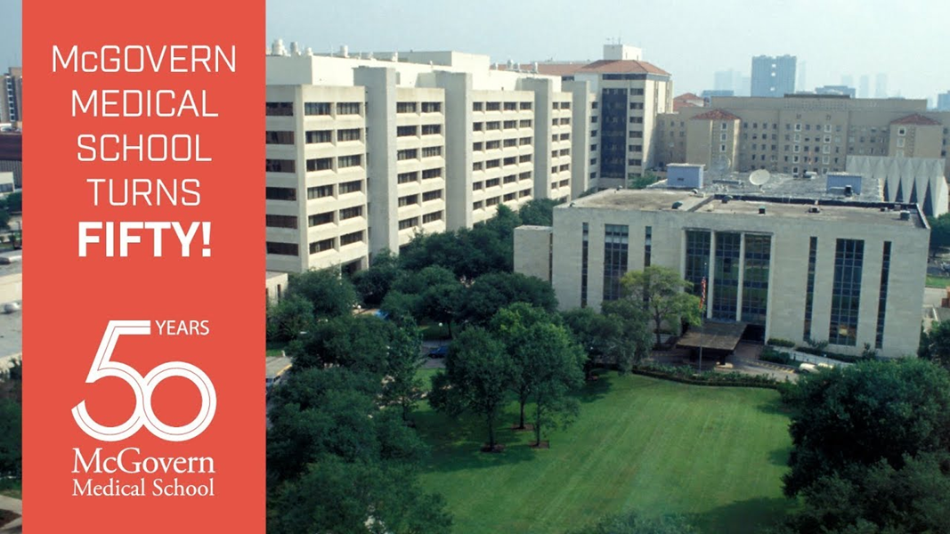
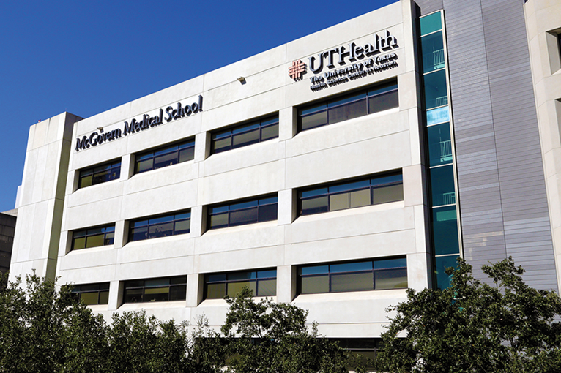
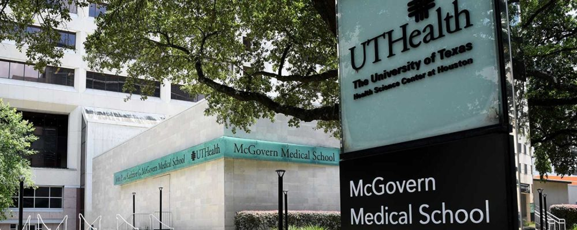
UTH Factbook
https://med.uth.edu/mcgovern-facts-figures/

Slide 5
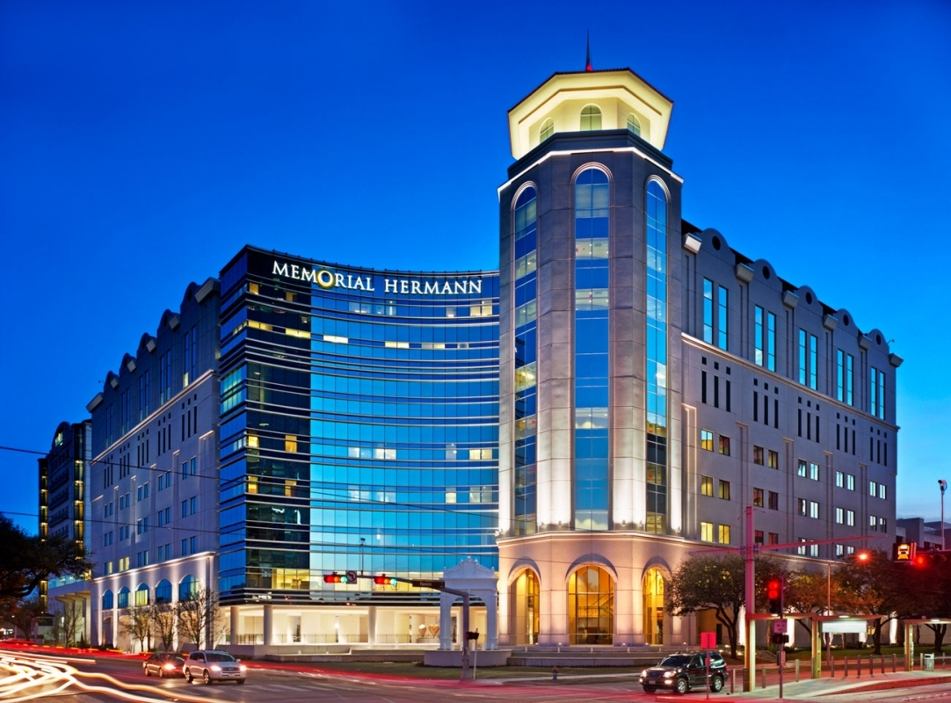
MHMP
MHH
MMS
Texas Medical Center
Sarofim Pavilion
New EP labs
Heart & Vascular
Institute
Memorial Hermann
Medical Plaza

Slide 6
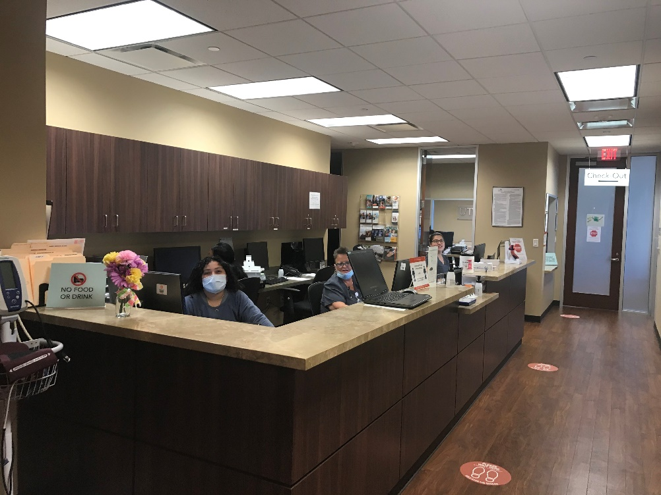
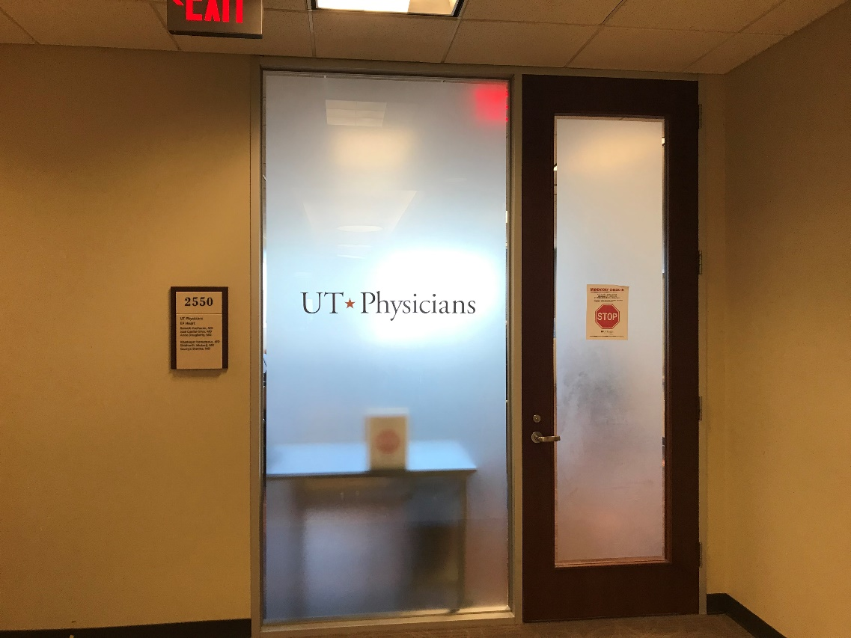
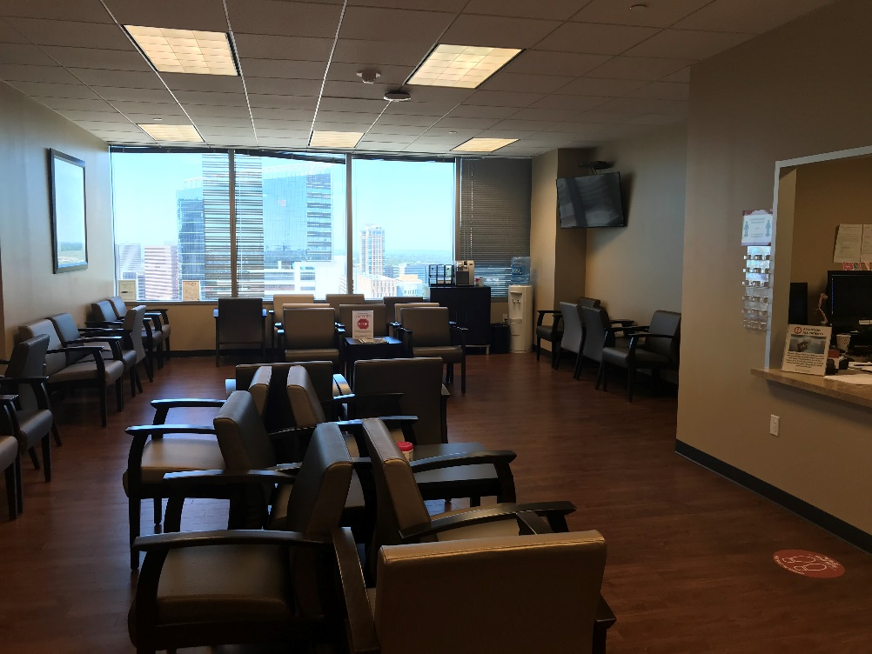
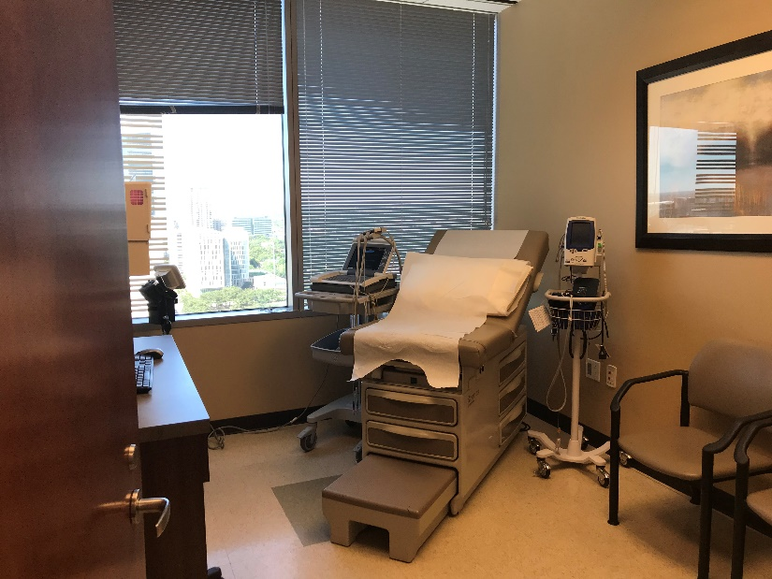
Complex Arrhythmia Center Memorial Hermann Medical Plaza 25th Floor
EP flagship at TMC
One of 14+ outpatient offices

Slide 7
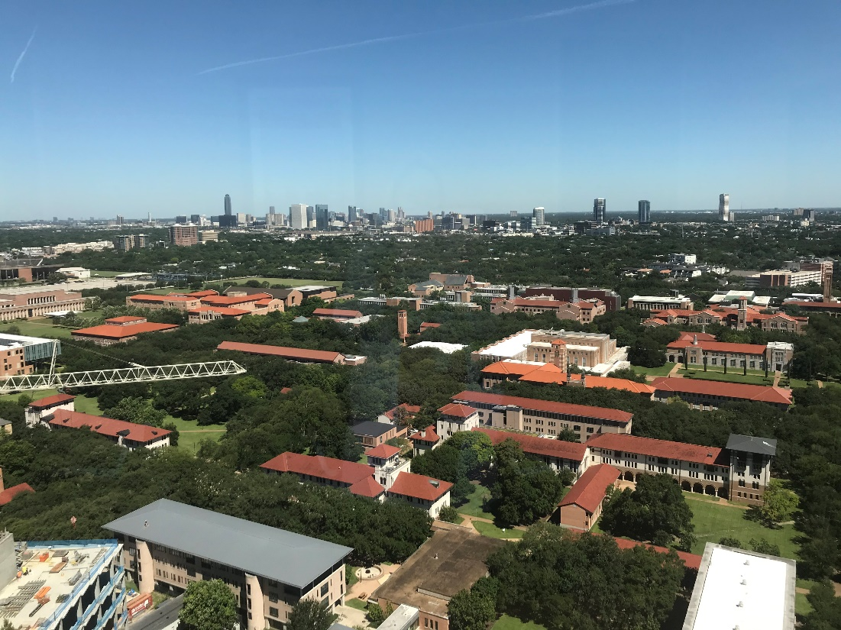
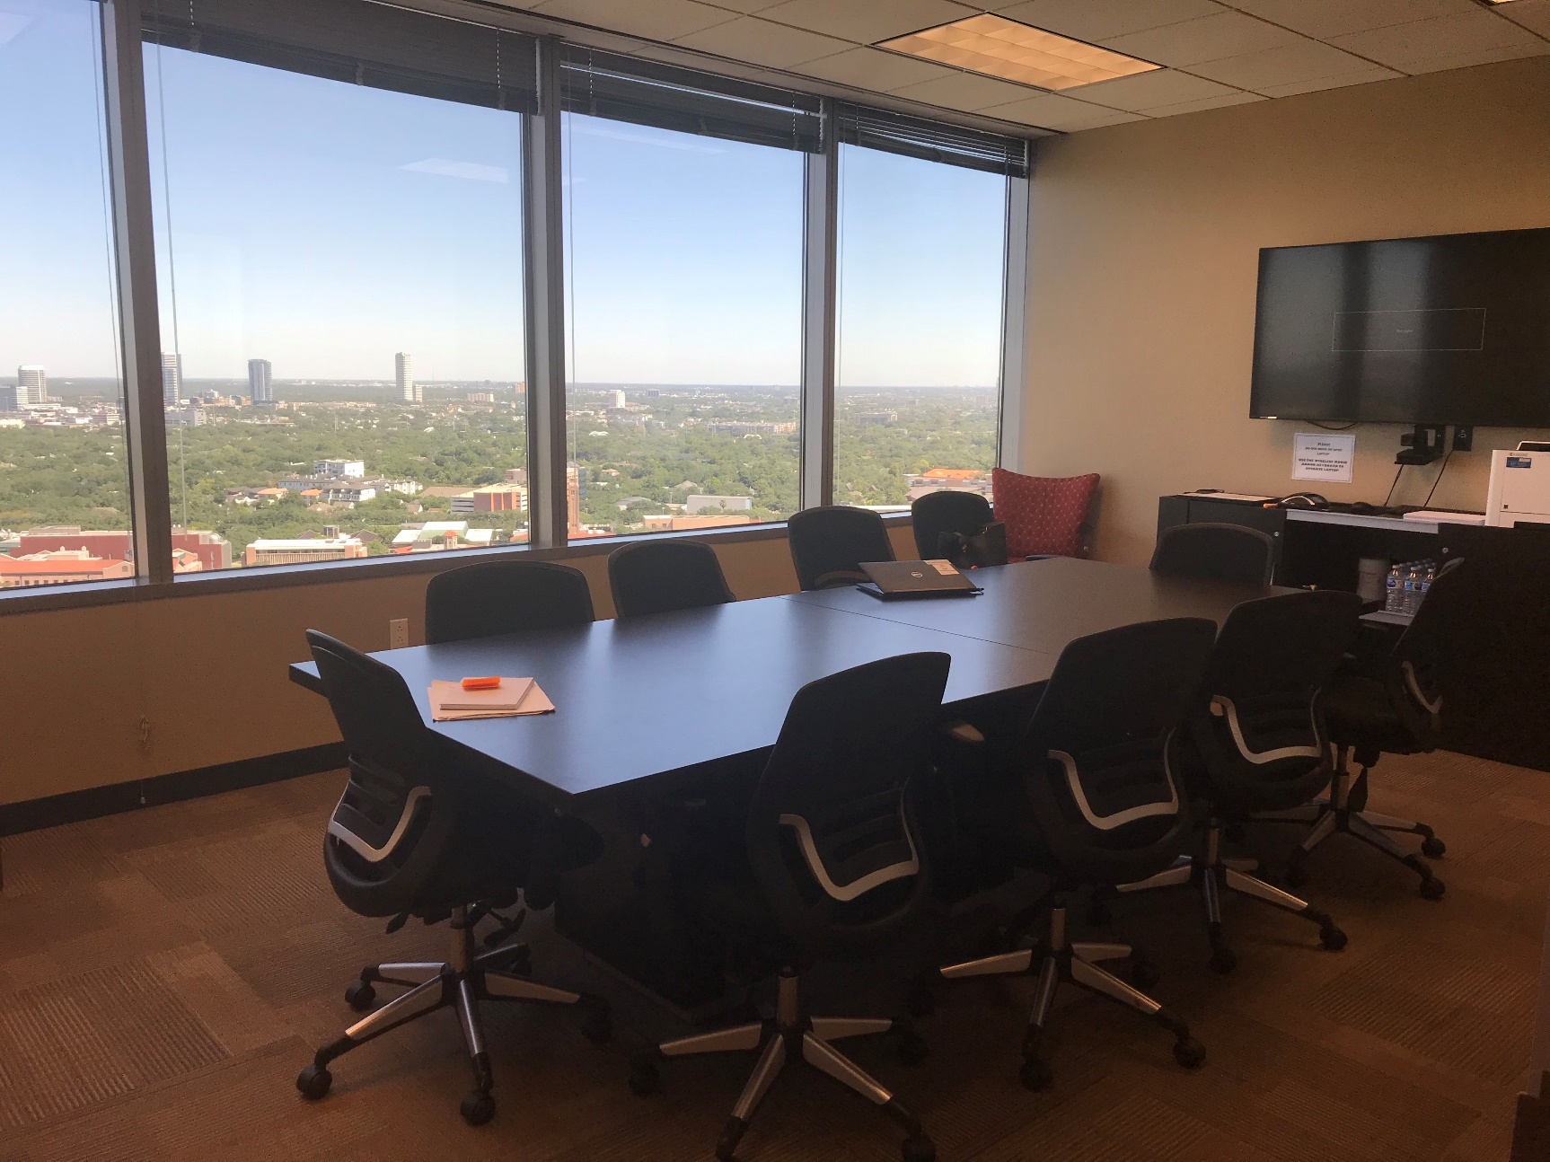
EP Conference Room Memorial Hermann Medical Plaza 25th Floor
Site of the Thursday morning didactic conferences
Overlooks Rice University campus with Greenway Plaza in the distance

Slide 8
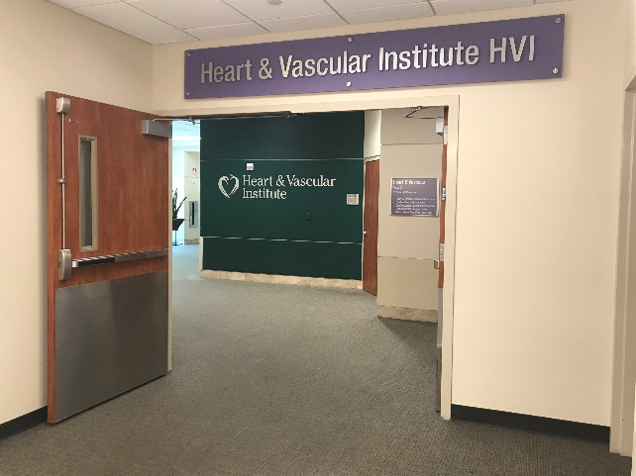
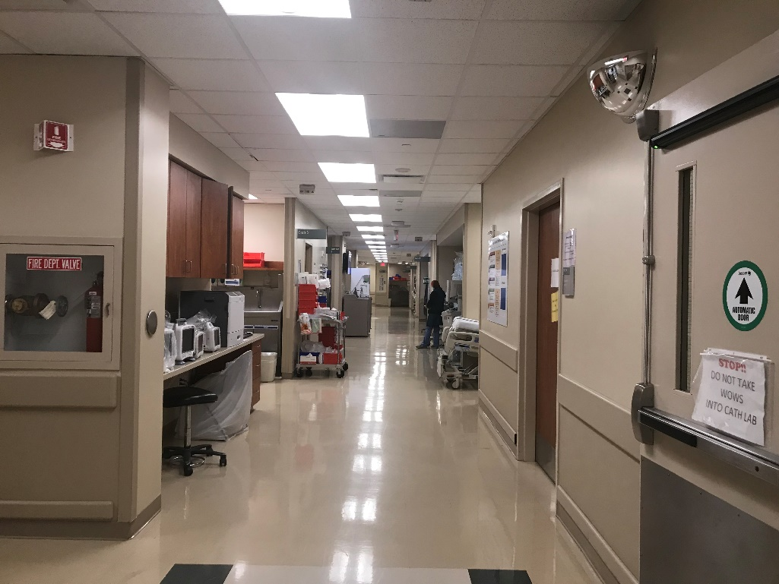
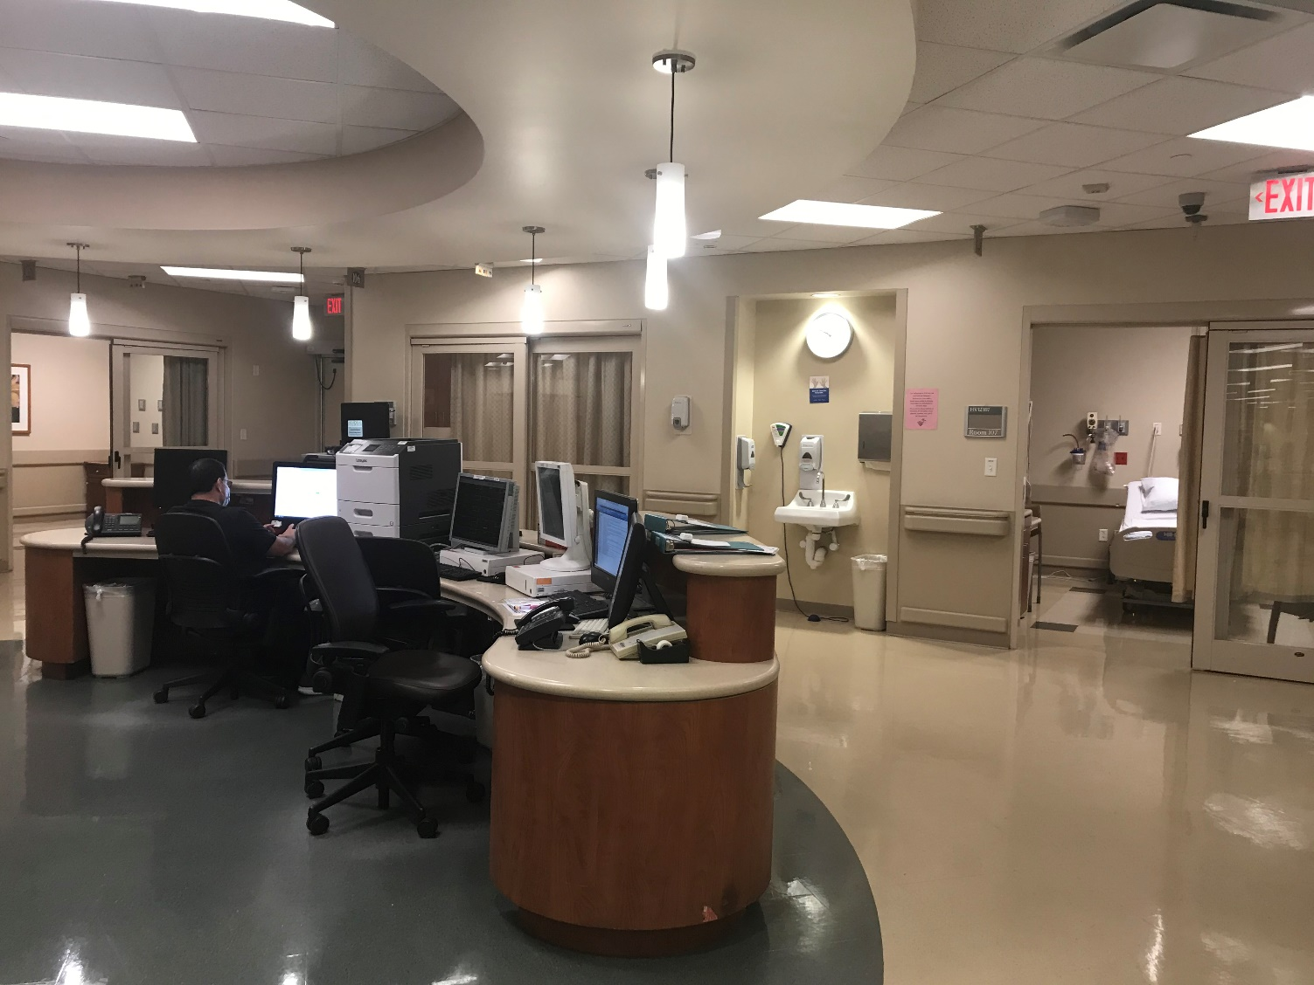
Main Cath Lab Memorial Hermann Hospital Heart & Vascular Institute - TMC
6 labs
23 bed holding area

Slide 9
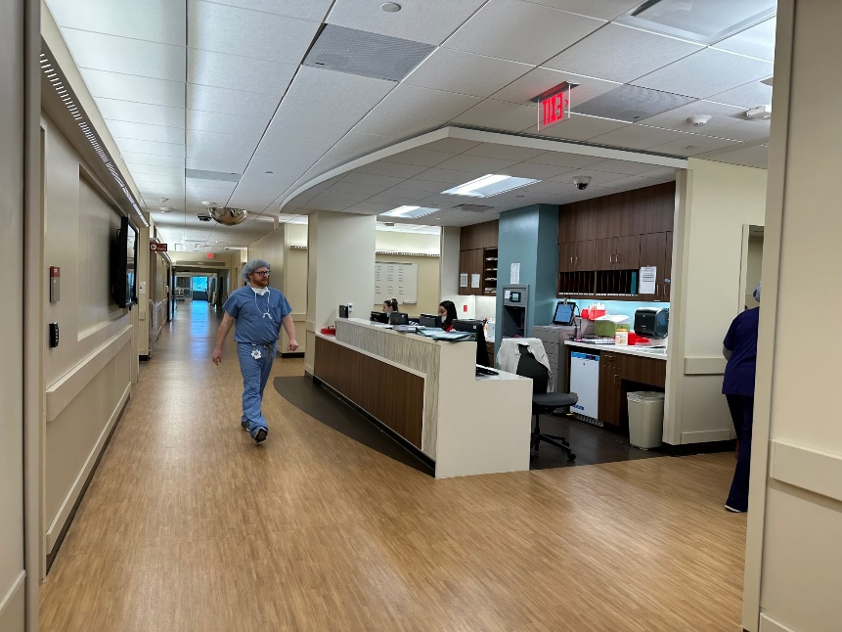
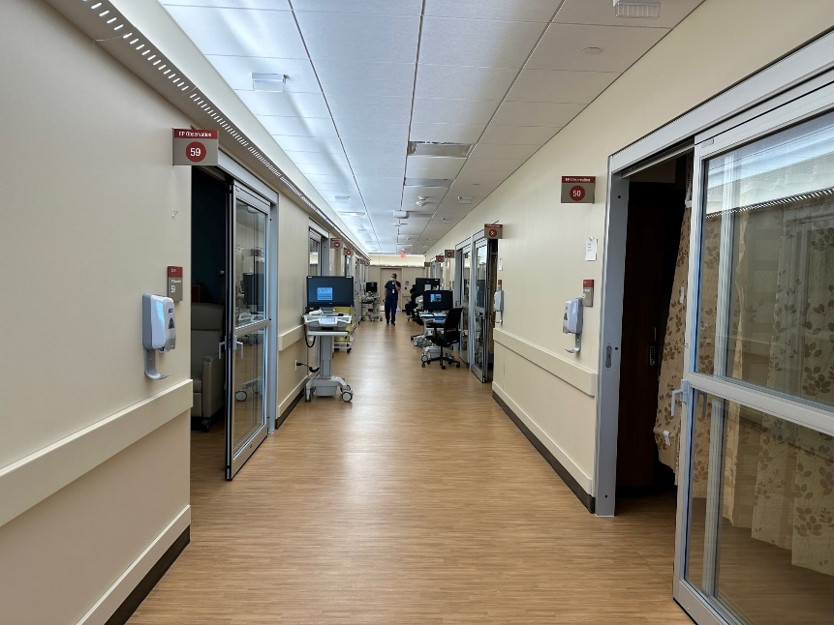
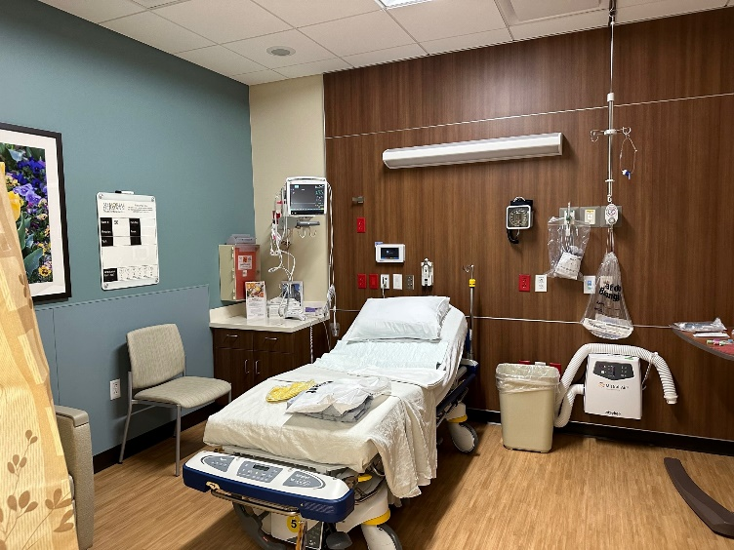
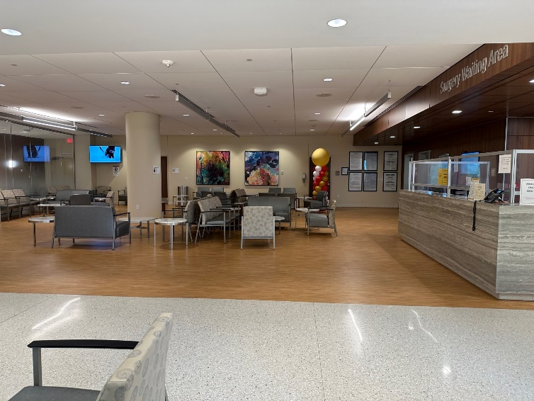
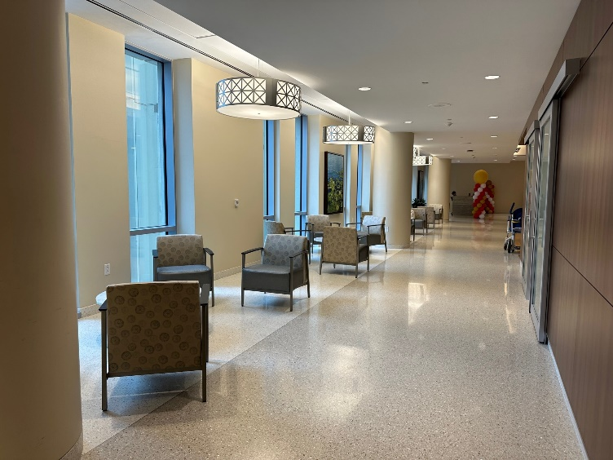
New EP Labs Memorial Hermann Hospital Sarofim Pavilion
3 labs plus Hybrid OR
14 holding beds plus PACU

Slide 10
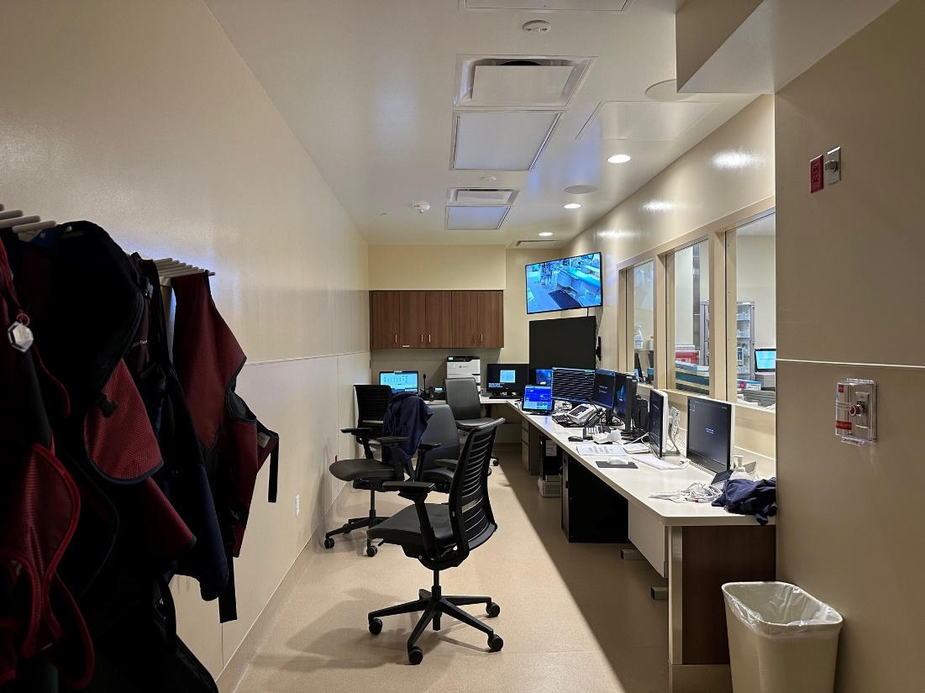
EP Lab
Claris recording system

Slide 11
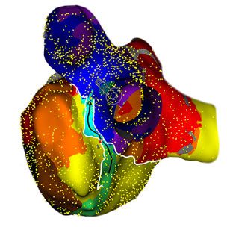
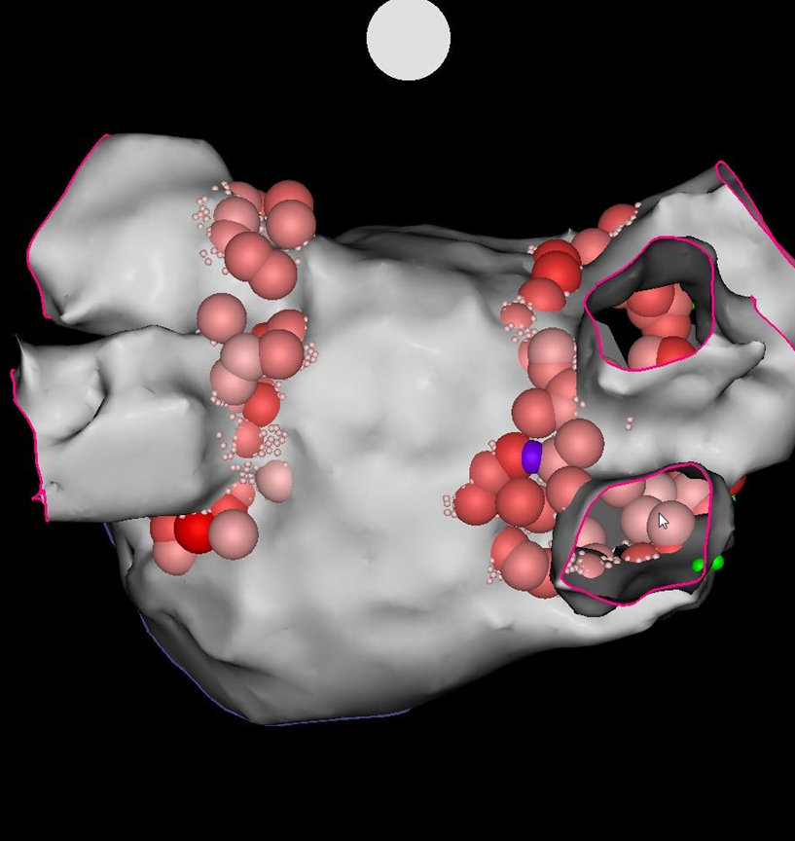
3-D Mapping Systems at MHH-TMC
Rhythmia
CARTO
Ensite

Slide 12
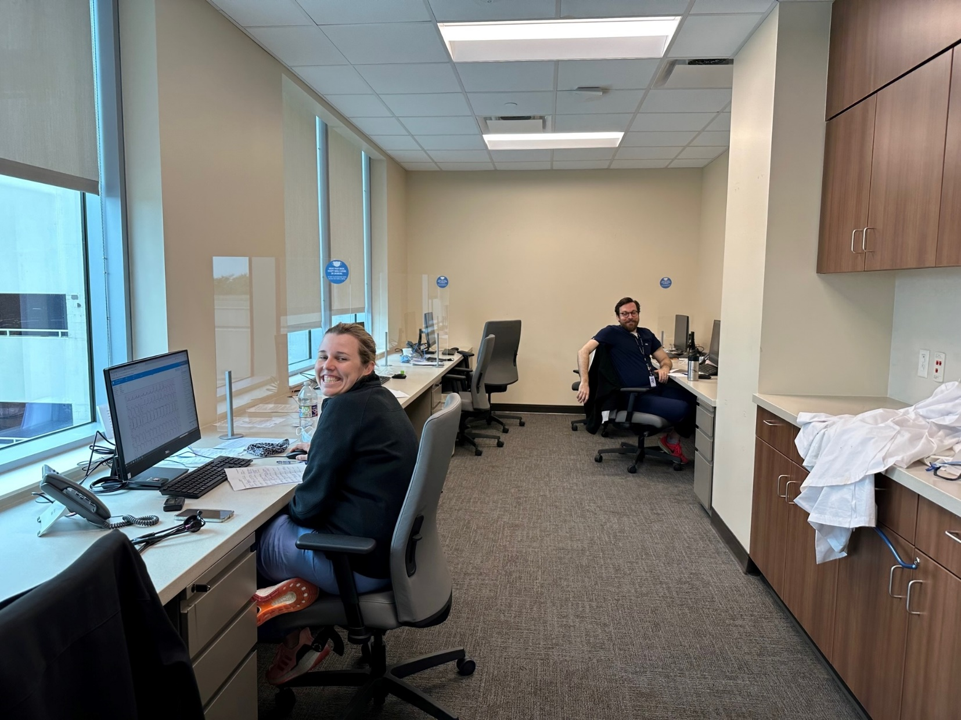
The EP Fellows’ Room

Slide 13
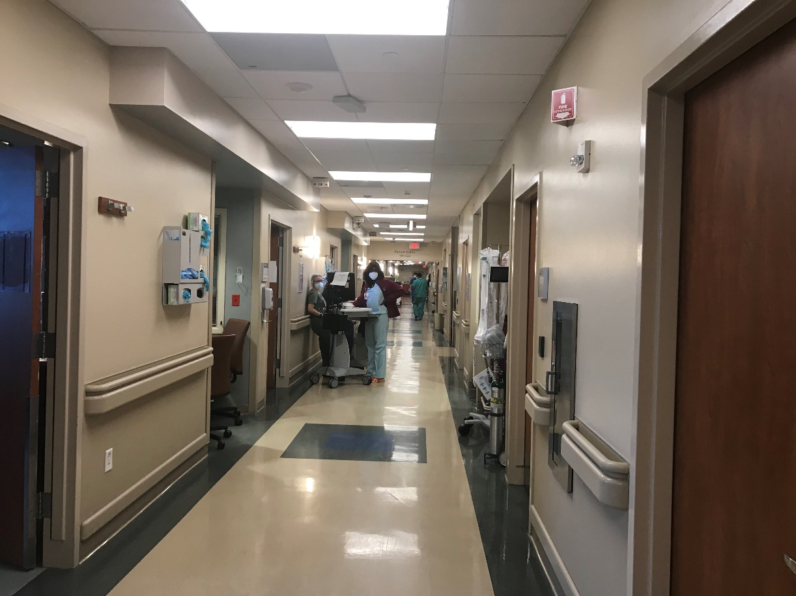
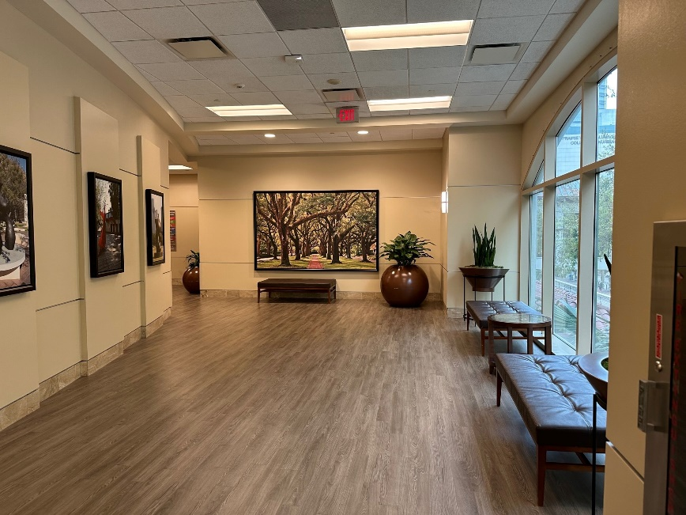
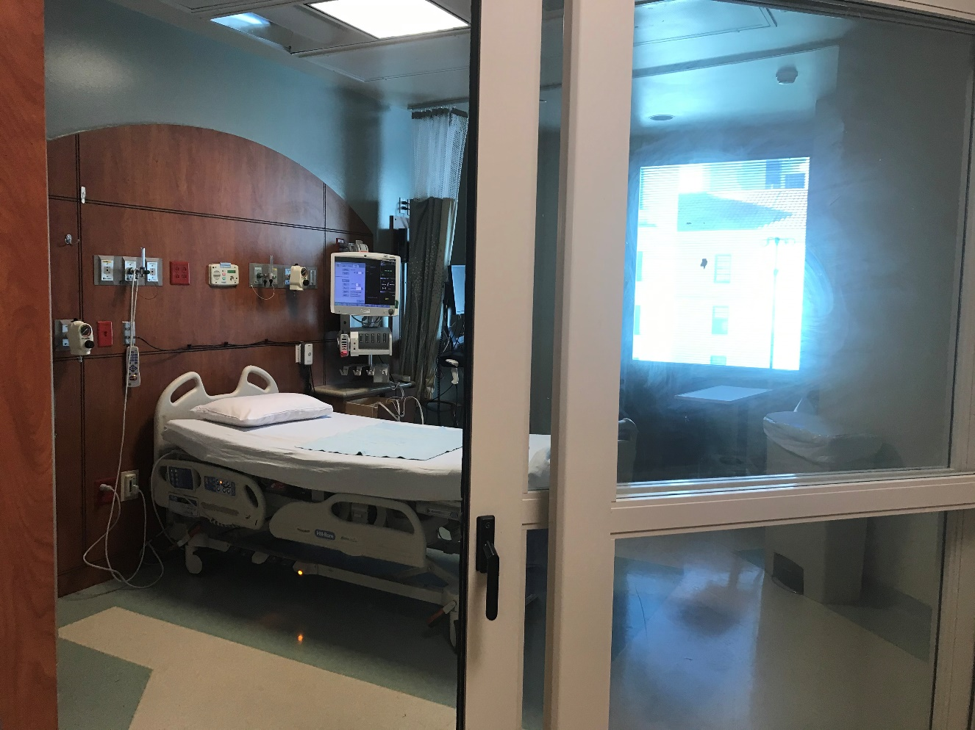
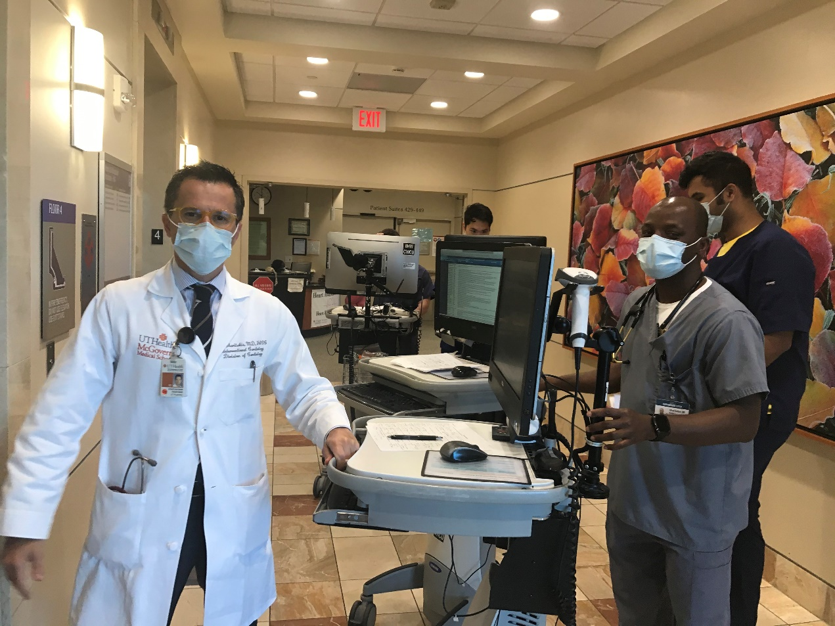
CCU MHH HVI

Slide 14
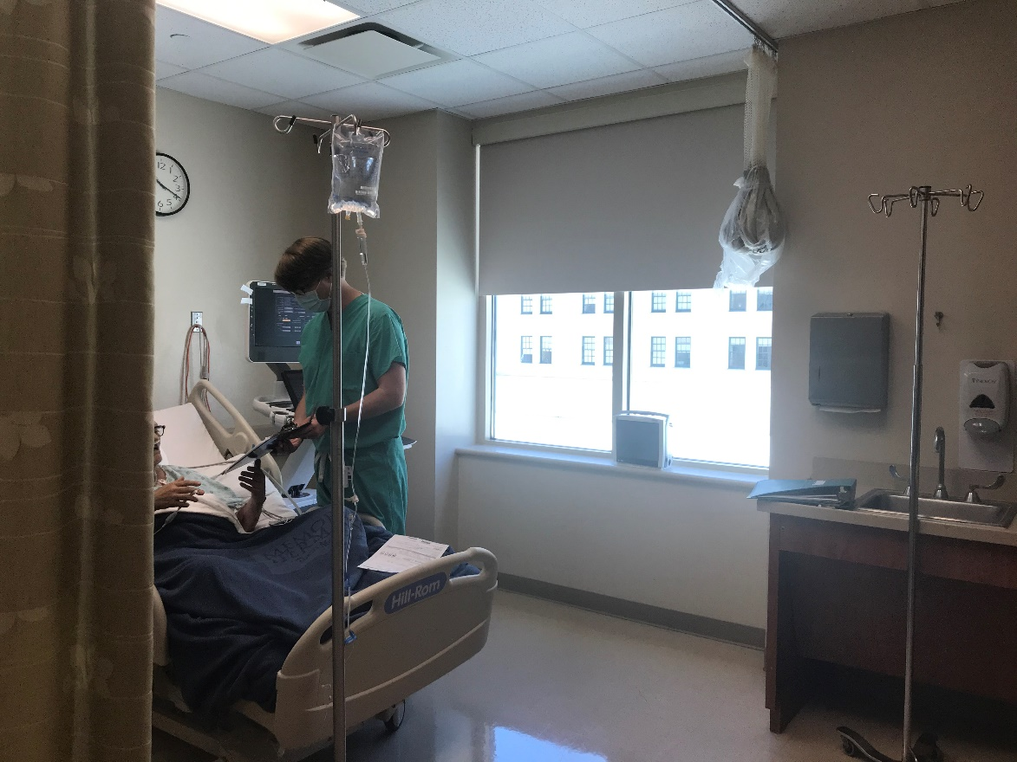
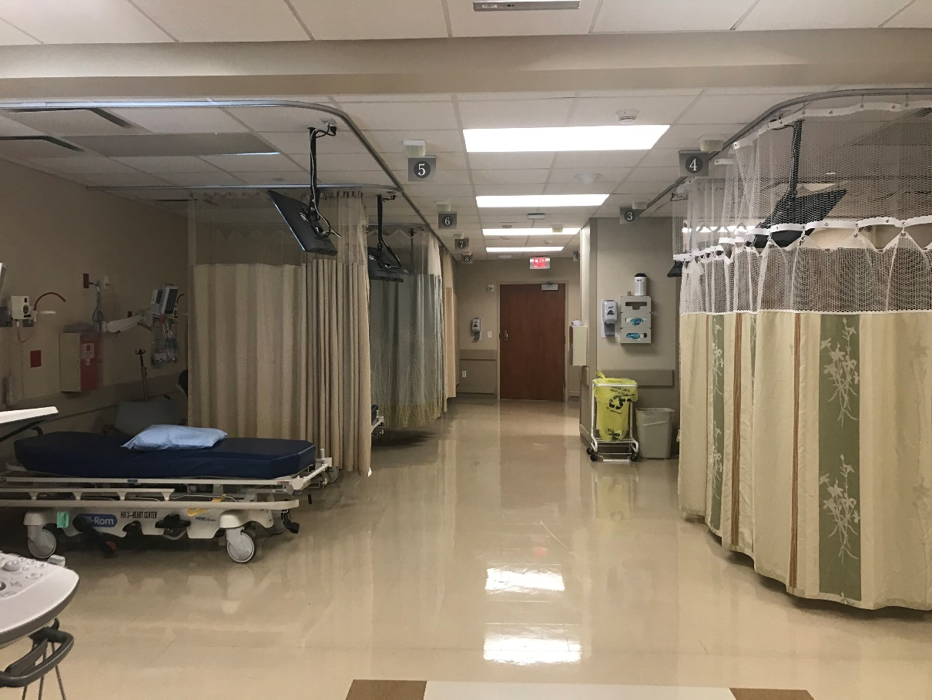
Noninvasive Labs MHH HVI
Outpatient TEE and DC cardioversions performed here or in Sarofim EP suite

