Slide 1
WELCOME
Student Orientation 2019

Slide 2
Orientation Process Outline
PowerPoint Presentations (MSB 1.006)
Laptop Configuration (MSB 1.006)

Slide 3
Power Point Presentations
Power Point Presentations in 1.006
Presentation I
Speaker: Nermin Suljic
Duration: 10 Minutes
Subject: Orientation Process, Policies, Procedures
Presentation II
Speaker: Dr. William Weems
Duration: 20 Minutes
Subject: Trusted Identities in Cyberspace, UTH-Share
Presentation III
Speaker: Salman Khan
Duration: 10 Minutes
Subject: Protecting Your Computer and its Data
Wrap-up
Speaker: Nermin Suljic
Q/A (5 minutes)

Slide 4
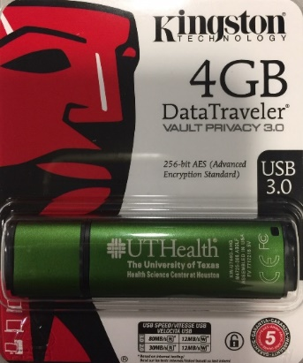
Secure Flash Drive
Students will be given an Kingston encrypted flash drive in LRC at a later date
Required to use for all UT Health related activities
Password Requirements
6 – 16 characters in length
Password must contain Upper case, lower case,
numeric and/or special characters(!, $, Etc.)

Slide 5
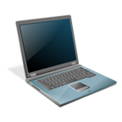
After the presentation
Following configuration/setup will be made:
Configure Wireless
Install VPN and Setup Two Factor Authentication
To access UT resources from outside the network
Install Examplify – Exam software
Setup 15 minutes lockout policy
Setup UTH-Share account
Signup Mobile Device Acknowledge form for Email access on cellphone
Uninstall Dell Data Protection if needed (conflict with exam software)

Slide 6
Laptop Policies
You will be required to use your MSIT approved laptop for computer-based exams
Your laptop must be encrypted using BitLocker full-disk encryption
We will record your computer’s Service Tag number
If you replace your laptop, please bring it to LRC to be checked

Slide 7
Laptop Policies (cont.)
Students must store protected information only on UTHealth-approved and encrypted systems.
Students should not store protected data on non-University owned devices or media.
MSIT will verify that all student laptops meet the full disk encryption requirements. Once encryption is verified, MSIT will place orange stickers on the laptops indicating that the laptops are encrypted and that they have been verified by MSIT. The sticker is tamper-evident and should not be removed from the laptops without MSIT approval. Removing or disabling encryption from your laptop while enrolled as a student at University of Texas Medical School at Houston is strictly prohibited. Failure to adhere to this policy will result in disciplinary action.

Slide 8
BitLocker Encryption Key
During the BitLocker encryption process, an encryption key is generated and required to save on Microsoft account, USB drive or printed.
Student Laptops are covered by Dell 4-year ProSupport warranty. In case of any hardware replacement, BitLocker Key will be required to unlock your Hard Drive.
Without BitLocker Key, All data will be lost

Slide 9
Operating System Updates
Windows Security updates – ok to install
Windows 10 Feature Updates – do not install until Educational Programs certifies compatibility with exam software. Typically features updates are released in May and October
Current version: Windows 10, version 1903

Slide 10
Laptop Warranty
Student Dell laptops come with “4-Year ProSupport with next Business Day Onsite Service”
Does not cover accidental damage (caused by drops, spills and electrical surges…)
Students can call Dell customer service directly or come to Learning Resource Center for help

Slide 11
Cost of Attendance Adjustment
Students may request an increase to cost of attendance (COA) for the purchase of a laptop:
Students must complete the revision request form:
https://www.uth.edu/sfs/documents/revision_request_19-20.pdf
Students must attach a copy of final purchase receipt
This is a one-time COA increase allowance
Complete instructions may be found on the form

Slide 12
Computing Resources in the Medical School
Equipment
171 All-in-One computers available 24/7 in Learning Resource Center (LRC), MSB G.200
16 All-in-One computers available at the LBJ Hospital Satellite LRC
Black & White and Color Printers (Purchase Print Cards in the LRC)
Network scanner scans directly to UTHealth email account
Software
Microsoft Office Suite
Educational Programs in support of Medical School Curriculum

Slide 13
LRC Computer Policy
Do not save any data on the LRC computers
School issued encrypted Kingston USB flash drive is the only external USB storage device allowed to save files.
User profiles on the LRC computers are deleted every last Saturday of the month as part of regular maintenance
Do not disconnect any cables from the LRC computers
Please remember to Log Out when you are finished using the computer

Slide 14
Microsoft Office 365
Students are provided with free Microsoft Office 365
visit: https://office365.uth.edu to download the software
Sign in with UTHealth email address and password

Slide 15
Discounted Software
Students are eligible to purchase discounted software through https://uthealth.onthehub.com
Sign in with UTHealth UserID and password

Slide 16
Webmail
Convenient way to check your e-mail
Please visit https://webmail.uth.tmc.edu
Sign in with UTHealth UserID and password
Required UTH Two Factor Authentication after sign in
Both Webmail and Microsoft Outlook can check and send encrypted e-mail
Start the e-mail subject with [encrypt] to send encrypted e-mail to external recipients

Slide 17
Students MSIT Helpdesk
If you require help with your laptop, please submit a ticket to schedule a convenient time to meet with one of our student helpdesk representatives.
Please visit: http://go.uth.edu/MSITHelp
Following services will be available:
Installing, troubleshooting and supporting Windows operating systems
Installing licensed software applications
Contact Dell warranty for Hardware replacement

Slide 18
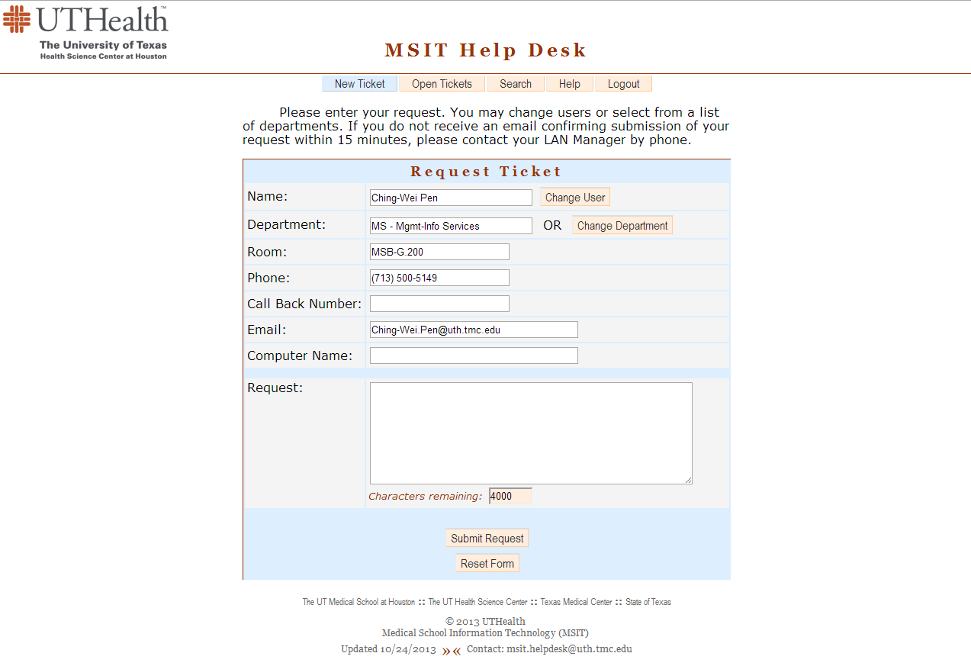
Submitting a Ticket to Student Helpdesk

Slide 19
Trusted Identities in Cyberspace: A Critical Component In Healthcare Information Technology & Collaborative Systems
William A. Weems, Ph.D.
Associate Dean Information Technology
Medical School
U. Texas Health Science Center at Houston

Slide 20
Today’s Cyberspace Realities
7, 587,311,245 people on earth!
Over 4 billion people have Internet access!
Facebook alone has over 2.38 billion users!
U.S. Population 328,202,756
Collaboration is no longer just among persons, but also between people and increasingly intelligent digital assistants, and among the digital assistants!
Interactions are sometime anonymous, but increasingly must be among identified entities that have a high degree of trust.
E-Learning skills are indispensable!
Estimates U.S. & World Population Clocks
13.52.45 UTC (EST+5) July 25, 2019

Slide 21
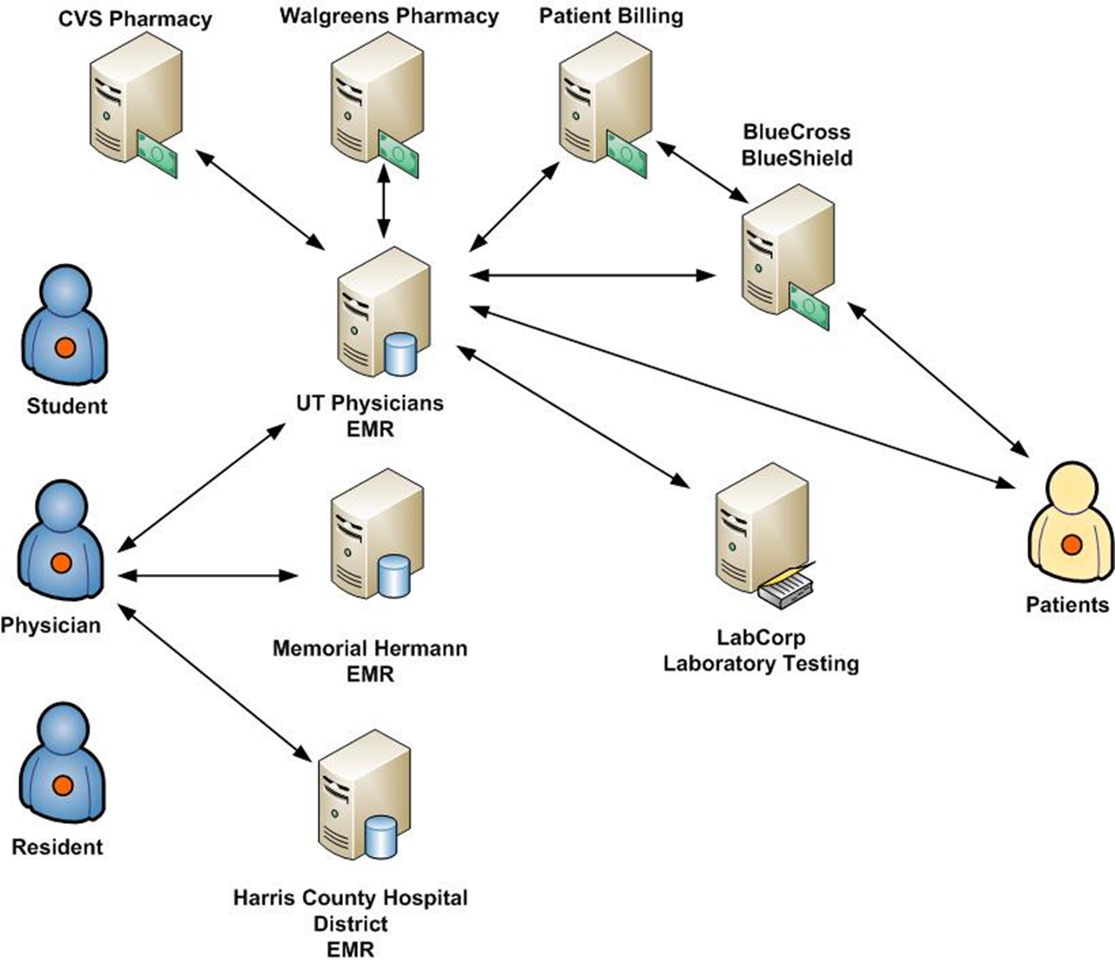
Identity, Trust, Privacy, Accountability: Being a Responsible Citizen in Cyberspace

Slide 22
Trust Issues in Cyberspace
How do you prove you are who you say you are to a relying party?
What is identity?
How do you know that you can trust a person or a specific digital system in cyberspace?
If your identity is stolen and used fraudulently, or personal records are altered without your knowledge or permission, how do you prove that it was not you?
Notes:
Phishing Scams

Slide 23
What Constitutes Identity in Cyberspace?
Two aspects of a person’s identity
Physical Identity - absolutely unique to one person and can be certified by a credential provider using various physical characteristics of that person.
Personal attributes – constant and time varying characteristics associated with an identified person and verified by trusted attribute providers.
Notes:
Note, attributes vary with time. For example, a person may have been a medical student at a university for four years, but after the fourth year they graduated and are no longer at the university.

Slide 24
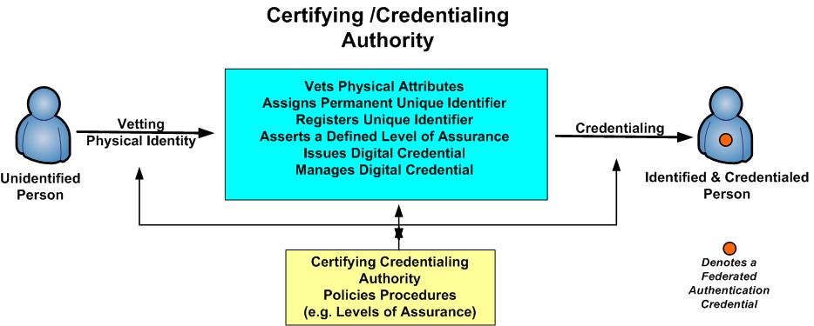
Notes:
Current problem is that we have too many credential authorities. Would be nice to have only one or two or maybe three. Today, each on for you were given identity credentials by UTHealth.

Slide 25
An authentication credential when presented to a relying party:
can only be activated by you,
positively verifies your physical identity.
positively identifies the certifying authority (CA) that is attesting it is “you”.
provides a certified unique identifier issued to you and registered with the CA, and
asserts a defined level of assurance (LOA) that the credential is presentable only by you – i.e. the person it authenticates.

Slide 26
Notes:
But presently, there are to many authentication credential providers. Consider the ~ 4,000 university & Colleges in the USA! Then expand this to the world.

Slide 27
National Strategy Trusted Identities in Cyberspace
Ideally, individuals would each like a minimal number of authentication credentials that can be securely used to authenticate his or her identity anytime authentication of identity is required to secure any transaction between relying parties.
Notes:
But presently, there are two many authentication credential providers. Consider the ~ 4,000 university & Colleges in the USA! Then expand this to the world.

Slide 28
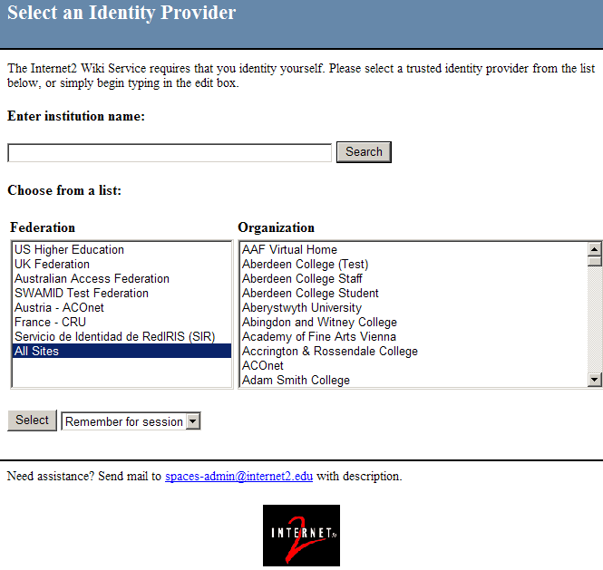

Slide 30
UTHealth Strategic Authentication Goals
Three types of authentication credentials.
UTHealth Username/Password: Identity Provider Service (Shibboleth)
Low level of assurance (one-factor authentication)
UTHealth userID (UID) & Password transmitted via Internet
Less functionality: Only for authentication of physical identity
UTH-Share (Google Suite For Education Collaborative System)
UTHealth userid@uth.edu e.g. wweems@uth.edu
Can be upgraded to two-factor authentication
Digital ID on eToken (two-factor authentication)
High level of assurance – some thing you know and have
Password only goes to e-token
Only the e-Token owner, i.e. you, can manage password
More functionality (e.g. authentication as well as digital signatures)

Slide 31
Using Public Key digital IDs (DIDs)
Digital Signatures
authenticates senders
guarantees that messages are unaltered (message integrity)
provides for non-repudiation
legal signature with the United States
Encryption of e-mail and electronic documents
Provides confidentiality of e-mail when required
Digitally Signing On-line Forms
Strong Authentication for Access Control

Slide 32
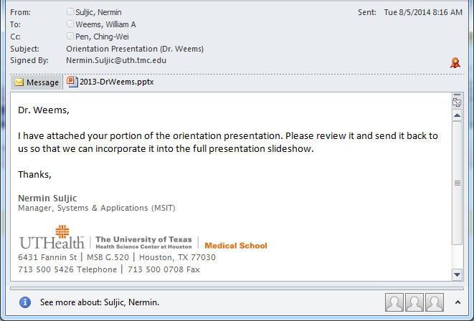

Slide 33
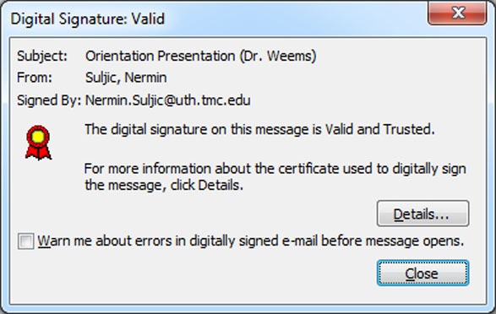

Slide 34
Value of Public Authentication Credentials with Public Identifiers
A presenter’s physical identity is immediately known to any party accepting the credential!
Risk of identity theft becomes very unlikely!
The presenter is “in control” of his or her “trusted” actions in cyberspace.
Relying parties “know” it is the actual physical person initiating an action!
The presenter has “increased control” over release of his/her personal attributes from attribute providers.

Slide 35
UTHealth Identifiers
Jane E. Doe
Email: Jane.E.Doe@uth.tmc.edu
UTHealth UserID (UID): jdoe
Scoped UserID: jdoe@uth.edu
Used for your UTH-Share ID – Google Apps EDU
External Identifiers
jdoe23@gmail.com
Notes:
Update this slide with privacy info!!!!!!!!!!!!!!!!

Slide 36
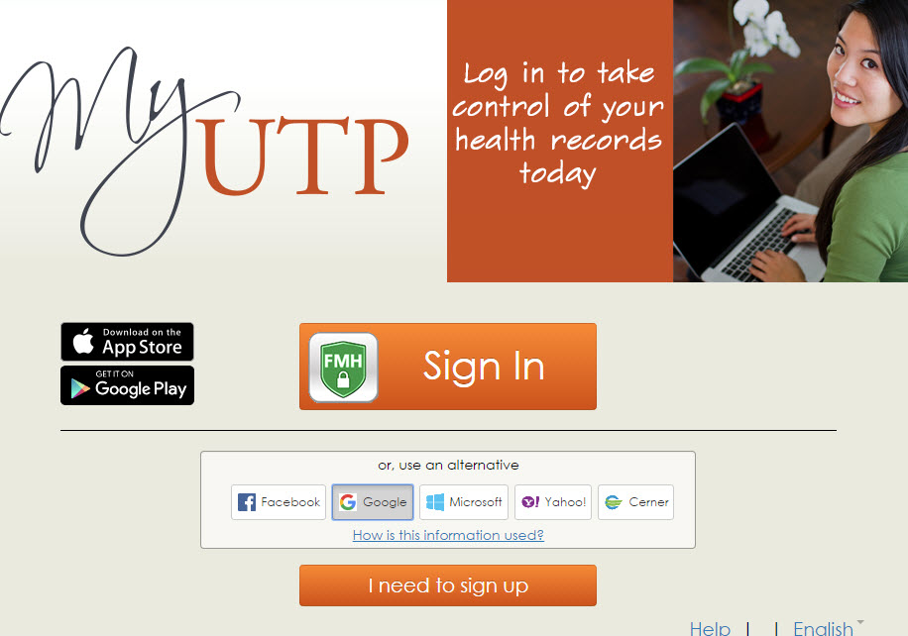

Slide 37
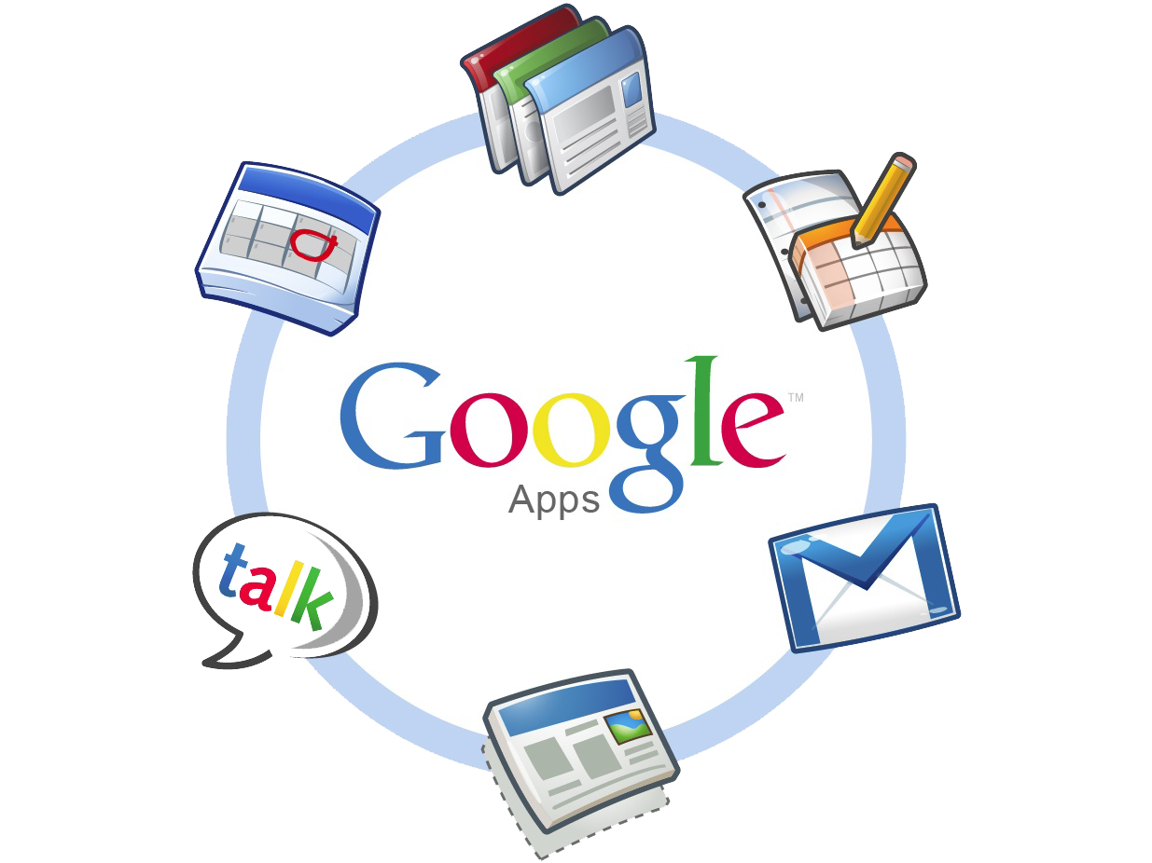
UTH-Share
UTHealth’s Implementation of
Google’s G Suite for Education
Notes:
It is easy to convert PowerPoint presentations to Google presentations and vice versa. Faculty, student & staff can go anywhere, bring up the browser and get to their content - don’t have to fumble around with secured thumb drives.

Slide 38
Why Implement
G Suite for Education ?
Users want a Collaborative System providing
Document and file sharing (All files & folders have URLs)
Shared workspaces
Online document creation and editing of linked documents
Automatic, instant saving with versioning
Online, simultaneous editing by multiple individuals
Globally grant secure access to credentialed individuals
Powerful search and discovery (Intelligent Digital Assistants)
Integrated Voice/Video Conferencing
Unlimited storage: Individual files: <= 5 Terabytes!
Easy & functional access via most mobile devices
Notes:
Two major competitors: Google with Google apps for personal, education and work and Microsoft’s Office 365: Many universities are doing this as well as many public and private schools in the US

Slide 39
Google Collaborative Cloud Services
G Suite for EDU includes many familiar Google applications and new innovations UTH-Share
Text Documents
Presentations
Spreadsheets
Forms
Drawings
Drive
Intelligent Digital Assistants
Sites
Video Hangouts
Calendar
Groups
Notifications
Mobile Devices
Notes:
Files on a USB drive or within a computer drive are not generally linked! When presenting a lecture one only has to bring up the browser and begin with the first document.

Slide 40
IT Security Awareness for New Students
July 2018

Slide 41
Phishing and data breaches

Slide 42
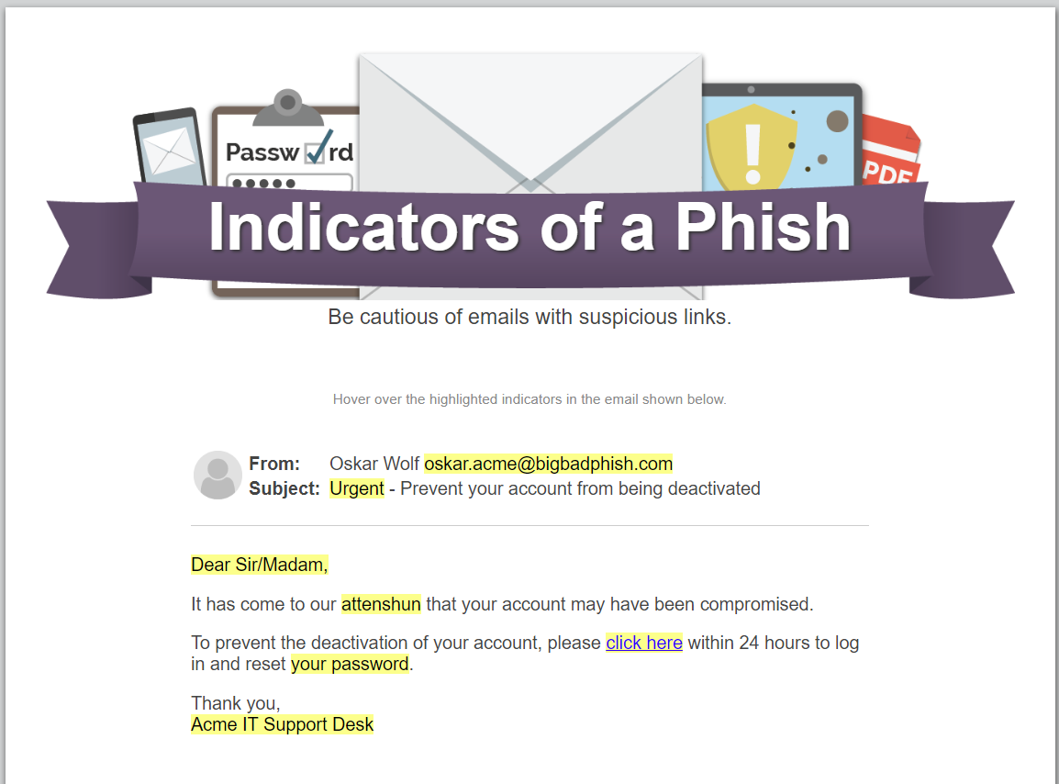
Does the message plant a false sense of urgency?
Do you recognize the sender?
Is the greeting generic?
Can you spot typos or grammatical errors?
Does the email involve sensitive data, such as your password?

Slide 43
Might be a phish, say something
You must forward the original e-mail as an attachment for IT Security to be able to gather all the information needed to address the phish.
Pressing “Ctrl+Alt+F” simultaneously will enable you “Forward as Attachment”
You can also select “More” and then select “Forward as Attachment”
Send the new forward to: its@uth.tmc.edu

Slide 44
Safeguard Sensitive Information
Use encryption: Bitlocker FDE, Outlook e-mail encryption and TigerText
Protected Health Information (PHI)
HIPAA
Encrypt devices; email & texts
Don’t share passwords
Don’t store PHI on personal devices
Protect against malware
Avoid public networks
Use two factor authentication
Attackers often exploit public networks
Two-factor authentication (DUO) helps protect access
Use firewalls and antivirus
Anything done under your log-in is your responsibility!
Store all PHI in the Electronic Health Record (EHR) system (including photos)

Slide 45
E-mail Security
1
2
3
[ENCRYPT] All e-mails containing PHI
No PHI in Subject field of ANY e-mails
Report Suspicious e-mails to IT Security
Type [ENCRYPT] in the Subject field of all e-mails containing PHI.
DO NOT include PHI in the Subject field of any e-mails; the Subject field is never encrypted.
Forward “phishy” e-mails as an attachment to IT Security at its@uth.tmc.edu.

Slide 46
E-mail Security
4
5
6
Use Patient Portals to communicate with Patients
If sending an email to multiple recipients; use BCC
Report Incidents or Misuse to IT Security
E-mail is not the method of communicating with patients
DO NOT show the names of other e-mail recipients.
If you see something, say something to IT Security at its@uth.tmc.edu.

Slide 47
We are not Immune

Slide 50
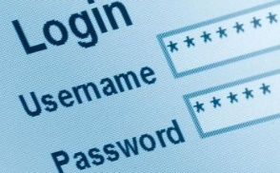
KEY POINTS TO REMEMBER
Be cautious of e-mails
Be cautious with confidential and sensitive information

Slide 51
Connect with IT Security
Contact
Follow
facebook.com/uthealthsec
twitter.com/uthealthsec
713.486.4848 [HelpDesk]
its@uth.tmc.edu
Phishing Blog
itsecurity/sac/phish/index.htm
inside.uthouston.edu/itsecurity/

Slide 52
UTHealth E-mail Support for Students
Connectivity to the UTHealth Exchange e-mail system with an approved mobile device is available to students.
Students are allowed to connect supported device through Intelligent Hub MDM Agent
Jailbroken or Rooted devices are not supported.

Slide 53
UTHealth E-mail Support for Students (cont.)
Upon joining a supported mobile device to the UTHealth e-mail system, pre-defined policies will be enforced. These policies include but are not limited to minimum password length, inactivity timeout period & number of failed unlock attempts allowed. For more detailed information on what policies are being applied, see https://inside.uth.edu/dcos/services/mobile-device-management/policies.htm. This URL is accessible while connected to the UTHealth network.
Notify the LRC immediately if your device is lost or stolen. UTHealth has the ability to remote wipe your device in this instance but can only do so while the cellular account is still active.

Slide 54
Two Factor Authentication
Two-factor authentication adds an additional layer of assurance onto your normal login process
UTHealth is using Duo Security which uses your phone as the second factor in addition to the login method
Smartphone users can install DUO Mobile app for more authentication option
This service is mandatory for VPN and Webmail access

Slide 55
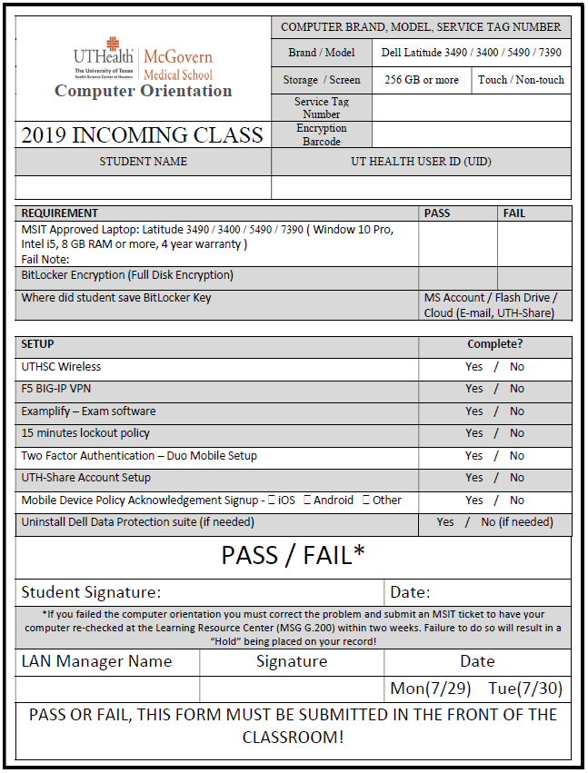

Slide 56
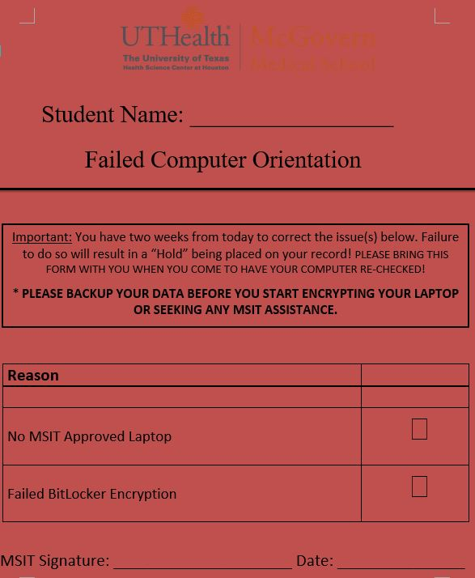

Slide 57
2019 Student Computer Orientation Presentation

Slide 58
Important Reminders
Keep your BitLocker key saved in a secure location, without it, you may not be able to access your data!
Do not install new Windows 10 Feature updates until approved by Educational Programs. Security updates are okay to install.

Slide 59
Thank you!
Questions?
Ticket#

