Slide 1
Inter-areal cortical connections
Systems Neuroscience
GSBS 2023
Ariana Andrei, PhD
ariana.r.andrei@uth.tmc.edu

Slide 2
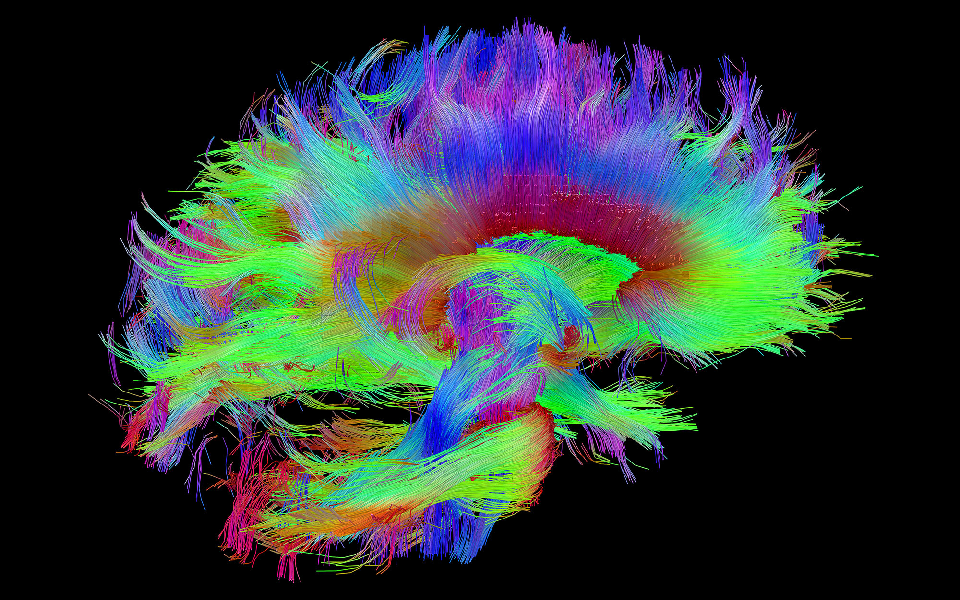
overview
Sensory input to the cortex
Feedforward pathways
Feedback pathways
Readings:
The importance of being hierarchical, Markov & Kennedy 2013
The neocortical circuit: themes and variations, Harris & Shepherd 2015

Slide 3
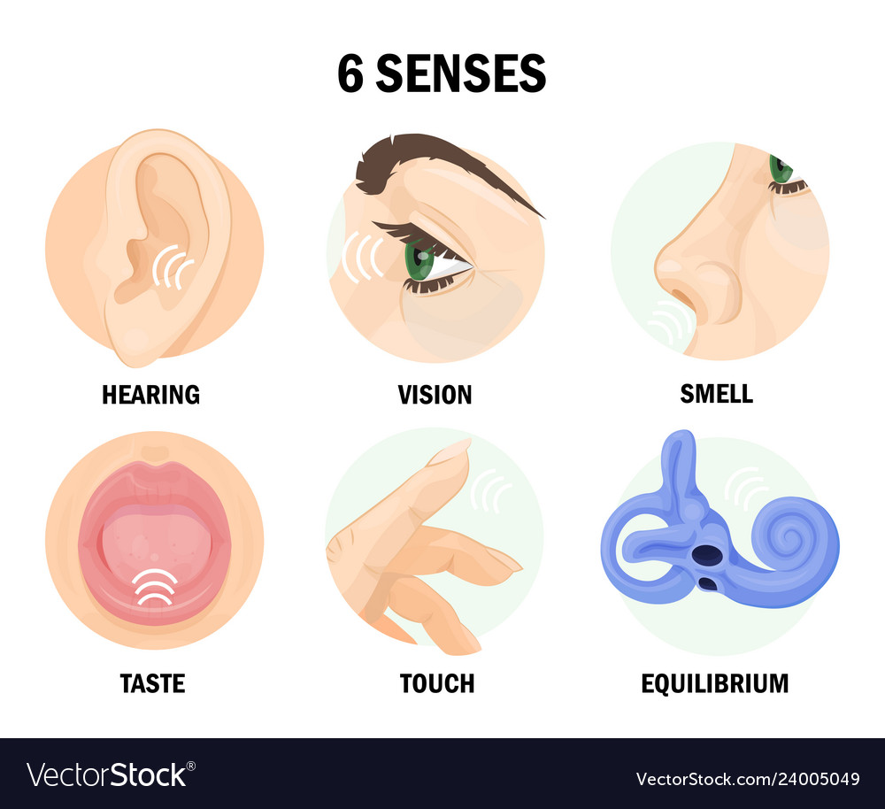
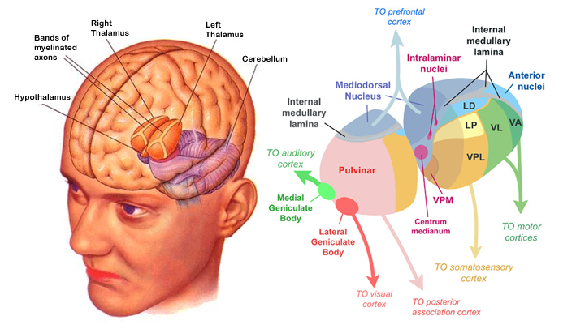
5-6 kinds of sensory inputs reach the cortex via the relay nuclei of the thalamus (only smell does not)

Slide 4
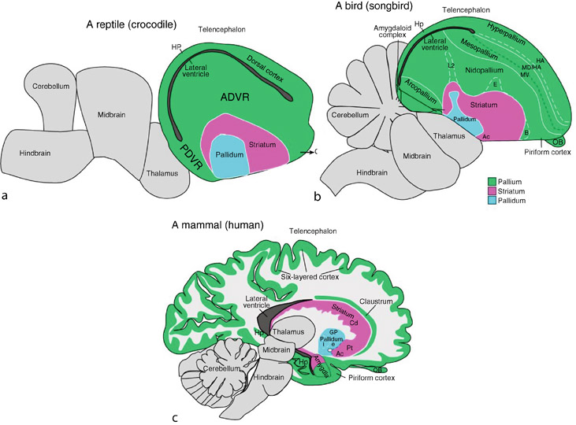
Sensory afferents reach the cortex/ pallium via thalamus in mammals, birds (and maybe reptiles too)
“Evolution of the Pallium in Birds and Reptiles”, E. Jarvis
Encyclopedia of Neuroscience, 2009
https://link.springer.com/referenceworkentry/10.1007/978-3-540-29678-2_3165

Slide 5
Thalamus has many nuclei divided into 2 broad classes
“Relay” nuclei receive input from periphery and project to cortex
“Higher order nuclei” receive input from cortex and mainly project to cortex

Slide 6
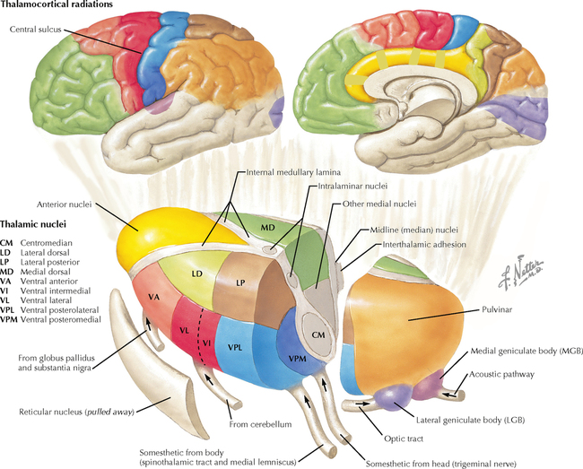
Relay nuclei are located along the lateral thalamus
Thal. Nuc – cortical target
LGN – V1
MGN – A1
VPL – S1, body
VPM – S1, face
    + taste

Slide 7
Cortex is sometimes called “isocortex”
“Iso” means “same”
In mammals, cortex is (mostly) a 6-layered structure
This “sameness” means that connectivity patterns repeat throughout the cortex
Brodmann, 1908

Slide 8
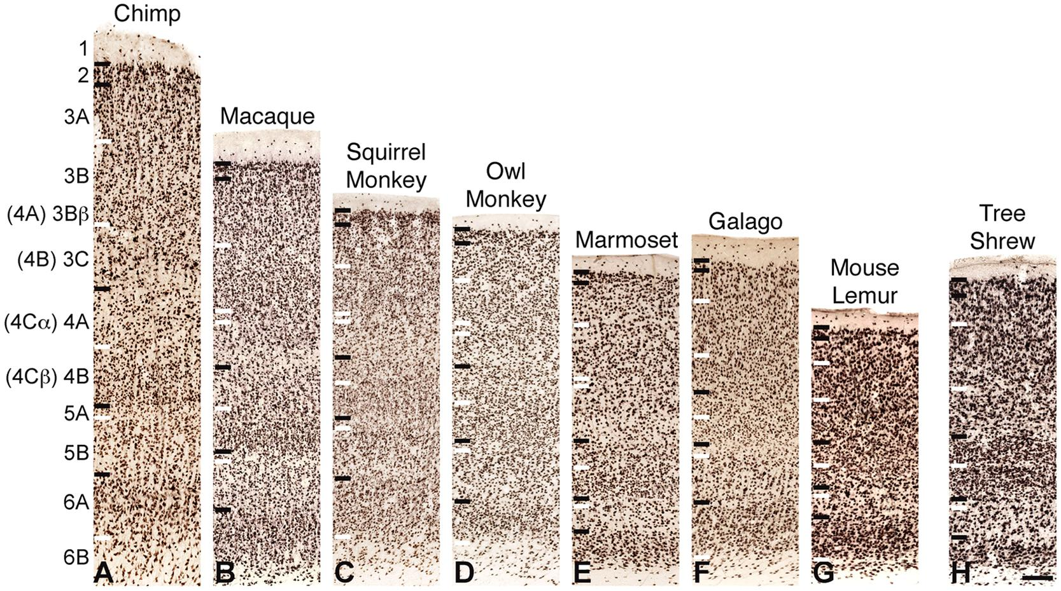
Primary visual cortex (V1) across primates
Balaram & Kaas 2014 Front Neuroanat

Slide 9
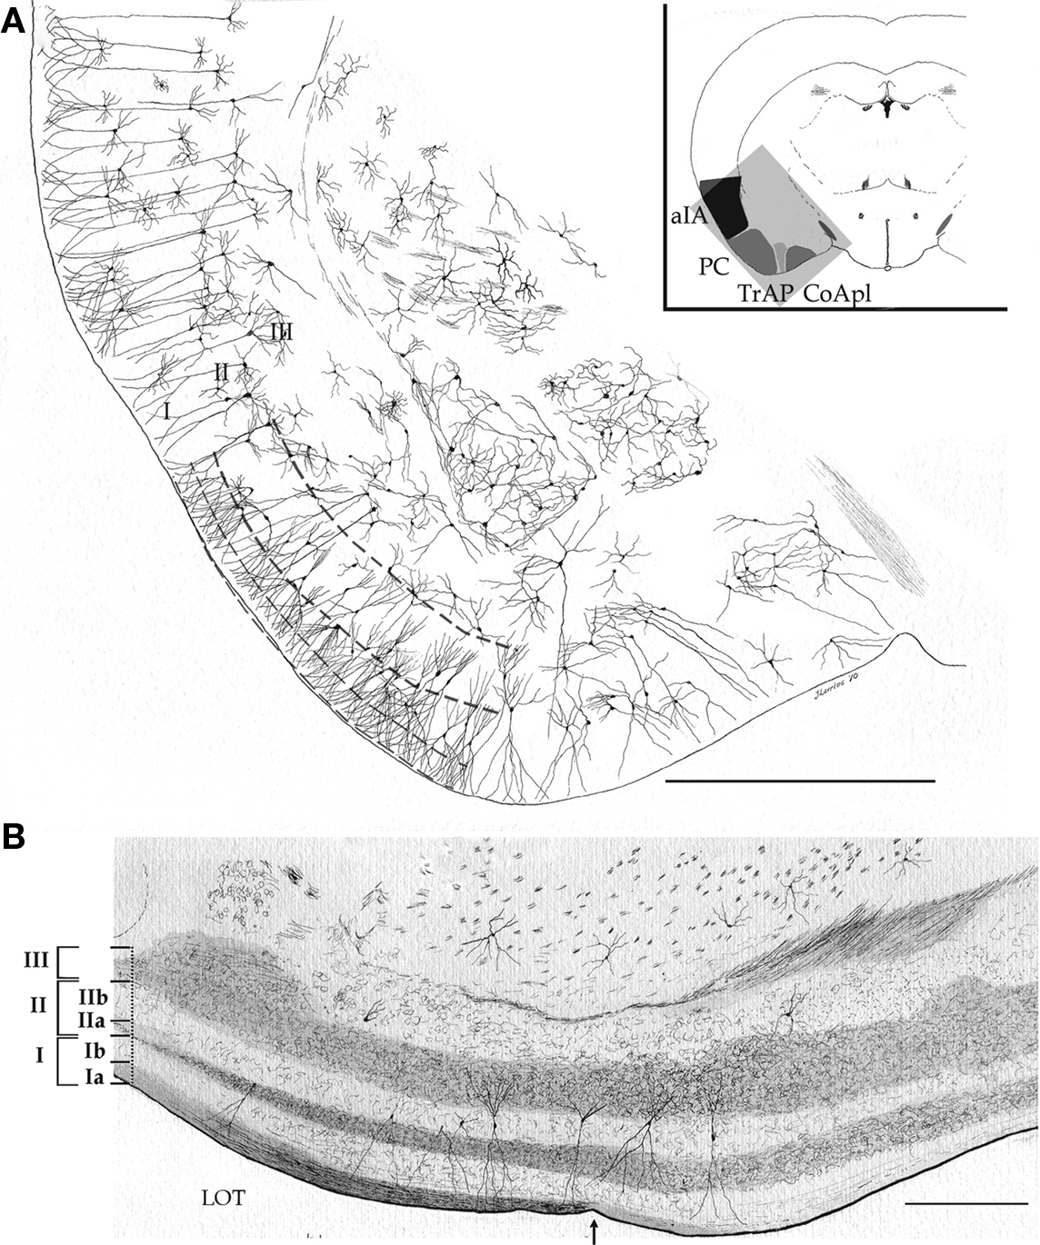
Some cortex (“archicortex” & “paleocortex”) has fewer layers (e.g. piriform, entorhinal, hippocampus)
Mouse piriform cortex (primary site of cortical olfactory inputs)
Larriva-Sahd 2010 Front Neuroanat

Slide 10
2. Feedforward circuits through cortex
We’ll use visual cortical circuits as an example, but remember, the same connectivity patterns apply throughout the cortex

Slide 11
Definitions
FEEDFORWARD:
  connection between an areas with simpler stimulus response properties (simple features, smaller receptive fields etc), to an area with more complex stimulus response properties.
  Provides “driving” activity, generally
  Less complex area → more complex area
  Sensory-organ driven
FEEDBACK:
  more complex area → less complex area
  Provides “modulating” activity, generally
  Cortically-driven

Slide 12
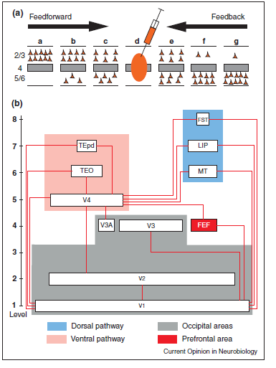
FF & FB implies a cortical hierarchy
“…a hierarchical distance rule, long-distance feedforward (FF) originating uniquely from supragranular layers and progressively more infragranular layers are recruited on approaching the injection site,
likewise long-distance feedback (FB) projections originate uniquely from the infragranular layers and more supragranular layers are recruited nearer the injection site.”
Laminar connectivity patterns can be used to define hierarchy position (important for complex association areas)
Markov & Kennedy, 2013

Slide 13
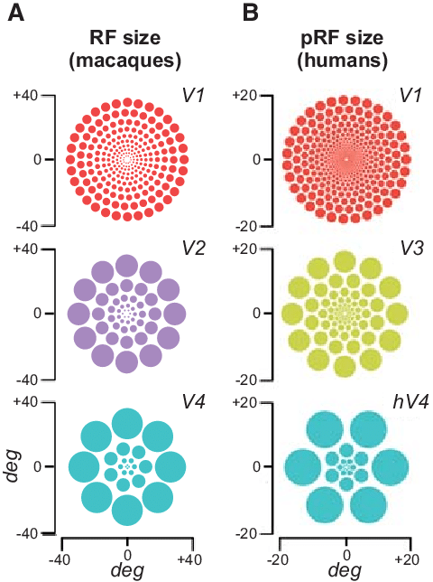
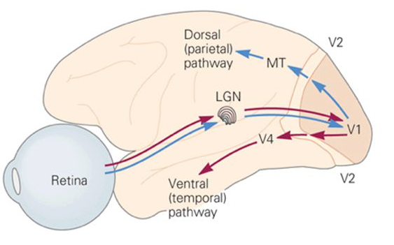
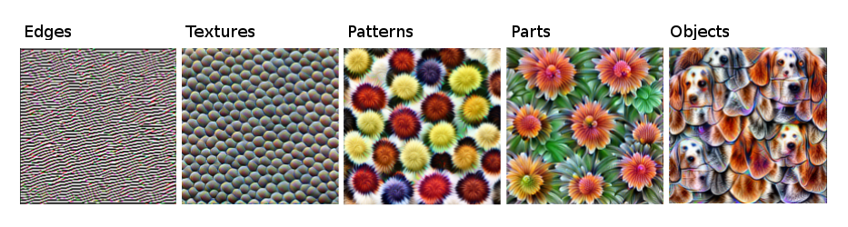
Increasing complexity across visual hierarchy (ventral stream example)
Carrasco, Marisa & Barbot, Antoine. (2015). How Attention Affects Spatial Resolution.
Cold Spring Harbor symposia on quantitative biology. 79. 10.1101/sqb.2014.79.024687.
https://christophm.github.io/interpretable-ml-book/cnn-features.html

Slide 14
Layer 4
Main input layer
•Specialized for each sensory modality in primary sensory cortex (V1, S1, A1 etc)
•Contains L4 intracortical neurons that project within a column
•Creation of new sensory response properties
• L4 has a deep homology across species: it is found in marsupials, and even nonmammalian vertebrates such as birds and turtles.

Slide 15
Thalamic relay nuclei project to cortical layer 4
LGN projects to layer 4 of primary visual cortex (V1).
LGN = lateral geniculate nucleus
Stimulus features are kept along separate pathways

Slide 16
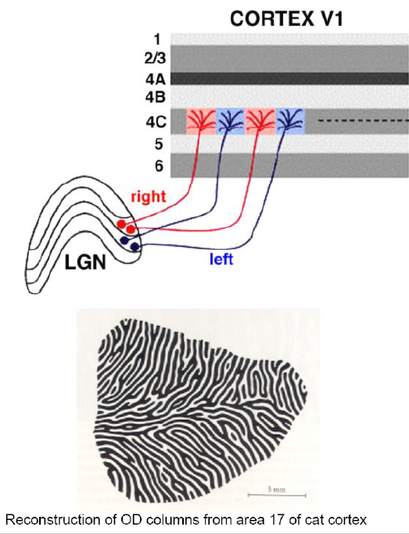
Feature representation is systematically organized
Inputs from separate eyes are kept separate to create ocular dominance “stripes” across V1.
Cells within a column will be driven by the same eye
Cells in adjacent columns will be driven by input from opposite eyes

Slide 17
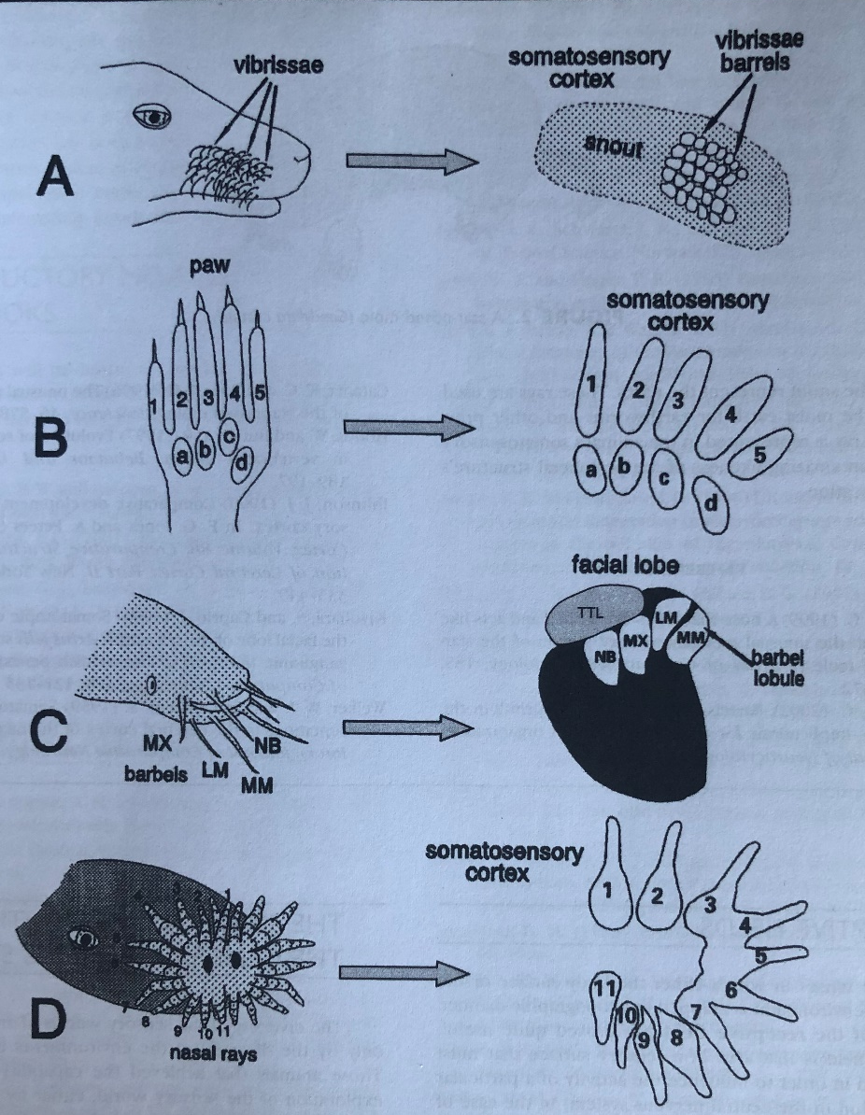
Across species, layer 4 is more specialized in accordance with the reliance on that modality
Rodents rely heavily on their vibrissae and their S1 barrels are strikingly specialized compared to other sensory areas
Primates have layer 4 in visual cortex that is subdivided into different input streams
The star-nosed mole has a map of its nose represented in the layer 4 of S1
Even the catfish has its barbels (gustatory ‘whiskers’) isomorphically mapped across its frontal lobe (though no 6 layered cortex here).
More about mapping next time!

Slide 18
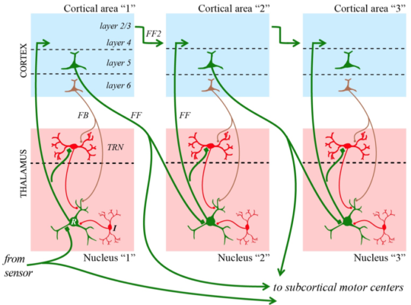
Cortico-cortical feedforward connections arise in layer 2/3 and project to layer 4

Slide 19
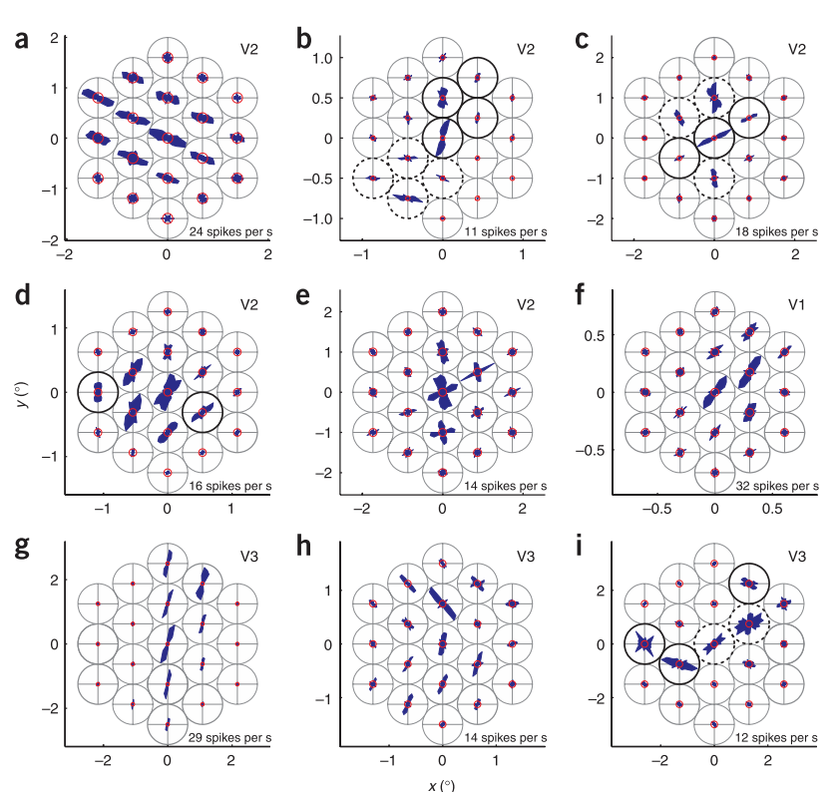
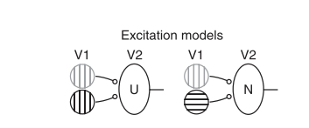
Feedforward functional example: V2 neurons encode combinations of orientations
Anzai et al. Nat Neurosci, 2007

Slide 20
Aside: layer 2/3 is expanded in primates compared to rodents and carnivores
Appears to be due to increased cell proliferation afforded by longer gestation period
Open question of whether the expansion of Layer 2/3 is a key evolutionary feature that differentiates primate cognitive capacities from other animals

Slide 21
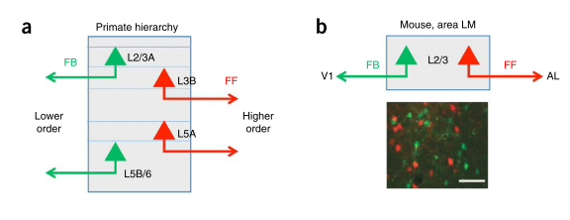
In mouse L2/3, FF & FB cells are intermingled populations, but segregated in primates
Harris & Shepherd, 2015

Slide 22
In mouse L2/3, FF & FB cells are intermingled populations, but segregated in primates
Harris & Shepherd, 2015

Slide 23
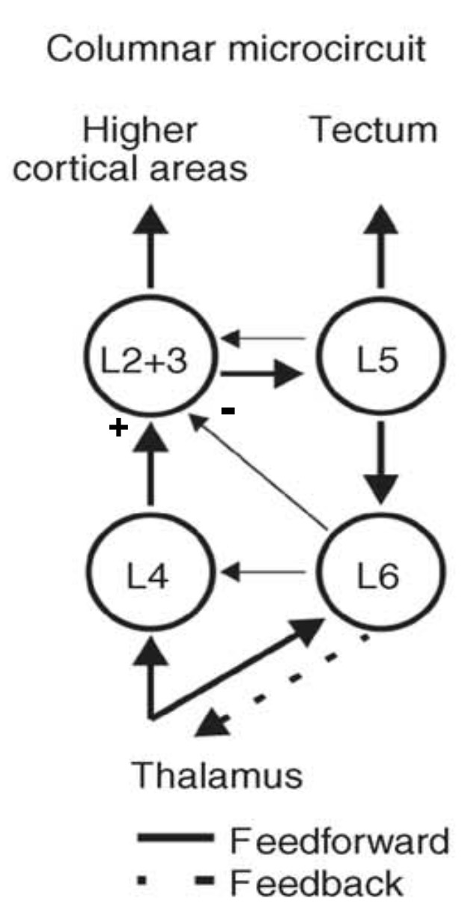
Canonical columnar microcircuit
Martin & Douglas, 2004

Slide 24
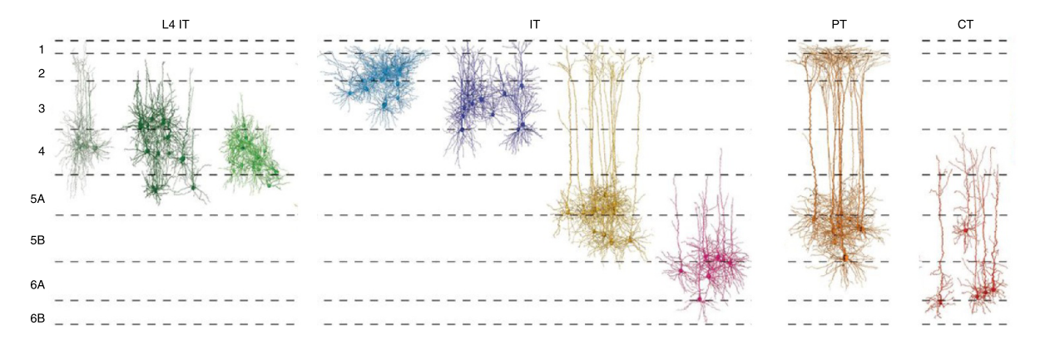
Not all cells in each layer conform to the canonical circuit:
Subcortical
Projecting neurons
(PT = pyramidal tract)
Rat S1
Cortical projecting neurons
(IT = intratelencephalic)
Thalamic
Projecting neurons
(CT = corticothalamic)
Harris & Shepherd, 2015

Slide 25
A second (indirect) feedforward connection (cortico-thalamo-cortical projections) originates from layer 5

Slide 26
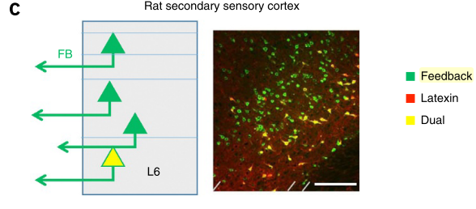
Feedback: projections avoid layer 4 cells
In secondary visual, auditory and somatosensory cortices, a molecularly distinct type of cell (yellow) in deep layers sends feedback projections to corresponding primary sensory cortex, but not higher cortical areas, or to contralateral hemisphere.
Dedicated feedback cells!

Slide 27
In primates, all visual cortical areas send feedback to V1, but not all receive direct input from V1
Feedback projections from extrastriate visual areas originate from layer 6 cells in those areas (Perkel et al, J Comp Neurol, 1986)
Essentially the same pattern as in rat S2 to S1 (previous slide)!
So what does feedback do?

Slide 28
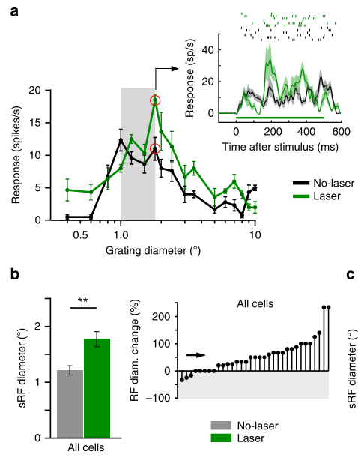
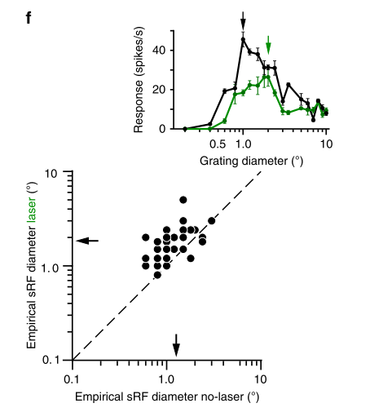

Feedback functional example: suppressing FB from V2 increases the RF size of V1 neurons
Nurminen et al. Nat Comms, 2018

Slide 29

Voluntary attention, deployed by forebrain areas, operates via feedback!
Find all the
  Red objects
  Boats
  Stripes
  Waldo!

Slide 30
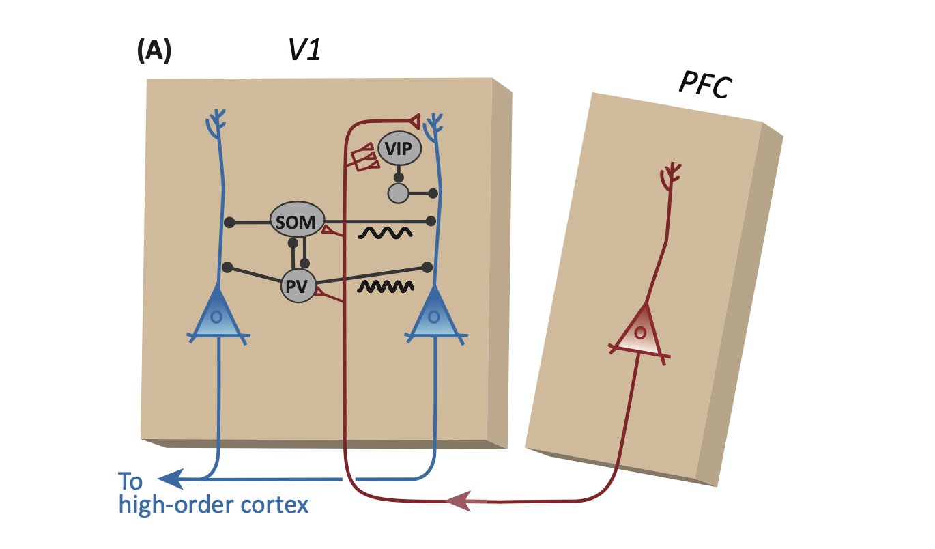
PFC feedback acts to enhance relevant sensory signals, and quench irrelevant ones
Knudsen, Trends in Neurosciences, 2018

Slide 31
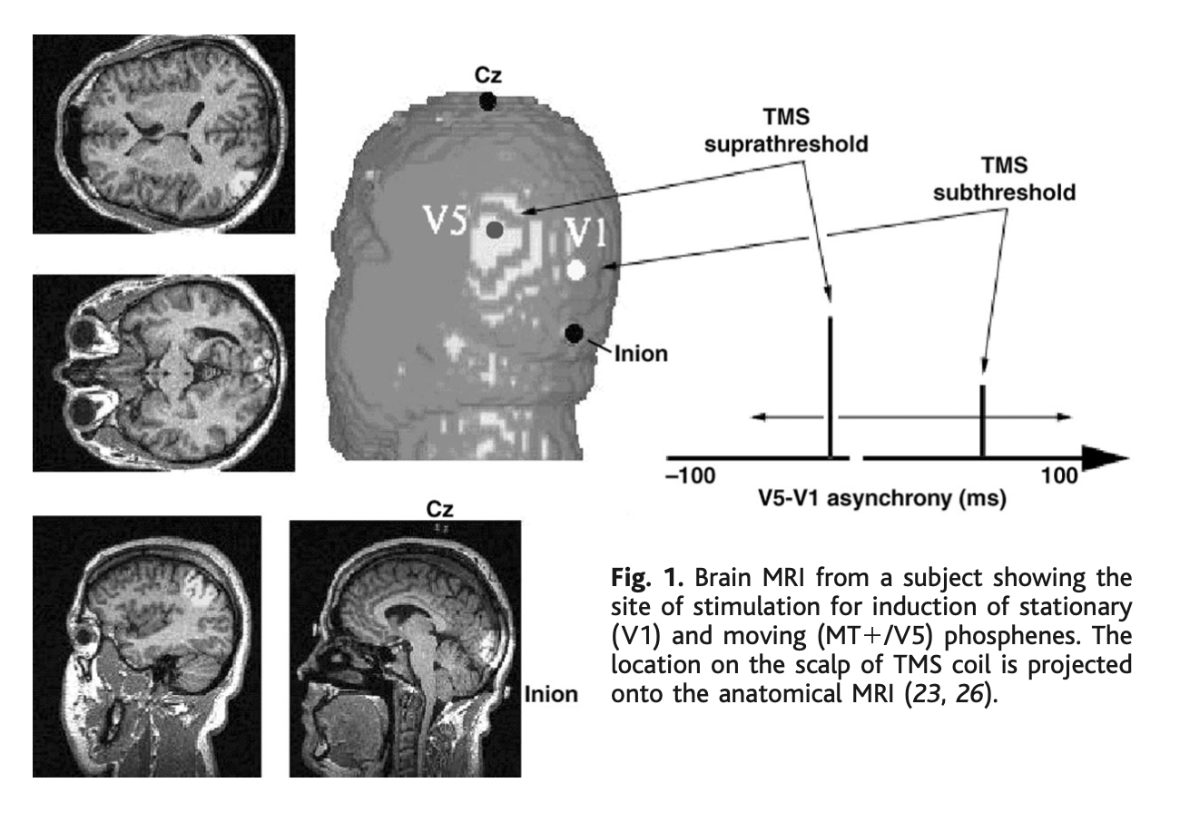
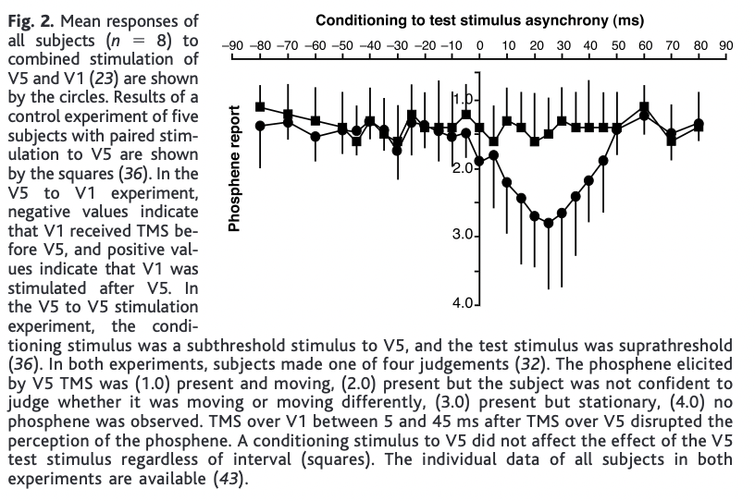
Some evidence that sensory awareness/ conscious perception requires feedback
Pascual-Leone & Walsh, Science 2001

Slide 32
Questions:
1) let’s draw the reciprocal connections between 2 cortical areas with 6 layers
2) which comes first, feedforward or feedback?
3) how can you measure this?

Slide 33
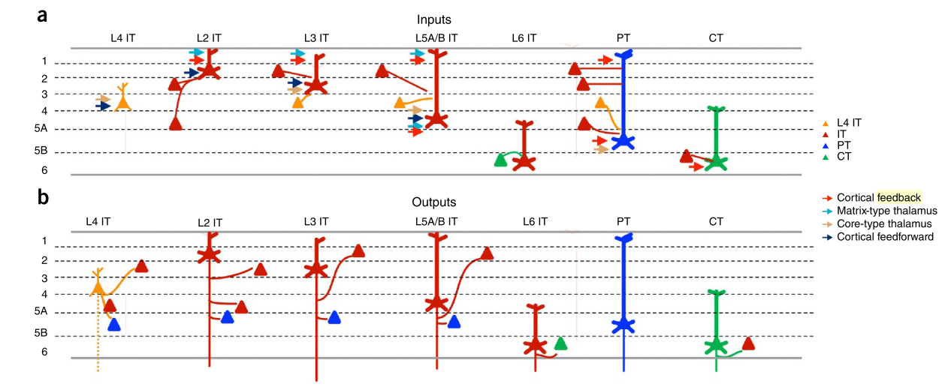
Summary of FF & FB between excitatory cells
Harris & Shepherd, 2015

Slide 34
Summary
Cortical cells are more likely to be connected to other cells vertically, rather than horizontally (hence column).
Layer 4 is the input layer to any cortical column
Layer 4 is specialized in sensory cortex
Layers 2/3 and 5/6 send/receive projections to/from other cortical areas
Relative hierarchy positions of two cortical areas can be determined based on their laminar connections
Layers 5/6 also send projections to subcortical targets
Cortical areas can also be connected via subcortical structures

Slide 35
Questions?

