Slide 1

Introduction to Circadian Biology
- The Mammalian Circadian System
Lecture 1/2
Christophe P. Ribelayga – April 2021

Slide 2
Objectives:
Become familiar with the concept of circadian biology (lecture 1)
Acquire a basic understanding of how sleep works and of its circadian
component (lecture 2)
Questions?: Christophe.p.Ribelayga@uth.tmc.edu

Slide 3
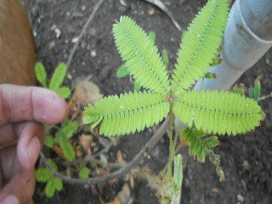
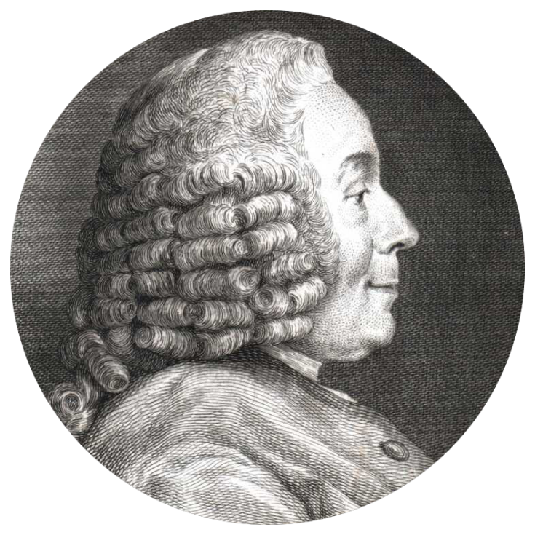
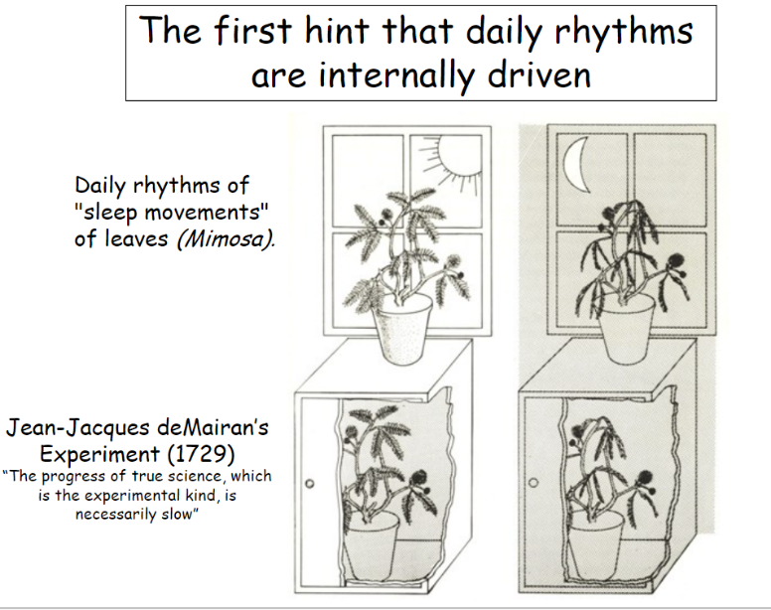
Mimosa pudica
Jean-Jacques d’Ortous de Mairan
(1678-1771)
Augustin de Candolle (1778-1841)
observed in 1832 that endogenous
period was 22-23h (<<24h)

Slide 4
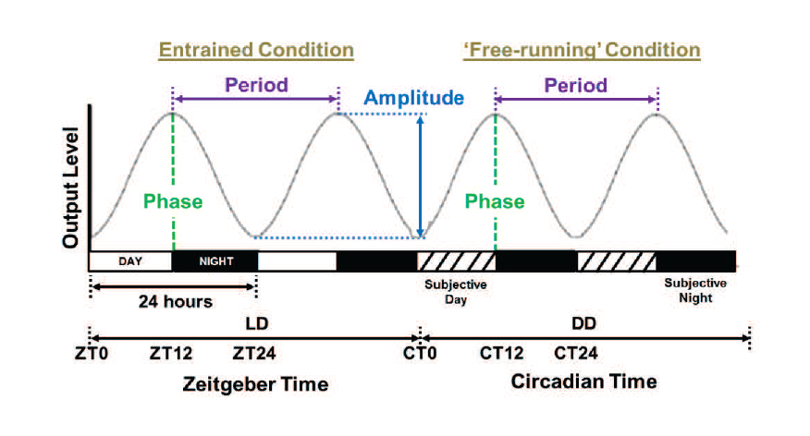
Circadian from “Circa diem”, about a day
(τ)
(ϕ)
(≠ ZT)
(= astronomical time
or time at your watch)
Key features of circadian rhythms: a) they remain/persist despite lack of environmental cues indicating the time of day; b) τ ≠ 24 h

Slide 5



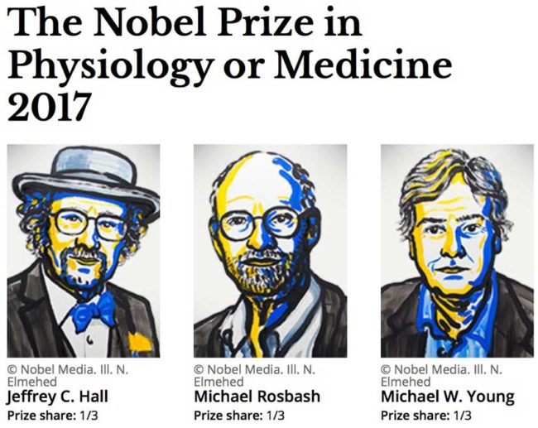
1st clock mutant
(Per) identified
(Drosophila)
“Chronobiology”
DOB 1832
1725-1850
1920s
1960s
1971
other models
developed
(bacteria, plants, fungi…)
1st clock gene
cloned
(Drosophila period)
mammalian clock
in the SCN*
Mammalian clock
transplant SCN
1972
1970s-1980s
1984
1980s
1st clock mutants
identified in mammals
(Tau, Clock**, etc…)
proposed mechanism
for the clock
link clock
and diseases,
cancer, etc…
1980s-1990s
1990-
2000-
SCN*: suprachiasmatic nucleus of the hypothalamus
Clock**: Circadian Locomotor Output Cycles Kaput (clock ≠ clock!!!)

Slide 6
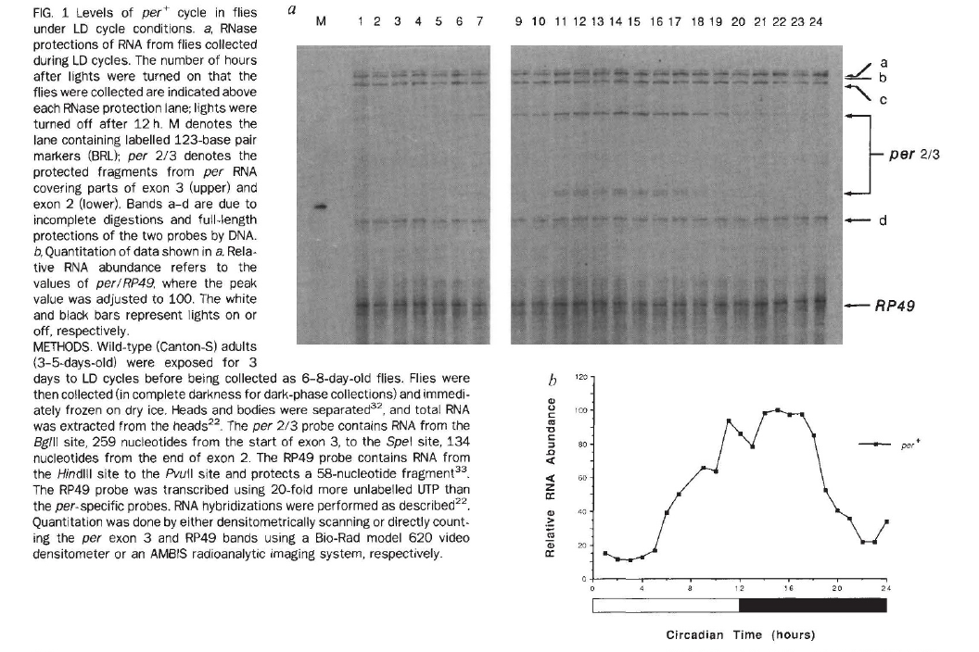
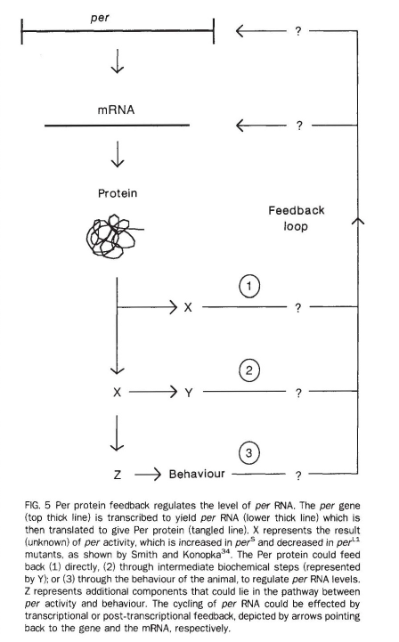
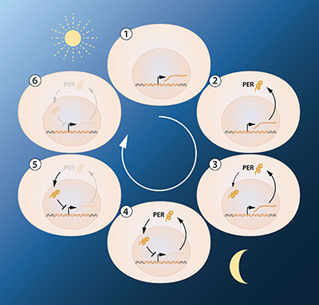
Nobel Prize announcement
Hardin, Hall, and Rosbash (1990) Nature

Slide 7
Proposed clock mechanism: the “transcriptional/translational feedback loop”
Nobel Prize announcement

Slide 8
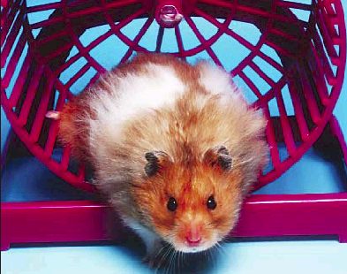
Circadian component of the
locomotor activity of the
rodent
Locomotor activity
(wheel turns/15 min)
Day
Night
Light/Dark
cycle
Subjective day
Subjective night
Constant dark
[circadian
cycle]
Lesion of the suprachiasmatic
nucleus of the hypothalamus
(SCN)
Stephan & Zucker, PNAS 1972

Slide 9
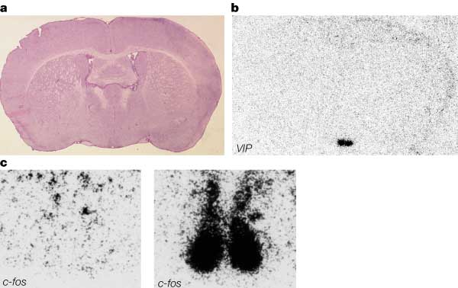
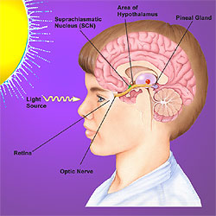
1972
The clock is in the suprachiasmatic nucleus of the hypothalamus (SCN)
Lesioning the SCN abolishes normal rhythms
- Moore, R.Y and Eichler, V.B. (1972) Loss of a circadian adrenal cortisone rhythm following suprachiasmatic lesions in rat. Brain Res. 42:201-206.
- Stephan, F.K. and Zucker, I. (1972) Circadian rhythms in drinking behavior and locomotor activity of rats are eliminated by hypothalamic lesions. Proc. Natl. Acad. Sci. USA 69:1583-1586.
- Moore, R.Y. and Klein, D.C. (1974) Visual pathways and the central neural control of a circadian rhythm in pineal serotonin N-acetyltransferase activity. Brain Res. 71:17-33.

Slide 10
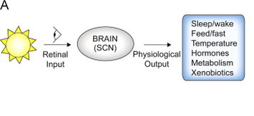
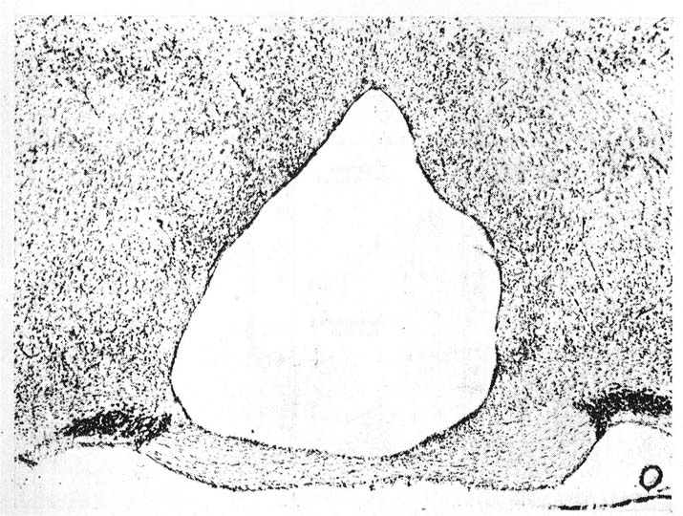
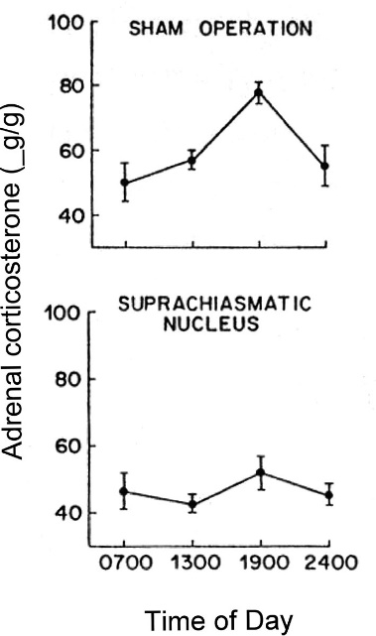
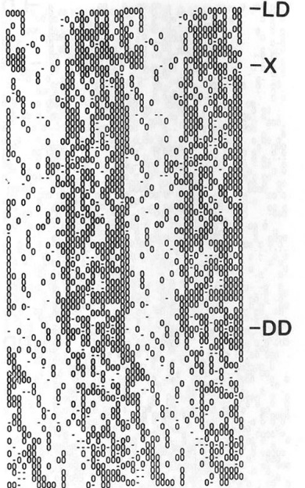
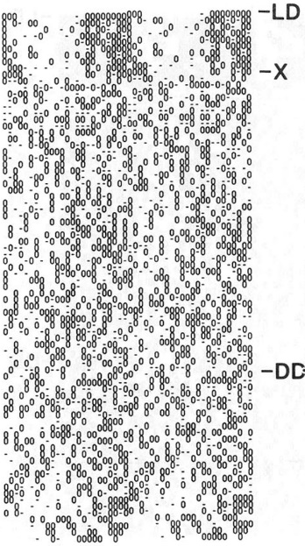
SCN anatomy
One and only site in brain to receive light
information: termination site of the
retinohypothalamic tract (RHT)
Lesion studies: behavioral, endocrine, and seasonal rhythms were compromised when the SCN was damaged
Locomotor Activity
Sham
SCN-X
SCN Lesion
Moore, 1972
Stephan and Zucker, 1972; Kittrell, 1988

Slide 11
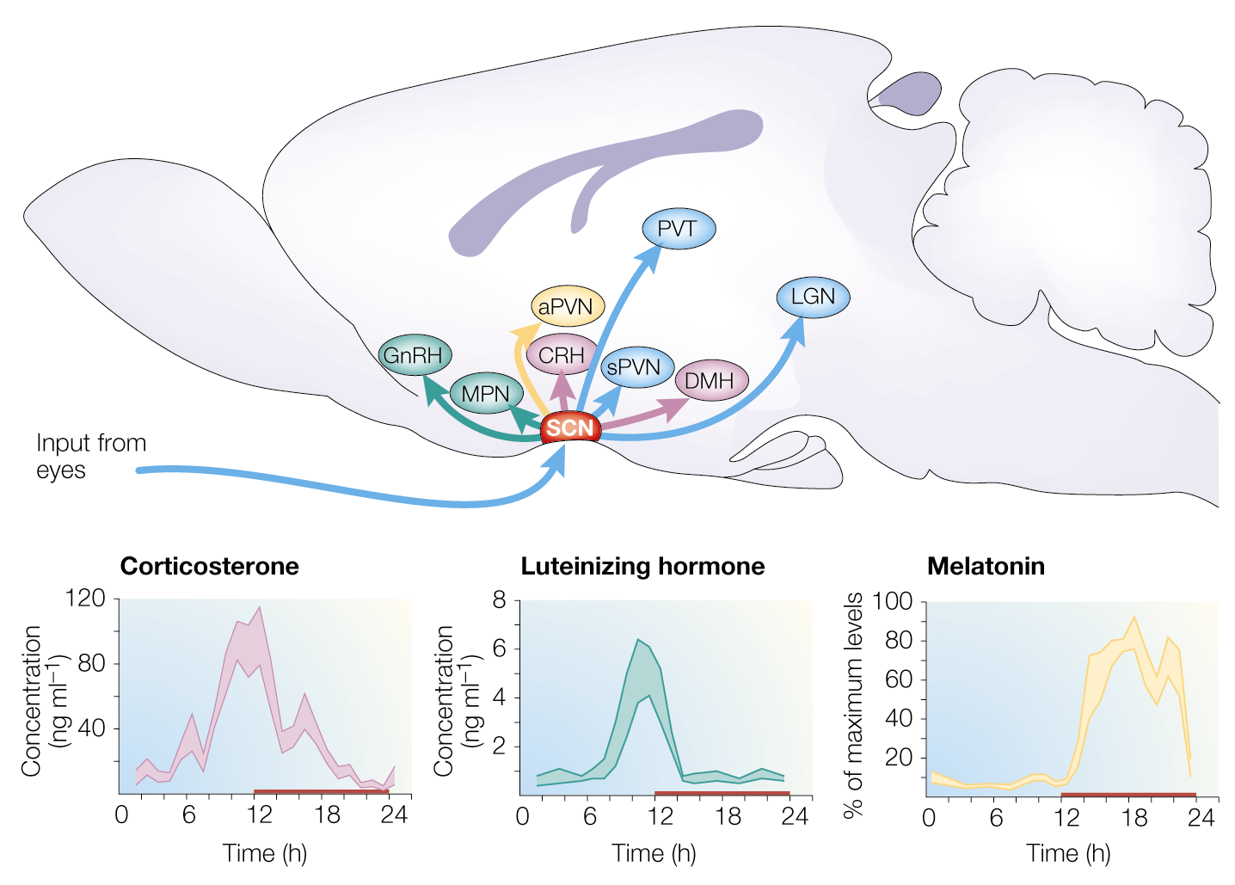
Former view of the circadian system…
(Central role of the SCN)
retino-hypothalamic tract

Slide 12
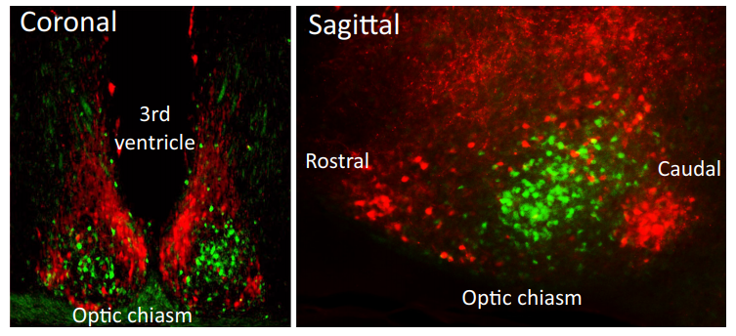
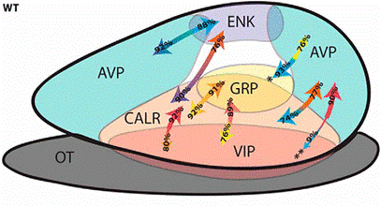
SCN: 10,000 neurons…. may contain more than 100 peptides!
AVP
VIP
AVP
VIP

Slide 13
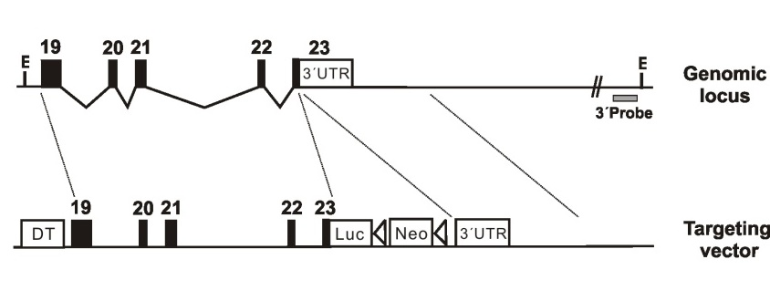
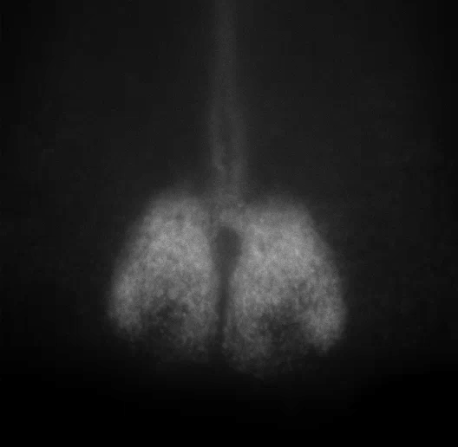
Monitoring the molecular rhythm
Luc
Bioluminescence recording
from PER2::LUC SCN slice
PER2 WB
0 4 8 12 16 20 24 hr
Yoo et al. PNAS 2004

Slide 14
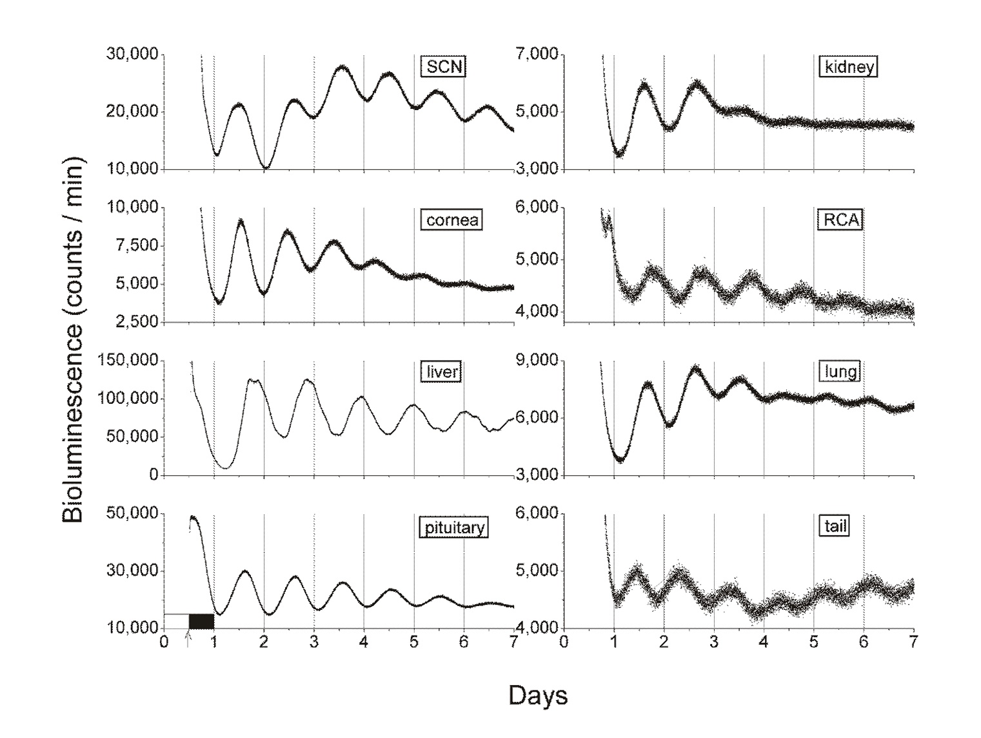
Real-time bioluminescence recordings from
PER2::LUC mouse tissue explants

Slide 15

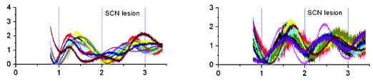
The master clock functions not to generate peripheral rhythms,
but to synchronize and coordinate!
0
DD Control
Pituitary
Lung
Relative Unit of
Bioluminescence
SCN Lesion
Phase asynchrony among animals
Relative Unit of
Bioluminescence
Days
Days
Phase asynchrony among animals

Slide 16
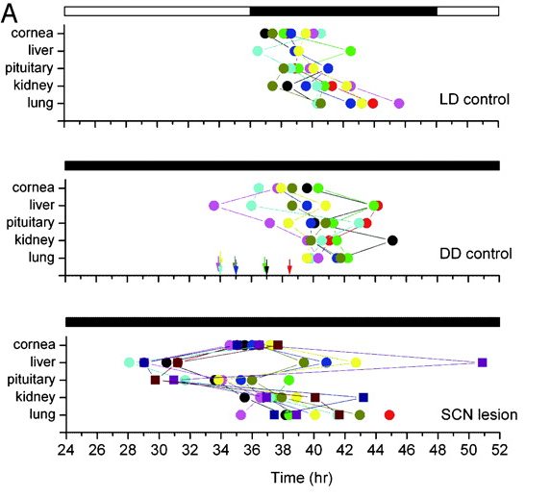
SCN lesion disrupts phase coordination
among peripheral tissues
0
Internal phase desynchronization
within an animal

Slide 17
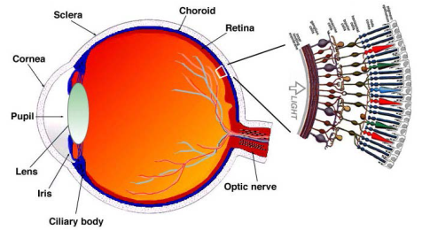
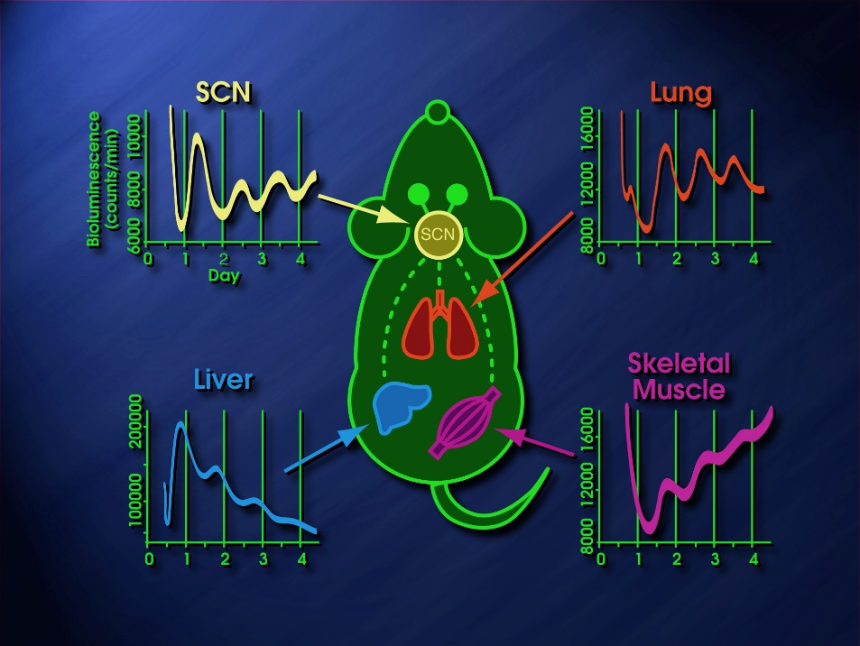
Mammalian clock system (SCN = master synchronizer!)
SCN
Input
Multi Oscillator Network
Sleep-wake
Locomotion
Feeding
Temperature
Metabolism
Physiology
output

Slide 18
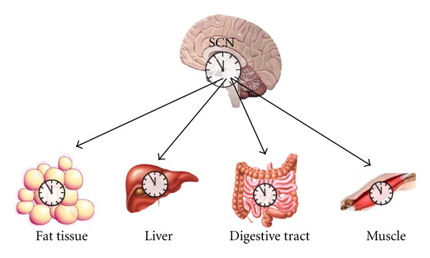
Mammalian clock system (SCN = master synchronizer!)
Autonomic innervation
Body temperature
Sleep
Oscillating blood-borne signals
Feeding-related cues

Slide 19
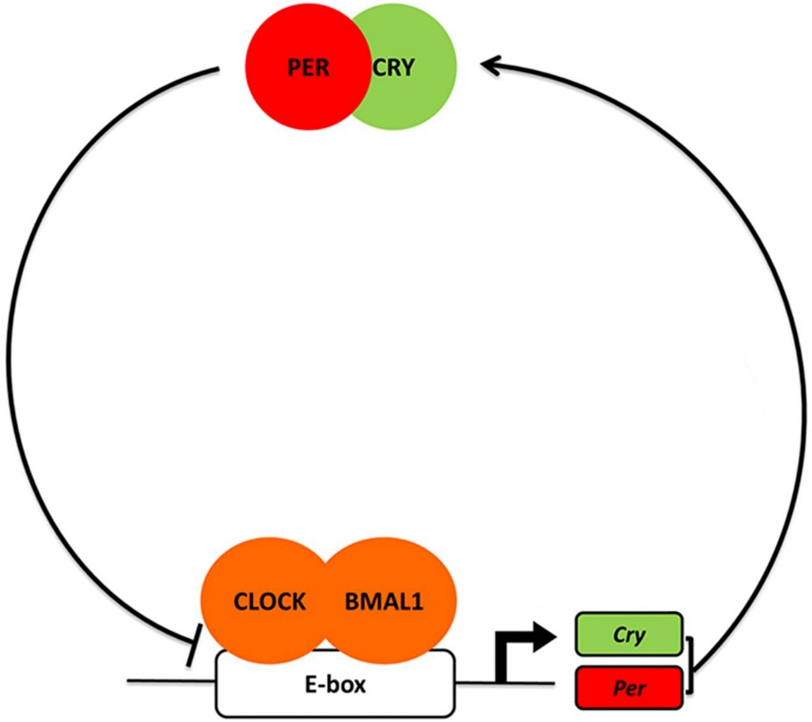
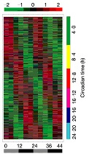
The transcriptome is the primary output of the molecular circadian clockwork
clock controlled
processes/behavior
transcriptome
(enzymes, channels,
synaptic proteins, electrical activity,
behavior, etc…)
transcriptional/translational
feedback loop
E-box
clock controlled genes

Slide 20
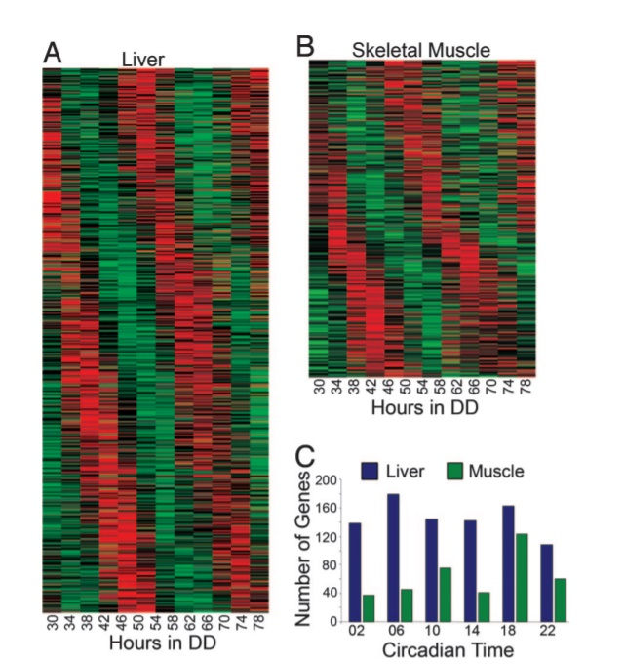
The circadian clock control of the transcriptome/output is tissue-dependent
clock controlled
processes/behavior
transcriptome
clock controlled
processes/behavior
CYP450, Acot, Hmgcs1, Lipin, Thrsp, Scd, …
Myod1, Ucp3, Atrogin1 (Fbxo32), and Myh1 (myosin heavy chain IIX)…
Miller et al. (2006) PNAS

Slide 21
Molecular oscillator & Pharmacological targeting
AMPK activators:
AICAR, Metformin
E-box
Per/Cry
AMPK
CKI inhibitors:
IC261, CKI-7, Longdaysin, PF-670642, PF-48000567, Compund1-3
SIRT1 activator:
Resveratrol, SRT compounds
FBXL3
~24 hr cycle
FBXL21
CRY1/2
CK1
βTRCP
PER1/2
SIRT1
CLOCK
Dbp
E-box
BMAL1
E-box/D-box/RORE
Clock controlled genes
DBP
E4bp4
RORE
Bmal1
RORE
FBXW7
RORs
E4BP4
D-box/E-box
Rors/Rev-erbs
REV-ERBs
ROR ligands:
SR1078, SR1001, nobiletin, neoruscognenin, Digoxin, Ursolic acid,SR3335
REV-ERB ligands:
GSK4112, GSK2945, SR9009/9011, SR8278, ARN5187
Annu Rev Pharmacol Toxicol 2018

Slide 22
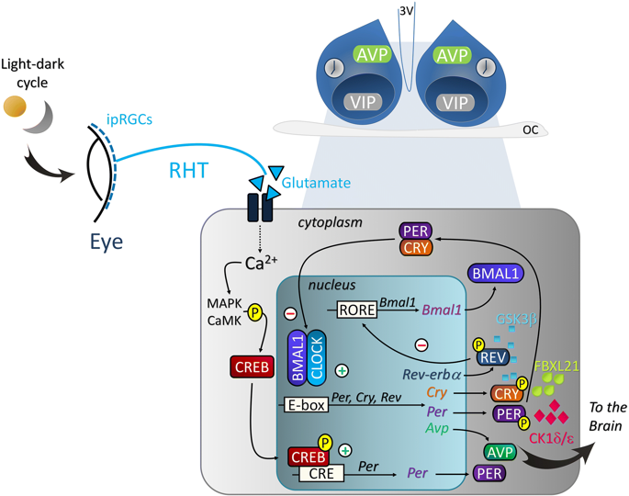
Light entrainment pathway in mammals involves induction of clock gene expression in SCN
Light pulses - entrainment & masking
Per
Per
delay
Per
advance
light - retinal ganglion cells – RHT – glutamate/PACAP – increase in Ca2+/CREB activity – increase in clock gene exp.

Slide 23
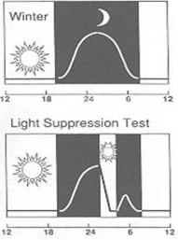
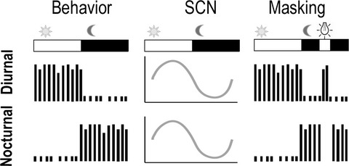
Light has 2 major effects on circadian rhythms: entrainment and masking
Masking = override of the clock effects (masking can be positive or negative)
Light pulses - masking
Melatonin suppression
Locomotor activity
+
-

Slide 24
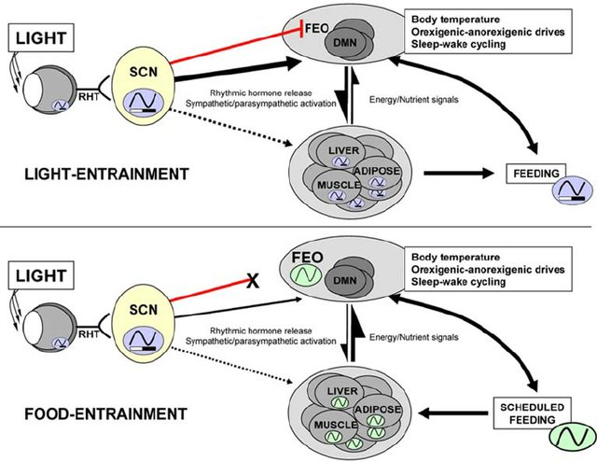
Entrainment of circadian clocks by light and feeding

Slide 25
Circadian clocks are essential for the regulation of fundamental biological processes
Mop3 (BMAL1)
Kondratov et al., Genes Dev 1998
Bunger et al., Genesis 2005

Slide 26
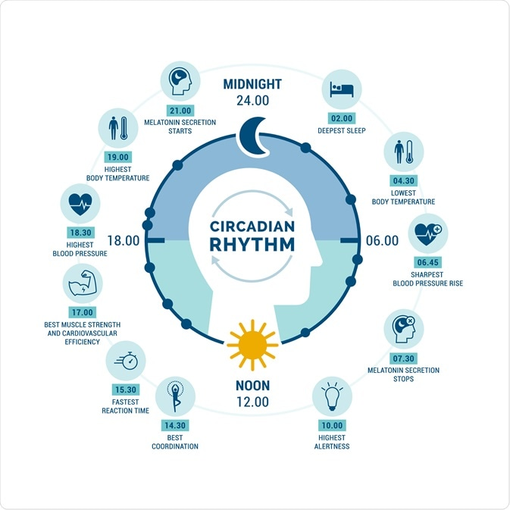
Circadian rhythms in humans

Slide 27

Consequences of the clock function alterations
Jet lag (= phase shift)
https://www.jetlagrooster.com/

Slide 28


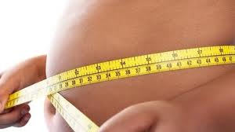

Consequences of the clock breaking down
Sleep disorders (FASPS, etc.)
Depression
Obesity/metabolic disorders
Aging
Cancer
Notes:
In humans (confirmed with rodent studies)
Transition: how are organisms “entrained”

Slide 29

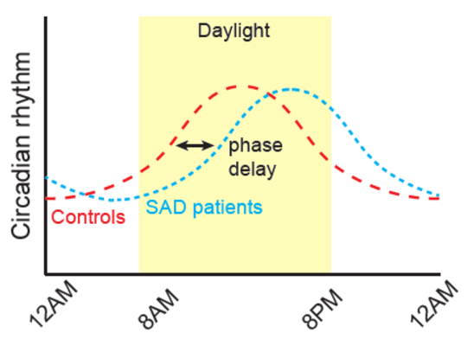
Light entrainment of the clock and seasonal affective disorder
Seasonal affective disorder (SAD) (a.k.a. Winter depression) is a mood disorder subset in which people who have normal mental health throughout most of the year exhibit depressive symptoms at the same time each year, most commonly in winter. Common symptoms include sleeping too much, having little to no energy, and overeating.

Slide 30
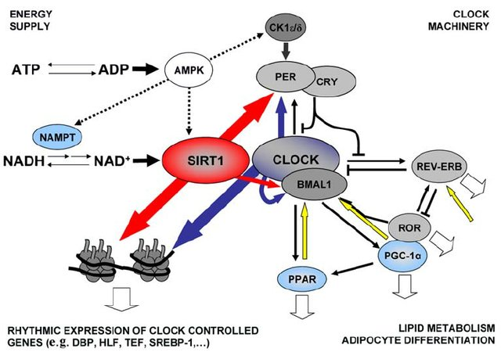
Molecular interactions of the clock and metabolic regulators

Slide 31
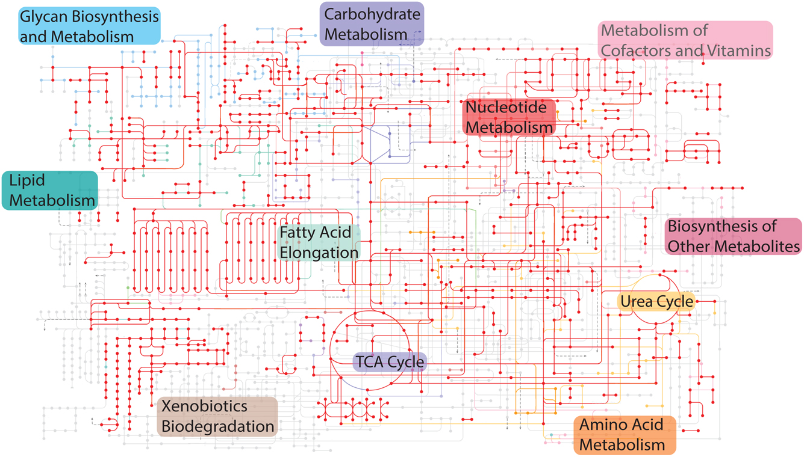
BMAL1 regulation of metabolism.
Overlay of BMAL1 target genes (indicated in red) on diverse metabolic pathways in the liver. BMAL1 occupancy data are from a previously published ChIP-seq dataset (Koike et al. 2012). The original metabolic pathway is from a KEGG analysis (used with permission) and has been simplified to show major nodes (Kanehisa & Goto 2000, 2017). In KEGG, nodes indicate enzymes and lines indicate connections in metabolic pathways, with colors indicating pathways serving similar functions. The red dots and lines indicate BMAL1 interactions with genes involved in these pathways.

Slide 32
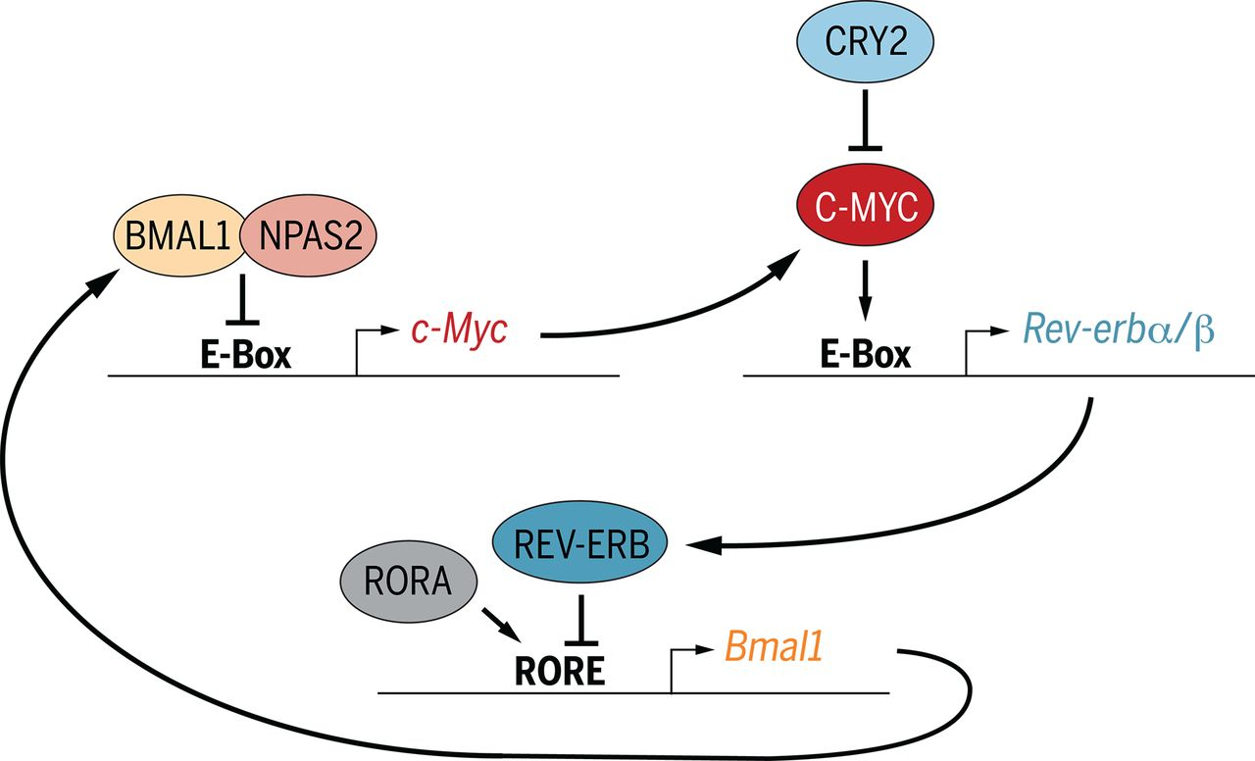
Molecular interactions of the clock and cancer regulators (example with c-Myc)

Slide 33
Take home message
Circadian rhythms, as characterized by endogenous periods of nearly 24 h, are an inherent property of living beings.
The circadian clock mechanism is made of a set of genes (clock genes) and their protein products (clock proteins). It is present within single cells (almost every single cell in the body contains a clock.)
The major output of the cellular clock is transcriptional (tissue dependent).
The circadian system represents a complex multioscillatory temporal network in which an ensemble of coupled neurons comprising the principal circadian clock in the suprachiasmatic nucleus of the hypothalamus is entrained to the daily light/dark cycle and subsequently transmits synchronizing signals to local circadian clocks in peripheral tissues.
The circadian system regulates fundamental biological processes such as the cell cycle and metabolism.
Disrupted or abnormal circadian function has been associated with disorders of sleep, mood, behavior, metabolic diseases, and cancer.

Slide 34
Readings:
(mandatory)
1971 Konopka and Benzer
2019 Rijo-Ferreira and Takahashi
(optional)
1990 Hardin et al.
2004 Yoo et al.
2016 Book A Time For Metabolism And Hormones

