Slide 1
Introduction to Sleep Biology
Lecture 2/2
Christophe P. Ribelayga – April 2021

Slide 2
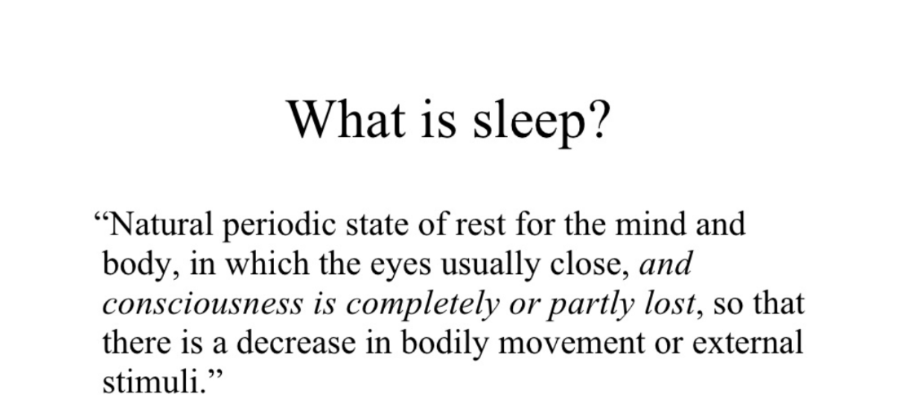
Sleep as a passive, dormant part of our daily lives...

Slide 3
Why do we sleep?
Inactivity theory (a means of staying safe!)
Energy conservation theory (so that animals don’t have to be constantly searching for food, decrease in temperature, decrease in muscle activity)
Restorative theory (clean the body/brain of toxins, proteins are rebuilt, etc…)
Brain plasticity theory (required for healthy brains, consolidate/preserve memories)
Personality theory (to preserve an individual's psychological heredity, the basis of personality)
Etc…

Slide 4
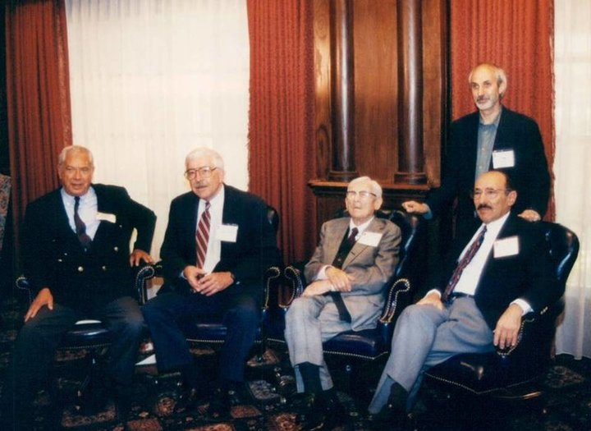
The pioneers…
Jouvet, Dement, Kleitman, Aserinsky and Rechtschaffen (standing) in 1995.

Slide 5
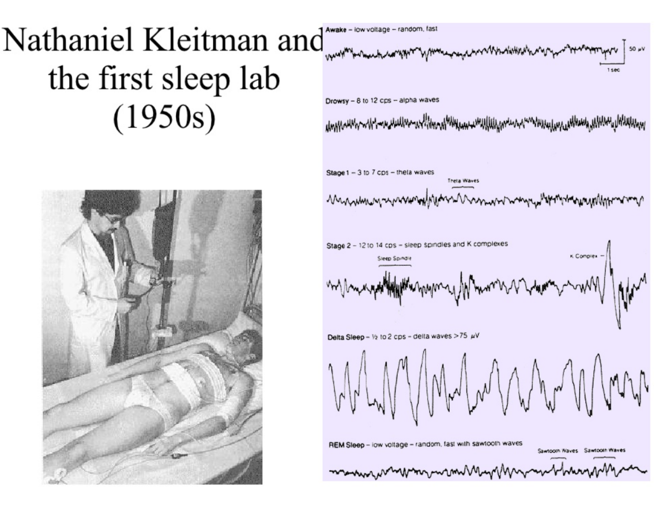

Slide 7
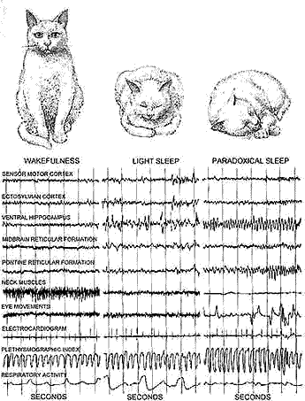
Michel Jouvet and the “paradoxical” sleep (1950- )
The paradox is that even though the brain is quite active during REM sleep, consuming large amounts of energy, the body remains completely inactive.

Slide 9
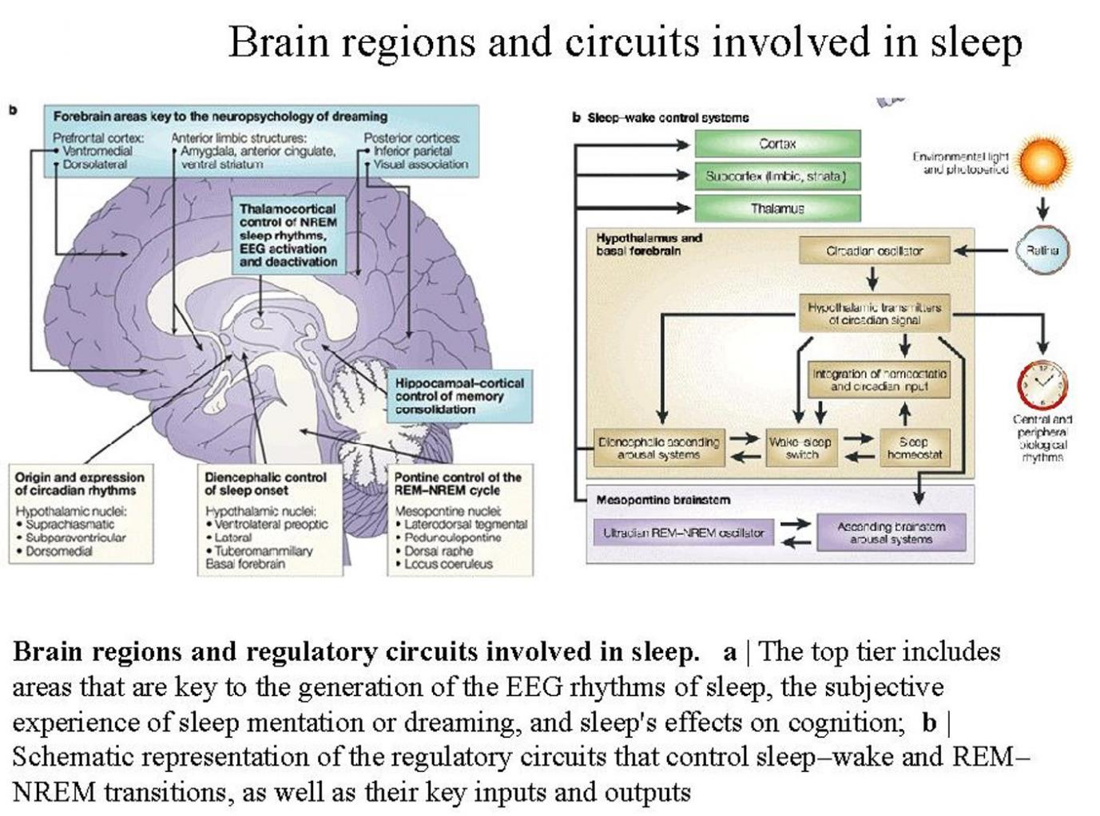

Slide 10
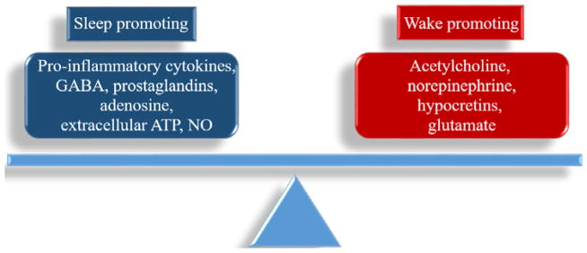
Sleep and wakefulness are determined by a balance of sleep-promoting and wake-promoting substances.

Slide 11
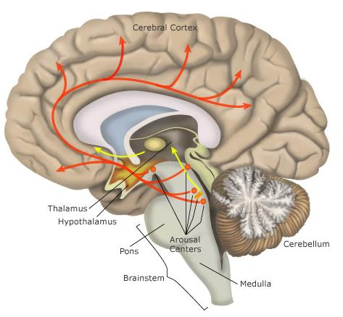
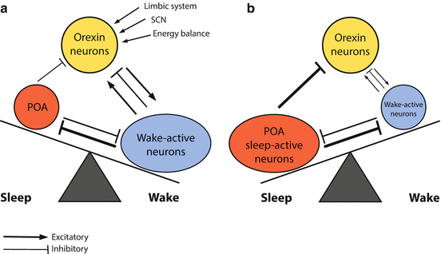
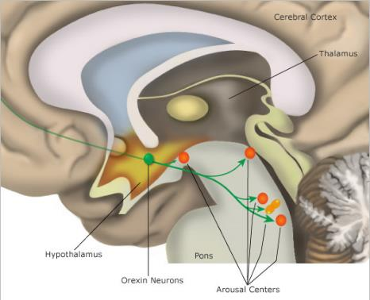
A "Flip-Flop Switch" Between Sleep and Wakefulness
Orexin
neurons
VLPO
Wake-active neurons
Wake-active neurons in the brainstem
(a.k.a. The ascending reticular activating system (ARAS))
Locus Coeruleus: norepinephrine
Tubero Mammillary Nucleus: histamine
Dorsal Raphe Nucleus: serotonin
Pedunculopontine and Laterodorsal Tegmental nuclei
(PPN/LDT): Acetyl choline
Orexin (hypocretin) neurons in lateral hypothalamus

Slide 12
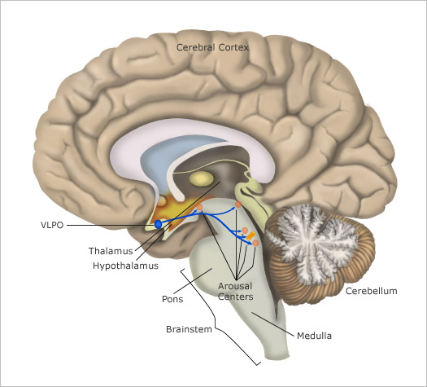
A "Flip-Flop Switch" Between Sleep and Wakefulness
Orexin
neurons
Wake-active neurons
VLPO
sleep-active neurons
VLPO: ventrolateral preoptic nucleus (GABAergic)

Slide 13
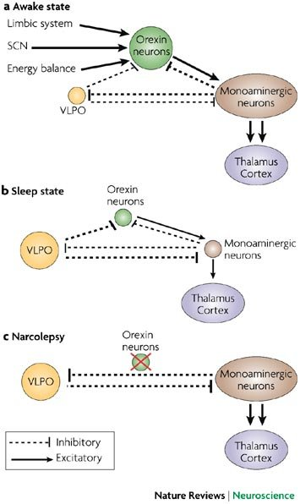
The central role of orexins in the
"Flip-Flop Switch"
between Sleep and Wakefulness

Slide 14
The central role of orexins in the
"Flip-Flop Switch"
between Sleep and Wakefulness

Slide 15
A "Flip-Flop Switch" Between REM and non-REM sleep
VLPO
sleep-active neurons
REM-OFF
REM-ON
Orexin
neurons
vlPAG
SLD
GLU
GABA
ventrolateral periaqueductal gray (vlPAG)
sublaterodorsal nucleus (SLD)
Brain regions that control
components of REM sleep
ACh neurons in
pons, forebrain
(cortical arousal,
tectum-REMs)
inhibitory neurons
motor neurons
(muscle atonia)

Slide 16
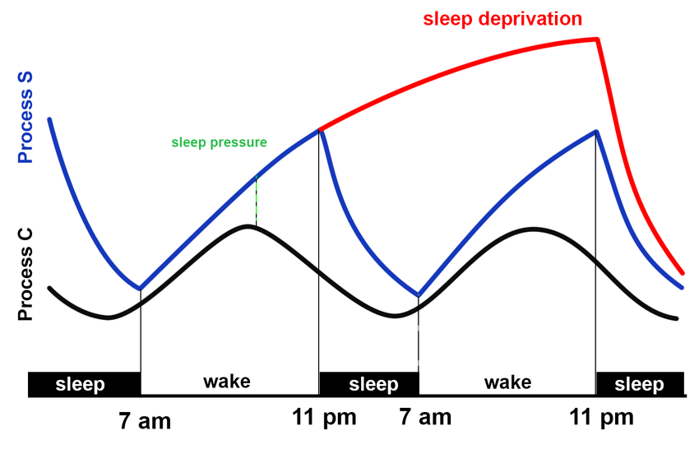
Two-process model of sleep regulation. Process S indicates the homeostatic built-up of sleep pressure and Process C represents the circadian rhythm. The difference between the two processes quantify the sleep pressure.

Slide 17
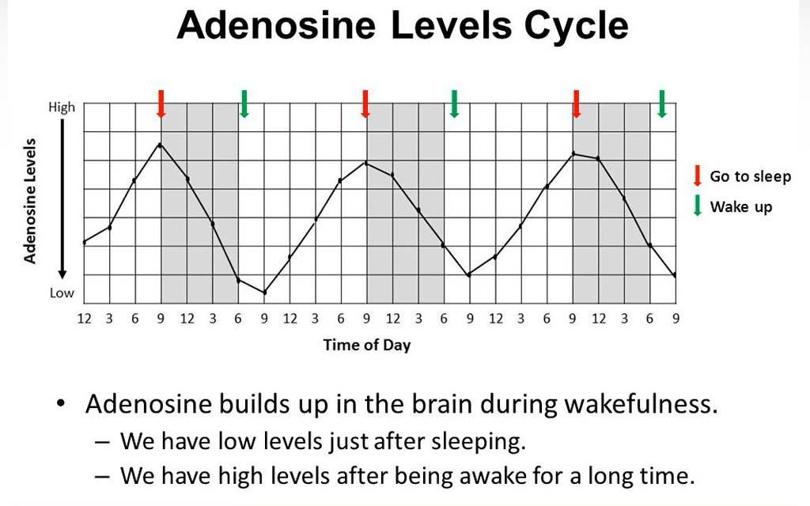
Role of adenosine in the process S

Slide 18
Role of adenosine in the process S

Slide 19
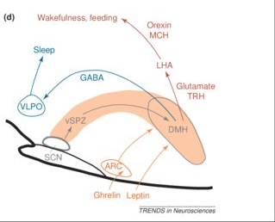
Circadian control of sleep
SCN clock stimulates LH/orexin neurons
SCN clock inhibits VLPO neurons
(Local) clocks control neuromodulators, etc…
(e.g. extracellular adenosine!)
activity of SCN neurons
peaks in the day

Slide 20
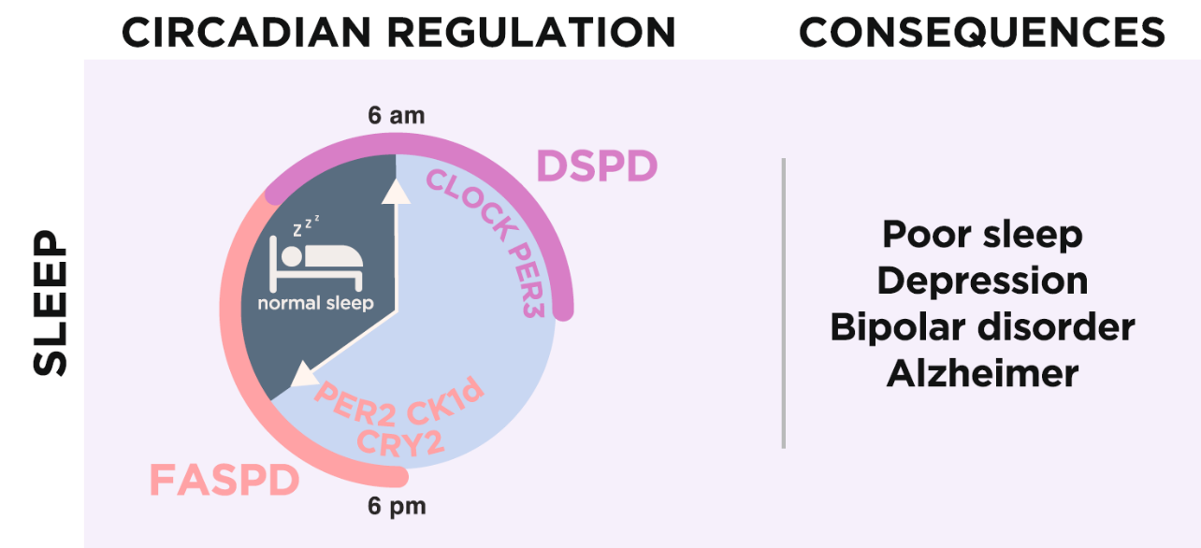
Human circadian sleep disorders
Familial advanced sleep phase disorder (FASPD)
Delayed sleep phase disorder (DSPD)
Rijo-Ferreira and Takahashi (2019) Genome Medicine

Slide 21
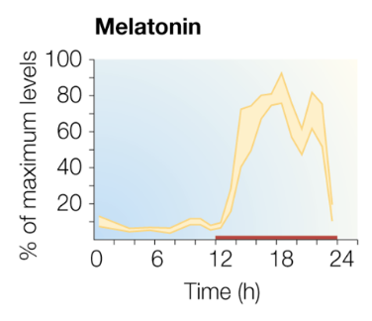
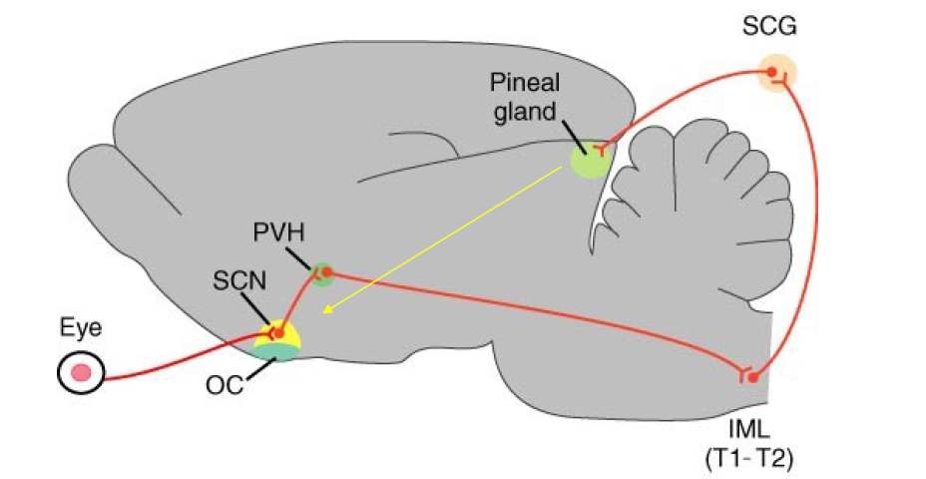
Melatonin (nighttime effector of the SCN clock)

Slide 22
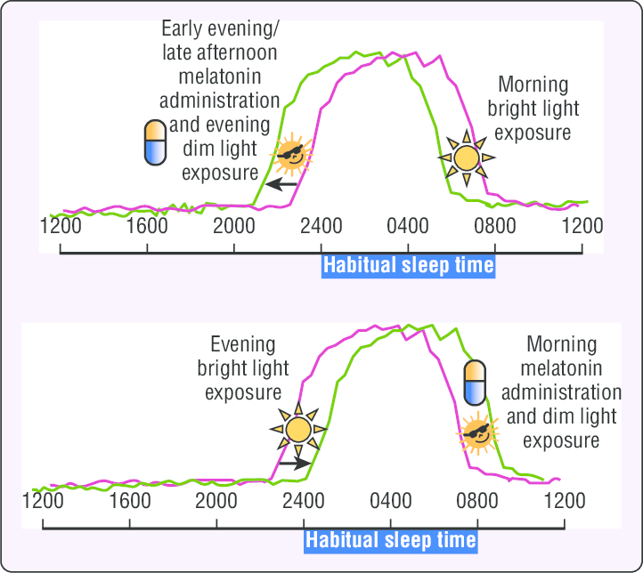
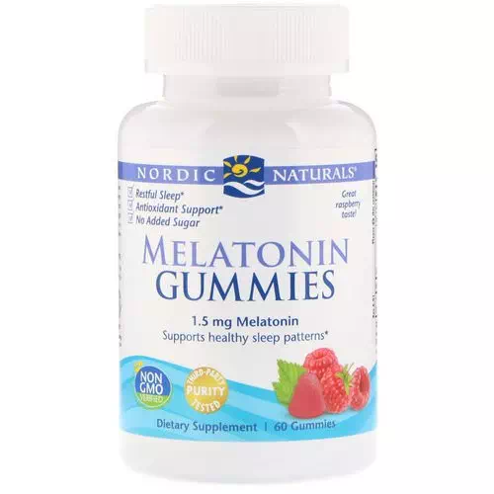
Chronotherapy
Entrainment by melatonin

Slide 23
Melatonin agonists currently on the market for use to treat sleep/circadian disorders:
Long-lasting melatonin
Under development

Slide 24
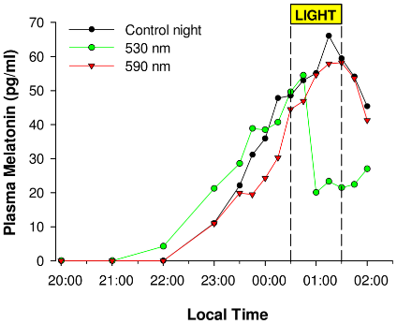
Light at night
Light suppresses melatonin
(and sleep, and induces phase shifts, melatonin
suppression, etc…)

Slide 25
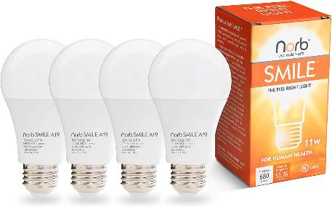
Chronotherapy - phototherapy

Slide 26
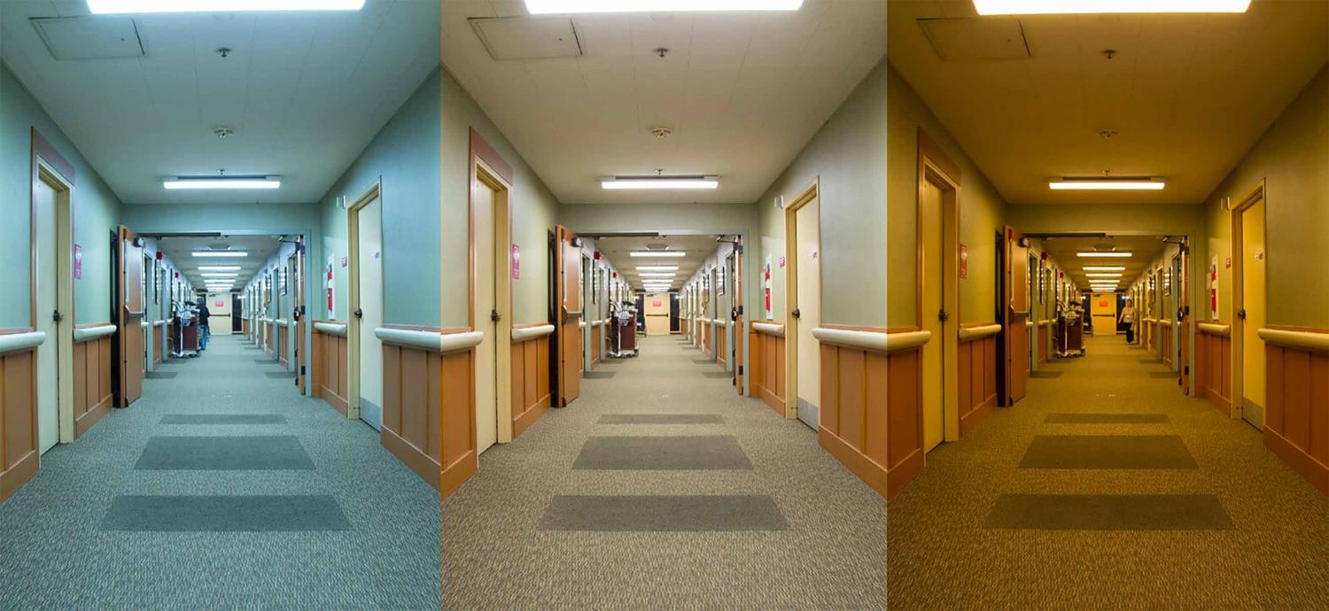
Environmental lighting changes with the time of day
▲ As part of a U.S. Department of Energy study, new tunable lighting was installed at the ACC Care Center for seniors in Sacramento, California. Shown here are programmed settings for morning, afternoon, and nighttime. Visual: U.S. DOE

Slide 27
Take-home message
- Sleep is an essential function (supported by specific circuits/neurotransmitters)
- Tow-process model: - Build-up of homeostatic sleep drive “S”
- Circadian rhythms “C”
Circadian clock malfunctions linked sleep problems
Pharmacological modulation of the circadian machinery (Chronotherapy)

Slide 28
Readings (mandatory)
2017 Scamell et al.
2012 Schaefer et al.
2019 Rijo-Ferreira and Takahashi

Slide 29
Registration now open for Summer 2021! (course starts on May 18th, 2021)

