Slide 1
Systems Neuroscience 2022 Brain Anatomy Overview
Patrick M Dougherty, Ph.D. Dept. of Pain Medicine Research
The University of Texas M.D. Anderson Cancer Center
FC13.2042
713-745-0438
pdougherty@mdanderson.org

Slide 2
The Main Objectives are to become familiar with:
The basic orientation and organization of the nervous system based on neurodevelopment
The organization of the meninges
The organization of the brain ventricles and the flow of cerebrospinal fluid
The blood supply of the CNS
The major functional divisions of cerebral cortex, architectonics, cortical columns
The major internal structures of the brain, caudate nucleus and diencephalon
The Main Principles you should be able to discuss are:
How ontogeny repeats phylogeny in brain development
How the structure of the adult brain reflects neurodevelopment
Why the major functional centers of the brain are located where they are

Slide 3
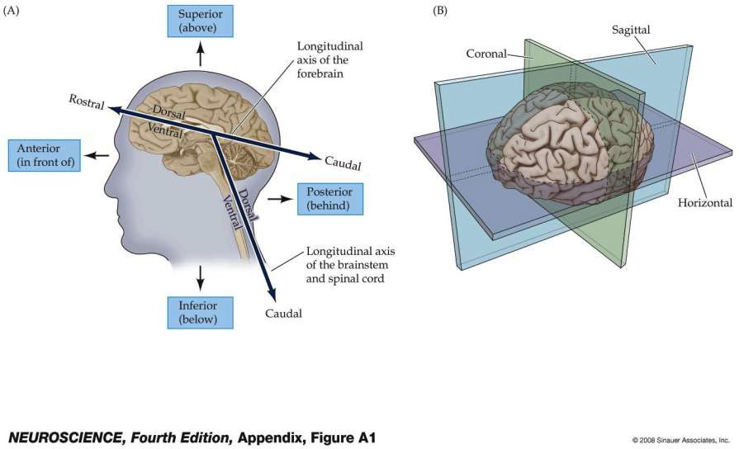
(A) Anatomical terminology of the brain and brainstem; (B) Major planes of section

Slide 4
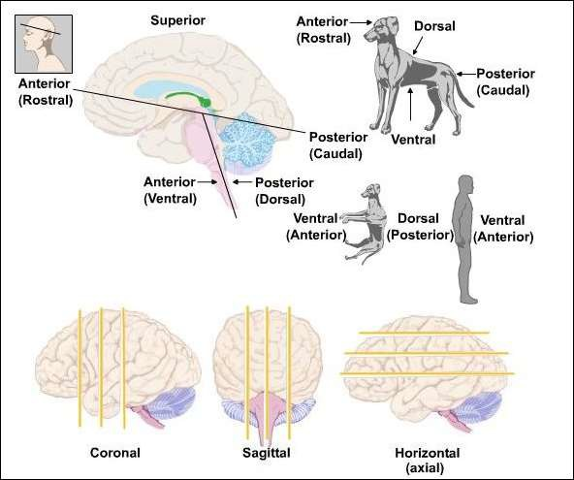
Axis Conventions in Human Neuroanatomy

Slide 5
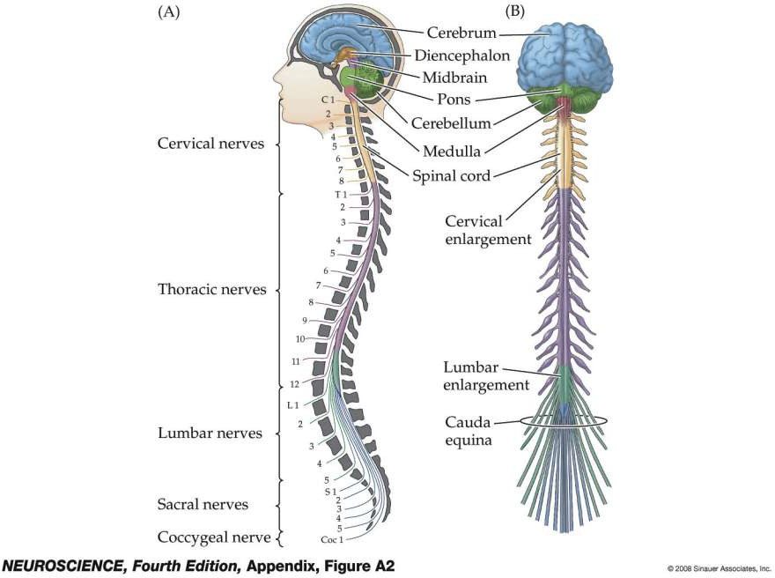
The subdivisions and components of the central nervous system

Slide 6
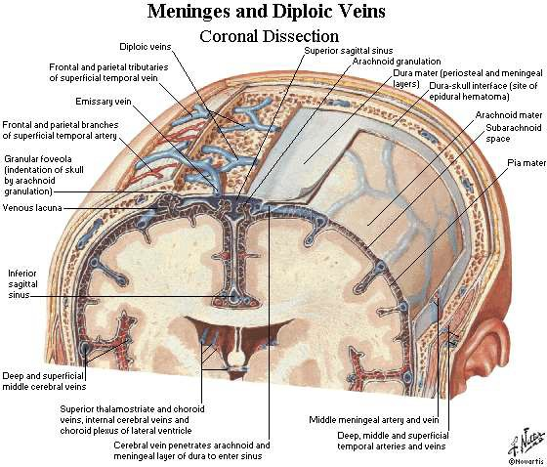
Meninges and Dural Sinuses

Slide 7
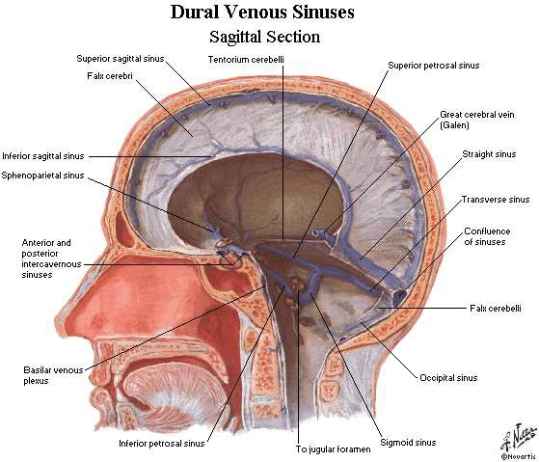
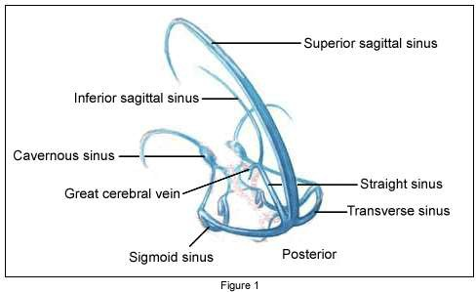
Dural sinuses

Slide 8
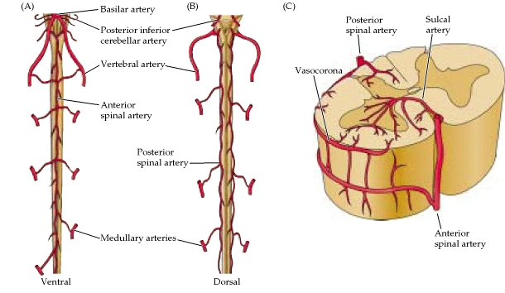
Two posterior spinal arteries (1/3 of cord)
One anterior spinal artery (2/3s of cord)
Arterial blood supply to the CNS

Slide 9
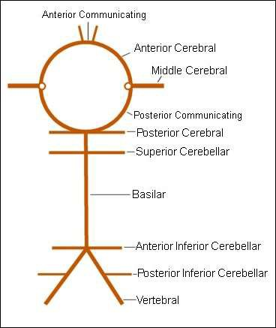
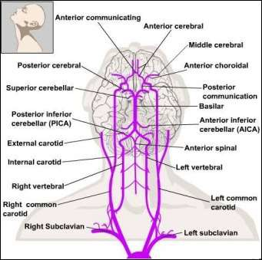
Arterial blood supply to the CNS

Slide 10
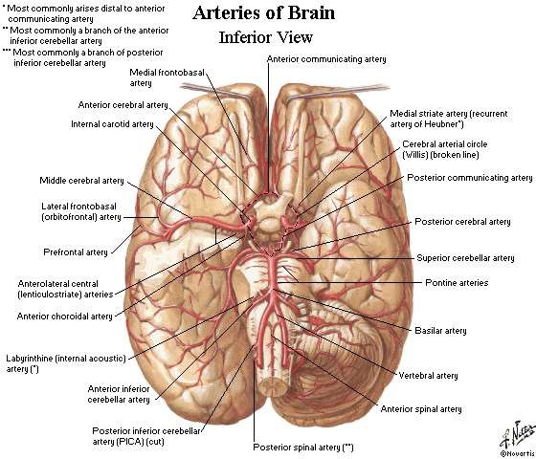
Arterial blood supply to the CNS

Slide 11
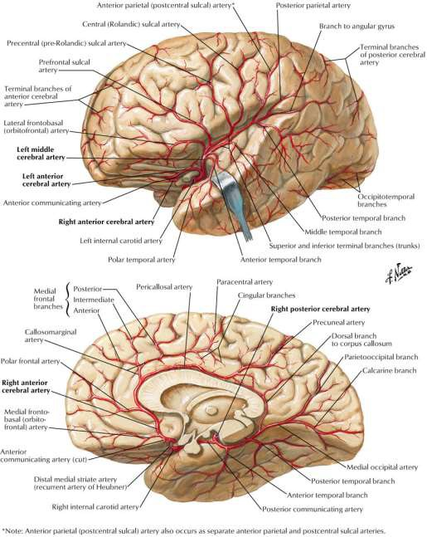
Arterial blood supply to the CNS

Slide 12
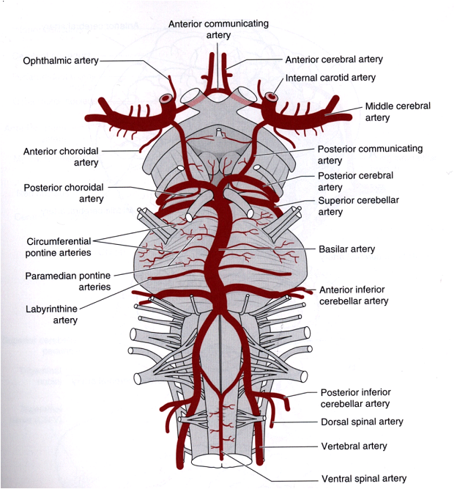
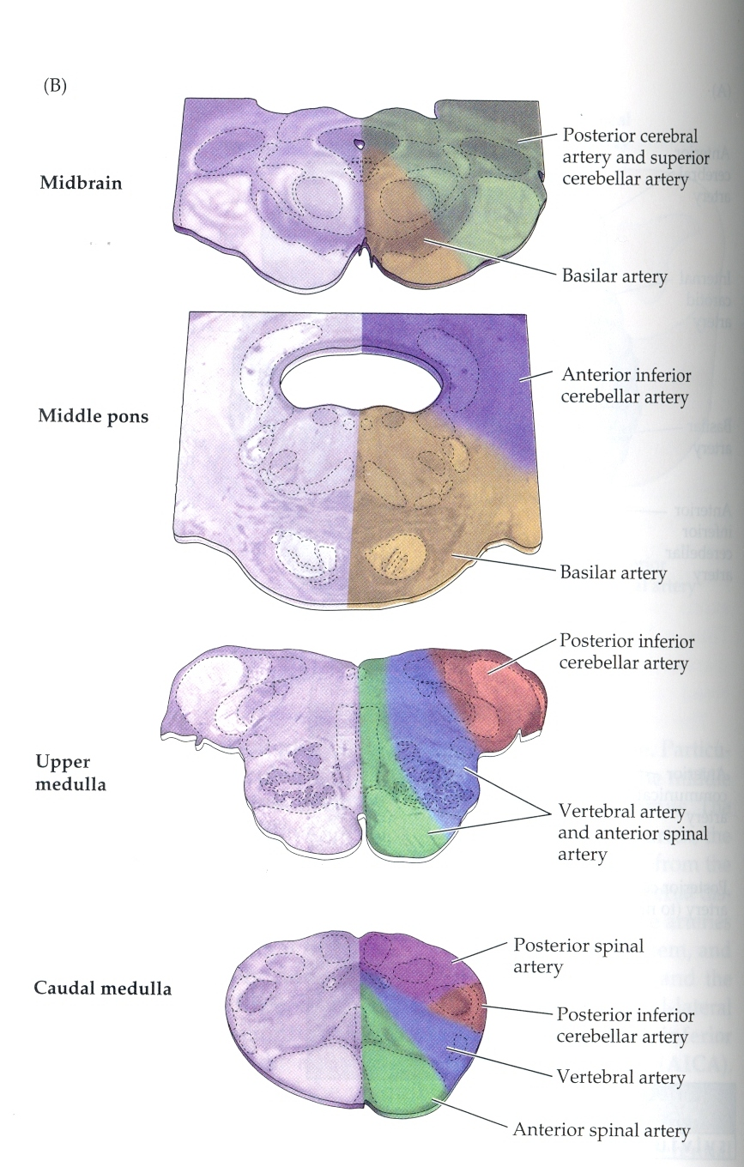
Arterial blood supply to the CNS

Slide 13
Development of the central nervous system

Slide 14
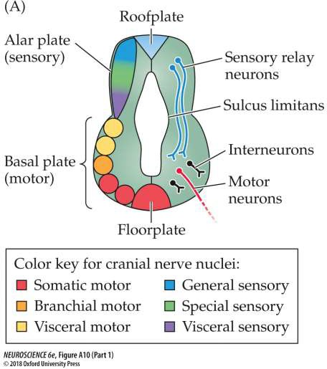
Neuro-development

Slide 15
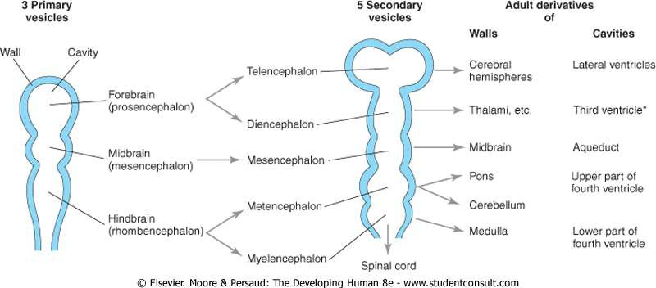
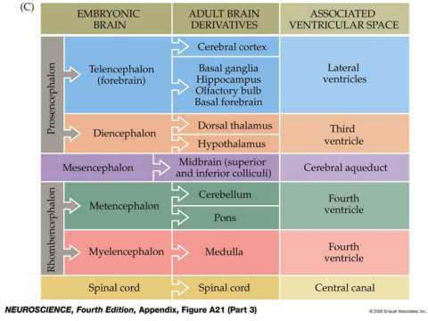
Neuro-development

Slide 16
Neuro-development

Slide 17
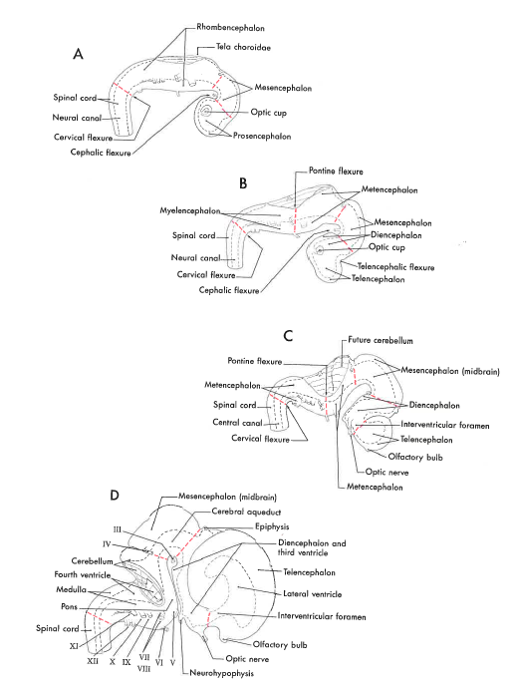
Neuro-development

Slide 18
Neuro-development
5 months
6 months
7 months
8 months
9 months

Slide 19
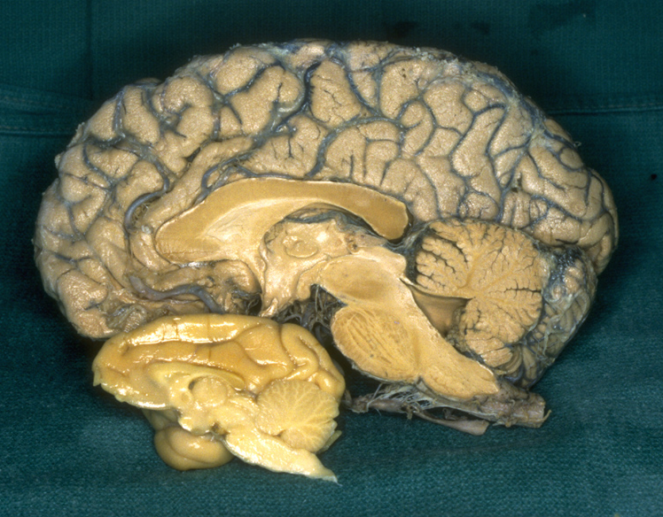

Slide 20
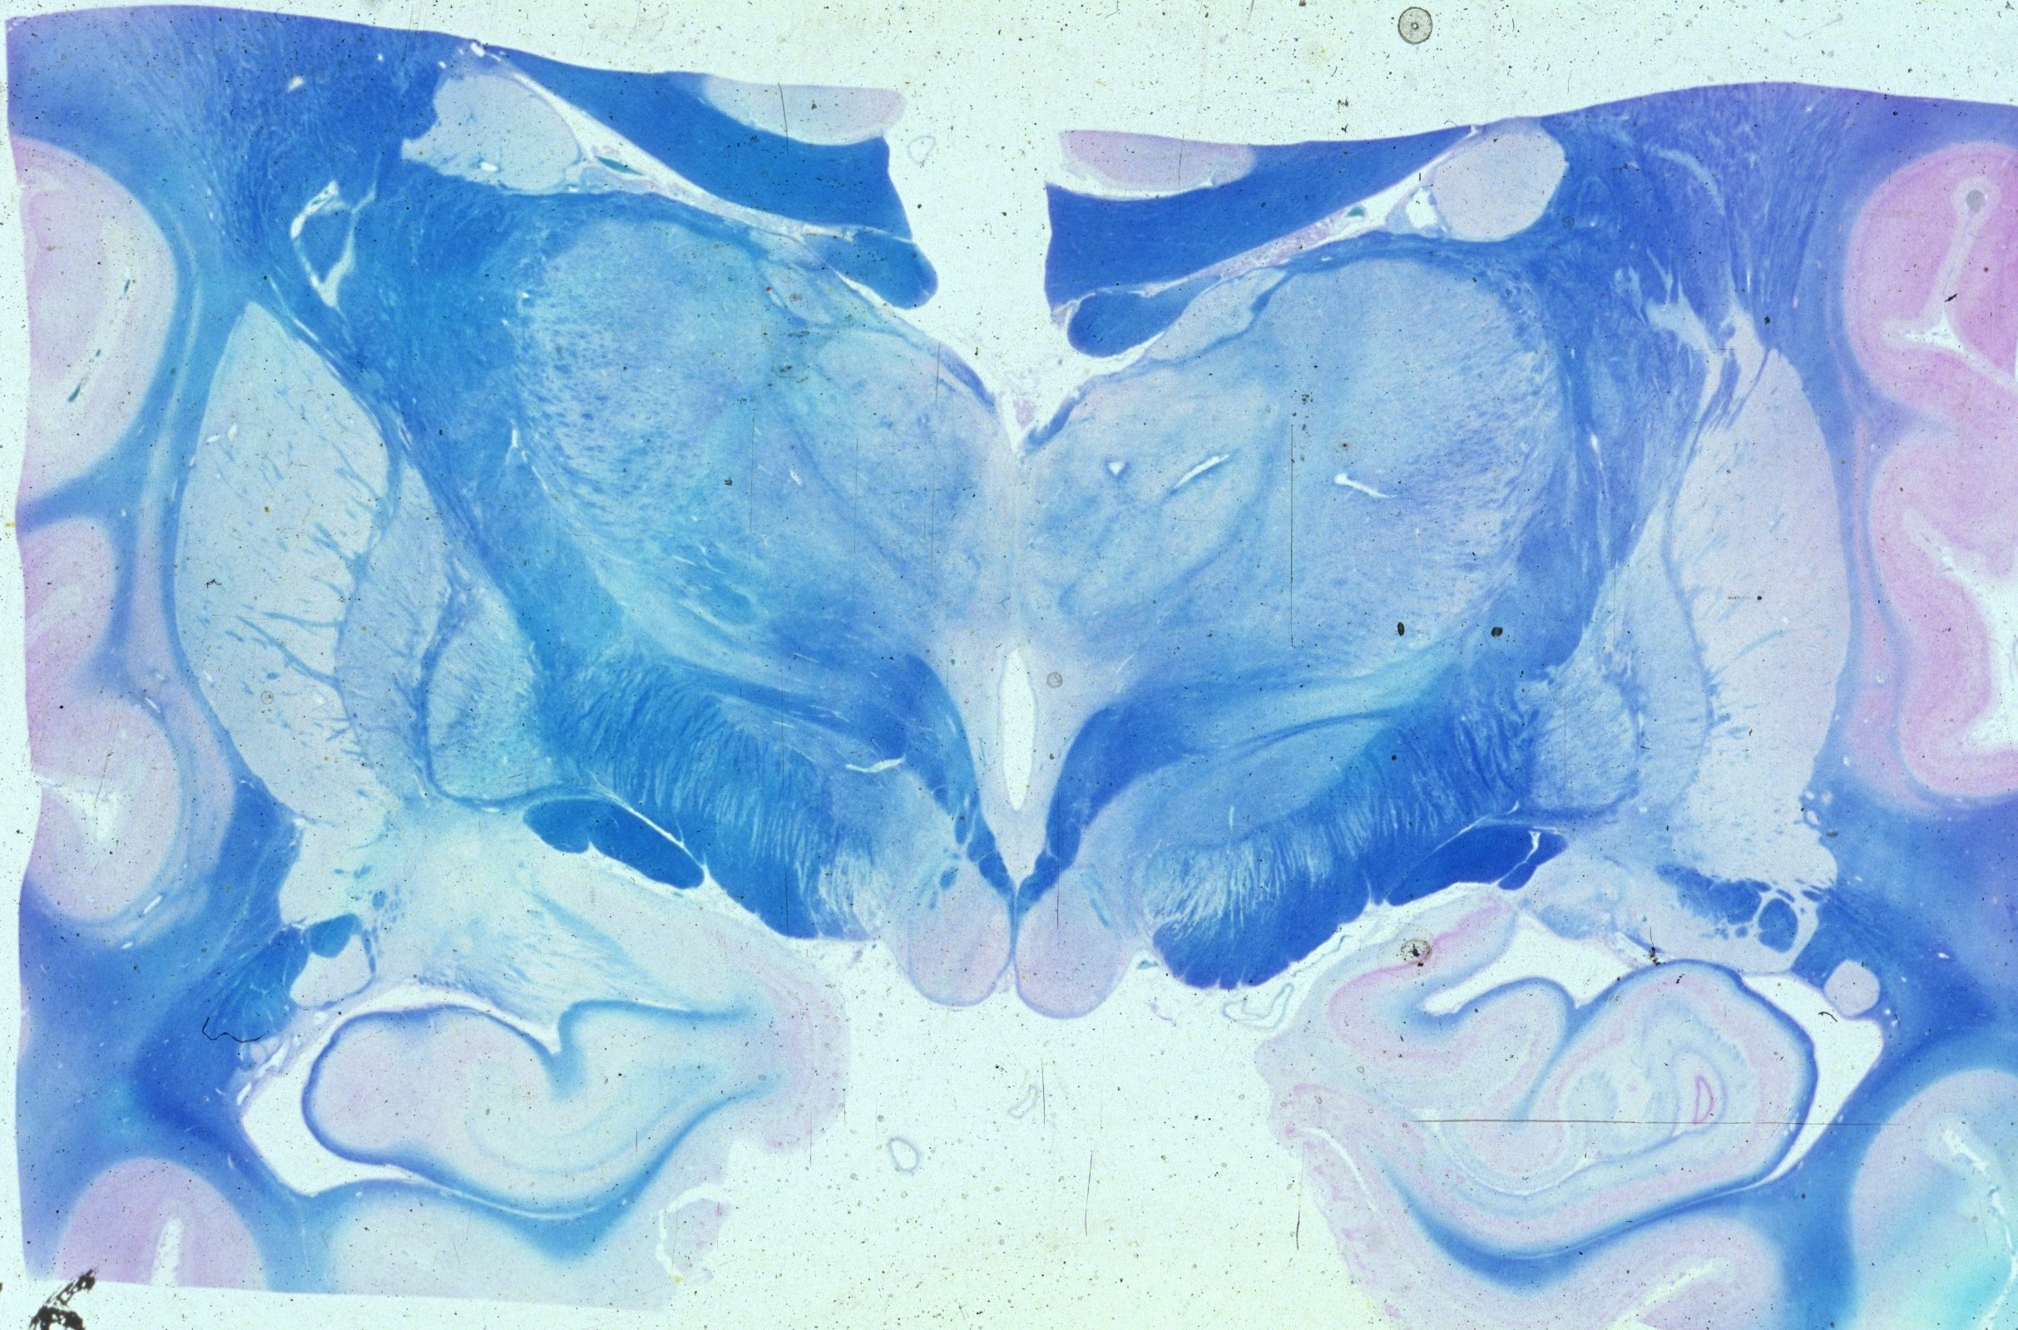

Slide 21
Ventricles and Cerebrospinal fluid

Slide 22
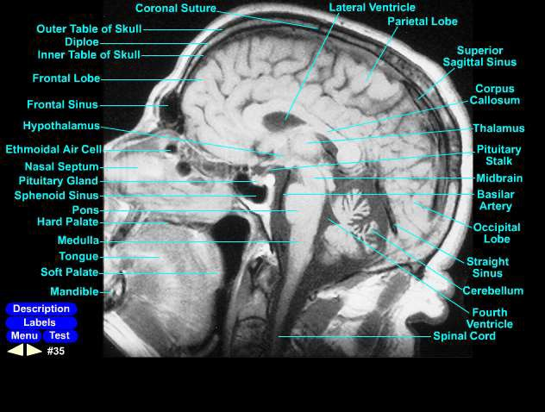
Ventricles and Cerebrospinal fluid

Slide 23
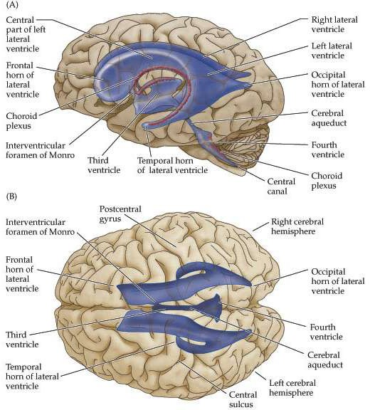
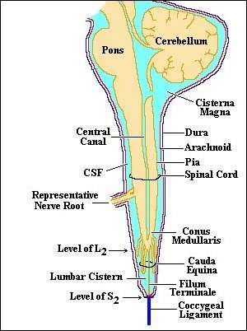
Ventricles and Cerebrospinal fluid

Slide 25
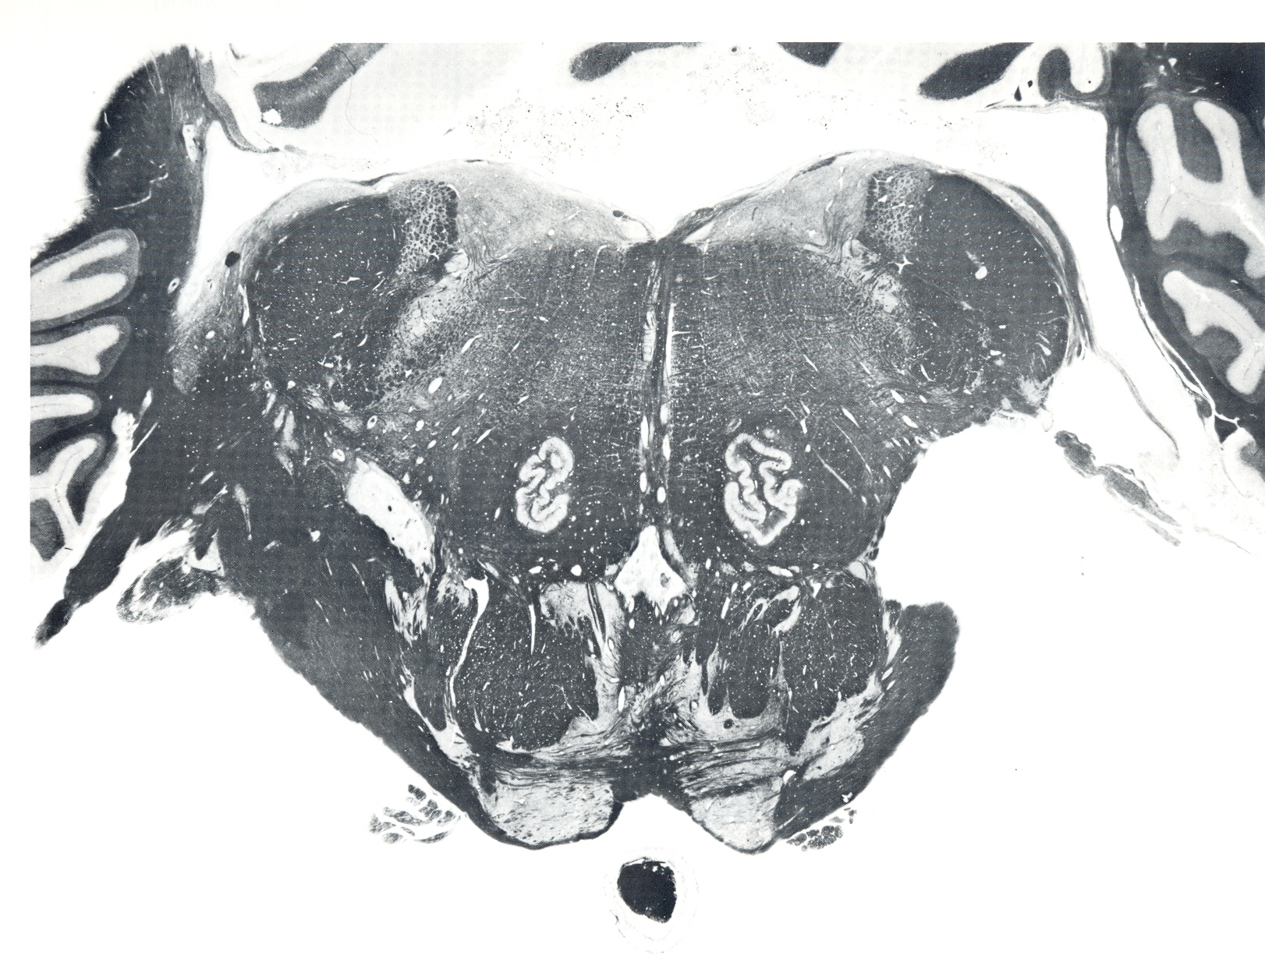

Slide 26
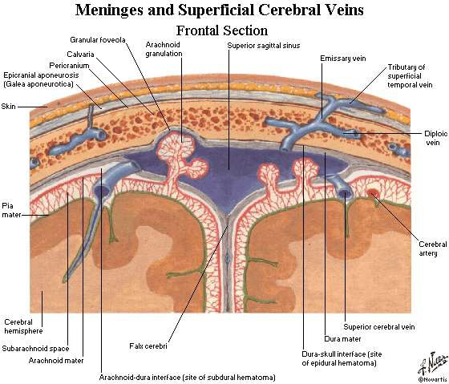
Ventricles and Cerebrospinal fluid

Slide 27
General Neuroanatomy of the central nervous system

Slide 28
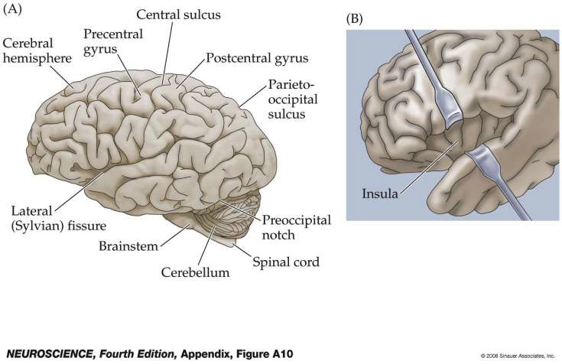
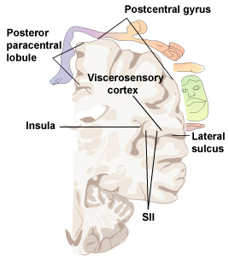
Lateral view of the human brain

Slide 29
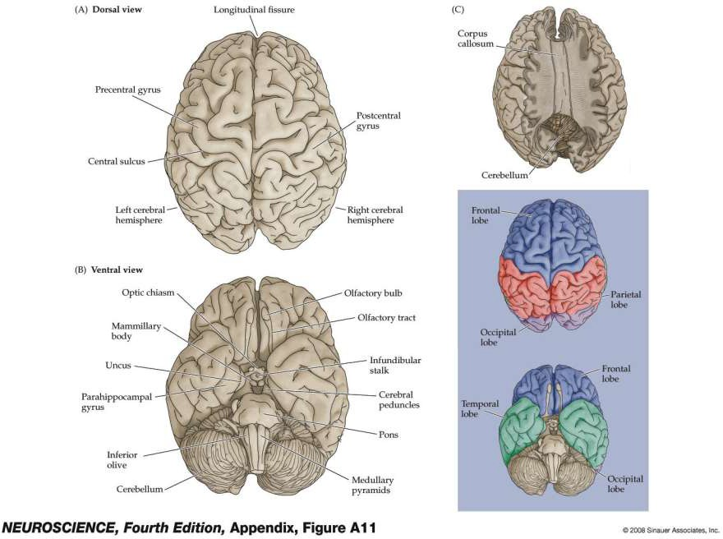
Dorsal and Ventral Views of the human brain

Slide 30
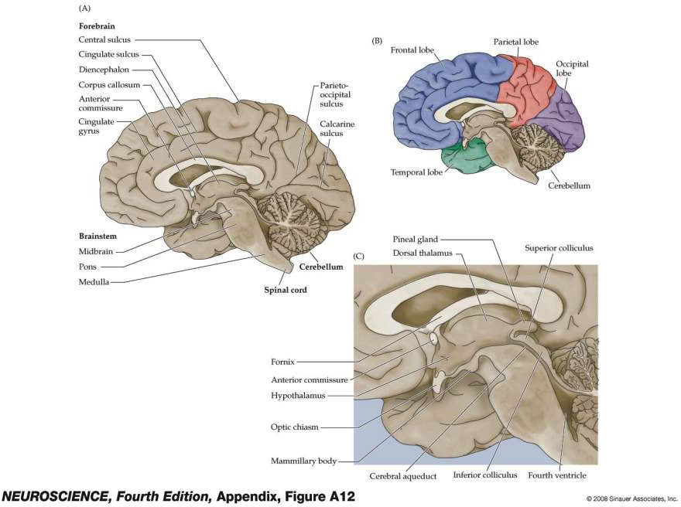
Midsagittal view of the human brain

Slide 31
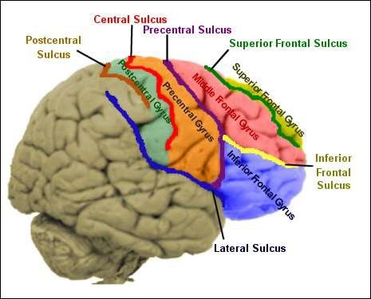
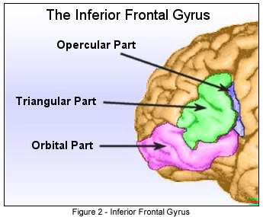
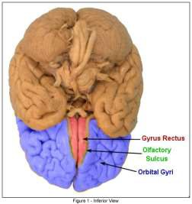
Organization of Cerebral Cortex: Lobes and Gyri
Frontal lobe major sulci and gyri

Slide 32
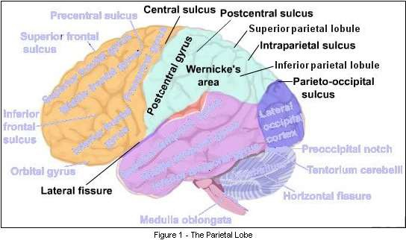
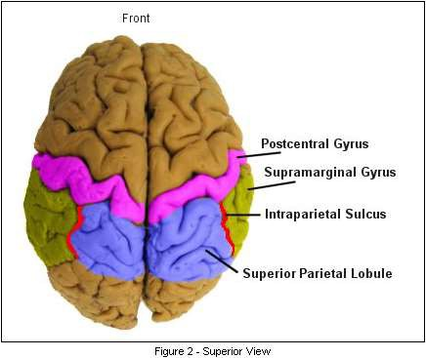
Organization of Cerebral Cortex: Lobes and Gyri III
Parietal lobe major sulci and gyri

Slide 33
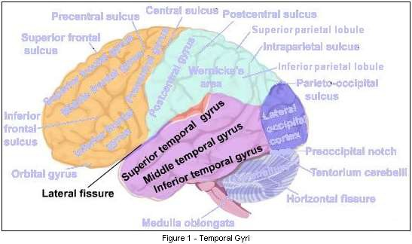
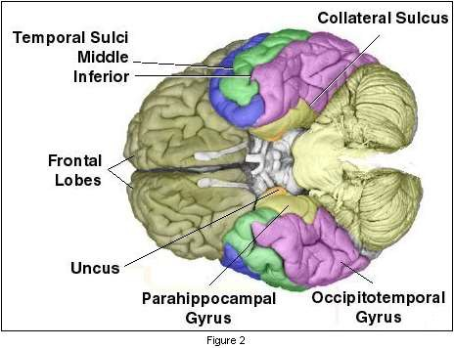
Organization of Cerebral Cortex: Lobes and Gyri
Temporal lobe major sulci and gyri

Slide 34
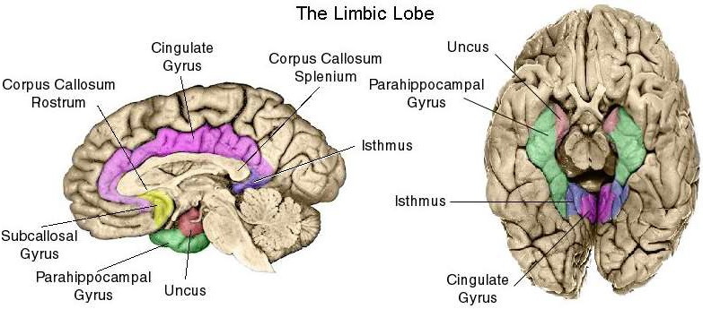
Limbic System

Slide 35
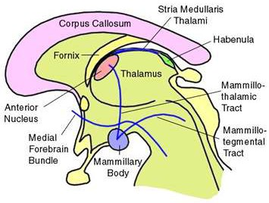
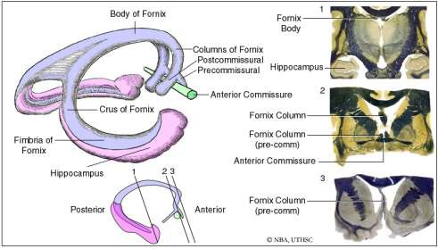
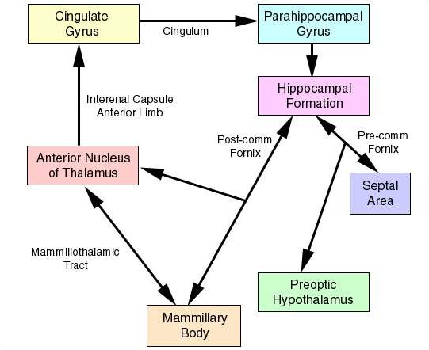
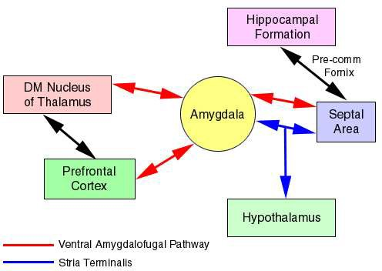
Limbic System

Slide 36
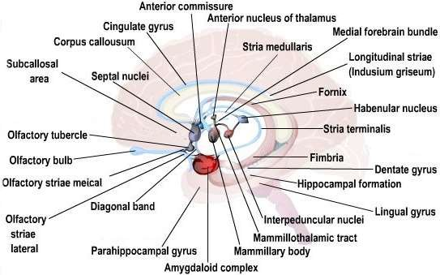
Limbic System

Slide 37
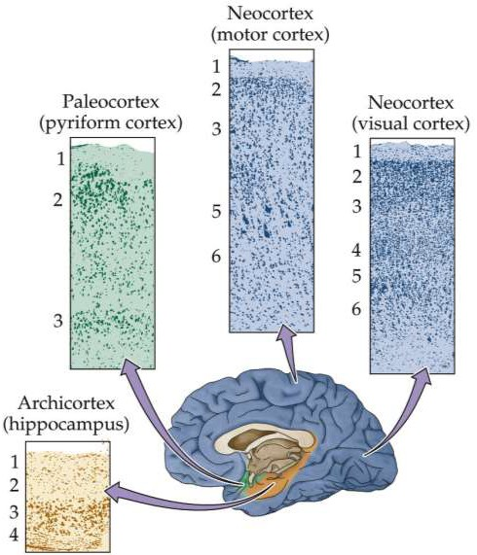
Cytoarchitectonics of the Brain

Slide 38
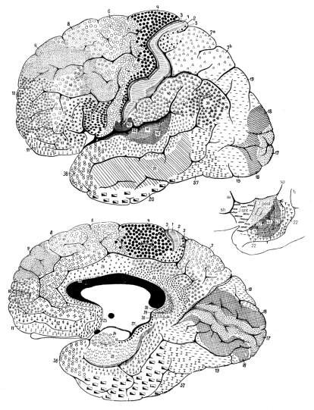
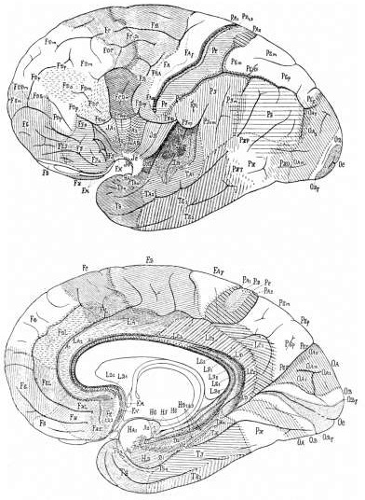
circa 1900
Cytoarchitectonics of the Brain

Slide 39
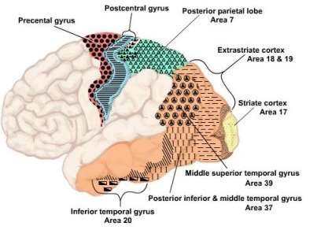
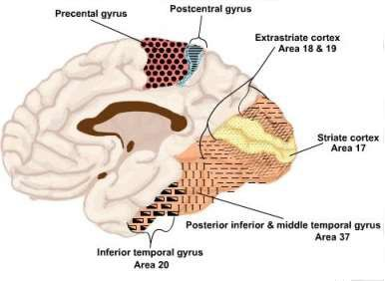
Cytoarchitectonics of the Brain

Slide 40
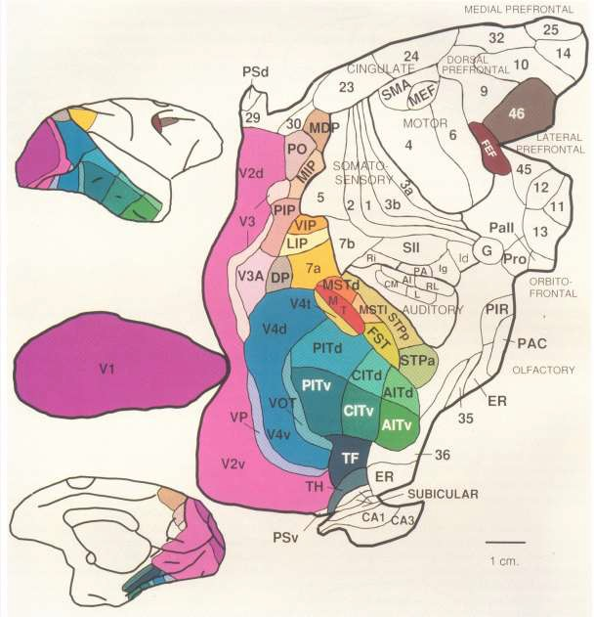
Modern Functional Subdivisions of the Brain

Slide 41
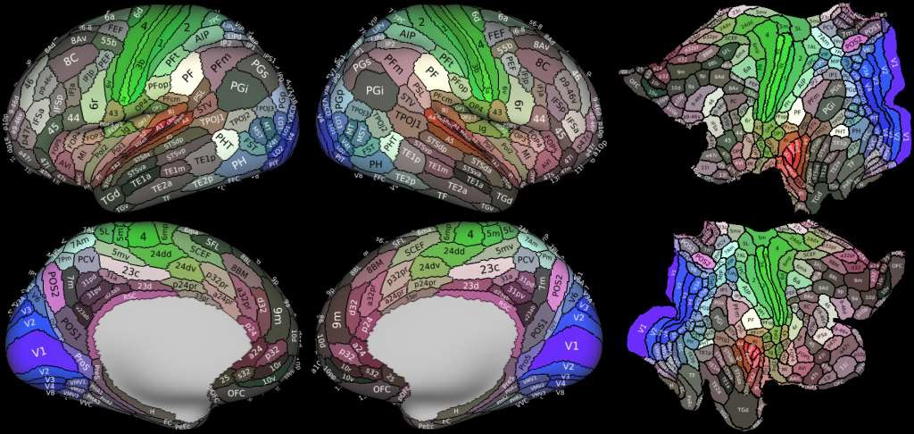
Human Connectome Project
190 areas on partially inflated cortical hemisphere- Left
Modern Functional Subdivisions of the Brain
190+ multi-modally defined areas vs. Brodmann (44) and other architectonic maps
Partially inflated cortical surface to aid the visualization of cortex within sulci
Full unfolded, 2D cortical maps

Slide 42
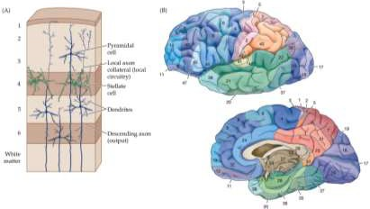
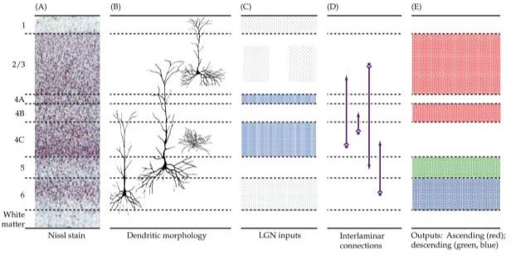
Principles of cortical lamination

Slide 43

Laminar Patterns Reciprocal Cortico-cortical Connections
Principles of cortical lamination: Circuits

Slide 44

Principles of cortical lamination: Circuits

Slide 45

Diffusion Tensor Imaging

Slide 46

Diffusion Tensor Imaging

Slide 47

Major Internal structures of the brain seen in coronal section

Slide 48



Slide 49


BOX A Thalamus and Thalamocortical Relations (Part 1)

Slide 50

Diencephalon: Hypothalamic Nuclei

Slide 51
Systems Neuroscience 2022 Overview of Major Ascending and Descending Pathways
Patrick M Dougherty, Ph.D. Dept. of Pain Medicine Research
The University of Texas M.D. Anderson Cancer Center
FC13.2042
713-745-0438
pdougherty@mdanderson.org

Slide 52
The Main Objectives are to become familiar with:
The basic organization of the major ascending and descending spinal pathways
The main similarities and differences between the peripheral and central nervous systems
The main similarities and differences between the somatic and autonomic nervous systems
The basic organization of the cranial nerves and their orientation in the midbrain, pons and medulla
The basic organization of inputs to the brain for smell, vision, hearing and body position
The Main Principles you should be able to discuss are:
Why the major ascending and descending pathways of the spinal cord are located where they are

Slide 53

Figure A4 Relationship of the spinal cord and spinal nerves to the vertebral column

Slide 54


Slide 55


Differences in glial support cells in CNS vs PNS

Slide 56


Slide 57



Slide 58


Dorsal Column-Medial Lemniscus
Spinothalamic Tract (Anterior lateral System)

Slide 59


Main Sensory Trigeminal Pathway
Spinal Trigeminal Pathway

Slide 60

Spino- & Cuneo-cerebellar tracts

Slide 61
Cortico-Bulbar Tracts for all Motor Cranial Nerves
Cortico-, Rubro- & Tecto-Spinal Tracts

Slide 62


Vestibulo-Spinal Tracts
Reticulo-Spinal Tracts

Slide 63

Descending Tracts
Ascending Tracts

Slide 64

The Cranial Nerves

Slide 65

Cranial Nerves as they enter or exit the midbrain, pons, and medulla

Slide 66

Locations of Brainstem Cranial Nerve Nuclei

Slide 67


Slide 68


Slide 69

Cranial Base Fossae, Foramina and Contents
Anterior Cranial Fossa
Middle Cranial Fossa
Posterior Cranial Fossa

Slide 70
CRANIAL FOSSA | FORAMINA | CONTENTS
Anterior Fossa | Foramen cecum | Nasal emissary vein
 | Foramina of cribriform plate | Axons of CN I
 | Anterior and posterior ethmoid foramina | Vessels and nerves of the anterior and posterior ethmoid.
Middle Fossa | Optic canals | CN II and ophthalmic a.
 | Superior orbital fissure | CN V1, CN III, IV, VI, ophthalmic veins, sympathetic fibers
 | Foramen rotundum | CN V2
 | Foramen ovale | CN V3 and accessory meningeal a.
 | Foramen spinosum | Middle meningeal artery and vein and meningeal branch of CN V3.
 | Foramen lacerum | Filled with cartilage in life. Internal carotid artery with sympathetic and venous plexuses passes over its superior aspect
 | Hiatus of greater petrosal n. | Greater petrosal n. and petrosal branch of middle meningeal artery
Posterior Fossa | Foramen magnum | Medulla and meninges, vertebral arteries, CN XI, spinal art., dural veins
 | Jugular foramen | CN IX, X, XI, sup. bulb of internal jugular v., inferior petrosal and sigmoid sinuses, meningeal branches of occipital and pharyngeal a.
 | Hypoglossal canal | CN XII

Slide 71



Slide 72

TABLE A3 Classification and Location of the Cranial Nerve Nucleiª

Slide 73


Slide 74

Autonomic Nervous System

Slide 75
Similarities and Differences Between Somatic and Autonomic Nervous Systems

Slide 76


Olfactory Pathways

Slide 77

Visual System: Optic Nerve Afferents and Efferents

Slide 78


Gustatory Pathways

Slide 79


Slide 80



Auditory Ascending Pathway

Slide 81


Slide 82


Vestibular Ascending and Descending Pathways

