Slide 1
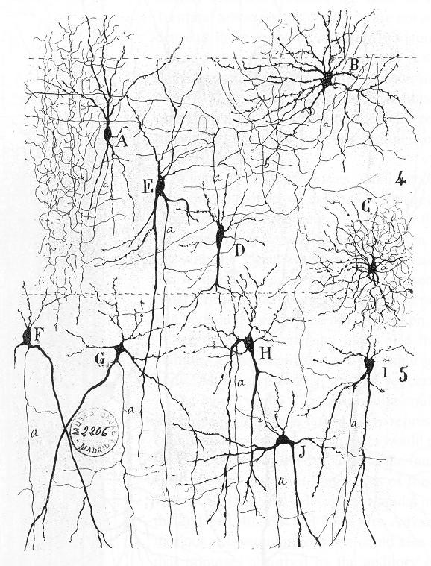
Cell types and feedforward circuits in neocortex
Michael Beierlein, PhD
Office: MSE R442
Email: michael.beierlein@uth.tmc.edu

Slide 2
Outline
Intro: circuit neuroscience
Defining cell types in neocortex
Feedforward inhibition

Slide 3
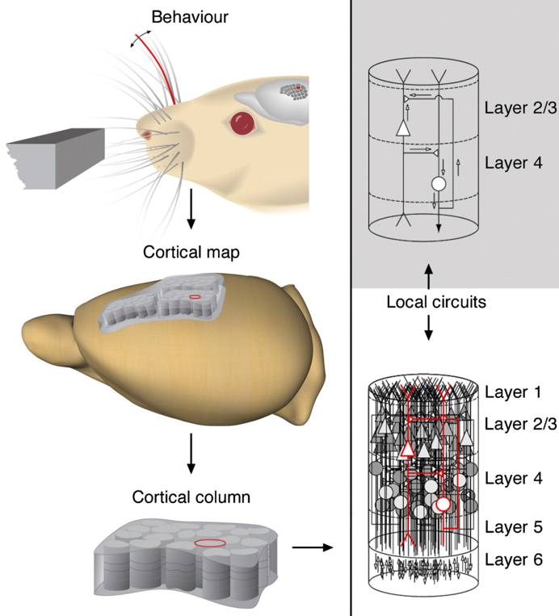
Circuit Neuroscience
Understanding of the computational function of neural circuits, linking this function with the underlying circuit structure.
Key principles (and challenges) of circuit neuroscience
There is a finite number of neuronal types with distinct properties. (Determine cell types)
Synaptic connections between these neuronal types are not random, but follow specific rules, giving rise to well defined local circuits. (Determine connectivity)
Circuits show emergent functional properties, i.e. their behavior does not simply reflect the behavior of individual cells. (Determine algorithm & temporal dynamics)
Local circuits are the basic anatomical and functional building block of the mammalian brain (“canonical circuit”), with each brain area containing a massive number of circuits arranged in parallel.
https://doi.org/10.3389/neuro.01.017.2008

Slide 4
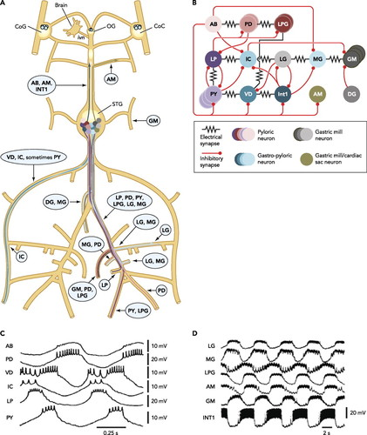
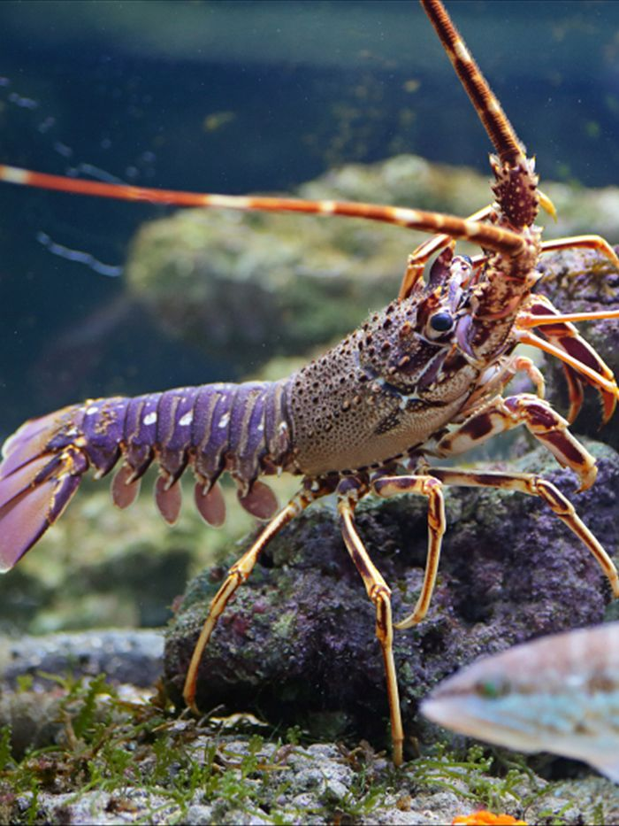
For some invertebrate systems (e.g. stomatogastric ganglion of lobster), structure and function of local circuits are well understood.

Slide 5
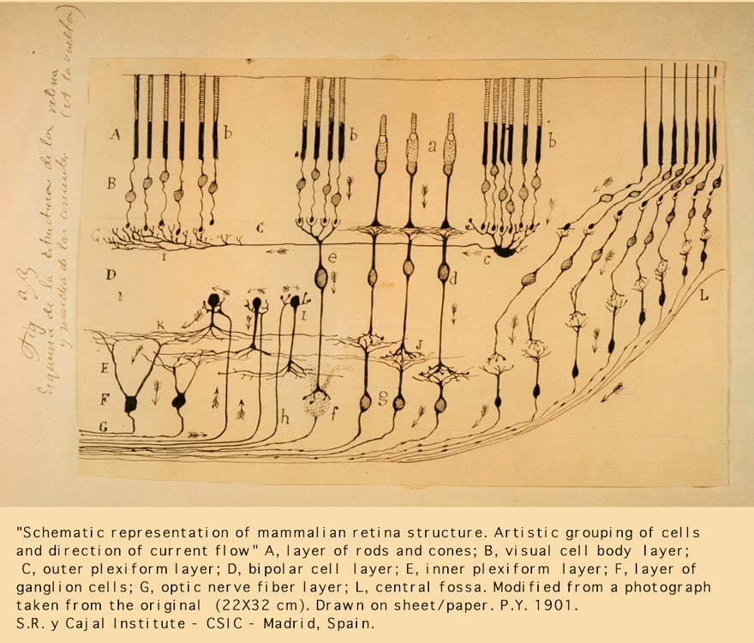
Retina: Composed of well-defined circuits with a finite number of distinct cellular elements , decent understanding of function(s)

Slide 6
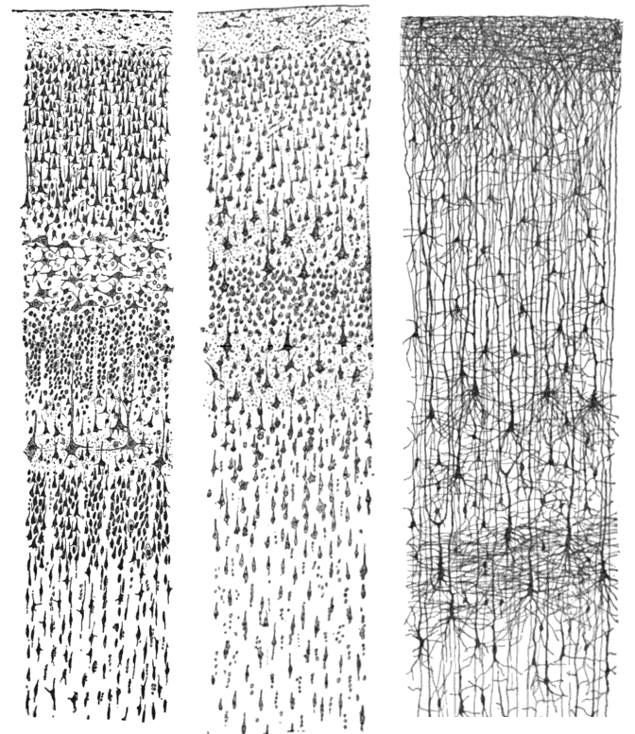
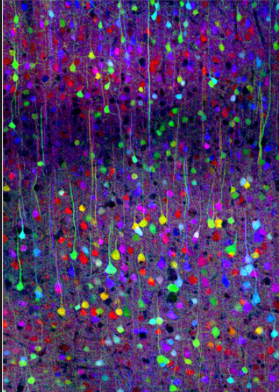
For other systems (e.g. neocortex): Defining local circuits and their functions is more challenging
Golgi stain of neocortex, Ramón y Cajal, 1899
Multicolor labelling of cells in Neocortex in Brainbow transgenic mice

Slide 7
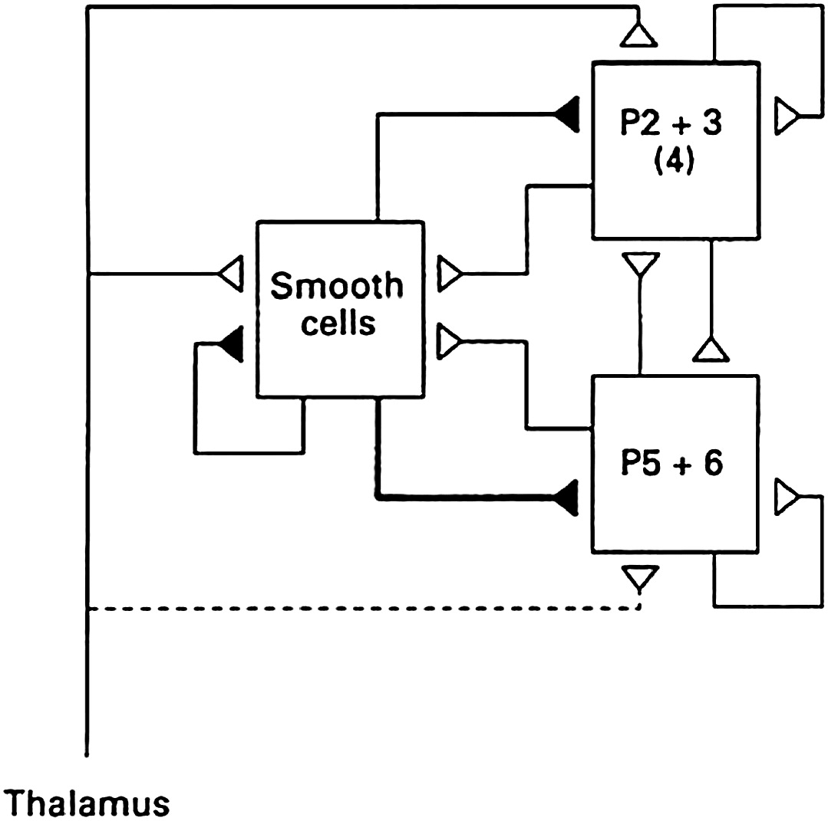
Local circuit model of neocortex – simple
Smooth cells: Inhibitory neurons
P2+3: Pyramidal (excitatory) neurons in layers 2/3
Douglas and Martin, J. Physiol. 1991

Slide 8
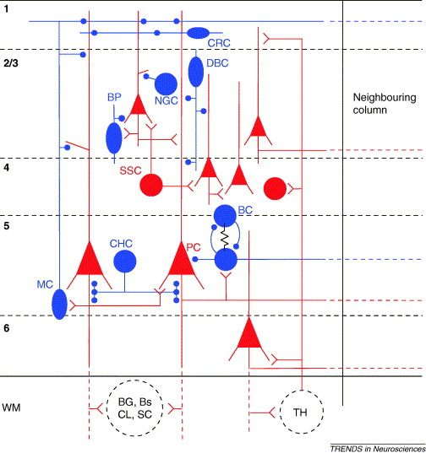
More realistic local circuit model
incorporation of knowledge about cell types & their connectivity
More challenging to define clear circuit function/algorithm
Grillner et al., TINS 2005

Slide 9
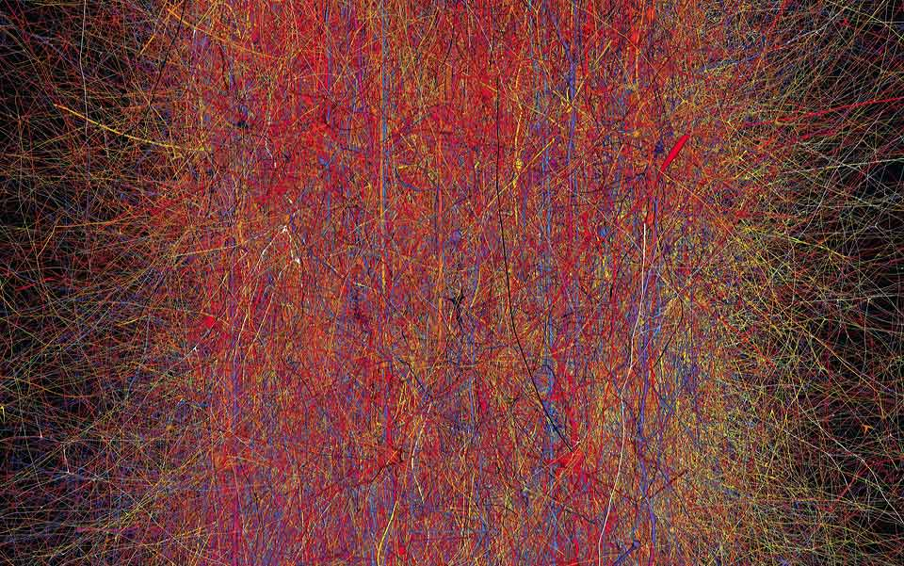
Local circuit model of neocortex – extremely realistic (and too complex?)
Blue Brain Project
Markram et al. Cell, 2015, https://www.cell.com/fulltext/S0092-8674(15)01191-5
Footnote: “In silico” documents the effort to simulate the human brain on super-computers, teaser here https://insilicofilm.com/

Slide 10
Outline
Intro: circuit neuroscience
Defining cell types in neocortex
Feedforward inhibition mediated by distinct types of interneurons

Slide 11
Why classify neurons?
Creation of “parts list” for local circuits
Reproducibility: Allows for comparison of different studies done at different times by different investigators
Genetic access (molecular classifications): labeling and/or manipulating distinct types of neurons in vivo
Discovery: Classifying most cells in a given area might highlight previously unrecognized neurons
Studying neurodegeneration: certain diseases only affect specific types of neurons
Zeng & Sanes, Nature Rev Neuro, 2017

Slide 12
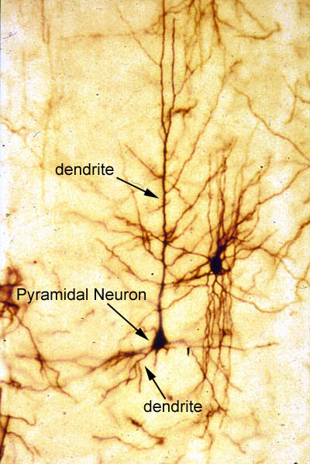
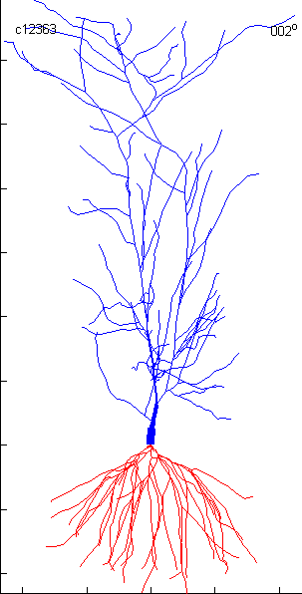
Pyramidal cells: the principal type of excitatory neuron of neocortex

Slide 13
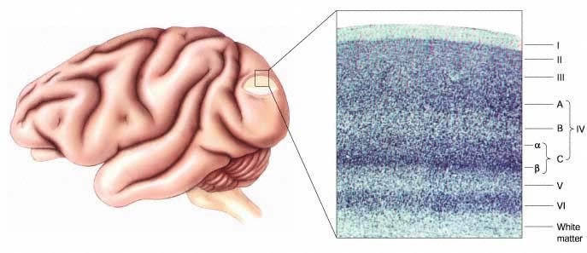
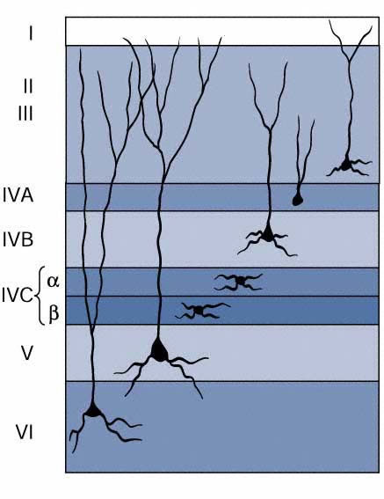
Pyramidal cells are located in cortical layers 2-6, while spiny stellate cells (also excitatory) are only found in layer 4
lengths of dendrites are very variable
dendrites can span multiple layers in order to collect various synaptic inputs
some dendrites are short to limit the types of synaptic input the neuron receives
pyramidal cells

Slide 14
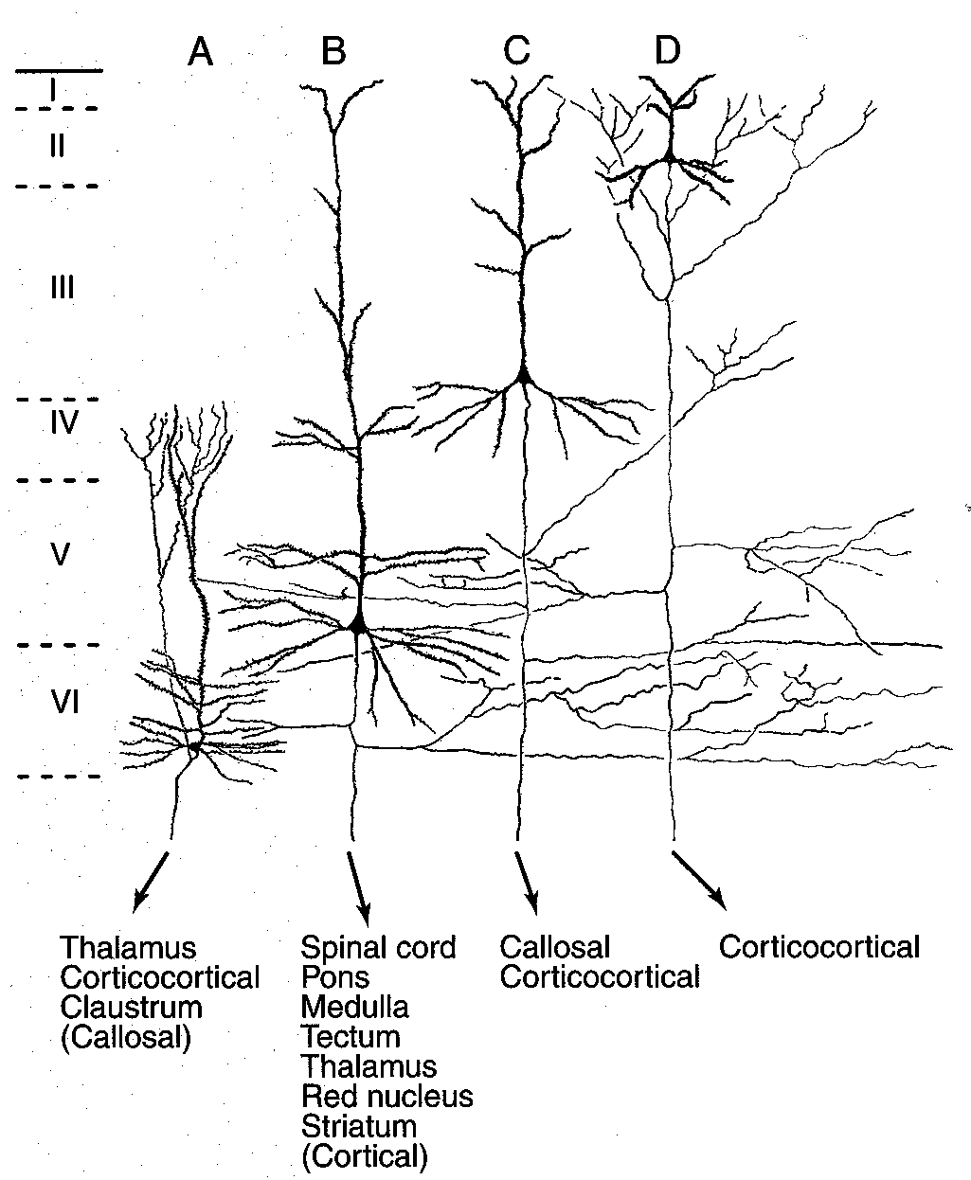
Pyramidal cells show form distinct projections to targets within and outside cortex
dendrites
axons
targets of pyramidal cell axons

Slide 15
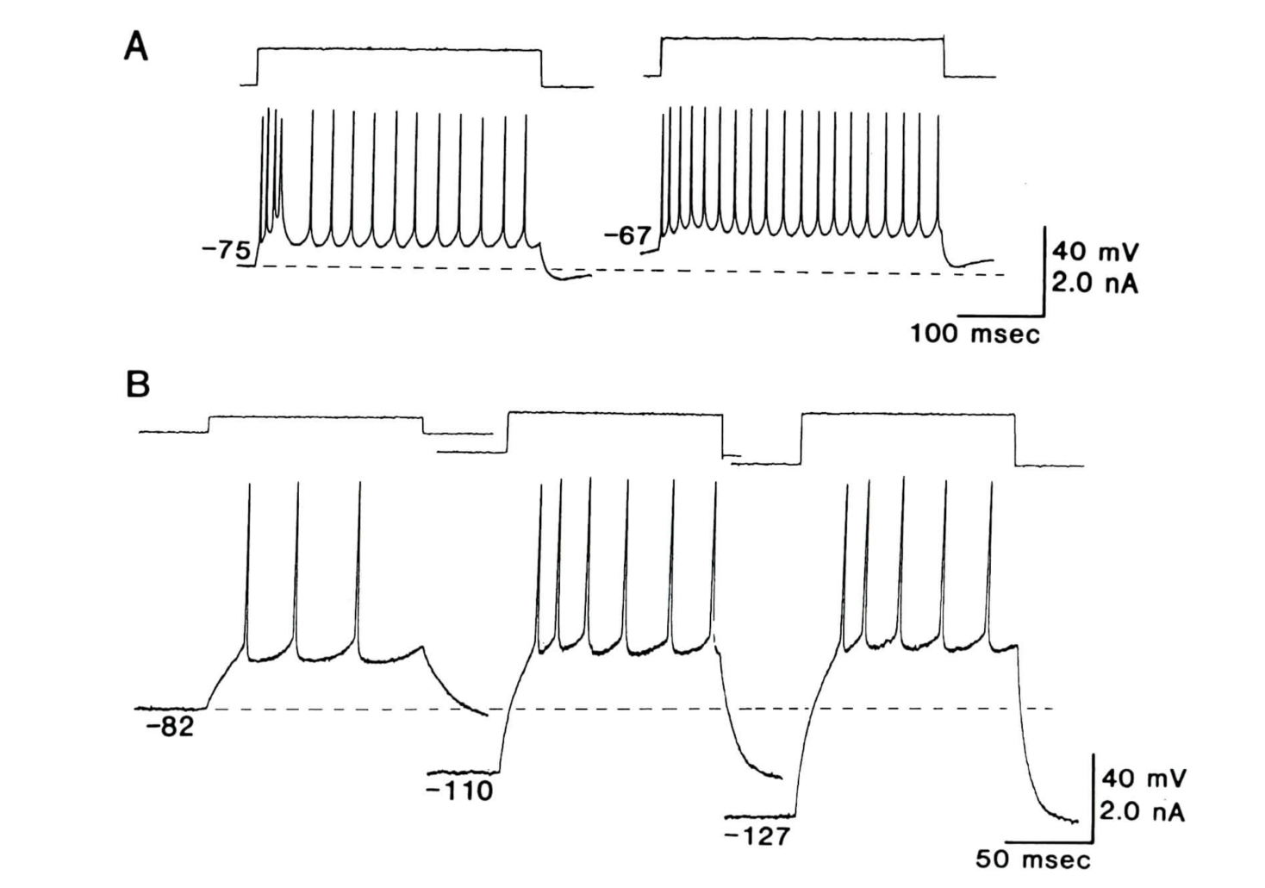
Most pyramidal (and spiny stellate neurons) show the same “intrinsic firing pattern” (response to depolarizing current step)
“intrinsically bursting” (IB)
-> some Layer V pyramidal neurons
“regular spiking” (RS)
-> almost all pyramidal neurons
and spiny stellate cells
McCormick et al., J Neurophys 1985

Slide 16
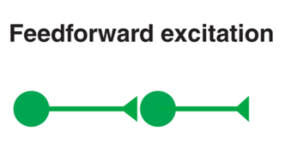
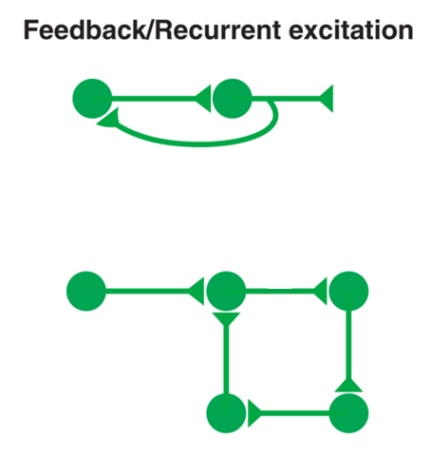
Recurrent excitatory loops dominate circuitry in neocortex

Slide 17
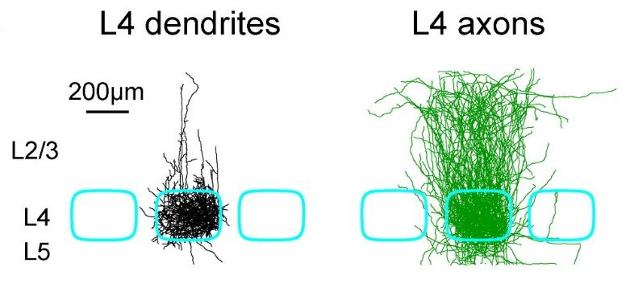
Recurrent excitatory loops dominate circuitry in neocortex
Petersen, 2007, https://doi.org/10.1016/j.neuron.2007.09.017

Slide 18
Slight alterations in GABA function can cause epileptic seizures, measurable as gross EEG abnormalities
blocking GABA_{A} receptors, even a little, causes seizures
many useful anti-convulsant drugs act by enhancing GABA function (e.g. barbiturates, benzodiazepines) or blocking breakdown of GABA (e.g. vigabatrin)

Slide 19
Normal inhibitory tone
more inhibition
less inhibition
coma
sedative
general anesthetic
seizures
status epilepticus
anxiolytic/anticonvulsant
anxiety/hyperexcitability

Slide 20
Recurrent excitatory loops dominate cortical circuitry,
controlled by inhibitory neurons (~20% of all cortical neurons)
Smooth cells: Inhibitory neurons
P2+3: Pyramidal (excitatory) neurons in layers 2/3
Douglas and Martin, J. Physiol. 1991

Slide 21
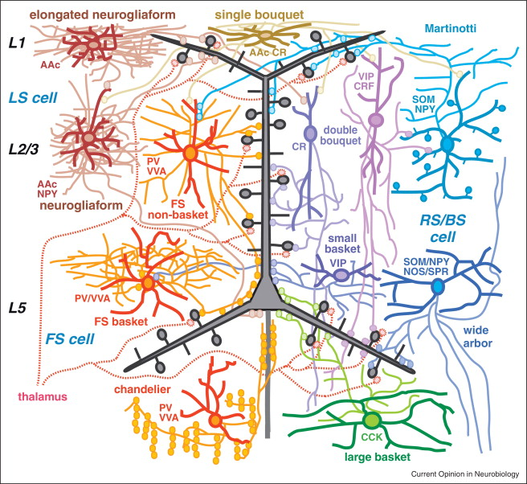
GABAergic interneurons in neocortex are highly diverse
Kawaguchi and Kubota

Slide 22
Classifying interneurons
Anatomical properties
Dendritic and axonal arborization pattern
Postsynaptic targets: Proximal vs. distal inhibition
Physiological/biophysical properties
Intrinsic firing pattern
Response to neuromodulators
Ionotropic & metabotropic receptors
Ion channels
Synaptic properties
Dynamic properties (e.g. short-term plasticity) of synaptic inputs and outputs
Molecular properties
Transcription factors (Dlx1, Dlx2, Dlx5, Arx…)
Neuropeptides (Somatostatin, VIP, CCK, NPY)
Calcium-binding proteins (e.g. Parvalbumin)

Slide 23
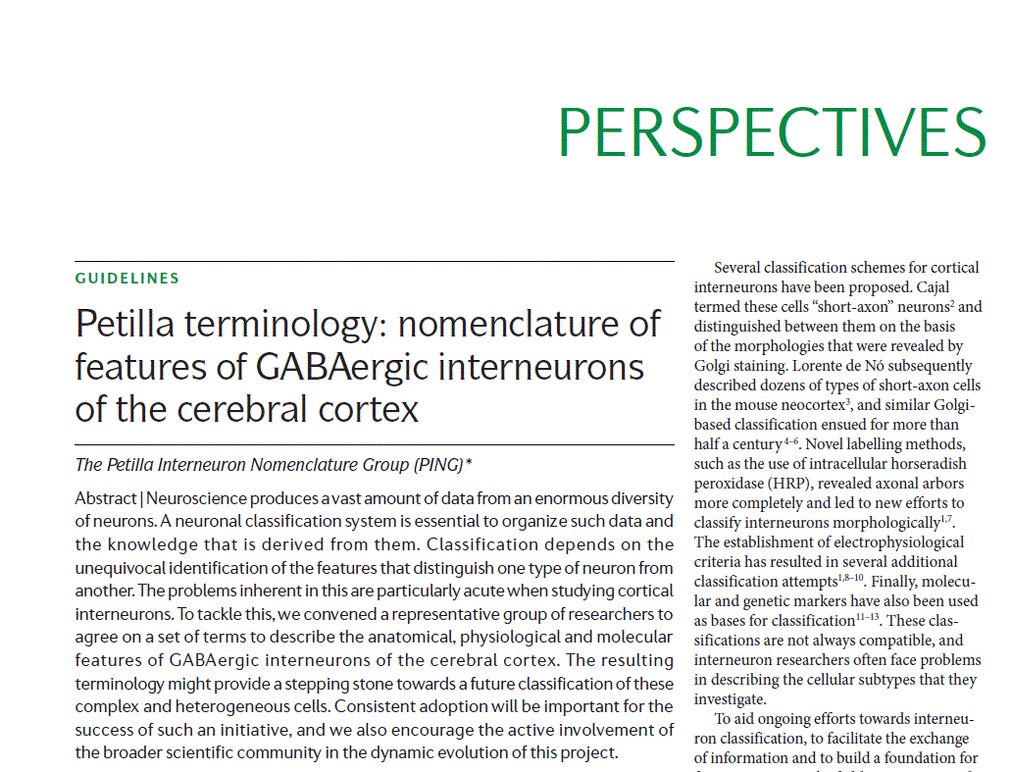
Classifying interneurons

Slide 24
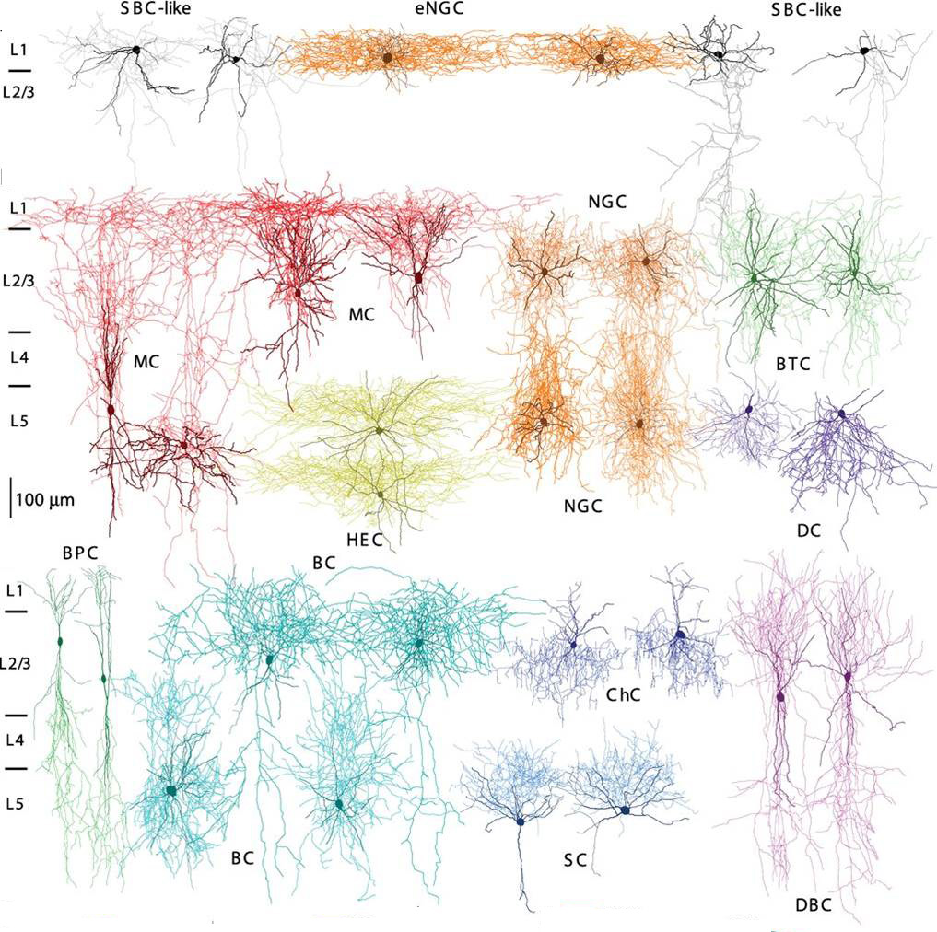
Morphological types of interneurons (latest count: 15)
Jiang et al., Science, 2015

Slide 25
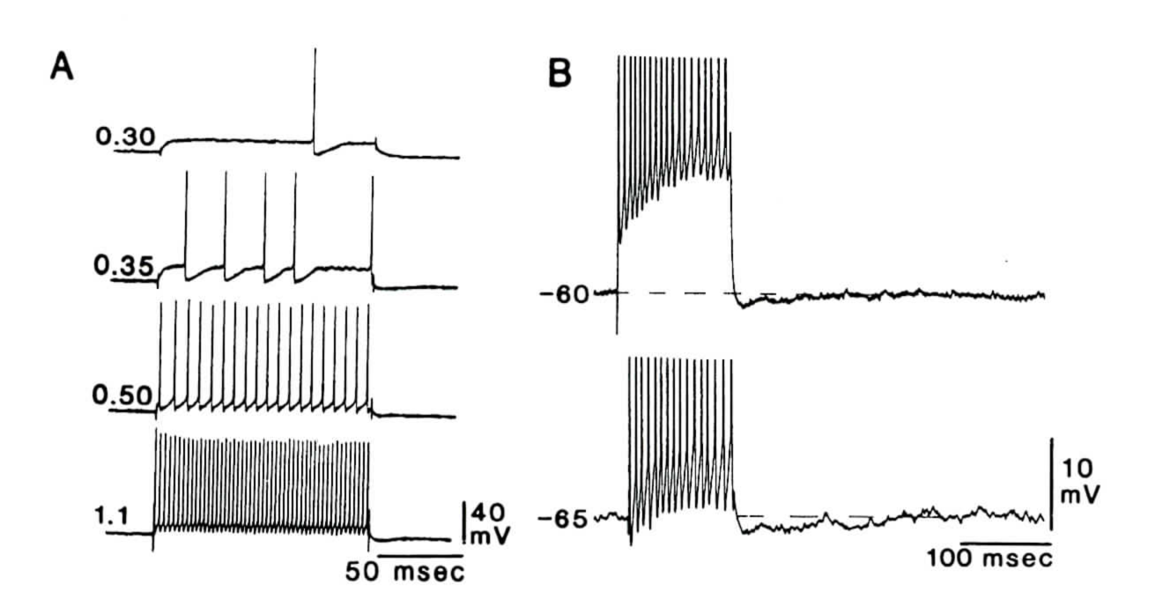
Basket and Chandelier neurons show “fast-spiking” (FS)
(no spike frequency adaptation, very high spike rates, short-duration spikes)
McCormick et al., J Neurophys 1985

Slide 26
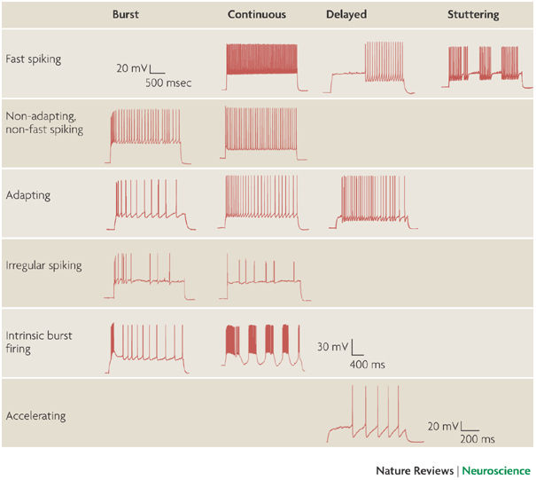
Other GABAergic Interneurons show distinct firing patterns….
Petilla Interneuron Nomenclature Group (PING), 2008

Slide 27
Distinct types of interneurons contact specific postsynaptic targets
Marin, Nature Reviews Neuroscience, 2012

Slide 28
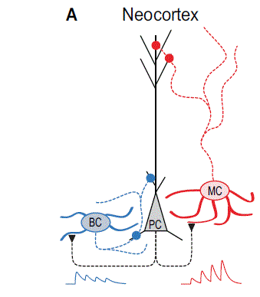
Short-term synaptic plasticity differs based on interneuron subtype
Short-term depression (use-dependent decrease in synaptic strength)
Short-term facilitation
(use-dependent increase in synaptic strength)

Slide 29
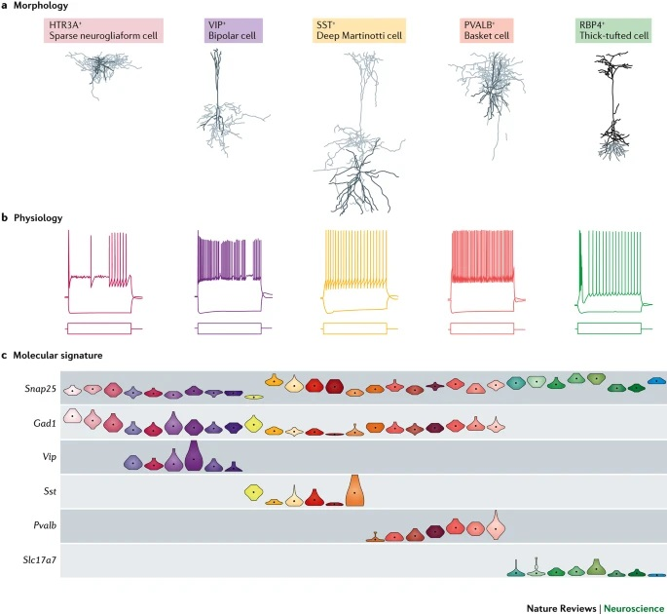
Neurons can be classified using molecular markers
Zeng & Sanes, Nature Rev Neuro, 2017

Slide 30
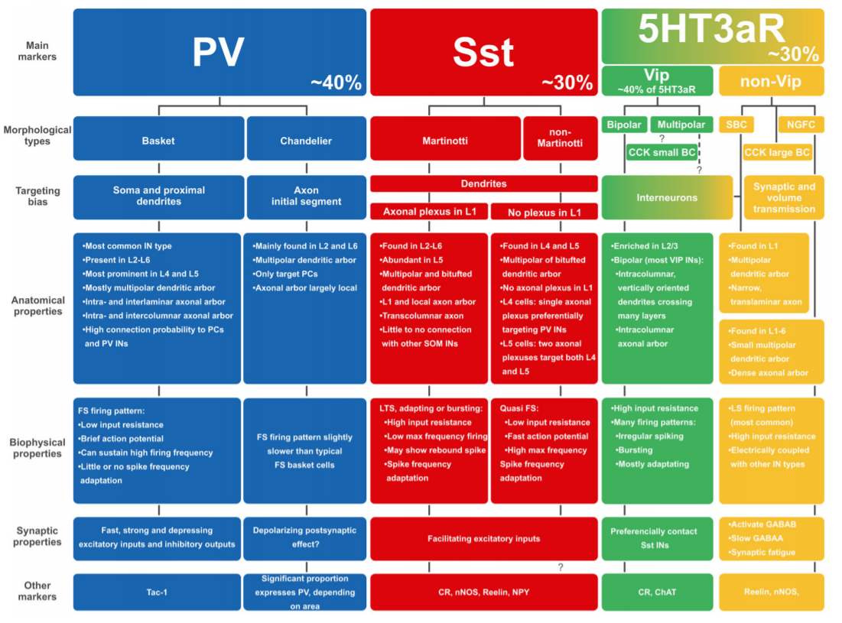
Classification of virtually all interneurons based on 4 molecular markers
Tremblay et al., Neuron, 2016

Slide 31
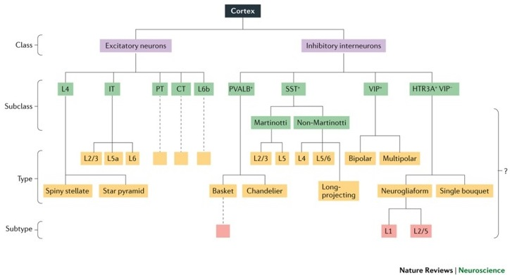
Proposed hierarchical classification of cells in neocortex
Zeng & Sanes, Nature Rev Neuro, 2017

Slide 32
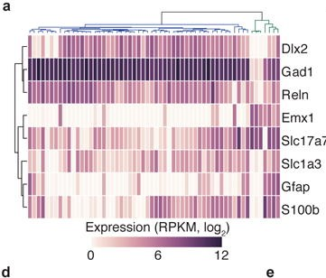
Patch seq: Electrophysiological and morphologic characterization of single neurons (in vitro or in vivo), followed by characterization of entire single cell transcriptome
-> large diversity of cell types and transcriptomes
Cadwell et al, Nature Biotechnology, 2016 10.1038/nbt.3445

Slide 33
Challenges with classifying (“naming”) neurons in neocortex
No universal agreement over “essential features” (firing patterns, axonal and dendritic morphology, molecular markers)
Lumping vs splitting: good agreement about classes and subclasses of neurons, less agreement about types and subtypes
Ignores (functionally important) variability of neurons within a category, overemphasizes distinctions between categories
Certain criteria (e.g. firing patterns) can be rather qualitative
Classifications might be unique to e.g. specific cortical areas, developmental stages, or species
Ignores action of neuromodulators, plasticity, trophic factors, age…

Slide 34
Outline
Intro: circuit neuroscience
Defining cell types in neocortex
Feedforward inhibition mediated by distinct types of interneurons

Slide 35
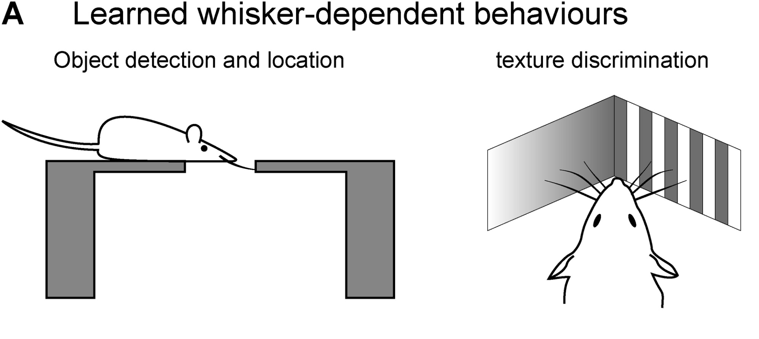
Petersen, Neuron, 2007

Slide 36
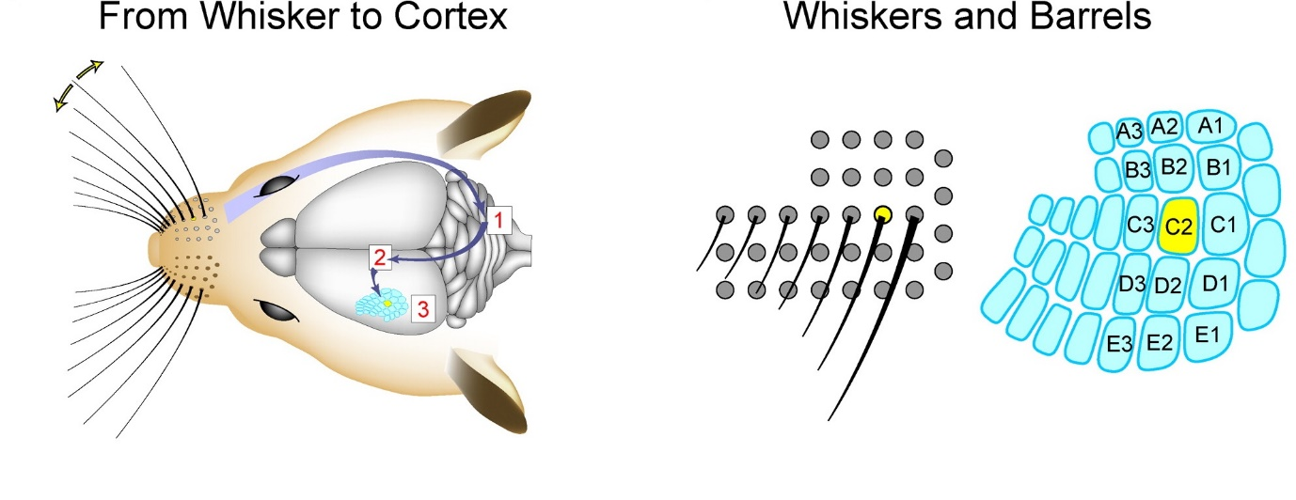
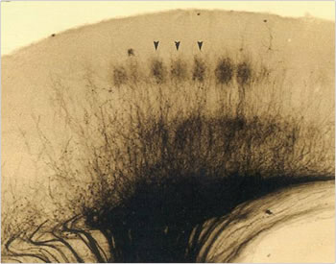
Rodent somatosensory (“barrel”) cortex
Thalamocortical (TC) axons targeting layer
4 neurons in barrel cortex
Initial processing of TC inputs in layer 4 is confined to individual barrels
https://doi.org/10.1016/j.neuron.2007.09.017

Slide 37
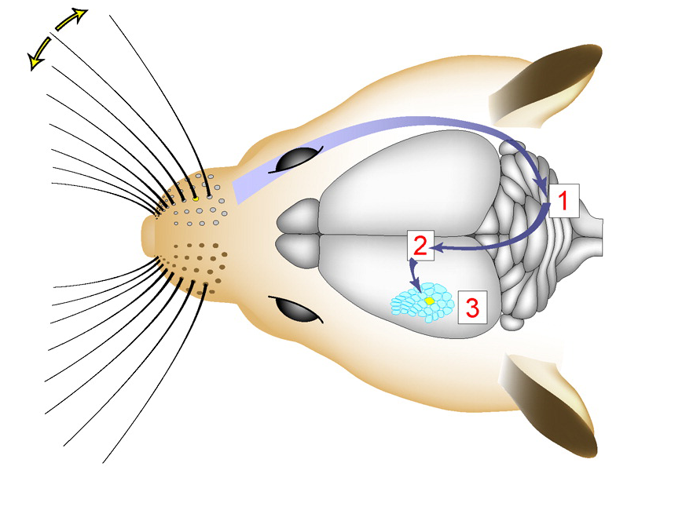
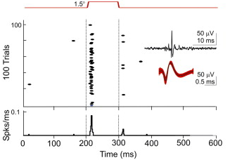
Moving individual whiskers triggers only a single spike in neurons of
layer 4 in barrel cortex
Gabernet et al., Neuron 2005
Excitatory cells in layer 4 and 2/3 within a single barrel column are
heavily interconnected
-> why do thalamic inputs only trigger single spikes???

Slide 38
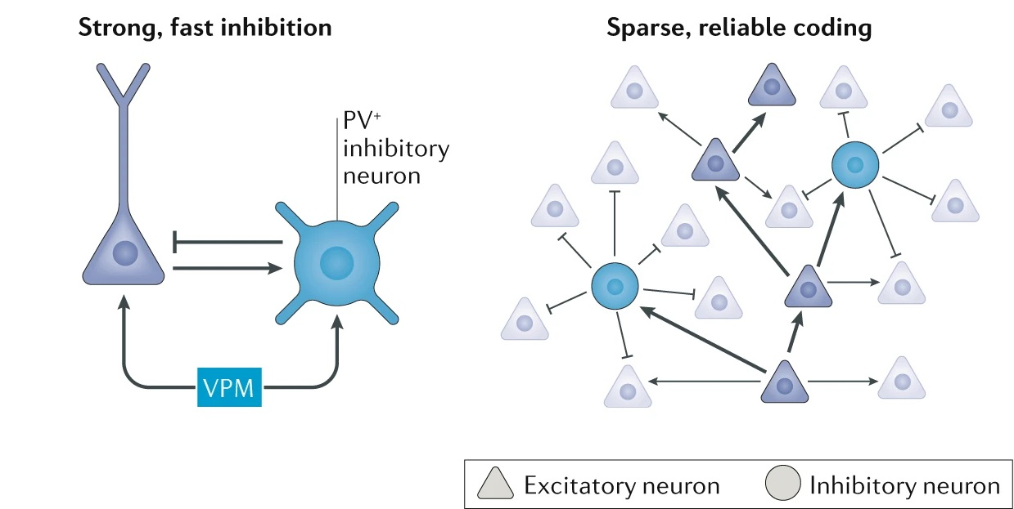
PV interneurons mediate “sparse” and reliable activity in local circuits of barrel cortex
Thalamus
Petersen, Nature Reviews Neuroscience, 2019

Slide 39
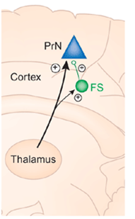
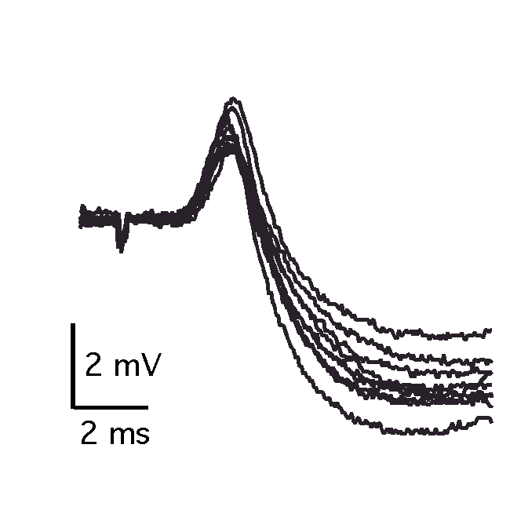
Inhibitory fast-spiking (FS) cells mediate rapid and precise feedforward inhibition
of thalamocortical inputs
Thalamocortical monsosynaptic EPSP
Disynaptic IPSP
Based on in-vitro recordings in brain slices

Slide 40
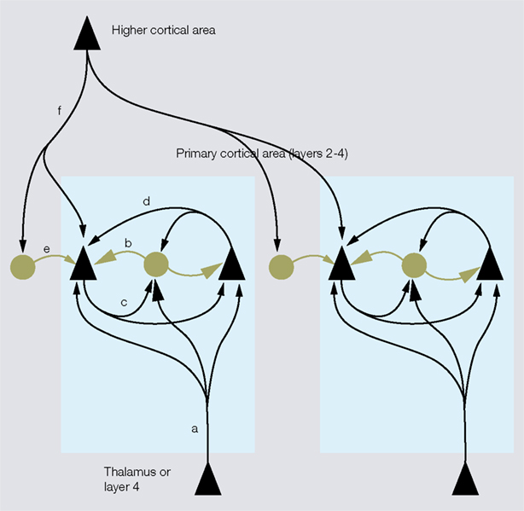
Feedforward inhibitory circuits are common for thalamocortical, interlaminar and
inter-area cortical circuits

Slide 41
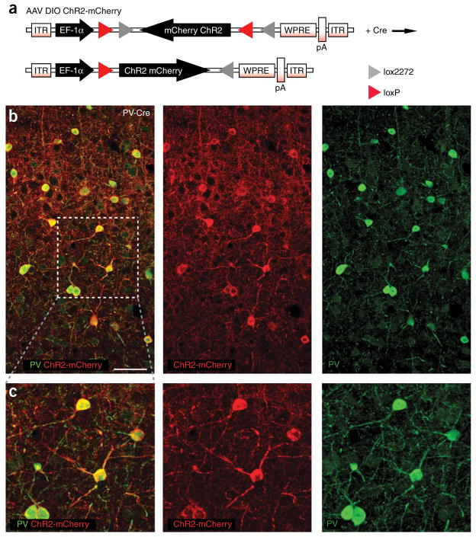
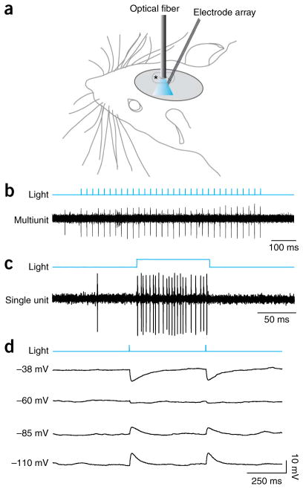
Manipulating PV neuronal activity in vivo using ChR2
PV ChR2-mCherry ChR2-mCherry PV
ChR2 expression in PV (FS) interneurons using
AAV DIO ChR2-mCherry in PV-Cre knock-in mouse
Cardin et al., Nature Protoc., 2010

Slide 42
Light-evoked activity in PV⁺ inhibitory interneurons suppresses
sensory processing in nearby excitatory neuron
Cardin et al., Nature 2009

Slide 43
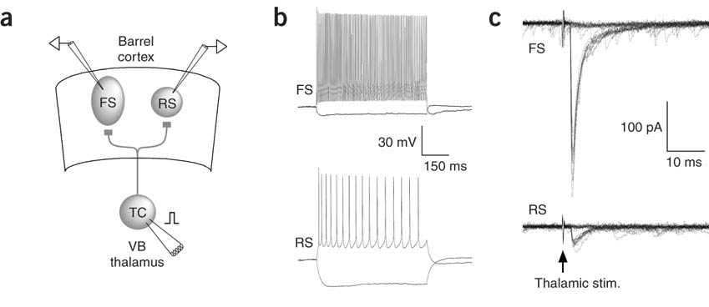
Synaptic basis for strong and rapid feedforward inhibition
mediated by FS/PV neurons
Excitatory synapses formed onto FS interneuron are larger than the ones
formed onto excitatory (RS) neuron
Cruikshank et al., Nature Neuroscience 2007

Slide 44
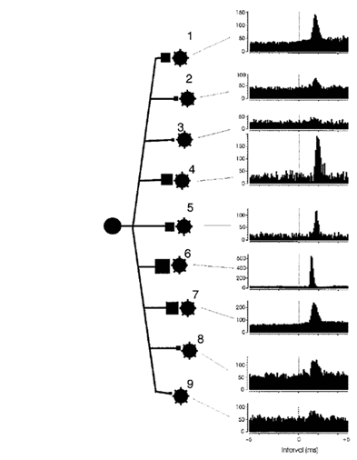
2. Synaptic divergence
Cross-correlation analysis in vivo: Individual thalamocortical axons contact
many FS interneurons, but fewer RS cells
Synaptic weight
Relay cell
In thalamus
FS cell
Swadlow and Gusev,
Nature Neuroscience, 2002

Slide 45
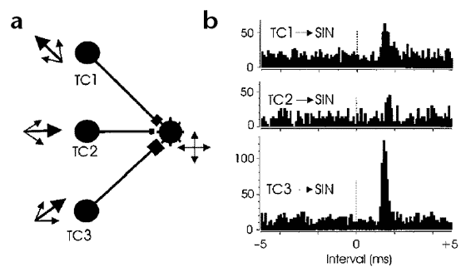
3. Synaptic convergence:
Individual FS cells are contacted by multiple thalamic relay neurons
Swadlow and Gusev,
Nature Neuroscience, 2002

Slide 46
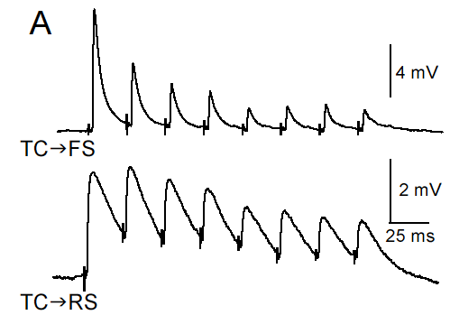
Strength of most synapses is dynamic and changes in a use-dependent manner (short-term plasticity)
Thalamocortical (TC) excitatory inputs onto FS cells shows strong short-term
synaptic depression (activity-dependent decrease in synaptic strength)
More modest synaptic depression of TC synapses onto RS cells

Slide 47
Synaptic depression at inhibitory synapses formed by FS neuron onto layer 4 RS cells
0
.
5
m
V
5
0
m
s
-> Feedforward inhibition (2 synapses in series) mediated by FS cells shows
strong activity dependent depression

Slide 48
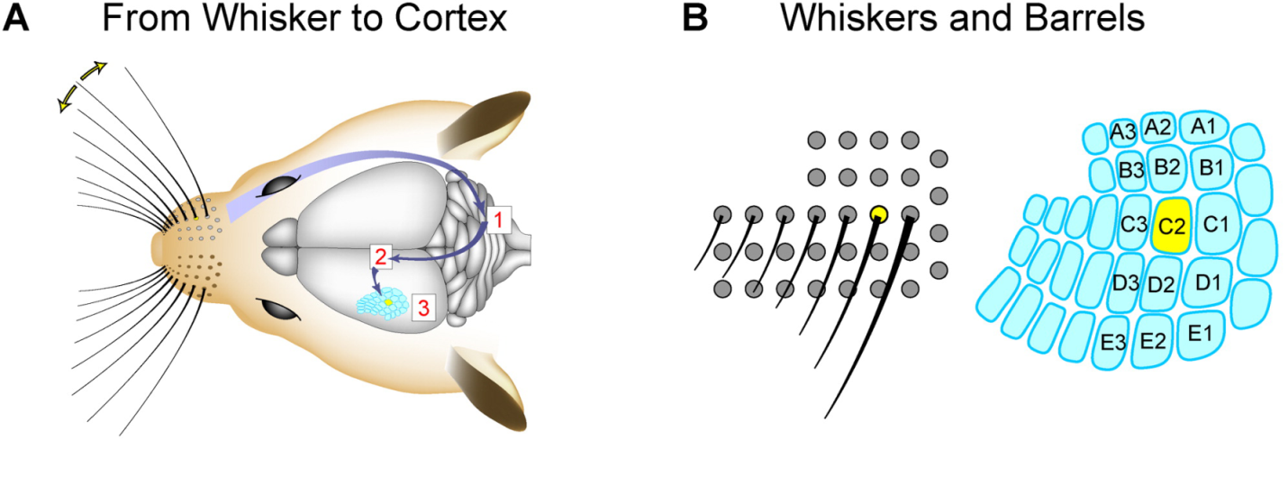
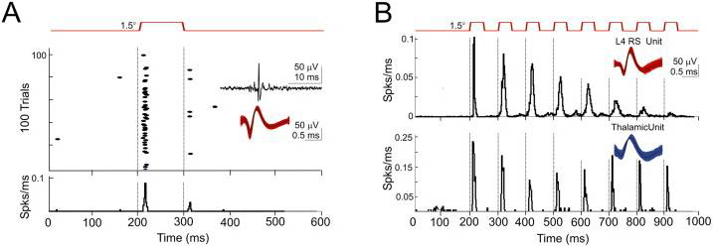
Increased Spike Jitter of Layer 4 RS cells In Vivo by Repetitive Whisker Stimulation
-> activity dependent synaptic depression of feedforward inhibition allows for longer integration time of thalamocortical excitatory inputs in cortical RS cells
Gabernet et al., Neuron 2005

Slide 49
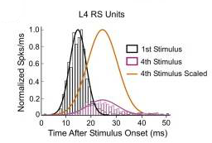
Activity dependent change in integration window in excitatory RS cells
-> time window in which spike can be generated becomes longer
Gabernet et al., Neuron 2005

Slide 50
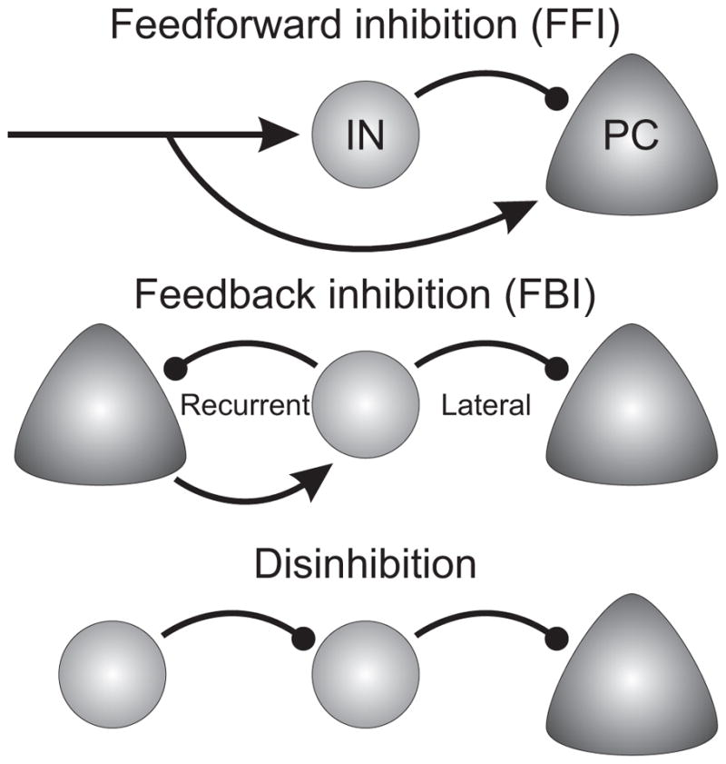
Examples of circuit “motives” involving distinct types of GABAergic interneurons (IN)
PV
VIP
SOM
Tremblay et al., Neuron 2016

Slide 51
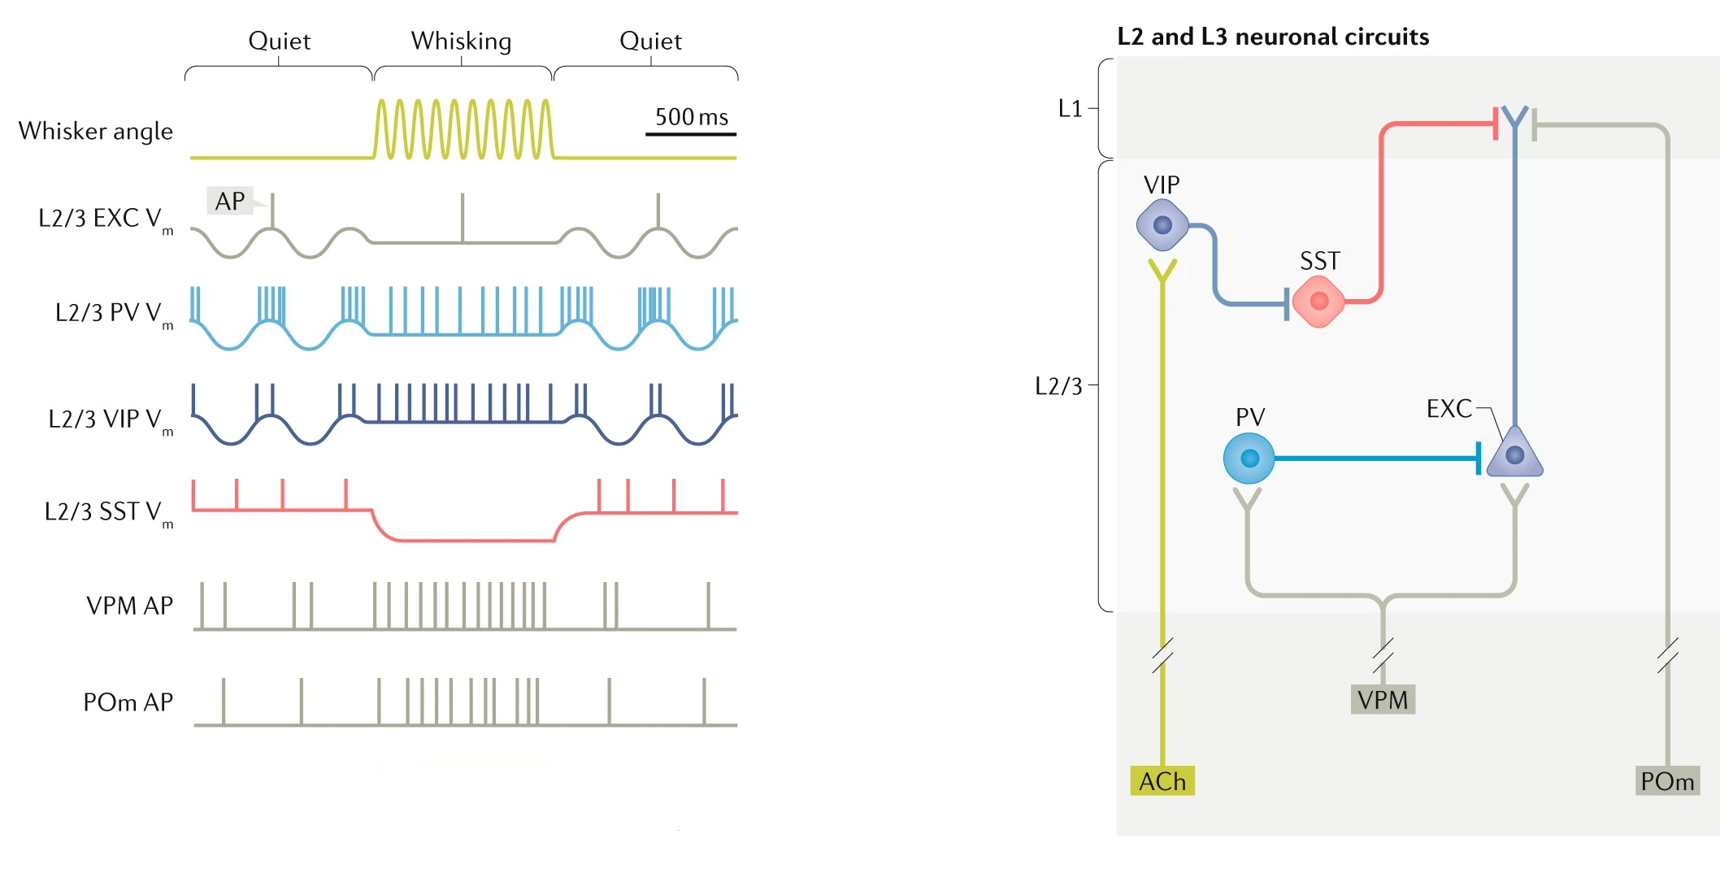
Differential recruitment of interneuron types during distinct behavioral states
Neuromodulators (e.g. ACh) have distinct effects on certain IN types
Synaptic connectivity (e.g. circuit motives) and synaptic plasticity varies with IN type
Petersen, Nature Reviews Neuroscience, 2019

Slide 52
Further (optional!) Reading:
Cell types:
Zeng & Sanes. Neuronal cell-type classification: challenges, opportunities and the path forward Nature Reviews Neuroscience volume 18, 530–546 (2017)
https://www.nature.com/articles/nrn.2017.85
(balanced and fairly recent review, which includes extensive discussion of experimental approaches)
Tremblay, Lee & Rudy. GABAergic interneurons in the neocortex: From cellular properties to circuits, Neuron. 2016 Jul 20; 91(2): 260–292.
https://www.ncbi.nlm.nih.gov/pmc/articles/PMC4980915/
Circuits:
Petersen Sensorimotor processing in the rodent barrel cortex
Nature Reviews Neuroscience volume 20, pages533–546 (2019)
https://www.nature.com/articles/s41583-019-0200-y
Niell and Scanziani How Cortical Circuits Implement Cortical Computations: Mouse Visual Cortex as a Model Annual Review of Neuroscience (2021)
https://www.annualreviews.org/doi/full/10.1146/annurev-neuro-102320-085825

