Slide 1

INTRODUCTION TO SYSTEMS NEUROSCIENCE
Valentin Dragoi
Department of Neurobiology and Anatomy

Slide 2
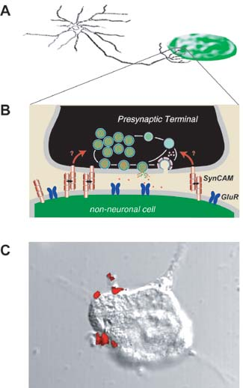
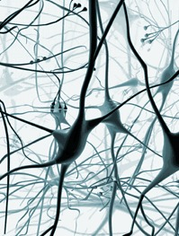
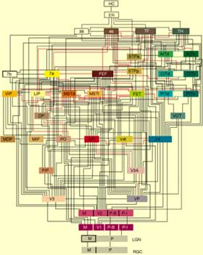
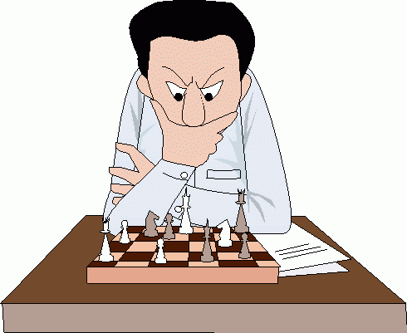
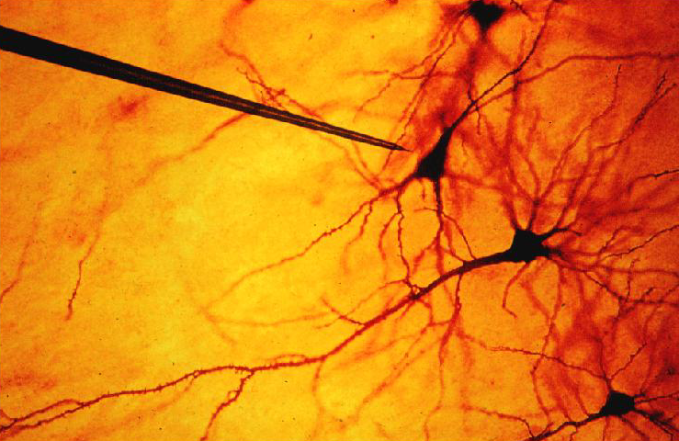
Molecules
Neurons
Populations
Systems
Behavior

Slide 3
Systems neuroscience is a subdiscipline of neuroscience which studies the function of neural circuits and systems.
Main questions:
1. How do neurons behave when connected together to form neural networks?
2. How do neural circuits analyze sensory information, form perceptions of the external world, make decisions, and execute movements?

Slide 4
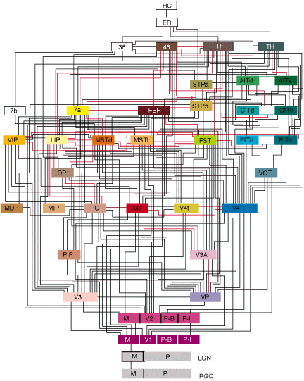
Hierarchical processing in cerebral cortex
Felleman and van Essen, Cereb Cortex, 1991

Slide 5
Single-electrode recording of neuronal activity

Slide 6
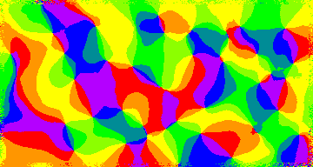
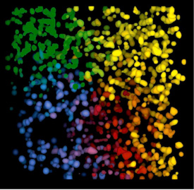
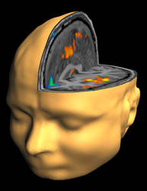
Optical techniques to examine population activity
fMRI
spatial resolution ~ 10³ μm
temporal resolution ~ 10³ ms
optical imaging
spatial resolution ~ 10-10² μm
temporal resolution ~ 10² ms
two-photon calcium imaging
spatial resolution ~ μm
temporal resolution ~ 10² ms

Slide 7
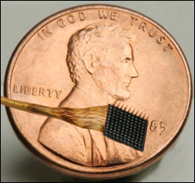
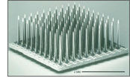
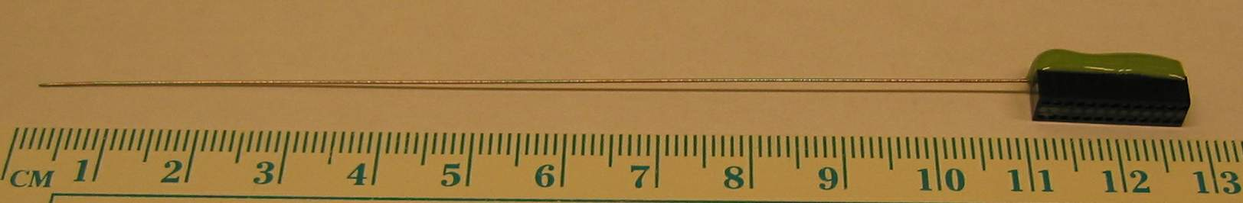
Electrophysiological recordings in human and non-human primates (Cyberkinetics)
4 mm by 4 mm base
100 silicon spikes that are 1.0 or 1.5 mm long

Slide 8
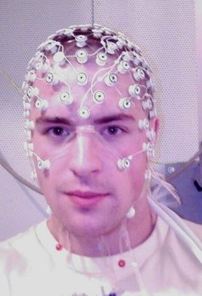
Scalp multi-electrode recordings in human cortex
Subdural multi-electrode recordings in human cortex

Slide 9
Course Information
Basics: 4 credit course meeting Tues/Thurs from 10:45-12:45 online (via Webex)
Textbook: “Neuroscience” 6th Edition by Purves, Augustine, Katz, Fitzpatrick, etc.
Lecturers: Dr. Michael Beierlein, Dr. Jack Byrne, Dr. Fabricio Do Monte, Dr. Pat Dougherty, Dr. Valentin Dragoi, Dr. Dan Felleman, Dr. Shin Nagayama, Dr. Christophe Ribelayga, Dr. Harel Shouval
Evaluation: Three take-home examinations will be used to assess the student’s acquisition of presented information. Grades will be assigned based on exam performance and student participation in class (e.g., 2As and 1B or 1A and 2Bs could result in a final A or B depending on class participation).

Slide 10
Outline
Functional neuroanatomy (11 hrs)
Brain anatomy – 1 hr, Felleman
Ascending and descending pathways – 1 hr, Felleman
Functional imaging techniques I (intrinsic signal imaging, voltage-sensitive dye imaging) – 1 hr, Felleman
Functional imaging techniques II (two-photon imaging) – 1 hr, Nagayama
Cell types – 1 hr, Beierlein
Cortical circuits (feedforward circuits) – 1 hr, Beierlein
Cortical circuits (recurrent circuits, canonical microcircuits) – 2hrs, Dragoi
Long-range intracortical connections – 1 hr, Dragoi
Inter-areal cortical connections (feedforward, feedback, corticofugal, cortico-cortical connections, etc) – 1 hr, Felleman
Functional architecture of the cerebral cortex – 1 hr, Felleman
EXAM 1

Slide 11
Neural circuits and information processing (11 hrs)
Receptive fields – 1 hr, Dragoi
Signal detection theory – 1 hr, Shouval
Cortical processing (non-linear properties of cortical responses) – 1 hr, Dragoi
Cortical processing: Extra-classical receptive field influences – 1 hr, Dragoi
Neuronal response properties revealed by imaging techniques – 1hr, Felleman
Cortical processing: Top-down modulation – 1 hr, Dragoi
Multiple-electrode recording (multiple single units, LFPs, EEG) – 2 hrs, Dragoi
Neuronal synchronization – 1 hr, Shouval
Signal and noise correlations – 1 hr, Dragoi
Introduction to population coding and decoding – 1 hr, Shouval
From neural circuits to systems (11 hrs)
Visual pathways – 1 hr, Dragoi
Auditory pathways – 1 hr, Dragoi
Somatic sensory system – 1 hr, Dougherty
Olfactory system – 1 hr, Nagayama
Motor control – 1 hr, Beierlein
Association cortex (parietal, temporal, prefrontal, etc) – 2 hrs, Dragoi
Sensory motor integration (eye movements, motor planning) – 1 hr, Dragoi
Space representation (hippocampus, entorhinal cortex) – 2 hrs, Shouval
Representation of reward – 1 hr, Shouval
EXAM 2

Slide 12
Plasticity and development of neural circuits (10 hrs)
Synaptic plasticity – 1 hr, Byrne
Consequences of synaptic plasticity – 2 hrs, Shouval
Adaptation-induced plasticity – 1 hr, Dragoi
Learning-induced plasticity – 2 hrs, Dragoi
Development of cortical circuits – 3 hrs, Felleman
Recovery from neural injury – 2 hrs, Felleman
Brain state (8 hrs)
Impact of brain state on neural responses – 1 hr, Dragoi
Circadian rhythms, arousal, and sleep – 2 hrs, Ribelayga
Stress – 1 hr, Do Monte
Fear and anxiety – 2 hrs, Do Monte
Reward and motivation – 2 hrs, Do Monte
EXAM 3

