Slide 1

ADAPTATION-INDUCED PLASTICITY
Valentin Dragoi
Department of Neurobiology and Anatomy
Notes:
1

Slide 2
Neuronal adaptation
Stimulus
t=4s
Adaptation: prolonged exposure to a potent stimulus reduces responses to subsequent stimuli (Blakemore & Campbell, 1969; Maffei et al., 1973; Movshon & Lennie, 1979; Ohzawa et al., 1982; Hammond et al., 1985, 1989; Geisler & Albrecht, 1992; Carandini & Ferster, 1997).
Adaptation to similar stimuli reduces the redundancy of natural signals and improves information transmission (Attneave, 1954; Barlow, 1990; Muller et al., 1999; Wainwright, 1999).

Slide 3
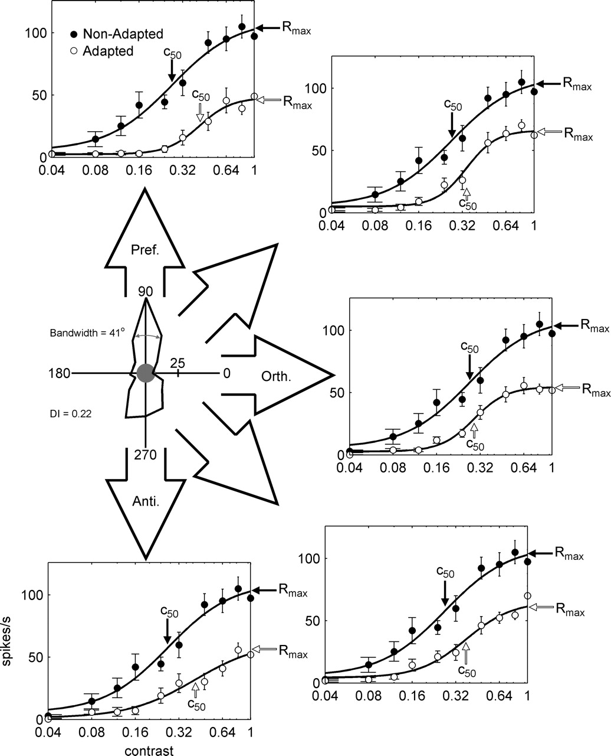
Adaptation reduces contrast sensitivity of individual neurons
Crowder NA, Price NS, Hietanen MA, Dreher B, Clifford CW, Ibbotson MR.
J. Neurophysiol, 2006
Relationship between contrast adaptation and orientation tuning in V1 and V2 of cat visual cortex.

Slide 4
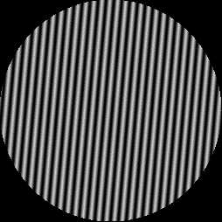
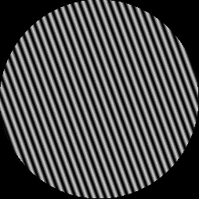

Tilt aftereffect
Adapting stim
2 minutes
Test stim
1 second
Perceived stim

Slide 5




Adaptation-induced orientation plasticity in V1
…
…
Control
Adaptation
Dragoi et al., Neuron, 2000

Slide 6
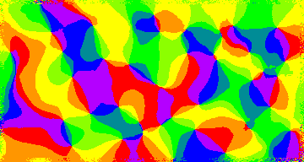

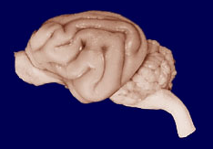
How is the capacity for adaptive changes mapped onto the cortex?
Orientation domain
Pinwheel center

Slide 7
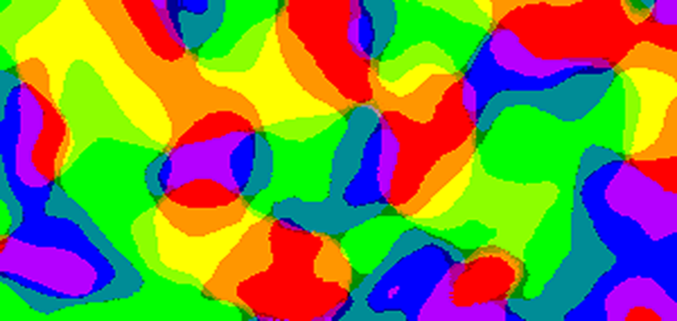
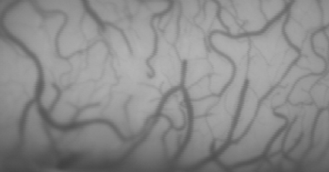
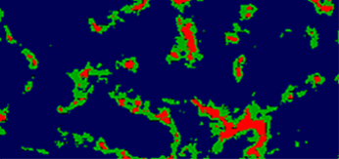

Pinwheels and orientation domains
0.66-1
0.33-0.66
0-0.33
1 mm
L
A
P
M
Dragoi, Rivadulla, and Sur, Nature, 2001

Slide 8
The distribution of local inputs to cortical neurons is heterogeneous across the cortical surface
high ODI
low ODI
Dragoi, Rivadulla, and Sur, Nature, 2001

Slide 9




The capacity for adaptation in NOT uniform across the cortex
8
Control
Adaptation
Firing rate (Hz)
4
0
0
45
90
135
180
Orientation (º)
28
Firing rate (Hz)
14
0
0
45
90
135
180
Orientation (º)
40
Firing rate (Hz)
20
0
0
45
90
135
180
Orientation (º)
Dragoi et al., Nature, 2001

Slide 10
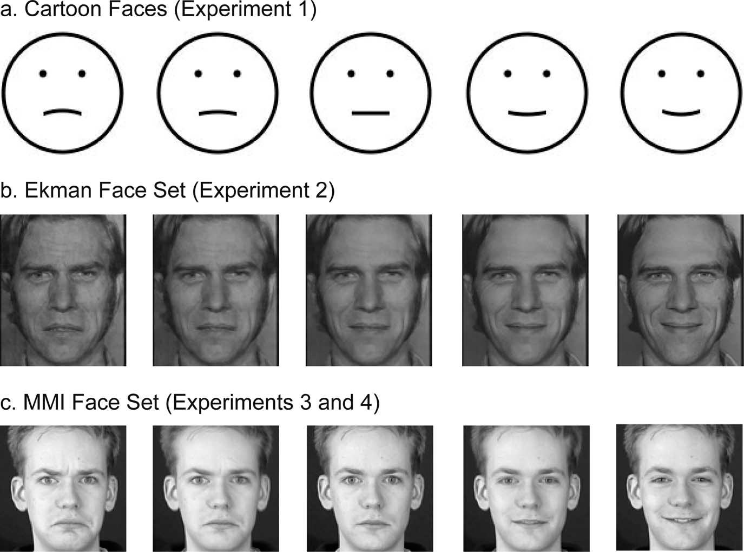
Adaptation to high-level stimulus features

Slide 11
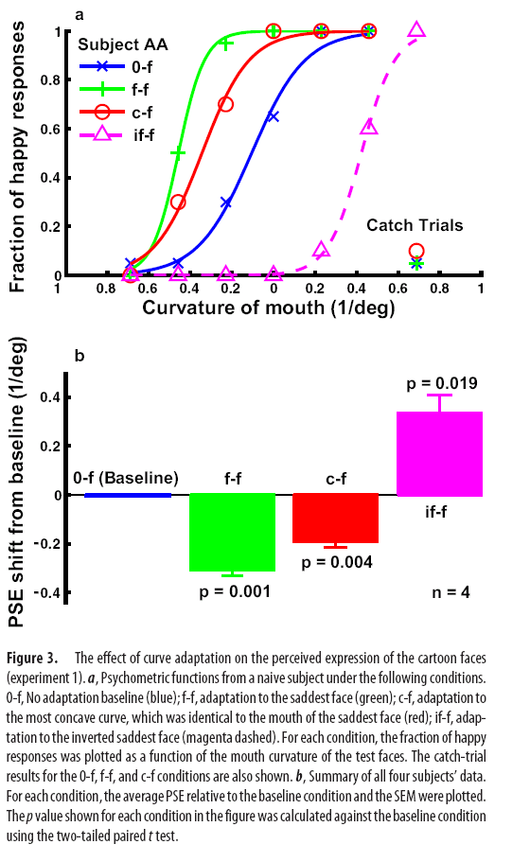
Adaptation across the Cortical Hierarchy: Low-Level Curve
Adaptation Affects High-Level Facial-Expression Judgments
J. Neurosci, 2008
Hong Xu,1 Peter Dayan,2 Richard M. Lipkin,1 and Ning Qian1

Slide 12
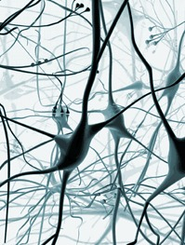
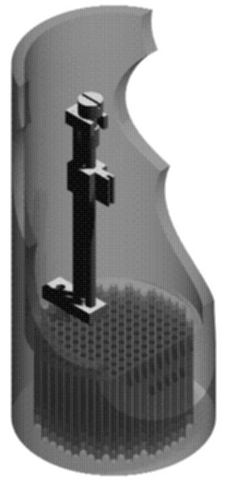
Do the properties of the population code change after adaptation?

Slide 13
Correlation in trial-by-trial variability before adaptation
sc (neuron 2)
sc (neuron 1)
Gutnisky and Dragoi, Nature, 2008

Slide 14
Adaptation decorrelates V1 responses
sc (neuron 2)
sc (neuron 1)
Gutnisky and Dragoi, Nature, 2008

Slide 15
Correlation strength is reduced after adaptation
Gutnisky and Dragoi, Nature, 2008

Slide 16
Rapid adaptation improves the population orientation discrimination performance
Independent
4
Control correlation (mean)
Control correlation (mean + var)
Adaptation correlation (mean)
3
Adaptation correlation (mean + var)
Threshold (º)
2
1
0
100
200
300
400
500
Population size
Gutnisky and Dragoi, Nature, 2008

Slide 17
Suggested readings
1. Dragoi V, Sharma J, Sur M. Adaptation-induced plasticity of orientation tuning in adult visual cortex. Neuron. 2000 Oct;28(1):287-98.
2. Dragoi V, Rivadulla C, Sur M. Foci of orientation plasticity in visual cortex.
Nature. 2001 May 3;411(6833):80-6.
3. Kohn A, Movshon JA. Adaptation changes the direction tuning of macaque MT neurons. Nat Neurosci. 2004 Jul;7(7):764-72. Epub 2004 Jun 13.
4. Xu H, Dayan P, Lipkin RM, Qian N. Adaptation across the cortical hierarchy: low-level curve adaptation affects high-level facial-expression judgments. J Neurosci. 2008 Mar 26;28(13):3374-83.

Slide 18
LEARNING-INDUCED PLASTICITY
Valentin Dragoi
Department of Neurobiology and Anatomy
Notes:
18

Slide 19
Spike timing dependent plasticity
Breakthough experiments:
Markram et al., Science, 1997
Bi et al., J. Neuroscience, 1998 (MM Poo group)
Synaptic plasticity is sensitive to the temporal order (in ms) between pre-synaptic and post-synaptic firings.
In Bi’s experiment: repeatedly, in low frequency (1 HZ), introducing pre- & post- synaptic spiking pairs.
Pre-syn
Pre-syn
Post-syn
Post-syn
Δt>0
Δt<0

Slide 20
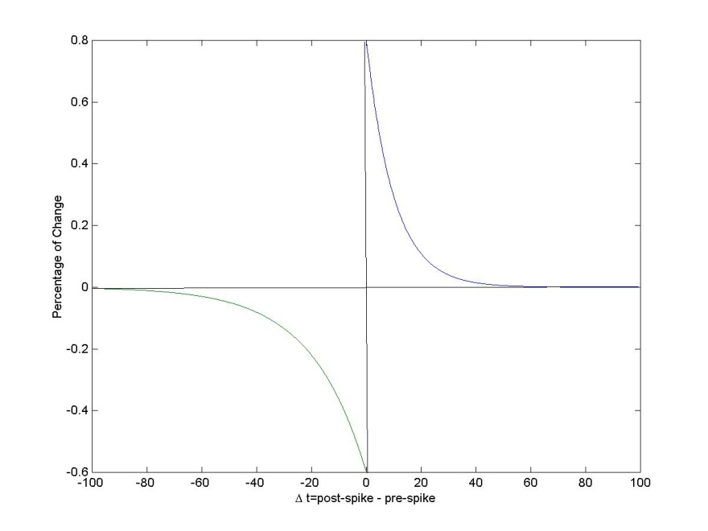
The time-window
For the culture of rat Hippocampal cell
Time window ~ 20 ms
LTP, if Δt > 0
LTD, if Δt < 0
The percentage of change:

Slide 21
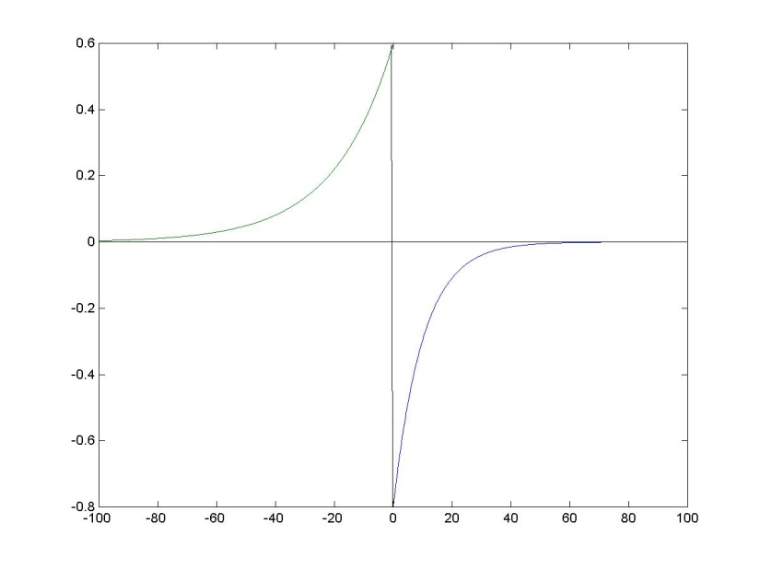
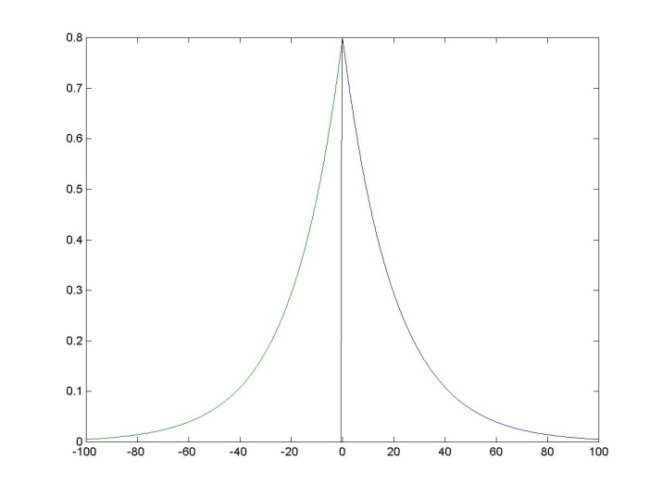
Other forms of STDP
Reversed LTP/LTD
Symmetrical time-window

Slide 22
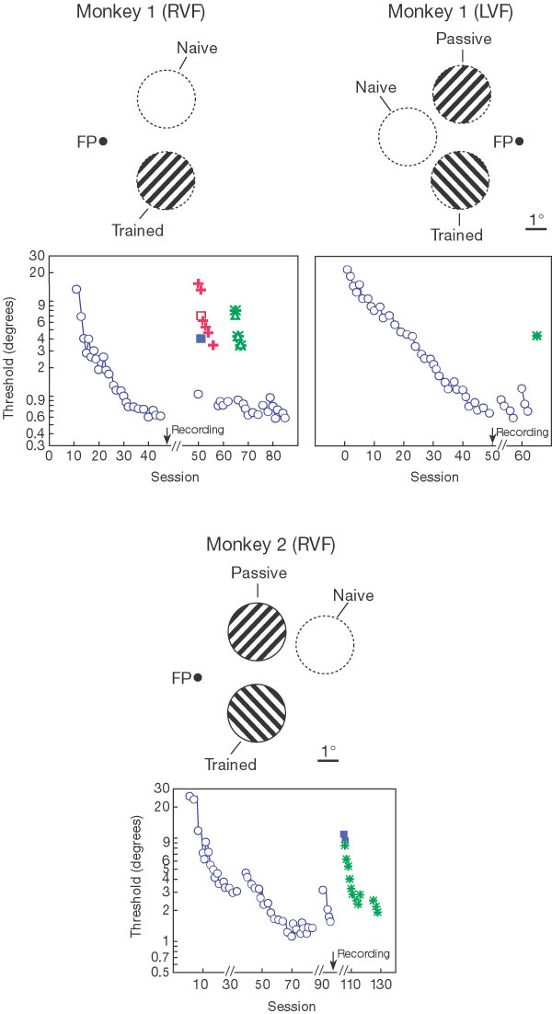
Perceptual learning improves orientation discriminability in V1
Practising orientation identification improves orientation coding in V1 neurons.
Schoups A, Vogels R, Qian N, Orban G.
Nature. 2001

Slide 23
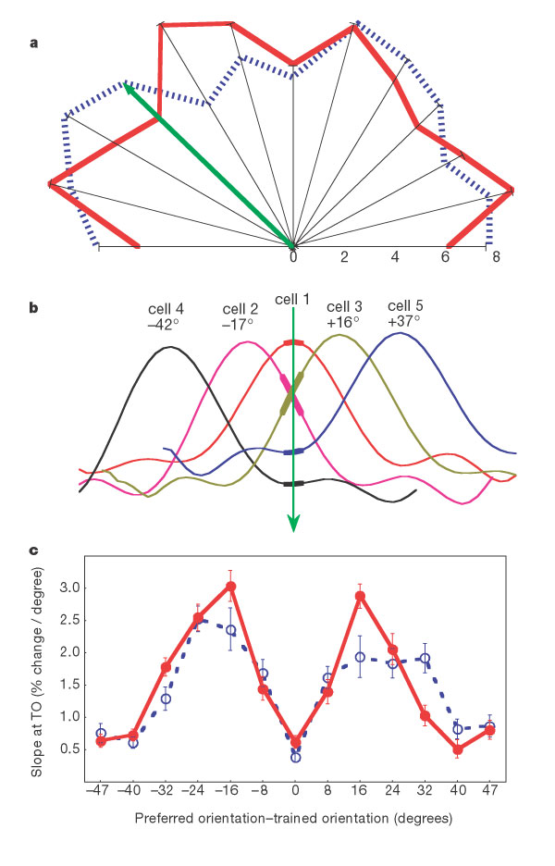
Perceptual learning improves orientation discriminability of neurons around the trained orientation

Slide 24
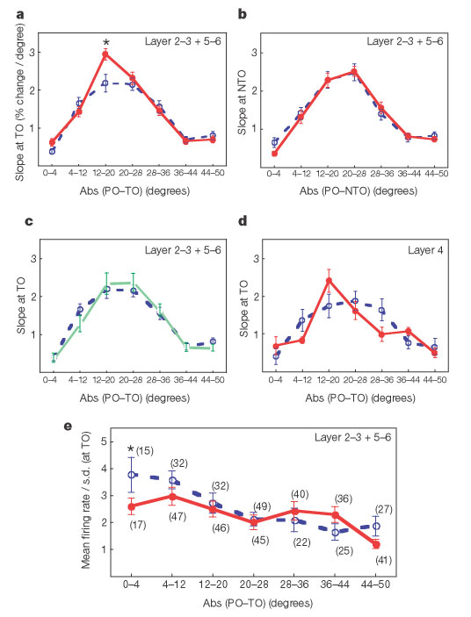
Perceptual learning improves orientation discriminability of neurons around the trained orientation

Slide 25

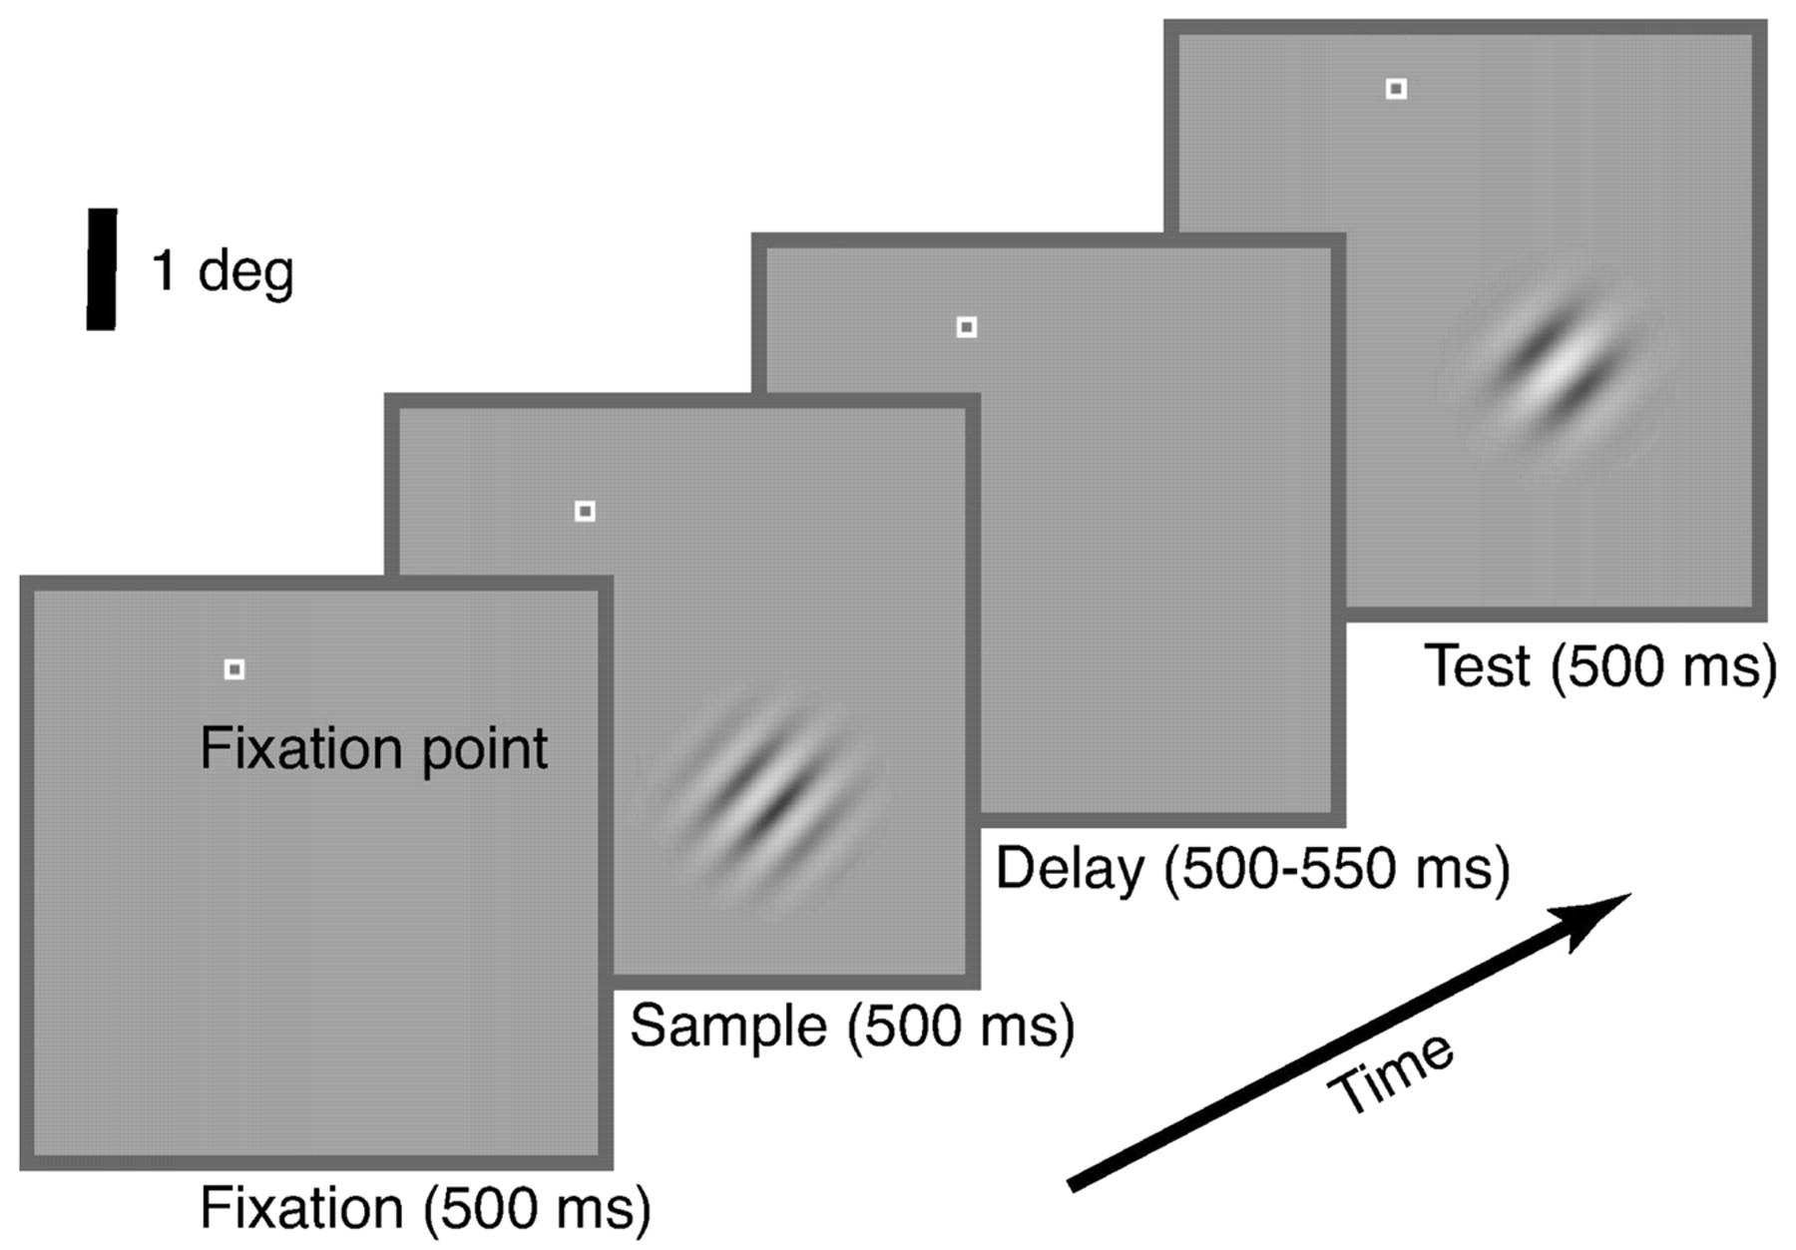

Neuronal responses in visual cortex (area V4) are influenced by learning
Yang, T. et al. J. Neurosci. 2004;24:1617-1626
Copyright ©2004 Society for Neuroscience

Slide 26
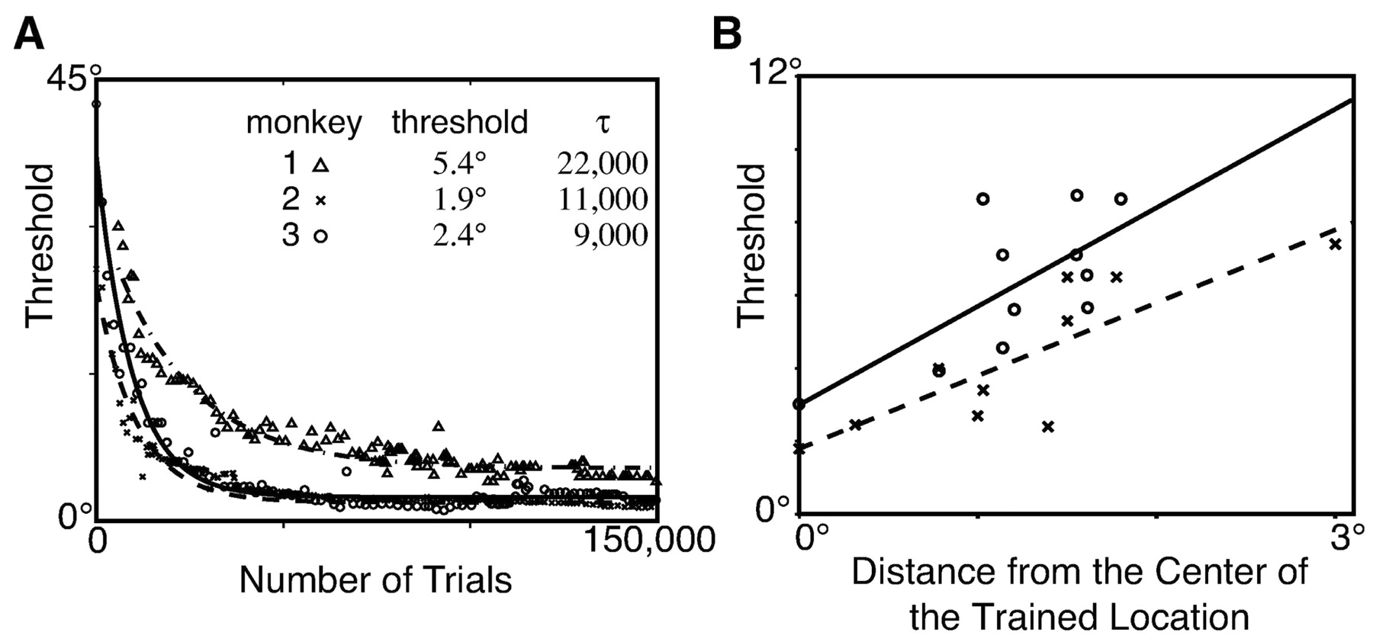
Improvement in behavioral performance during learning
Yang, T. et al. J. Neurosci. 2004;24:1617-1626
Copyright ©2004 Society for Neuroscience

Slide 27
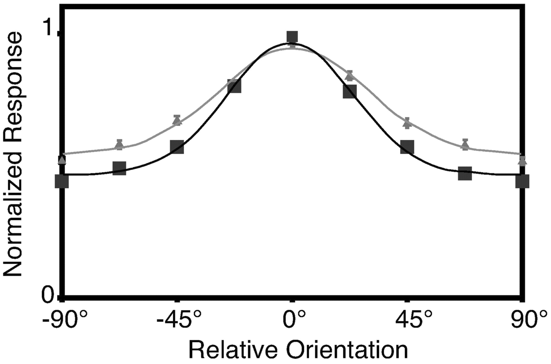
Population orientation tuning curves in V4 (before and after learning)
Trained
Control
Yang, T. et al. J. Neurosci. 2004;24:1617-1626
Copyright ©2004 Society for Neuroscience

Slide 28
What are mechanisms by which learning induces neuronal plasticity?
Changes in synaptic efficacy: LTP/LTD
Reward
Persistent activity

Slide 29
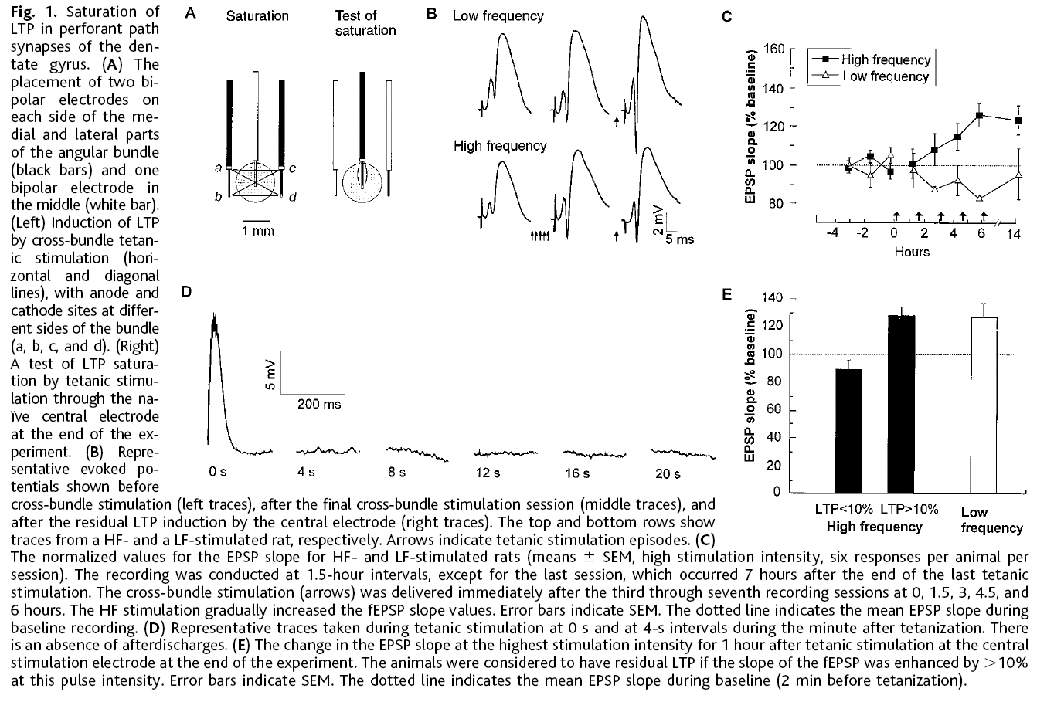
Impaired learning after saturation of LTP
(Moser et al., 1998)

Slide 30
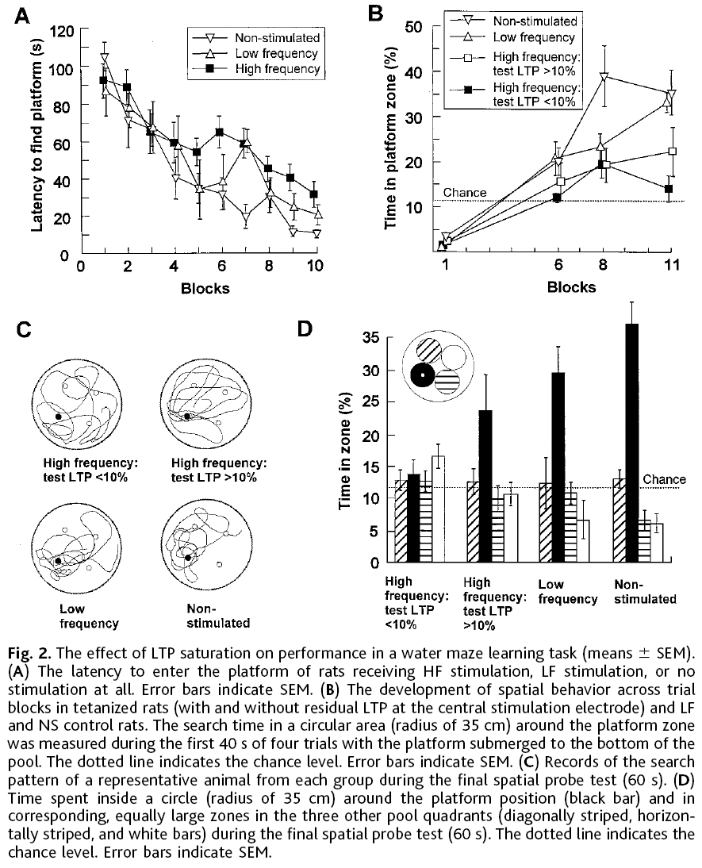
Impaired learning after saturation of LTP
(Moser et al., 1998)

Slide 31
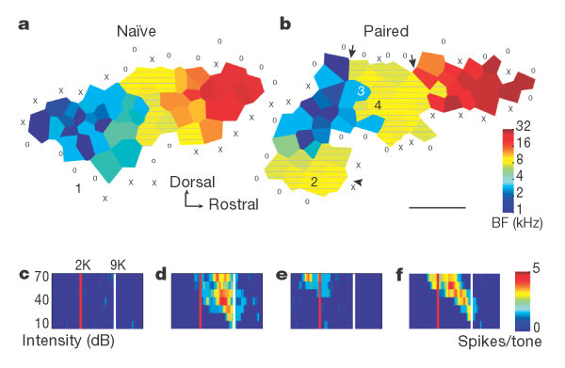
Plasticity of sensory representation after VTA microstimulation
(Bao et al., Nature,2001)
a, b, Cortical maps from a naive (a) and a VTA/tone-paired animal (b) (9-kHz pulsed tone). Hatched areas have best frequencies (BF) within 0.3 octaves of 9 kHz. Scale bar, 500 m. 0, unresponsive site; X, non-AI site. The tone-responsive auditory cortex of the paired animal consists of two separate zones: AI and a ventroposterior field (arrowhead). In AI, the representation of 9 kHz was expanded while representations of adjacent frequencies were reduced, creating sharp best-frequency transitional boundaries (arrows). c–f, Receptive fields recorded from sites marked 1–4 in the two representative maps.

Slide 32
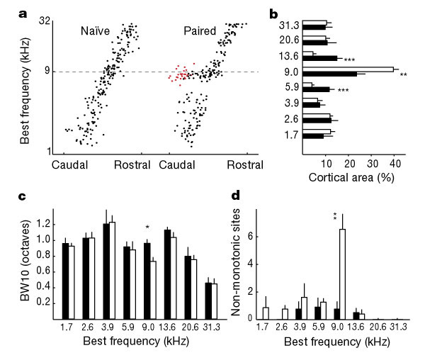
Plasticity of sensory representation after VTA microstimulation
(Bao et al., Nature,2001)
a, Distribution of best frequency along the anterior–posterior axis of the auditory cortex. Points corresponding to the sites in the ventorposterior field are indicated in red (n = 4 for each group). b, Per cent of the auditory cortex that was tuned to each frequency. Black bar, naive; white bar, paired; bin size, 0.6 octave. c, Response bandwidth at 10 dB (BW10) above threshold. d, Number of penetrations with non-monotonic rate–level function. For b–dn = 6 for the naive group and n = 7 for the paired group. Asterisk, P < 0.01; double asterisk, P < 0.005; triple asterisk, P < 0.001.

Slide 33
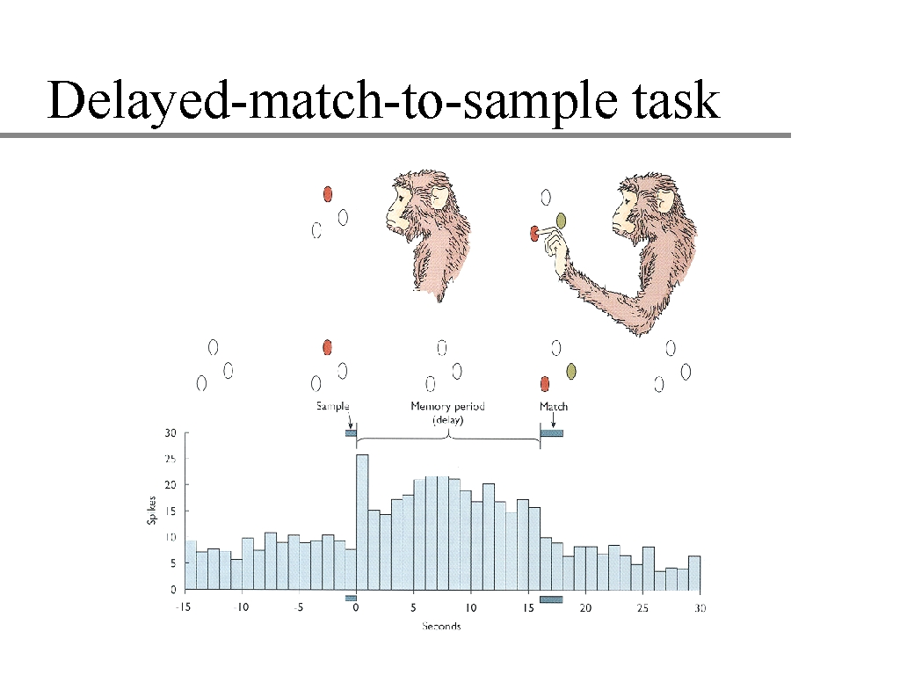
Does learning influence persistent activity?

Slide 34
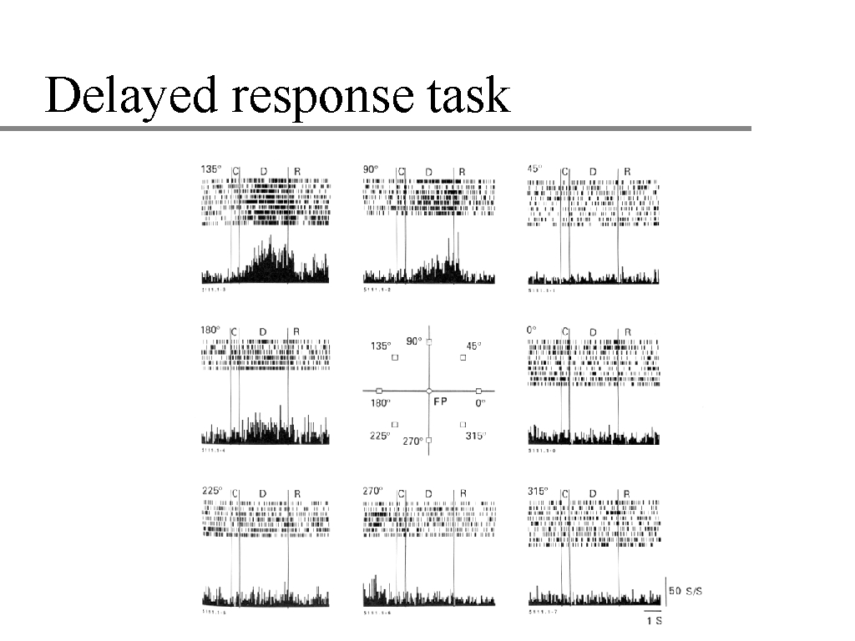
from Goldman-Rakic lab

Slide 35
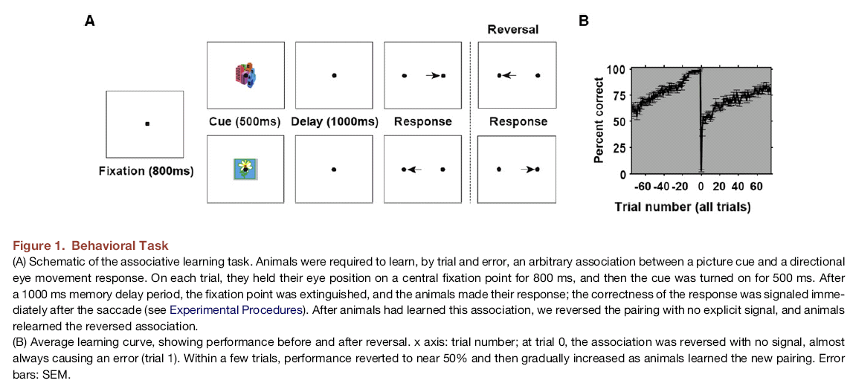
Associative learning is accompanied by pronounced persistent activity indicating the correctness of the behavioral response
(Histed et al, Neuron, 2009)

Slide 36
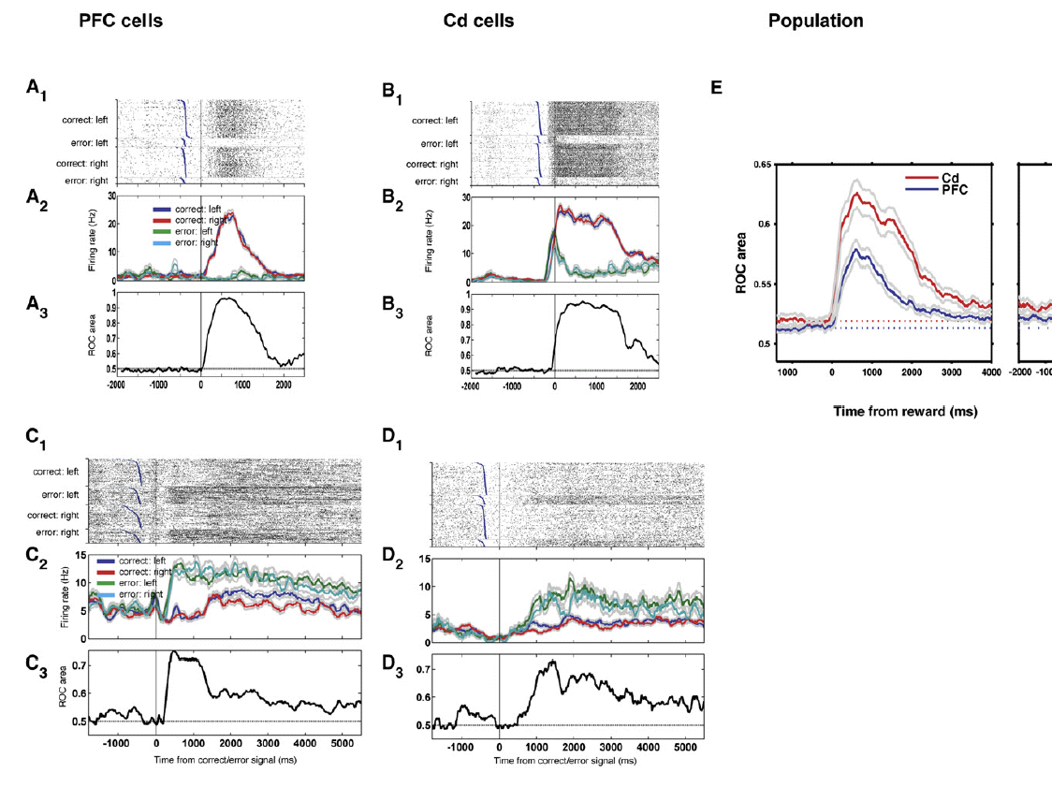
Histed et al, Neuron, 2009
Cells Signal Correct or Error Outcome (A1–A3) Single cell recorded from the PFC showing an increase in firing rate after the correct outcome was signaled. (A1): trial raster; each tick corresponds to a spike. (A2): histogram of the same trials. Firing rates (colored lines) were computed by convolving the spike trains in (A1) with a 140 ms square kernel. (A3): information that this cell gives about correct versus error at each time point, measured as area under ROC curve (y axis). (B1–B3) A second cell from Cd that exhibits a similarly strong increase in firing rate on correct trials. (C1–C3 and D1–D3) Single PFC and Cd cells showing sustained responses about reward versus error that lasted for several seconds into the next trial. (E) Population summary. y axis: mean reward information (reward ROC area) over the population of cells from each area.

Slide 37
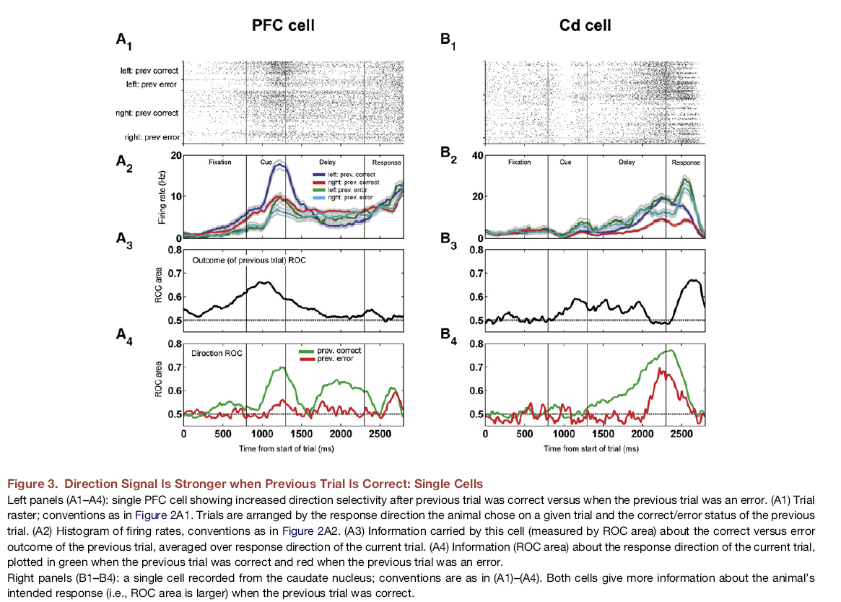
Histed et al, Neuron, 2009

Slide 38
Suggested readings
1. Schoups A, Vogels R, Qian N, Orban G. Practising orientation identification improves orientation coding in V1 neurons. Nature. 2001 Aug 2;412(6846):549-53.
2. Yang T, Maunsell JH. The effect of perceptual learning on neuronal responses in monkey visual area V4. J Neurosci. 2004 Feb 18;24(7):1617-26.
3. Bao S, Chan VT, Merzenich MM. Cortical remodelling induced by activity of ventral tegmental dopamine neurons. Nature. 2001 Jul 5;412(6842):79-83.
4. Histed MH, Pasupathy A, Miller EK. Learning substrates in the primate prefrontal cortex and striatum: sustained activity related to successful actions. Neuron. 2009 Jul 30;63(2):244-53.

