Slide 1
Impact of brain state on neural responses
Russell Milton
Valentin Dragoi
Systems Neuroscience Lecture
4-15-2021

Slide 2
Behavioral state naturally changes over the course of the day

Slide 3
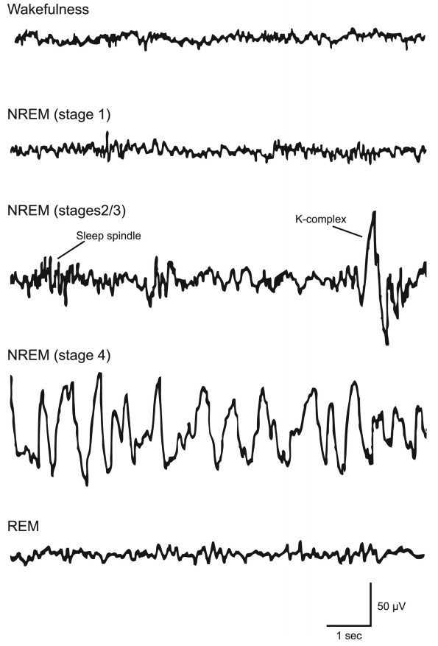
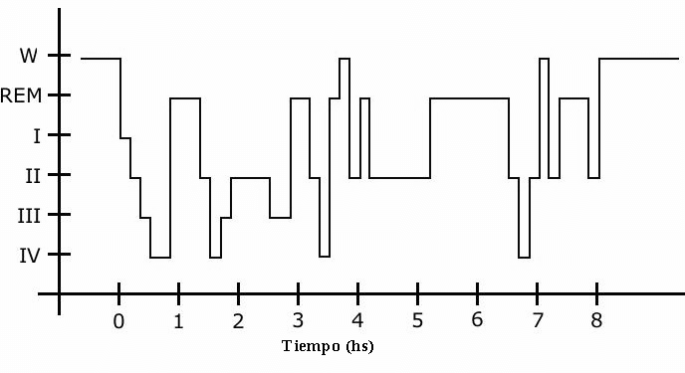
Cortical activity becomes increasingly synchronized as sleep stage deepens
Time (hours)
Garces et al., Int. J. Med. Sci. (2008)
Brown et al., Physiol Rev. (2012)

Slide 4
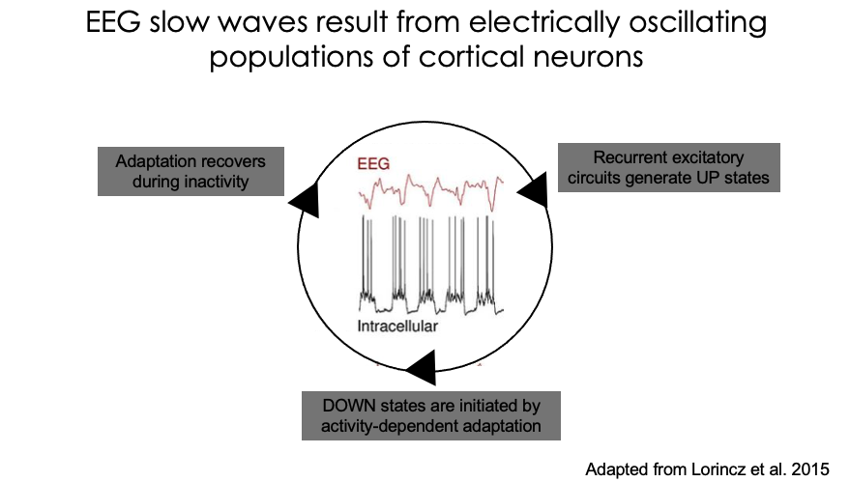
Slow-wave activity results from coherently oscillating neuronal populations

Slide 5
During whisking, membrane potential of somatosensory cortical neurons exhibit reduced low-frequency (0-10Hz) fluctuations and increased high-frequency (30-90Hz) fluctuations.
Exploratory whisking in mouse shifts neurons to a more activated cortical state
Low-frequency spectrogram
High-frequency spectrogram
Adapted from Crochet and Petersen. Nat Neurosci. 2006.
Notes:
Supplementary Figure 2. Membrane potential fluctuations switch from
low frequencies to high frequencies during whisking behaviour.
(a-d) Two examples illustrating the decrease in low frequencies (a, b) and
increase in high frequencies (c, d) of Vm fluctuations during whisking
behaviour. The recording in panel a is from a layer 4 spiny stellate neuron
located in the C2 barrel. Panel c shows a recording from a layer 2/3 pyramidal
2
neuron located in the C2 barrel column. (a, c) The top panel shows the
whisker movements detected with the position sensing photodiode (green
traces) and the simultaneously recorded Vm (black traces). The lower panel
depicts the evolution of the frequency spectrum during the recording. The FFT
was computed for a time window of 1 s that was shifted by steps of 0.1 s.
Note the different scaling in a and c (grey area in b and d) to show the
decrease in amplitude for low frequencies (around 3 Hz) in a and the increase
for high frequencies (> 30 Hz) in c during large whisker movements. (b, d)
The FFT was computed for periods of 3 s of quiet (blue) or whisking (red)
behaviour and depicted in log/log scale. Note the decrease in FFT amplitude
for low frequency band (b and d) and the increase in the high frequency band
(d). (e) The area below the FFT was calculated for the low frequency (LF, 1-5
Hz) and the high frequency (HF, 30-90 Hz) bands. The plots show the change
in FFT areas between quiet periods (Q, blue) and whisking behaviour (W, red)
for 23 neurons (grey lines). The right plot shows the change in the ratio
between high frequency area and low frequency area. Open squares indicate
the mean value ± SD. (f) Mean frequency spectra were obtained for quiet and
whisking behaviours by averaging the frequency spectrum for all 23 neurons.

Slide 6
Locomotion changes the state of mouse sensory cortices
The ‘quiet’ state has greater low-frequency power and lower high-frequency power relative to running, or the ‘active’ state
Adapted from Niell and Stryker. Neuron. 2010.
Notes:
Figure 1. (A) The mouse's head is fixed on top of a styrofoam ball suspended by air. Multisite silicon probes are used to measure spiking units, while data from pairs of optical mice are used to calculate the motion of the ball under the mouse. (B) Local field potential (LFP) power during the duration of a single recording, with corresponding speed trace shown below in green. (C) Distribution of mouse speed, showing a large fraction of time spent stationary and a wide distribution of running speeds. (D) Average power spectrum from recording shown in (B), during stationary versus moving periods. (E) Scatter plot of power around gamma peak (60–70 Hz) versus speed of movement, demonstrating a sharp transition between stationary and moving states.

Slide 7
Locomotion desynchronizes prefrontal cortical state in primates
Adapted from Milton et al. Nat Commun. 2020.

Slide 8
Pupil diameter increases in more ’aroused’ cortical states
Mouse
Primate
Adapted from McGinley et al. Neuron. 2015.
Adapted from Milton et al. Nat Commun. 2020.

Slide 9
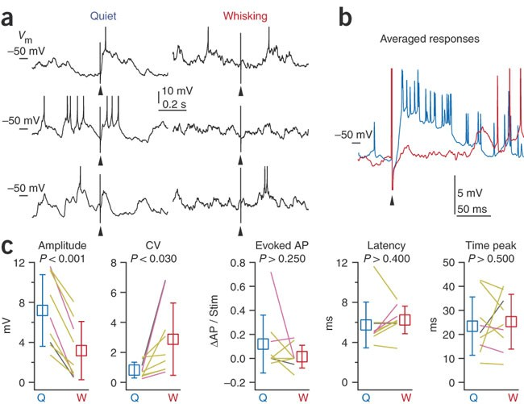
Responses to whisker stimulation are strongest and least variable when not whisking
Indicates whisker stimulation
Adapted from Crochet and Petersen. Nat Neurosci. 2006.
Notes:
Figure 2. (a) Brief whisker stimuli (arrowheads) were delivered randomly during a recording from a layer 4 spiny stellate neuron (black traces, V_{m} with truncated action potentials). Evoked responses were classified according to behavior (quiet, left column; whisking, right column). (b) The average sensory response for the same cell during quiet wakefulness (blue) was reduced during whisking (red) without a change in prestimulus V_{m} in this recording. (c) During whisking (W), the amplitude of sensory responses decreased and the coefficient of variation increased relative to quiet periods (Q). There was no statistically significant change in the number of evoked action potentials (APs, difference between post- and prestimulus), the latency or the time to peak. Lines indicate individual experiments (yellow, layer 2/3 neurons; magenta, layer 4 neurons; gray, neuron from unknown layer). Open squares show the mean values ± s.d. P values calculated with Student's paired t-test.

Slide 10
Auditory stimulus responses are strongest and most reliable at an intermediate pupil diameter
Pupil diameter is increased in more ‘aroused’ cortical states
Walking is associated with decreased auditory responses
Adapted from McGinley et al. Neuron. 2015.
Notes:
Figure 4. Subthreshold and Suprathreshold Evoked Responses in Auditory Cortex Are of Maximal Amplitude and Reliability at Intermediate Levels of Arousal
(A) Example whole-cell recording of responses to repeated presentation of a complex sound (TORC) sorted by pupil diameter. Sound presentation evokes the most spikes and largest, most reliable membrane potential depolarizations at intermediate pupil diameters. Tick marks on left are at the same membrane potential for reference.
(B) Group data (n = 6 recordings, N = 5 animals) illustrating that the maximal evoked action potential response in the Vm occurs at intermediate pupil dilation.
(C) Average TORC-evoked PSP amplitude (over baseline; see Experimental Procedures) peaks at intermediate pupil diameters.
(D) Reliability of synaptic responses (trial-to-trial cross-correlation of membrane potential) is highest at intermediate pupil dilations.
(E) Example PSTH responses of ACtx multiunit activity to a complex (TORC) sound are largest and most reliable at intermediate levels of pupil dilation.
(F) Group (n = 18 recordings, N = 6 animals) data illustrate that the average evoked firing rate is largest for intermediate pupil diameters. Both small and large pupil diameters are associated with decreased evoked (over spontaneous) responses. Walking is associated with decreased auditory responses, but to an extent not significantly different from responses during periods of non-walking with the same pupil diameters.
(G) Response reliability (average trial-to-trial cross correlation) is highest at mid-pupil diameters. Walking increases reliability over periods of non-walking with correspondingly large pupil diameters (p < 0.05).
(H) The increase in variance explained (over the PSTH alone) by incorporating walking status (left), pupil diameter (middle), or both (right). Incorporating both walking and pupil explains more variance than walking along, but not more than pupil diameter alone (n = 18; p < 0.05). Shaded areas indicate 68% CI.

Slide 11
Stationary Moving
Responses to preferred visual stimuli are greater during locomotion
Stimulus on
Trials
Adapted from Niell and Stryker. Neuron. 2010.
Notes:
Figure 2. Gray bar represents the period of stimulus presentation to an optimal full-field drifting grating. (A) Raster plot for a typical broad-spiking neuron, with individual trials coded as red (stationary) and blue (moving). (B and C) Histogram of responses during stationary (B) and moving (C) periods. (D) Orientation tuning curve. (E)–(H) show similar results for a typical narrow-spiking neuron. (I)–(L) show similar results representative of a subset of narrow-spiking neurons whose activity is suppressed in response to visual stimuli.

Slide 12
Locomotion can enhance the capacity for cortical plasticity in adult mice
Gray area indicates the range of response amplitude or ODI in age-matched mice with normal visual experience
Only visual stimulus + running condition lead to recovery of normal visual responses
Visual stimulation or running alone are not sufficient for recovery of responses
Adapted from Kaneko and Stryker. Elife. 2014.
Notes:
Visual stimulation during locomotion enhances recovery of cortical responses through the deprived eye after prolonged MD.
(A) Experimental schedule to examine changes in visual cortical responses over 21d-BV following prolonged MD started at postnatal day (P) 22–24. (B and C) Examples of intrinsic signal responses to the closed eye in the binocular visual cortex during 21d-BV in a home-cage control mouse (B) and in a mouse viewing contrast-modulated noise as VS during daily runs (VS+run, C). (D and E) Changes in intrinsic signal responses evoked by the noise through the closed (D) and open (E) eyes in home-cage (n = 8) and VS+run mice (n = 8). (F) Ocular dominance index (ODI) computed from response amplitude to contralateral (closed) and ipsilateral (open) eyes shown in D and E. ODI represents normalized difference in response magnitude between two eyes with 0 being equal amplitude to two eyes; the higher the number, more contralateral eye dominant. (G and H) Changes in intrinsic signal responses evoked by the noise through the closed (G) and open (H) eyes in run-only (n = 7) and VS-only mice (n = 7). (I) Ocular dominance index (ODI) computed from response amplitude to contralateral (closed) and ipsilateral (open) eyes shown in G and H. Gray area in D–I indicates the range of response amplitude or ODI in age-matched mice with normal visual experience. **p<0.01, *p<0.05, between groups.

Slide 13
Performance in an auditory detection task is maximized at an intermediate pupil diameter
Walking does not impact performance after pupil diameter is controlled for
Adapted from McGinley et al. Neuron. 2015.

Slide 14
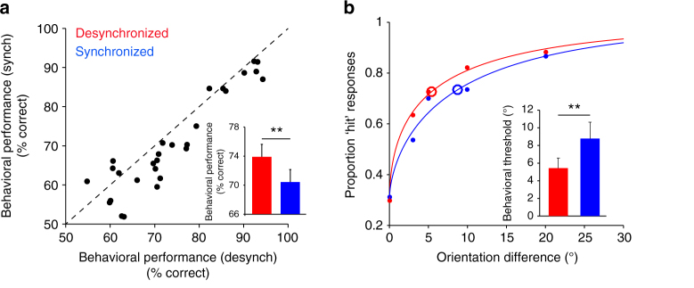
When the cortex is desynchronized, behavioral performance in an orientation discrimination task is improved and smaller changes can be detected
Adapted from Beaman et al. Nat Commun. 2017.
Notes:
Fig. 3 Population synchrony impacts behavioral performance. a Scatter plot of the behavioral performance (% correct responses) in synchronized vs. desynchronized trials. Each point represents one session. Inset, mean behavioral performance is significantly higher in desynchronized trials (**P < 0.001). Error bars represent standard error. b Psychometric curves associated with the synchronized and desynchronized cortical states. Large circles represent the psychometric thresholds. Solid dots represent the cumulative proportion of hit responses across trials and sessions for each orientation difference. We did not include the 2° orientation difference since it was only used in four sessions (however, the difference in the proportion of hit responses between desynch vs. synch trials was 5.6%). Inset, average behavioral performance threshold is significantly lower in desynchronized trials (**P < 0.005). c Percent difference in behavioral and decoder performance between the desynchronized and synchronized trials using the cell-dropping procedure (behavior: black; decoder: purple). The two curves represent exponential fits. Error bars represent standard error. d Percent difference in behavioral and decoder performance between desynchronized and synchronized trials for different window sizes to define PSI (**P < 0.005, *P < 0.05). e Percent difference in behavioral and decoder performance between desynchronized and synchronized trials after removing the high-firing rate (outlier) neurons from the population. Ø represents no neurons removed, >3 s.d. and >2 s.d. represent removing neurons with average spontaneous firing rates >3 s.d. and 2 s.d. above the population mean (**P < 0.005, *P < 0.05)

Slide 15
Summary
During wakefulness, ‘active behaviors’, such as whisking and locomotion, shift cortical activity to a more desynchronized state
Active wakefulness is associated with reduced low-frequency activity and increased high-frequency activity in membrane potentials and local-field potentials
Pupil diameter is increased in more activated states
Stimulus-evoked responses are enhanced in the visual cortex, but reduced in auditory and somatosensory cortices during active wakefulness

Slide 16
Suggested readings
1. Crochet S, Petersen CC. Correlating whisker behavior with membrane potential in barrel cortex of awake mice. Nat Neurosci. 2006 May;9(5):608-10.
2. Niell CM, Stryker MP. Modulation of visual responses by behavioral state in mouse visual cortex. Neuron. 2010 Feb 25;65(4):472-9.
3. Kaneko M, Stryker MP. Sensory experience during locomotion promotes recovery of function in adult visual cortex. Elife. 2014 Jun 26;3:e02798.
4. McGinley MJ, David SV, McCormick DA. Cortical Membrane Potential Signature of Optimal States for Sensory Signal Detection. Neuron. 2015 Jul 1;87(1):179-92.
5. Beaman CB, Eagleman SL, Dragoi V. Sensory coding accuracy and perceptual performance are improved during the desynchronized cortical state. Nat Commun. 2017 Nov 3;8(1):1308.
6. Milton R, Shahidi N, Dragoi V. Dynamic states of population activity in prefrontal cortical networks of freely-moving macaque. Nat Commun. 2020 Apr 23;11(1):1948.
Notes:
Crochet and Petersen. Nat Neurosci. 2006.
Niell and Stryker. Neuron. 2010.
Kaneko and Stryker. Elife. 2014
McGinley et al. Neuron. 2015.
Beaman et al. Nat Commun. 2017.
Milton et al. Nat Commun. 2020.

