Slide 1

SIGNAL AND NOISE CORRELATIONS
Valentin Dragoi
Department of Neurobiology and Anatomy
Notes:
1

Slide 2
Trial-by-trial fluctuations in neuronal responses
Trial 1
0
400
800
1200
1600
2000
Trial 2
0
400
800
1200
1600
2000
Trial 3
0
400
800
1200
1600
2000
Trial 4
0
400
800
1200
1600
2000
Time (ms)

Slide 3
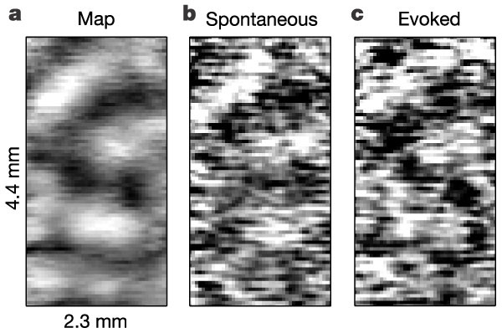
Spontaneous fluctuations resemble patterns of activity in response to specific stimuli
Kenet, Bibitchkov, Tsodyks, Grinvald, and Arieli, Nature, 2003

Slide 4
Responses of cortical neurons are correlated
Channel 1
Channel 2
Channel 3
…
…
Channel 24

Slide 5

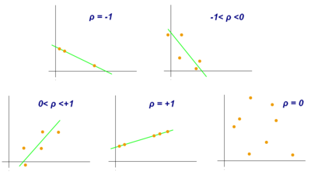
Pearson correlation coefficient

Slide 6
Correlation in trial-by-trial variability in visual cortex (noise correlations)
sc (neuron 2)
sc (neuron 1)

Slide 7
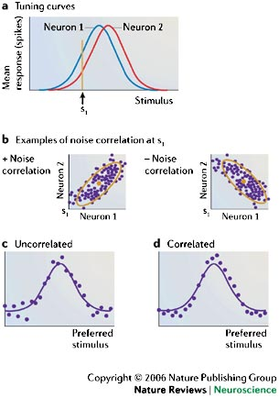
Signal and noise correlations
Population codes are often characterized by the 'tuning curve plus noise' model. In this model, the tuning curve represents the average response of a neuron to a set of stimuli, with the average taken across many presentations of each stimulus, and the noise refers to the trial-to-trial variability in the responses. In panel a, tuning curves are shown for two neurons that have slightly different preferred stimuli. In panel b, we show two hypothetical scatter plots of the single trial responses for this pair of neurons, in response to the repeated presentation of a single stimulus s₁ (arrow in panel a). Ellipses represent 95% confidence intervals. Responses also show a second sort of correlation known as signal correlation⁶¹. These are correlations in the average response. Neurons with similar tuning curves (panel a) typically have positive signal correlations, because when s increases, the mean responses of both neurons tend to increase, or decrease, together. Conversely, neurons with dissimilar tuning curves typically have negative signal correlations. In panels c and d we illustrate the response of a population of neurons. The x-axis corresponds to the preferred orientation of the neuron, the response of which is plotted on the y-axis. Each dot corresponds to the firing rate of one neuron in this example trial, and the purple curve shows the average response of each neuron in the population. Although the neurons in both panels c and d exhibit noise fluctuations, there is a difference in the structure of those fluctuations: on individual trials the responses of nearby neurons in panel c are uncorrelated (fluctuating up and down independently), whereas in panel d they are correlated (tending to fluctuate up and down together). Note that nearby neurons in panel d are positively correlated (as in panel b, left) whereas those that are far apart are negatively correlated (as in panel b, right).
Averbeck et al. Nature Reviews Neuroscience 7, 358–366 (May 2006)

Slide 8
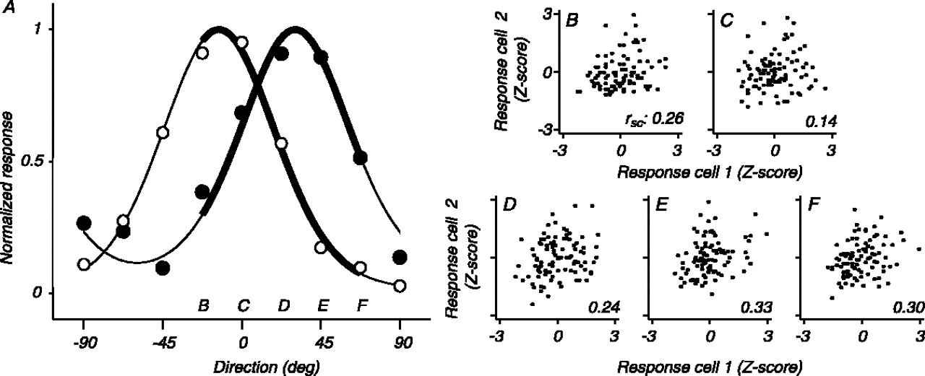
Noise correlations in primary visual cortex
Figure 1. Example of the independence of spike count correlation and orientation. A, Tuning curves for two V1 neurons. Range of orientations used to measure correlation are indicated by thick lines; letters indicate the stimulus used for each scatter plot. B-F, Scatter plots of responses of V1 pair to 100 presentations of each stimulus. The response of each cell is normalized by subtracting the mean response to that stimulus and dividing by the SD of the responses. The r_{sc} values are indicated. deg, Degrees.

Slide 9
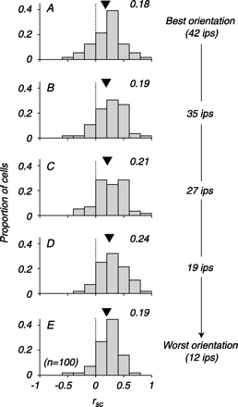
Relationship between firing rate and noise correlations for stimuli of different orientations
(Kohn and Smith, J Neurosci, 2005)
Population histograms of r_{sc}, arranged for each cell from the stimulus that drove the pair most effectively to that which evoked the weakest response (average firing rate for each condition indicated at right). The number next to each plot is the mean of the distribution (shown by arrowhead). The distributions are not significantly different.

Slide 10
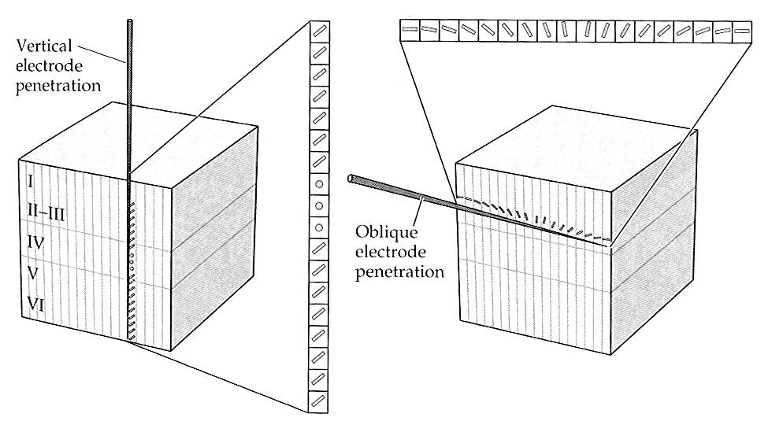
Nearby cells are strongly correlated
strong correlations
moderate correlations
weak correlations
Hubel and Wiesel, 1962

Slide 11
Noise correlations depend on stimulus preference
Probability density
x 10
-4
3
2.5
Correlation coefficient
2
1.5
1
0.5
0
30
60
90
Orientation difference (Δθ)
Gutnisky and Dragoi, Nature, 2008

Slide 12
Neurons use their full dynamic range if responses are uncorrelated
S₂
S₂
Neuron 2
Neuron 2
Neuron 1
Neuron 1
S₁
S₁
Adapted from Barlow and Foldiak, 1989

Slide 13
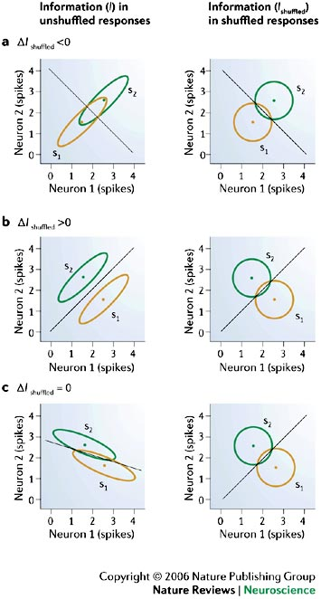
Noise correlations and stimulus classification
Response distributions for two neurons that respond to two different stimuli. The panels on the left show the unshuffled responses, those on the right show the shuffled responses. Each ellipse (which appears as a circle in the uncorrelated plots) indicates the 95% confidence interval for the responses. Each diagonal line shows the optimal decision boundary — that is, responses falling above the line are classified as stimulus 2 and responses below the line are classified as stimulus 1. The x-axis is the response of neuron 1, the y-axis the response of neuron 2. a | A larger fraction of the ellipses lie on the 'wrong' side of the decision boundary for the true, correlated responses than for the independent responses, so Δ I_{shuffled} <0. b | A smaller fraction of the ellipses lie on the wrong side of the decision boundary for the correlated responses, so Δ I_{shuffled} >0. c | The same fraction of the ellipses lies on the wrong side of the decision boundary for both the correlated and independent responses, so Δ I_{shuffled} = 0.
Averbeck et al. Nature Reviews Neuroscience 7, 358–366 (May 2006)

Slide 14
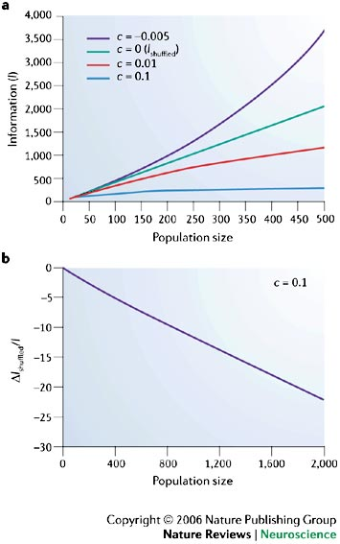

Impact of correlations on the amount of information in the population code
a | Information, I, versus population size, for different correlation coefficients, c. Positive correlations (c = 0.01 or c = 0.1) decrease information with respect to the uncorrelated (c = 0) case. Furthermore, for positive correlations, information saturates as the number of neurons increases. b | ΔI_{shuffled}/I versus population size. An important feature of this plot is that correlations have large effects at the population level even though I_{shuffled}/I is small for individual neuronal pairs. I_{shuffled}, uncorrelated information; I_{shuffled}, I–I_{shuffled}. Encoding model in panels a and b was taken from Ref. 45 and the information measure was Fisher.
Averbeck et al. Nature Reviews Neuroscience 7, 358–366 (May 2006)

Slide 15
Homogeneous responses
Heterogeneous responses

Slide 16
Synaptic variability controls response heterogeneity
Standard deviation of synaptic conductances: c ·
c varied between 0 and 0.35
max conductance caused by presynaptic inputs
spike timing
Chelaru and Dragoi, PNAS, 2008

Slide 17
Neuronal correlations are reduced in heterogeneous networks
Chelaru and Dragoi, PNAS, 2008

Slide 18
Heterogeneous networks encode more information
Stimulus orientation θ was decoded from the firing rates of the excitatory neurons by using a linear decoder: (e.g., Series and Pouget, 2004):
Decoder weights W and b were optimized such as to minimize the discrimination threshold between two nearby stimulus orientations: θ₁=89º and θ₂=91º.
Chelaru and Dragoi, PNAS, 2008

Slide 19
Suggested readings
Averbeck BB, Latham PE, Pouget A. Neural correlations, population coding and computation. Nat Rev Neurosci. 2006 May;7(5):358-66. Review.
2. Kohn A, Smith MA. Stimulus dependence of neuronal correlation in primary visual cortex of the macaque. J Neurosci. 2005 Apr 6;25(14):3661-73.
3. Chelaru MI, Dragoi V. Efficient coding in heterogeneous neuronal populations.
Proc Natl Acad Sci U S A. 2008 Oct 21;105(42):16344-9. Epub 2008 Oct 14.

