Slide 1
Academic Medicine
What does that mean?
Is it right for me?
How do I Prepare?
Prepared by Mary E. Kollmer Horton, MPH, MA, PhD
For the Academic Medicine Student Organization
Seminar, 12/6/2021
Notes:
Good Morning
I’m so excited to speak with you today and so grateful to the AMSO leaders who invited me.
Today – talk about Academic Med, what it is and how to consider if it is the right career path for you.
If you think it maybe – what can you do now.

Slide 2
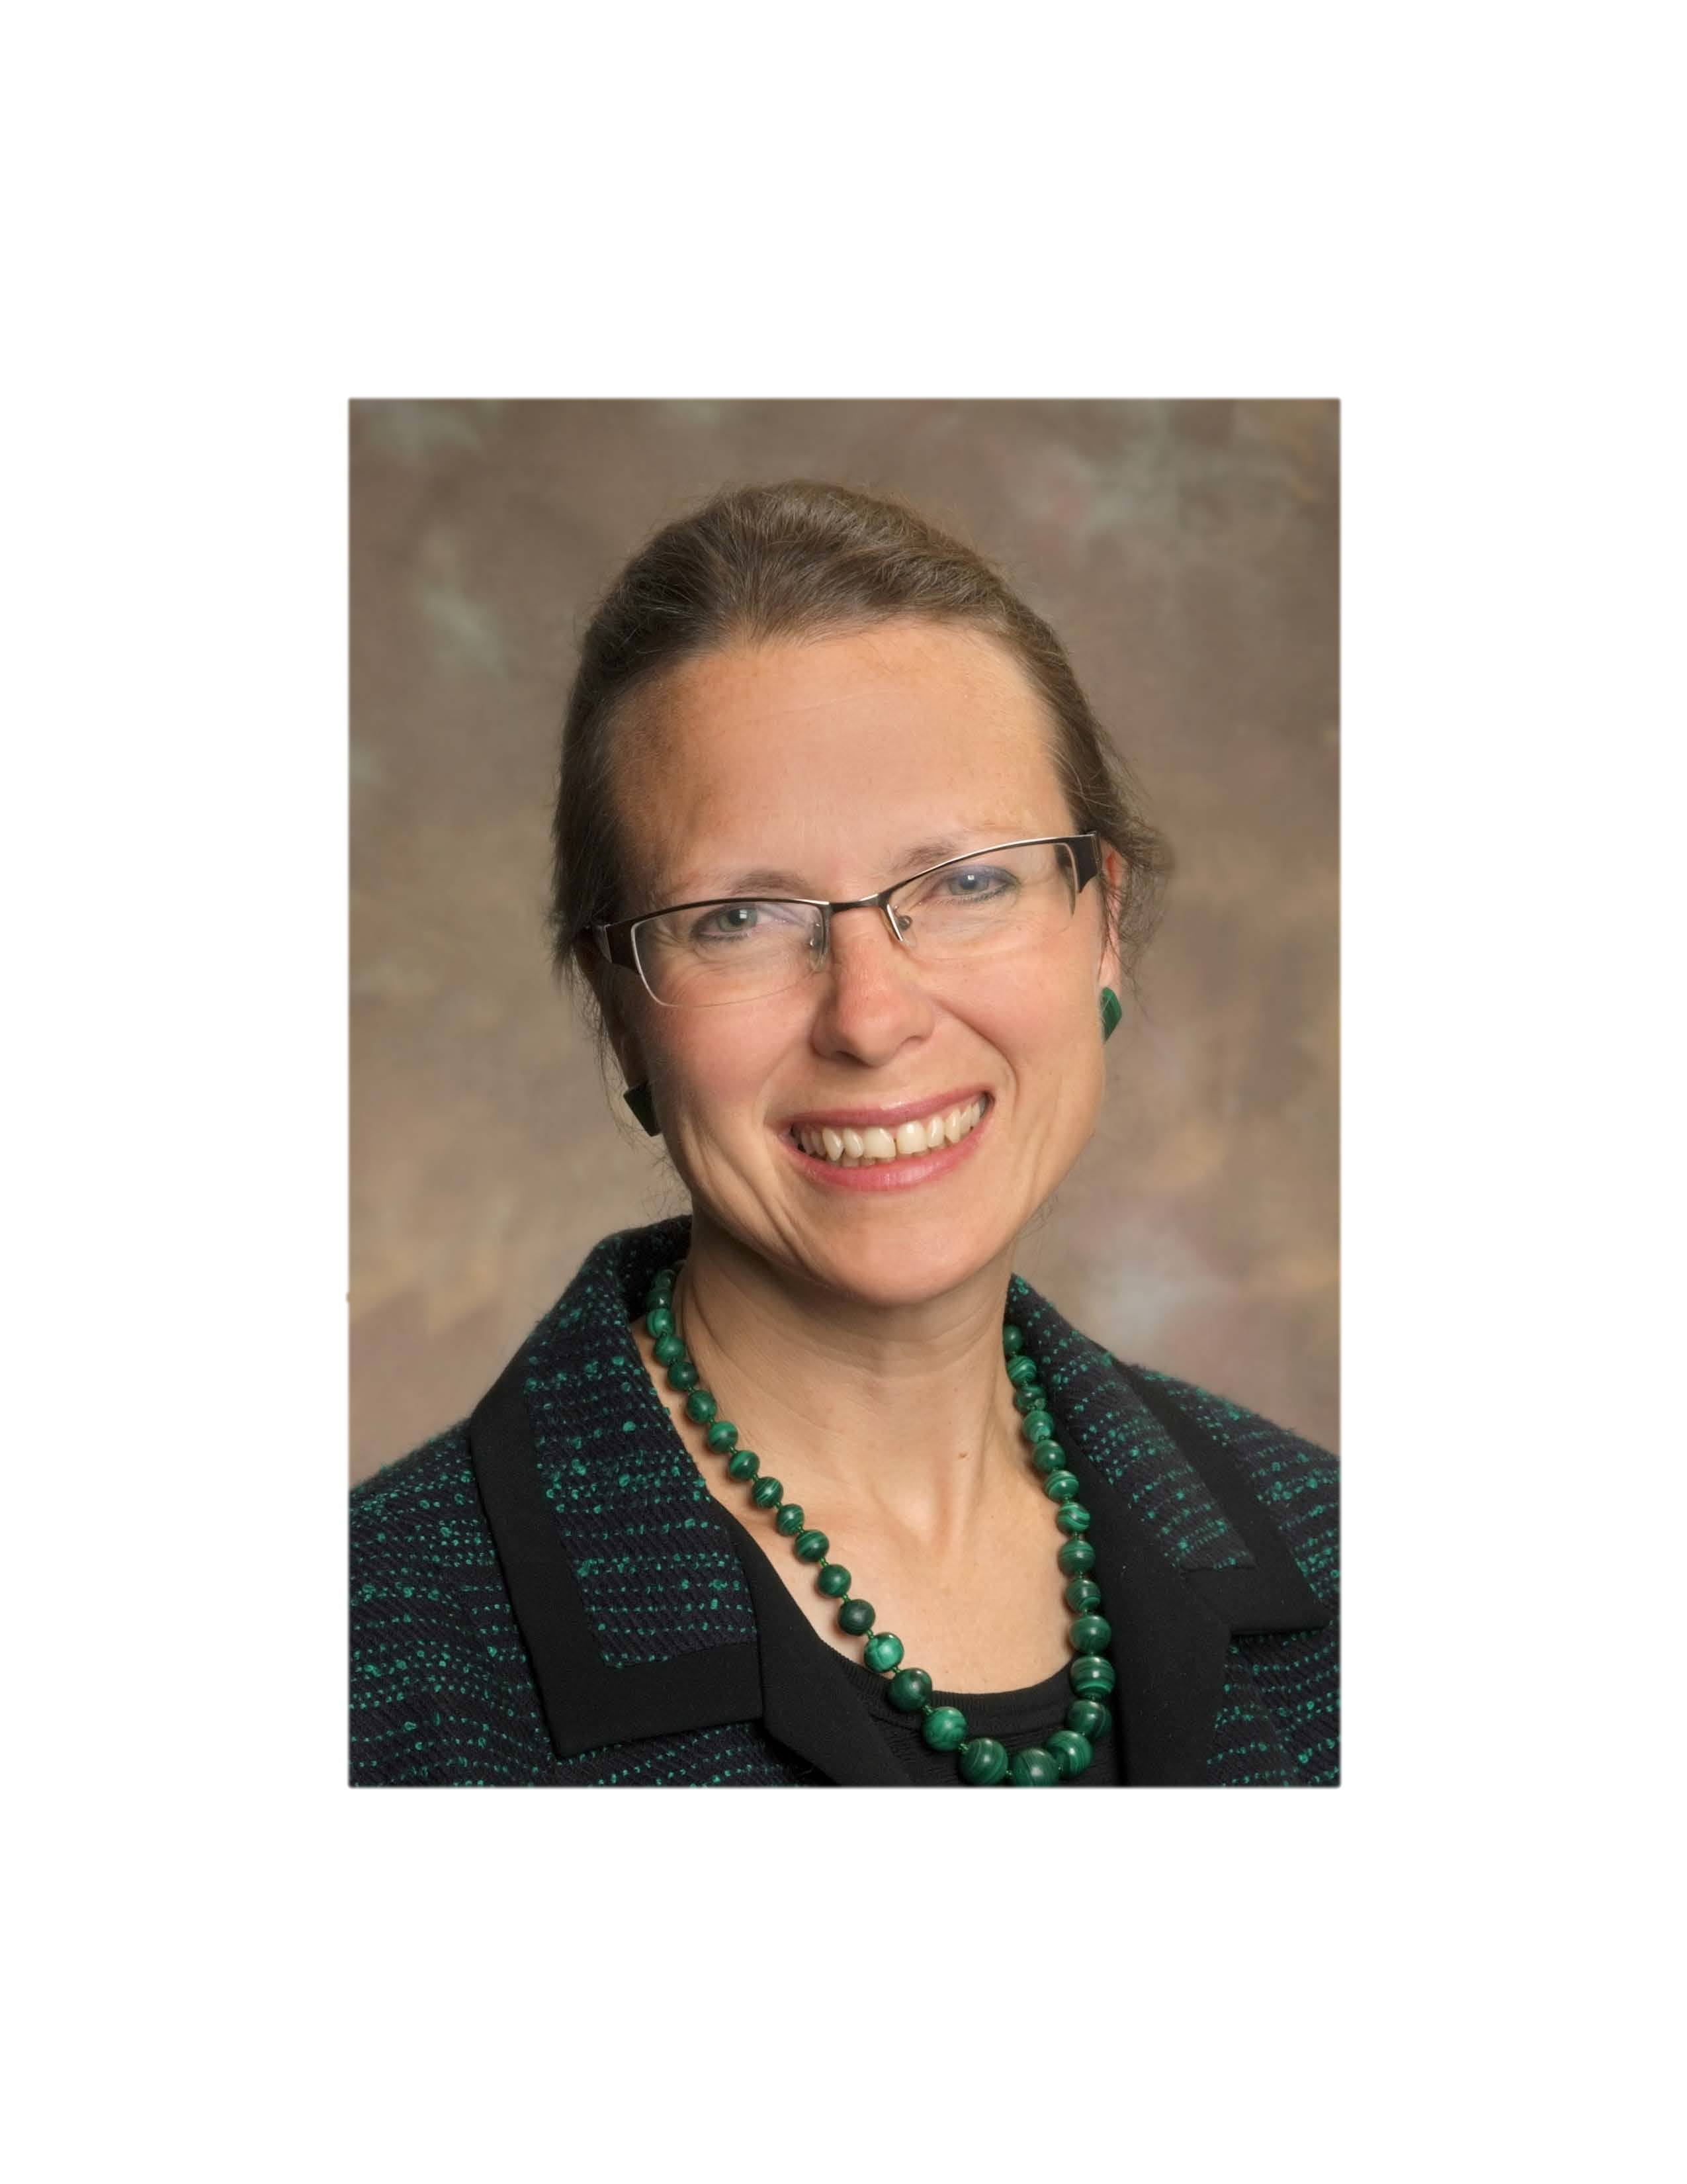
Who am i?
Mary E. Kollmer Horton, MPH, MA, PhD
Health Education Fellow & Assistant Professor
Office of Educational Programs
Adjunct Faculty, Center for Humanities and Ethics
McGovern Medical School
Past Executive Co-Director of a Medical Scientist Training Program
AAMC National MD-PhD Program Association Steering Committee Member
Past Assistant Dean of Student Affairs & Professional Development in a Graduate School
Notes:
A little about myself
I am faculty in the Office of Educational Programs and soon to be affiliated with the new Medical Student Research Office
I also have an appointment in the Center for Humanities and Ethics. My PhD is an interdisciplinary humanities PhD in the following areas: history of medicine, philosophy of medicine, and sociology of education. I examine American medical education, its history and development.
The reason I am talking to you today and why MMS hired me is because of my extensive experience working in graduate and professional education, specifically with high achieving medical students interested in research.
My approach to working with students is wholistic, I look at you as a whole person, with a history and a set of skills and goals. Then we discuss how to achieve them.

Slide 3
Academic medicine
Definition
“Academic medicine is a loosely defined term which describes the branch of medicine pursued by doctors who engage in a variety of scholarly activities. ”*
“scholarly activities” include: Teaching, Clinic, and Research *
Sometimes all 3 (Triple Threat), not always
Professional home is generally an Academic Medical Center
* BMJ 2008;336:s172; https://doi.org/10.1136/bmj.39576.631238.CE (Published 17 May 2008)
Notes:
Basics – what is Academic Medicine? In working with students I find going back to the basics and foundations of language and communication is important.

Slide 4
Scholarship versus research are they different?
Scholarship: “academic study or achievement; learning of a high level”
Research: “the systematic investigation into and study of materials and sources in order to establish facts and reach new conclusions.”
Definitions from Oxford Languages accessed by Google search 11/24/2021
Notes:
Again, basics of language – what do we mean when we use these terms? It is not always straightforward or well understood.

Slide 5
Is an academic career right for me?
“Who thinks during medical school about the possibility of being an academic doctor? Very few. But you should think about it and try out some research and teaching if you can, remembering that performing your own research on your own ideas is much more fun than following the lab boss’s directions as a technician.”
From “Academic Medicine? No way! (But are you so sure?)” by John F. Hunt, MD. The Student Doctor Network. February 4, 2014. https://www.studentdoctor.net/2014/02/04/academic-medicine-no-way-but-are-you-so-sure/
Accessed 11/23/2021
Notes:
Once you understand what you mean …
DO NOT BE AFRAID TO EXPLORE …
And, have FUN doing it.

Slide 6
How do I prepare?
BREATH
Explore your interests and passions
Remain open and take advantage of opportunities
Network, meet people in your areas of interest
Attend talks, join interest groups, shadow clinical faculty
Consider who you want your future colleagues to be, and what you want to do from day to day
Notes:
So you think maybe this is interesting and you may want to try this professional pathway … how …
You are NOT behind.
My best advice … here I put on my coaching hat …
Take advantage of all opportunities that seem interesting to you, while gauging and managing your time and academic work load. Remember to prioritize your time and interests. Your wellness and school success are your top priorities, always. When considering specialties to pursue, keep in mind that the specialty you choose needs to be about what you want to do and who you want to be around every day.

Slide 7
OPTIONS AT MC GOVERN MEDICAL SCHOOL (MMS)
MS1 students
SUMMER RESEARCH PROGRAMS
  MMS SUMMER RESEARCH PROGRAM (SRP)
    Identify a research mentor
  MD ANDERSON CANCER CENTER
  OUTSIDE OF HOUSTON
    PROFESSIONAL SOCIETIES
    NIH
    CHECK OUT THE AAMC WEBSITE
    https://students-residents.aamc.org/research-and-training-opportunities/research-and-training-opportunities
STUDENT SPECIAL INTEREST GROUPS/Societies
  Value of Vertical Mentorship
Notes:
Regarding exploring research and looking for opportunities, there are readily available resources under the Summer Research Program site (faculty database). Use it.

Slide 8
… And after preparing for ms1 summer
SCHOLARLY CONCENTRATIONS PROGRAM (SCP)
STUDENT SPECIAL INTEREST GROUPS
  Explore new ones if needed
  Use matching programs to meet new mentors, apply to participate in clinical studies
  Consider future leadership roles
DUAL DEGREE PROGRAMS
Notes:
Consider that the more you interact with faculty, senior students and trainees (residents, fellows, postdoctoral fellows) you are engaged in a key skill for your success – ‘networking’.
Determination or GRIT(Growth, Resilience, Innovation, Transition), strategically allowing yourself the freedom explore, and interpersonal communication skills are the keys to success. Nurture these.

Slide 9
How to find a mentor?
There are many types of mentors:
Clinical role model
Teaching mentor
Personal role model
Life coach
Research advisor
Finding good mentors is a key to success in all aspects of life, professional and otherwise

Slide 10
The RESEARCH ADVISOR/mentor
How to find?
Data bases
https://med.uth.edu/oep/faculty-mentor-mcgovern-medical-students/
Networking
  Student or faculty word of mouth
  Special Interest Groups/professional groups
Always review and know a faculty’s interest and papers before contacting
Contact strategically
Honesty goes hand in hand with building trust, integrity, and good relationships

Slide 11
Scholarships, Fellowships and awards
Generally monetary awards that support some work/project that requires and application/proposal
Often sponsored by professional organizations in specific fields or specialties
Often require a research mentor and benefit of previous research and relationship
Funding support for research experiences
  Stipend
  Travel
  Lab support
Generally have requirements
  Expected or required hours or weeks of work, seminar attendance
  Possible travel and presentation at a regional or national conference
Benefits outweigh the work
  These are honors that translate into a metric of success for applications and your CV
  Experience in proposal development or grant writing
  Experience in scholarly/scientific writing and presentations
  May offer exposure to a specialty of interest and connections
Notes:
Again, foundations and language – what are these? See this link for a compilation of some of the Fellowships available to medical students.
https://med.uth.edu/oep/wp-content/uploads/sites/70/2021/10/Fellowships-and-Awards-Table-REV-10_20_2021.pdf

Slide 12
Benefits of research experience?
Sets you apart from others applying to competitive residencies
Attainment of valued metrics of success: presentations, publications, awards
Does it matter what type of research … maybe?
There are many ways to become a successful academic physician. These are just some of the ways.
In the end … do what you love.
Academic physicians love new things, discovery, teaching others, and what their students and patients teach them – Does this sound like you?
Notes:
You don’t need to necessarily do research, but you may want to depending on the selection criteria of your residency program of interest.
It is very important to find out what the residency programs of interest to you want in an applicant. You do this by talking to key people in the specialty, like residency directors.
Research offers the potential for building your CV (academic resume) with metrics of success
other ways to become an academic physician include choosing to do a research clinical fellowship or doing a research postdoctoral fellowship. There are many ways to retool and redirect, but it takes time – In academic medicine you must be a lifelong learner – not think ‘what I want to be when I grow up’ but just enjoy the constant process of ‘growing up’.

Slide 13
Resources
Medical Student Research Office & new website are coming ….
I am here to help: reviewing potential research advisors, discussing strategies/plans, writing assistance, reviewing proposals, abstracts, considering fellowships.
We are all here to help you engage with research and scholarship
Mary Horton, MPH, MA, PhD
mary.e.kollmerhorton@uth.tmc.edu
Linh Trinh
Linh.h.trinh@uth.tmc.edu
JJL 315B
Gary Rosenfeld, PhD
gary.c.Rosenfeld@uth.tmc.edu

Slide 14
Your turn!
QUESTIONS
?????
Don’t hesitate to ask!

