Slide 1
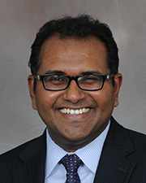
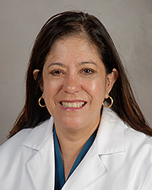
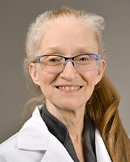
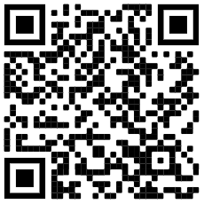
ATTENTION: All Interested Faculty
McGovern Medical School at UTHealth Houston Academy of Master Educators
and the Office of Educational Programs
Academy of Master Educators Open House
Tuesday, May 17, 2022, 12-1 p.m. Via Webex
Meeting number (access code): 2621 834 3538
Dr. John
Chairman, AME
This session will provide information regarding the goals and objectives of the Academy, as well as the qualifications for joining, nomination, and application process.
Dr. Donna Mendez
Chair, Advocacy Committee
For more information, call the Office of Educational Programs at 500-5140, or visit the website at
https://med.uth.edu/oep/academy-of-master-educators-2/membership/
Dr. Pamela Berens
Chair, AME Membership Committee

Slide 2
OPEN HOUSE
Notes:
My name is Donna Mendez and I am the Advocacy Cahir for The Academy of Master Educators,
-This academy has been in existence since 2009 and open to faculty who each at Medical School, Dental School and Graduate School

Slide 3
What is a Master Educator
A Master Educator:
has clear, realistic and important goals that reflect the needs of the profession, society, learners and other faculty
is prepared to teach effectively and takes advantage of new strategies
uses appropriate methods to teach or design an educational program or curriculum
employs educational strategies that can serve as a model for others
formally shares lessons learned or shares enduring materials with peers at the local, regional, or national level
acts as a peer reviewer of educational grants, journals, curriculum or awards.
uses feedback from learners and peers
provides vision, direction, and leadership for educational programs
serves the educational community through active participation in and contribution to local, regional, national, and international educational organizations
Notes:
has clear, realistic and important goals that reflect the needs of the profession, society, learners and other faculty.
is prepared to teach effectively, and takes advantage of new strategies to deal with challenging issues.
uses appropriate methods to teach or design an educational program or curriculum that is consistent with the current literature.
employs educational strategies that can serve as a model for others. Goals are outlined. Results are disseminated or published.
formally shares lessons learned or shares enduring materials with peers at the local, regional, or national level.
acts as a peer reviewer of educational grants, journals, curriculum or awards.
uses feedback from learners and peers to modify his or her leadership style, teaching, and educational materials.
provides vision, direction, and leadership for educational programs, while incorporating effective group processes to achieve desired programmatic goals effectively and efficiently.
serves the educational community through active participation in and contribution to local, regional, national, and international educational organizations.

Slide 4
Why an Academy?
Symbol of Medical School’s educational mission
Raises the standard for educators
Provides a “ home” for the community of educators

Slide 5
Mission Statement
McGovern Medical School (MMS) Academy of Master Educators (AME) at UTHealth serves to:
1. recognize, develop, and promote outstanding faculty educators
2. support excellence in undergraduate and graduate teaching
3. improving curriculum
4. advancing educational scholarship

Slide 6
AME Member survey 2020:

Slide 7
Myths (local) about AME:
Dependent on Academic Rank
Need strong publication history
National Reputation is Essential
Extremely competitive process

Slide 8
AME Goals
A formal organization of distinguished scholars recognized for their teaching and educational excellence and committed to the enhancement of medical and graduate education
An overarching goal of AME is to have diverse membership representing the many disciplines in health science education
AME Goals
Educate future physicians, dentists, and biomedical scientists
Enhance knowledge and skills of all teaching faculty
Promote curriculum design and innovation
Support professional development and academic advancement of educators
Recognize and reward outstanding educators for their exceptional contributions;
Foster educational scholarship with dedicated resources, including endowments and grants
Sponsor innovative AME educational initiatives and collaboration among disciplines and institutions
Notes:
-AME members will encourage faculty who are dedicated to scholarly teaching and to educational scholarship and will serve as professional role models and mentors for faculty, residents, fellows, and students.

Slide 9
Benefits
Recognition as a "Master Educator" by peers. All Academy members will be eligible for the designation of "Distinguished Educator Professor."
Opportunity to participate in local "learning communities" with other faculty educator
Opportunity to meet new collaborators and to participate in scholarly activities and projects
Support for personal development of one's educational knowledge and skills (education meetings, courses, workshops, colloquia, seminar programs, journal clubs)
Opportunity to mentor and to be mentored
Participation in enhancement of the educational environment for the entire MMS at UTHeath community and for advocating institutional recognition and rewards of faculty educators
Opportunity to promote new and enhanced disciplinary and interdisciplinary educational programs
Opportunity for financial support as it becomes available (e.g., support for education-related activities, Master-Teacher Program, endowed professorships)

Slide 10
Current Members
Elaheh Ashtari
Jeffrey Actor
Sasha Adams
Chiamaka Aneji
Gabriel Aisenberg
Bindu Akkanti
Jammie Barnes
Michelle Barratt
Asha Bhalwal
Pamela Berens
Eugene Boisaubin
Eliana Bonfante
Lauren Brollier
Maximilian Buja
Patricia Butler
Nathan Carlin
Phillip Carpenter
Sujith Cherian
Len Cleary
Thomas Cole
Johanna Blair de Haan
Pratik Doshi
Rhashedah Ekeoduru
Hilary Fairbrother
Daniel Felleman
Chase Findley
Renee Flores
Gerard Francisco
Johnnie Frazier
Jonathan Giordano
Anneliese Gonzalez
Veronica Gonzalez
Richard Gordon
Amalia Guardiola
Katie Guttenberg
Sara Guzman-Reyes
David Hall
Syed Hashmi
Sara Holcombe
Mark Hormann
Peggy Hsieh
Amanda Jagolino
Rachel Jantea
Vineeth John
Bruce Kone
Gus Krucke
Nick Kumaravel
Katherine Loveland
Samuel Luber
Rebecca Lunstroth
Pedro Mancias
Travis Markham
David Marshak
Brandy McKelvy
Donna Mendez
Donald Molony
Elizabeth Nugent
Omonele Nwokolo
Emma Omoruyi
Philip Orlander
Allison Ownby (Advisor)
Katherine Normand
Bela Patel
Deborah Pearson
Roy Riascos-Castaneda
Evan Pivalizza
Pamela Promecene
Adan Rios
Gary Rosenfeld
Joshua Samuels
Joyce Samuel
Marsal Sanches
Cynthia Santos
Mya Schiess
Srikanth Sridhar
Christopher Stephens
Erin Stimming
Jennifer Swails
Ethan Taub
Eugene Toy
Ana Ugueto
Margaret Uthman
Naveen Vanga
Monica Verduzco-Gutierrez
Dia Waguespack
Michael Weaver
Mark Warner
Priya Weerasinghe
Robby Wesley
George Williams
John Zaki
Cristian Zeni
Han Zhang

Slide 11
Academy Member Responsibilities
Attend Academy-sponsored events and functions
Serve on Academy committees and teams
Develop and evaluate innovative educational programs
Mentor other MMS faculty engaged in educational activities
Participate in Academy-sponsored seminars and journal clubs
Engage in scholarly educational activities
Participate in institutional applications for educational grants and other financial resources
Represent the Academy locally, regionally and nationally
Notes:
Attend Academy-sponsored events and functions. Sponsored educational coursers, workshops and retreats
Serve on Academy committees and teams.
Develop and evaluate innovative educational programs.
Mentor other MMS faculty engaged in educational activities.
Attend Academy-sponsored educational courses, workshops and colloquia.
Participate in Academy-sponsored seminars and journal clubs.
Attend Academy-sponsored educational retreats.
Engage in scholarly educational activities.
Participate in institutional applications for educational grants and other financial resources.
Represent the Academy locally, regionally and nationally.

Slide 12
AME Education Activities
Induction ceremony and banquet
Dean’s Educational Lecture
Faculty development workshop
Journal club
Learning communities
MMS/UTMB/Baylor/MDACC joint academy educational symposium: TEACH S Symposium
UT SHINE Academy symposium (Annual meeting in Austin)
Medical Education “Scholarly Concentration”
History of medicine: Blue Book elective

Slide 13
AME Activities
2020-2021
AME ED Talks: Conversations with Master Educators (Via WebEx) - TED style talks featuring Academy Members; Drs. Len Cleary, Hilary Fairbrother and Vineeth John, 11/20/20
Induction ceremony (Via WebEx): Eugene Toy, M.D., Assistant Dean for Educational Programs, Professor and Vice Chair of Medical Education, Dept of Obstetrics and Gynecology, Distinguished Teaching Professor of the UT System, UTMB Health, “The Teacher’s Heart”, 11/08/21
Induction ceremony (Via WebEx): Gary Rosenfeld, PhD, Associate Dean for Educational Programs, Professor, Integrated Biology & Pharmacology, “AME & Beyond: My Journey”, 02/17/22
Joint Educational Symposium:
2021 Texas Educators Academies Collaborative for the Health Professions (TEACH-S) (Via WebEx)
2022 Texas Educators Academies Collaborative for the Health Professions (TEACH-S) (Via WebEx)
Journal Club: Ongoing

Slide 14
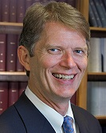
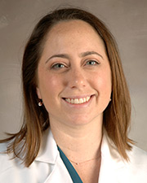
Academy of Master Educators (AME) presents
AME “ED Talks”: Conversations with Master Educators
Friday, November 20, 2020 * WebEx (access code): 120 163 7131 * 12:00 – 1:00 P.M.
Leonard Cleary, PhD
“Learning about Lifelong Learning”
Hilary Fairbrother, MD, MPH
“In Search of Expertise”
Vineeth John, MD, MBA
“Power of Mentorship”
https://uthealth.webex.com/uthealth/j.php?MTID=mcc583fce33f1e359c14b9fb8c9ac96f5
ACADEMY of MASTER EDUCATORS The Office of Educational Programs

Slide 15
AME Committees
Advocacy
Developing opportunities for member interactions and Academy publicity
Promotes monthly or quarterly socials that highlight current AME member activities
Responsible for AME web development
Promotes AME member participation
AME-PCG (Peer Coaching Group)
voluntary observation with formative evaluation of faculty lectures, clinical instruction, and small group facilitation
Faculty Mentoring
Organizes group and individual activities and consultations
Provides junior faculty the guidance and support
Organizes and promotes the annual spring education workshop
Learning Communities - The Education Scholarship
Fosters educational scholarship activities of AME members and other faculty at McGovern Medical School
Journal Club
Develops and publicizes monthly schedule of journal articles or topics for discussion (September-April)
Membership
determines if applicants have met the AME teaching and scholarship standards as described in the educational portfolio template
Standards
defines and determines the procedures and process for faculty application to the Academy
refines the model portfolios to ensure that all faculty have a standard of reference

Slide 16
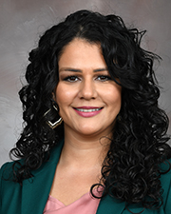
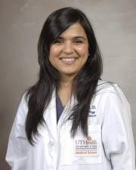
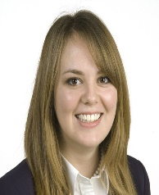
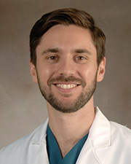
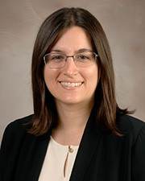
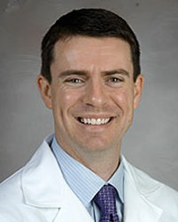
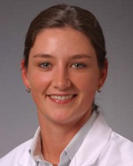
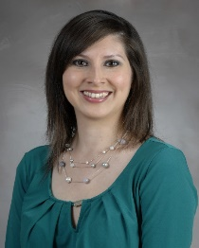
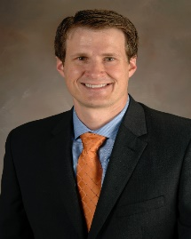
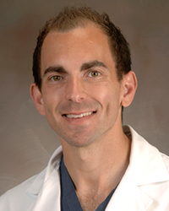
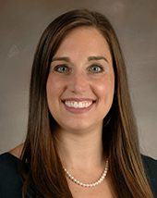
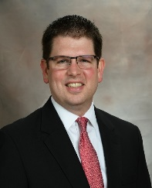
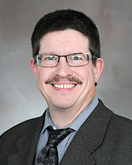
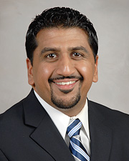
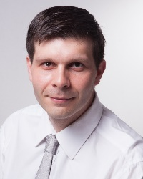
2020 New Inductees
Elaheh Ashtari, PsyD
Asha Bhalwal, MD
Johanna Blair de Haan, MD
Jonathan Giordano, DO
Katie Guttenberg, MD
David Hall, MD
Sara Holcombe, DO
Veronica Gonzalez, MD
Travis Markham, MD
Ethan Taub, DO
Dia Waguespack, MD
Mark Warner, MD
Michael Weaver, MD
Robby Wesley, DO
Cristian Zeni, MD, PhD

Slide 17
2021 New Inductees
Eliana Bonfante-Mejia, MD
Radiology
Lauren Brollier, MD
Anesthesiology
Sujith Cherian, MD
Internal Medicine
Amanda Jagolino, MD
Neurology
Rachel Jantea, MD
Internal Medicine
Marsal Sanches, MD, PhD
Psychiatry
Ana Ugueto, PhD
Psychiatry
Naveen Vanga, MD
Anesthesiology
John Zaki, MD
Anesthesiology

Slide 18
Questions???
https://go.uth.edu/AME-ER

Slide 19
AME Application: Deadline June 30, 2022
Phase 1: Nomination Process (faculty member a minimum of 3 years)
Candidate’s chairperson/division head letter of nomination with specific reference to the candidate’s educational accomplishments, and with agreement to the candidate’s commitment to an average of 4 hours/month for academy activities.
Candidate letter that includes reasons for interest in the Academy and agreement with the commitment to an average of 4 hours/month for academy activities.
List of current direct teaching activities: medical students, dental students, graduate students, postdoctoral students, residents, clinical fellows, faculty.
Current CV.
(PDF FORMAT PREFERRED)

Slide 20
AME Application
Phase 2: Application Process
Highlighted summary of the candidate’s outstanding educational contributions (see criteria);
Personal statements that includes:
brief essay describing the candidate’s educational philosophy;
enumeration of the candidate’s long-term educational goals;
statement of commitment, including expected new (or continuing) contributions to the Academy;
List of professional development efforts in education;
Three (3) letters of support from peers (at least one from a faculty member at the home or other institutions) and learners who benefited from the educational expertise of the candidate.

Slide 21
AME Application
Phase 2: Application Criteria (in addition to documented direct teaching)
Outstanding achievement in one or more of the following categories:
Direct teaching and assessment of learner performance;
Mentoring and advising;
Development of enduring educational materials (e.g., curriculum development, instructional design or re-design; development of assessment strategies and evaluation instruments)
Educational leadership;
Educational scholarship (dissemination, peer review, impact of education-related product).

Slide 22
AME Application
Membership Selection: The Membership Committee selection criteria include,
Breadth and variety of the educational contributions;
Quantity of the educational contributions;
Quality of the educational contributions as measured by outcomes;
Innovation and impact of the educational contributions;
Scholarly activities related to education
Reputation as an educator;
Length of time at the health science center(s) with active involvement in educational effort.

Slide 23
Questions???
https://go.uth.edu/AME-ER

