Slide 1
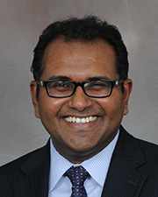
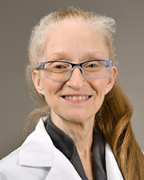
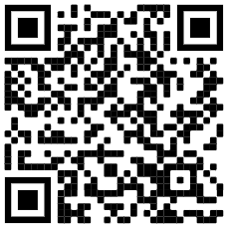
ATTENTION: All Interested Faculty
McGovern Medical School at UTHealth Houston Academy of Master Educators
and the Office of Educational Programs
Academy of Master Educators Open House
Thursday, August 17, 2023
12-1 p.m., MSB B.100 or virtually at
https://uthealth.zoom.us/j/91285835567
Meeting ID: 912 8583 5567
Dr. John
Chairman, AME
This session will provide information regarding the goals and objectives of the Academy, as well as the qualifications for joining, nomination, and application process.
For more information, call the Office of Educational Programs at 500-5140, or visit the website at
https://med.uth.edu/oep/academy-of-master-educators-2/membership/
Dr. Pamela Berens
Chair, AME Membership Committee

Slide 2
OPEN HOUSE
Notes:
My name is Donna Mendez and I am the Advocacy Cahir for The Academy of Master Educators,
-This academy has been in existence since 2009 and open to faculty who each at Medical School, Dental School and Graduate School

Slide 3
Agenda:
Welcome – AME Chair & Membership Chair, Drs. Vineeth John & Pamela Berens
Introduction to AME – Dr. Vineeth John
Nomination/Application process – Dr. Pamela Berens
A short Intro on Educator Portfolio: Dr. Vineeth John
Member Presentation- Dr. Peggy Hsieh
Questions and discussion – Drs. Vineeth John & Pamela Berens and Ms. Alicia Howard

Slide 4
Gratitude
Alicia Howard
Mark Hormann, MD
Patricia Butler, MD
Gary Rosenfeld, PhD
Allison Ownby, PhD, MEd
AME Committee Chairs
AME Committee Members
AME Members

Slide 5
Why an Academy?
Symbol of Medical School’s educational mission
Raises the standard for educators
Provides a “ home” for the community of educators

Slide 6
What is a Master Educator
A Master Educator:
has clear, realistic and important goals that reflect the needs of the profession, society, learners and other faculty
is prepared to teach effectively and takes advantage of new strategies
uses appropriate methods to teach or design an educational program or curriculum
employs educational strategies that can serve as a model for others
formally shares lessons learned or shares enduring materials with peers at the local, regional, or national level
acts as a peer reviewer of educational grants, journals, curriculum or awards.
uses feedback from learners and peers
provides vision, direction, and leadership for educational programs
serves the educational community through active participation in and contribution to local, regional, national, and international educational organizations
Notes:
has clear, realistic and important goals that reflect the needs of the profession, society, learners and other faculty.
is prepared to teach effectively, and takes advantage of new strategies to deal with challenging issues.
uses appropriate methods to teach or design an educational program or curriculum that is consistent with the current literature.
employs educational strategies that can serve as a model for others. Goals are outlined. Results are disseminated or published.
formally shares lessons learned or shares enduring materials with peers at the local, regional, or national level.
acts as a peer reviewer of educational grants, journals, curriculum or awards.
uses feedback from learners and peers to modify his or her leadership style, teaching, and educational materials.
provides vision, direction, and leadership for educational programs, while incorporating effective group processes to achieve desired programmatic goals effectively and efficiently.
serves the educational community through active participation in and contribution to local, regional, national, and international educational organizations.

Slide 7
Mission Statement
McGovern Medical School (MMS) Academy of Master Educators (AME) at UTHealth serves to:
1. recognize, develop, and promote outstanding faculty educators
2. support excellence in undergraduate and graduate teaching
3. improving curriculum
4. advancing educational scholarship

Slide 8
Myths (local) about AME:
Dependent on Academic Rank
Need strong publication history
National Reputation is Essential
Extremely competitive process

Slide 9
AME Goals
A formal organization of distinguished scholars recognized for their teaching and educational excellence and committed to the enhancement of medical and graduate education
An overarching goal of AME is to have diverse membership representing the many disciplines in health science education
AME Goals
Educate future physicians, dentists, and biomedical scientists
Enhance knowledge and skills of all teaching faculty
Promote curriculum design and innovation
Support professional development and academic advancement of educators
Recognize and reward outstanding educators for their exceptional contributions;
Foster educational scholarship with dedicated resources, including endowments and grants
Sponsor innovative AME educational initiatives and collaboration among disciplines and institutions
Notes:
-AME members will encourage faculty who are dedicated to scholarly teaching and to educational scholarship and will serve as professional role models and mentors for faculty, residents, fellows, and students.

Slide 10
Support the career development of educators, establish HPE as an academic discipline.
Build community, promote collaboration, provide a professional “home”.
Improve teaching skills through faculty development.
Reinvigorate the teaching mission
Spearhead a change in culture
Recognize and value teachers, support professional identity formation.
Stimulate innovation.
Advance educational scholarship.

Slide 11
Benefits
Recognition as a "Master Educator" by peers. All Academy members will be eligible for the designation of "Distinguished Educator Professor."
Opportunity to participate in local "learning communities" with other faculty educator
Opportunity to meet new collaborators and to participate in scholarly activities and projects
Support for personal development of one's educational knowledge and skills (education meetings, courses, workshops, colloquia, seminar programs, journal clubs)
Opportunity to mentor and to be mentored
Participation in enhancement of the educational environment for the entire MMS at UTHeath community and for advocating institutional recognition and rewards of faculty educators
Opportunity to promote new and enhanced disciplinary and interdisciplinary educational programs
Opportunity for financial support as it becomes available (e.g., support for education-related activities, Master-Teacher Program, endowed professorships)

Slide 12
Current Members
Peggy Hsieh
Amanda Jagolino
Randa Jalloul
Rachel Jantea
Vineeth John (Chairman)
Bruce Kone
Gus Krucke
Nick Kumaravel
Katherine Loveland
Samuel Luber
Rebecca Lunstroth
Pedro Mancias
Travis Markham
David Marshak
Brandy McKelvy
Donald Molony
Thy Nguyen
Katherine Normand
Elizabeth Nugent
Omonele Nwokolo
Jennifer Swails
Ethan Taub
Eugene Toy
Ana Ugueto
Naveen Vanga
Dia Waguespack
Alia Warner
Mark Warner
Michael Weaver
Priya Weerasinghe
Robbey Wesley
George Williams
William Yao
John Zaki
Cristian Zeni
Han Zhang
Elaheh Ashtari
Jeffrey Actor
Sasha Adams
Chiamaka Aneji
Gabriel Aisenberg
Bindu Akkanti
Ben Barnett
Michelle Barratt
Asha Bhalwal
Pamela Beren
Eugene Boisaubin
Eliana Bonfante-Mejia
Lauren Brollier
Maximilian Buja
Patricia Butler
Amber Campbell
Nathan Carlin
Phillip Carpenter
Shivika Chandra
Sujith Cherian
Len Cleary
Thomas Cole
Johanna Blair de Haan
Pratik Doshi
Jenny Duret-Uzodinma
Rashshedah Ekeoduru
Monaliza Evangelista
Hilary Fairbrother
Daniel Felleman
Emma Ferguson
Chase Findley
Renee Flores
Gerard Francisco
Anneliese Gonzalez
Veronica Gonzalez
Richard Gordon
Amalia Guardiola
Katie Guttenberg
Sara Guzman-Reyes
David Hall
Syed Hashmi
Nadia Hernandez
Sara Holcombe
Mark Hormann
Emma Omoruyi
Philip Orlander
Allison Ownby (Advisor)
Katherine Normand
Bela Patel
Deborah Pearson
Roy Riascos-Castaneda
Evan Pivalizza
Pamela Promecene
Adan Rios
Gary Rosenfeld
Joshua Samuels
Joyce Samuel
Latifa Sanhaji
Cynthia Santos
Mya Schiess
Lokesh Shahani
Srikanth Sridhar
Christopher Stephens
Erin Stimming

Slide 13
Academy Member Responsibilities
Attend Academy-sponsored events and functions
Serve on Academy committees and teams
Develop and evaluate innovative educational programs
Mentor other MMS faculty engaged in educational activities
Participate in Academy-sponsored seminars and journal clubs
Engage in scholarly educational activities
Participate in institutional applications for educational grants and other financial resources
Represent the Academy locally, regionally and nationally
Notes:
Attend Academy-sponsored events and functions. Sponsored educational coursers, workshops and retreats
Serve on Academy committees and teams.
Develop and evaluate innovative educational programs.
Mentor other MMS faculty engaged in educational activities.
Attend Academy-sponsored educational courses, workshops and colloquia.
Participate in Academy-sponsored seminars and journal clubs.
Attend Academy-sponsored educational retreats.
Engage in scholarly educational activities.
Participate in institutional applications for educational grants and other financial resources.
Represent the Academy locally, regionally and nationally.

Slide 14
AME Education Activities
Induction ceremony and banquet
Dean’s Educational Lecture
Faculty development workshop
Journal club
Learning communities
MMS/UTMB/Baylor/MDACC joint academy educational symposium: TEACH S Symposium
UT SHINE Academy symposium (Annual meeting in Austin)
Medical Education “Scholarly Concentration”
History of medicine: Blue Book elective

Slide 15
AME Activities
2022-2023
AME ED Talks: Conversations with Master Educators (Via WebEx) - TED style talks featuring Academy Members; The next AME Ed Talks has been scheduled for Wednesday, November 1 from 2-4 pm in the MSB 5th Floor Gallery; Planned Speakers – Dr. Allison Ownby, PhD, MEd; Professor and Associate Dean, Educational Programs and Chase Findley, MD – Associate Professor, Psychiatry and Behavioral Sciences, Assistant Dean, Educational Programs.
2022 Induction ceremony – Planned for December, 2023; Location, Date and Time TBD
AME Retreat - “Reimagining AME’s Role at McGovern”; Thursday, January 26, 2023; MSB B.100; 3-5 p.m.
Joint Educational Symposium:
2023 Texas Educators Academies Collaborative for the Health Professions (TEACH-S) - Teaching to your Mission; Plenary Speaker – Stephen J. Spann, M.D., MBA; Founding Dean, College of Medicine & Vice President for Medical Affairs; Humana Endowed Dean's Chair in Medicine; Clinical Professor, Family Medicine; University of Houston, Tilman J. Fertitta Family College of Medicine, 06/14/22
Journal Club: Ongoing

Slide 16
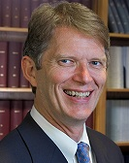
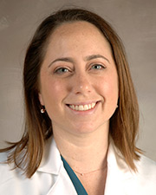
Academy of Master Educators (AME) presents
AME “ED Talks”: Conversations with Master Educators
Friday, November 20, 2020 * WebEx (access code): 120 163 7131 * 12:00 – 1:00 P.M.
Leonard Cleary, PhD
“Learning about Lifelong Learning”
Hilary Fairbrother, MD, MPH
“In Search of Expertise”
Vineeth John, MD, MBA
“Power of Mentorship”
https://uthealth.webex.com/uthealth/j.php?MTID=mcc583fce33f1e359c14b9fb8c9ac96f5
ACADEMY of MASTER EDUCATORS The Office of Educational Programs

Slide 17
AME Committees
Advocacy
Developing opportunities for member interactions and Academy publicity
Promotes monthly or quarterly socials that highlight current AME member activities
Responsible for AME web development
Promotes AME member participation
AME-PCG (Peer Coaching Group)
voluntary observation with formative evaluation of faculty lectures, clinical instruction, and small group facilitation
Faculty Mentoring
Organizes group and individual activities and consultations
Provides junior faculty the guidance and support
Organizes and promotes the annual spring education workshop
Learning Communities - The Education Scholarship
Fosters educational scholarship activities of AME members and other faculty at McGovern Medical School
Journal Club
Develops and publicizes monthly schedule of journal articles or topics for discussion (September-April)
Membership
determines if applicants have met the AME teaching and scholarship standards as described in the educational portfolio template
Standards
defines and determines the procedures and process for faculty application to the Academy
refines the model portfolios to ensure that all faculty have a standard of reference

Slide 18
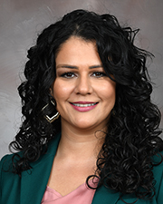
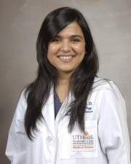
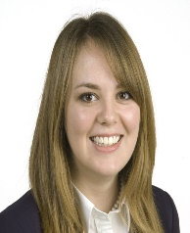
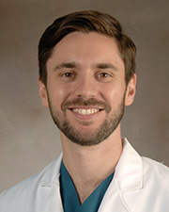
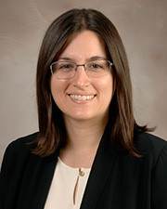
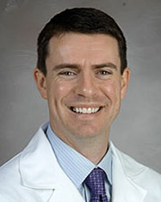
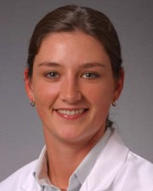
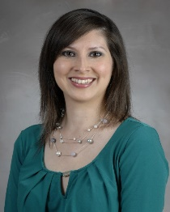
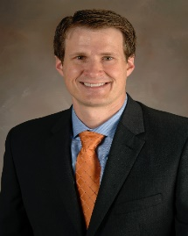
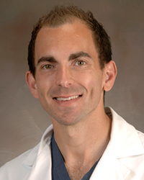
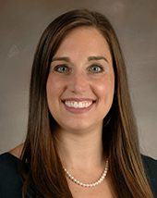
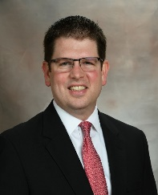
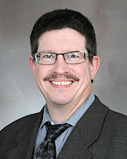
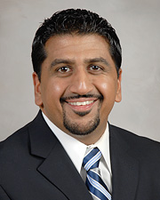
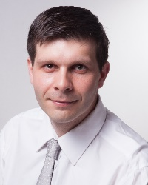
2020 New Inductees
Elaheh Ashtari, PsyD
Asha Bhalwal, MD
Johanna Blair de Haan, MD
Jonathan Giordano, DO
Katie Guttenberg, MD
David Hall, MD
Sara Holcombe, DO
Veronica Gonzalez, MD
Travis Markham, MD
Ethan Taub, DO
Dia Waguespack, MD
Mark Warner, MD
Michael Weaver, MD
Robby Wesley, DO
Cristian Zeni, MD, PhD

Slide 19
2021 New Inductees
Eliana Bonfante-Mejia, MD
Radiology
Lauren Brollier, MD
Anesthesiology
Sujith Cherian, MD
Internal Medicine
Amanda Jagolino, MD
Neurology
Rachel Jantea, MD
Internal Medicine
Marsal Sanches, MD, PhD
Psychiatry
Ana Ugueto, PhD
Psychiatry
Naveen Vanga, MD
Anesthesiology
John Zaki, MD
Anesthesiology

Slide 20
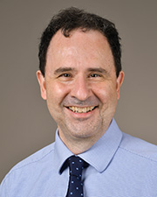
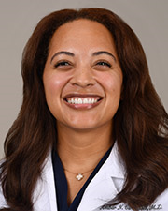
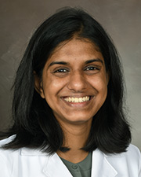
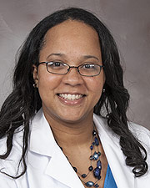
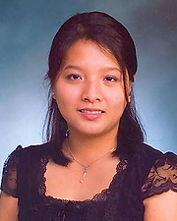
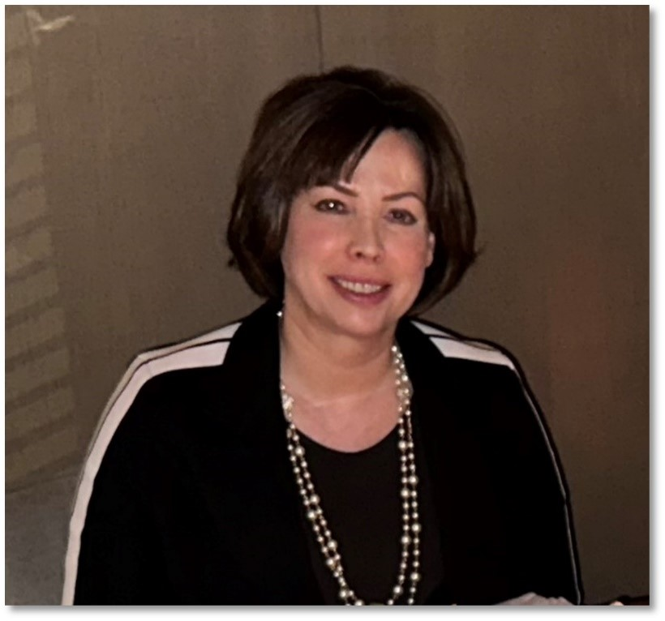
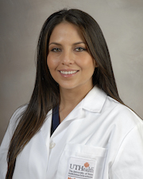
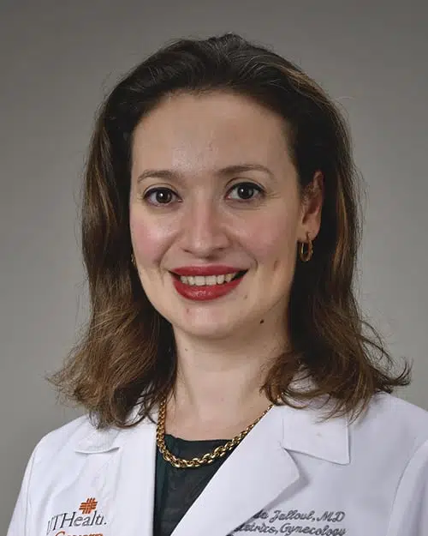
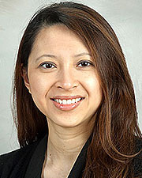
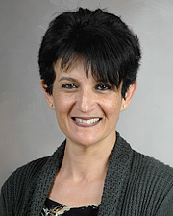
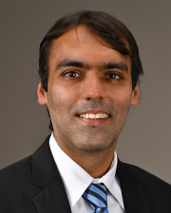
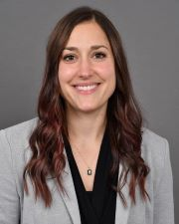
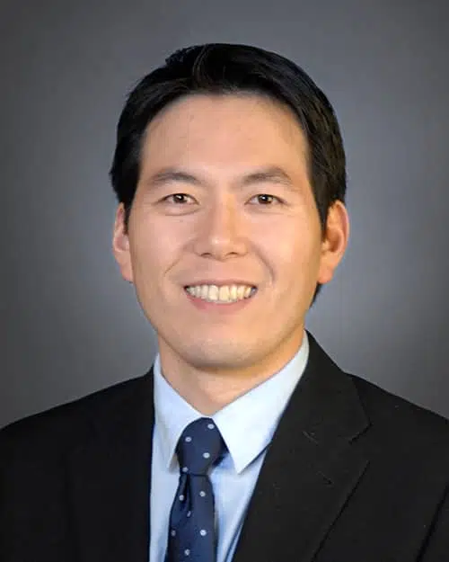
2022 New Inductees
From Left to Right: Drs. Ben Barnett, Amber Cambell, Shivika Chandra, Jenny Duret-Uzodinma, Monaliza Evangelista, Emma Ferguson, Nadia Hernandez, Randa Jalloul, Thy Nguyen, Latifa Sanhaji, Lokesh Shahani, Alia Warner and William Yao

Slide 21
Questions???
https://go.uth.edu/AME-ER

Slide 22
AME Application:
Phase 1: Nomination Process (faculty member a minimum of 3 years)
Candidate’s chairperson/division head letter of nomination with specific reference to the candidate’s educational accomplishments, and with agreement to the candidate’s commitment to an average of 4 hours/month for academy activities.
Candidate letter that includes reasons for interest in the Academy and agreement with the commitment to an average of 4 hours/month for academy activities.
List of current direct teaching activities: medical students, dental students, graduate students, postdoctoral students, residents, clinical fellows, faculty.
Current CV.
(PDF FORMAT PREFERRED)

Slide 23
AME Application
Phase 2: Application Process
Highlighted summary of the candidate’s outstanding educational contributions (see criteria);
Personal statements that includes:
brief essay describing the candidate’s educational philosophy;
enumeration of the candidate’s long-term educational goals;
statement of commitment, including expected new (or continuing) contributions to the Academy;
List of professional development efforts in education;
Three (3) letters of support from peers (at least one from a faculty member at the home or other institutions) and learners who benefited from the educational expertise of the candidate.

Slide 24
AME Application
Phase 2: Application Criteria (in addition to documented direct teaching)
Outstanding achievement in one or more of the following categories:
Direct teaching and assessment of learner performance;
Mentoring and advising;
Development of enduring educational materials (e.g., curriculum development, instructional design or re-design; development of assessment strategies and evaluation instruments)
Educational leadership;
Educational scholarship (dissemination, peer review, impact of education-related product).
EDUCATOR PORTFOLIO TO DEMONSTRATE EDUCATIONAL CONTRIBUTIONS

Slide 25
AME Application
Membership Selection: The Membership Committee selection criteria include,
Breadth and variety of the educational contributions;
Quantity of the educational contributions;
Quality of the educational contributions as measured by outcomes;
Innovation and impact of the educational contributions;
Scholarly activities related to education
Reputation as an educator;
Length of time at the health science center(s) with active involvement in educational effort.

Slide 26
Timeline
Deadline for Phase 1: September 30, 2023.
Applications Open for Phase 2: January 1, 2024
Deadline for Phase 2: March 31, 2024

Slide 27
What is an educator portfolio?
A written (or electronic) compilation of supporting documents which highlight the impact of your educational activities
Complements and substantiates the CV
Demonstrates scope, quantity, and quality of your educational contributions
Notes:
Rachel
Who has heard of this?
Similar to the way patient surveys and quality metrics measure your clinical activities

Slide 28
How is this relevant to me?
Facilitates annual review
Guides self-evaluation of career trajectory
Supports applications (awards, grants, leadership, programs)
SUPPORTS PROMOTION
Notes:
Rachel
Developmental educator portfolio= “shoebox” repository; tracks, organizes
- Show how to create an educator portfolio to track education-related accomplishments using concrete data that can drawn on when you create your promotion packet. Also show you the type of data you should be tracking for all your educational and teaching activities

Slide 29
Major Sections of Educator Portfolio
Teaching & Assessment | Products of Educational Scholarship
Mentoring, Advising, & Coaching | Educational Service & Leadership
Curriculum Development | Professional Development in Education
Notes:
Only 6 sis sections,one slide to summarize the rest. Be more general about teaching philosophy, important for everyone esp if applying for hefp or ame
Rachel
Different sections as appropriate for your role and path, but these are major ones that apply to most people
Orange=covered fairly well with CV
Teaching philosophy=required for the AME

Slide 30
Educator Portfolio: Teaching & Assessment
Include:
Courses
Lectures
Small group facilitation
Clinical teaching or facilitating
Laboratory teaching
Distance learning facilitation
Faculty Development workshop presentation
Community education
Research skills assessment
Clinical skills assessment (e.g. OSCEs, simulations)
Other direct types of student assessment
REFERENCE
Syllabi, content
Handouts, PowerPoints
Videos
Notes:
Rachel
Quantify and qualify EVERYTHING
How many learners, how many weeks, how many hours, what was your role
Hyperlink to google shared drive is a great way to organize electronic resources
Consider teaching done for patients, families, communities

Slide 31
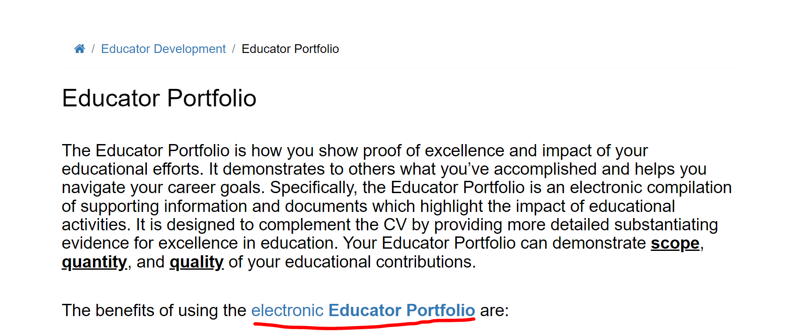
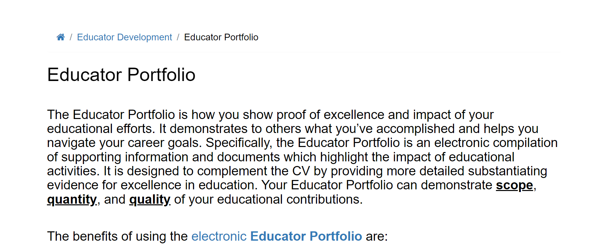

Slide 32
EDUCATOR PORTFOLIO:
https://med.uth.edu/oep/cite/educator-portfolio/

Slide 33
Questions???
https://go.uth.edu/AME-ER

