Slide 1
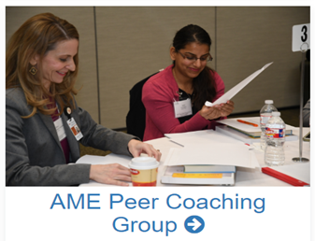
Academy of Master Educators- Peer Coaching Group (PCG)
August 17, 2023

Slide 2
What’s in it for me? Purpose of Peer Coaching for MMS Educators
Formative feedback
Development of educators
Reflective educational practice
Collegial exchange of teaching ideas.

Slide 3
Who will be observing me?
OEP Educators
AME Trained Peer Coaches
Within your own department/division
Outside your department/division
Where will the information go? How can the information be used?
Confidential
Personal documentation of reflective practice

Slide 4
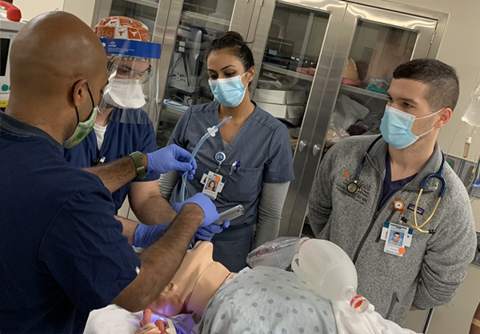
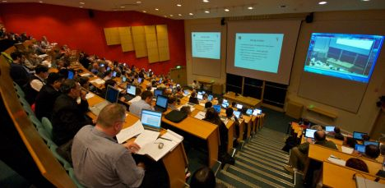
What areas can I ask feedback on?
Content
Teaching methods
Teaching tools
Presentation & communication skills.

Slide 5
Peer Coaching Process
Meet with peer observer to discuss goals for observation
Peer completes observation form/ documentation
Peer Coach provides feedback
Peer Coach observes

Slide 6
AME-PCG Coaches
Philip Orlander
Han Zhang
Eugene Toy
Len Cleary
Gabe Aisenberg
Roy Riascos
Michelle Barratt
Philip Carpenter
Mark Hormann
Erin Furr-Stimming
Elizabeth Nugent
Srikanth Sridhar
Hilary Fairbrother
Nahid Rianon
Rachel Jantea
Shira Goldstein
Jeffrey Actor
Jennifer Swails
Josh Samuels
Abbey Bachmann

Slide 7
Interested in being coached OR being a coach?
Sign up to be observed
OEP educator/AME Coach will meet with you to discuss observation goals
OEP educator /AME Coach will observe your teaching session
Schedule time for feedback on teaching session
Faculty will be trained to become peer coach.

