Slide 1
Rare Myelopathy Seen in Neonatal/Infantile Lupus Erythematosus
Presented by Camille Keenan, MS3
& Matthew Covey, MS3
at Pediatric Neurology Grand Rounds
Friday, October 3, 2014
Mentor: Ian J. Butler, MD
Notes:
Add date pedi neuro

Slide 2
Chief complaint
Child 1
Child 2
Full term African American female born with red and scaly butterfly rash.
3 month old African American male with scaly rash on cheeks.

Slide 3
History of present illness
Child 1
Child 2
No evidence of congential heart block
Rash faded to atrophy and hypopigmentation
Delays in standing and walking (evaluated at 16 months), otherwise normal development
Rash persisted and worsened
At 2 years – generalized seizure, scissoring gait with toe-walking, spasticity and weakness of legs
Rash and gait improved with IV and oral corticosteroids
Notes:
Include child 2 decline at age 3 on this slide? Currently mentioned on Physical exam slide…

Slide 4
Past medical history
Child 1
Child 2
Full term, 3.2 kg at birth
Family History
Mother with positive ANA (speckled), anti-Ro/SSA Ab, RF, and anti-SM Ab (but no clincal symptoms)
Later developed fever, polyarthritis, Coombs positive autoimmune hemolytic anemia, hypocomplementemia, and antibodies to native DNA and nRNP
Uneventful pregnancy, labor, and delivery
Family History
Mother had normal complement levels and negative ANA
Sister died of SLE, 2 other siblings clinically normal

Slide 5
Physical examination
Child 1
Child 2
Evaluated at 16 months due to delayed walking
LE spasticity
Increased reflexes, extensor plantar response
Contractures at the ankles
Flexed posture
Toe-walking, circumduction of right leg
UE normal
No sensory abnormalities
Reevaluated at age 3 due to neurological decline
LE spasticity
Increased reflexes, extensor plantar response
Flexion contractures of hips, knees, ankles
UE normal
Facial scarring

Slide 6
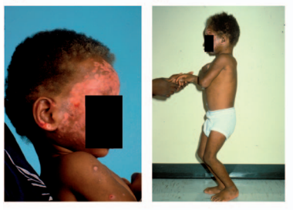
Physical examination
Child 2
Reevaluated at age 3 due to decline
LE spasticity
Flexion contractures of hips, knees, ankles
Increased reflexes, extensor plantar response
UE normal
Facial scarring
Wu et al. Clinical presentations and molecular basis of complement C1r deficiency in a male African-American patient with systemic lupus erythematosus. Lupus 2011;20:10-13.

Slide 7
Relevant labs
Child 1
Child 2
Negative HSV serology and cultures
Anti-Ro/SSA detected (from 2-8 months)
Negative anti-La/SSB Ab
Negative ANA initially
1:80 ANA at age 2 with anti-ssDNA, anti-dsDNA, and anti-SM
Skin biopsy at 19 months – C3 deposits at dermal-epidermal junctions
Elevated serum C3 (227 mg/dl) and C4 (116 mg/dl) at 19 months
Microscopic hematuria
Total C1r deficiency by age 3

Slide 8
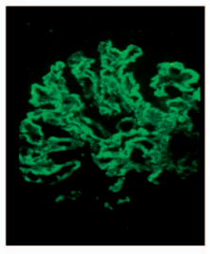
Imaging/Diagnostics
Child 1
Child 2
Normal brain CT, EEG, somatosensory evoked potentials, and myelogram
Normal CSF
Normal oligoclonal bands, myelin basic protein, Igs, and anti-neuronal Abs
Normal brain CT, EEG, somatosensory and brainstem evoked potentials, and myelogram
Mild elevation of CSF myelin basic protein
Renal biopsy - mesangial glomerulonephritis with focal proliferative changes and C3 and IgA deposits
Image - Wu et al. Clinical presentations and molecular basis of complement C1r deficiency in a male African-American patient with systemic lupus erythematosus. Lupus 2011;20:10-13.

Slide 9
Differential diagnosis – based on initial skin manifestations
TORCH infections – newborn rash
Toxoplasmosis, Rubella, CMV, HSV
Telangiectasia
Hemangioma
Dermatophytosis
Eczema
Stevens Johnson Syndrome
MRSA
Epidermolysis bullosa
Neonatal lupus erythematosus
Johnson, Benay. Overview of Neonatal Lupus. Journal of Pediatric Health Care 2014;28(4):331-341.

Slide 11
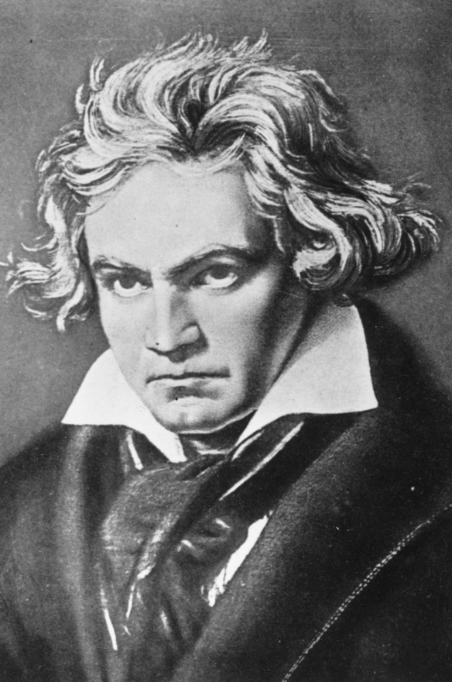
Famous Lupus Patients
Flannery O’Connor, author of A Good Man is Hard to Find
Ludwig von Beethoven

Slide 12
Historical Perspective
Hippocrates: “herpes esthiomenos” – “gnawing dermatosis”
Lupus sufferers in the Middle Ages were feared to be able to transform into animals (werewolves)
Virchow: any necrosis or ulceration of the face was called lupus before the mid-1800s

Slide 13
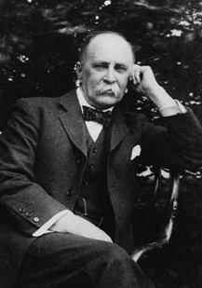
Historical Perspective Cont.
Osler: coined the term “systemic lupus erythematosus” at the turn of the 19th century
Modern understanding began in 1948 with the mixing of SLE serum with normal subjects
Classification criteria (4 out of 14) established in 1971 by the American College of Rheumatology

Slide 14
Systemic Lupus International Collaborating Clinics (SLICC) clinical/immunological criteria (2012)
Cutaneous (4) | Joints (1) | Serositis (1) | Renal (1) | Hematologic (3) | Immunologic (6) | Dx
ACLE/SCLE (typically malar & photosensitive rash) | Synovitis in 2+ peripheral joints | Pleuritis or EKG evidence of pericardial fusion | urine protein > 0.5g/24h | Hemolytic anemia | + ANA | 4+ Items (with 1+ clinical, 1+ immune)
CCLE (aka discoid LE) |  |  | RBC casts | Leukopenia or lymphopenia | + anti-dsDNA
Oral ulcers |  |  |  | Thrombo- cytopenia | Anti-Sm
Non-scarring alopecia |  |  |  |  | Antiphospholipid antibody
 |  |  |  |  | Low complement (C3, C4, CH50)
 |  |  |  |  | Direct Coombs (in absence of hemolytic anemia)

Slide 15
ACR neuropsychiatric syndromes seen in SLE
CENTRAL NERVOUS SYSTEM | PERIPHERAL NERVOUS SYSTEM
Aseptic meningitis | Acute inflammatory demyelinating polyradiculoneuropathy
Cerebrovascular disease | Guillain-Barre syndrome
Demyelinating syndrome | Autonomic disorder
Headache (includes migraine and benign intracranial hypertension) | Mononeuropathy, single/multiplex
Movement disorder (chorea) | Myasthenia gravis
Myelopathy | Cranial neuropathy
Seizure disorder | Plexopathy
Acute confusional state; cognitive dysfunction | Polyneuropathy
Anxiety & mood disorders, psychosis
***Validated in 2001 in a population-based study covering 440,000 people Jeltsch-David H, and Muller, S, 2014

Slide 16
Neuropsychiatric SLE
Up to 75% of adults and kids with SLE will experience some type of neuropsychiatric effects of the disease

Slide 17
Etiology/Pathophysiology/Genetics
Neonatal Lupus Erythematosus (NLE)
Between 1/12,500-20,000 newborns have NLE
Maternal autoantibodies (IgG) cross placenta
Mother may appear healthy or have known AI disease
Anti-Ro/SSA and Anti-La/SSB are heavily implicated
Antibodies deposit in various areas (i.e. the calcium channels in the myocardium) and initiate an inflammatory response
Neural and cardiac tissues have the largest amount of Ro/SSA antigen

Slide 18
Clinical Presentation
Neonatal Lupus Erythematosus (NLE)
Can present in utero
Presumptive with any degree of heart block (usually begins 2nd trimester)
Can present postnatally
Often diagnosed based on skin manifestations (can be different from mother’s)

Slide 19
15-25% of neonates with NLE present with typical skin findings
Annular erythema in 4-week old girl
“owl eyes” or raccoon eyes” in a 12 week-old girl
“seborrheic” plaques in 23-week old boy
“Erythema multiforme-like” plaques in 12-week old boy
Inzinger, Martin, et al. “Neonatal lupus erythematosus and its clinical variability.” Journal der Deutschen Dermatologischen Gesellschaft. 2012: 407-410.

Slide 20
Natural Progression of Disease
Neonatal Lupus Erythematosus (NLE)
Normal pregnancies with most women with high Anti-Ro/SSA titers
Cutaneous, hepatobiliary, or hematologic NLE findings usually reverse by 6 months – coincides with the lifespan of maternal IgG
Atrophy and pigmentation changes can remain in skin findings
3rd degree heart block permanent; myelopathy rare complication
NLE pts at higher risk for developing an AI disease later

Slide 21
Etiology/Pathophysiology/Genetics
INFANTILE Lupus Erythematosus (ILE)
Homozygous mutation in C1r gene: C→T mutation at nucleotide-6392 in exon 10 of the C1R gene – stop codon (R380X)
Homozygous deficiencies of early components for complement activation are major risk factors for SLE
The mother of the infant in case 2 was heterozygous for the mutation; father not available for testing
The R380X mutation is a rare variant but plays a big role in SLE development
C1r deficiency has been strongly correlated with SLE for 40 years, but only in 2011 has the molecular basis been discovered
Wu YL, et al. Clinical presentations and molecular basis of complement C1r deficiency in a male African-American patient with systemic lupus erythematosus. Lupus 2011;20:10-13.

Slide 22
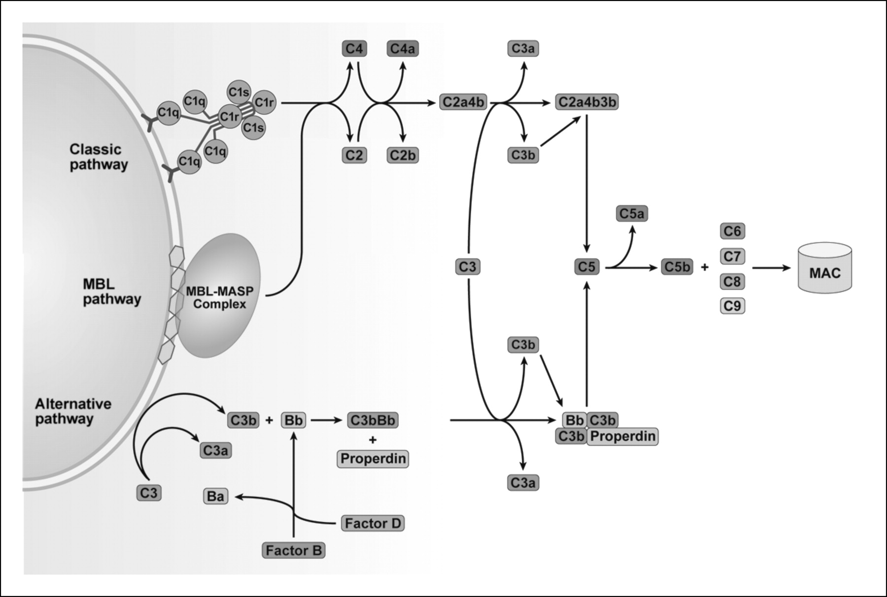
http://mcr.aacrjournals.org/content/8/11/1453/F1.expansion.html

Slide 23
Etiology/Pathophysiology/Genetics Cont.
INFANTILE Lupus Erythematosus (ILE)
C1r & C1s form a tetramer that must remain stable
Leads to reduced activation and consumption of C4 and C2
lowers the engagement of the C1-inhibitor
higher levels of C4 & C2 in the circulation

Slide 24
Etiology/Pathophysiology/Genetics Cont.
INFANTILE Lupus Erythematosus (ILE)
Overall, the patient is complement-deficient, especially in the Classical pathway
Poor long-term clearance of apoptotic/necrotic material →
Loss of immunotolerance →
Autoimmunity develops
Wu YL, et al. Clinical presentations and molecular basis of complement C1r deficiency in a male African-American patient with systemic lupus erythematosus. Lupus 2011;20:10-13.

Slide 25
Clinical Presentation
Infantile Lupus Erythematosus (ILE)
Complement-deficient patients are more susceptible to bacterial infection
Severe cutaneous lesions
High renal disease prevalence
Earlier onset of SLE than non-complement-deficiency

Slide 26
Natural Progression of Disease
Infantile Lupus Erythematosus (ILE)
End-organ damage & eventually death
Complications from steroid treatment (i.e. infection)

Slide 27
Diagnostics
No specific diagnostic criteria
Presence of anti-Ro/SSA, anti-La/SSB, anti-RNP Abs in any combination warrants further evaluation
Prenatal
Test fetal anti-Ro/SSA and anti-La/SSB Abs if mother is at risk (lupus, Sjogren, other autoimmune disorder, previous NL pregnancy)
Mother with SLE and previous neonatal lupus pregnancy – serial fetal ECG starting at 16 weeks
Monitor for signs of congenital heart block (CHB) beginning in second trimester (persistent bradycardia)
Notes:
18-24 weeks gestation is the highest risk for development of heart block

Slide 28
Diagnostics cont.
Postnatal
Skin manifestations – skin biopsy showing characteristic vacuolation, lymphocytic infiltration, and IgM deposits
Serum antibody levels
Congenital heart block – for persistent bradycardia, evaluate with ECG and Doppler
ECG for all infants born to mothers with anti-Ro/SSA and/or anti-La/SSB Abs
Notes:
18-24 weeks gestation is the highest risk for development of heart block

Slide 29
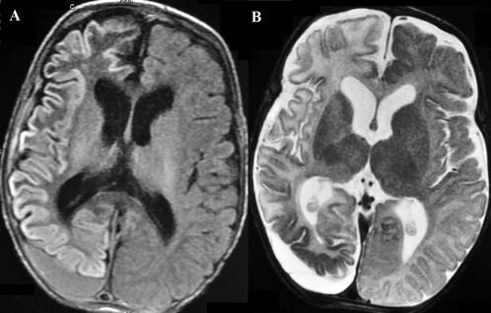
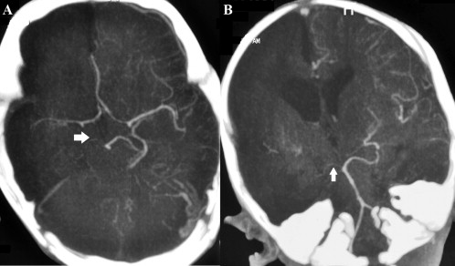
Diagnostics – brain MRI for rare CNS findings
Altered signal intensity in right cerebral hemisphere and left occipital lobe consistent with subacute infarct and subacute subdural hemorrhage.
Diffusely attenuated right supraclinoid internal carotid artery, ACA, MCA (A, arrow) and PCA (B, arrow); bilaterally decreased cortical vasculature and right-sided cerebral chronic infarct.
Saini et al. CNS vasculitis and stroke in neonatal lupus erythematosus: A case report and review of literature. European Journal of Pediatric Neurology 2014; 18(3):444-448.
Notes:
From a case described in Saini et al…
2 month old female with acute ischemic stroke secondary to CNS vasculitis without any cardiac, cutaneous, or hematological manifestations
Mother with positive ANA (speckled), negative dsDNA, positive anti-Ro/SSA, negative antiphospholipid Abs and h/o “pauci-symptomatic” (fever and joint pains lasting for one week a year before, occasional joint stiffness of hands in morning)
“If the disease producing autoantibodies and the anti-idiotypic anti- bodies/blocking antibodies have differential placental transfer, the baby may have disease when the mother does not.”

Slide 30
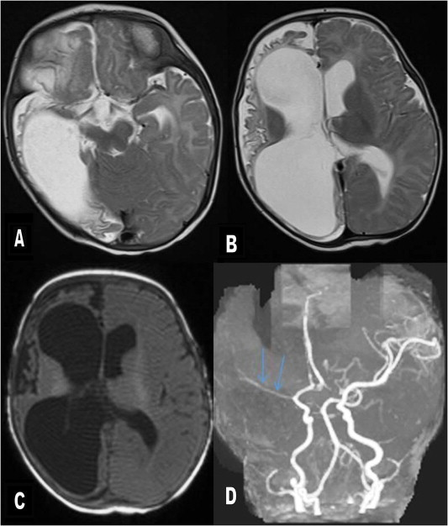
Diagnostics – brain MRI for rare CNS findings
3 month follow-up:
Right cerebral hemi-atrophy with cystic encephalomalacic changes and marked volume loss; markedly attenuated MCA.
Clinically – incomplete head control, intermittent visual fixation and left-sided hemiparesis with cortical thumb
Saini et al. CNS vasculitis and stroke in neonatal lupus erythematosus: A case report and review of literature. European Journal of Pediatric Neurology 2014; 18(3):444-448.

Slide 31
Management/Treatment – In utero
Management
Hydroxychloroquine
May decrease risk of cardiac manifestations of neonatal lupus
The only suggested preemptive therapy (for mother with previous NL pregnancy)
Treatment
Prenatal prednisone or dexamethasone
Produces good outcomes in neonates, can reverse 1st or 2nd degree heart block but not 3rd or complete
IVIG – to decrease ability of antibodies to cross placenta
Steroid + IVIG = better results than steroid alone, although congenital heart block can still occur
Johnson, Benay. Overview of Neonatal Lupus. Journal of Pediatric Health Care 2014;28(4):331-341.
Notes:
**site paper on slide

Slide 32
Management/Treatment – Newborn
Management
Ongoing heart block requires pacemaker
Follow-up screening if patient has a positive maternal history (even if prenatal screening was negative)
Instruct to avoid direct sunlight
Treatment
No treatment for 3rd degree or complete heart block
Prednisolone
IVIG
Or both steroid and IVIG depending on symptom severity
For skin manifestations
Topical steroids
Laser therapy for persisting lesions
Johnson, Benay. Overview of Neonatal Lupus. Journal of Pediatric Health Care 2014;28(4):331-341.
Notes:
Remember, symptoms may not appear right after birth – make follow-up pediatrician aware of maternal status in case of development of later symptoms

Slide 33
Prognosis
Typically newborn symptoms subside after 6 months (life of the IgG Ab), except 3rd degree heart block
Poorer outcomes if premature, low birth weight, low ventricular rate or dysfunction, or have structural heart disease
Cardiac
Exercise limitation and possible death in patients with asymptomatic complete heart block (hence without pacemaker)
Fatality later in life due to possible pacemaker failure
5-11% risk of cardiomyopathy even with pacemaker
Skin
Benign, but help identify risk factors for more serious disorders in family
Notes:
Skin lesions are benign but their persistence indicates an underlying genetic factor that may predispose family members to other autoimmune disorders
Develop AI dz after transplacental???? Yes, but magnitude of the risk is not known (The clinical spectrum of neonatal lupus, Lela A. Lee, Archives of Dermatological Research, 2009)

Slide 34
Ongoing research/Recent development
Future treatment goal
Decrease levels of autoantibodies
Continue to use whole-genome and exome sequencing
Find all the causal variants of SLE
Notes:
**

Slide 35
Summary
Consider neonatal lupus in differential for newborns/infants presenting with seizures, even when lacking cardiac or cutaneous findings
Negative maternal history (no SLE and/or associated Abs) does not rule out infantile lupus – consider complement deficiency
Further research needed to ID biomarkers useful in predicting outcomes and treating SLE
Notes:
Circle back & talk about nature vs nurture ways to get dz
One transplacental & one molecular → both get same dz but one gets worse
Pregnancy rate of mom’s with RA, SLE → why aren’t we seeing more of this, esp. with IVF

Slide 36
Summary cont.
Nature vs. Nurture
Inherited genetic defect affecting normal immune response → development of Abs
Infantile presentation
Transplacental transfer of auto-antibodies from mother to fetus
Neonatal presentation
Auto-antibody mediated damage to native tissues → Patient with lupus erythematosus including cutaneous manifestations and myelopathy.

Slide 37
References
Kaye EM, Butler IJ, Conley S. Myelopathy in neonatal and infantile lupus erythematosus. Journal of Neurology, Neurosurgery, and Psychiatry.1987;50:923-926.
Wu YL, Brookshire BP, Verani RR, Arnett FC, Yu CY. Clinical presentations and molecular basis of complement C1r deficiency in a male African-American patient with systemic lupus erythematosus. Lupus. 2011;20:10-13.
Inzinger, Martin, et al. “Neonatal lupus erythematosus and its clinical variability.” Journal der Deutschen Dermatologischen Gesellschaft. 2012: 407-410.
Johnson, Benay. Overview of Neonatal Lupus. Journal of Pediatric Health Care. 2014;28(4):331-341.
Jeltsch-David H, and Muller, S. “Neuropsychiatric systemic lupus erythematosus: pathogenesis and biomarkers. Nat Rev Neurol. 2014: Epub ahead of print.
Mallavarapu, Ravi and Grimsley, Edwin. “The history of lupus erythematosus.” Southern Medical Journal. 2007: 896-8.
Saini AG, Naveen S, Bhattad S, Vyas S, Saikia B, Singhi P. CNS vasculitis and stroke in neonatal lupus erythematosus: A case report and review of literature. European Journal of Paediatric Neurology. 2014; 18(3):444-448.
Buyon, JP. Neonatal lupus. In: UpToDate, Post TW (Ed), UpToDate, Waltham, MA. (Accessed on September 30, 2014.)
Yu, Cong, et al. “Diagnostic criteria for systemic lupus erythematosus: A critical review.” Journal of Autoimmunity. 2014: 10-13.

Slide 38
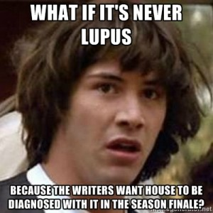
Special Thanks to…
Dr. Butler
Dr. Bala, Dr. Fitzgerald, and Dr. Grant
Any Questions?

