Slide 1


Pediatric Neurology Grand Rounds
November 14, 2014
SYNTAXIN – binding protein 1 (STXBPI) and infantile epileptic encephalopathy (E1EE4) – role of topiramate treatment.
CASE PRESENTATION: STXBP1 MUTATION AND TOPIRAMATE
Daniel Calame, MS3
Kishan Patel, MS3
Jon Wolfshohl, MS3

Slide 2
History of Present Illness
CC: abnormal movements
Patient is an 11mo twin male for evaluation of “abnormal movements”
Mother says it started at around 5-6 months of age
Family lives in Florida – came to Houston for medical evaluation

Slide 3
History of Present Illness
Episodes are described as flexion of the neck with extension of the arms and legs
Episodes last 1-2 seconds, with patient awake during episodes
Episodes occur in clusters that last up to1 hour, but recently have lasted for 15-20 minutes
Some days have no episodes, but most days have at least one cluster

Slide 4
History of Present Illness
Episodes also occur at night
Mother thinks episodes increase when the patient is stressed out
Mother was previously told it may be related to colic or reflux
  Short course proton pump inhibitor (PPI) showed no improvement

Slide 5
Review of Systems
Gen: No fevers, weight loss, chills, fatigue
HEENT: no issues
CV: no issues
Pulm: no issues
GI: no issues
GU: no issues
Neuro: mentioned in HPI
Endo: no hx of growth problems
Skin: no issues
Musc: no issues

Slide 6
History
Allergies: Ibuprofen
Meds: Acetaminophen
PMH:
  No hx of frequent infections
  No prior hospitalizations
PSH: none
Birth Hx:
  Twin (shared placenta)
  Born via C/S at 37 weeks
  BW 6lb 4oz
Immunizations:
  None
  Mother choosing not to vaccinate
Family Hx:
  MGM – stroke
  Mother – migraines
  No hx of seizures, devo delay, psych, or neuro problems
Social Hx:
  Lives at home with mother and twin brother in Florida
  Does not attend daycare

Slide 7
History
Dev Hx:
  Began sitting at 6mo
  Crawling at 7mo
  Currently is pulling to stand and has taken a few steps on his own
  Babbles but has not spoken first words

Slide 8
Physical Examination
General: awake and alert, well-nourished, crying but consolable
Vital signs:
  Temp: 99.4 °F (tympanic temp)
  Height: 80.01 cm (97%)
  Weight: 11.17 kg (91%), BMI 17.4 kg/m²
  Head circum: 49.2 cm (99%)
HEENT: ant font small and flat, macrocephalic; no clefts/pits/masses; no dysmorphic facial features
Resp: clear to auscultation
CV: RRR, no murmurs
Abdomen: soft, nontender, no hepatosplenomegaly
Extremities: normal digits, no sacral pits or dimples
Skin: 2 small hyperpigmented macules (medial L knee, L shoulder)

Slide 9
Physical Examination
Neuro:
  CN: pupils equal, round, and reactive and to light and accommodation; extraocular movements full and intact; face moves symmetrically; tongue midline; palate elevates symmetrically; symmetric facies
  Motor: normal bulk; strength 5/5 throughout; normal tone and symmetrical throughout
  Sensation: grossly intact
  Coordination: normal for age and symmetrical, no tremor
  Reflexes: normal and symmetrical throughout, no tremor

Slide 10
Labs
Lactic acid: 1.5 → 2.5
Pyruvic acid: 8.37 → 0.79
Ammonia: 53 → 63
Hematocrit: 36.8
Hemoglobin: 12.4
MCV: 73.1
MPV: 7.1
Platelet: 477
CMP: unremarkable
Acylcarnitine profile: unremarkable
Amino acids: Numerous elevations likely due to dietary status

Slide 11
Routine EEG
Single electroclinical myoclonic seizure
Periodic generalized polyspike and wave discharges
  Persisted for 1-5 seconds
  Located at the T6 electrode (right posterior temporal predominance)
Started topiramate 25 mg QHS x 1 week,
then 25 mg BID

Slide 12
Brain MRI
Unremarkable
Myelination normal for patient’s age
No gross abnormalities

Slide 13
EMU
Admitted to the EMU for 3 days for continuous VEEG monitoring
Medications include: topiramate

Slide 14
EMU
Day 1: generalized epileptiform discharges (L posterior quadrant)
Day 2: One cluster of myoclonic spasms with generalized high amplitude arrhythmic sharps followed by periods of electrodecrement
  Patient’s arms go upwards with eyes wide open
  Bursts occur every 5-10 seconds, 14 total over 5 minutes
Day 3: L > R fronto-temporal focal slowing and epileptiform discharges interictally
No evidence of hypsarrhythmia, background activity appropriate for age

Slide 15
Genetic Testing
Genetic Variants: Genes Related to Reported Phenotype
Gene | Amino acid change | Zygosity/Mode of Inheritance | Disease Association
STXBP1 | p.Asp151Glu | heterozygous AD | Early infantile epileptic encephalopathy type 4 (EIEE4) and non-syndromic intellectual disability type 3
SLC6A5 | pHis119Arg | heterozygous AD or AR | Hyperekplexia
CDON | p.Val576Ile | heterozygous AD | Holoprosencephaly
RPGRIP1L | p.Leu57Phe | heterozygous AR | Joubert syndrome type 7 (JBTS7) and Meckel syndrome type 5
RPGRIP1L | p.Asn210Asp | heterozygous AR | Joubert syndrome type 7 (JBTS7) and Meckel syndrome type 5
All listed genetic variants have pathogenicity of “variant of uncertain significance”

Slide 16
Summary
Hx of abnormal flexion of neck with extension of arms and legs since 5mo
  Episodes last 1-2 seconds
  Episodes occur in clusters that last up to an hour
EEG with generalized epileptiform discharges
  Myoclonic jerks with high amplitude sharps followed by electrodecrement
  Normal brain MRI
Started on topiramate
STXBP1 mutation identified

Slide 17
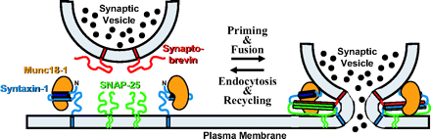
What is STXBP1?
Syntaxin-binding protein 1 (AKA Munc18-1)
Part of the SNARE complex
Facilitates fusion of synaptic vesicles with plasma membrane

Slide 18
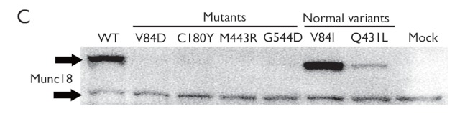
STXBP1 mutations in Ohtahara syndrome
  One microdeletion and four missense mutations
  Mutant proteins are unstable
  Thus, haploinsufficiency of STXBP1 linked with OS

Slide 19
Multiple phenotypes linked to STXBP1 mutations
Early-onset epileptic encephalopathies
  Ohtahara syndrome
  West syndrome
Non-syndromic epilepsy with MR
MR without epilepsy

Slide 20
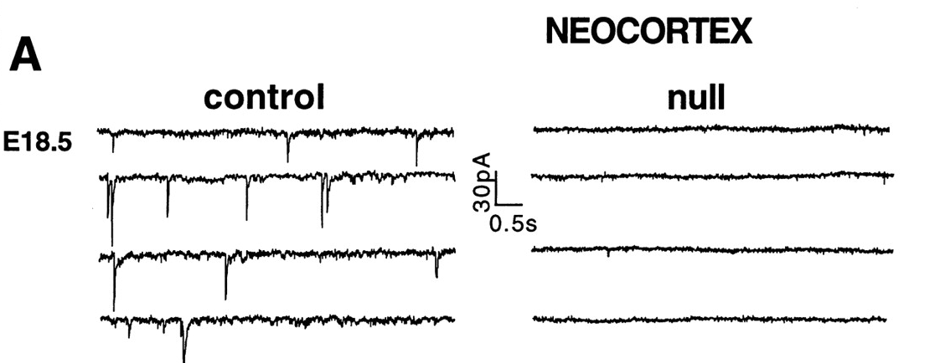
STXBP1 is required for neurotransmission
STXBP1 null mice – respiratory failure at birth
Lack synaptic neurotransmission
Normal brain development
Some neurodegeneration observed in later stages

Slide 21
STXBP1 & the GABA-Glutamate balance
STXBP1 helps maintain synapse function during intense stimulation
Greater degree of synaptic depression seen in GABAergic neurons than in Glutaminergic neurons
Glutamate
GABA

Slide 22
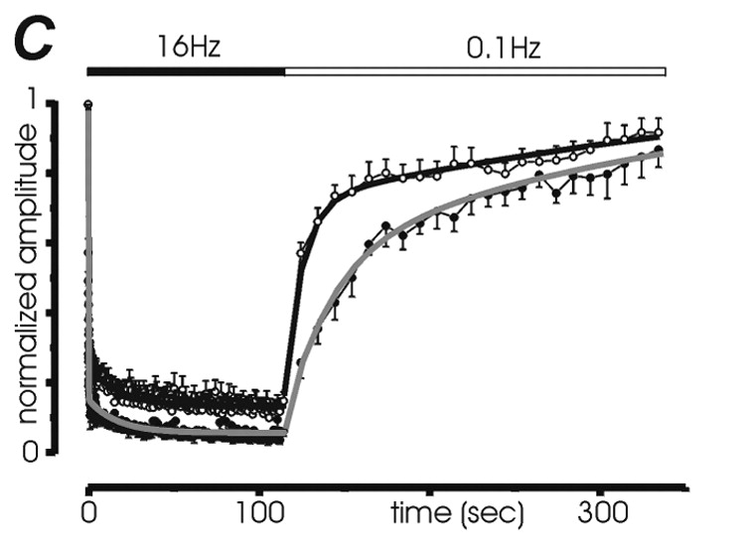
Synapsins and GABA
Synapsins I & II – presynaptic proteins, modulate exocytosis
Mutations identified in sporadic epilepsy
Deficiency impairs GABAergic activity

Slide 23
Topiramate
FDA labeled indications
Epilepsy in patients ≥2 years of age
  Both monotherapy and adjunctive therapy
Seizures assoc. with Lennox-Gastaut Syndrome (≥2 yrs old)
Migraine headaches
Chronic weight management (in combination with phentermine)
Off-label indications
Alcoholism
Eating disorder
Essential tremor
Obesity
Type 2 diabetes mellitus in obese patients (adjunct)

Slide 24
Topiramate
Mechanism(s) of Action
blockage of voltage-dependent Na+ channels
augmentation of GABA activity at GABA-A receptors
antagonism of AMPA/kainite subtype of the glutamate receptor, and
inhibition of the carbonic anhydrase enzyme

Slide 25
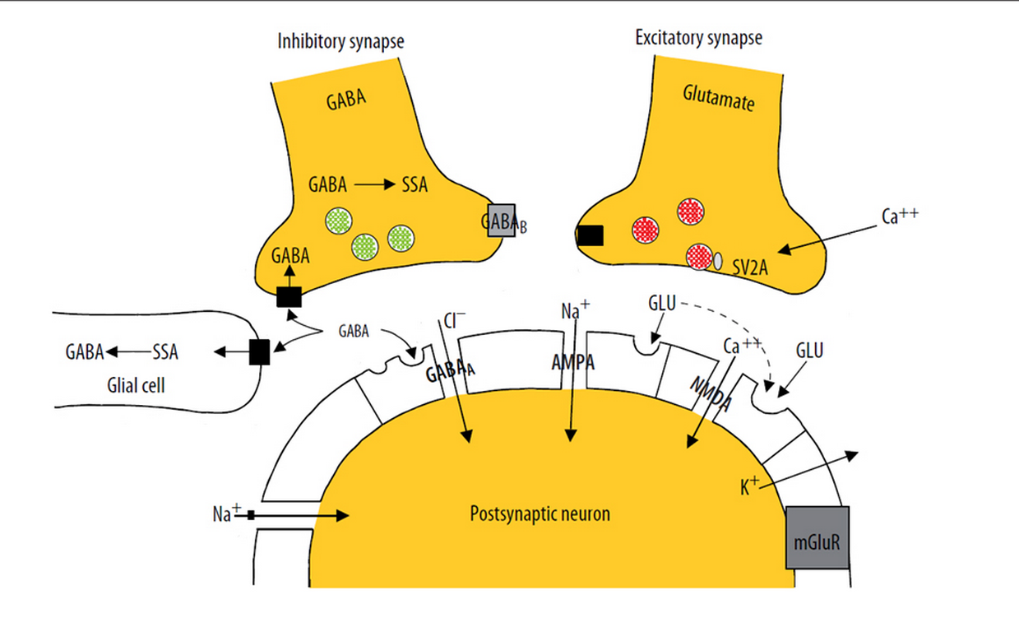
Topiramate
Topiramate

Slide 26
Considerations for clinical use
Common Adverse Effects of Topiramate
Dermatologic: Flushing (pediatrics 5%)
Endocrine metabolic: Serum bicarb abnormal (25 - 67%)
GI: Loss of Appetite (10-24%) and Weight Loss (4 - 21%)
Immunologic: Infectious Disease (2 – 8%)
Neurologic:
  Confusion (3 - 11%)
  Dizzyness (4 – 25%)
  Impaired Cognition (2 – 7%)
  Impaired psychomotor performance (2 – 13%)
  Memory impairment (3 – 12%)
  Paresthesia (1 – 51%)
  ↓Concentration (2 – 10%)
  Somnolence (6 – 29%)
Psychiatric: Feeling Nervous (4 – 16%) and Mood Disorder (4 – 11%)
Other: Fatigue (6 – 16%) and Fever (1 - 12%)

Slide 27
Considerations for clinical use
Serious Adverse Effects of Topiramate
Dermatologic: SJS and TEN
Endocrine metabolic:
  Hyperammonemia (Adolescents 26%)
  Hypohidrosis
  Metaboic Acidosis
Hepatic: Liver Failure
Neurologic: Drug-induced encephalopathy
Ophthalmic: Glaucoma, Myopia, or Visual Field Defect (≤1%)
Psychiatric: Suicidal thoughts
Renal: Nephrolithiasis (adults, 1 – 3%)

Slide 28
Case Summary
11mo presenting with infantile spasms likely associated with STXBP1 mutation
STXBP1 mutation
  Gene product found in SNARE complex
  May disproportionally affects GABAergic neurons
Topiramate has many actions
  Augmentation of GABA activity
  Inhibition of Glutamate
Doing very well on topiramate 15mg TID

Slide 29
References
Saitsu H, Kato M, Mizuguchi T, et al. 2008. De novo mutations in the gene encoding STXBP1 (MUNC18-1) cause early infantile epileptic encephalopathy. Nat Genetics 40: 782-788
Vatta M, Tennison MB, Aylsworth AS, et al. 2012. A Novel STXBP1 Mutation Causes Focal Seizures With Neonatal Onset. J Child Neurol 27: 811-814.
Deprez L, Weckhuysen S, Holmgren P, et al, 2010. Clinical spectrum of early-onset epileptic encephalopathies associated with STXBP1 mutations. Neurology 75: 1159-1165.
Hamdan FF, Gauthier J, Dobrzeniecka S, et al. 2011. Intellectual disability without epilepsy associated with STXBP1 disruption. Eur J Hum Genetics 19: 607-609.
Verhage M, Maia AS, Plomp JJ, et al. 2000. Synaptic Assembly of the Brain in the Absence of Neurotransmitter Secretion. Science 287: 864-869.
Dulubova I, Khvotchev M, Liu S, et al. 2007. Munc18-1 binds directly to the neuronal SNARE complex. PNAS 104: 267-2702.
Toonen RFG, Wierda K, Sons MS, et al. 2006. Munc18-1 expression levels control synapse recovery by regulating readily releasable pool size. PNAS 103: 18332-18337.
Baldelli P, Fassio A, Valtorta F, et al. 2007. Lack of Synapsin I Reduces the Readily Releasable Pool of Synaptic Vesicles at Central Inhibitory Synapses. J Neurosci 27: 13520-13531.
Medrihan L, Ferrea E, Greco B, et al. 2014. Asynchronous GABA Release Is a Key Determinant of Tonic Inhibition and Controls Neuronal Excitability: A Study in the Synapsin II-/- Mouse. Cereb. Cortex doi: 10.1093/cercor/bhu141
Landmark, Cecilie. 2007. Targets for Antiepileptic Drugs in the Synapse. Med Sci Monit. 13(1): RA1-7.
Topiramate . Micromedex. Accessed Nov 2014.

