Slide 1
Muscle without a Matrix: A Biological Love Story Gone Wrong
Corey Cannon, MS3
Russell Romano-Kelly, MS3
Corbin Shawn, MS3
Presentation given by 3rd year medical students
at Pediatric Neurology Grand Rounds,
Valentines Day (2/14/2014)

Slide 2
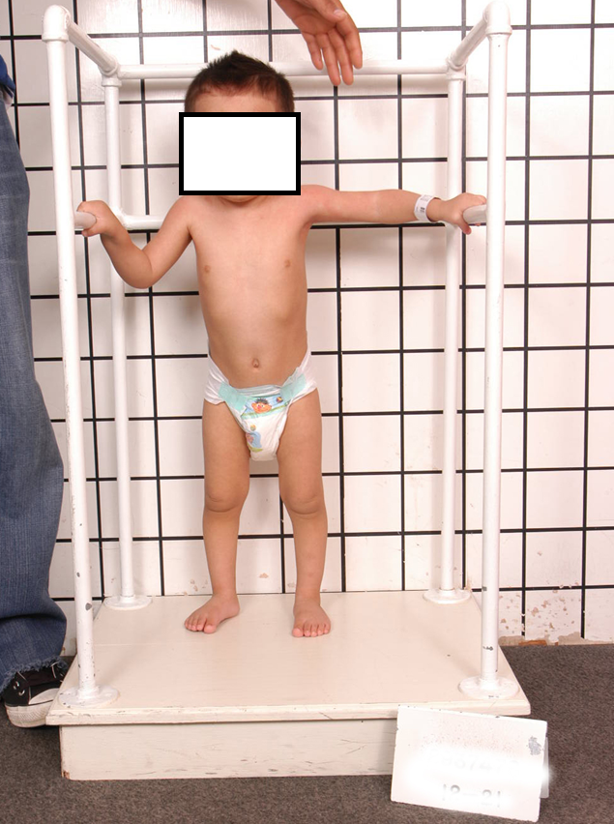
HPI
Chief Complaint:
Increased laxity and muscle weakness
5 year old former term baby who has been followed at Shriner’s Neuromuscular clinic for increased laxity and muscle weakness.
Initial visit in November 2011 (age 3) for muscle weakness.
Parents report hypotonia since birth, but no subsequent feeding, no swallowing difficulties and never requiring a ventilator.
Hypotonia persistently manifested as difficulty getting up from the floor, unsteady with frequent falls and weakness.

Slide 3
HPI - Follow up visit May 2012
Saw genetics for significant joint laxity and concern for Ehlers Danlos Syndrome, which genetics did not feel was significant. No testing was sent.
Family concern about upper extremities weakness due to difficulty with using steering wheel on toy car.
Muscle biopsy planned
Example of great motor activity

Slide 4
PMH
Developmental Hx –
Sat 7 months, didn’t walk until 18 months, frequent falls.
No regression and has been improving with time.
Normal cognitive and language development.
Medical Hx - Congenital hypotonia. Delayed motor milestones.
Surgical Hx - Muscle Biopsy 4/17/2013
Meds: None
Family Hx – Younger brother healthy, but older sibling born at 7.5 mo G.A who died at 8 days of life likely from respiratory issues. Negative for any similar problems. No consanguinity.
Social Hx – Parents are from Mexico.

Slide 5
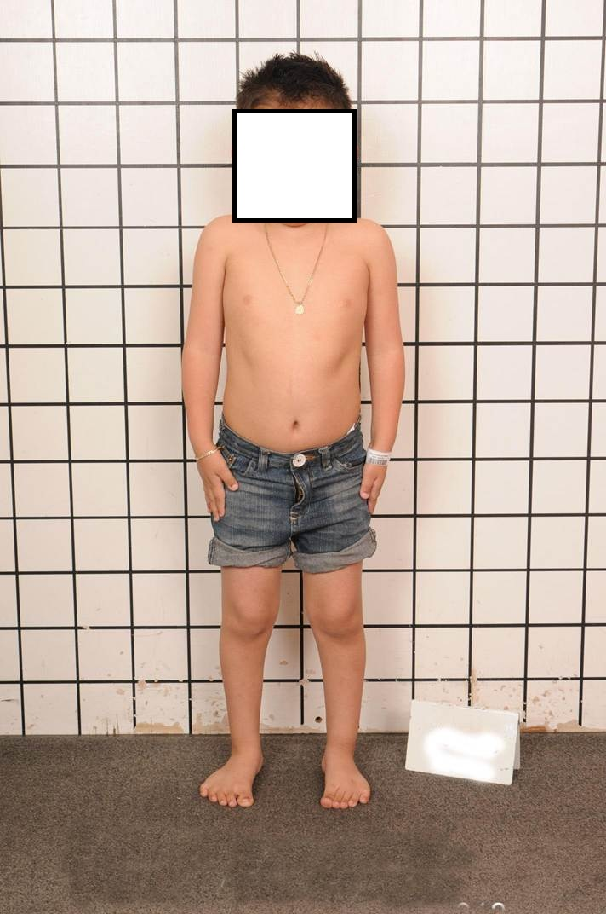
Physical Exam
Vitals: Height: 113cm (80%), Weight: 23kg (90%), HOC: 53cm (~75%)
General: Awake, alert, oriented. Has prominent forehead. No dysmorphic features.
CV: RRR, no murmurs
Resp: Breathing comfortably on room air.
Abdomen: no hepatosplenomegaly
Derm: small erythematous papules over upper arms, triceps area, and mildly on forearms. No neurocutaneous stigmata.

Slide 6
Neurological Exam
Mental Status: pleasant and interactive, follows commands
Language: normal speech and cognition.
Cranial nerves: intact
Sensation: intact to light touch.
Motor:
Tone: significant hypotonia throughout, + axillary slippage and joint laxity, especially with flexion at the wrist, + hyperextensible finger extension and at knees. + mild contractures at bilateral elbows.
Power: diffuse muscle weakness 4/5 throughout, but neck flexor 2/5. + significant head lag when pulled from the lying position.
Reflexes: DTRs 1+ throughout. No clonus or Babinski.
Gait/Station: + hyperlordotic and + waddling gait.
Other: Mild scapular winging. + Gowers maneuver.

Slide 7
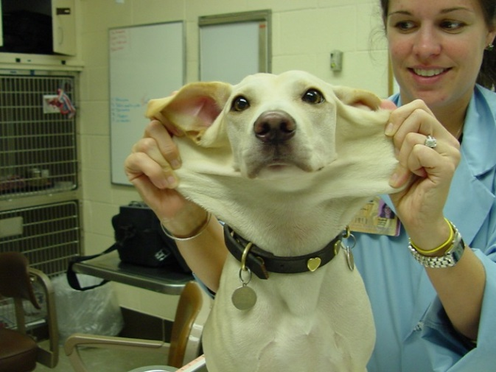
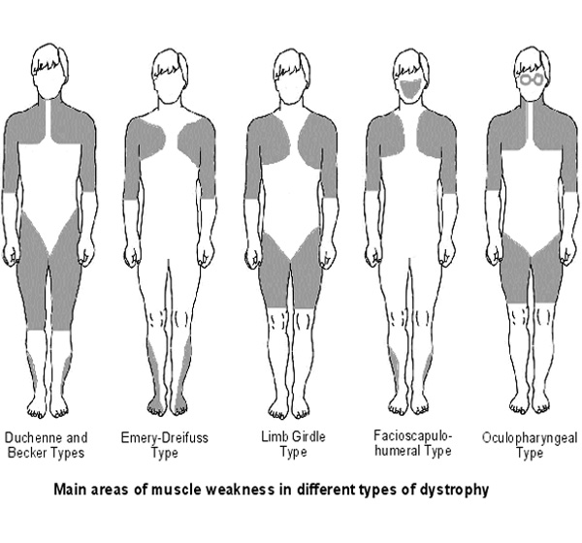
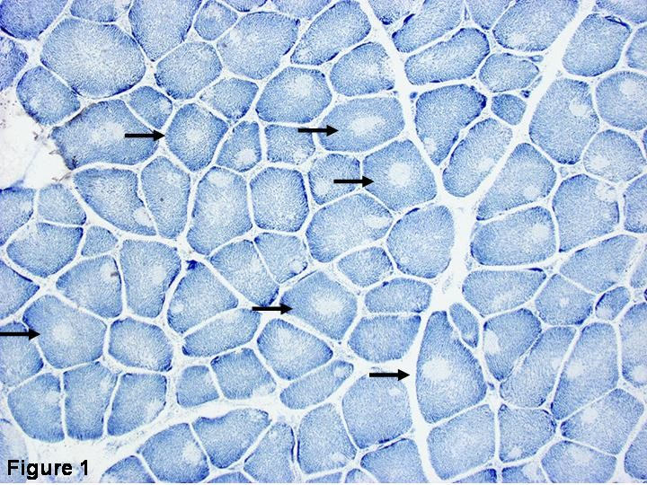
Differential Diagnosis
Limb-girdle Muscular Dystrophy
Ehlers- Danlos Syndrome
Emery-Dreifuss Muscular Dystrophy
Central Core disease and Fiber type Disproportion
Collagen VI Congenital Myopathies

Slide 8
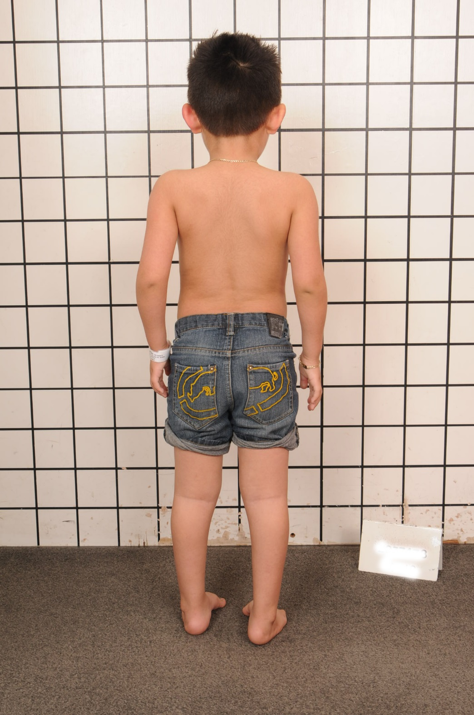
Work - Up
Follow up visit 6/14/2013
Labs (11/2011): Aldolase mildly elevated. ALT/AST normal. Total CK normal.
EMG/NCS (3/2012): normal.
Muscle biopsy (4/2013): evidence of muscular dystrophy with multiple lobulated fibers.
SMN1 gene (4/2013): normal.
Over last few months, he seems a little stronger and his falls are less frequent. He still had significant laxity and muscle weakness.
Molecular tests for collagen 6 mutations were performed.

Slide 9
Overall, we think this is…
Collagen 6 Muscular Dystrophy!

Slide 10
Collagen
Most abundant protein in the human body
Main component of connective tissue in humans
tendons, ligaments and skin
Produced by fibroblast cells
Basic structural unit is the triple helix
At least 16 different subtypes of collagen, 80-90% in humans is type I, II, and III

Slide 11
Major Collagen Molecules
Type | Representative tissues | Commonly Associated Diseases
I | Skin, tendon, bone, ligaments, dentin, interstitial tissues | Osteogenesis Imperfecta, Ehlers- Danlos Syndrome
II | Cartilage, vitreous humor
III | Skin, muscle, blood vessels | Ehlers – Danlos Syndrome
VI | All basal laminaes | Alport Syndrome
V | Skin, tendon, bone, ligaments, dentin, interstitial tissues, fetal tissues | Ehlers – Danlos Syndrome
VI | Most interstitial tissues | Collagen VI Myopathies
IX | Cartilage, vitreous humor;

Slide 12
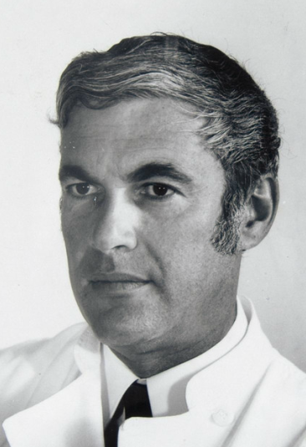
Discoverers of the Collagen VI Myopathies
Ullrich Congenital Muscular Dystrophy
Named after Otto Ullrich (1894-1957), German pediatrician and published first paper about the disorder in 1930 paper in the German literature
Bethlem Myopathy
Named after Jaap Bethlem (1924-) who first described Bethlem myopathy in paper coauthored by George van Wijngaarden published by Brain journal in 1976

Slide 13
A Spectrum of Disease
MOST SEVERE
Severe Ullrich CMD
Typical Ullrich CMD
Intermediate Collagen VI Myopathy
Bethlem Myopathy
LEAST SEVERE

Slide 14
Presentation of UCMD
may initially show reduced fetal movement
Hypotonia
Weakness
Hyperlaxity of distal joints
Joint contractures of elbows, knees, spine, neck
Clubfoot (rare)
Dysphagia with transient feeding difficulties

Slide 15
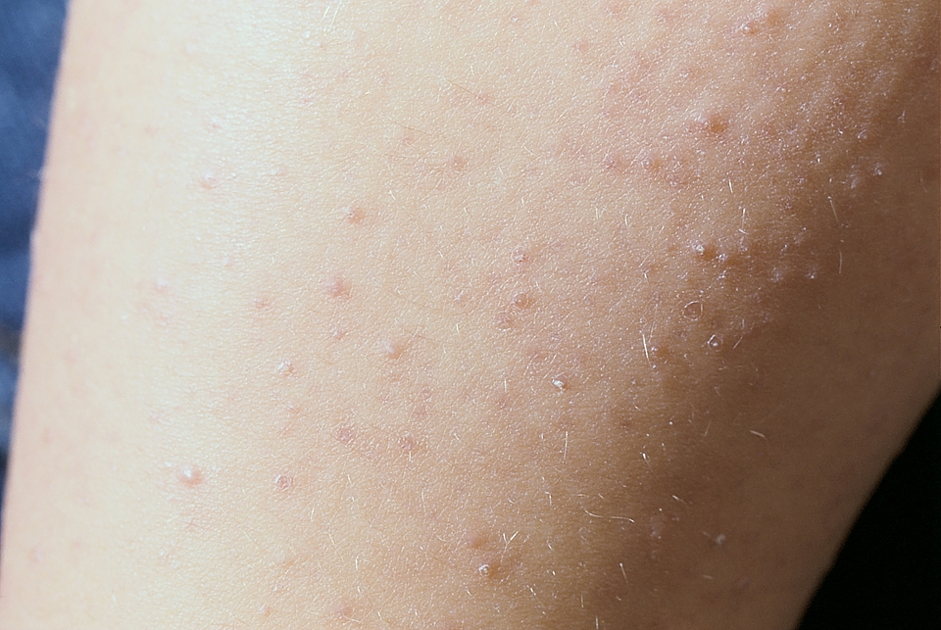
Presentation of UCMD (continued)
Propensity for abnormal (atrophic, keloid) scars
Prominent keratosis pilaris of extensor surfaces
In severe cases may not gain the ability to walk, but majority walk by 2 years of age
Loss of ability usually by adolescence
Eventual respiratory insufficiency
Cranial and heart musculature is preserved

Slide 16
Presentation of Bethlem Myopathy
Similar symptoms to UCMD but milder with wide variability
May first be diagnosed in adulthood but signs may be present in infancy
Hypotonia, torticollis, foot deformities
Congenital contractures usually resolve by age 2
Patients rarely fully symptomatic before 5 years of age
May have weakness in proximal distribution without contractions or prominent contractures without weakness

Slide 17
Early Symptoms of Bethlem Myopathy

Slide 18
Presentation of Bethlem Myopathy (continued)
Typical contractures of the Achilles tendon and elbows around the beginning of adolescence
Progress to affect long finger flexors, shoulders and spine
Bethlem Sign
Eventual walking difficulties
Increased risk of restrictive lung disease and subsequent respiratory insufficiency

Slide 19
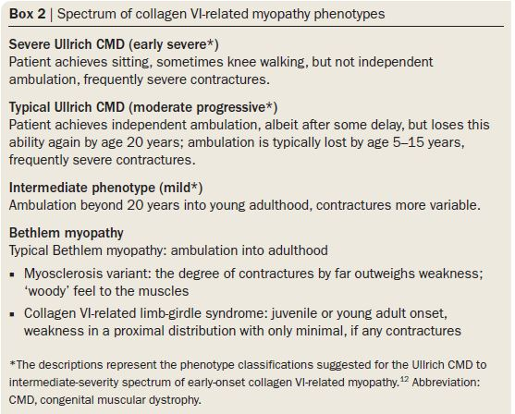
A Spectrum of Disease
MOST SEVERE
LEAST SEVERE

Slide 20
Natural History
Ullrich Congenital Muscular Dystrophy
Hyperlaxity, hypertonia, joint contractures may be present at birth
mean onset of disease by 12 months
Muscle weakness is progressive
Disability aggravated by significant contractures in large joints
Loss of ability to walk usually by early teenage years
Respiratory insufficiency usually occurs before loss of ability to walk and manifests first as nocturnal hypoxemia
Deterioration imminent, but not necessarily associated with age or severity at onset
Bethlem Myopathy
Joint contractures may be present at birth but may resolve by age 2
Patients experience progressive deterioration and eventual loss of ability to ambulate in 4th or 5th decade of life
Significant decrease in muscle strength reported also around 4th or 5th decade of life

Slide 21
Diagnosis
Detection of mutations by microarray and sequencing in collagen VI gene
Disease caused by mutation in α-chain peptides α1 (encoded by COL6A1), α2 (COL6A2) or α3 (COL6A3)
Diagnosis typically depends on clinical features
Muscle biopsy may be useful adjunct showing myopathic or dystrophic changes with collagen VI immunolabelling normal in BM but moderately to severely reduced in UCMD
Prenatal diagnosis only considered for UCMD (not BM) in rare case studies

Slide 22
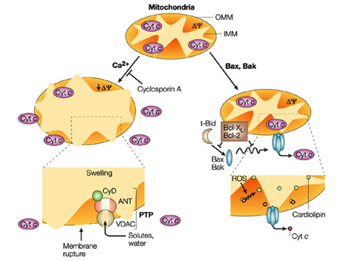
Pathophysiology
Col6a1 knock-out mouse models
Exhibit little weakness with mild neuromuscular disorder
Increased apoptosis of myocytes
Prevented with cyclosporin to inactivate cyclophilin D (CyD), resulting in improvement of muscular function
Impairment of mitochondrial autophagy

Slide 23
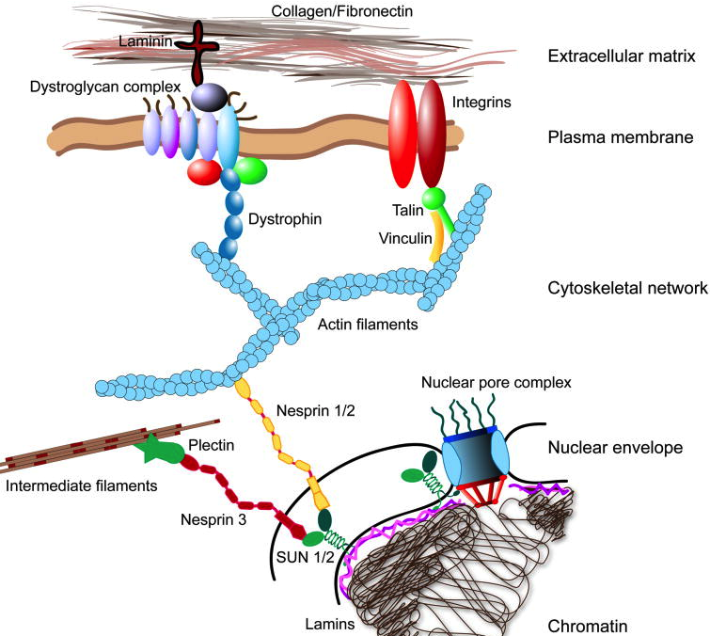
Pathophysiology
Cell anchorage is an important factor in the prevention of apoptosis
Collagen VI-deficient cell cultures show decreased adhesion to extracellular matrix

Slide 24
Normal
Collagen VI-related myopathy
Collagen VI (red)
Laminin γ-1 (green)

Slide 25
Pathophysiology
Ullrich CMD
Classically AR, though AD patterns of inheritance exist (usually de novo mutations)
AR forms result in complete absence of collagen VI in the extracellular matrix due to nonsense mutations, splice-site mutations, and intragenic deletions
AD/sporadic forms result from in-frame skipping of exons in the N terminus of the α-chain domains

Slide 26
Pathophysiology
Bethlem CMD
AD predominate, but AR exist
Exon-14 skipping mutations of C-terminus of α-1 chain most common
Result in disrupted formation of the monomers from the three peptide subunits, thus decrease tetramer formation
25% of patients have no known mutation in the COL6 genes

Slide 27
Treatment and Management
Prior to the introduction of respiratory management, collagen VI myopathies were typically survivable to the teens
Sleep studies often needed for nocturnal hypoxemia
Can be managed for years with noninvasive bilevel positive airway pressure ventilation
Scoliosis can be managed with a trunk orthosis, such as a Garchois brace
Regular stretching, standing, splinting, and serial casting for contractures

Slide 28
Future directions
Most promising target is to halt apoptosis in myocytes
Inhibition of cyclophilin D with ciclosporin or DEBIO-025 (alisporivir)
Small study of 5 patients showed stabilized mitochondrial function and decreased apoptotic nuclei via biopsy after 4 weeks of therapy with ciclosporin, though no strength testing was performed
More research is required to elucidate exact mechanism responsible for myocytes becoming susceptible to apoptosis when the extracellular matrix is deficient of collagen VI

Slide 29
Case Update
Most recent visit 1/10/2014 - Still not able to stand alone, has to hold on to objects/handles in order to pull himself up from chair. Recently began using braces. Denies trouble swallowing or chewing or respiratory distress.
Results for Collagen 6 testing done on 11/27/2013 showed mutation in the collagen 6A1 gene. Two heterozygous mutations were noted.
P.GLY 287GLU which was predicted to be pathogenic
P.ALA112THR, which clinical relevance is not yet known.

Slide 30
References
Collagen: The Fibrous Proteins of the Matrix. Molecular Cell Biology. 4th edition. Lodish H, Berk A, Zipursky SL, et al. New York: W.H Freeman. 2000
Bethlem J, Wijngaarden GK. Benign Myopathy, With Autosomal Dominant Inheritance. Brain. (1976) 99: 91-100.
Lampe AK, Bushby KM. Collagen VI related muscle disorders. J Med Genet 2005.
Bönnemann CG. The collagen VI-related myopathies: muscle meets its matrix. Nat. Rev. Neurol. 7, 379–390 (2011)
Nagappa M, Atchayaram N, Narayanappa G. A large series of immunohistochemically confirmed cases of congenital muscular dystrophy seen over a period of one decade. Neurol India 2013;61:481-7
Jobisis GJ, Boers JM, Barth PG, de Visser M. Bethlem myopathy: a slowly progressive congenital muscular dystrophy with contractures. Brain. (1999) 122 (4): 649-655.doi: 10.1093/brain/122.4.649

Slide 31
References (continued)
Nadeau, A. et al. Natural history of Ullrich congenital muscular dystrophy. Neurology 73, 25–31 (2009).
Wang, C. H. et al. Consensus statement on standard of care for congenital muscular dystrophies. J. Child. Neurol. 25, 1559–1581 (2010).
Orrenius S, Zhivotovsky B, Nicotera P. Regulation of cell death: the calcium-apoptosis link. Nature Reviews Molecular Biology 2003 Jul, 4, 552-565.
Jaalouk DE, Lammerding J. Mechanotransduction done awry. Nat Rev Mol Cell Biol. 2009 Jan;10(1):63-73.

