Slide 1
Virtual Card (vCard) Requests

Slide 2
Agenda
vCard Summary
vCard Transaction Types
Request a vCard Transaction
vCard Transaction Approval Process
Transaction
vCard Request Form
Delivery
List of Restricted Items

Slide 3
vCard Summary
vCard is a Virtual Card that replaces the Buycard.
Single-use Card # for the Requested Merchant.
Requests must be submitted for approval prior to your transaction. Please allow 7-14 business days for the approval process.

Slide 4
Vcard Transaction Types
Transactions made via Internet or Phone
Internet Transaction with Recurring Charges
Registration for Conferences, but RTA must be pre-approved
Please note that the University prefers that we use one of the other transaction types to complete transactions. Please consider using a PO or Non-PO before opting to use the vCard.

Slide 5
Request a vCard Transaction
Email Ms.PsychiatryProcurement@uth.tmc.edu with the following details:
Completed vCard Request Form with:
CFS;
Preferred method for completing your transaction
Justification for using a vCard vs. a PO or Non-PO

Slide 6
vCard Transaction approval process

Slide 7
Requestor submits vCard Request to Psy Procurement
Psy Procurement acquires DMO Signature
Psy Procurement Enters Request in Coupa
Request proceeds through 5-levels of approval in Coupa
Once approved, vCard details are generated and available for view in Coupa
Psy Procurement notifies Requestor of approval to complete transaction
Transaction is completed via Requestor’s preferred method
We recommend allowing
7-14 business days to complete the approval process.

Slide 8
Transaction
There are two options for completing this transaction.
You will provide the vCard holder with your login details, including username and password, to complete the transaction on your behalf.
Psychiatry Procurement will provide you with the one-time vCard information so that you can complete the transaction. You will provide the receipt to the vCard holder within 24 hours of completing the transaction.
You will need to communicate your preferred option on the vCard Request Form.

Slide 9
vCard Request Form

Slide 10
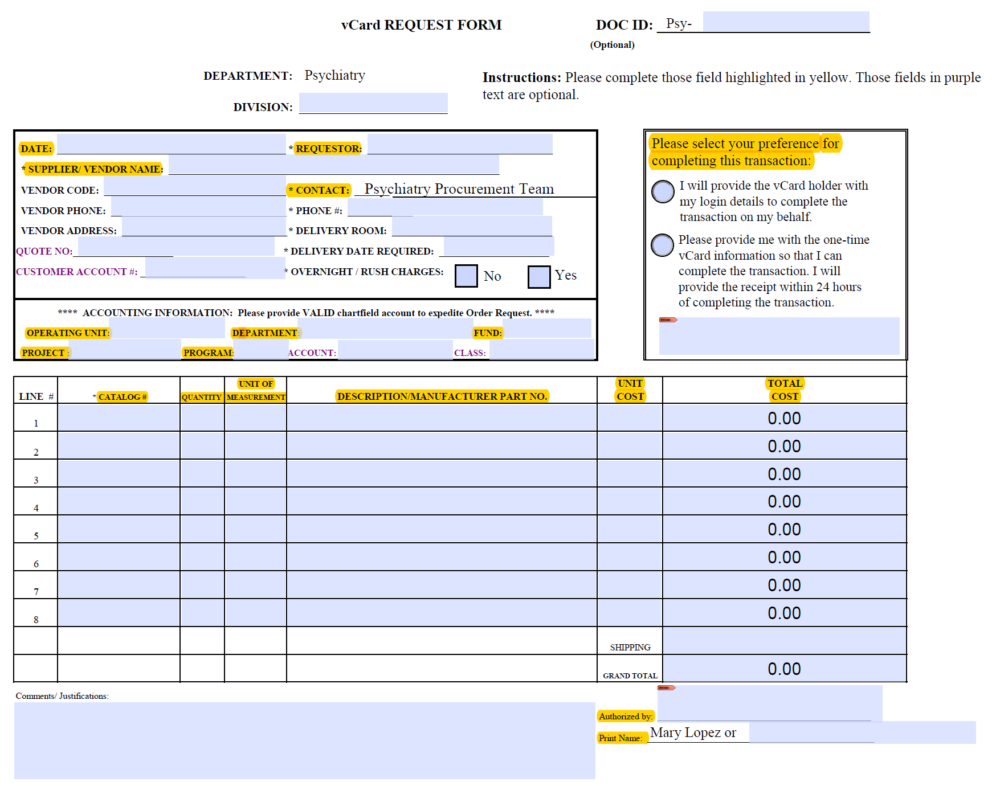
Fields highlighted in yellow are required.
Fields in purple text are optional.
Requestor: Include Physician &
Admin Name
Please provide the full CFS. We can add the class code, if needed, and account number.
There are two options for completing your transaction. Please select your preferred course of action.
After your selection, please sign.
Must be signed by
your PI or Mary.
Include your reason/need for this purchase.
Type your PI’s name, if needed.

Slide 11
Delivery
Once your transaction is complete, the delivery date will be the shipping date indicated by the vendor when the order is placed.
Upon receipt of merchandise, please email Ms.PsychiatryProcurement@uth.tmc.edu your packing slip.
Please ensure that you have emailed Psy Procurement your receipt as well.

Slide 12
List of restricted items

Slide 13
Animals
Cab and Limousine Service ( no exceptions)
Cash advances, cash instruments, or cash refunds
College tuition
Consulting or personal services (unless under a contract through Purchasing)
Deposits for retreats, conventions, etc.
e-bay or on-line auction (including Paypal Suppliers)
Entertainment
Flowers - Flower arrangements and plants over $75 are prohibited on the Buycard, those under $75 may be purchased using the Buycard but must be paid on Discretionary Funds
Food & drink items (only acceptable for departmental coffee and water services which must be paid using Discretionary Funds, no luncheons, parties, etc. allowed)
Gasoline (except for official UT vehicles)
Gift Cards
Gifts – Qualified expenses (see HOOP 2.31) should be reimbursed using a Non-PO voucher and Discretionary Funds
Hotel Fees
Memberships
Notary Public Fees
Office supplies (only suppliers that are "Active" in PeopleSoft database)
Parking
Radioactive material – (Contact Radiation Safety for list of approved suppliers)
Prescription drugs and/or controlled substances
U.S. Postage Stamps

