Slide 1
What Now? (Abscess)
T. Alex Rogers
1/8/2021
Diagnostic Radiology- RAD 4001
Corresponding Resident: Brandon Wang, M.D.

Slide 2
Clinical History
35 year old male presenting to the ER for 3 days of continuous abdominal pain
  Pain is sharp and nonradiating
  Aggravating factors: eating, movement
  ROS: Positive for nausea and chills, all else negative
  PMH: Polysubstance abuse, HIV (untreated, CD4 unknown)
  PSH: Laparotomy with hemicolectomy, hepatorrhapy, ileostomy, ERCP with pancreatic duct stent placement, and GJ tube on 10/14/2020
  Lipase at outside facility= 12,000 U

Slide 3
Physical Exam
Afebrile (Now-was 101 F @ OSH)
BP: 116/58
HR: 90
RR: 20
Abdominal exam: tender abdomen, non-distended. GJ in place with no signs of infection, midline incision healing, ostomy present with good output
Labs:
  Lipase 12000
  Hct/Hgb 37.6%/12.2
  WBC: 23.4

Slide 4
Relevant Imaging
A CT scan with IV contrast was obtained at the outside facility due to concern for an abscess or seroma in the pancreas
  Contrast: 100 mL Isovue 300
Notes:
Isovue 300= Iopamidol 612 mg/mL
Iodine= 300 mg/mL

Slide 5
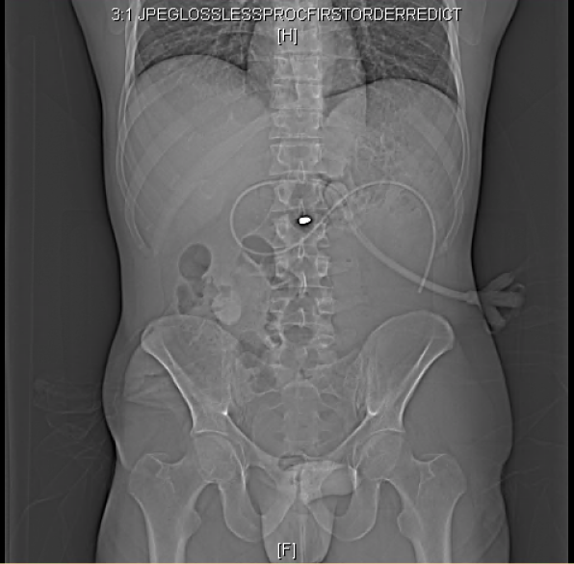
Scout Image
Notes:
Mention GJ Tube
Bullet @ L2

Slide 6
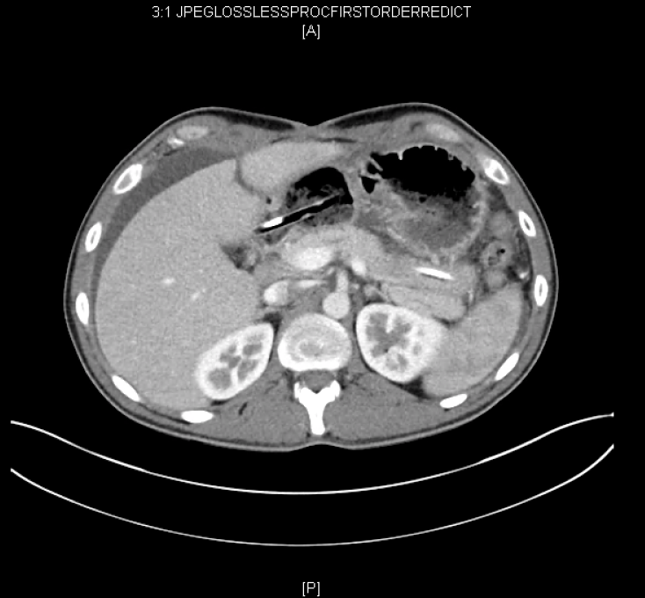
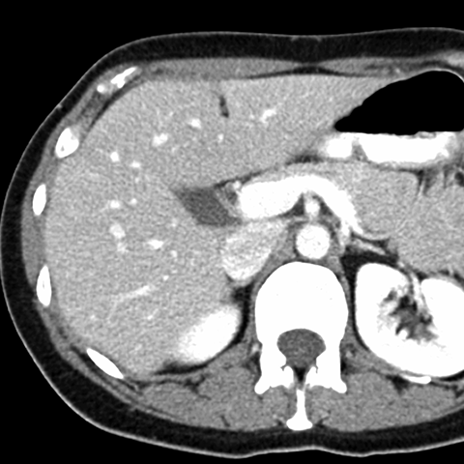
Relevant Imaging
Patient’s liver with a transection in segment 4
Normal anatomy of the liver
https://web.stanford.edu/dept/radiology/radiologysite/site305.html
Notes:
Liver segment 4 laceration (Left lobe)

Slide 7
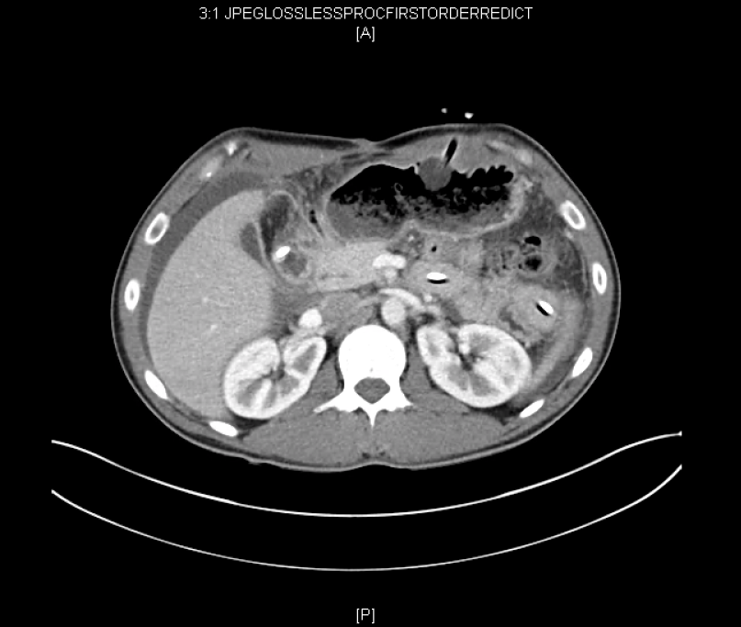
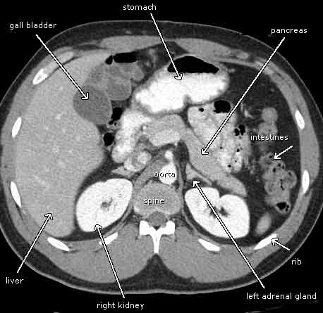
Relevant Imaging
4.0 X 3.9 cm mass near pancreatic head, peripancreatic fat stranding
Normal anatomy of the abdomen
https://www.radiologyinfo.org/en/info.cfm?pg=abdominct

Slide 8
Key Findings
Liver: Left liver lobe laceration in segment 4 and right liver lobe laceration in segment 6 (originally noted in 10/2020 scans)
Gallbladder: Edematous and thickened gallbladder wall. No stones
Pancreas: Peripancreatic fat stranding, 4.0X 3.9 cm fluid collection abutting the pancreatic head, pancreatic duct stent in place
Stomach: Percutaneous GJ tube in place
Colon: Colostomy in right lower quadrant
Bullet fragment noted at L2

Slide 9
Differential Diagnosis
Peripancreatic Abscess
Acute Pancreatitis with necrosis of the pancreatic head
Seroma

Slide 10
Treatment
Started on Cefepime (2 g TID) and Flagyl (500 mg TID) in ED
Patient underwent CT-guided Percutaneous Aspiration on Hospital Day 2
Drainage of the postsurgical abscess is always the first-line treatment, and percutaneous drainage is preferred in most cases of abdominal abscess
Percutaneous drainage of pancreatic abscesses is controversial, and it is a decision made by a multidisciplinary team of surgeons and interventional radiologists.
CT guidance allows for positioning of the needle in 3 dimensions, and this is superior to fluoroscopic guidance.
Complications include superinfection of a sterile fluid collection, bleeding, and bowel wall injury.
Disadvantages are primarily the increased amount of radiation exposure during the procedure.

Slide 11
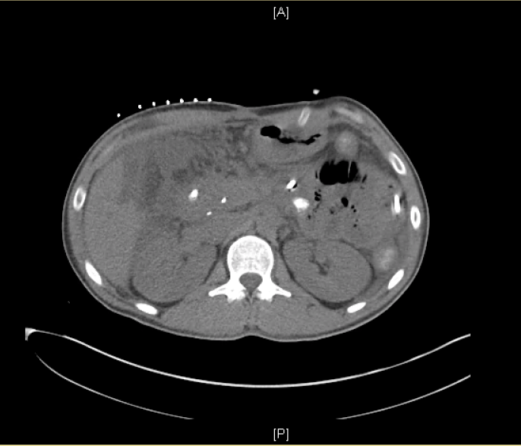
Post-CT-Guided Aspiration
Aspiration of 14 cc of serous-appearing fluid with reduction in size of the mass

Slide 12
Final Diagnosis
Acute Pancreatitis with necrosis and peripancreatic abscess
  Cultures grew out pansensitive Enterococcus

Slide 13
Discussion
Inflammation of the pancreas and peripancreatic fat from immune response results in peripancreatic fat stranding and altered pancreatic density
Introduction of bacteria during surgery results in a nidus of infection.
Our patient’s original CT scan demonstrated a walled-off pocket of fluid and peripancreatic fluid consistent with pancreatitis and an abscess.
CT-guided drainage results in a >90% first treatment success rate
Mortality rates of intra-abdominal abscesses ranges from 45%-100% depending on location and cause of the abscess if not treated.

Slide 14
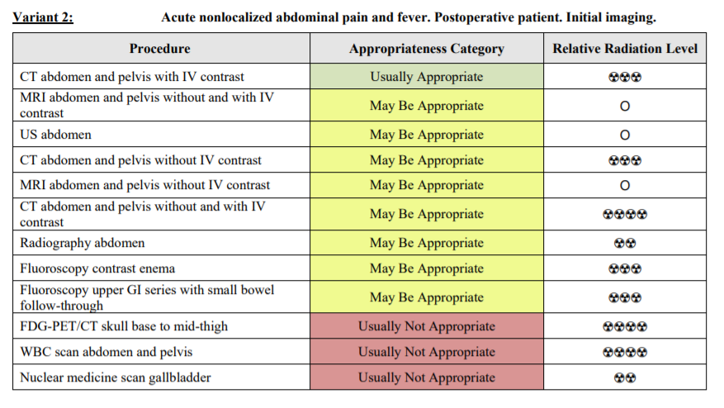
ACR Appropriateness Criteria
Given his history of major abdominal surgery less than 2 months prior, our patient with acute onset abdominal pain and fever was appropriately imaged with an abdominal CT with contrast.

Slide 15
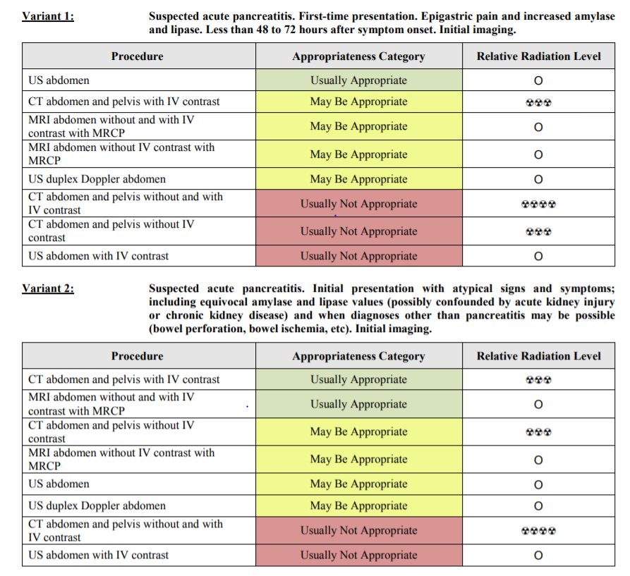
ACR Appropriateness Criteria
Even if physicians were only concerned about pancreatitis, an abdominal CT with IV contrast would have been considered appropriate. Our patient’s history of surgery raises the possibility of some other diagnosis being the root cause of his abdominal pain.

Slide 16
Cost (Derived from MHH Master List
Exam | Cost
Abdominal CT with IV Contrast | $5540.00
CT-guided Cyst Aspiration | $2656.50
Chest X-ray (1 view) | $683.00
Total | $8879.50
While hospitalized, our patient also complained of self-limited chest pain, resulting in an order for a chest x-ray.
MHH Master Fee Schedule: https://www.memorialhermann.org/-/media/memorial-hermann/org/files/patients-and-visitors/standard-hospital-charges/charge-description-master-tmc.ashx?la=en

Slide 17
Take Home Points
The cost of multiple scans adds up quickly, both in monetary value and radiation exposure
Postsurgical abscesses have an extremely high mortality rate and require intervention
First pass success in CT-guided aspiration of abscess is >90% with few complications
Treatment of most intra-abdominal abscesses is preferred to be via percutaneous drainage rather than surgical

Slide 18
References
https://web.stanford.edu/dept/radiology/radiologysite/site305.html
https://www.radiologyinfo.org/en/info.cfm?pg=abdominct
https://www.empr.com/drug/isovue-300/
https://acsearch.acr.org/docs/69467/Narrative/
Roberts BW. CT-guided Intra-abdominal Abscess Drainage. Radiologic Technology. 2015;87(2):187CT-207CT.
De Waele J, Vogelaers D, Decruyenaere J, De Vos M, Colardyn F. INFECTIOUS COMPLICATIONS OF ACUTE PANCREATITIS. Acta Clinica Belgica. 2004;59(2):90-96. doi:10.1179/acb.2004.013
Lee MJ. Non-traumatic abdominal emergencies: imaging and intervention in sepsis. European Radiology. 2002;12(1):2172-2179. doi:10.1007/s00330-002-1570-4

Slide 19

Questions?

