Slide 1
Acute Triquetral Fracture and Radiocarpal Subluxation
Jason Fuller
1/8/21
RADS 4013 (Emergency Radiology)
Dr. Ron Bilow, MD

Slide 2
HPI
41 y.o. Female presenting as level I Trauma after an MVC in which she drove through a concrete barrier at highway speeds and fell approx. 50 ft onto pavement below. Prolonged extrication by EMS.
GCS 13. Initially complained of pain to her L occiput, neck, L chest, L hip, and L forearm/wrist. CTs were ordered of the head and C-spine and Xrays of the chest, LLE and LUE.
Exam showed tenderness over the L wrist and decreased ROM secondary to pain. Overlying abrasions and swelling noted. Denied neuro deficits.
Pt was initially found to be hypotensive on arrival and was given 1 unit of pRBC.

Slide 3
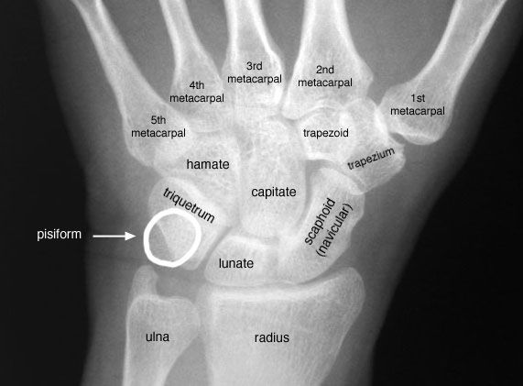
PA view Left Wrist 12/28/20
Lister’s Tubercle (Distal radial)
https://www.pinterest.com/pin/211174966968730/

Slide 4
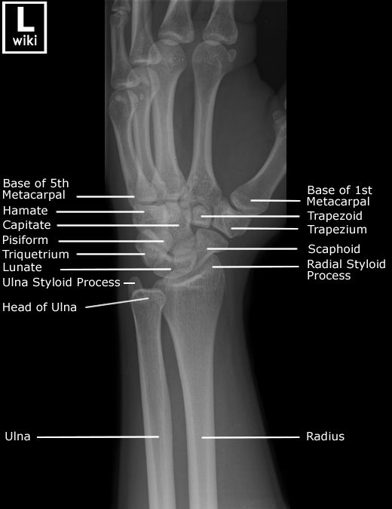
Oblique view Left Wrist
Triquetrium
https://www.pinterest.com/pin/45528646203328481/

Slide 5
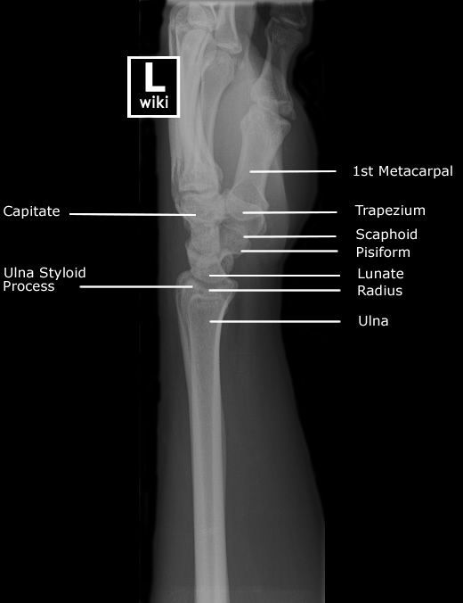
Lateral view L wrist
Triquetral fragment (Pooping Duck Sign)
https://radiopaedia.org/articles/pooping-duck-sign?lang=us
https://www.pinterest.com/pin/110760472061910919/

Slide 6
Summary of Key Findings
Medially displaced radiocarpal subluxation of approx. 1 cm
Comminuted fracture of Triquetrum with approx. 5 mm dorsal fragment
Soft tissue swelling of the distal forearm and wrist
No evidence of fracture to the radius, ulna, metacarpals, or phalanges

Slide 7
Differential Diagnosis
Comminuted Triquetral fracture
Fractures to other carpal bones
Radiocarpal subluxation
Ligamentous injuries

Slide 8
Discussion
Injuries depicted on patient’s Xray are consistent with high impact wrist trauma, so entire extremity should be evaluated
Injuries are consistent with the exam findings of tenderness, swelling, and decreased ROM of the L wrist
CT should be performed for additional evaluation of carpal bones and potential ligamentous injuries based on ACR guidelines
Displaced triquetral fractures are managed operatively with open reduction and internal fixation
Radiocarpal subluxations are assessed for instability and fixated as needed with dorsal spanning plates in order to avoid risk of infections with external fixation and assist with post-op rehab and functionality.
https://pubmed.ncbi.nlm.nih.gov/31847582/
https://www.uptodate.com/contents/triquetrum-fractures?search=triquetral%20fracture&source=search_result&selectedTitle=1~10&usage_type=default&display_rank=1#H6

Slide 9
Discussion (cont)
Triquetral fractures make up between 13-28% of all carpal bone fractures with scaphoid being the most common
Sensitivity of diagnosis with conventional radiography is around 20-29%
These fractures are difficult to appreciate on PA views because the pisiform obstructs the view of the triquetral body
3 types of triquetral fractures have been described: Dorsal avulsion, Triquetral body, and volar avulsion
Rarely seen in isolation. Typically fractures to additional carpal bones and ligamentous injuries to distal radiocarpal and radioulnar joints are present
Highly favorable prognosis is expected after 4-6 weeks of immobilization and adequate rehabilitation to restore strength and ROM
https://radiopaedia.org/articles/triquetral-fracture?lang=us
https://www.uptodate.com/contents/triquetrum-fractures?search=triquetral%20fracture&source=search_result&selectedTitle=1~10&usage_type=default&display_rank=1#H1758940736

Slide 10
Final Diagnosis
Comminuted Triquetral fracture
Volar scaphoid subluxation
Volar Lunate subluxation
Small nondisplaced fractures to the Hamate, Capitate, and Lunate found on CT
No evidence of Ligamentous injuries on CT

Slide 11
ACR appropriateness Criteria
Variant 1: Acute blunt or penetrating trauma to the hand or wrist
Suggest Plain Film Radiographs (rad variable)
Variant 4: Initial radiographs showing distal radioulnar joint or carpal malalignment in the absence of fracture. Next imaging study.
CT w/o contrast (rad lvl 1), MRI w/o contrast, or MRI arthrography (rad none)

Slide 12
Estimated Cost of Imaging
Ankle 3 view unilateral = $741.25
Elbow 3 view unilateral = $615
Femur 1 view unilateral - $667
2 x Femur Series DX = $3782.50
Foot 3 view unilateral = $1233.75
Forearm 2 views unilateral = $1190.50
Hand 3 views unilateral = $1319.75
Hip 2/3 views unilateral = $8740.50
Humerus 2 views unilateral = $1181.25
Knee 3 views unilateral = $2794.75
Knee 1-2 views unilateral = $887.25
Pelvis 1-2 views = $973
Shoulder 2+ views unilateral = $674.25
Wrist 3 view unilateral = $482.50
Tib/Fib 2 views unilateral = $1327.25
CT Pelvis w/o contrast = $139.75
CT Head or Brain w/o contrast = $4111.75
CT chest/abd/pelv with contrast = $5574.25
CT Facial Bones w/o contrast = $10219.75
CTA Neck = $670
CT C-spine w/o contrast = $3325.25
CT wrist w/o contrast = $1838
MRI C-Spine w/o contrast = $6247.75
Total = $58737

Slide 13
Take Home Points
Triquetral fractures are a rare in isolation and somewhat difficult to diagnose with plain film Xray
Important to consider fractures other than scaphoid and radial head when evaluating the wrist in the setting of trauma
Use CT or MRI to assess for additional carpal fractures and soft tissue injury

Slide 14
References
https://www.uptodate.com/contents/triquetrum-fractures?search=triquetral%20fracture&source=search_result&selectedTitle=1~10&usage_type=default&display_rank=1#H1758940736
https://radiopaedia.org/articles/triquetral-fracture?lang=us
https://pubmed.ncbi.nlm.nih.gov/31847582/
Memorial-Hermann Chargemaster

Slide 15
Questions?

