Slide 1
Diabetic Foot Osteomyelitis
Min Yi Dong
December 9, 2020
Diagnostic Radiology, RAD 4001
Dr. Roland Pomfret

Slide 2
Clinical History
58 y.o. male with PMH of ESRD on HD, DM2, HTN, right BKA (2009), and L great toe amputation presented with chronic left foot wound and increasing left foot pain for several days. He was admitted to another hospital for the wound a month ago and received wound care monthly with Home Health.
Current Symptoms:
Left foot pain, fever, chills
Physical Exam:
Vitals: 100.8 F, HR 116, RR 19, BP 112/62
CV: DP and PT 2+ on left
Extremities: L plantar midfoot ulcer, 2nd plantar ulcer at base of 2nd toe, mild tenderness to palpation of L posterior foot and calf, no erythema

Slide 3
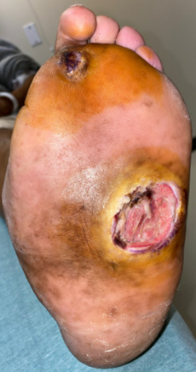
Work Up
Labs:
WBC 14.3 with left shift
ESR 46, CRP 18.8
Culture:
Blood culture negative
Wound culture – ESBL E.coli
Imaging:
LLE doppler negative
Chest xray negative
L foot xray

Slide 4
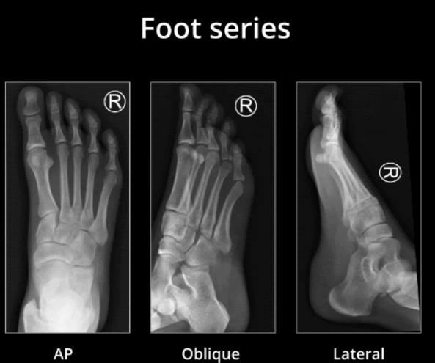
Normal Foot x-ray
A
A
A
A) Phalanges
B) Metatarsals
C) Cuneiforms
D) Cuboid
E) Navicular
F) Talus
G) Calcaneus
B
B
B
C
C
C
E
E
E
F
D
D
F
F
G
G
Notes:
https://radiopaedia.org/articles/foot-series?lang=us

Slide 5
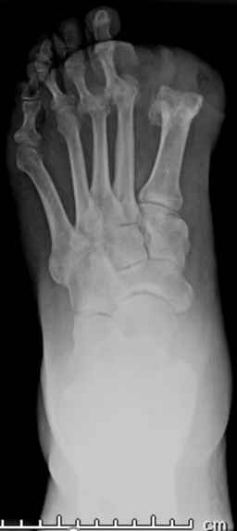
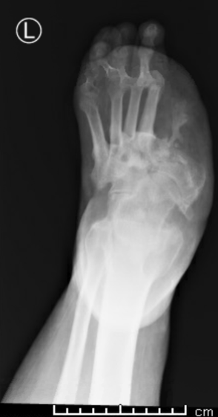
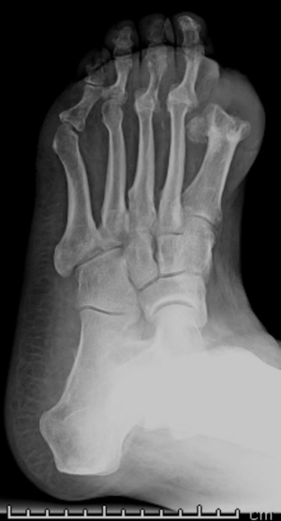
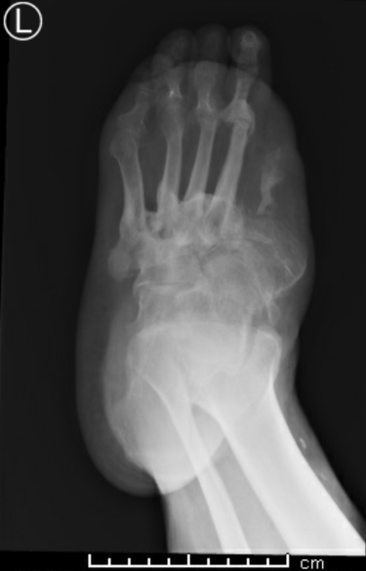
X-ray (Left Foot) - AP and oblique views
Destruction of first metatarsal
Dislocation of phalanges at MTP joints
s/p Amputation of left great toe
Destruction with sclerosis and remodeling of midfoot bones
8/18/15
11/24/20
8/18/15
11/24/20

Slide 6
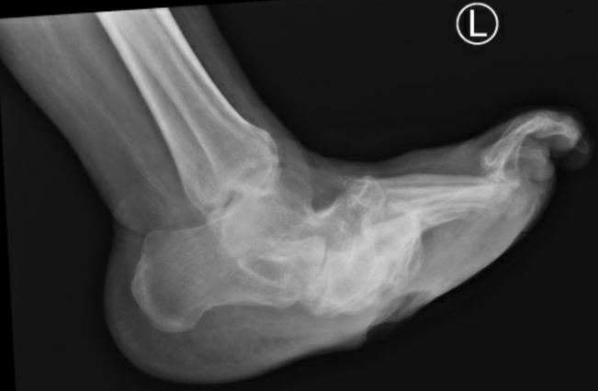
X-ray (Left Foot) – Lateral view
Plantar collapse of midfoot bones
Soft tissue swelling
8/18/15
11/24/20

Slide 7
Summary of Key Imaging Findings
CC: Left foot pain
PMH: ESRD on HD, DM2, HTN, right BKA and L great toe amputation (2009)
Imaging Findings on Foot X-ray:
s/p amputation of left great toe
Chronic dorsal dislocation of 2nd and 3rd metatarsophalangeal joints
Erosive destruction with sclerosis and remodeling of the midfoot bones and proximal metatarsals with plantar collapse of midfoot
Almost complete destruction of first metatarsal
Soft tissue swelling on plantar midfoot

Slide 8
Differential Diagnosis
Osteomyelitis
Charcot Arthropathy
Metastatic tumor
Primary bone neoplasm
Septic arthritis

Slide 9
Diagnosis: Diabetic Foot Osteomyelitis
Clinical History: Diabetic with chronic left foot ulcer requiring prior hospitalization and IV antibiotics. New left foot pain.
Labs:
Elevated ESR & CRP
Positive wound culture
Imaging (x-ray):
Plantar collapse of midfoot may represent changes of Charcot disease
Plantar midfoot ulcer with focal erosion of collapsed midfoot bones – concerning for acute osteomyelitis
Chronic destructive lesions may represent changes of chronic osteomyelitis

Slide 10
Discussion
Lew and Waldvogel Classification of Osteomyelitis:
Acute: Symptom duration of a few days or weeks; bony sequestra absent
Chronic: Infection present over months or years; bony sequestra usually present radiographically; sinus tract is pathognomonic
Non-hematogenous: Spread of infection from adjacent joints/soft tissue or direct inoculation from surgery/trauma
With or without vascular Insufficiency
Hematogenous: Spread to bone via bacteremia

Slide 11
Discussion
Can be challenging to differentiate osteomyelitis from Charcot arthropathy
Single bone adjacent to an ulcer/sinus tract vs. multiple bones of midfoot
Both can be present
Bone biopsy
Failure of empiric antibiotic therapy
Concern for antibiotic-resistant organism
Presence of midfoot or hindfoot lesion

Slide 12
Treatment
Treatment of diabetic foot osteomyelitis usually involves surgical debridement followed by antibiotics
Empiric therapy
Antimicrobial against staph (MRSA) and gram negatives
Vancomycin + 3rd/4th generation cephalosporin (cephalosporin/cefepime)
Pathogen-specific therapy
Patient’s wound culture came back positive for ESBL E.coli resistant to cefepime and susceptible to ciprofloxacin – Discharged with 6 weeks course
Monitor
CBC
Inflammatory markers (ESR/CRP)
Clinical presentation

Slide 13
ACR Appropriateness Criteria
Those suspected of diabetic foot osteomyelitis should get plain radiography as initial imaging
Not adequate for detecting early osteomyelitis
Sensitivity – 0.54; Specificity – 0.68
Those with soft tissue swelling with ulcer and suspected diabetic foot osteomyelitis with or without neuropathic arthropathy should get additional imaging with MRI (with or without contrast).
Can detect edema as early as 1-5 days
Sensitivity – 0.9; Specificity – 0.79
Patient did not get MRI – could have improved visualization of soft-tissue and determine extent of involvement
Price of imaging/diagnostics at Memorial Hermann TMC for uninsured patients:
Unilateral foot x–ray 3 views $279
Chest x-ray 1 view $246
Doppler Extremity (Veins) - Unilateral/Limited $626
MRI Lower Extremity w/o contrast - Unilateral $1,605
MRI Lower Extremity w/ contrast - Unilateral $2,212
Notes:
https://www.memorialhermann.org/patients-caregivers/pricing-estimates-and-information/

Slide 14
Take Home Points
Plain radiography is the initial imaging of choice for diagnosing diabetic foot osteomyelitis
MRI is usually recommended if additional imaging is needed in cases with soft tissue swelling with or without ulceration/neuropathic arthropathy
Use other modalities if these are unavailable or contraindicated

Slide 15
References
Mandell, J.C., Khurana, B., Smith, J.T. et al. Osteomyelitis of the lower extremity: pathophysiology, imaging, and classification, with an emphasis on diabetic foot infection. Emerg Radiol 25, 175–188 (2018). https://doi.org/10.1007/s10140-017-1564-9
Momodu II, Savaliya V. Osteomyelitis. [Updated 2020 Nov 21]. In: StatPearls [Internet]. Treasure Island (FL): StatPearls Publishing; 2020 Jan-. Available from: https://www.ncbi.nlm.nih.gov/books/NBK532250/
Senneville E, Melliez H, Beltrand E. et al. Culture of percutaneous bone biopsy specimens for diagnosis of diabetic foot osteomyelitis: concordance with ulcer swab cultures. Clin Infect Dis. 2006;42(1):57.
Dinh MT, Abad CL, Safdar N. Diagnostic accuracy of the physical examination and imaging tests for osteomyelitis underlying diabetic foot ulcers: meta-analysis. Clin Infect Dis. 2008 Aug 15;47(4):519-27. doi: 10.1086/590011. PMID: 18611152; PMCID: PMC7450707.
Mader JT, Cantrell JS, Calhoun J. Oral ciprofloxacin compared with standard parenteral antibiotic therapy for chronic osteomyelitis in adults. J Bone Joint Surg Am. 1990 Jan;72(1):104-10. PMID: 2295657.
Lazzarini L, Lipsky BA, Mader JT. Antibiotic treatment of osteomyelitis: what have we learned from 30 years of clinical trials? Int J Infect Dis. 2005 May;9(3):127-38. doi: 10.1016/j.ijid.2004.09.009. PMID: 15840453.
Expert Panel on Musculoskeletal Imaging, Walker EA, Beaman FD, Wessell DE, Cassidy RC, Czuczman GJ, Demertzis JL, Lenchik L, Motamedi K, Pierce JL, Sharma A, Ying-Kou Yung E, Kransdorf MJ. ACR Appropriateness Criteria® Suspected Osteomyelitis of the Foot in Patients With Diabetes Mellitus. J Am Coll Radiol. 2019 Nov;16(11S):S440-S450. doi: 10.1016/j.jacr.2019.05.027. PMID: 31685111.
Images: https://radiopaedia.org/articles/foot-series?lang=us
Pricing: https://www.memorialhermann.org/patients-caregivers/pricing-estimates-and-information/

