Slide 1
Distal Femur Fracture Due to Trauma
Maryam Haider
Date: 1/5/2021
RAD 4013- ER Radiology
Dr. Ron Bilow

Slide 2
Initial H&P- 12/28/20
45yo M with no significant PMH/PSH who presented as a Level 1 trauma to MHH ED s/p auto ped accident.
Presented with bilateral LE deformities due to a forklift running over his legs multiple times. On arrival, pt was HDS with a GCS of 15.
Physical exam:
VS: WNL
Pertinent findings: 2+ radial pulses bilat, DP palpable b/l, deformity of RLE and L thigh, doppler signal b/l, ABIs 0.9 b/l
Pertinent lab findings: elevated wbc 16
Pertinent imaging: XRays: L femur series + R tibia/fibula series
Pt was admitted to the trauma floor w/plan to consult ORS trauma and with MMPC for pain management.

Slide 3
Differential Diagnosis
Fracture 2/2 trauma
Compartment syndrome
Soft tissue injury
Hematoma
Hip dislocation
Muscle contusion

Slide 4
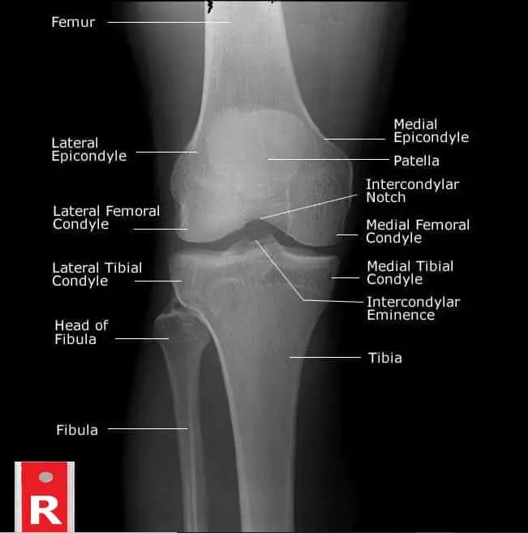
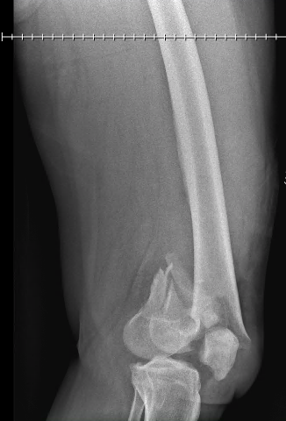
XR L distal femur- AP view 12/28/20
Femur
Distal comminuted and displaced L femur fx
Femoral condyles
Fibula
Patella
Intercondylar eminence
Not for diagnostic use.
Link: https://theradiologictechnologist.com/normal-knee-xray-knee-joint-anatomy-knee-replacement-surgery/
Tibia

Slide 5
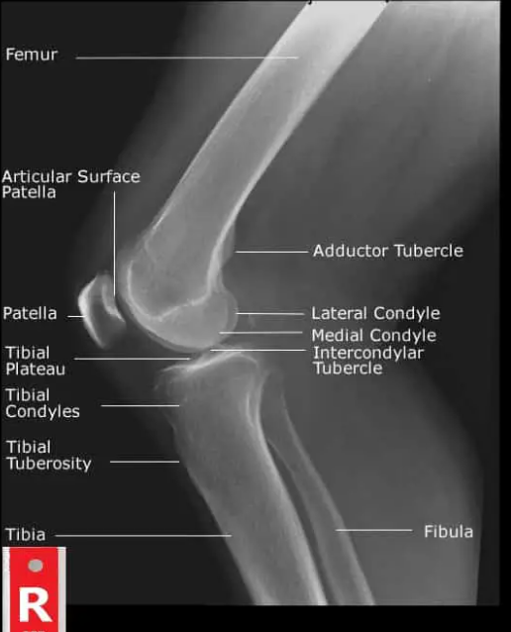
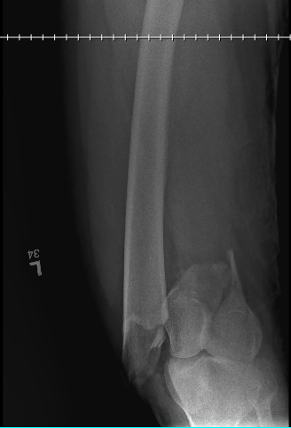
XR L distal femur- lateral view
Femur
Medial femoral condyle
Lateral femoral condyle
Not for diagnostic use.
Link:https://theradiologictechnologist.com/normal-knee-xray-knee-joint-anatomy-knee-replacement-surgery/

Slide 6
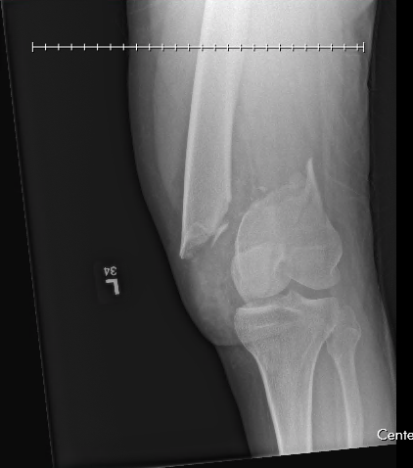
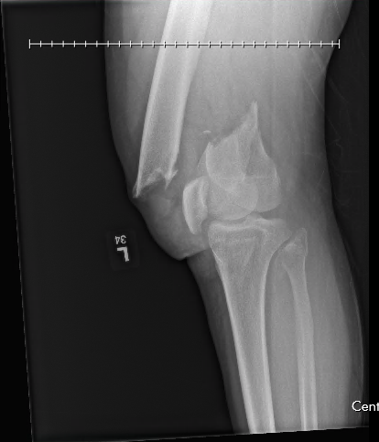
XR L knee- lateral view
Oblique fx in distal fragment of femur possibly extending into knee joint

Slide 7
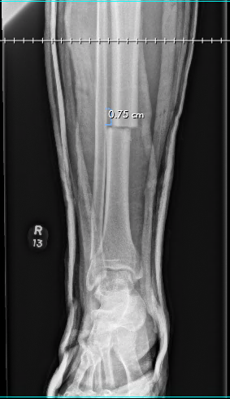
XR- R tib fib AP view
tibia
Fibula
Displaced transverse fx of R tibia
Minimally displaced fx of distal fibula
Lateral malleolus
Medial malleolus

Slide 8
Key imaging findings
XR Femur series:
Distal metadiaphyseal comminuted and displaced fracture of the L femur. Proximal component overrides the distal fragment by approx. 7 cm and the proximal part is displaced anteriorly and medially relative to the distal fragment.
Oblique oriented fx extending longitudinally through the distal fragment of the femur- likely extends into the knee joint.
XR Tibia fibula series:
Displaced transverse fx of the mid diaphyseal R tibia.
Second oblique minimally displaced fx of the distal metadiaphyseal fibula w/o involvement of the ankle joint.

Slide 9
Distal Femoral Fractures
Typically involve the femoral condyles and the metaphyseal region and are often the result of high energy trauma like MVC or a fall from height. Elderly- may occur because of a domestic accident
Young pts, typically males are more affected and in the elderly- more women
Presents with pain on weight bearing, swelling and bruising, deformity, and in the context of polytrauma. Some complications include dislocations, meniscal or vascular injuries
Dx is typically with plain radiographs, however CT is helpful as most of these fx’s are intra-articular. MRI can be useful if there is concern for a ligamentous or meniscal injury

Slide 10
Distal Femoral Fx Cont.
Radiological description includes:
Fracture lines and plane
location of fracture in relation to the joint
Extra-articular, partial, or completely articular
Involvement of the condylar weight-bearing surfaces or the notch
Simple, fragmentary, or multi-fragmentary
Common example is Hoffa fracture- distal condylar femoral fx that is intra-articular and in the coronal plane
Tx typically includes surgery depending on the severity of the fx- options include simple screw fixation, intramedullary nailing, or ORIF

Slide 11
Examples 1
https://www.researchgate.net/figure/Radiograph-showing-coronal-plane-Hoffa-fracture-of-the-medial-femoral-condyle_fig2_282896930
Hoffa fracture

Slide 12
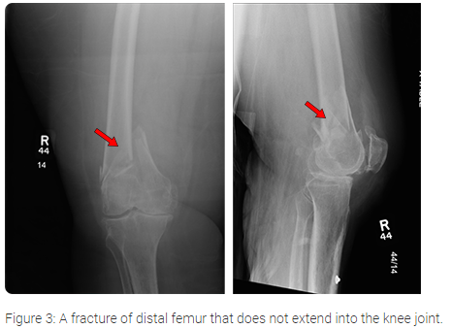
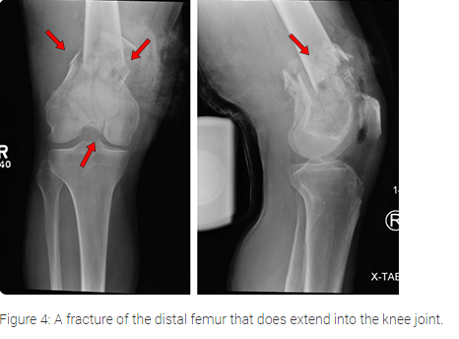
Examples 2
https://ota.org/for-patients/find-info-body-part/3716

Slide 13
Final Diagnosis + Treatment
Pt’s injuries included
L distal femur fx that is comminuted and both anteriorly and medially displaced
Second fx extending through the distal femur fragment and is possibly intra-articular
Transverse R tibia fx
Second oblique fx of the distal fibula
Pt’s treatment course included initial LLE traction splinting + plaster splinting of R tib-fib
12/30- OR: underwent IMN of R tibia and L femur
Monitored on the trauma floor; PT/OT consulted

Slide 14
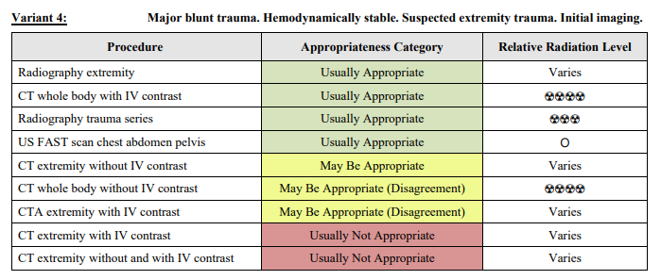
ACR appropriateness Criteria

Slide 15
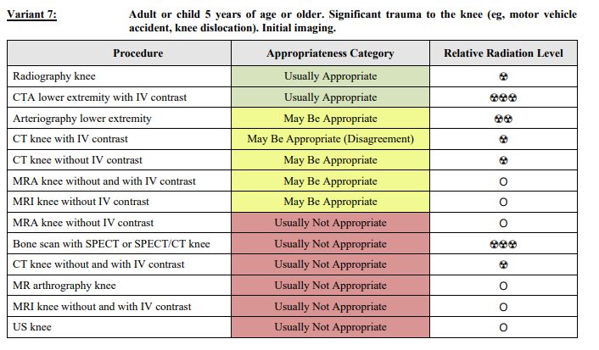
ACR appropriateness criteria

Slide 16
Total Cost of MHH Imaging (Inpatient)
CXR 1V: $274.68
Ankle XR 2V: $410.33
Ankle XR 3V: $261
L hip XR 2V: $265.32
L femur XR 2V: $237.31
L knee XR 3V: $237.31
L tibia-fibula XR 2V: $237.31
L foot XR 3V: $239.11
XR Abdomen/pelvis 1V: $206.50
CTA LE with or w/o contrast: $2008.44
MRI Pelvis w/o contrast: $2114.71
Total: $6492.02
https://www.memorialhermann.org/patients-caregivers/pricing-estimates-and-information

Slide 17
Take Home Points
Pt presents with blunt force trauma- include trauma radiography series of the injured area
May need multiple imaging modalities to confirm different types of injuries
Distal femoral fx’s are quite common in the setting of high intensity trauma

Slide 18
References
https://radiopaedia.org/articles/hoffa-fracture?lang=us
https://radiopaedia.org/articles/distal-femoral-fracture?lang=us
https://www.orthobullets.com/trauma/1041/distal-femur-fractures
https://ota.org/for-patients/find-info-body-part/3716

Slide 19
Questions?

