Slide 1
Filum Terminale Lipoma
Zachary DeZeeuw
Date
General Diagnostic Radiology| RADS 4001
Dr. Samant

Slide 2
Clinical History
7m HF brought in by her mother for R leg weakness. Mother voiced concerns that her daughter was “unable to bear weight on R foot”. Pt started using walker/bouncer 2wks ago but was only using her L leg to move/ bounce. This issue has been reportedly stable for the past 2wks. Mother denies any hx of trauma. Pt has not started crawling but can sit upright independently. Mother endorses one episode of “R leg shaking at 4mo” without recurrence.

Slide 3
Clinical History
  PMH
  - None
  PSH
  - None
  FH
  - 1 brother, 1 sister. Both healthy.
  - Both parents alive and healthy.
  SH
  - Second hand smoke. Father. Outside.
  Allergies
  - None
  Medications
  - None
  ROS
  - Negative

Slide 4
Clinical History
  Physical Exam:
  - Gen: NAD, well developed, well nourished, well developed, smiling, and interactive.
  - HEENT: pupils ERRL, normocephalic, atraumatic, mucosa moist
  - Lungs: clear to auscultation b/l
  - Back: No lesions. No sacral dimple.
  - MSK: No swelling or deformity.
  - Neuro: motor strength in LE equal b/l. When being held upright in a standing position, pt is able to bear weight on both legs. Tone normal and symmetrical b/l. Plantar reflex present b/l.

Slide 5
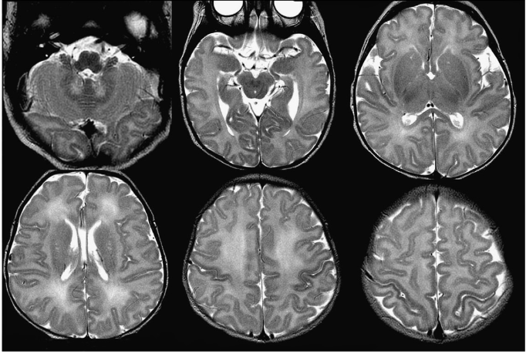
Relevant Imaging
https://www.google.com/url?sa=t&rct=j&q=&esrc=s&source=web&cd=&ved=2ahUKEwj2toe2jv7tAhWBmq0KHXjcCk4QFjAJegQIAxAC&url=https%3A%2F%2Fgeiselmed.dartmouth.edu%2Fradiology%2Fwp-content%2Fuploads%2Fsites%2F47%2F2019%2F04%2FNormal-Myelination-2013-Branson.pdf&usg=AOvVaw2NDPQ7569bvWHBAxDWYIVV
Notes:
Normal T2 axial showing proper myelination patterns; myelination occurs from bottom to top and from back to front

Slide 6
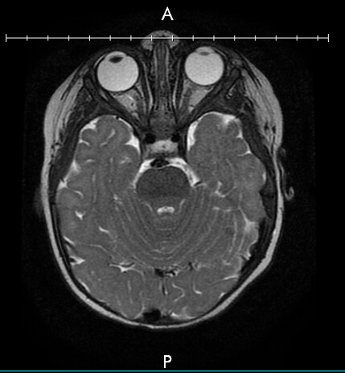
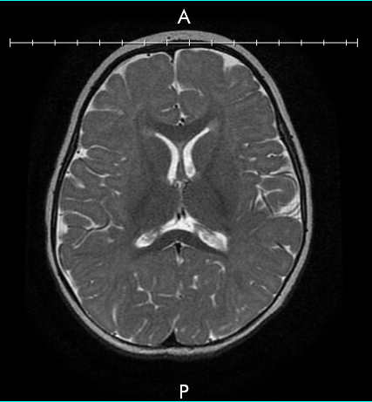
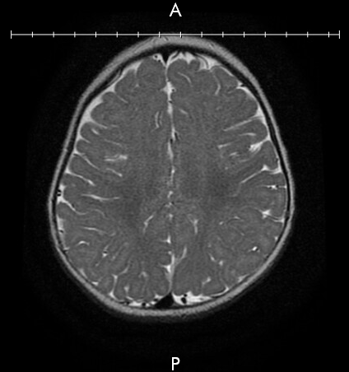
Relevant Imaging – 12/30/20
Notes:
Patients T2 axial showing proper myelination patterns and structural anatomy appropriate for their age.

Slide 7
Relevant Imaging
Vitrious chamber
Lens
Optic nerve
Internal Carotid
Basilar Artery
Fourth ventricle
Pons
Cerebellar vermis
Cerebellum
Temporal lobe
Notes:
Patient T2 axial showing proper anatomy

Slide 8
Relevant Imaging
Frontal Lobe
Corpus callosum
Caudate Nucleus
Lateral Ventricles
Putamen
Internal Cerebral Vein
Thalamus
Occipital horn – Lateral ventricle
Straight Sinus
Notes:
Patient T2 axial showing proper anatomy

Slide 9
Relevant Imaging
White matter
Grey matter
Falx Cerebri
Superior sagittal sinus
Notes:
Patients T2 axial showing proper myelination patterns

Slide 10
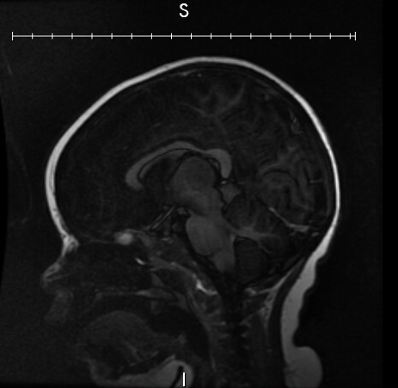
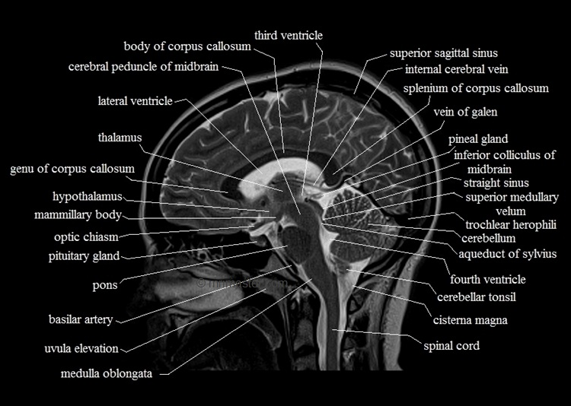
Relevant Imaging – 12/30/20
https://mrimaster.com/anatomy%20brain%20sagittal.html
Notes:
Normal T1 sagittal showing proper development of corpus callosum with pituitary bright spot indicating proper development. Cerebellar tonsils in proper position above the cisterna magna.

Slide 11
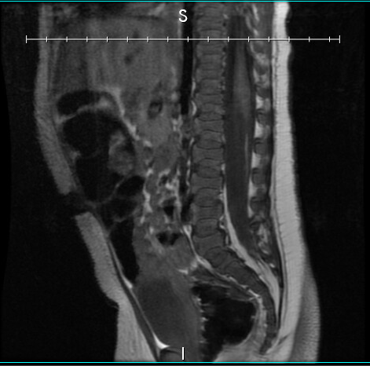
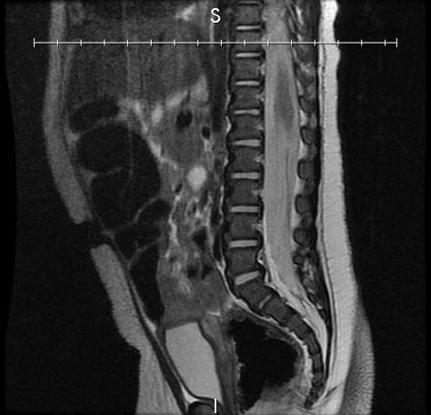
Relevant Imaging – 12/30/20
L1
Conus Medullaris
L1
L2
L2
Hyperintense lipoma of filum terminale
L3
L3
L4
L4
L5
L5
T1 Sagittal MRI Spine
T2 Sagittal MRI Spine
Notes:
T1 sagittal MRI spine with hyperinesity possibly indicating lipoma of filum terminale alongside T2 sagittal MRI spine

Slide 12
Summary key imaging findings
MRI Brain :
    Appropriate white myelination pattern. Corpus callosum completely formed. Normal positioning of the cerebellar tonsils. Ventricles normal in size and position. No cerebral edema, mass effect, midline shift, or intracranial hemorrhage.
MRI Spine:
    Normal conus level terminating at the baseplate of T1 but showing a hyperintensity on T1 consistent with a lipoma of the filum terminale. No evidence of spinal cord tethering currently.

Slide 13
Differential Diagnosis
  Lipoma
  Metastasis/ drop metastasis
  Spinal hematoma

Slide 14
Final Diagnosis
Spinal lipoma - category 1a
http://surgpathcriteria.stanford.edu/softfat/lipoma/grading.html

Slide 15
Discussion
Spinal lipomas are an abnormal growth of mature adipocytes that can present congenitally in infants and adults. While many can present asymptomatically, symptomatic patients can benefit from prophylactic removal/ untethering to prevent worsening of neurological deficits or tethered cord syndrome (which can exist even with a normal conus level).
Further work up or management:
  Surgical evaluation

Slide 16
(optional) Continued discussion
Cools et al. presented their findings that the location of spinal lipomas can impact the likelihood of developing symptoms .
  Normal conus level
    Adults: T12-L2 (91.3%)
    Children:
      W/o FTL – T2 or above (96.6%)
      W/o FTL – T2 or above (38.7%)
  Percentage of patients with symptoms based on conus level
      L1 & L2 - <10%
      L3 - ~30%
      L4 - ~35%
      L5 - ~67.5%
Notes:
Significantly lower conus level in children age 1-5yr w/ FTL; Lower conus levels associated with higher percentage of patients that exhibited symptoms

Slide 17
(optional) Continued discussion
Le Marca et al. studied 55 pts with FTL and found that 96% of the symptomatic patients showed an improvement in symptoms following surgical resection.
Complication rates are important to consider
  Can be as high as 12%
Notes:
Significantly lower conus level in children age 1-5yr w/ FTL; Lower conus levels associated with higher percentage of patients that exhibited symptoms

Slide 18
ACR appropriateness Criteria
Discuss whether case was in accordance to the ACR appropriateness guidelines
  Can include a screenshot of the table with the modality completed highlighted
Discuss the cost of the imaging throughout the entirety of the case
Must include url or reference to the cost calculations

Slide 19
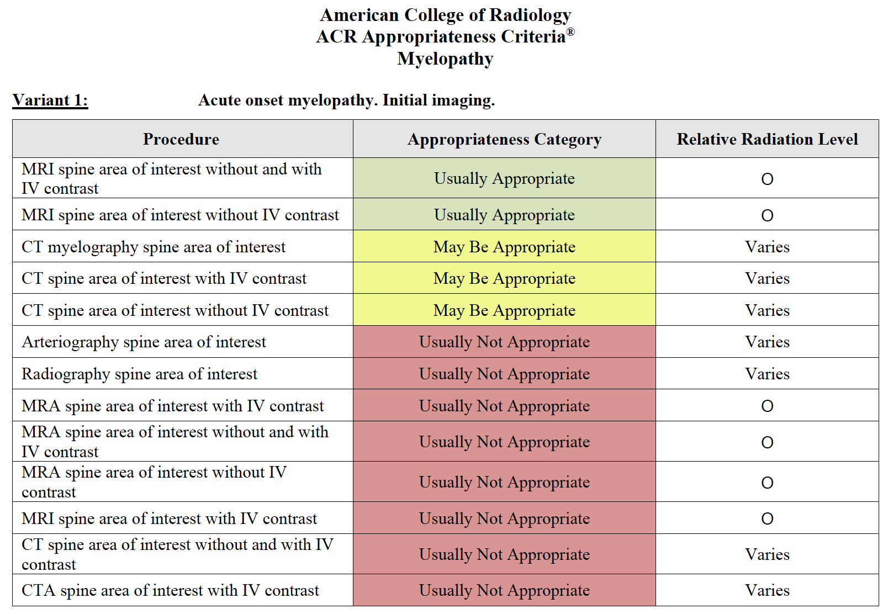
ACR appropriateness Criteria
Notes:
MRI spine was appropriately ordered given the suspected neurological deficit in the child. There is no current ACR criteria for brain MRI for suspected leg weakness 2/2 to a neurological cause. Normal cost of an MRI is $1500-2000 plus the cost of anesthesia in kids.

Slide 20
Take Home Points / Teaching points
FTL with symptoms and low conus: Surgery for management. No controversy.
FTL with symptoms and normal location conus: Surgery for management. Not really controversial.
FTL asymptomatic with normal level conus: No surgery. Monitor for symptoms. Most will stay asymptomatic.
FTL asymptomatic with low lying conus: This is where there is a difference in opinion. Newer literature is leaning towards early surgical release as surgical complications have decreased significantly over years.

Slide 21
References
Cools, M. J., Al-Holou, W. N., Stetler, W. R., Jr., Wilson, T. J., Muraszko, K. M., Ibrahim, M., La Marca, F., Garton, H. J. L., & Maher, C. O. (2014). Filum terminale lipomas: imaging prevalence, natural history, and conus position, Journal of Neurosurgery: Pediatrics PED, 13(5), 559-567. Retrieved Jan 2, 2021, from https://thejns.org/pediatrics/view/journals/j-neurosurg-pediatr/13/5/article-p559.xml
La Marca F, Grant JA, Tomita T, McLone DG. Spinal lipomas in children: outcome of 270 procedures. Pediatr Neurosurg. 1997 Jan;26(1):8-16. doi: 10.1159/000121155. PMID: 9361112.
Arai H, , Sato K, , Okuda O, , Miyajima M, , Hishii M, & Nakanishi H, : Surgical experience of 120 patients with lumbosacral lipomas. Acta Neurochir (Wien) 143:857–864, 2001
Bulsara KR, , Zomorodi AR, , Villavicencio AT, , Fuchs H, & George TM: Clinical outcome differences for lipomyelomeningoceles, intraspinal lipomas, and lipomas of the filum terminale. Neurosurg Rev 24:192–194, 2001
Cornips EM, , Vereijken IM, , Beuls EA, , Weber JW, , Soudant DL, & van Rhijn LW, : Clinical characteristics and surgical outcome in 25 cases of childhood tight filum syndrome. Eur J Paediatr Neurol 16:103–117, 2012
Ostling LR, , Bierbrauer KS, & Kuntz C IV: Outcome, reoperation, and complications in 99 consecutive children operated for tight or fatty filum. World Neurosurg 77:187–191, 2012
Yong RL, , Habrock-Bach T, , Vaughan M, , Kestle JR, & Steinbok P: Symptomatic retethering of the spinal cord after section of a tight filum terminale. Neurosurgery 68:1594–1602, 2011

Slide 22

Questions?

