Slide 1
A Dagger to the Spine
Frederick LeMaistre
12/11/2020
Diagnostic Radiology RAD 4001
Corresponding faculty: Dr. Hester

Slide 2
Clinical History
45yo male w/ a PMHx of ankylosing spondylitis who presented w/ bilat leg weakness after falling from wheel chair
  Pt is ambulatory at baseline, wheelchair use due to meniscus injury
  Denied LOC, able to return to wheelchair and into house to dial 911 due to neck pain, arm weakness, bilat hand numbness, and BLE numbness below knee
  Unable to move legs upon arrival to ED

Slide 3
Clinical History
Vitals WNL
Labs
Physical Exam
  Deceased sensation in BUE elbows down, BLE form knees down w/ 0/5 strength bilat legs
  obesity, neck tenderness, reducible ventral hernia
  Pertinent negs: No saddle anesthsia present, normal rectal tone
137
105
11.0
11.6
119
11.5
224
3.7
22
0.6
36.7

Slide 4
Next Steps
Initial trauma workup of patient
  CT head
  CXR
  CT C-spine w/o Contrast
  CT Chest

Slide 5
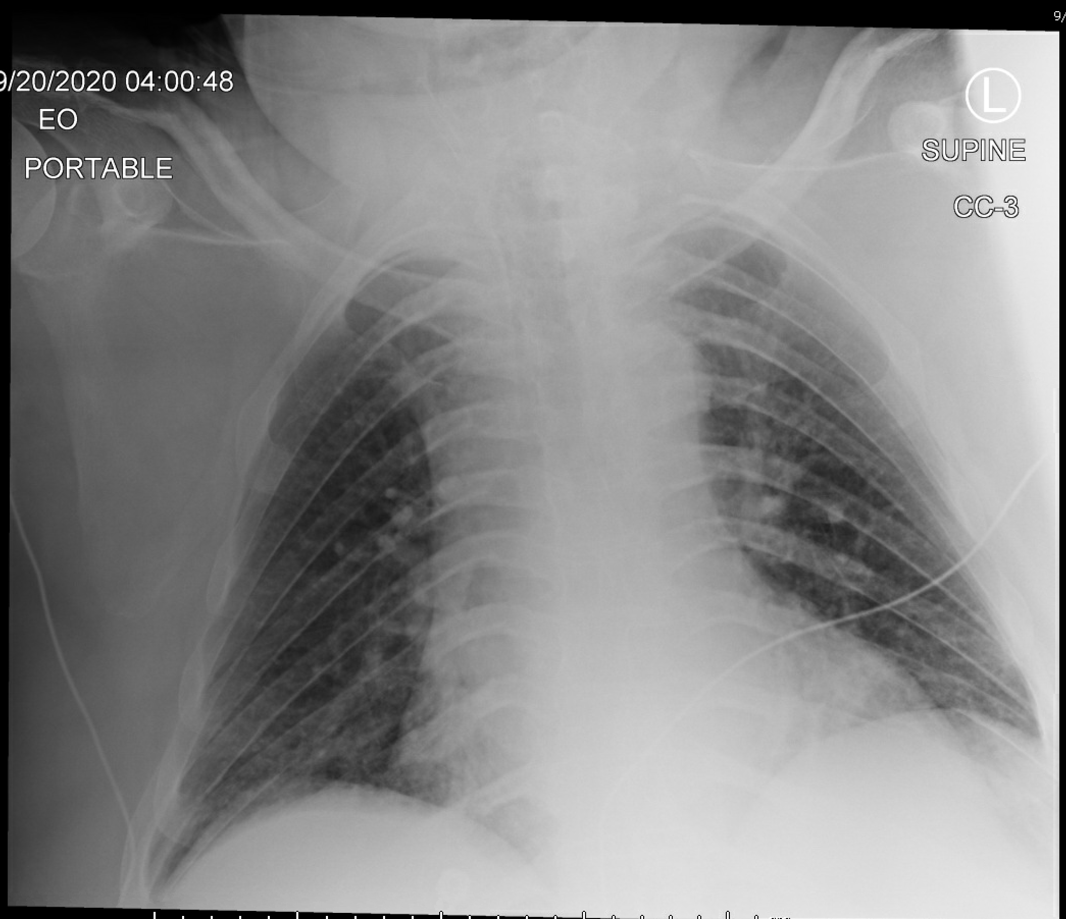
CXR 9/20
Notes:
No acute findings
Importantly no findings of pulmonary fibrosis

Slide 6
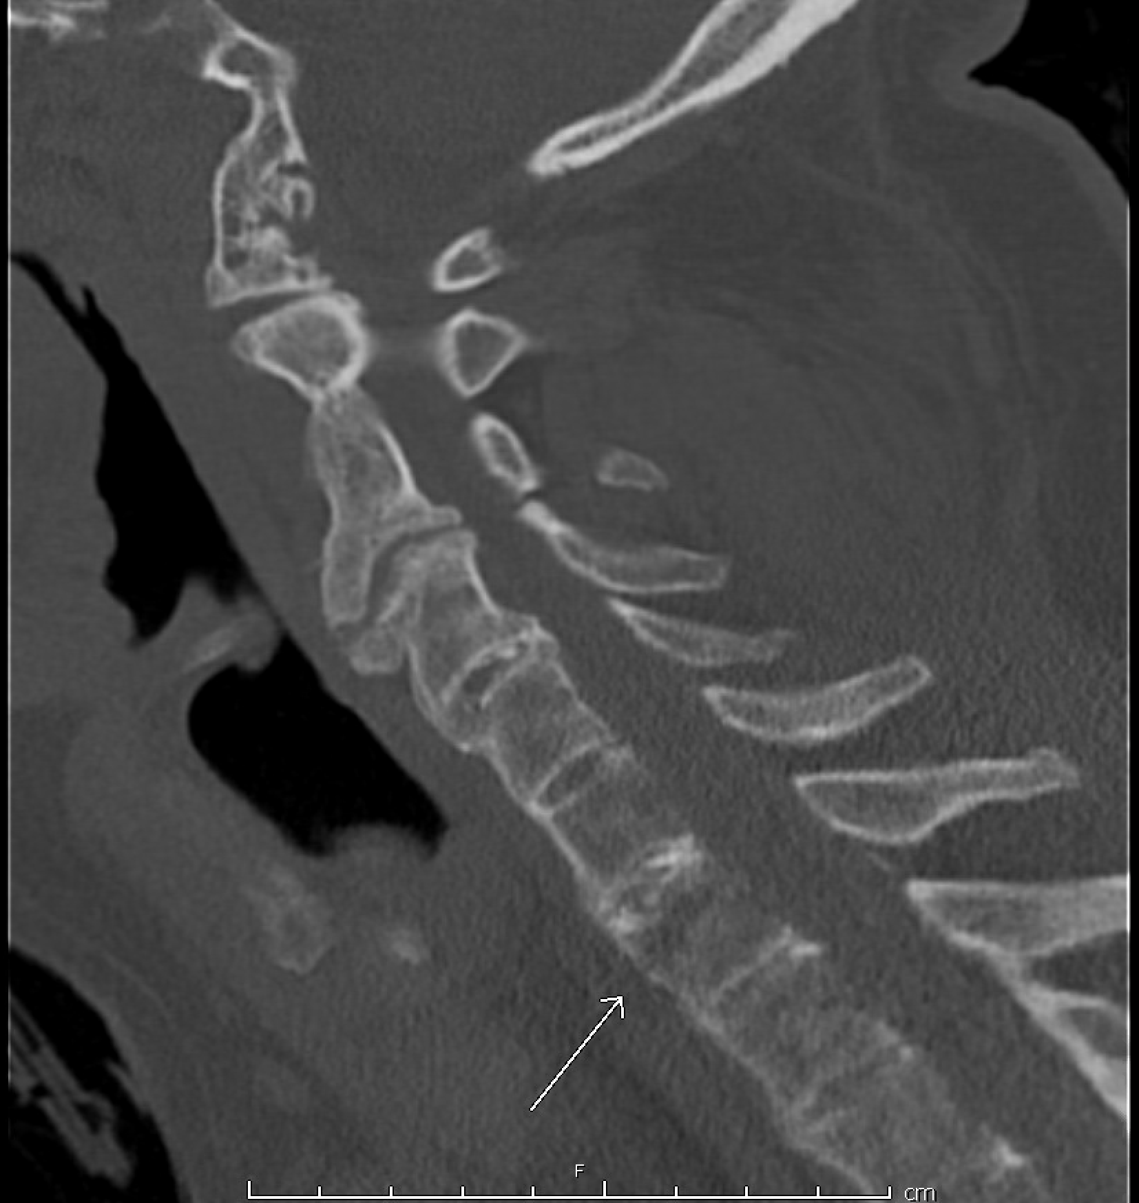
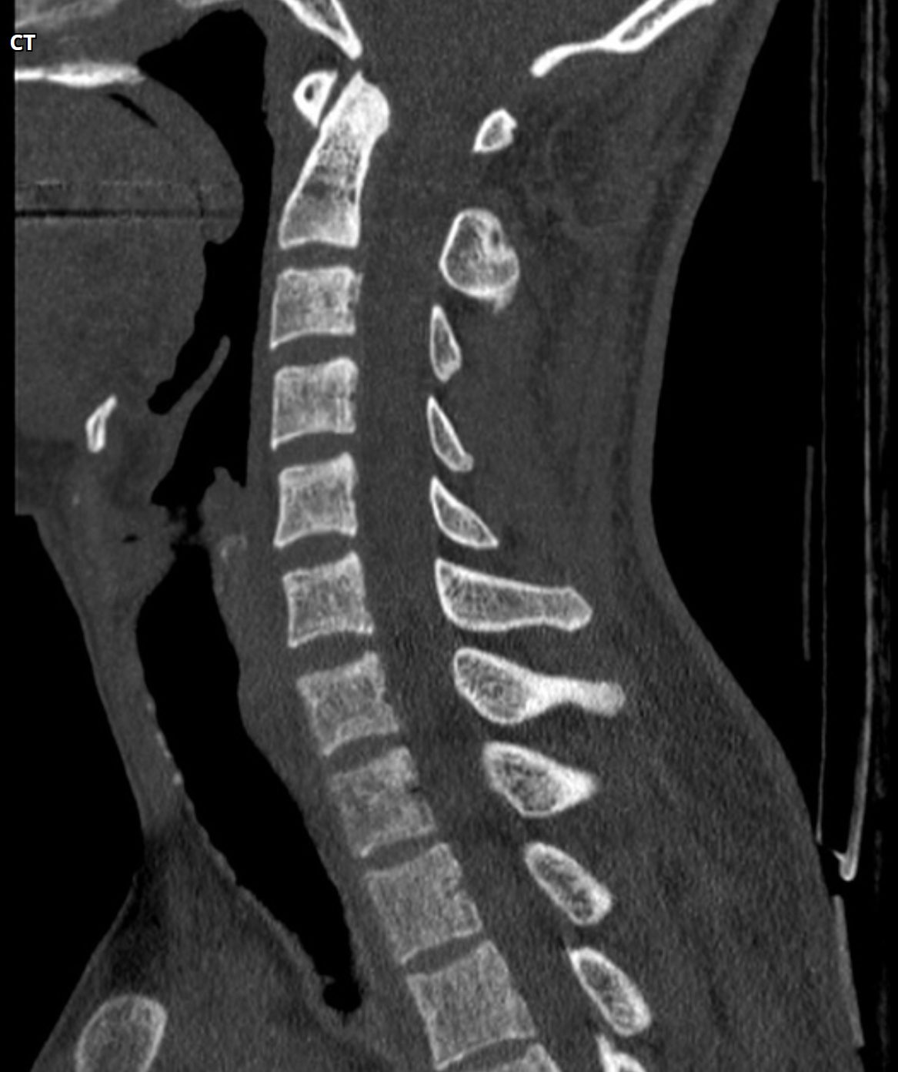
CT C-Spine w/o Contrast 9/20
C3
C4
C5
C6
C7
Normal C-spine
C7 B1 fracture
Notes:
Normal C-spine
- https://radiopaedia.org/cases/39801/studies/42231?lang=us#images

Slide 7
CT Spine w/o Contrast Findings
Tension band injury of C7 vertebral body
  Extends through the facets bilaterally
  AO spine C7: B1
  No significant subluxation
Severe changes of ankylosing spondylitis w/ near total ankylosis of vertebral bodies and facet joints throughout

Slide 8
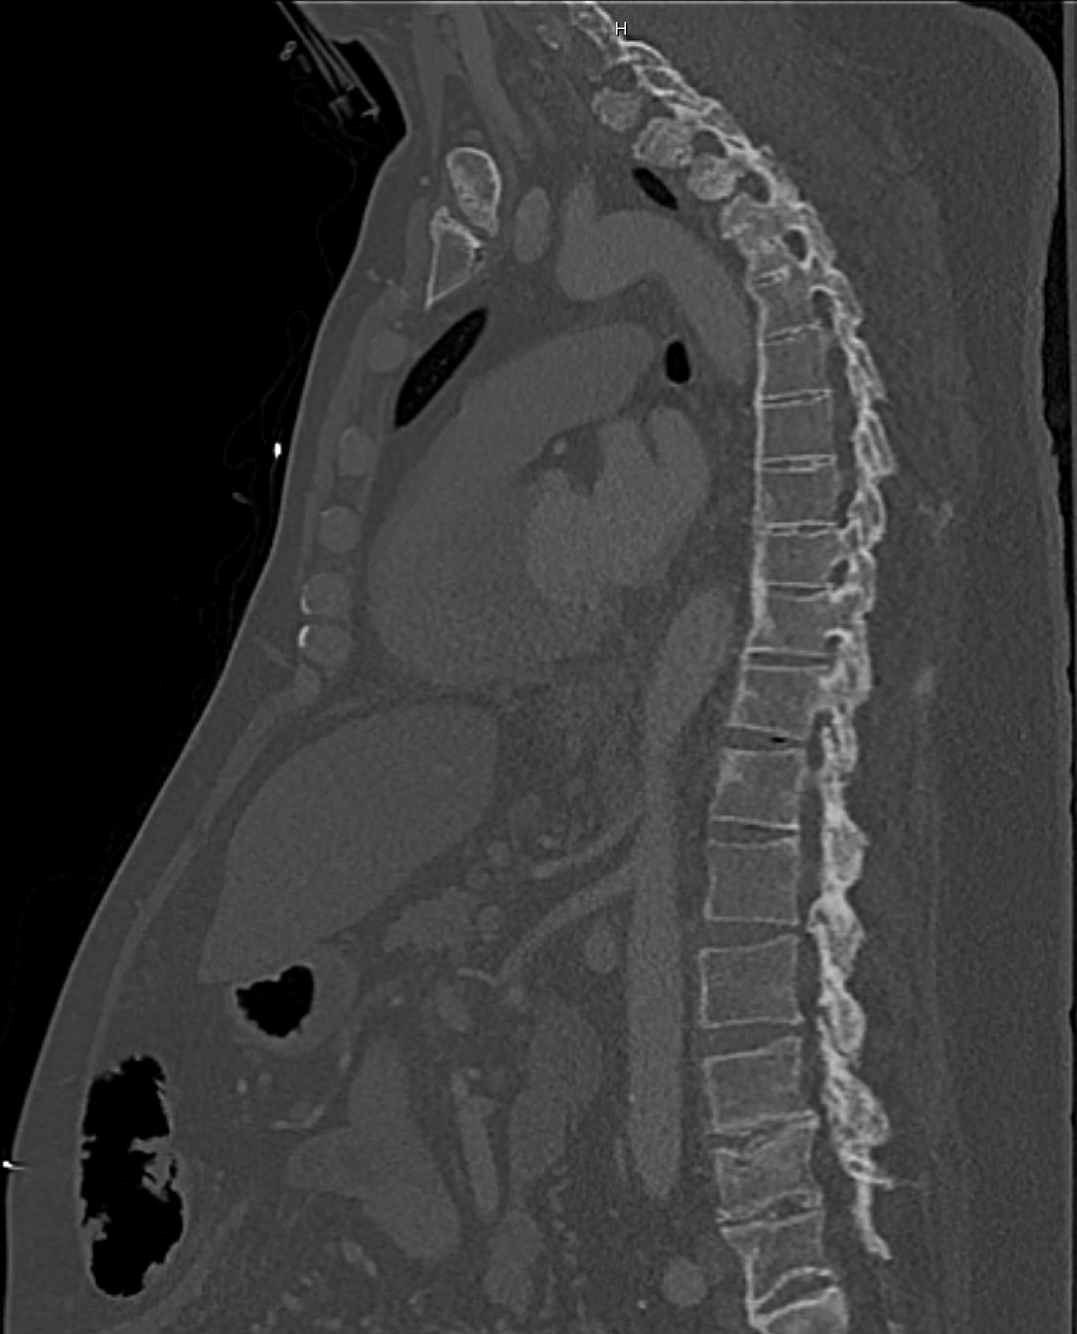
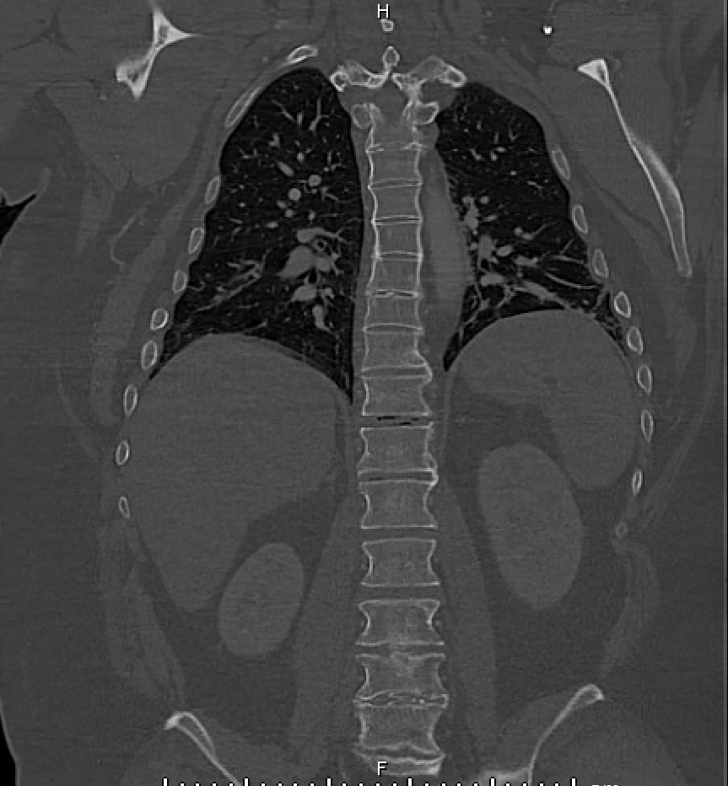
CT Chest 9/20 w/ contrast
Aortic Arch
Main PA Trunk
Liver
CT Spine Sagittal

Slide 9
Chest CT w/ Contrast Findings
Diffuse changes of AS seen w/ fusion of bilateral SI joints and ankylosis of T-spine from T11 and above
Severe degenerative facet disease throughout spine
Large ventral hernia w/ non-obstructed loops of small bowel

Slide 10
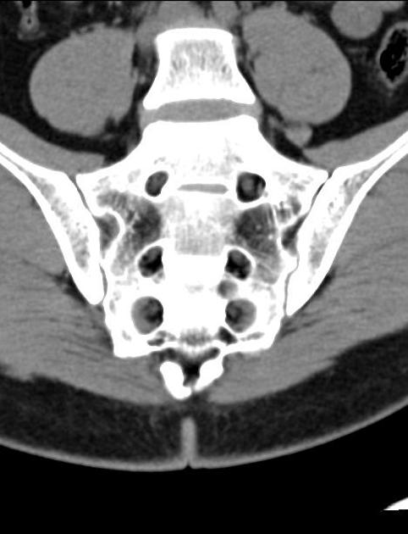
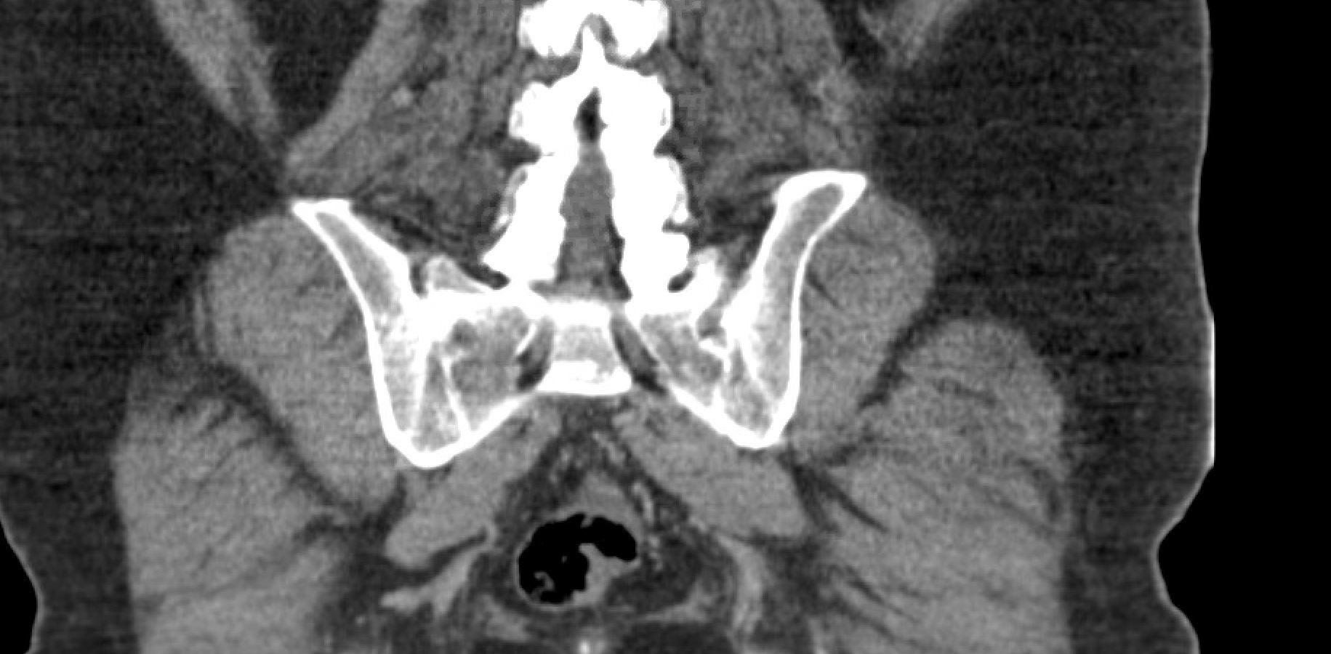
CTAP 9/20 w/ contrast
Coronal CTAP
Normal Comparison

Slide 11
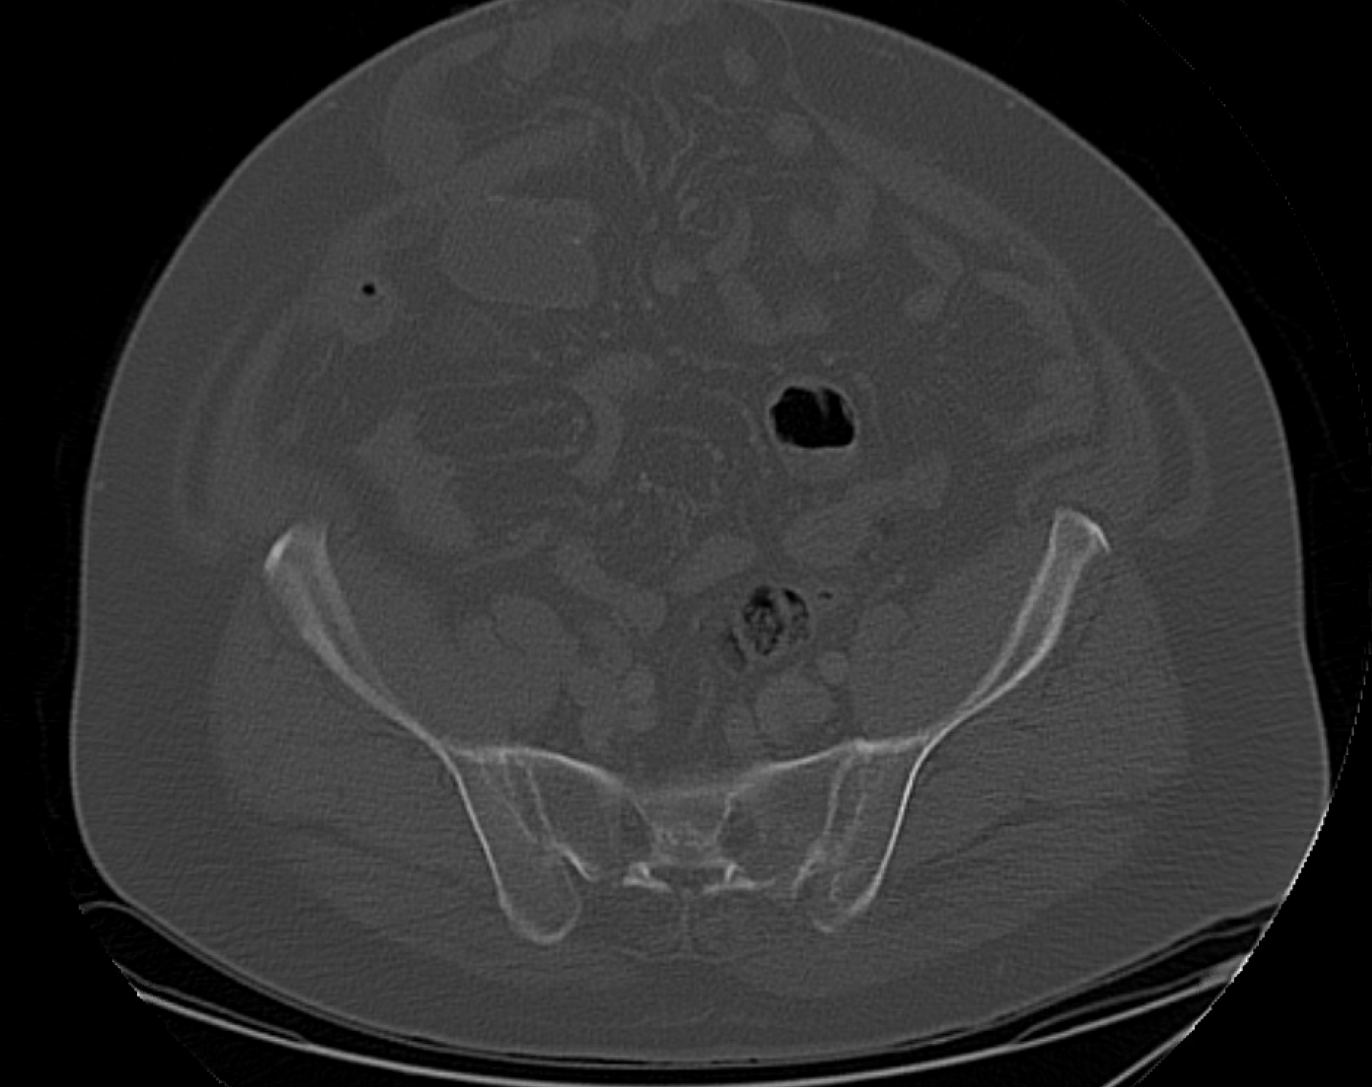
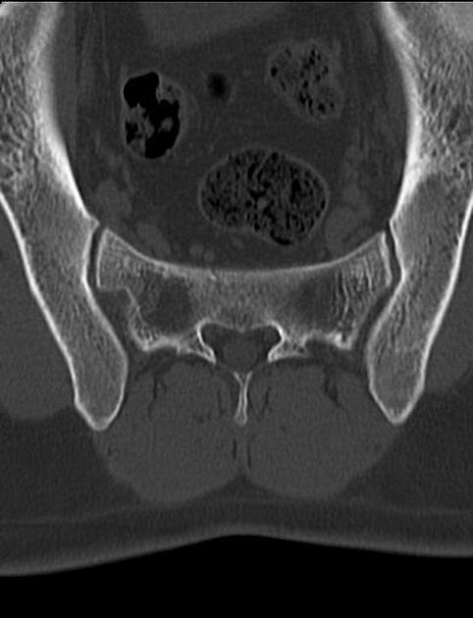
CTAP 9/20 w/ contrast
Axial CTAP
Normal Comparison
Notes:
sclerosis and erosion of the sacroiliac components of both joints (arrows) are seen, with areas of decrease and fusion of the joint space (arrowheads).

Slide 12
CT abdomen/pelvis Findings
Diffuse changes of ankylosing spondylitis with fusion of the bilateral SI joints and ankylosis of the thoracic spine from T11 and above
  Severe degenerative facet disease throughout the spine

Slide 13
Differential Diagnosis
Fracture
  Most likely given neurologic symptoms after acute trauma
  Likely a/w ASIA
Hyperextension Injury
  Injury seen commonly with ankylosing spondylitis
CVA/Stroke
  Less likely due to absence of acute abnormality on CT head

Slide 14
AO Spine Classification of Thoracolumbar injuries
Does not aim to determine treatment (unlike TLICS)
AO terminology provides systematic overview to think/describe injury
Fracture components considered; Morphology, presence of neuro sx, presence of modifiers
Broadly categorized
  A: Compression injuries
  B: Distraction injuries
  C Displacement or dislocation
Notes:
TLCIS = thoracolumbar injury classification and severity score
Modifiers = ligamentous injuries or co-morbid conditions

Slide 15
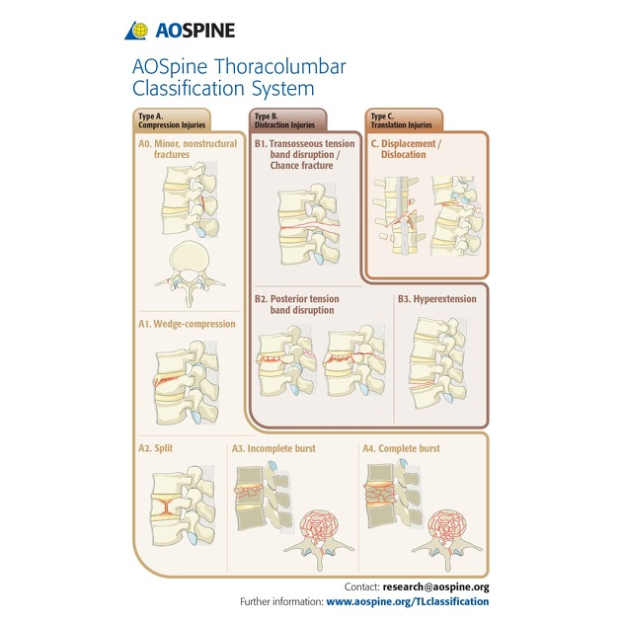
A: Compression Injuries
Involve anterior portion of vertebral column w/ intact posterior tension band
A0: no or clinically insignificant fractures
A1: Wedge compression injuries
  Singler anterior or middle endplate of vertebral body w/o posterior aspect involvement of posterior vertebral wall
A2: split or pincer type injury
  Involve both endplates w/o posterior wall
A3: Incomplete burst injury
  Involve single endplate and posterior vertebral wall
  Laminar fracture may be present
A4: Complete burst injury
  Involve both endplates and posterior vertebral wall
  Often a/w laminar fracture
Notes:
Tension band = groups of muscles, ligaments, process/pedicles that maintain the integrity of the vertebral column

Slide 16
B: Distraction Injuries
Type B Injuries involve the anterior or posterior tension band
B1: disrupt pedicles and spinous process in single vertebral level
  Aka Chance fractures or pure transosseous tension band disruption
  Distracted horizontal fracture thru vertebral body may be present
B2: intervertebral body level w/ disruption to posterior tension band w/ or w/o involving posterior bones
  AKA osseoligamentous posterior tension band disruption
  Type A fracture often present
B3: disruption of anterior tension band, extend thru intervertebral disk or vertebral body
  Hyperextension injury
Notes:
Type C: translation injuries involve displacement in any direction. No subtypes present as they are numerous possibilities of dislocating fracture

Slide 17
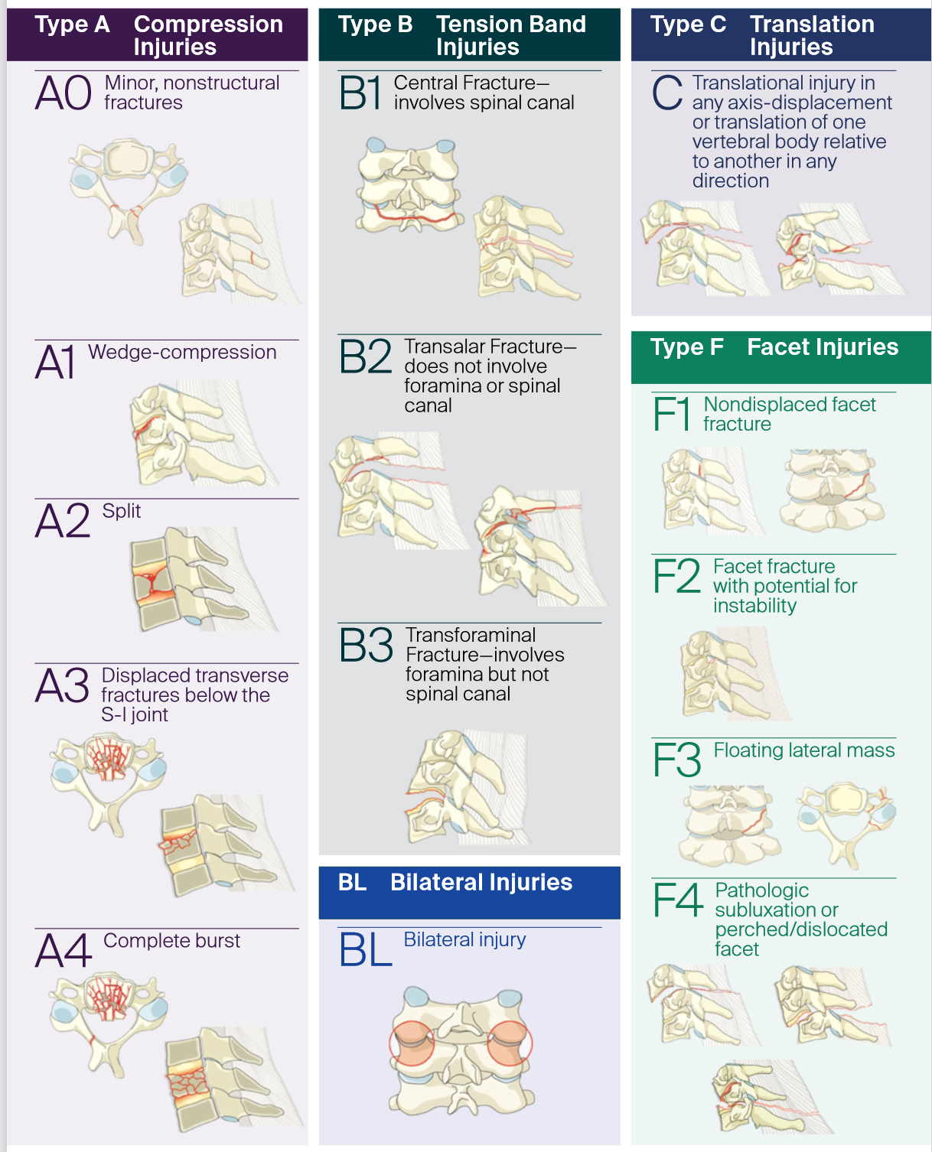
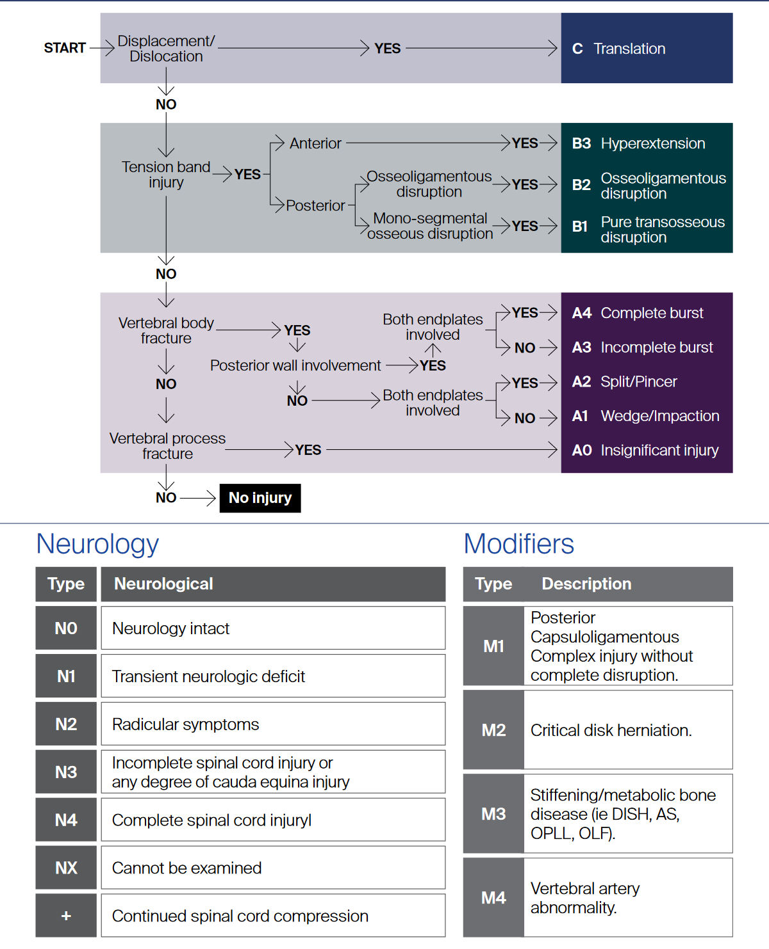

Slide 18
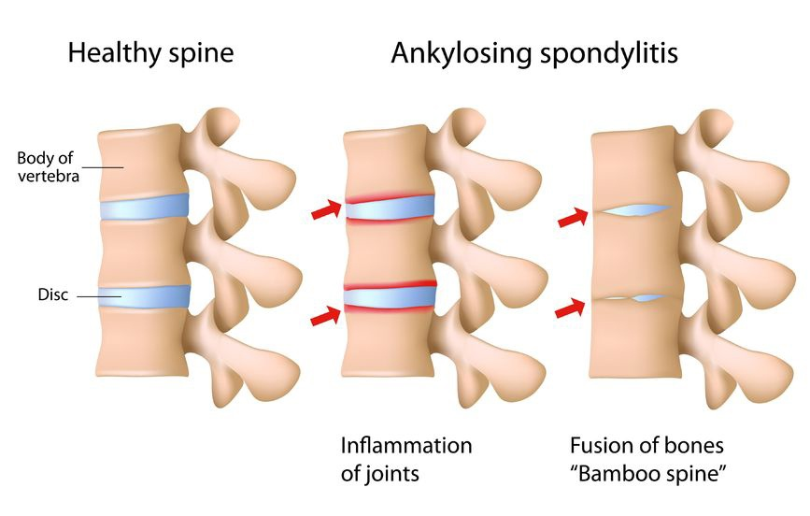
Ankylosing Spondylitis
Seronegative Spondyloarthropathy
  Strong association with HLA-B27, M>F, onset in adolescence/YA
  Bilateral sacroiliitis prerequisite for dx
  Fusion of spine in ascending manner (lumbar to c-spine)
Clinical Features
  Low back pain/stiffness, hip/shoulder pain, neck pain/limited c-spine mobility
  Enesthitis
  Prone to fracture 2/2 brittle spine, severe SCI w/ trauma
  Constitutional symptoms
  Loss of lumbar lordosis (inability to stand upright)
  Associated with IBD, eye involvement, cardiac involvement

Slide 19
Ankylosing Spondylitis
Complications
  Osteopenia
  Fractures
    Vertebral fragility fractures from trauma ~2x as common
    Minimal trauma required
    Lower C-spine most commonly involved area
    Extension fracture most common
  Neuro
    SCI
      50-65% of spinal fractures a/w neuro sx
  Renal disease
Tx
  NSAIDs, anti-TNF meds (infliximab), PT, surgery
  AS pts with neck/back pain should be strictly immobilized to prevent SCI until thorough imaging studies obtained
Notes:
Increased fracture risk thought to be due to decreased bone mass density and increased neck rigidity
Type B1 is a flexion rather than an extension
They tend to occur from a flexion injury of the vertebral body and distraction type injury of the posterior elements ¹

Slide 20
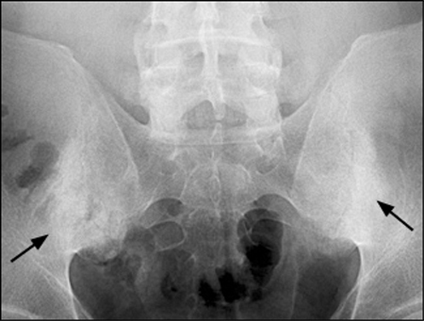
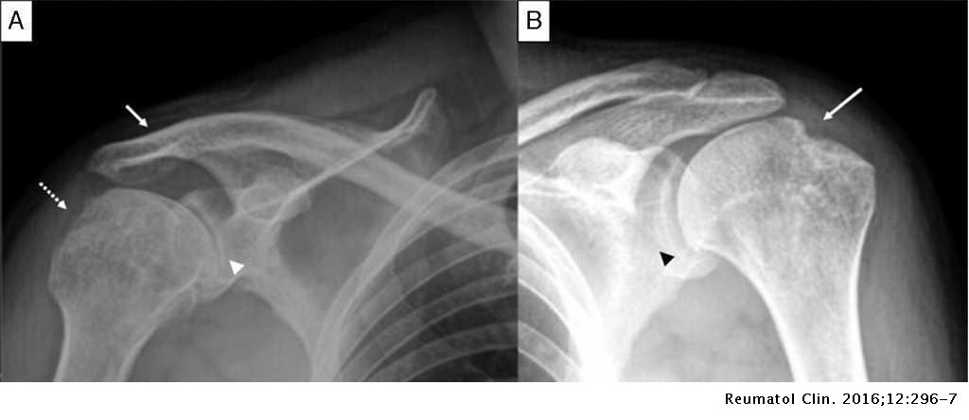
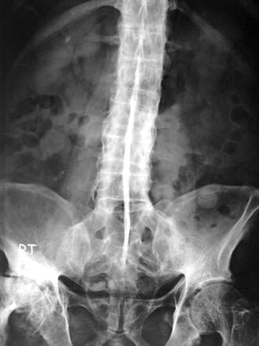
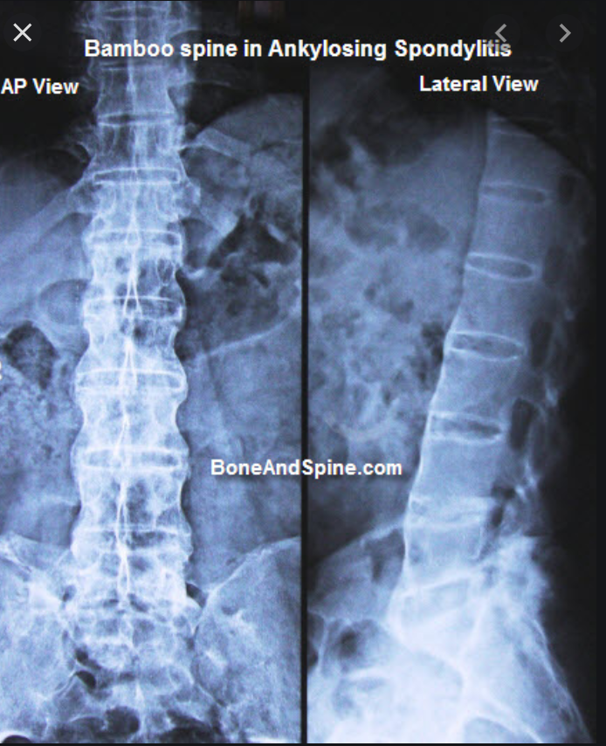
Fusion of SI joints
Hatchet sign
Dagger Sign
Notes:
Bamboo Spine
- complete fusion of all vertebral bodies
Sequel to florid anterior spondylitis and diskitis -> resulting in bony ankylosis
Fusion is 2/2 syndesmophytes
syndesmophyte is a bony growth originating inside a ligament, commonly seen in the ligaments of the spine, specifically the ligaments in the intervertebral joints leading to fusion of vertebrae.
Linear ossification along the central spine; representing interspinous ligament ossification can give a "dagger spine" appearance on frontal radiographs;
Shoudlers
Shoulder joint involvement is not uncommon and demonstrates a large erosion of the anterolateral aspect of the humeral head, producing a 'hatchet' deformity.
Marrow edema of acromion process, at the site of origin of deltoid muscle has been described as a very specific sign of the disease.

Slide 21
Outcomes
Pt transferred to BT ER for further eval given fracture and severe LE weakness
Underwent posterior C4-T3 instrumented fusion and C7 laminectomy
Outcomes
  Gradually regained LE strength with PT and transferred to floor
  Routine catheterization regularly
  Stay complicated by severe constipation resolved by enemas and rectal stimulation
  Ambulating w/ minimal assistance on d/c
Outcomes vary widely on a case by case basis depending on degree of trauma/fracture
  Restoration of sensation is common albeit slow sequala s/p fusion and laminectomy
AS a/w development of osteopenia/osteoporosis, hyperkyphosis, extra-spinal organ involvement (i.e. heart, eye, colon)

Slide 22
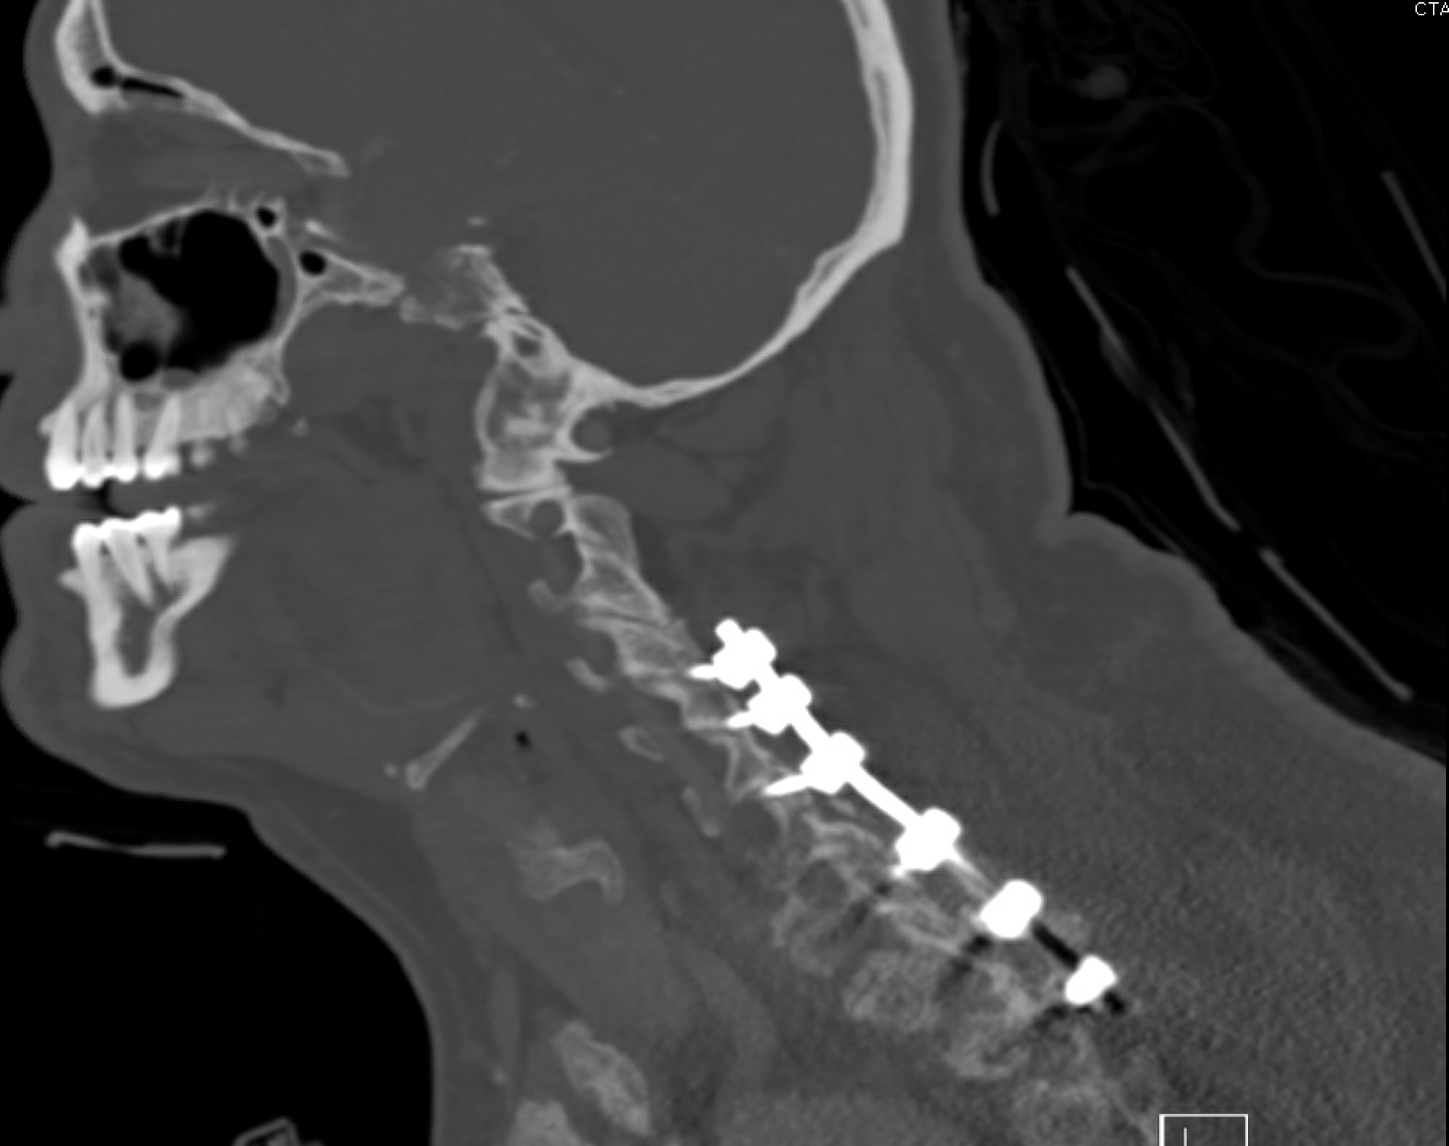
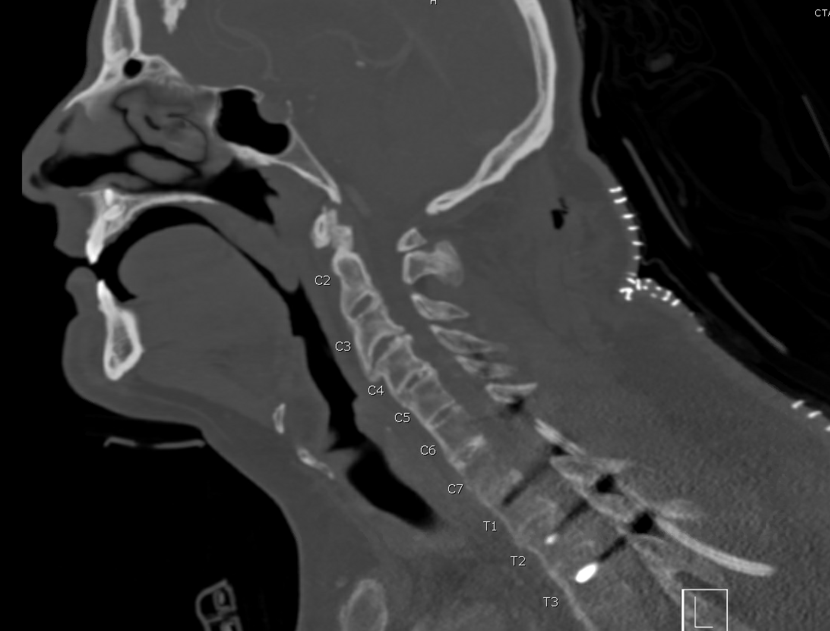
Post Op

Slide 23
Final Diagnosis
C7:B1 N3 M2 fracture with ankylosing spondylitis

Slide 24
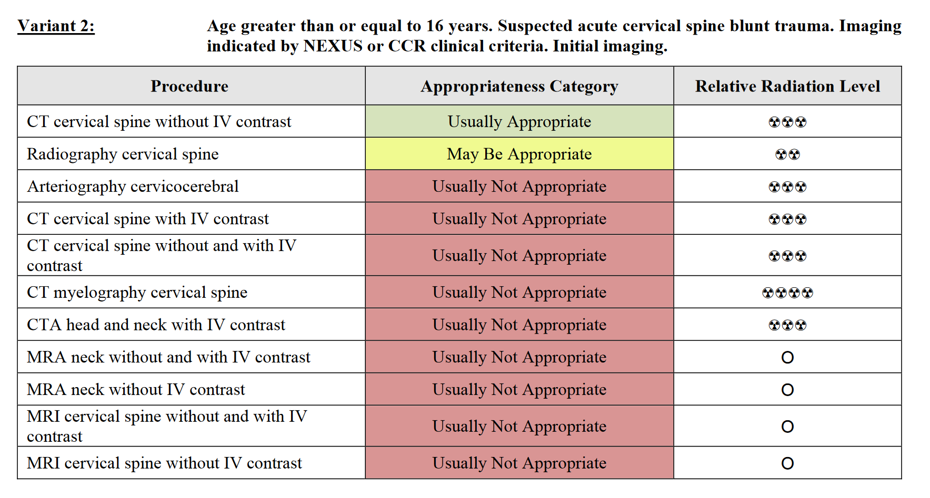
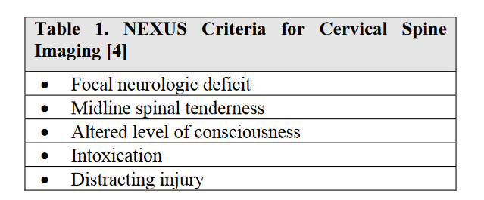
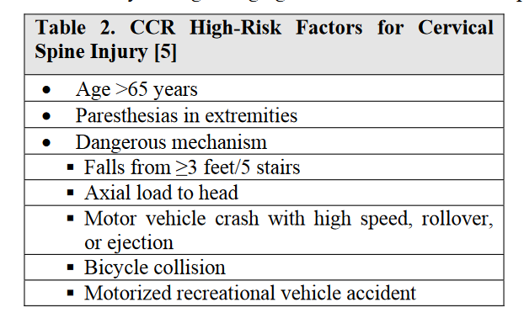
ACR appropriateness Criteria
Nexus and CCR have high sensitivity but low specificity
  If pt doesn’t meet criteria, imaging may not be indicated/necessary
CT C-Spine gold standard for ID of C-spine fractures
  Outperforms radiographs
  <1% of unexaminable pt has evidene of C-spine instability on MRI not appreciated on CT
Notes:
NEXUS criteria has 99.6% sensitvity for detecting clinically sig cervical injury, but a low specificity

Slide 25
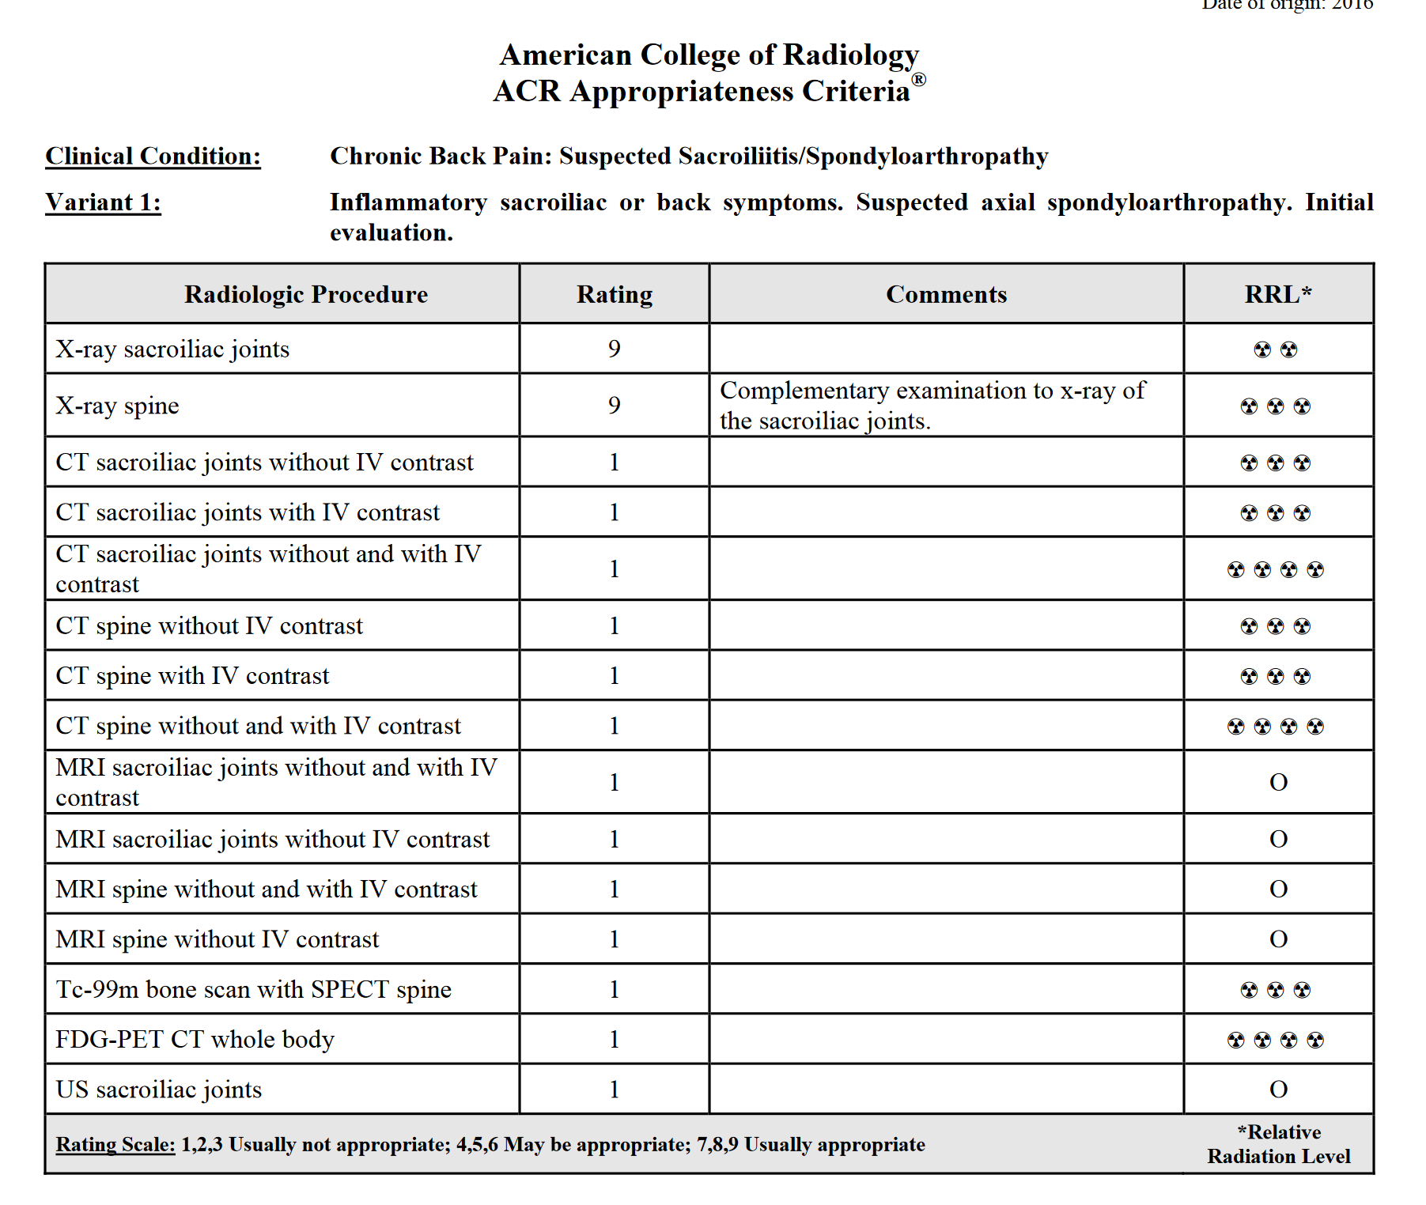
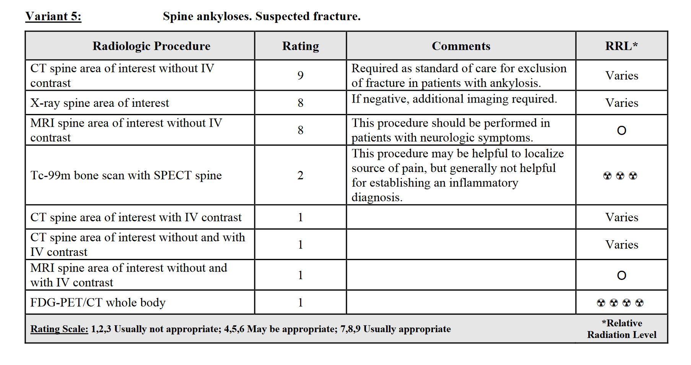
ACR Appropriateness Criteria
Radiographs recommended as first imaging modality
  Low sensitivity for detecting abnormalities in early stage
  Begin with SI joints
MRI of SI joints as next appropriate imaging in absence of radiographic findings
CT may be helpful in improved sensitivity over radiographs if patient cannot undergo MRI
  Detection of subtle erosions/reparative changes
Notes:
Initial evaluation for inflammatory arthropathy is best performed with radiographs of the sacroiliac joints and symptomatic areas of the spine.
MRI plays an essential role in identifying early inflammatory disease when radiographic evidence of disease is absent and should begin with sacroiliac joint imaging.
MRI of the spine may be helpful in establishing the diagnosis when other imaging is negative. The MRI request should indicate that the examination is being performed to evaluate for possible axial spondyloarthropathy as the imaging sequences may need to be modified.
Gadolinium-enhanced MRI may be helpful at initial assessment, especially when nonenhanced MR images are normal. Intravenous contrast is probably not needed for follow-up MR imaging outside of research protocols or for specific patient indications.
Patients with ankylosis of the spine have a high incidence of unstable fractures that may occur from seemingly minor trauma. As a result, a high clinical suspicion is needed when these patients present with spine pain and multiplanar CT is required for exclusion of fracture.

Slide 26

Cost
Total Cost of imaging
  In-Network Cost: $1,591
  Out of Network Cost: $3610
Notes:
All costs calculated from FAIR Health consumer calculator
https://www.fairhealthconsumer.org/medical/select-medical-totalcost
Out of network/in network
Studies on 9/20/2020
CTAP w/ Contrast: 915/403
CT Chest w/ Contrast: 319 / 173
3. ncCT Head: 258/110
4. CT C-spin w/o Contrast 386 / 164
5. CXR 1 View: 95/41
6. CT neck w/ contrast 410/174
Studies 9/21/2020
XR spine 1 view 46/19
Studies 9/22
CXR 95/41
9/24, 25, 26
XR abdomen x3 48/21
9/28
CTAP w/ contrast: 915/403

Slide 27
Take Home Points / Teaching points
CT scan as gold standard for evaluation of neck trauma
Fractures, especially C-spine fractures, are more common in individuals with AS
AO classification can help describe fracture type and character to a greater degree

Slide 28
References
Verma, Rishabh. “AO Spine Classification of Thoracolumbar Injuries: Radiology Reference Article.” Radiopaedia Blog RSS, radiopaedia.org/articles/ao-spine-classification-of-thoracolumbar-injuries?lang=us
Gaillard, Frank. “Ankylosing Spondylitis: Radiology Reference Article.” Radiopaedia Blog RSS, radiopaedia.org/articles/ankylosing-spondylitis?lang=us.
Radiology Quiz 39801, radiopaedia.org/cases/39801/studies/42231?lang=us#images.
Melchior, Julian & Azraq, Yusef & Chary-Valckenaere, Isabelle & Rat, Anne-Christine & Texeira, Pedro & Blum, Alain & Loeuille, Damien. (2017). Radiography and abdominal CT compared with sacroiliac joint CT in the diagnosis of sacroiliitis. Acta radiologica (Stockholm, Sweden : 1987). 58. 284185116688377. 10.1177/0284185116688377.
American Colle of Radiology Readiness Assesment Criteria. Accessed December 2020.
American College of Radiology. Acessed December 2020.
https://www.uptodate.com/contents/clinical-manifestations-of-axial-spondyloarthritis-ankylosing-spondylitis-and-nonradiographic-axial-spondyloarthritis-in-adults?search=Ankylosing%20spondylitis&source=search_result&selectedTitle=1~150&usage_type=default&display_rank=1#H360346583
AOSpine classification systems. Accessed Dec 2020.
https://www.fairhealthconsumer.org/medical/select-medical-totalcost
Davis JM, Beall DP, Lastine C et-al. Chance fracture of the upper thoracic spine. AJR Am J Roentgenol. 2004;183 (5): 1475-8
Vaccaro AR, Oner C, Kepler CK, Dvorak M, Schnake K, Bellabarba C, Reinhold M, Aarabi B, Kandziora F, Chapman J, Shanmuganathan R, Fehlings M, Vialle L. AOSpine thoracolumbar spine injury classification system: fracture description, neurological status, and key modifiers. (2013) Spine. 38 (23): 2028-37.
Schuld C, Franz S, Bruggerman K, Heutehaus L, Weidner N, Kirshblum SC, Rupp R. International standards for neurological classification of spinal cord injury: impact of the revised worksheet (revision 02/13) on classification performance. (2016) J Spinal Cord Med. 39(5): 504–512

Slide 29

Questions?

