Slide 1
Ground level fall in a patient with cerebral palsy (Ankle fracture)
Jacqueline Dickey
1/04/2021
Diagnostic Radiology 4001
Ronald Bilow

Slide 2
Clinical History
57 y.o. M with PMH of cerebral palsy, HTN presents after awkward trip and ground level fall. Pt is ambulatory without assistance at baseline
  CBC, CMP wnl
  Associated R ankle pain with decreased ROM
  RLE exam:
    Obvious deformity to right ankle with foot in external rotation/eversion
    Foot rigid to attempted manipulation
    Motor: 0/5 big toe extension/flexion, 3/5 gastric/TA 2/2 pain, 5/5 hip/knee
    Sensation, vascular, and ligamentous knee exam all in tact

Slide 3
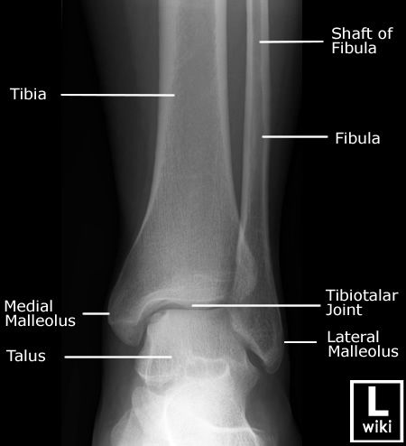
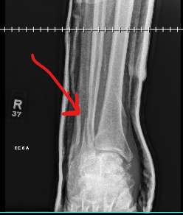
X-ray right ankle - 12/31
-s/p splinting of fibular Danis-Weber type B3 fracture subluxation
  http://www.wikiradiography.com/page/Ankle+Radiographic+Anatomy
Notes:
Can also see talar fracture in this pic

Slide 4
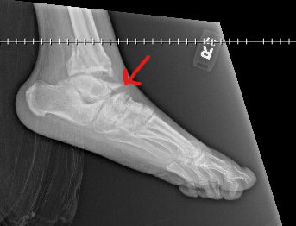
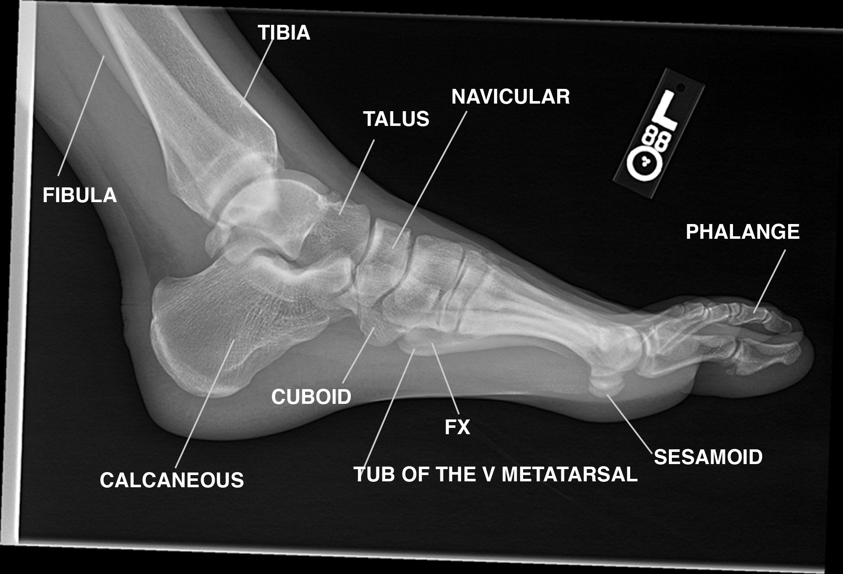
X-ray foot - 12/31
-Displaced age indeterminant fracture of the talar neck with associated disruption of anterior subtalar joint with age indeterminant midfoot collapse
https://www.google.co.uk/search?tbm=isch&tbs=rimg:Cc9yMWP0c15KIjgkNSHmKK3tthE9zhKWbX7mAOW3Hgn-0ZrfNvoHPt5slXKA-wFwG5Bm-vmnyHDHuDk2X-iUTcs0MyoSCSQ1IeYore22EWZ9uaIpmYPaKhIJET3OEpZtfuYRJv0_1AVdbSx0qEgkA5bceCf7RmhG3BBS2YFPahyoSCd82-gc-3myVEfXH5s4FhIcoKhIJcoD7AXAbkGYREG2ZHrQu7d8qEgn6-afIcMe4ORGOTDCXyrlJ4ioSCTZf6JRNyzQzEaCDANqwysA4&q=anatomy%20musculoskeletal%20x%20ray&imgdii=cRqAD5D1rnrOmM:;cRqAD5D1rnrOmM:;yp64MkXB_DvKVM:&imgrc=cRqAD5D1rnrOmM:&cad=h#imgrc=RmnqY_0N4_qz_M:
Notes:
Can see midfoot collapse by angle of line

Slide 5
Key imaging findings
Danis-Weber type B3 fracture subluxation
Displaced age indeterminant fracture of the talar neck with associated disruption of anterior subtalar joint with age indeterminant midfoot collapse
Soft tissue swelling about ankle and dorsal aspect of foot

Slide 6
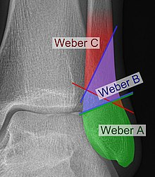
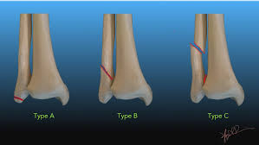
Danis-Weber Classification
Weber B subclassificantions:
B1: isolated
B2: associated with a medial lesion (malleolus or ligament)
B3: associated with a medial lesion and fracture of posterolateral tibia
https://faculty.washington.edu/jeff8rob/trauma-radiology-reference-resource/11-lower-extremity/danis-weber-classification-of-ankle-fractures/
https://en.wikipedia.org/wiki/Danis%E2%80%93Weber_classification
https://radiopaedia.org/articles/weber-classification-of-ankle-fractures?lang=us
Notes:
The more proximal the fracture, the more external rotation that occurred and less stable the injury

Slide 7
Differential Diagnosis
Ankle fracture
Soft tissue injury
Acute compartment syndrome
Foot fracture
Ankle sprain
Tendon injury

Slide 8
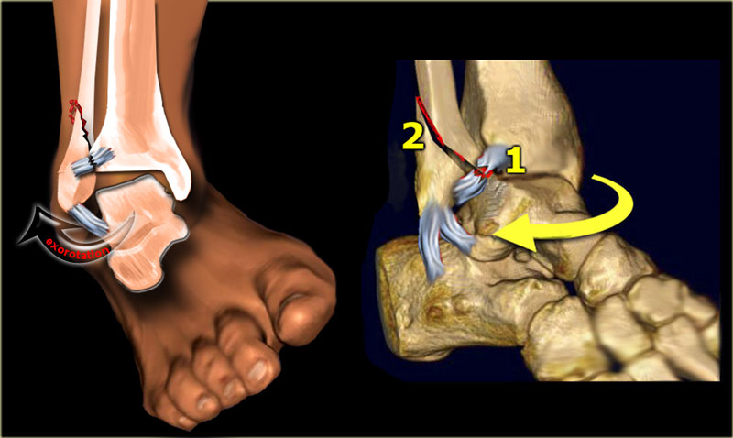
Discussion- Mechanism of injury
Closed reduction performed in the ED, placed in splint
Post-reduction films show acceptable alignment
https://radiologyassistant.nl/musculoskeletal/ankle/weber-and-lauge-hansen-classification

Slide 9
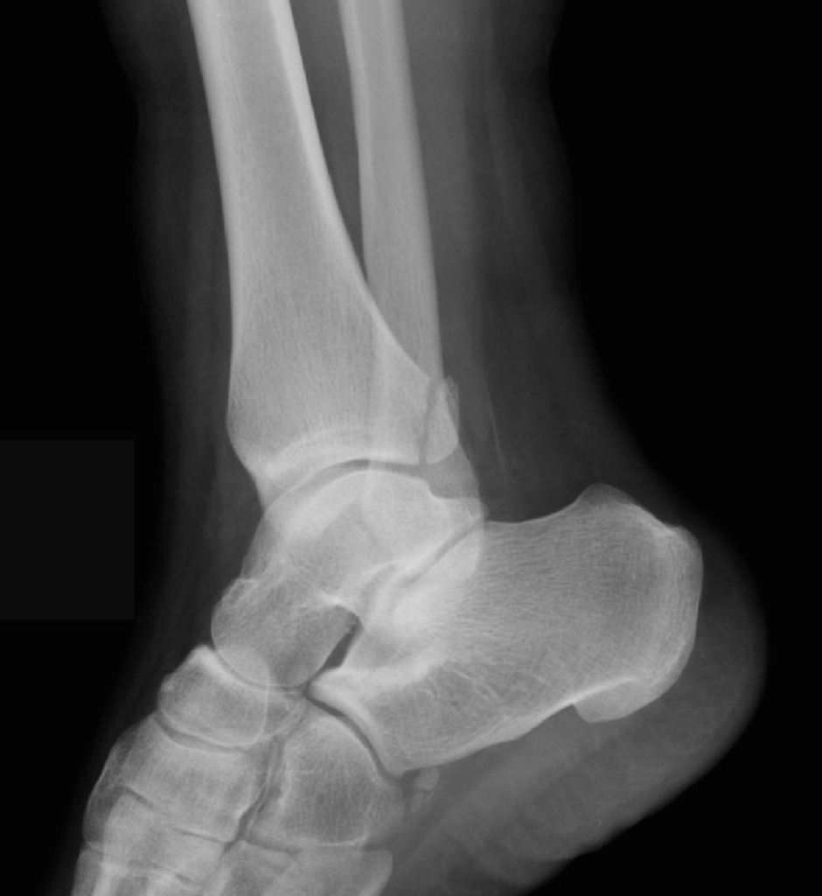
Posterior malleolus fracture
Rare– isolated posterior malleolus fractures = 1% of ankle fractures
Trimalleolar fracture occurs more frequently (medial, lateral, and posterior malleolar fracture) or bimalleolar
  Often associated with ligament damage
CT scan most useful imaging
More difficult to treat (reduction and fixation)
Surgery indicated if ankle instability present
  Plates and screws for stability
  https://www.orthobullets.com/trauma/1047/ankle-fractures
  https://radiopaedia.org/cases/posterior-malleolus-fracture

Slide 10
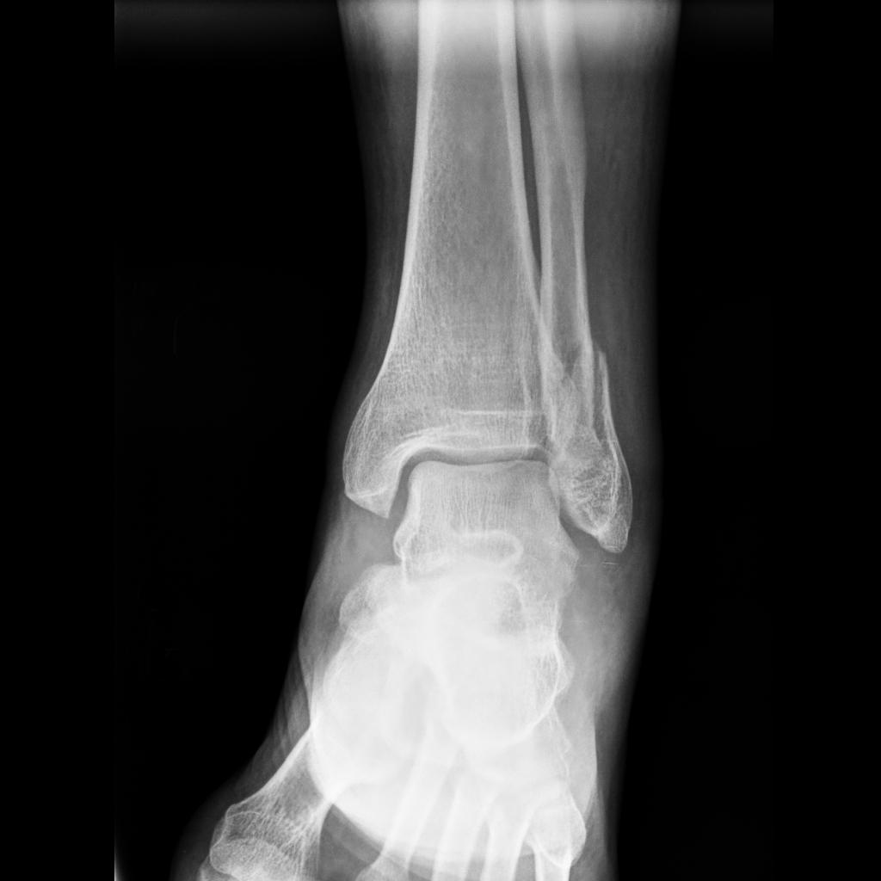
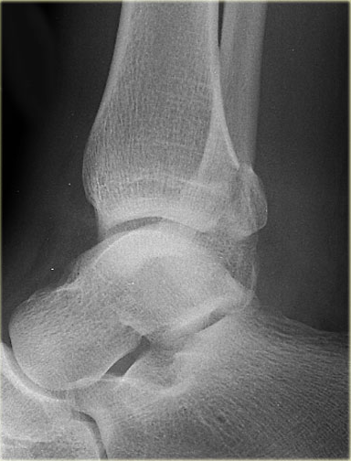
Medial/lateral malleolus fracture
Lateral malleolar fracture is fracture of the fibula
Medial malleolar fracture is fracture in tibia
  May occur with fibular fractures (lateral malleolus), aka bimalleolar fracture
  May occur with posterior tibial fractures (posterior malleolus)
  May occur with injury to ankle ligaments
Lateral malleolar fracture
Medial malleolar fracture
https://radiopaedia.org/cases/lateral-malleolar-fracture
https://radiologyassistant.nl/musculoskeletal/ankle/weber-and-lauge-hansen-classification

Slide 11
Discussion- Treatment
Joint stability
  If bone/ligament “ring” of stability in ankle is broken at one site, joint remains stable
  If “ring” of stability is broken in more than one site, it becomes unstable
  Joint instability → SURGERY
  Assess stability with abduction/external rotation force
  Stress test is used during imaging to determine whether joint is stable
    Laxity indicates instability → ankle is either displaced or easily displaced with stress
    *Weber B is most likely to become unstable compared to Weber A or Weber C fractures
https://www.ncbi.nlm.nih.gov/pmc/articles/PMC5994620/#:~:text=The%20ankle%20joint%20can%20be,two%20columns%3A%20lateral%20and%20medial.
https://www.physio-pedia.com/Stress_tests_for_Ankle_ligaments
https://www.massgeneral.org/orthopaedics/foot-ankle/conditions-and-treatments/ankle-fractures-unstable

Slide 12
Final Diagnosis
Danis-Weber type B3 fracture subluxation
Displaced fracture of talar neck associated with disruption of the anterior subtalar joint and midfoot collapse. Both age-indeterminant

Slide 13
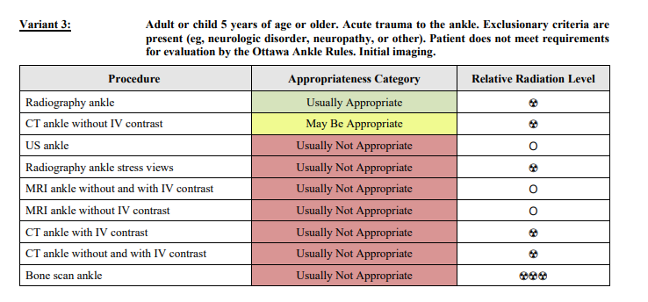
ACR appropriateness Criteria
$180 with insurance
$449 without insurance
https://nhhealthcost.nh.gov/costs/medical/result/x-ray-ankle-outpatient?carrier=uninsured

Slide 14
Take Home Points / Teaching points
Danis-Weber scale is useful for prognosis. Weber B most commonly causes joint instability
Mechanism of injury gives clues to diagnosis, so a thorough H&P is important
Non-weight bearing and ankle deformities require further assessment
Posterior malleolar fractures are rare and commonly occur with medial and/or lateral malleolus fractures
Can use cortical lines and shape of bones to help determine age of fracture

Slide 15

Questions?

