Slide 1
MVA Fractures and Pneumothorax
Bert Ma
12/09/2020
Pedi Radiology RAD 4003
Dr. Greenfield

Slide 2
Clinical History
17 y.o M who was ejected from car and car fell on his torso
  PMH: insignificant
  PSHx: insignificant
Physical Exam
  HDS, HR RRR, normal neurovascular exam, GCS 15
  Anterior neck and chest bruising, subcutaneous emphysema in R chest
Initial Chest X-ray
  Small pneumothorax and 1st R rib fracture

Slide 3
Differential Diagnosis
Blunt abdominal trauma
  Solid organ injury: liver, spleen, kidneys, pancreas
  Hollow organ: stomach, large and small bowel, gallbladder, urinary bladder
Chest trauma
  pneumothorax, hemothorax
  Rib fractures with/without flail chail, spinal cord injury
  Cardiac damage
Pelvic injury
  Hip/pelvic fracture
  Urethral injury

Slide 4
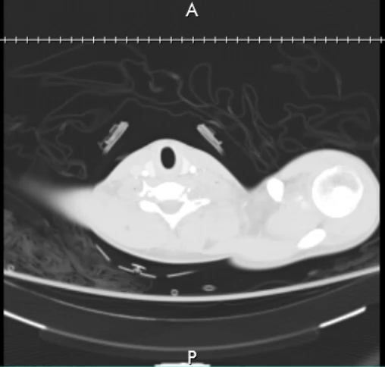
ED Chest w/ contrast CT 11/17/2020 - Axial

Slide 5
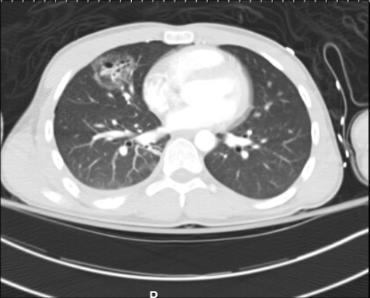
ED Chest w/ contrast CT 11/17/2020 - Axial
Ground glass opacities consistent with pulmonary contusions
Air cyst-like structures with fluid levels consistent with traumatic pneamtoceles

Slide 6
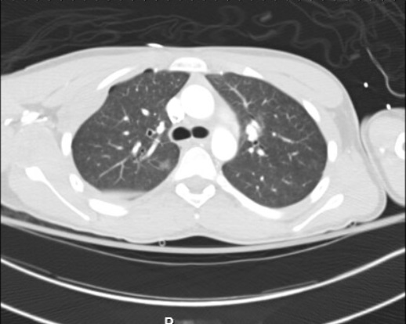
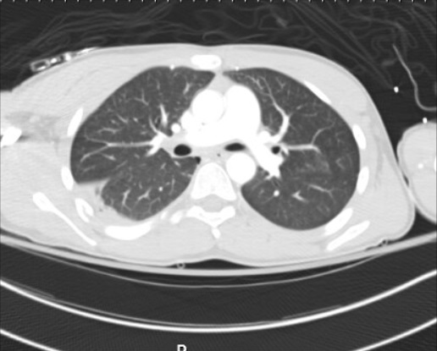
ED Chest w/ contrast CT 11/17/2020 - Axial
Small pneumothorax and hemothorax

Slide 7
Differential Diagnosis
Pulmonary contusion
Segmental atelectasis
Pulmonary hemorrhage
Pneumonia
Lung abscess

Slide 8
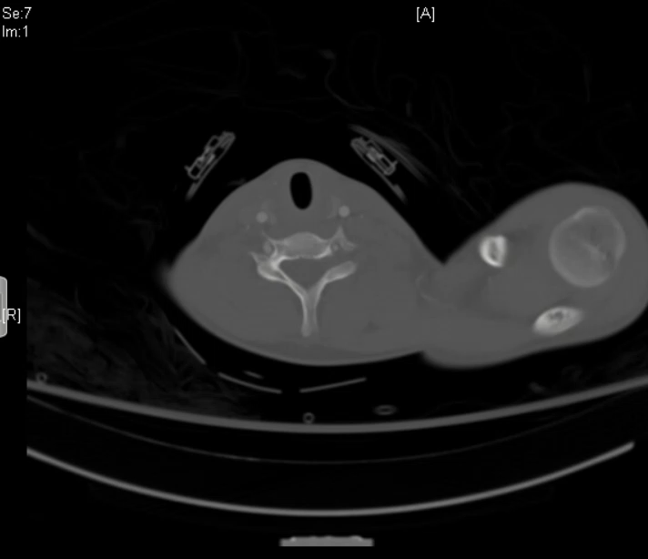
ED Chest w/ contrast CT 11/17/2020 - Axial

Slide 9
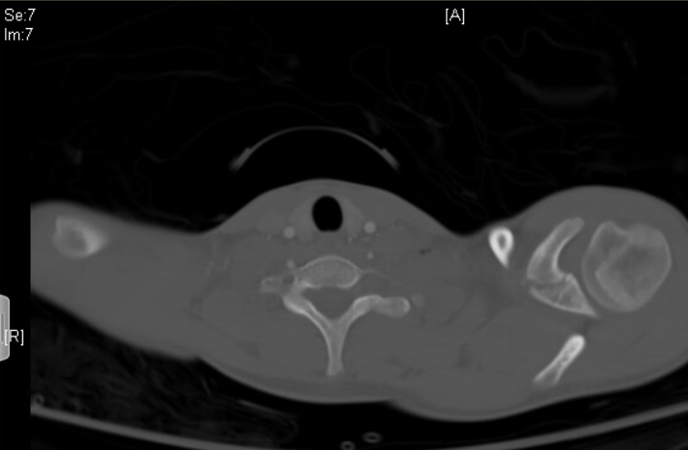
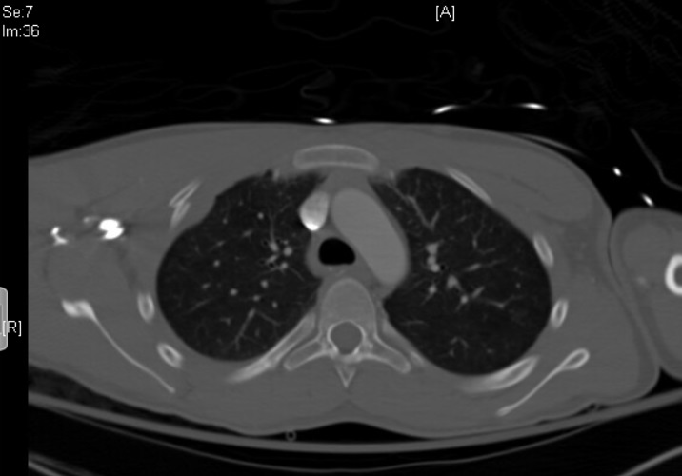
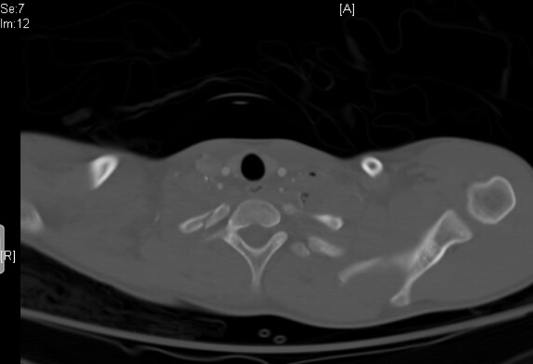
ED Chest w/ contrast CT 11/17/2020 - Axial
Multiple rib fractures
Fracture of the L coracoid process

Slide 10
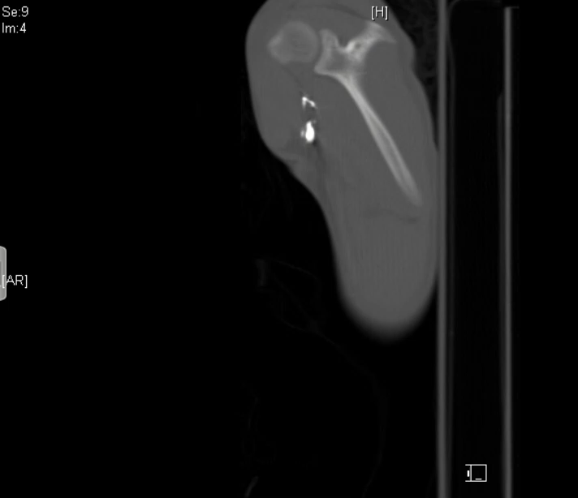
ED Chest w/ contrast CT 11/17/2020 – ParaSag

Slide 11
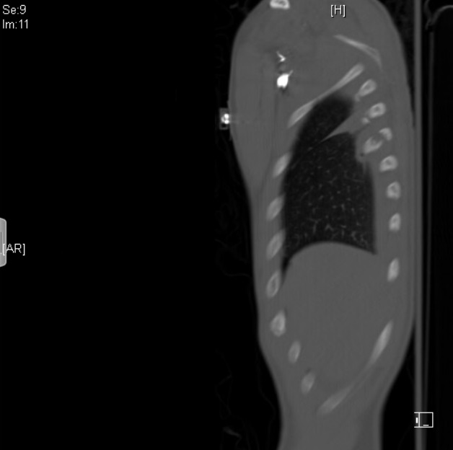
ED Chest w/ contrast CT 11/17/2020 - ParaSag
Segmental fractures of the posterior ribs

Slide 12
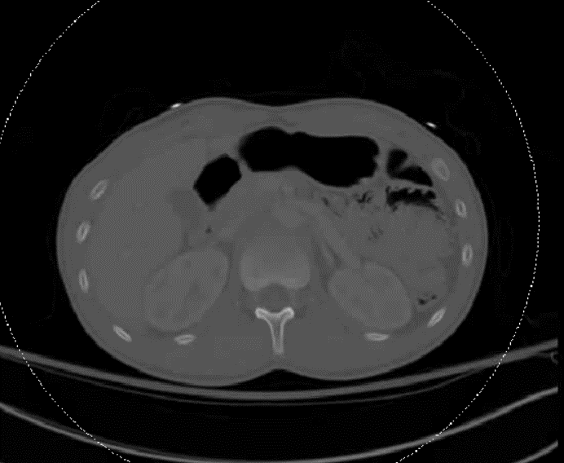
ED Abd w/ contrast CT 11/17/2020 – Axial

Slide 13
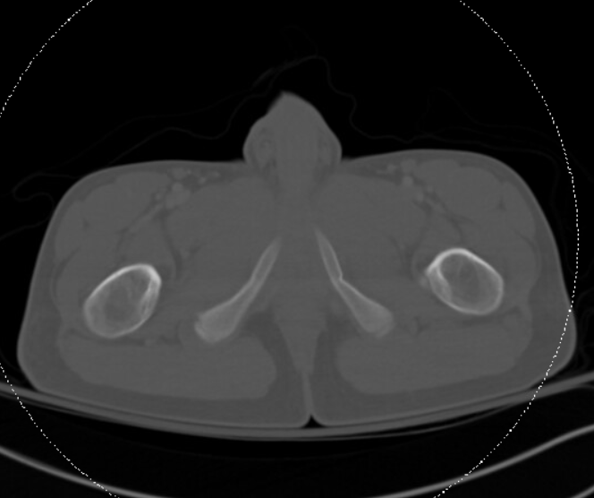
ED Abd w/ contrast CT 11/17/2020 – Axial
Buckle fracture of the L inferior pubic ramus

Slide 14
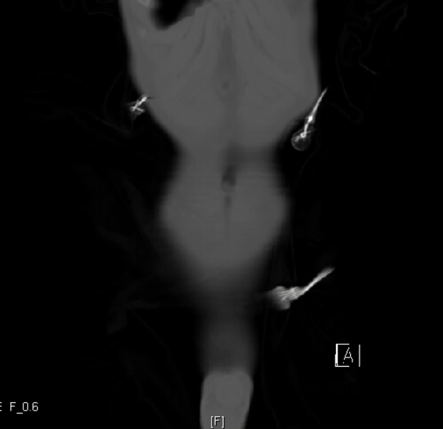
ED Abd w/ contrast CT 11/17/2020 – Coronal

Slide 15
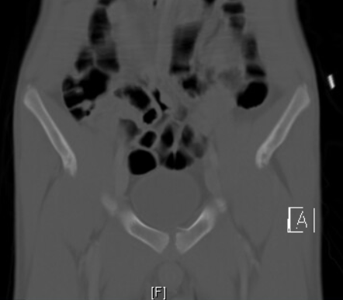
ED Abd w/ contrast CT 11/17/2020 – Coronal
Fracture at the superior aspect of the L pubic body

Slide 16
Summary of Findings
HDS 17 yo M in MVA w/ Anterior neck and chest bruising, subcutaneous emphysema in R chest on physical exam
CT chest showed pulmonary contusions, pneumothorax, hemothorax, and multiple rib fractures
CT abdomen/pelvis w/ contrast did not show any organ damage or hemorrhage; did show pelvic fractures

Slide 17
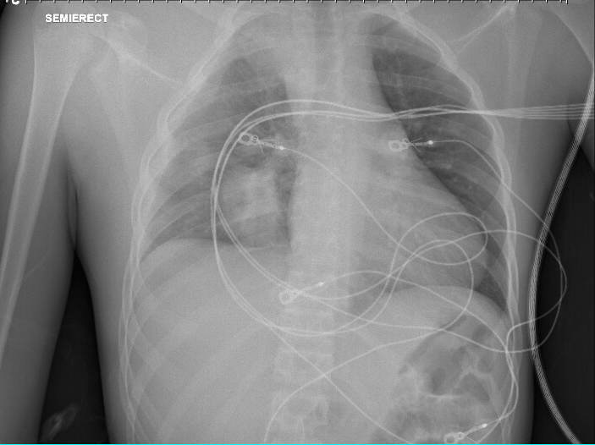
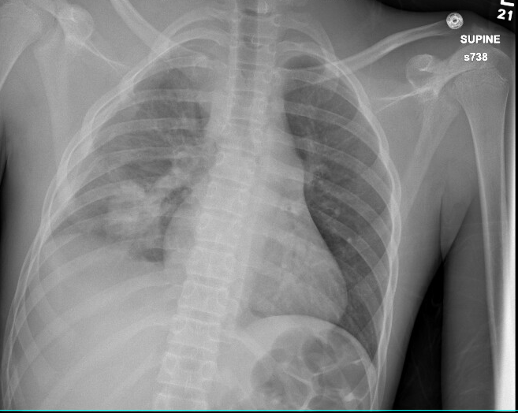
F/u imaging Chest X-ray AP
11/19/2020: R lower lung pulmonary contusion
  Stable small R hemothorax
  No change in alignment of R rib fractures
11/20/2020: enlarging R pulmonary contusion
  Small to moderate size R pneumothorax

Slide 18
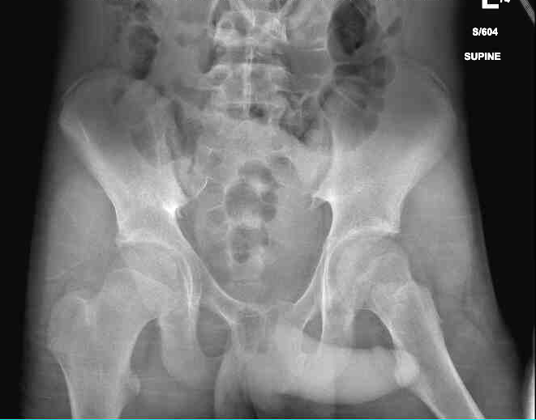
F/u imaging Pelvis X-ray AP 11/18/2020
unchanged appearance of fractures of the bilateral superior and inferior pubic rami and right sacral

Slide 19
Treatment
Pubic fractures: non-operative management; use of wheelchair
L Coracoid fx: sling
Pulmonary contusions/pneumothorax: supportive measures (inspiratory spirometry, volume expansion protocol)
Pain medication
PT/OT
10 day F/U orthopedic surgery; d/c institutional facility, jail

Slide 20
Final Diagnosis
Multiple R rib fractures w/ R hemopneumothorax and R pulmonary contusions and traumatic pneumotocele
Pelvic ring fractures
L coracoid process fracture

Slide 21
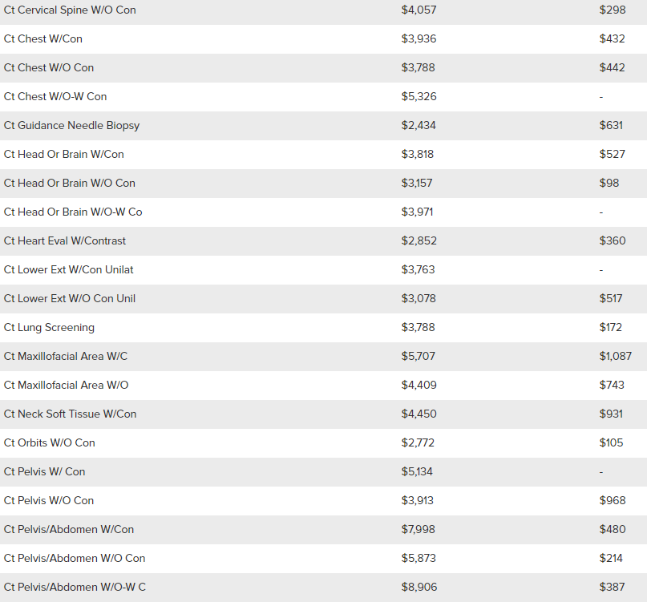
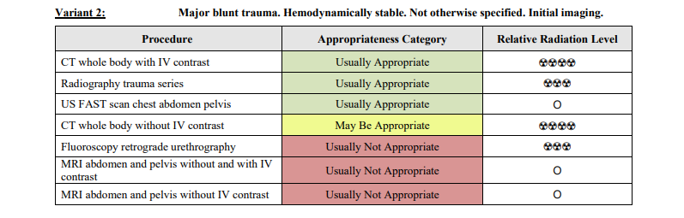
ACR appropriateness Criteria
CT chest w/ contrast = $3,936
CT pelvis/abd w/ contrast = $7,998
Total Cost = $11,934

Slide 22
Take Home Points / Teaching points
For HDS MVA patient should receive whole body CT w/ contrast
MVA patients are at risk for organ damage, hemorrhagic shock, and bone fractures
Multiple fractures can be expected so make sure not to miss subtle ones

Slide 23
References
https://www.uptodate.com/contents/initial-evaluation-and-management-of-blunt-abdominal-trauma-in-adults
https://radiopaedia.org/articles/pulmonary-contusion?lang=us
https://www.memorialhermann.org/patients-caregivers/pricing-estimates-and-information/

Slide 24

Questions?

