Slide 1
Malrotation
Keziah Thomas
01/05/2021
Pediatric Radiology and RAD 4003
Dr. Yang Qiao

Slide 2
Clinical History
Patient is a 6 week old (ex-33+4 weeker) female with left polycystic kidney disease, right aortic arch with aberrant subclavian, and type C long gap tracheoesophageal fistula s/p esophago-esophagostomy 11/11/20 and GJ tube presenting in inpatient with concern for malrotation
12/13 – KUB identified possible malrotation
  Patient asymptomatic: tolerating feeds, stooling
  Physical Exam:
    Abdomen – soft, non-tender, non-distended without palpable masses, no hepato-splenomegaly, GJ in place with no surrounding erythema or leakage
12/15 – Modified Barium Swallow Study (MBSS) + Upper GI (UGI)

Slide 3
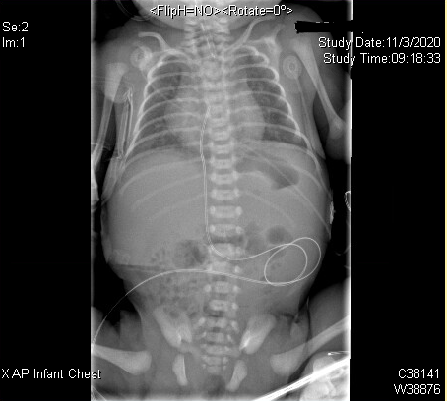
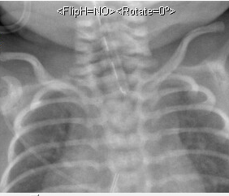
Type C Esophageal Atresia & Tracheoesophageal Fistula
Imaging Information
Type: Chest/ Abdomen Pediogram 1 View Dx
Date obtained: 11/03
Read: Findings of esophageal atresia with distal tracheoesophageal fistula
Replogle Tube
Notes:
The presence of air in the stomach and bowel in the setting of esophageal atresia implies that there is a distal fistula.

Slide 4
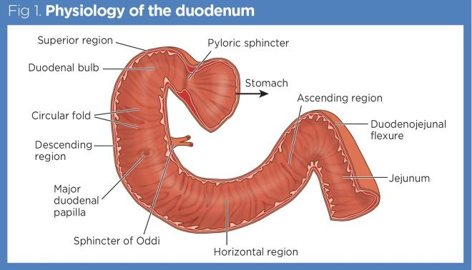
Duodenal Anatomy

Slide 5
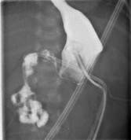
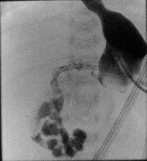
Upper GI
Imaging Information
Type: Upper GI
Date obtained: 12/15
Notes: Contrast injected through G-tube port
Read:
Normal emptying of the contrast into the duodenum.
Contrast coursed posteriorly, crosses midline and adjacent to bowel loops projecting over the right upper quadrant.
Complete retroperitoneal passage was not visualized.
Normal duodenojejunal junction within right upper quadrant at the level of the duodenal bulb was not visualized

Slide 6
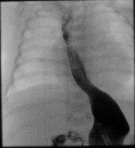
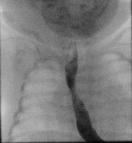
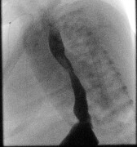
Upper GI
Imaging Information
Type: Upper GI
Date obtained: 11/15
Read:
Esophagus is normal in caliber
Severe esophageal reflux while supine

Slide 7
Highlight and summarize key imaging findings
Abnormal emptying of contrast into bowel loops projecting over the right upper quadrant consistent with malrotation
Severe esophageal reflux while supine up to the level of the proximal cervical spine
The key findings of malrotation is an abnormal duodenojejunal (DJ) junction location:
  DJ junction fails to cross the midline to the left of the left-sided vertebral body pedicle
  DJ junction lies inferior to the duodenal bulb

Slide 8
Differential Diagnosis
  Malrotation
  Duodenum inversum
  Duodenal atresia
  Pediatric gastroesophageal reflux
  Normal duodenum with surrounding abnormal architecture (Gastric distension, renal agenesis, etc)

Slide 9
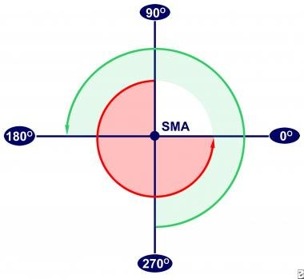
Discussion
Normal development:
  Between week 4 and 8: the primary intestinal loop comes out of the embryonic cavity to allow rapid expansion of GI tract.
  The axis of this loop is the developing superior mesenteric artery (SMA)
  Loop begins the normal rotation of the bowel by twisting 90 degrees counterclockwise
  Between week 8 and 10, the loop returns and an additional 180 degrees turn occurs for total of 270 degree counterclockwise turn
Intestinal malrotation: congenital anatomical anomaly that results from an abnormal rotation of the gut as it returns to the abdominal cavity during embryogenesis.
Associated with congenital diaphragmatic hernia, gastroschisis, esophageal atresia, VACTERL, etc

Slide 10
Intestinal Malrotation
Clinical presentation
  Bilious or nonbilious vomiting
  Hemodynamic instability (due to hypovolemia and/or septic shock)
  Abdominal distention
  Abdominal tenderness
  Peritonitis
  Failure to thrive
  Malabsorption

Slide 11
Treatment
Ladd procedure:
  widens the base of the mesentery
  places the bowel in a position of nonrotation
  creates adhesions which "hold" the intestines in place, making subsequent volvulus less likely
  Complications: short gut syndrome, small bowel obstruction
Asymptomatic malrotation: Evidence lacking on management
  Recommendation is elective Ladd procedure
Outcomes: Resolution of “symptoms” occurs in up to 89 percent of patients
Plan for patient: Ladd procedure prior to hospital discharge – pending adequate weight gain, currently on J tube feeds

Slide 12
Final Diagnosis
Intestinal Malrotation

Slide 13
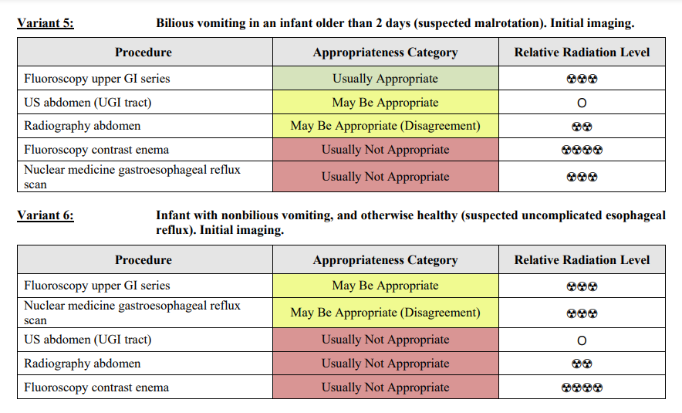
ACR appropriateness Criteria

Slide 14
Cost
Cost* for patient at Memorial Hermann
  Upper GI: $538.49 - $807.73
  MBSS: $192.89 - $289.33
  * Estimate does not include any physician or other professional costs
  https://onlinepatientestimation.com/PatientPortal/patient/selfservice

Slide 15
Take Home Points / Teaching points
Intestinal malrotation occurs when primary intestinal loop fails to rotate 270 degrees counterclockwise during development
First line imaging is upper GI – fail to visualize the DJ junction crossing midline
Treatment for symptomatic malrotation is Ladd procedure

Slide 16
References
https://radiopaedia.org/articles/intestinal-malrotation?lang=us
https://radiopaedia.org/articles/congenital-tracheo-oesophageal-fistula?lang=us
https://emedicine.medscape.com/article/930313-differential
https://www.uptodate.com/contents/intestinal-malrotation-in-children
https://acsearch.acr.org/docs/69445/Narrative/

Slide 17

Questions?

