Slide 1
Shoulder Dislocation with Bony Defects
Sahira Farooq
12/9/2020
RAD 4001 – Diagnostic Radiology
Jessica Pelz, MD

Slide 2
Clinical History
58 y/o M with hx of L rotator cuff injury and prior L shoulder dislocation who presented to ED with throbbing, non-radiating L shoulder pain after falling out of his bed and onto his shoulder.
ROS: (-) numbness/tingling, (+) L shoulder pain
PE of LUE: 2+ radial pulse. Normal capillary refill. Sensation intact. TTP of distal clavicle. Decreased passive ROM at shoulder. Visible deformity of shoulder.

Slide 3
Differential Diagnosis and Initial Imaging
DDx:
Clavicle fracture
Shoulder dislocation
Humeral fracture
AC joint separation
Initial Imaging
Xray Shoulder 2 Views
Xray Clavicle

Slide 4
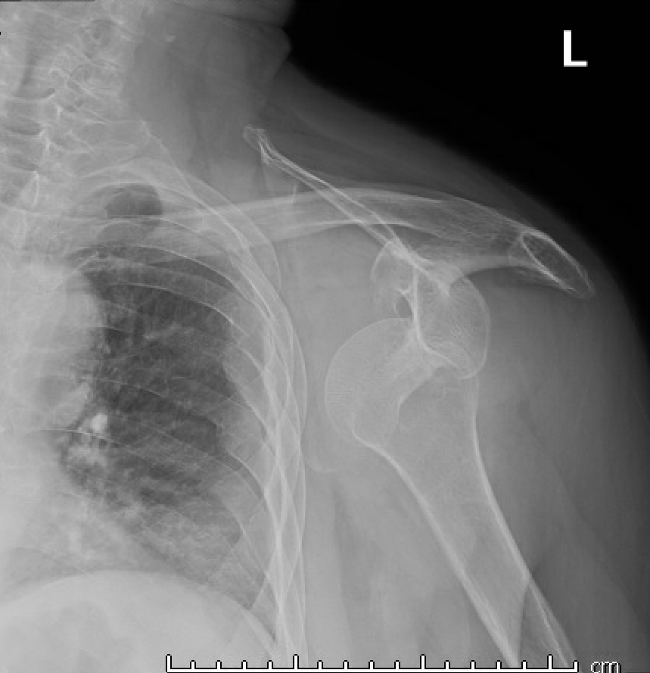
XR Shoulder AP View (12/3/2020)
Normal XR Shoulder AP View
clavicle
AC joint
head of humerus
glenoid fossa
anterior inferior glenoid rim
wikiradiography.net

Slide 5
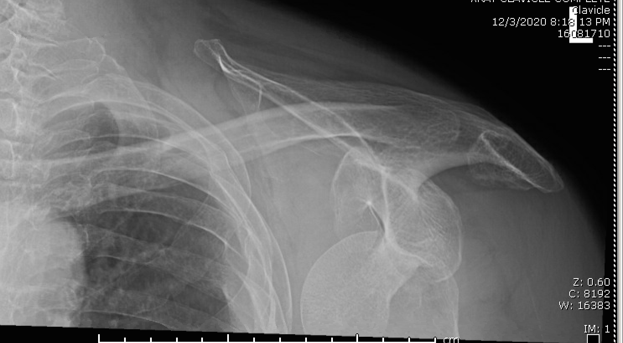
XR Clavicle (12/3/2020)
head of humerus
anterior inferior glenoid rim

Slide 6
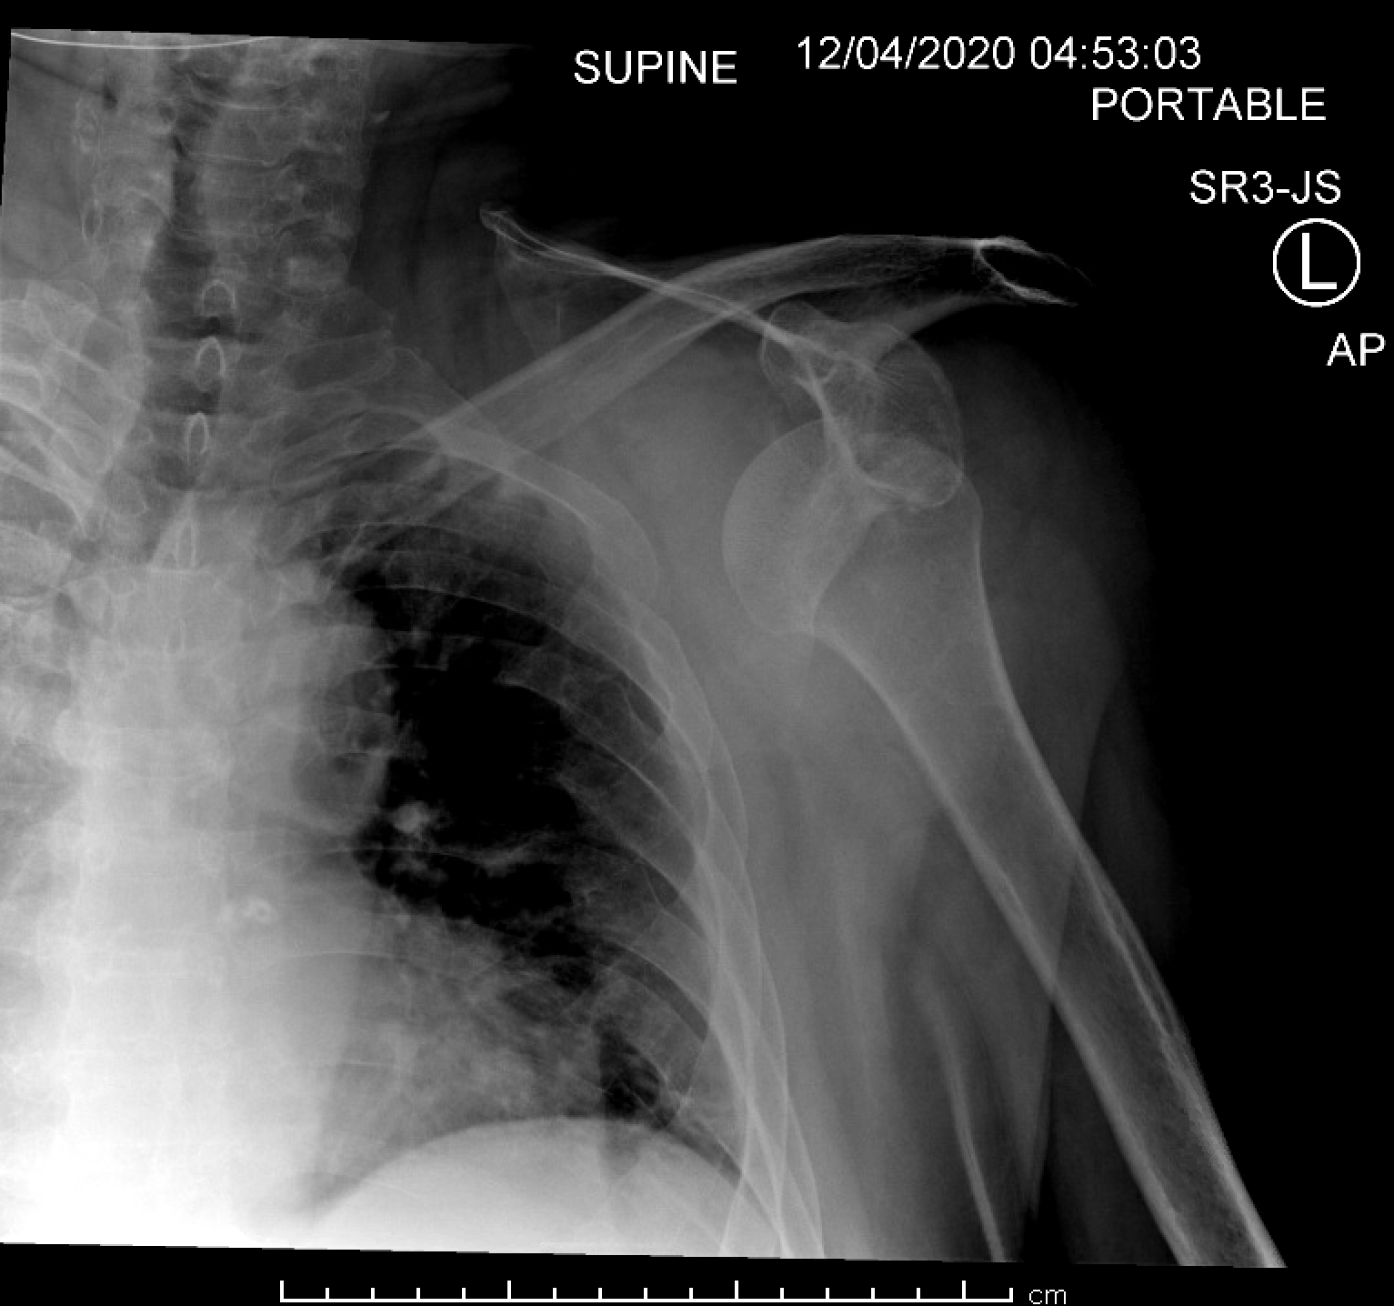
XR Shoulder AP View – Post-Reduction Attempt in ED (12/4/2020)
Normal XR Shoulder AP View
head of humerus
anterior inferior glenoid rim
Notes:
XR after attempting reduction. Persistent dislocation. Ortho consulted.

Slide 7
Patient’s XR Shoulder AP View – Post-Reduction by Ortho (12/4/2020)
head of humerus
anterior inferior glenoid rim

Slide 8
Key History and Imaging Findings
History:
hx of prior shoulder dislocation
Imaging:
anterior inferior glenohumeral dislocation
moderate-sized Hill-Sachs deformity and surrounding soft tissue swelling
probable minimally displaced fracture of anterior inferior glenoid rim

Slide 9
Differential Diagnoses to Consider
Hills Sachs Lesion: compression fracture of posterolateral humeral head. Can be observed in up to 90% of patients after first anterior shoulder dislocation. Occurs due to impact of the humeral head on glenoid rim.
Pseudo-Hill Sachs Lesion: normal flattening of posterolateral humeral head below the level of the coracoid. This patient’s defect is far too large to be considered normal.
Bony Bankart Lesion: fracture of anterior inferior glenoid, often follows anterior shoulder dislocation. May not be visible on plain radiograph but better seen on CT or MRI. In our patient, further imaging would help to confirm this suspicion.

Slide 10
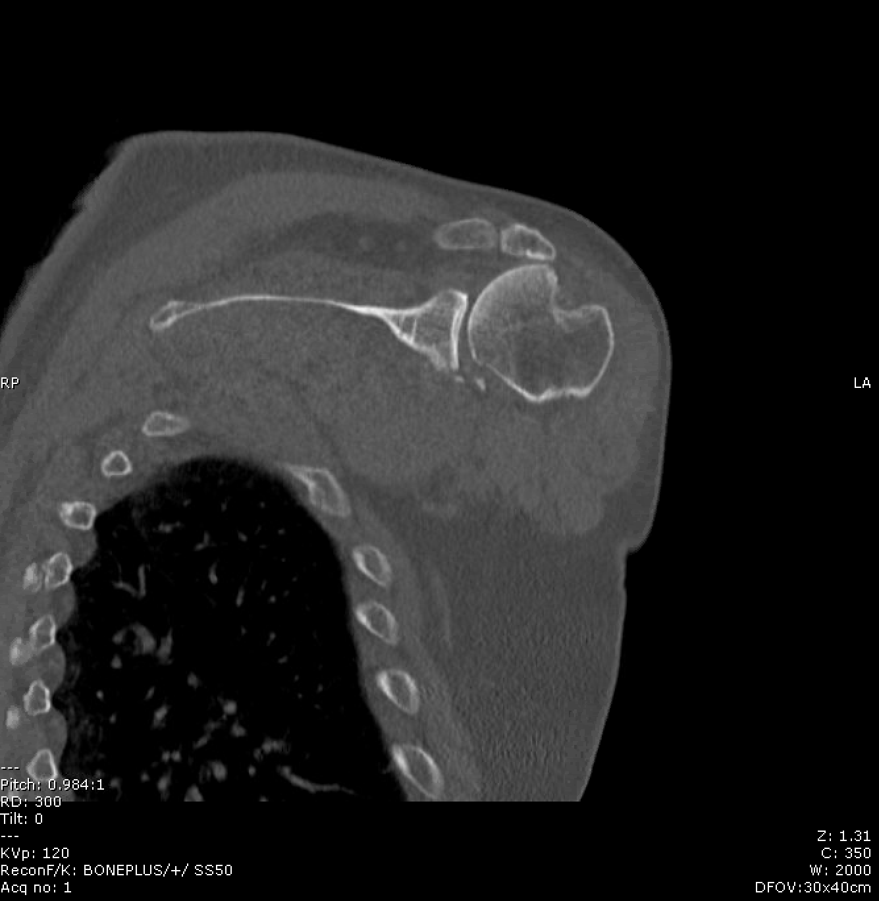
CT Shoulder W/O Contrast – Coronal (12/7/2020)
Multiple osseous fragments of anterior inferior glenoid
Large, wedge-shaped defect of superior lateral left humeral head
B
A:
A

Slide 11
Final Diagnosis
Anterior shoulder dislocation complicated by large Hill-Sachs defect and small bony Bankart lesion

Slide 12
Discussion

Slide 13
Continued Discussion
Types of Shoulder Dislocations
Anterior (up to 97%)
Mechanism: Blow to abducted, externally rotated and extended extremity
Associated injuries in up to 40% of anterior dislocations (e.g. nerve damage, fracture of glenoid or humerus, etc.)
Posterior (2-4%)
Mechanism: blow to anterior shoulder and axial loading of adducted, internally rotated arm. Violent muscle contractions (e.g. seizures, electrocution, etc.)
Higher risk of injuries (e.g. fracture of surgical neck or tuberosity, reverse Hill-Sachs, rotator cuff injury, etc.)
Inferior (<1%)
Mechanism: hyperabduction or axial loading on abducted arm
Often associated with injury (e.g. nerve damage, rotator cuff injury, internal capsule tears). Highest chance of axillary nerve and artery injury of all shoulder injuries.
Abrams R, Akbarnia H. Shoulder Dislocations Overview. [Updated 2020 Nov 1]. In: StatPearls [Internet]. Treasure Island (FL): StatPearls Publishing; 2020 Jan-. Available from: https://www.ncbi.nlm.nih.gov/books/NBK459125/

Slide 14
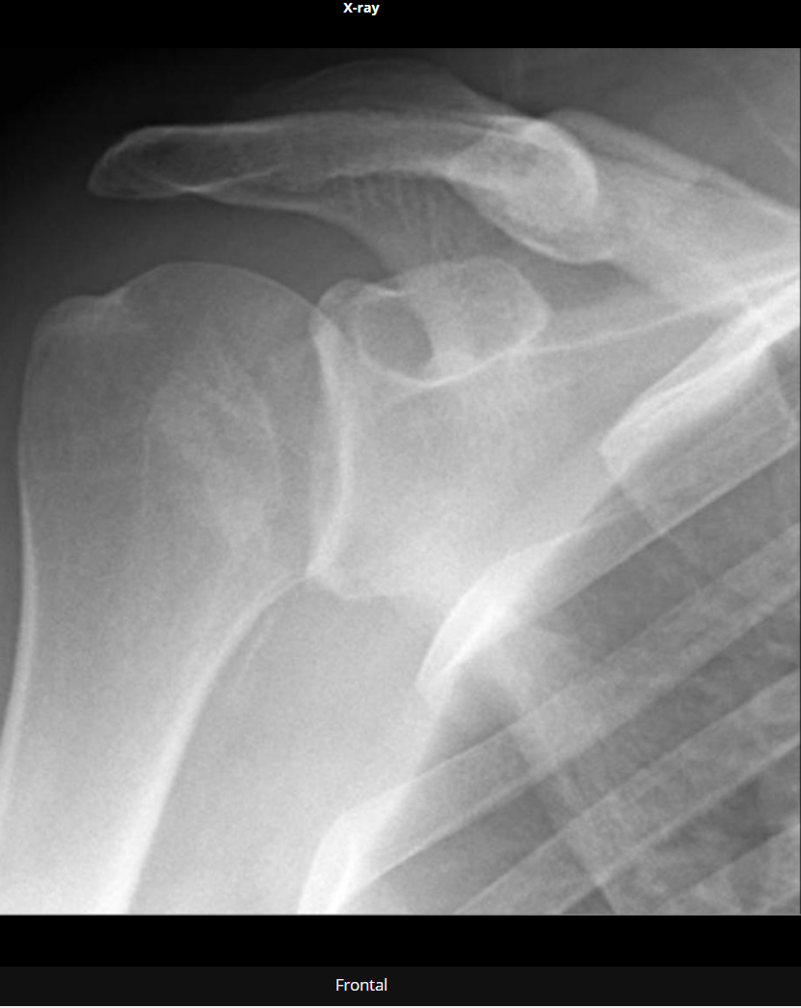
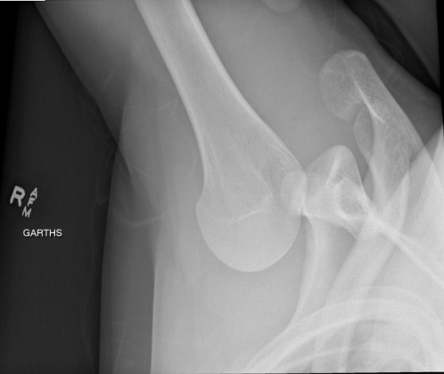
Posterior Dislocation
Inferior Dislocation
Inferior shoulder dislocation | Radiology Reference Article | Radiopaedia.org
Posterior shoulder dislocation | Radiology Reference Article | Radiopaedia.org

Slide 15
Continued Discussion
Hills Sachs and Bankart lesions are commonly associated with anterior shoulder dislocations. Result of humerus compressing against anterior inferior rim of the glenoid, so they often occur together.
Hill Sachs Lesion:
Observed in up to 90% of first-time anterior shoulder dislocations
Larger sizes observed with recurrent shoulder dislocations
Best appreciated on AP internal rotation view of the shoulder but small defects can be harder to identify. CT and MRI can show smaller defects.
Bankart Lesion:
“bony” vs “soft” (fracture of anterior inferior glenoid vs injury to labrum and glenohumeral capsule/ligament)
Easily missed on radiograph so CT is recommended whenever glenoid rim fracture is suspected.
Failure to recognize and correctly address → attrition of the fragment and increased instability recurrence rate

Slide 16
Management:
Assess for neurovascular injury, pain control, reduction of dislocation
Post-reduction films to evaluate for position and presence of fractures (such as Hill-Sachs)
Generally outpatient follow up with orthopedic surgery within 5-7 days and counsel to minimize activity that would result in abduction and external rotation.
For our patient, ortho had been consulted for reduction and remained onboard to evaluate for possible operative management of fractures. Decision for surgery currently pending.

Slide 17
Treatment of Hill Sachs and Bankart’s Lesions
These bony defects can lead to chronic instability.
For Bankart’s lesion, typically, bony glenoid reconstruction is considered when glenoid bone loss is 20-25%.
For Hill Sachs, the defect can be treated with bone grafting or placement of soft tissue within the defect, but this is generally reserved for large, engaging defects.

Slide 18
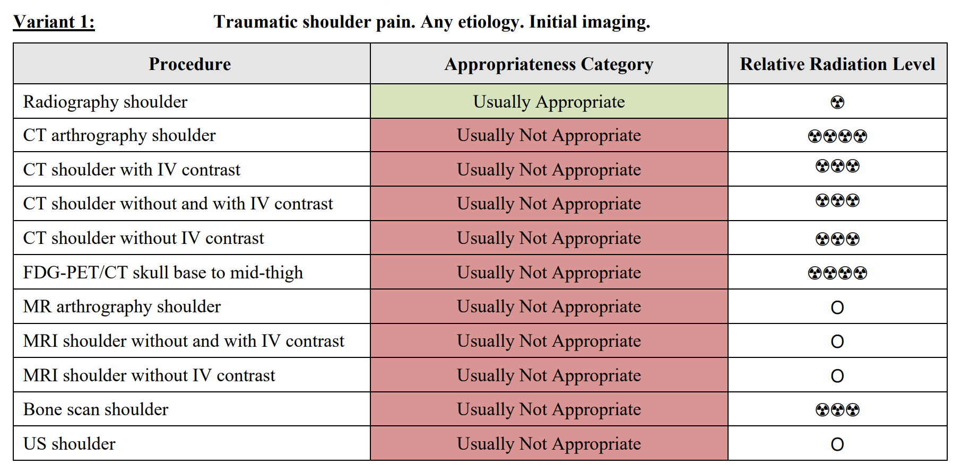
ACR appropriateness Criteria

Slide 19
ACR appropriateness Criteria
Notes:
CT Shoulder
Noncontrast CT has historically been used to assess Hill-Sachs and bony Bankart lesions. However, MRI has been shown to be equivalent to CT for assessing both glenoid and humeral head bone loss [12,18,53], and CT is limited in the assessment of cartilaginous Hill-Sachs lesions [11]. In addition, CT cannot assess injury to soft-tissue structures like the labroligamentous complex, which further limits its usefulness in evaluating Bankart lesions. CT should be reserved for patients with a contraindication to MRI or patients in whom MRI assessment of bone loss is limited

Slide 20
Cost of Imaging
XR Shoulder: $340
XR Clavicle: $269
CT Upper Extremity: $1888
Total (Self-Pay, Uninsured): $2,497
Source Link: Pricing Estimates and Information | Memorial Hermann

Slide 21
Take Home Points / Teaching points
Hill Sachs and Bankart lesions are common findings associated with shoulder dislocations
These lesions often occur together and if you identify one of the two, imaging should be carefully evaluated to seek out the other.
Both lesions can present as nonosseous lesions that are occult on radiographs. CT or MRI can help identify smaller defects and can confirm presence of bony defects.

Slide 22
References
Etoh T, Yamamoto N, Shinagawa K, Hatta T, Itoi E. Mechanism and patterns of bone loss in patients with anterior shoulder dislocation. J Shoulder Elbow Surg. 2020;29(10):1974-1980. doi:10.1016/j.jse.2020.03.022
Provencher MT, Midtgaard KS, Owens BD, Tokish JM. Diagnosis and Management of Traumatic Anterior Shoulder Instability [published online ahead of print, 2020 Dec 3]. J Am Acad Orthop Surg. 2020;10.5435/JAAOS-D-20-00202. doi:10.5435/JAAOS-D-20-00202
Abrams R, Akbarnia H. Shoulder Dislocations Overview. [Updated 2020 Nov 1]. In: StatPearls [Internet]. Treasure Island (FL): StatPearls Publishing; 2020 Jan-. Available from: https://www.ncbi.nlm.nih.gov/books/NBK459125/
https://www.memorialhermann.org/patients-caregivers/pricing-estimates-and-information/
https://radiopaedia.org

Slide 23
Questions?

