Slide 1
Tibial Avulsion Fractures
Nick Merutka
12/9/2020
Emergency Radiology RAD 4013
Ronald Bilow, MD

Slide 2
Clinical History of Patient 1
20 y/o M presenting as lvl1 trauma s/p high speed MVC
  Single car MVC at speeds of 100mph with death of passenger
  Pt complains of L knee pain and decreased ROM
  On exam, LLE is otherwise neurovascularly intact with no obvious deformities, there is moderate effusion, + anterior drawer sign, tender to palpation along medial joint line. Compartments are soft and compressible

Slide 3
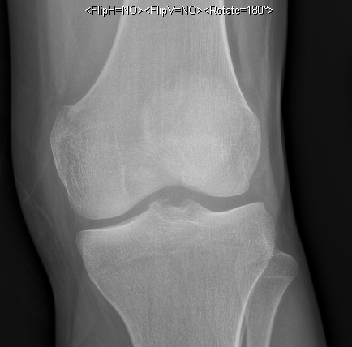
Frontal Plain Films of Patient 1
Patella
Medial condyle of Femur
Lateral condyle of femur
Intercondylar eminence
Medial condyle of Tibia
Lateral condyle of Tibia
Notes:
Rads read: avulsion fracture of anteromedial tibial intercondylar eminence and hemarthrosis, concerning for ACL injury

Slide 4
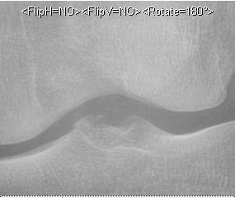
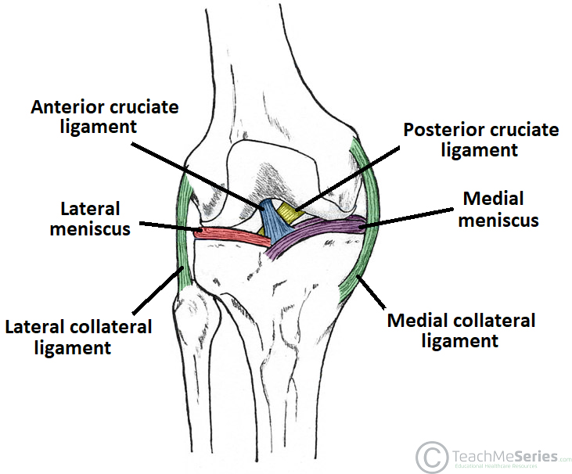
Zoomed frontal plain films for Patient 1
Displacement of anteromedial tibial intercondylar eminence
Notes:
https://teachmeanatomy.info/lower-limb/joints/knee-joint/
ACL runs from the posteromedial portion of lateral condyle of femur to attach to the anterior intercondylar eminence of tibia

Slide 5
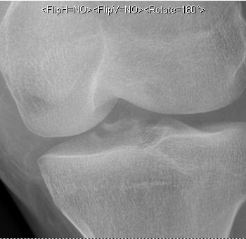
Zoomed oblique plain films for Patient 1
Displacement of anteromedial tibial intercondylar eminence
Notes:
https://teachmeanatomy.info/lower-limb/joints/knee-joint/
ACL runs from the posteromedial portion of lateral condyle of femur to attach to the anterior intercondylar eminence of tibia

Slide 6
Key Imaging Findings
Cruciate ligament avulsions are often identified on radiographs as a small osseous fragment located adjacent to the expected attachment site of the ligament
ACL Avulsion Injury
  Bone fragments in intercondylar notch with cortical irregularity of adjacent tibial eminence suggesting a donor site for the fragment are usual findings on plain radiographs
  CT improves visibility, can provide information regarding size, extent, shape, and degree of discontinuity
  MRI useful to assess for associated injuries

Slide 7
Key Imaging Findings
Displacement of anteromedial tibial intercondylar eminence
Displacement of anteromedial tibial intercondylar eminence

Slide 8
ACL Anatomy
Primary function is to resist anterior tibial translation and rotation
Runs from posterior aspect of inner surface of lateral femoral condyle, runs anteromedially to attach to the anterior intercondylar eminence of tibia

Slide 9
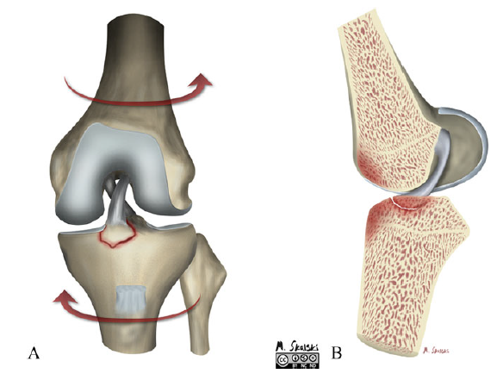
Pathophysiology of ACL Avulsion Fractures
In adults –forced hyperextension
  High incidence of concomitant ligamentous injury such as MCL and PCL

Slide 10
Pathophysiology of ACL Avulsion Fractures
In children – Forced flexion with internal rotation of tibia
  Less commonly associated with concomitant injury

Slide 11
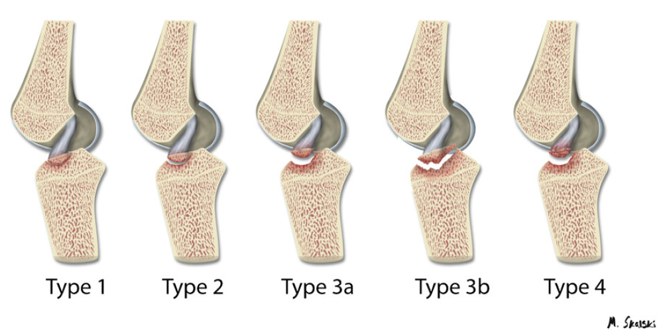
Meyers and McKeever Classification
Notes:
Type I injury is a minimally displaced fragment.
Type II injury involves anterior elevation of the fracture fragment.
Type III and IV injuries demonstrate complete separation of the fragment from the tibia.
Type IV injury includes a rotational component or comminution of the fragment.
The type IIIb fracture extends beyond the confines of the ACL insertion area

Slide 12
Treatment based on Classification
Type 1 – conservative management with cast at 20-degree knee flexion
  Pt 1 was discharged on hospital day 2 with a knee immobilizer and physical therapy
Type 2 – Controversial
  Conservative vs hemarthrosis aspiration and closed reduction
Types 3 and 4 – Internal fixation of displaced fragment via arthroscopy

Slide 13
Clinical History of Patient 2
64 y/o M presenting as lvl1 trauma s/p MVC
  Pt presents altered and history is unable to be obtained
  On exam, LLE is neurovascularly intact with obvious posterolateral dislocation of the L knee, there is a 3cm laceration to superior aspect of L knee with no gross contamination. + Posterior drawer. Compartments are soft and compressible

Slide 14
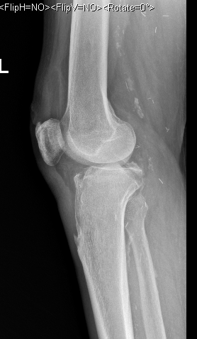
Lateral Plain Films of Patient 2
Severe atherosclerotic disease of arteries and surgical clips from hx of arterial bypass
Medial condyle of Femur
Patella
Tibial Tuberosity
Notes:
Rad Read: displaced bone fragment originating from posterior tibial plateau felt to be avulsion fracture secondary to PCL injury

Slide 15
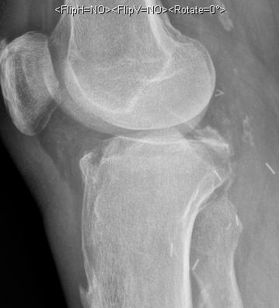
Zoomed Lateral plain films for Patient 2
Displaced bone fragment originating from posterior tibial plateau
Notes:
https://teachmeanatomy.info/lower-limb/joints/knee-joint/
PCL runs from anterolateral portion of medial femoral condyle to the posterior intercondylar area of tibia

Slide 16
Key Imaging Findings
Cruciate ligament avulsions are often identified on radiographs as a small osseous fragment located adjacent to the expected attachment site of the ligament
PCL Avulsion Injury
  On plain radiograph, appears as focal discontinuity of posterior aspect of the tibia, best appreciated on lateral view
  CT provides additional information about size and comminution of fracture fragment
  MRI can further assess for concomitant injury

Slide 17
Key Imaging Findings
Displaced bone fragment originating from posterior tibial plateau

Slide 18
PCL Anatomy
Primary function is to resist posterior tibial translation
Strongest ligament of the knee joint
Arises from lateral surface of medial femoral condyle, travels posterolateral to attach to the posterior intercondylar area of tibia

Slide 19
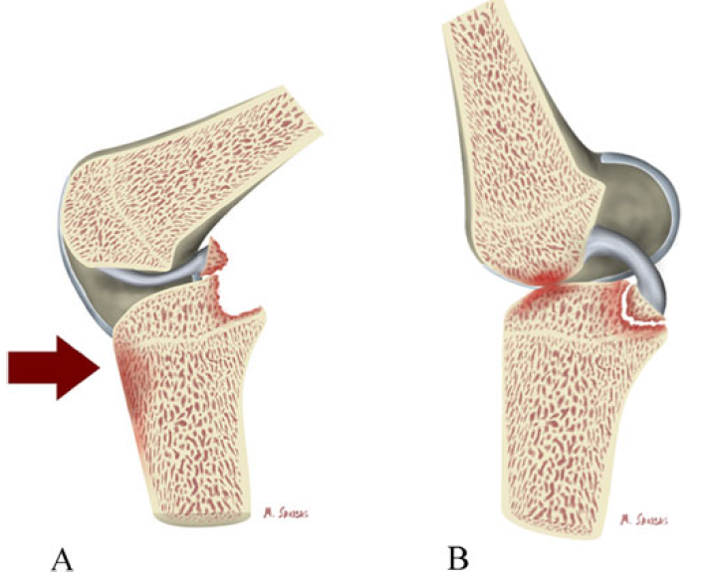
Pathophysiology of PCL Avulsion Fractures
Posteriorly directed force to tibia while knee is flexed
  Common in MVC’s

Slide 20
Pathophysiology of PCL Avulsion Fractures
Forced hyperextension
  Often occurs in athletic trauma

Slide 21
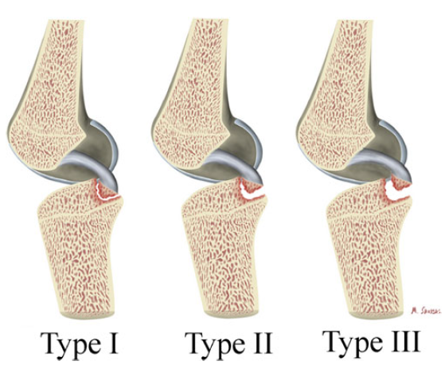
Classification
Notes:
Type I fractures are undisplaced.
Type II fractures are “hinged” with superior displacement of only the posterior aspect of the avulsed fragment.
Type III fractures are completely displaced

Slide 22
Treatment based on Classification
Type 1 – conservative management with immobilization at 15 degrees of flexion
Type 2 – Controversial
  Conservative vs Internal Fixation
Types 3 – Internal fixation of displaced fragment via arthroscopy
  Pt 2 was taken to the OR for an external fixation and 4 compartment fasciotomy

Slide 23
Final Diagnosis
Patient 1 – Type 1 ACL Avulsion Fracture
  Type 1 involves a minimally displaced fragment
  Conservative management with knee immobilization at 20 degrees of flexion
Patient 2 – Type 3 PCL Avulsion Fracture
  Type 3 involves a completely displaced fragment
  Surgical fixation warranted

Slide 24
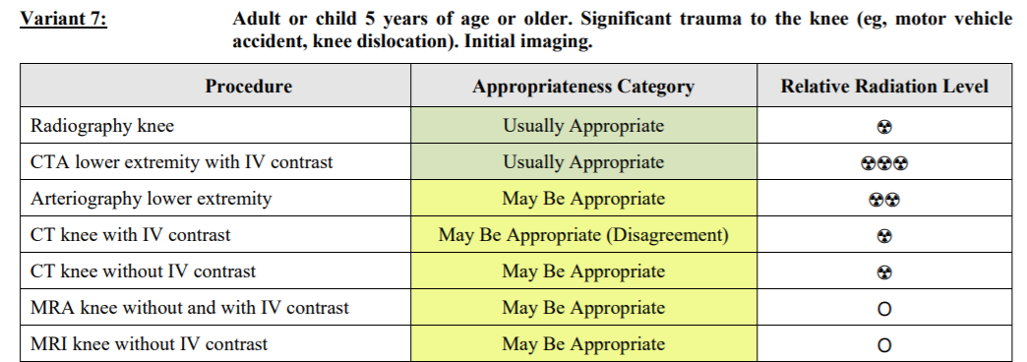
ACR appropriateness Criteria

Slide 25
ACR appropriateness Criteria
  Patient 1
    Knee Series x2 = $1,540
    Ankle Series x1 = $640
    Tib Fib Series x1 = $863
    MRI Knee x1 = $7,029
    CT Knee x1 = $3,078
    Total = $13,150
  Patient 2
    Knee Series x2 = $1,540
    Ankle Series x1 = $640
    Tib Fib Series x2 = $1,726
    Femur Series x1 = $651
    MRI Knee x1 = $7,029
    CTA Knee x1 $6,325
    Total = $17,911
All prices for imaging sourced from Memorial Hermann Chargemaster

Slide 26
Take Home Points / Teaching points
Tibial avulsion fractures can be hard to diagnose due to their relatively benign appearance, however, severe underlying damage to major stabilizing structures of the joint can be present even with such benign appearance
Analyze intercondylar eminence for deformities that can indicate an ACL avulsion fracture
Look at lateral knee radiographs for evidence of discontinuity that can indicate PCL avulsion fracture

Slide 27
References
White, E. A., Patel, D. B., Matcuk, G. R., Forrester, D. M., Lundquist, R. B., Hatch, G. F., . . . Gottsegen, C. J. (2013). Cruciate ligament avulsion fractures: Anatomy, biomechanics, injury patterns, and approach to management. Emergency Radiology, 20(5), 429-440. doi:10.1007/s10140-013-1121-0
https://teachmeanatomy.info/lower-limb/joints/knee-joint/
Memorial Hermann Chargemaster

Slide 28

Questions?

