Slide 1
Traumatic Pneumothorax
Stephen Palasi
1/4/2021
RAD 4001
Dr. Manickam Kumaravel and Dr. Pritish Bawa

Slide 2
Clinical History
CC: “My ribs hurt”
HPI: 48 y/o F s/p MVC, restrained front seat passenger. Has 10/10 constant rib pain, achy in quality, does not radiate
PMH/PSH: Unremarkable
PE: R chest tenderness
VS: Temp 98.5, HR 109, BP 122/82, RR 18, SpO2 99%
Glucose 190, lactic acid 7.9, WBC 19.5k
Positive for cannabis, BAC 0.053

Slide 3
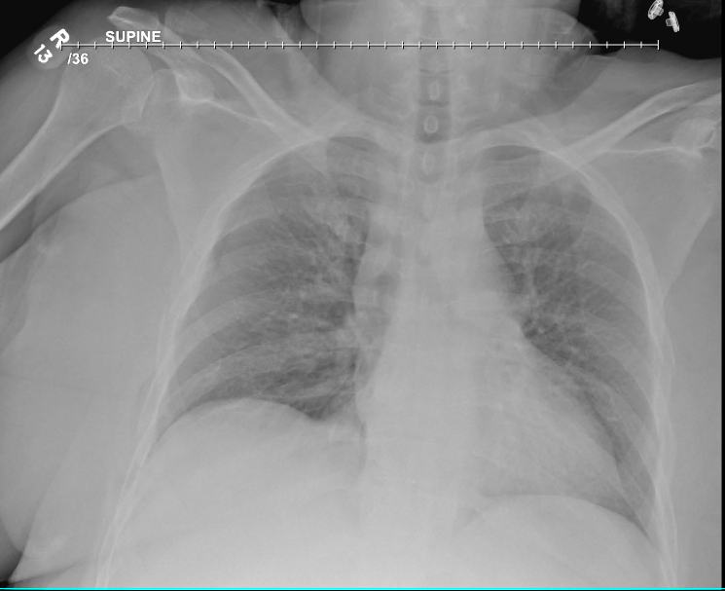
CXR on 12/28/20
Notes:
R hemidiaphragm elevated
Absent pulm markings on R side, mild-moderate R sided pneumothorax
Sharp costophrenic sulci, no mediastinal deviation
Minimally displaced fractures of lateral R 2-5th ribs and left 5-6th ribs
R distal clavicle fracture, superior displacement
Deep sulcus sign??

Slide 4
CXR on 12/28/20
Notes:
Keep in mind, a supine CXR can be misleading b/c air will spread out over anterior chest, might be deceivingly difficult to see
R diaphragm elevated
Absent pulm markings on R side, mild-moderate R sided pneumothorax
Sharp costophrenic sulci, no mediastinal deviation
Minimally displaced fractures of lateral R 2-5th ribs and left 5-6th ribs
R distal clavicle fracture, superior displacement
Note no real “deep sulcus sign” here

Slide 5
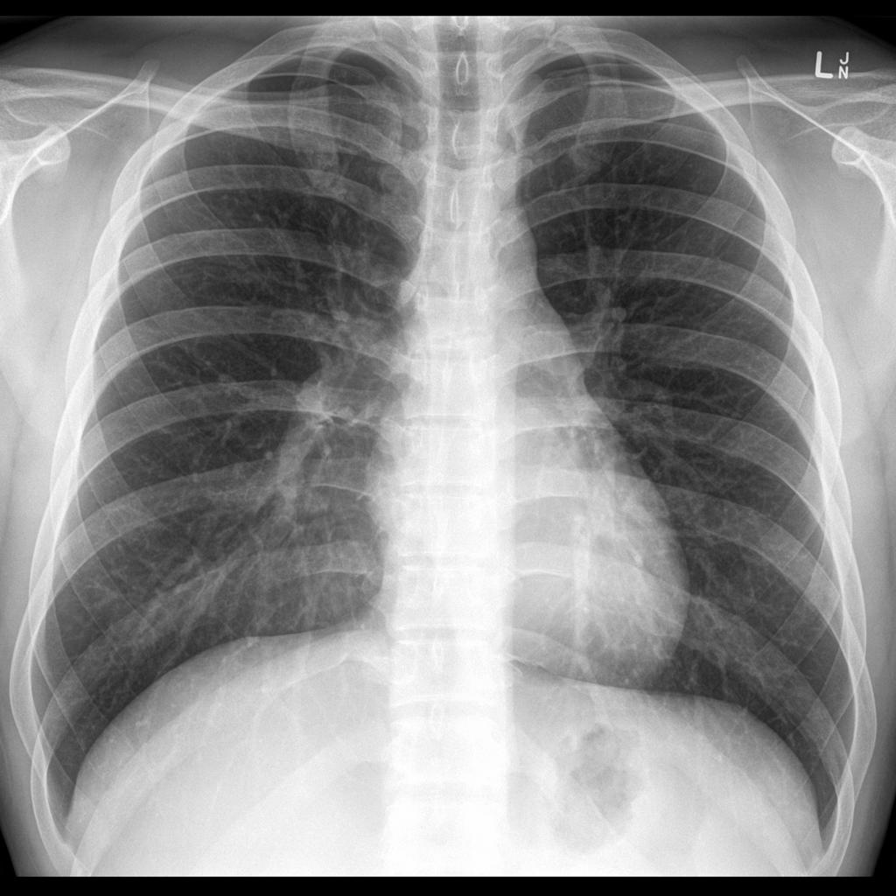
Normal CXR
CXR on 12/28/20
https://radiopaedia.org/cases/normal-frontal-chest-x-ray?lang=us

Slide 6
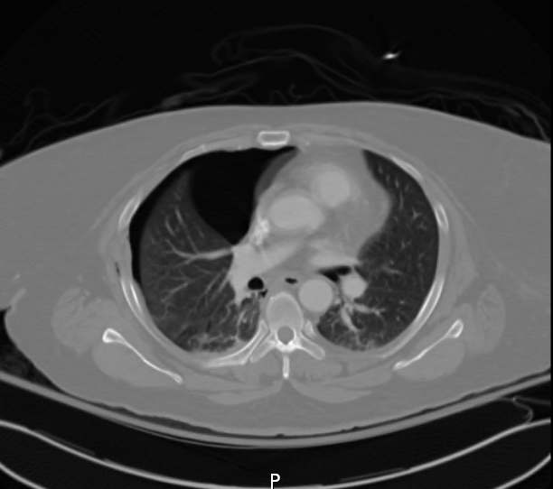
Axial Chest CT on 12/28/20
Notes:
-Large R pneumothorax seen more clearly now
-Pt also had a T8 burst fraction w/ minimal retropulsion of fragments approx. 2 mm, also prominent anterior & central vertebral height loss and paraspinal hematoma
-Had nondisplaced fx R lateral ribs 2-3 and L lateral ribs 5-8
-Subcutaneous emphysema within R lateral thoracic soft tissue next to rib fractures

Slide 7
Key imaging findings
Visceral pleural line with absent distal pulmonary markings on R side
Ipsilateral hemidiaphragm elevation
No mediastinal shift
Nondisplaced R lateral rib fractures
R sided simple pneumothorax (PTX) 2/2 trauma from MVC
https://radiopaedia.org/articles/pneumothorax?lang=us
Notes:
Technically traumatic “primary” – primary b/c no hx lung disease/smoking

Slide 8
Differential Diagnosis - Pneumothorax
Tension pneumothorax
Giant bullous emphysema/Pulmonary bullae
Acute bronchial obstruction
Skinfold artifact, breast margin, medial scapula border, etc. (CXR)
Notes:
-Tension pneumo – contralat mediastinal shift and hemidiaphragm depression (vs simple pneumothorax here)
-Bullous emphysema – damaged alveoli forming large air pockets esp in young male smoker, more than 1/3rd of apical lung, Marfan/Ehler Danlos/A1AT, contralat mediastinal shift
-Endobronchial obstruction 2/2 mucus plug, foreign body, tumor

Slide 9
Traumatic PTX - Discussion
Pathophysiology:
  Penetrating trauma -> air enters pleural space, OR
  Non-penetrating trauma -> rib fracture -> visceral pleura laceration -> air enters pleural space
Key early findings include chest pain, dyspnea, tachypnea, tachycardia, hyperresonance of chest wall, diminished breath sounds (ipsilateral side)
Required workup/management: Serial CXRs, CT scan (gold standard for occult traumatic PTX), 100% O2 therapy, tube thoracostomy
https://www.ncbi.nlm.nih.gov/pmc/articles/PMC2700561/
Notes:
Air can come from either chest wall or tracheobronchial tree
Sudden chest compression increases alv pressure leading to rupture, which then ruptures either visceral or mediastinal pleura
Worsening signs: hypotension, AMS, contralateral tracheal deviation, JV distention, cyanosis/O2 desaturation
1st gen cephalosporin for tube thoracostomy
Would do needle thoracostomy if it was a tension pneumo

Slide 10
Continued discussion
Prognostic factors
Classification by size
  BTS: “small” PTX is <2 cm between lung margin and chest wall¹
  Clinical picture more influential to management
Interesting facts
  15.6% of rib fractures result in PTX²
  Aerothorax is a synonym (no longer used)
¹https://thorax.bmj.com/content/65/Suppl_2/ii18
²https://pubmed.ncbi.nlm.nih.gov/27025223/
Notes:
BTS (British Thoracic Society) classifies

Slide 11
Treatment
Percutaneous pigtail chest drainage tube placed
100% O2
Serial CXRs
Further trauma evaluation
Mortality rate of patients with chest trauma & PTX: 38.1%³
This patient’s PTX resolved after chest tube placement
³https://pubmed.ncbi.nlm.nih.gov/2296073/
Notes:
BTS (British thoracic society) guidelines differentiate small from large PTX by 2 cm
38% deaths not necessarily due to PTX itself, can be due to other injuries

Slide 12
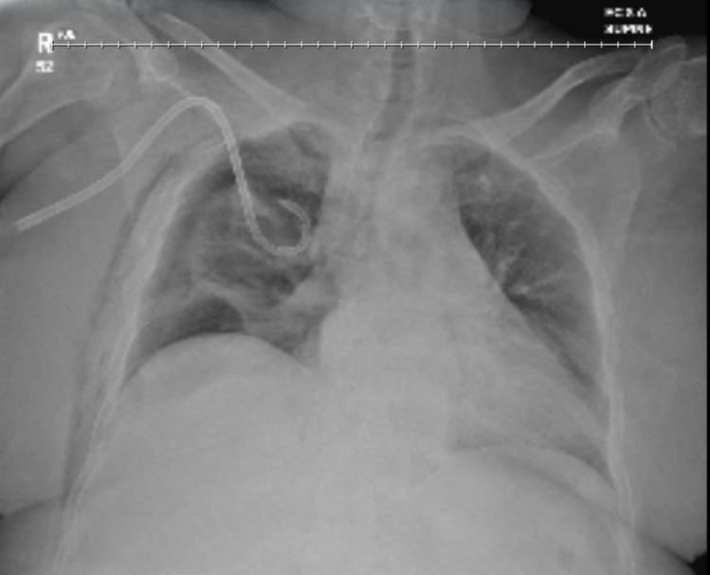
CXR 12/28/20
CXR 12/29/20
Notes:
Initial interval worsening (increased collapse of R lung) – note that R pigtail tube was slightly retract – this was repositioned
Some sub-q emphysema on R lateral chest wall likely as a result of the trauma
No effusion, no contralat mediastinal deviation

Slide 13
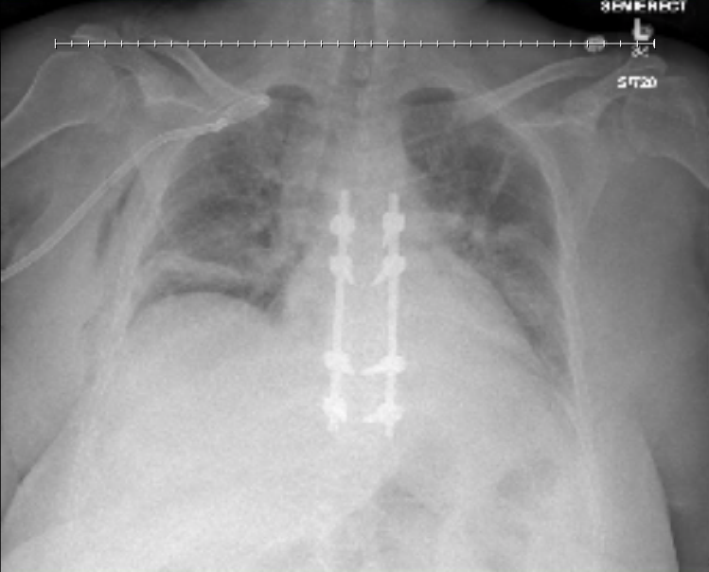
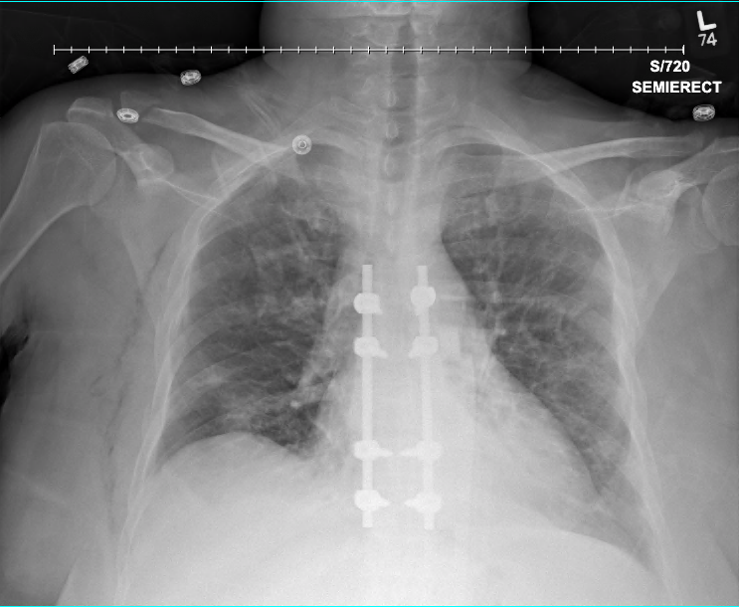
CXR 12/31/20
CXR 1/1/21
Notes:
Pigtail catheter over R apex -> trace R PTX
Pt had T6-T10 laminectomy w/ Thoracolumbosacral orthosis (TLSO) brace placement
Stable mediastinum
Next day better lung expansion, chest tube removed, still clav fx managed separately, small apical PTX, stable

Slide 14
Final Diagnosis
Large right apical traumatic pneumothorax
Pigtail chest tube placed 12/28/2020
Tube removed on 1/1/2021, minimal stable apical PTX
Discharged 1/2/2021

Slide 15
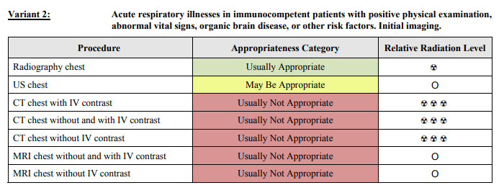
ACR appropriateness Criteria
https://acsearch.acr.org/docs/69446/Narrative/
Notes:
The case was in accordance w/ ACR criteria

Slide 16
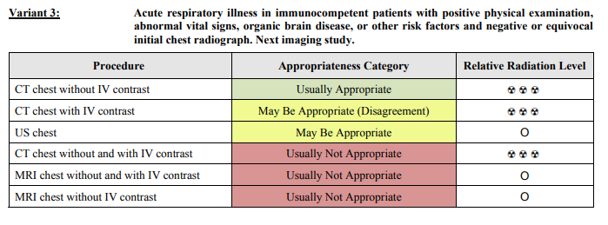
ACR appropriateness Criteria
https://acsearch.acr.org/docs/69446/Narrative/
Notes:
IV contrast b/c patient had an MVC with other problems: T8 burst fraction, paraspinal hematoma, r/o possible abdo bleed

Slide 17
Cost of imaging
No insurance
Imaging for PTX only
  7 CXRs (2 were for tube placement): ~$325 each
  CT chest: ~$1550
  $3825 total
Additional imaging:
  7 shoulder X-rays, 2 CT brain no contrast, 1 spine no contrast, MRI spine, CTAP
  $16245 total
Cost calculations: Memorial Hermann price estimation tool https://onlinepatientestimation.com/PatientPortal/patient/selfservice
Notes:
Had to assume no insurance for calculator to work
Shoulder xray: $235
CT head: $1500
CT spine: $1500
MRI spine: $7000
CTAP: $3100
With insurance probably about $100 for xray, $200-600 for CT, MRI

Slide 18
Take Home Points / Teaching points
PTX can be diagnosed on initial imaging with supine CXR
CT chest is gold standard for occult traumatic PTX
Manage with ABCs, 100% O2, tube thoracostomy, careful monitoring, serial CXRs
Notes:
Needle thoracostomy for tension pneumo
Monitor for worsening/tension pneumo

Slide 19
References
https://radiopaedia.org/cases/normal-frontal-chest-x-ray?lang=us
https://radiopaedia.org/articles/pneumothorax?lang=us
https://www.ncbi.nlm.nih.gov/pmc/articles/PMC2700561/
https://thorax.bmj.com/content/65/Suppl_2/ii18
https://pubmed.ncbi.nlm.nih.gov/27025223/
https://pubmed.ncbi.nlm.nih.gov/2296073/
https://acsearch.acr.org/docs/69446/Narrative/
https://onlinepatientestimation.com/PatientPortal/patient/selfservice

Slide 20

Questions?

