Slide 1
Traumatic Splenic Laceration
Kyle Lauck
12/09/2020
RAD 4013
Dr. Ronald Bilow

Slide 2
Initial H&P 11/26/2020
75 yo M with a PMH significant for CAD (on Plavix/ASA), HTN, HLD, and OSA.
2 days status post fall from a 17 foot ladder. Became hypotensive in the ED. Responded to 2 units of pRBC’s. Transferred to MHH for higher level of care.
Physical exam:
VS: BP 171/77 mmHg. Hemodynamically stable.
HEENT: Tender overlying bilateral mandibular angles with periorbital ecchymosis and swelling.
Abdomen: Soft, non-tender, non-distended, no palpable masses.
MSK: Full ROM of BUE and BLE.
Neuro: A&Ox3. GCS 15. Tender overlying lower C-spine and L-spine slightly left of midline.
No other pertinent positives outside of lacerations closed before transfer.
Pertinent labs: CBC WNL.

Slide 3
CT Chest/Abdomen/Pelvis 11/24 at Outside Hospital
Rectus Abdominis
External Oblique
Internal Oblique
Transversus Abdominis
Hypodense expansion with central contrast extravasation
Right Kidney
Psoas
Left Kidney
Vertebral Body
Transverse Process
Displacement of lateral component of the process

Slide 4
CT Chest/Abdomen/Pelvis 11/24 at Outside Hospital
Stomach
Liver
Aorta
Spleen
Pleural Calcifications

Slide 5
CT Chest/Abdomen/Pelvis 11/24 at Outside Hospital
Absent Lung Markings
Right Middle Lobe
Pericardial Fat
Left Upper Lobe
Aorta

Slide 6
CT Chest/Abdomen/Pelvis 11/24 at Outside Hospital
Stomach
Hyperdensity
Liver
Spleen
Aorta

Slide 7
Differential Diagnosis
Splenic Laceration
Subcapsular Hematoma
Intraparenchymal Hematoma
Pseudoaneurysm or AV fistula
Splenic Infarct
Grade?

Slide 8
Key imaging findings and Diagnosis
Previously healthy patient no history of splenic pathology prior to patient
New finding: Small amount of perisplenic fluid, with a focal area of increased density at the anterior aspect of the spleen consistent with active contrast extravasation.
This combined with history of trauma, Plavix, as well as other foci of hemorrhage present on imaging:
Consistent with Diagnosis: Grade 4 Splenic Laceration

Slide 9
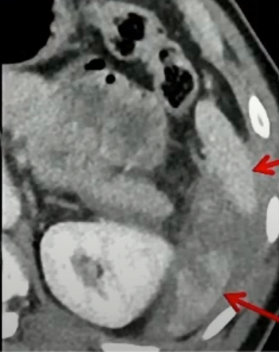
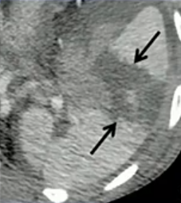
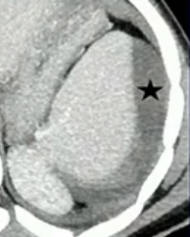
Splenic Trauma
splenic parenchyma should be assessed in portal venous phase as the inhomogeneous splenic enhancement (aka zebra or psychedelic spleen) seen on arterial phase can mimic splenic laceration/contusion.
Lacerations: appear as irregular linear or branching hypodensities (geographic pattern)
Intraparenchymal hematoma: Broader areas of hypoattenuation compared to lacerations
Subcapsular hematoma: Occur with bleeding between capsule and parenchyma, resulting in mass effect on parenchyma
Images from: https://www.youtube.com/watch?v=d4f_RFVUs14&t=584s

Slide 10
Splenic Trauma
Non-bleeding vascular injury
Active Hemorrhage
Arterial
Expands in Portal Veinous Phase
Portal Veinous
Instead of increasing in size, washing out becoming isodense to normal parenchyma
https://www.youtube.com/watch?v=d4f_RFVUs14&t=584s
https://www.youtube.com/watch?v=d4f_RFVUs14&t=584s

Slide 11
AAST Guidelines
Key Caveats:
Pseudoaneurysm or AV fistula - appears as a focal collection of vascular contrast which decreases in attenuation on delayed images
Active bleeding - focal or diffuse collection of vascular contrast which increases in size or attenuation on a delayed phase
Advance one grade for multiple injuries up to grade III
https://radiopaedia.org/articles/aast-spleen-injury-scale?lang=us

Slide 12
Further Discussion and Treatment
Spleen and liver are the most commonly injured intra-abdominal organs following blunt trauma. In up to 60 percent of patients, the spleen is the only organ injured.
Although the presence of rib fractures increases the likelihood of splenic injury, there is no association between the number of ribs fractured and splenic injury severity.
Splenic injury can be initially managed with observation, angiographic embolization, or surgery depending upon the hemodynamic status of the patient, grade of splenic injury, and presence of other injuries and medical comorbidities
Follow-up imaging — There is debate in the literature and among clinicians regarding the utility of follow-up imaging. Generally a follow-up study is performed in patients whose clinical situation indicates the need (eg, falling hemoglobin, increasing abdominal pain, left shoulder pain, fever).

Slide 13
Further Discussion and Treatment
Failure of observation — Patients who fail observation require either splenic embolization, or operative management. Patients may fail observational management either as an inpatient or, more rarely, as an outpatient presenting with "delayed splenic rupture."
Study of 383 patients from 11 trauma centers ascertained the long-term risk of splenectomy after an initial 24 hours of nonoperative management. Only one patient, among 366 patients discharged with a spleen, ruptured on postinjury day 12.
Likely that "delayed rupture" more accurately describes those patients with splenic parenchymal pseudoaneurysms, the walls of which degrade during the normal process of clot dissolution with bleeding in a delayed fashion.
In one review, delayed pseudoaneurysm or arterial extravasation was detected in 6 percent of patients and distributed among all injury grades.

Slide 14
Final Diagnosis and Treatment
Grade 4 Splenic Laceration.
Trauma also caused T8, T9, L2, L3, and L4 left transverse process fractures. Left rib fractures 3-9. Left small pneumothorax. Left flank hematoma. Facial fractures. Basal skull fractures. Subarachnoid hemorrhage.
Observed for splenic injury while being managed by neurosurgery and oral maxillofacial surgery.
Underwent operative reconstruction of face without complication.
Currently inpatient with plans to D/C within a few days.

Slide 15
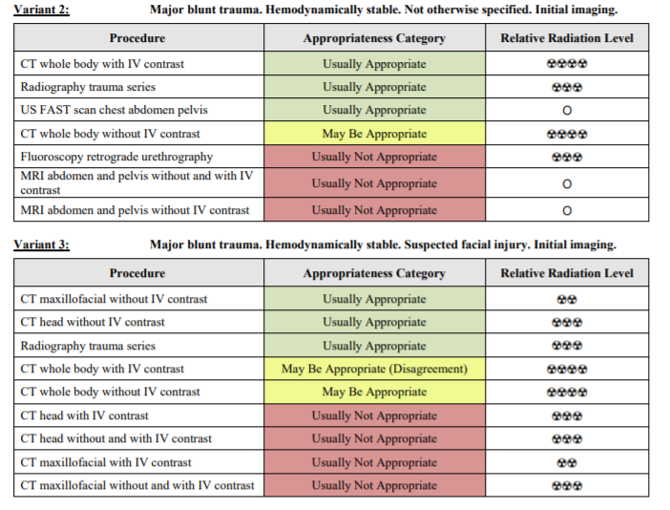
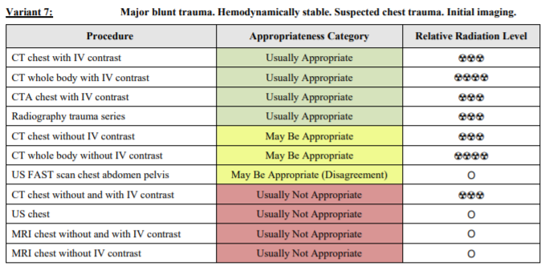
ACR appropriateness Criteria
Imaging obtained at OSH:
CT Chest/Abdomen/Pelvis (11/24)
Chest AP Radiograph (11/24)
Pelvic AP Radiograph (11/24)
CT Face WO Contrast (11/24)
CT Spine WO Contrast (11/24)
CT Head WO Contrast (11/24)

Slide 16
Total Cost of Imaging (based on MHH)
CT Chest W contrast: $3788
CT Abdomen/Pelvis W contrast: $7998
CXR 1V: $683
Pelvis XR 1V: $719
CT Maxillofacial Area W contrast: $5707
CT Cervical Spine W/O contrast: $4057
Ct Head Or Brain W/O contrast: $3157
Total: $26109
https://www.memorialhermann.org/patients-caregivers/pricing-estimates-and-information

Slide 17
Take Home Points
Uniform CT protocols: Important to image in late arterial and early portal venous phase
Also worthwhile to pursue uniform injection protocol to emphasize seeing the pathology in a similar way
Management may include observation, embolization, and/or operative but AAST grade is one component of determining management
Other factors like stability and comorbidities play a role

Slide 18
References
https://acsearch.acr.org/docs/3102405/Narrative/
https://radiopaedia.org/articles/aast-spleen-injury-scale?lang=us
https://radiopaedia.org/articles/splenic-trauma?lang=us
https://www.youtube.com/watch?v=d4f_RFVUs14&t=584s
https://www.uptodate.com/contents/management-of-splenic-injury-in-the-adult-trauma-patient?search=splenic%20injury&source=search_result&selectedTitle=1~99&usage_type=default&display_rank=1
https://www.memorialhermann.org/patients-caregivers/pricing-estimates-and-information

Slide 19
Questions?

