Slide 1
Ankle Pain
Angie Aceves
Diagnostic Radiology
Corresponding faculty member name

Slide 2
Clinical History
73 year old female presents to the emergency department with right ankle pain. She has history of a ground level fall two weeks ago that was placed in a splint at outside hospital but did not have follow up. She presented today because she bumped her ankle and had significant pain.
  On physical exam patient is unable to bear weight on right ankle. RLE has mild edema. Bruising over the anterior aspect of the tibia and bilateral malleoli with tenderness to palpation. RLE is neurovascularly intact, DP pulse 2+ and normal capillary refills.
  Patient denies pain elsewhere. Normal vital signs, no other pertinent physical findings.
  No other significant PMH

Slide 3
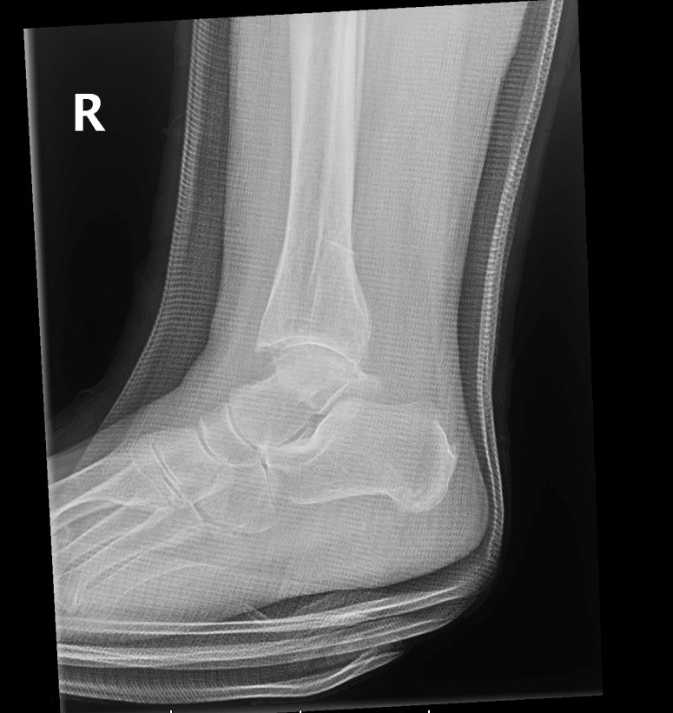
Lateral Ankle View Normal vs Abnormal
Navicular
Tibiofibular
Cuneiform
Calcaneus
The distal tibiofibular syndesmosis is widened

Slide 4
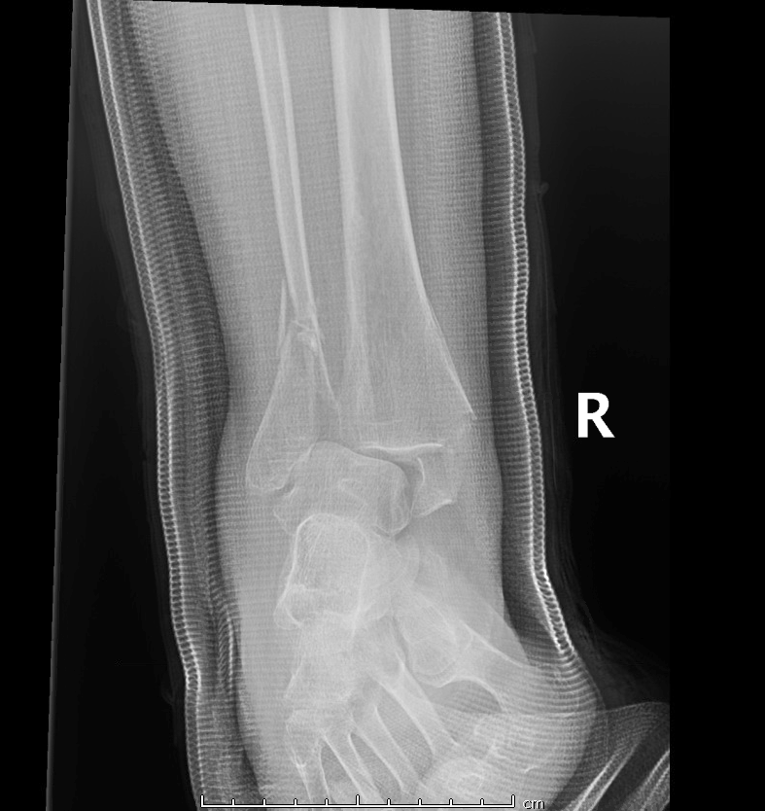
AP Ankle view Normal vs Abnormal
Fibula
Tibia
Medial Malleolus
Talus
Medial tilt of the talus, which is laterally subluxed relative to the distal tibia.

Slide 5
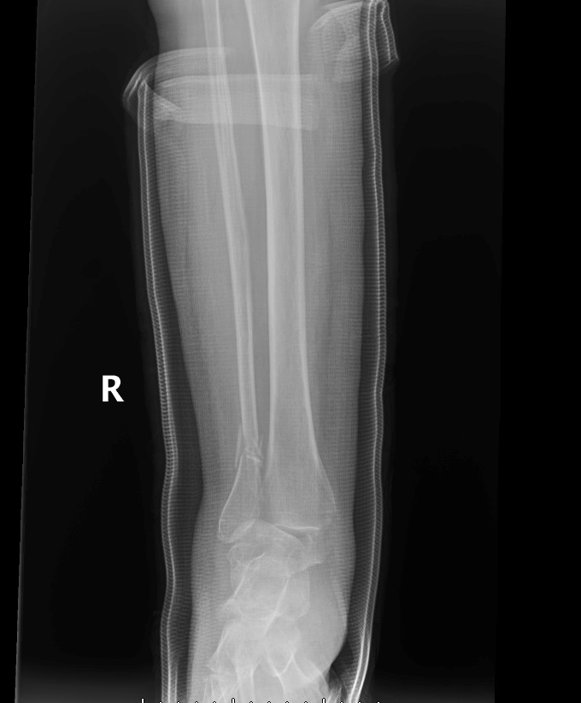
Tib Fib AP Lateral Normal vs Abnormal
Fibula
Shaft of Tibia
Shaft of Fibula
Medial Malleolus
Lateral Malleolus
Centre for distal tibia
- Comminuted fracture of the distal fibular shaft, extending into the level of the distal tibial fibular syndesmosis
Mildly comminuted and displaced transverse medial malleolus fracture
Medial tilt of the talus, which is laterally subluxed relative to the distal tibia

Slide 6
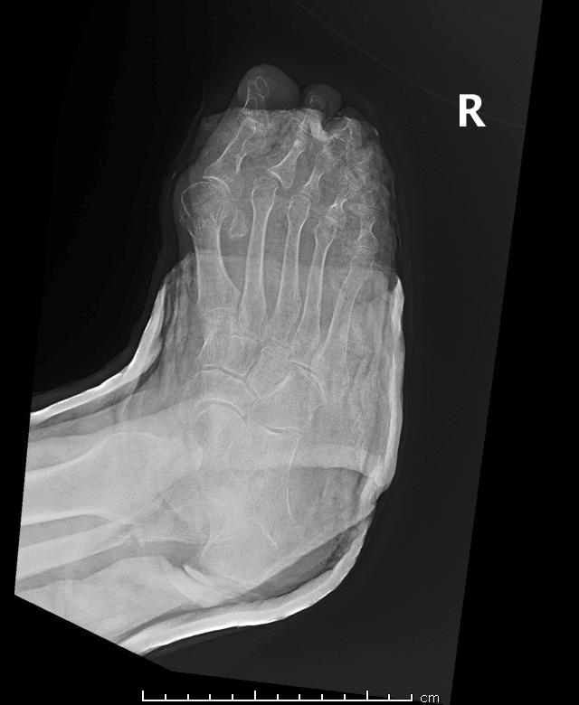
AP Foot radiographs Normal vs abnormal
1st
Metatarsal
Shaft
Base
Medial Cuneiform
Impression: Diffuse osteopenia. Cast overlies bony and soft tissue
detail. No acute fracture or malalignment of the foot is identified.
Redemonstrated comminuted fracture of the distal fibular diaphysis.

Slide 7
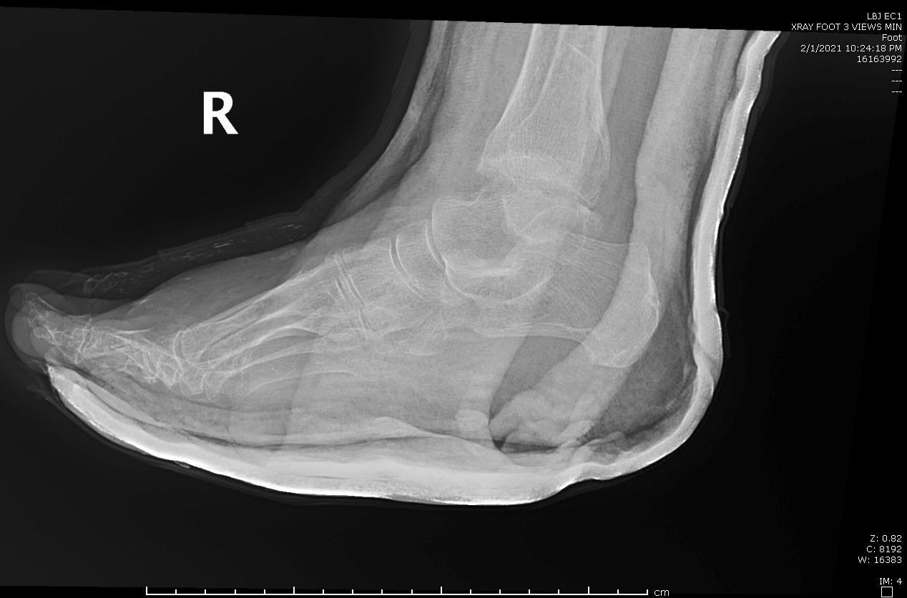
Lateral Foot Radiograph
Talus
Tibiotalar Joint

Slide 8
Key Findings
- Comminuted fracture of the distal fibular shaft, extending into the level of the distal tibial fibular syndesmosis
Mildly comminuted and displaced transverse medial malleolus fracture
Medial tilt of the talus, which is laterally subluxed relative to the distal tibia
Medial tilt of the talus, which is laterally subluxed relative to the distal tibia.

Slide 9
Discussion
The radiographs showed a medial malleolus fracture with minimal displacement with the tibiotalar joint appearing almost congruent
Distal fibular oblique comminuted fracture shows better alignment than the one cortical width offset
Based on imaging patients requires open reduction, internal versus external fixation for right ankle

Slide 10
Treatment Options
Short leg walking cast vs cast boot
  if intact mortise, no talar shift, and < 3mm displacement
ORIF
  if talar shift or > 3 mm of displacement
Total contact casting
  elderly or unable to undergo surgical intervention

Slide 11
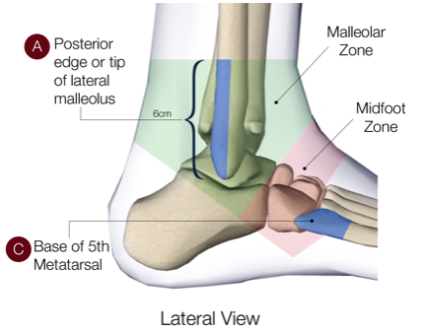
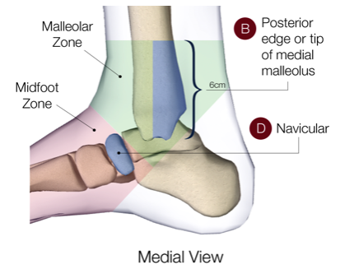
The Ottawa Ankle Rules
Discuss whether case was in accordance to the ACR appropriateness guidelines
  Can include a screenshot of the table with the modality completed highlighted
Discuss the cost of the imaging throughout the entirety of the case
Must include url or reference to the cost calculations
An ankle X-Ray series is only required if there is any pain in the malleolar zone and...
  Bone tenderness at the posterior edge or tip of the lateral malleolus (A)
      OR
  Bone tenderness at the posterior edge or tip of the medial malleolus (B)
      OR
  An inability to bear weight both immediately and in the emergency department for four steps

Slide 12
The Ottawa Ankle Rules
A foot X-Ray series is only required if there is any pain the midfoot zone and…
  Bone tenderness at the base of the fifth metatarsal (C)
    OR
  Bone tenderness at the navicular (D)
    OR
  And inability to bear weight both immediately and in the emergency department for four steps

Slide 13
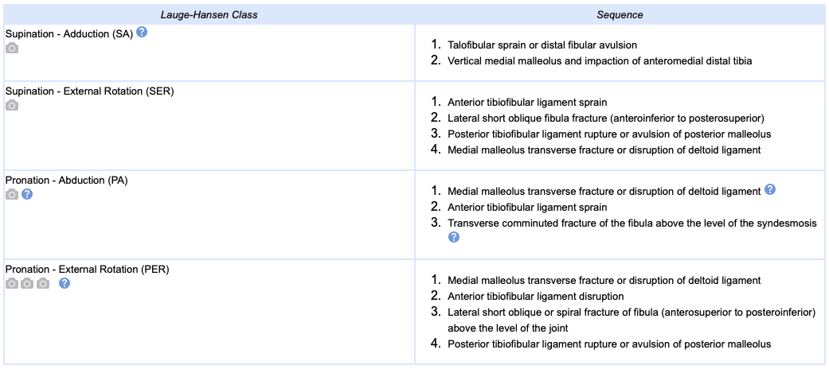
Lauge-Hanse

Slide 14
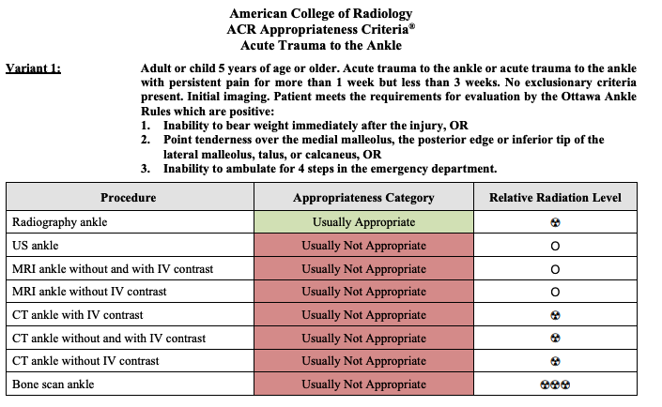
ACR appropriateness Criteria

Slide 15
Take Home Points / Teaching points
The Ottawa Ankle Rules allow for a clinical decision rule to determine the need for diagnostic imaging for ankle and/or foot trauma
Lauge-Hansen has been shown to predict the observed (via MRI) ligamentous injury in less than 50% of operatively treated fractures
Clinical judgement should prevail over the rules if the patient is intoxicated or uncooperative, has other distracting painful injuries, has diminished sensation in their legs, has gross swelling which prevents palpation of the malleolar bone tenderness

Slide 16
References
https://acsearch.acr.org/docs/69436/Narrative/
https://www.orthobullets.com/trauma/1047/ankle-fractures
http://www.theottawarules.ca/ankle_rules
http://www.pedxray.com/modules/images/images.php?id=10&image=347&langue=en&menu=34&sousmenu=188

Slide 17

Questions?

