Slide 1
Appendiceal rupture with abscess formation
Alexandra (Bili) Yin
1/31/2021
RADS 4001

Slide 2
Clinical History
38 yo male with no PMH/PSH presents with a 3 day history of RUQ pain and associated nausea
Acute onset, 10/10 severity at first, now 7/10, sharp non-radiating, nausea worse w/ PO intake
POCUS in ED (-) gallstones, non-contributory
Physical Exam: Abdomen soft, bowel sounds diminished, ttp in RUQ/RLQ, non-distended, (-) rebound/guarding
Vitals: wnl (afebrile)
Labs: WBC 13.0, Hgb 13.1, total bilirubin 0.7*
*Interestingly, mild elevations in serum bilirubin (total bilirubin >1.0 mg/dL) have been noted to be a marker for appendiceal perforation with a sensitivity of 70% and a specificity of 86%
Notes:
-increased acute phase reactants→ decreased bili destruction, increased toxin in portal venous system leading to hepatic damage
Diagnostic value of hyperbilirubinemia as a predictive factor for appendiceal perforation in acute appendicitis.AUSand M, Bechara FG, Holland-Letz T, Sand D, Mehnert G, Mann B SOAm J Surg. 2009;198(2):193. Epub 2009 Mar 23.

Slide 3
Differential Diagnosis
Cholelithiasis
Appendicitis
Diverticulitis (cecal, Meckel’s)
Bowel obstruction/ileus
Ileitis/Colitis (Yersenia commonly affects terminal ileum)
IBD (Crohn’s)
Gynocologic/obstetric complications (though our pt is male)
Renal colic
Testicular torsion/epididymitis

Slide 4
Relevant Imaging
Include relevant imaging with description of the modality, date acquired, labeled arrows of normal and abnormal anatomy
Optional: Side by side comparison of multiple images
Showing progression or imaging changes over time
Comparison with normal anatomy
(please include copy URL for each image obtain through online sources)

Slide 5
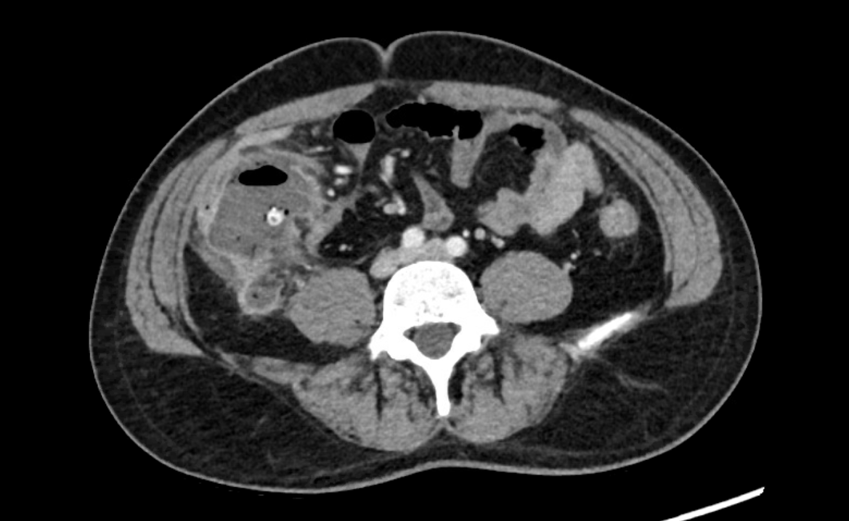
CT Abdomen/Pelvis with Contrast
12/9/2020
Rectus abdominus muscle
cecum
Small bowel
Descending colon
appendicolith
Common iliac veins
Common iliac arteries
Psoas muscle
Notes:
Axial slice

Slide 6
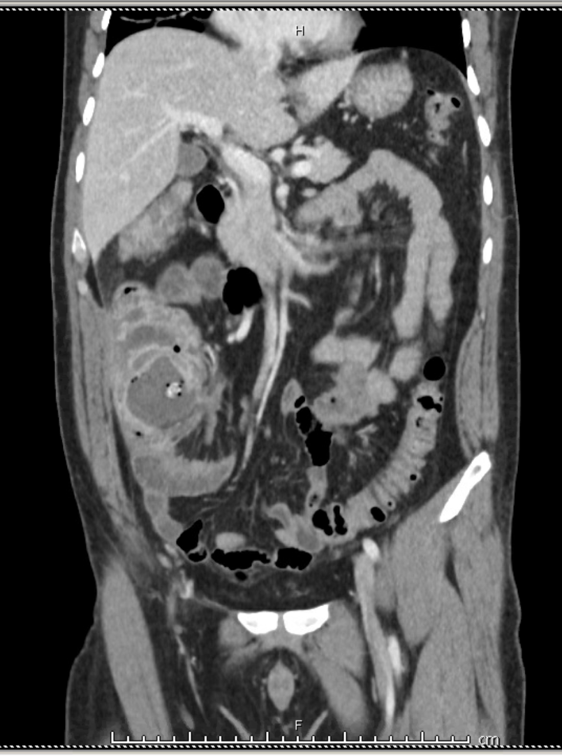
fat stranding
appendicolith
Well-defined fibrous capsule
ring enhancement/inflammation
Notes:
Coronal slice, RUQ/RLQ pain
-Central necrotic core of abscess (relatively low attenuation)
-Well defined fibrous capsule—peripheral neutrophils with fibrous capsule with dilated blood vessels and proliferation of fibroblasts
-mass effect on ileocecal valve

Slide 7
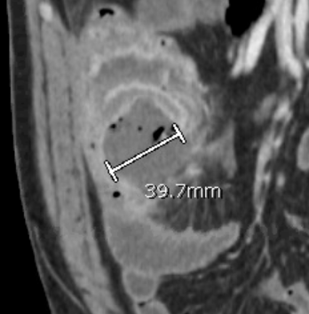

Slide 8
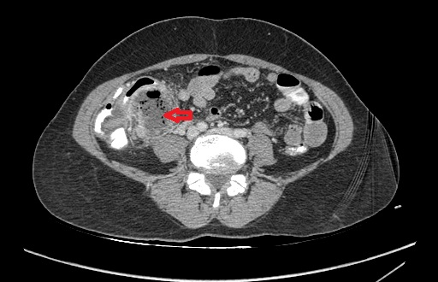
Case courtesy of Assis Prof Faeze Salahshour, Radiopaedia.org, rID: 80775

Slide 9
Key imaging findings
Intra-abdominal fluid and gas-containing abscess (~4cm) in the location of appendix with mass effect on ileo-cecal valve
Central necrotic core of abscess (relatively low attenuation)
Well defined fibrous capsule—peripheral neutrophils with fibrous capsule with dilated blood vessels and proliferation of fibroblasts
Indicates probable perforated appendicitis with subsequent abscess formation
Rim enhancement, periappendiceal fat stranding, bowel wall thickening (terminal ileum, cecum, ascending colon), appendicolith (seen in 25% of patients presenting with acute appendicitis)
Notes:
Other signs of appendicitis on imaging: appendiceal diameter >6mm, wall thickening >2mm

Slide 10
Differential Diagnosis
right-sided diverticulitis
inflammatory bowel disease (Crohn Disease)
appendiceal mucocele
lymphoid hyperplasia
appendiceal malignancy (CRC, peritoneal mets, carcinoid)
appendiceal diverticulitis
acute epiploic appendagitis (torsion)
omental infarction
Valentino syndrome (from perforated peptic ulcer)

Slide 11
Discussion
Acute appendicitis with perforation and subsequent abscess formation
Perforation found in 13-20% of patients who present with acute appendicitis (leads to abscess formation or diffuse peritonitis)
One study showed that 20% of patients develop perforation <24 hrs after symptom onset, 65% of patients have had symptoms >48 hrs
In this case, appendicitis likely secondary to intraluminal obstruction of appendix due to fecalith seen on imaging. Interestingly, appendicoliths are more associated with retrocecal appendix
Notes:
Diagnostic accuracy and perforation rate in appendicitis: association with age and sex of the patient and with appendicectomy rate. AU Andersson RE, Hugander A, Thulin AJ SOEur J Surg. 1992;158(1):37.
The natural history of appendicitis in adults. A prospective study.AUTemple CL, Huchcroft SA, Temple WJ SOAnn Surg. 1995;221(3):278.
Summary of the pathophysiology of the most likely diagnosis
How the diagnosis matches and fits this particular case
Further work up or management done/needed

Slide 12
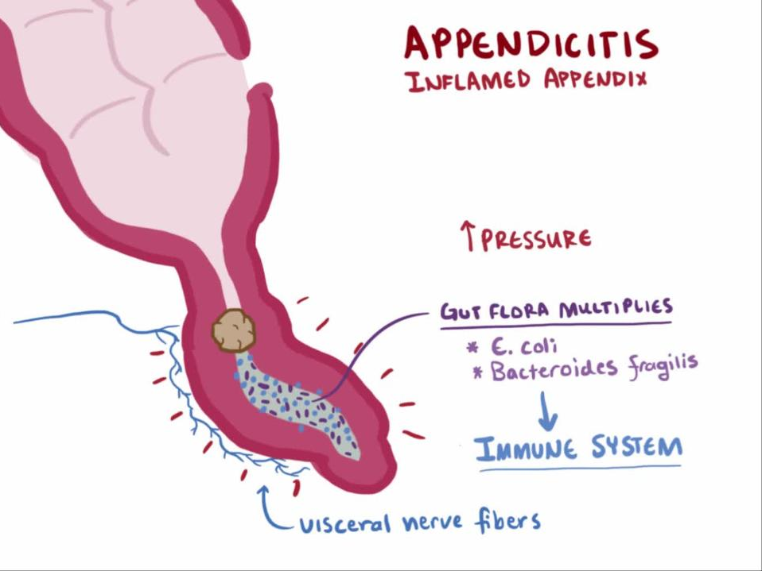
Pathophysiology
Appendix obstruction → increased intraluminal/intramural pressure → thrombosis and occlusion of small vessels in appendix wall → lymphatic stasis→ appendiceal engorgement and inflammation
Triggers afferent visceral nerve fibers at T8-10, leading to vague central umbilical pain. Sharp localized LRQ pain occurs later when parietal peritoneum involved
Notes:
https://f1.media.brightcove.com/8/3850378299001/3850378299001_5537624294001_5537610520001-vs.jpg?pubId=3850378299001&videoId=5537610520001

Slide 13
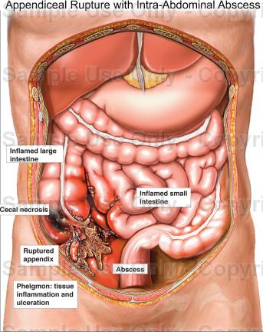
Treatment/Prognosis
A 2010 meta-analysis of 17 nonrandomized studies showed that, compared with immediate surgery, initial nonoperative management of perforated appendicitis with abscess or phlegmon is associated with fewer complications and similar length of stay and duration of antibiotics
Initial surgical management difficult due to adhesions, inflammation and can lead to increased risk of injuring surrounding structures and increased need for dissection
IV antibiotics, fluids, bowel rest, percutaneous drainage
Notes:
https://www.doereport.com/imagescooked/15061W.jpg

Slide 14
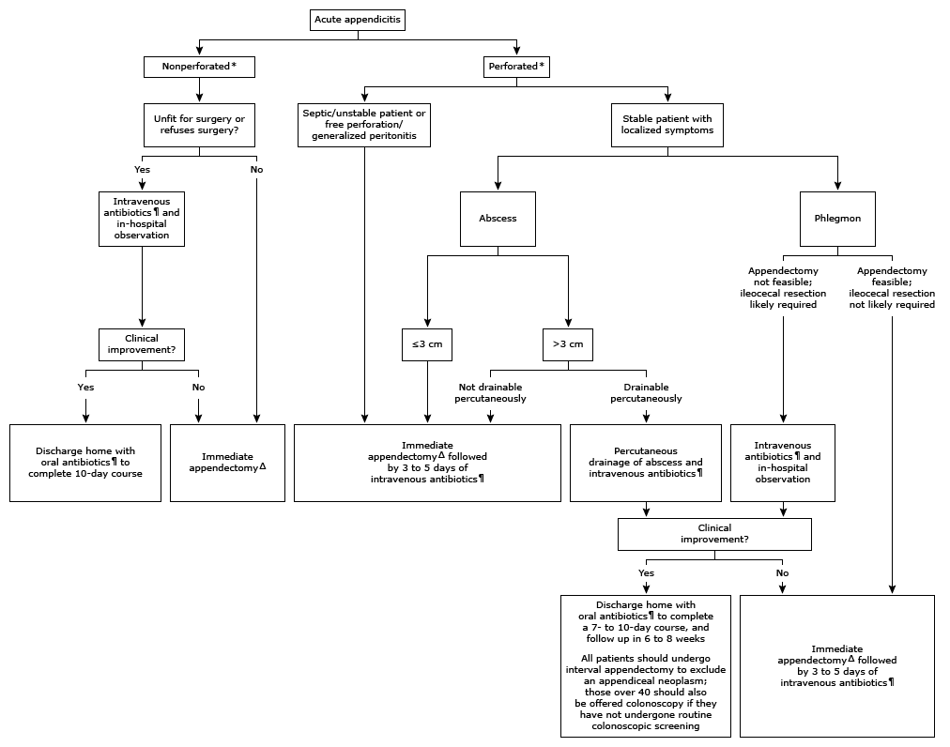
Treatment
Notes:
https://www.uptodate.com/contents/management-of-acute-appendicitis-in-adults?search=appendiceal%20abscess&source=search_result&selectedTitle=1~19&usage_type=default&display_rank=1#H18

Slide 15
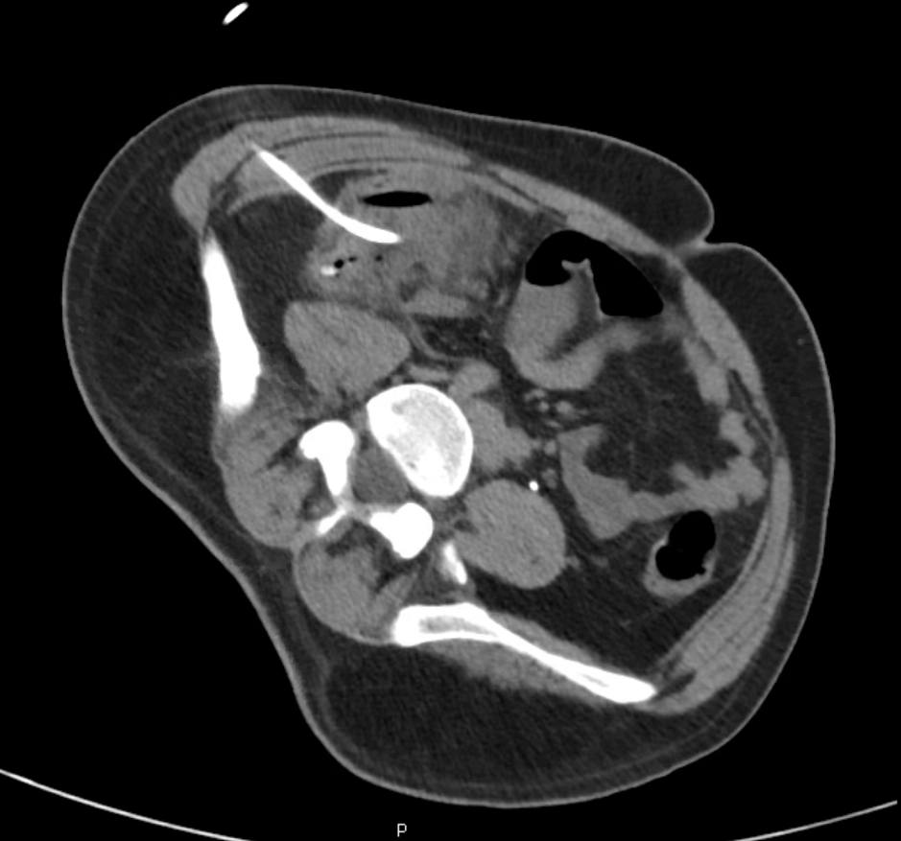
Treatment
IR consulted to place 10-French drainage catheter into RLQ abscess, yielded purulent fluid
Put on suction, FU outpatient to remove drain 20 days later
Plan for appendectomy in 3 months
Notes:
No FU imaging

Slide 16
Final Diagnosis
Appendiceal rupture with RLQ abscess development

Slide 17
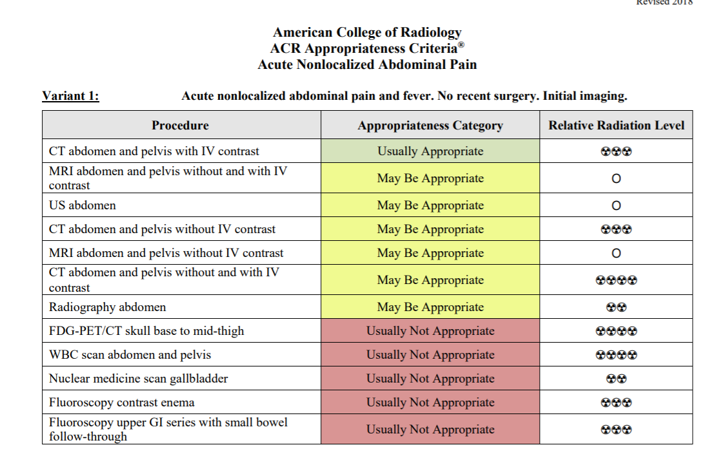
ACR appropriateness Criteria
Notes:
Discuss whether case was in accordance to the ACR appropriateness guidelines
Can include a screenshot of the table with the modality completed highlighted
Discuss the cost of the imaging throughout the entirety of the case
Must include url or reference to the cost calculations

Slide 18
Cost of Imaging
Imaging Study
Chest X Ray | ~$100
CT Abdomen/Pelvis w/contrast: (estimated lower in the Houston area) | ~$1,000
CT Guided Abdominal Biopsy (as a comparison to CT guided percutaneous drainage) | ~$700
Total | $1,800
Notes:
http://info.kaiserpermanente.org/info_assets/colorado-deductible-plans/pdfs/2018_fee%20sheet_radiology.pdf

Slide 19
Take Home Points / Teaching points
Appendiceal abscess more common in patients who have been symptomatic for >24hrs
CT A/P w/ contrast study of choice for the acute abdominal pain (unless radiation exposure of concern in which case can use u/s or MRI)
Management of stable patients with perforated appendix dependent on size of abscess and whether it can be drained– if not, immediate appendectomy

Slide 20
References
http://info.kaiserpermanente.org/info_assets/colorado-deductible-plans/pdfs/2018_fee%20sheet_radiology.pdf
https://acsearch.acr.org/docs/69467/Narrative/
Diagnostic value of hyperbilirubinemia as a predictive factor for appendiceal perforation in acute appendicitis.AUSand M, Bechara FG, Holland-Letz T, Sand D, Mehnert G, Mann B SOAm J Surg. 2009;198(2):193. Epub 2009 Mar 23.
Diagnostic accuracy and perforation rate in appendicitis: association with age and sex of the patient and with appendicectomy rate. AU Andersson RE, Hugander A, Thulin AJ SOEur J Surg. 1992;158(1):37.
The natural history of appendicitis in adults. A prospective study.AUTemple CL, Huchcroft SA, Temple WJ SOAnn Surg. 1995;221(3):278.
https://www.uptodate.com/contents/management-of-acute-appendicitis-in-adults?search=appendiceal%20abscess&source=search_result&selectedTitle=1~19&usage_type=default&display_rank=1#H18

Slide 21

Questions?

