Slide 1
Bisphosphonate Fracture
Eric Faiguan Tom
02/03/2021
RAD 4001
Dr. Manickam “Nicks” Kumaravel, Dr. Pritish Bawa,
Dr. Girija Rajakumar

Slide 2
Clinical History
  75 y/o female PMH arthritis, low back pain presents to the ED with 3 weeks of worsening bilateral hip pain, seen by PCP 2 weeks prior, XRAY negative & CT negative at clinic, and started on Tylenol, gabapentin, and meloxicam, states pain and weakness to BLE is worse, with numbness/tingling to LLE, and worsening pain to RLE. Pt states she ambulates at home with walker at baseline.
    IN ED: Stable vitals, GCS 15, PE (+) for Arthralgias/Weakness and tenderness present
    Imaging ordered: XRAY HIP BILATERAL 2 VIEWS AND AP PELVIS, XRAY SPINE LUMBROSACRAL AP & Lat,, CT ABDOMEN & PELVIS WITH CONTRAST
    Given Morphine and Zofran in ED

Slide 3
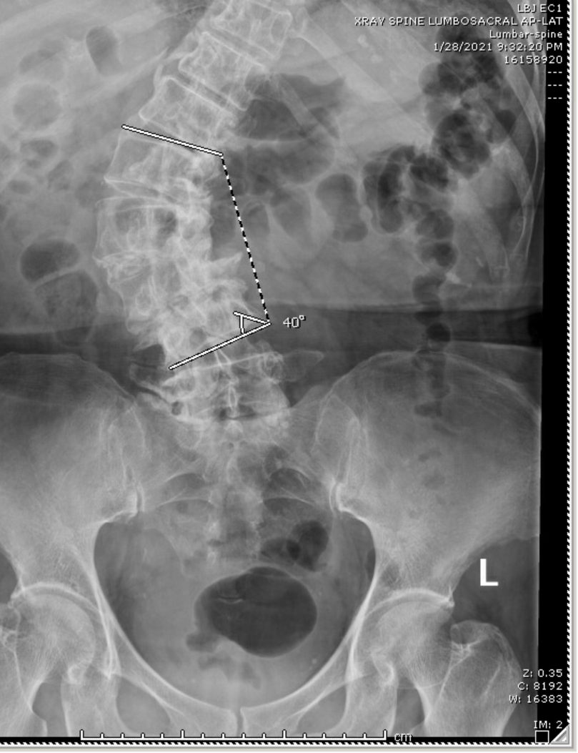
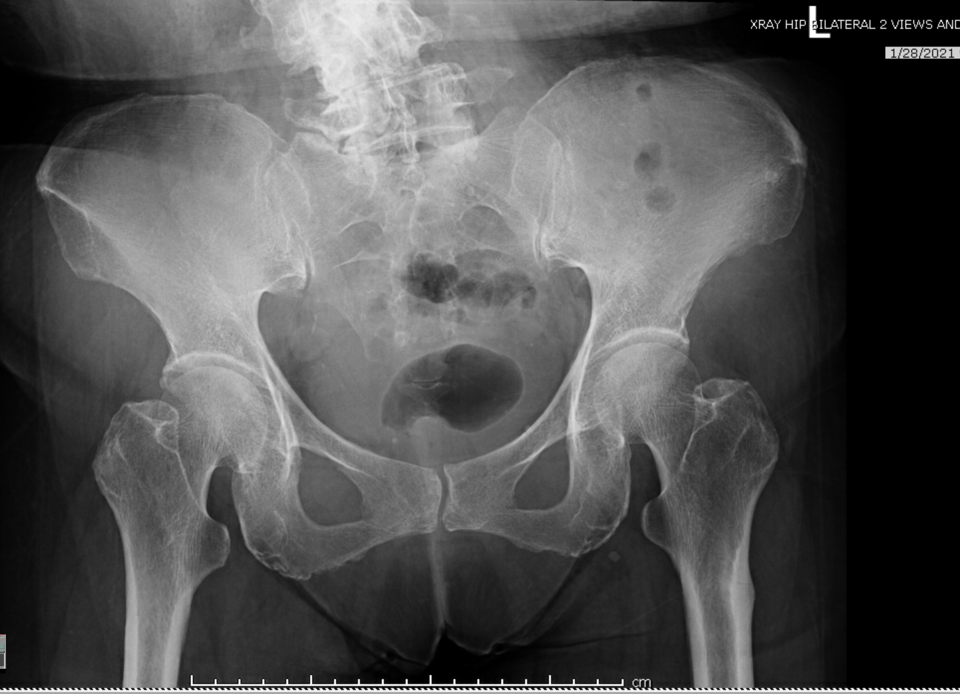
ED X-ray Initial Imaging (1/28)
L1
Iliac crest
L2
SI Joint
L3
L4
Acetabulum
L5
Greater Trochanter
Femoral Head
Sacrum
Pubic Symphysis
Lesser Trochanter
Femur
Ischial Tuberosity
Notes:
Limited evaluation of the lumbar spine on the coned lateral and lateral
radiographic views due to significant dextroscoliotic curvature centered
at L2 with about a Cobb angle of about 40 degrees.
5 lumbar type, non-rib bearing vertebral bodies are present. Extensive
degenerative change throughout the visualized thoracic spine as
evidenced by severe facet arthropathy and multilevel disc height loss.
Overall the vertebral body heights are maintained.

Slide 4
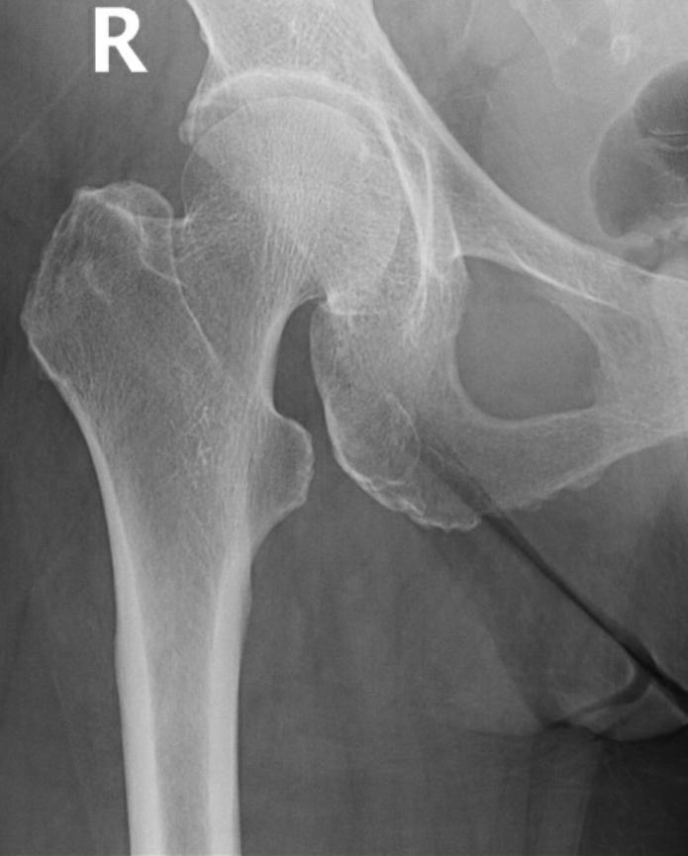
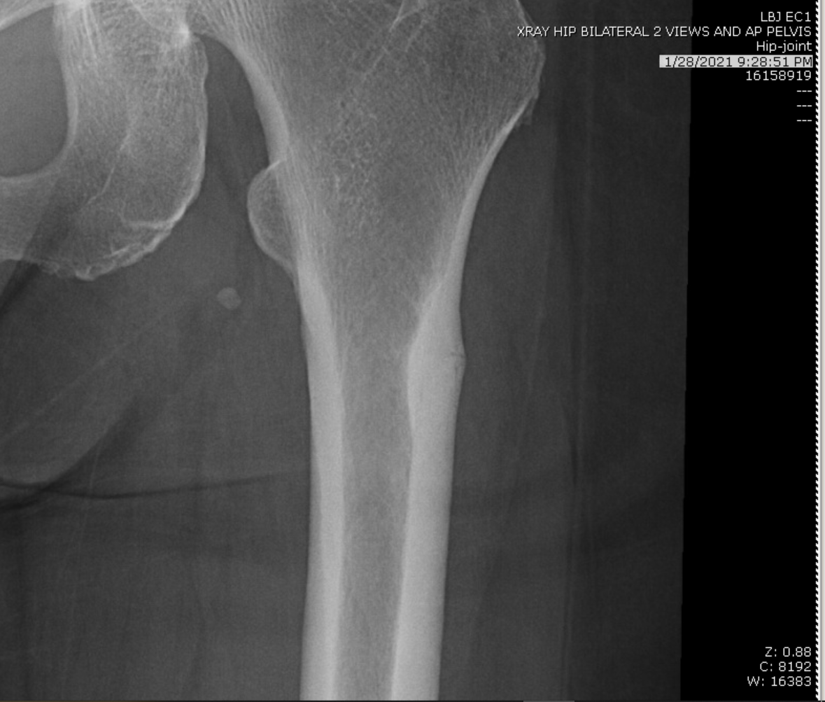
Xray 1/28 Cont.
Head
Greater Trochanter
Lesser Trochanter
Neck
Lesser Trochanter
Femur (shaft)
Notes:
Red arrow – indicates sclerosing area, notably periosteal in this Xray
Red line– fracture line

Slide 5
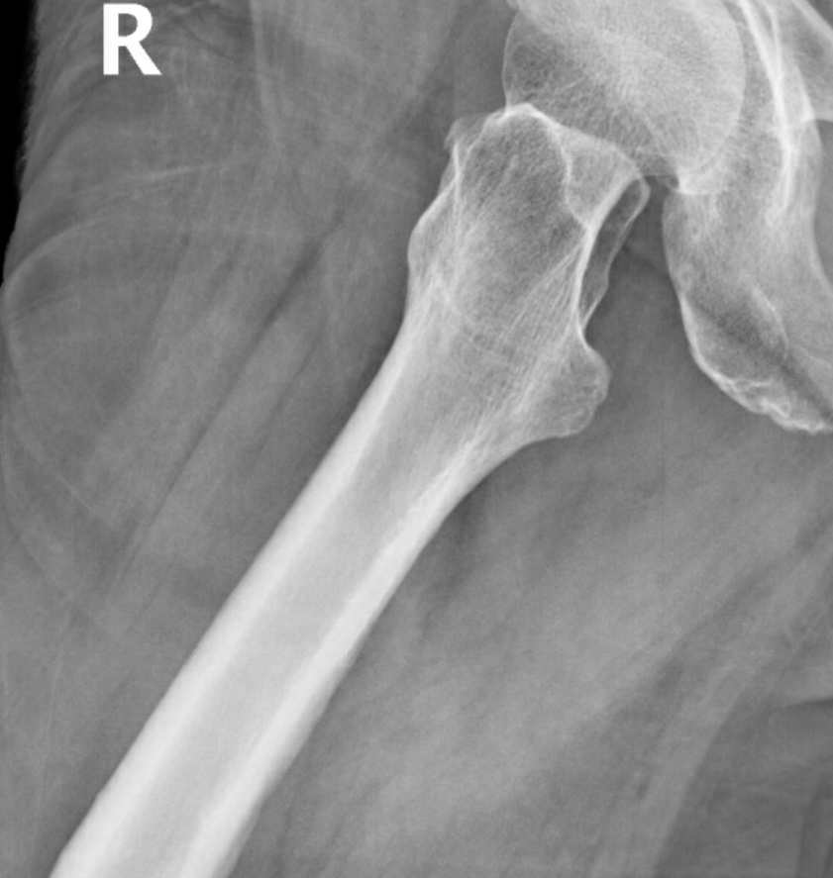
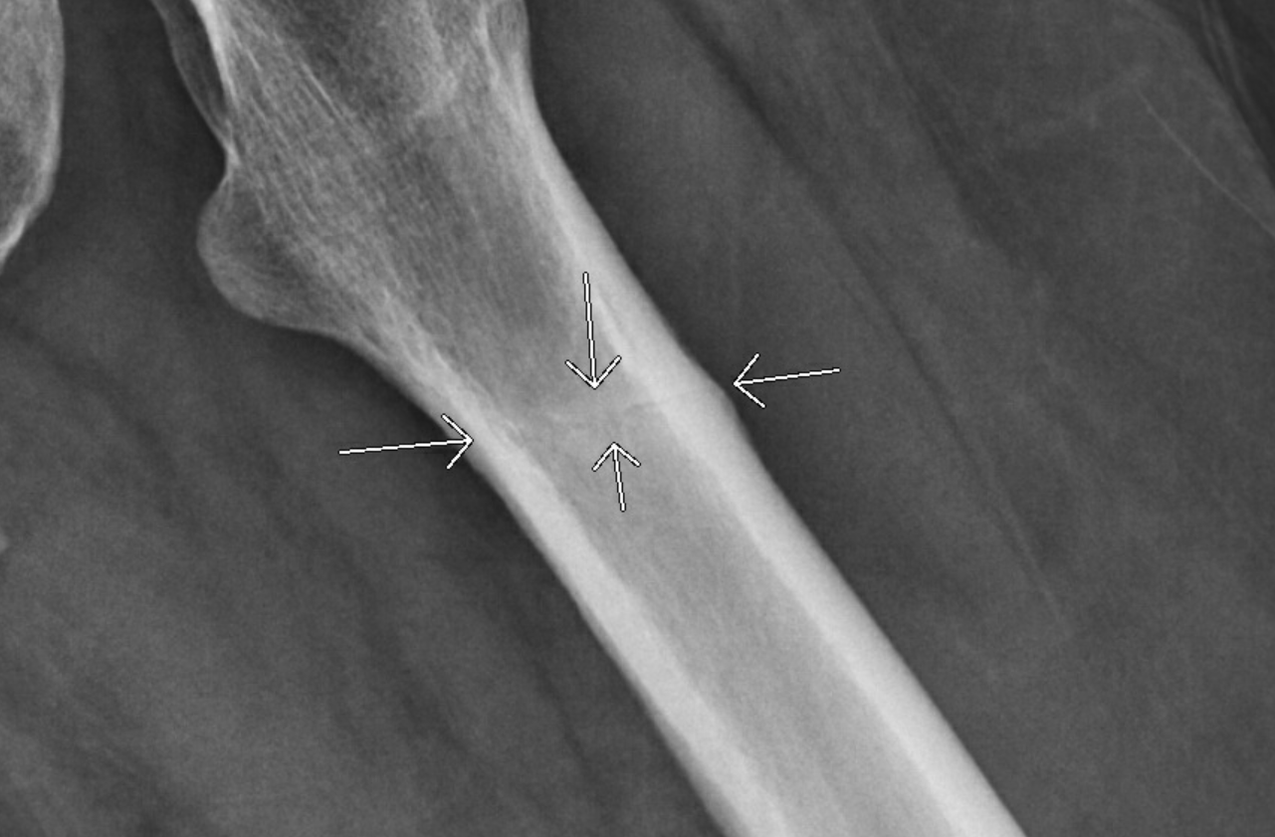
Continued X-ray 1/28
Head
Greater Trochanter
Greater Trochanter
Lesser Trochanter
Lesser Trochanter

Slide 6
Key Imaging Findings
X-ray Hip: Radiolucent line across the left proximal femur with some sclerosis may suggest subacute nondisplaced fracture.
CT ABD:
  No acute abnormality within abdomen/pelvis.
  Dextroscoliotic curvature of the lumbar spine with co-existing severe degenerative changes
Due to limited view of femurs on CT, ED ordered CT Hip w/o contrast

Slide 7
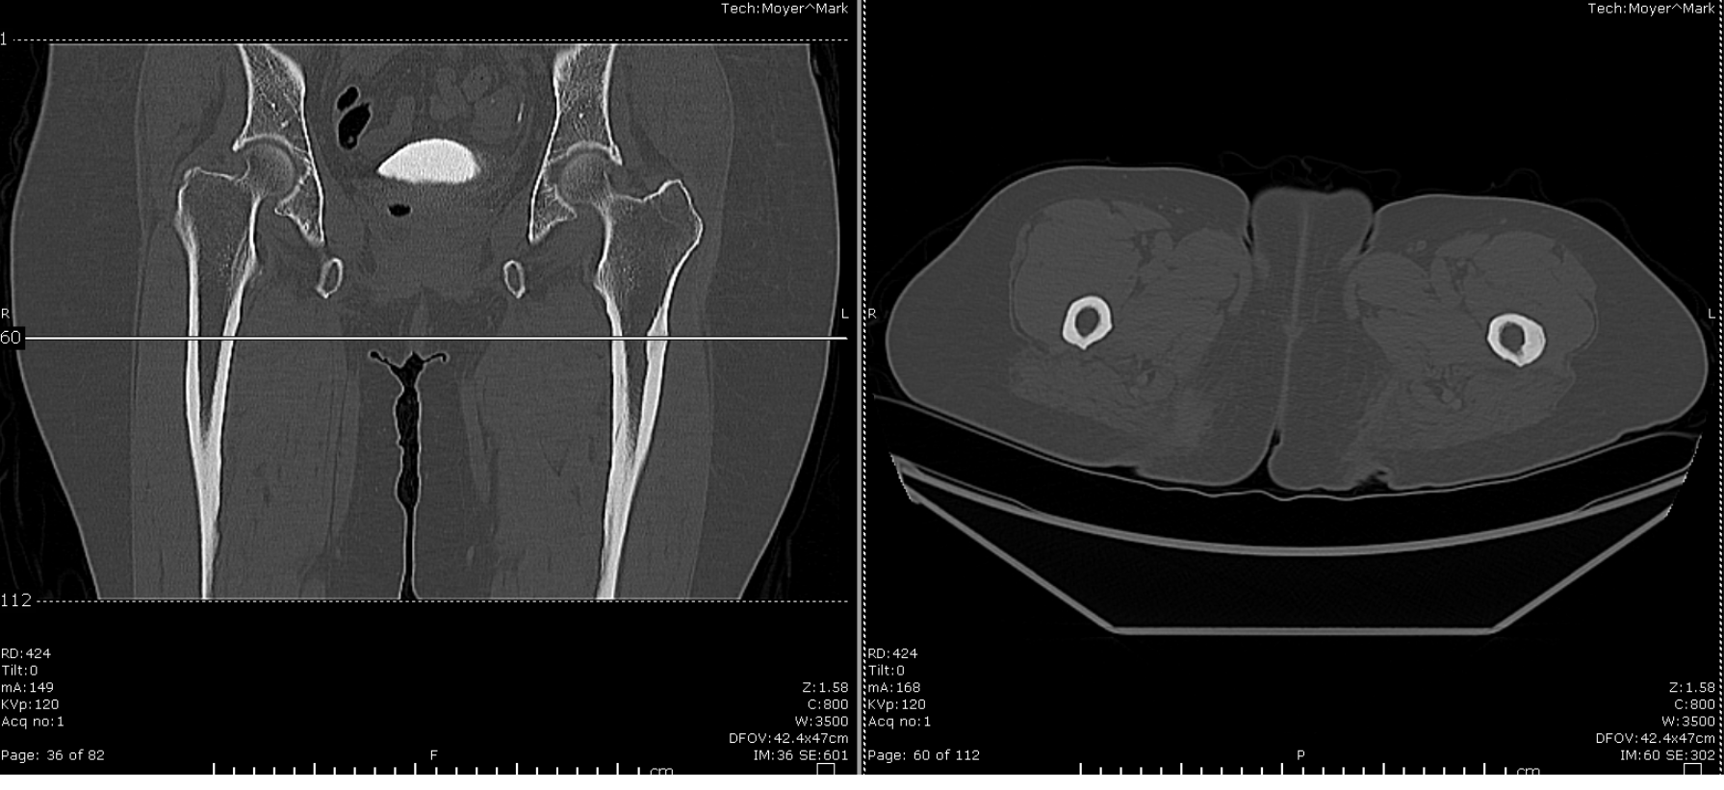
CT HIP

Slide 8
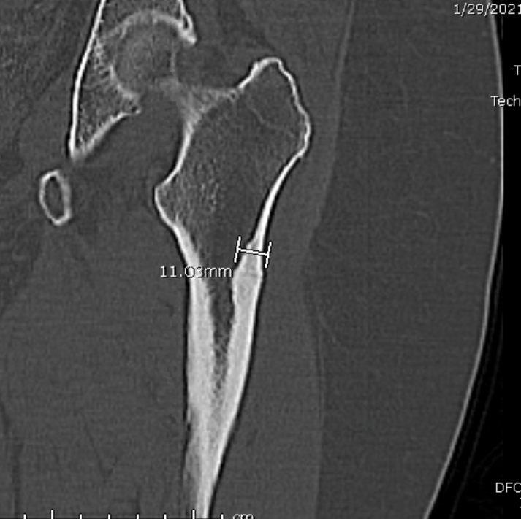
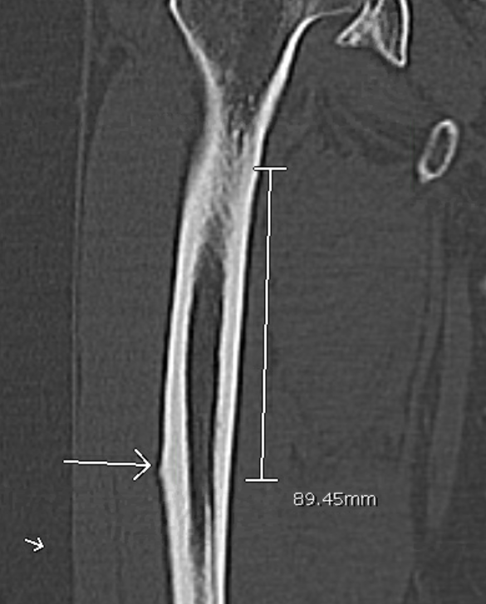
CT HIP
Head
Lesser Trochanter
Lesser Trochanter
Beaking

Slide 9
Key Imaging Findings from CT
Left femur - Hypertrophic periosteal and endosteal thickening at the lateral cortex of the with incomplete fracture lucency
Right femur - Hypertrophic periosteal thickening of the lateral cortex in the proximal shaft, approximately 9 cm below the lesser trochanter

Slide 10
Differential Diagnosis
Atypical femur fracture (bisphosphate-related proximal fracture)
Osteoporosis/previous fracture
Paget disease

Slide 11
Following up
ED was notified with results and orthopedics was consulted for the patient
Ortho consult:
  Anterior left thigh pain is localized more laterally than what would be expected for an intraarticular pathology.
  10 year history of continuous use of bisphosphonate starting with fosamax. She had a brief pause due to being unable to pay.

Slide 12
Final Diagnosis
75y.o. female with 10 years of bisphosphonate use and recent fall:
Left atypical femur fracture: Fracture incomplete through cortical thickening due to bisphosphonate use. High risk of progressing to a fully displaced subtrochanteric femur fracture.
Right femur impending fracture: Lateral beaking (Hypertrophic periosteal thickening of the lateral cortex) on femur radiographs at risk for future fracture. Possibility of future prophylactic nailing of her right femur.

Slide 13
Discussion
Patient has long term use of bisphosphonate , mechanism likely due to decreased osteoclast activity and inhibited bone remodeling. Microdamage is not repaired and increasing fragility. Pain the thigh or groin may be present for several weeks or months before the atypical femoral fracture occurs in ~70% of patients
Plain radiograph changes:
  Lateral cortex – periosteal reaction, cortical thickening
  Fractures progress laterally and can travel medially if unchanged
CT changes – allows for better visualization of cortical thickening vs endosteal thickening
Treatment:
  Halt bisphosphonate usage
  Consult surgery for intramedullary nailing for fracture
  rhPTH (Teriparatide) for restoration of bone quality

Slide 14
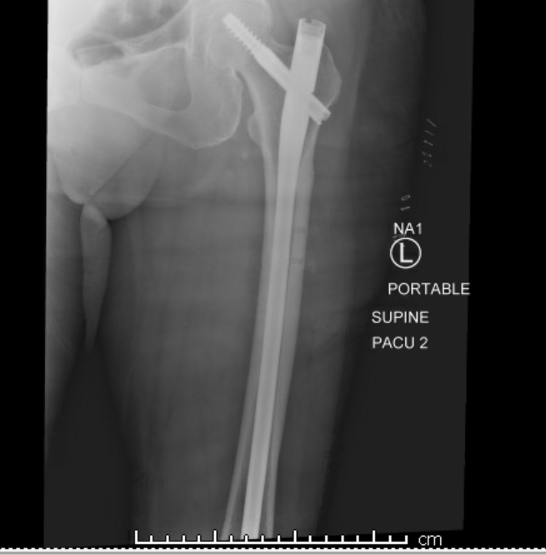
Treatment
Referred to Orthopedic surgery and scheduled for OR for L fracture
Operative treatment is recommended for all patients
Delayed fracture healing occurs in ~25% of cases

Slide 15
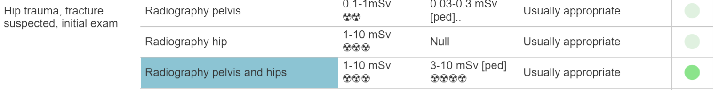
ACR appropriateness Criteria
Overall from the initial workup, the only questionable study done was the CT Abdomen/Pelvis initially done, but otherwise the rest of the studies seemed appropriate.
Notes:
Discuss whether case was in accordance to the ACR appropriateness guidelines
Can include a screenshot of the table with the modality completed highlighted
Discuss the cost of the imaging throughout the entirety of the case
Must include url or reference to the cost calculations

Slide 16
ACR appropriateness Criteria
https://onlinepatientestimation.com/PatientPortal/facility (Avg. costs)
X-ray spine – Lumbrosacral - $375
X-ray Hip bilateral - $667
CT ABD/Pelvis contrast - $2,980.15
CT Hip w/o Contrast x2 - $2,610.72
X-ray femur 2 view x2 - $473.04
Total costs: $7105.91

Slide 17
Take Home Points / Teaching points
Plain film can be useful in identifying bony sclerosis or degenerative changes
CT scan can help further evaluate extent of bony abnormalities and identify potential future issues
Long term medication side effects should be monitored carefully for clinical symptoms

Slide 18
References
https://www.acr.org/Clinical-Resources/ACR-Appropriateness-Criteria
https://www.ncbi.nlm.nih.gov/pmc/articles/PMC5386848/
https://radiopaedia.org/articles/atypical-femoral-fracture-1?lang=us

Slide 19

Questions?

