Slide 1
Type II Dens Fracture
Aashini Patel
3/2/21
MSK Radiology RAD 4014
Dr. Manickam Kumaravel

Slide 2
Clinical History
82 yo female presenting after tripping and hitting her head. Pt did not have LOC or any syncope
Physical Exam:
  +Occipital head and neck pain
  +Knee pain
  No neuro deficits
  Vitals: hypertensive (SBP-170s)
Past Medical Hx: osteopenia, hypotension, hypoglycemia
Initial workup
  EKG-normal
  CTA- atherosclerotic disease of bilateral bulbs. No traumatic injury to major arteries of head and neck

Slide 3
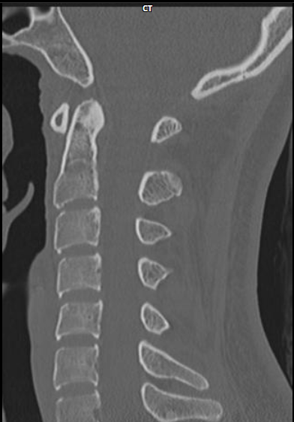
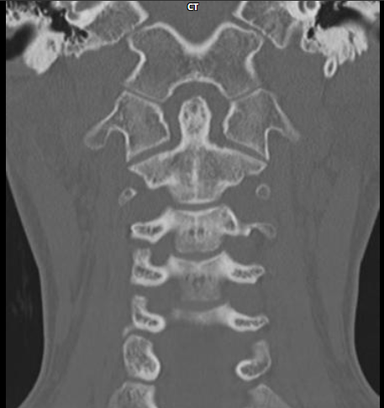
Normal Anatomy
Sagittal non-contrast C-Spine CT
Coronal non-contrast C-Spine CT
dens
C1
dens
C1
C1
C2
C2
C3
C3
C4
C4
C5
C6
https://radiopaedia.org/cases/normal-cervical-spine-ct?lang=us
https://radiopaedia.org/cases/normal-cervical-spine-ct?lang=us
Notes:
Normal cervical spine CT | Radiology Case | Radiopaedia.org

Slide 4
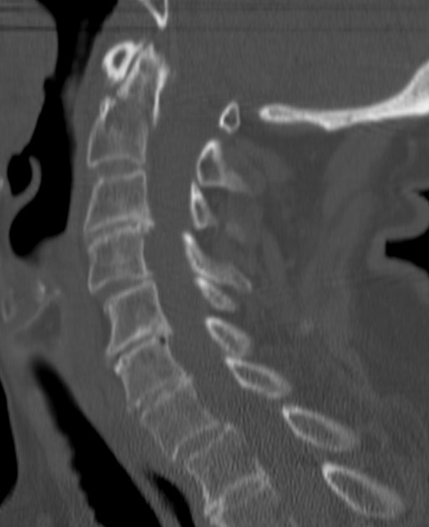
9/21- CT C-spine SAG w/o contrast
Fracture across the dens at the base (arrow)

Slide 5
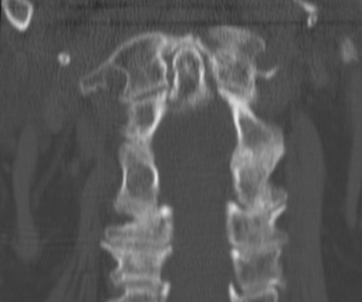
9/21- CT C-spine coronal w/o contrast
Fracture across the dens at the base (arrow)

Slide 6
Key Imaging Findings
Pt with head and neck pain after low impact fall with hyperextension of the neck
CT findings:
  Minimally displaced fracture at the base of the odontoid process (type II)
  Diffuse osteopenia
  Degenerative disc disease

Slide 7
Differential Diagnosis
Hangman fracture : Traumatic hyperextension injury involving the C2 vertebrae. Fracture is on both sides of the pars interarticularis with displacement. This is not seen in our case which involves the odontoid process.
Atlanto-occipital dissociation: Traumatic injury involving hyperflexion. Can have associated fracture of the C1 and C2. Increased space between these two vertebrae, which does not correlate with this case.
Extension cervical teardrop injury: Hyperextension of the neck in trauma or in elderly patients due to degenerative changes. It is associated with the anterior longitudinal ligament and a fracture involving the body to the vertebra.

Slide 8
Final Diagnosis
Pt has a fracture in the C2 vertebrae at the base of the odontoid process
Type II Dens Fracture

Slide 9
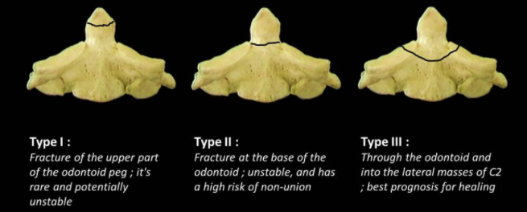
Anderson-D’ Alonzo classification system:
Type I: involves the tip of the odontoid process. Usually occurs due to pulling forces.
Type II: at the base of the odontoid process. This is the most common type. It has an increased risk of non-union.
Type III: involves the base of the odontoid process and goes into the body of the C2 vertebrae.
https://radiopaedia.org/cases/odontoid-fracture-classification-diagram-2?lang=us
Notes:
S. Tenny and M. Varacallo, "Odontoid Fractures," 21 July 2020. [Online]. Available: https://www.ncbi.nlm.nih.gov/books/NBK441956/. [Accessed 11 February 2021].

Slide 10
Discussion
Cause/ path: hyperextension/ hyperflexion of the neck
  high impact injury in young pt
  Low impact falls in older pt (predisposed due to degenerative bone changes)
Most common type: type II
  Accounts for 65-74% of C2 fractures
    Of that, 82-90% are seen in elderly pts
Symptoms: asymptomatic usually, no neuro deficits.
  Neck pain
  Severe cases can present with hematomas that cause dysphagia
Notes:
O. Gembruch, E. Lemonas, Y. Ahmadipour, U. Sure, N. El Hindy and O. Müller, "Nonoperative management of C-2 dens fractures: Single center experience and review of the literature," Clinical neurology and neurosurgery, vol. 169, pp. 166-173, 2018.

Slide 11
Discussion-Imaging
Preferred modality is non contrast CT
If neuro symptoms are present/ persistent symptoms, MRI can be performed
Plain film has low sensitivity and specificity
  AP lateral C-Spine
  Open mouth odontoid view

Slide 12
Discussion
Type II dens fractures associated with higher rates of non-union and mortality
Prognosis: consolidation rate per one study was at most 70% in geriatric pt with conservative treatment
Complications:
  Cervical cord injury
  Joint deformity/ cervical instability
  Vascular compromise
Factors that lead to non-union: age, type of injury/ fracture, vascular compromise, displacement >4mm

Slide 13
Treatment
Pt was conservatively managed with a Miami-J collar
Treatment options are surgical or conservative
Type I and III: usually conservatively managed
Type II: more debated about management especially in older pt
  Risk of surgical intervention vs long term cervical immobilization device
  Conservative:
    Semi-rigid collar (treatment of choice for older pt) or halo thoracic vest (reserved for younger pts for a 6-12 weeks)
      Complications for halo vest-skin irritation, pneumonia, DVT
      Complications for cervical collar-ulcer, dysphagia, pneumonia
  Surgical
    Anterior screw fixation(MC surgical treatment for type II)
    Posterior instrumentation
    Transoral odontoidectomy

Slide 14
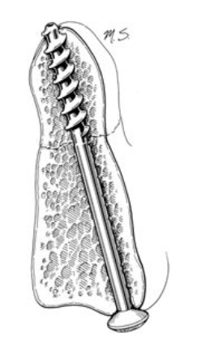
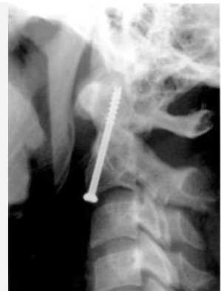
Anterior Screw Fixation Treatment Examples
https://www.barrowneuro.org/for-physicians-researchers/education/grand-rounds-publications-media/watch-neuroscience-grand-rounds/odontoid-screw-fixation/

Slide 15
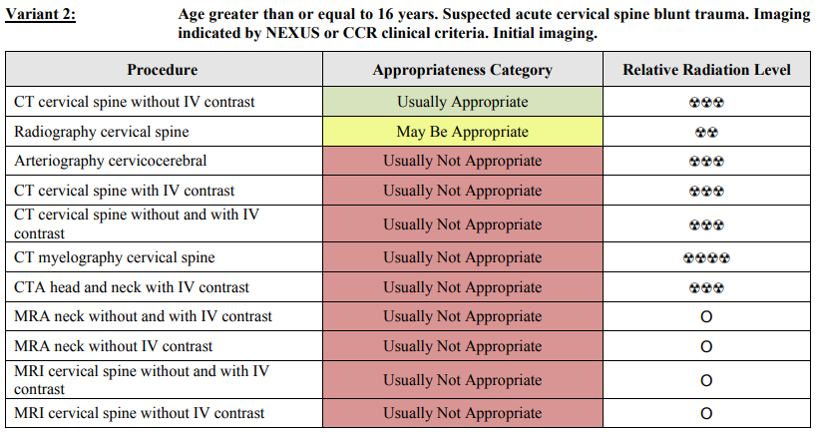
ACR appropriateness Criteria-Suspected Spine Trauma
Imaging modality used for this patient of CT cervical spine w/o IV contrast was appropriate
CTA of head and neck w/ IV contrast is not usually appropriate for spine trauma but it was included in the workup for the fall
https://acsearch.acr.org/docs/69359/Narrative/

Slide 16
Cost of Imaging-MHH Inpatient
CT Cervical Spine w/o contrast: $1,250.21-$1,875.31
CTA Head: $1,374.41-$2,061.61
CTA Neck: $821.52-$1,232.28
Total Cost: $3,445.62 -$5,169.20
https://onlinepatientestimation.com/PatientPortal/patient/selfservice

Slide 17
Take Home Points
Low Impact falls in elderly can lead to a dens fracture
Type II Dens Fractures are at higher risk of non-union
Treatment of Type II Dens Fracture is evaluated on a case-by-case basis especially in elderly pts to allow for stabilization of the spine

Slide 18
References
S. Tenny and M. Varacallo, "Odontoid Fractures," 21 July 2020. [Online]. Available: https://www.ncbi.nlm.nih.gov/books/NBK441956/. [Accessed 11 February 2021].
O. Gembruch, E. Lemonas, Y. Ahmadipour, U. Sure, N. El Hindy and O. Müller, "Nonoperative management of C-2 dens fractures: Single center experience and review of the literature," Clinical neurology and neurosurgery, vol. 169, pp. 166-173, 2018.
D. Pal, P. Sell and M. Grevitt, "Type II odontoid fractures in the elderly: an evidence-based narrative review of management," European Spine Journal , vol. 20, no. 2, pp. 195-204, 2011.
R. M. Marcon, A. F. Cristante, W. J. Teixeira, D. K. Narasaki, R. P. Oliveira and T. E. P. de Barros Filho, "Fractures of the cervical spine," Clinics, vol. 68, no. 11, pp. 1455-1461, 2013.

Slide 19

Questions?

