Slide 1
A Case of Lateral Epicondylitis
Annika Medhus
February 5, 2021
RAD 4014
Dr. Manickam Kumaravel

Slide 2
Clinical History
44 year old male with no significant past medical history presenting with right lateral elbow pain that had been going on “for a while”.
Unknown if history of overuse or trauma.
Initial work up included a right MRI elbow without contrast

Slide 3
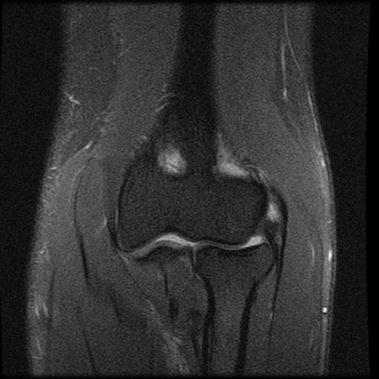
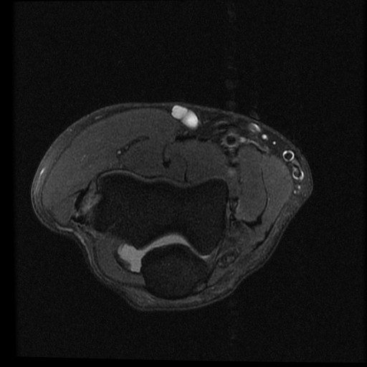
R MRI Elbow w/o Contrast (T2 Fat Sat)
Triceps brachii m.
Brachialis m.
BR
Fat Suppression is ideal for visualizing bone marrow, tendons, ligaments, and muscle.
CET
CET
ECRL
Hum
LE
PT
ERCB
Hum
Radial head
Radial collateral lig.
Anc
O
FDS
Forearm extensor compartment muscles
FCU

Slide 4
R MRI Elbow w/o Contrast Report
Minimally increased fluid signal intensity surrounding the extensor carpi radialis brevis attachment to the lateral epicondyle, suggesting a tendinosis.
All ligaments are intact.
No soft tissue abnormality.
No underlying bone changes.

Slide 5
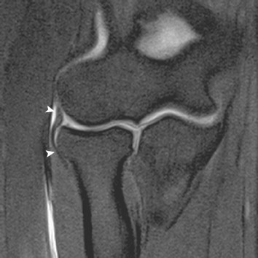
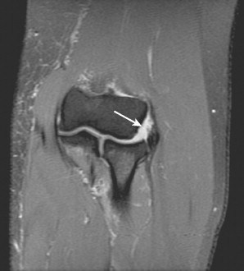
Differential Diagnosis
  Radial collateral ligament tear:
  The radial collateral ligament complex is a major lateral stabilizer of the elbow joint.
  Arises from the lateral epicondyle of the humerus and blends distally into the annular ligament and radial neck.
  A sprain of the radial collateral ligament would appear as a thickened or thinned ligament with increased T2 signal on MRI.
  A complete tear would show disruptions of the fibers along the ligament.
Coronal T2W image with fat suppression shows vertically oriented radial collateral ligament ( arrowheads ).
Coronal T2W image with fat suppression shows high signal at the origin of the proximal aspect of the radial collateral ligament
https://radiologykey.com/elbow-9/

Slide 6
Differential Diagnosis (cont.)
Calcific Tendinosis
Calcific tendinosis commonly affects the rotator cuff of the shoulder, most frequently involving the supraspinatus tendon.
Self-limiting pathology is associated with ill-defined fluffy calcifications best seen on plain radiographs.
Calcific tendinosis would show focal areas of hypointense calcium deposits on MRI and may present with peripherally increased T2 signal due to edema.
Case courtesy of Dr Ian Bickle, Radiopaedia.org, rID: 45010

Slide 7
Differential Diagnosis (cont.)
Trauma
In the setting of trauma, subcutaneous edema along with possible skin, muscle and bone contusions would typically be expected.
Typical features of bone and muscle contusions include focal areas of increased T2 signal on MRI.
Case courtesy of Dr Ahmed Abdrabou, Radiopaedia.org, rID: 24907

Slide 8
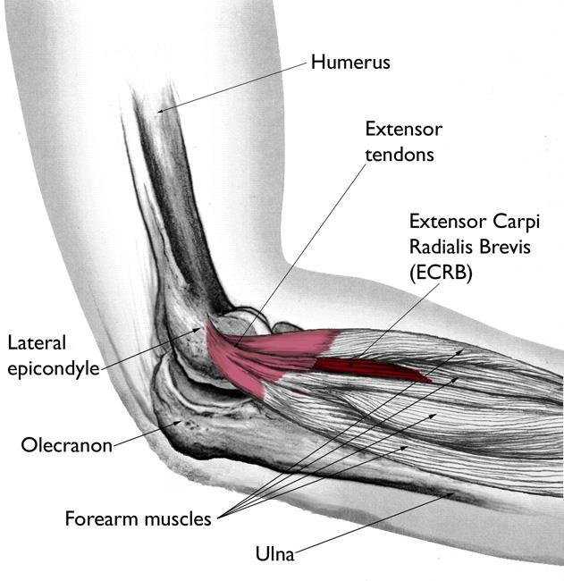
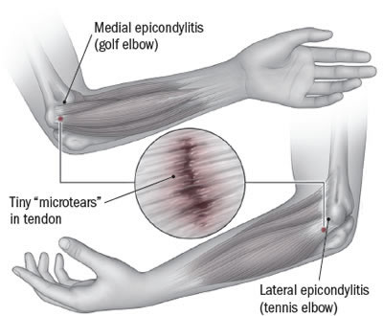
Final Diagnosis: Lateral Epicondylitis (tennis elbow)

Slide 9
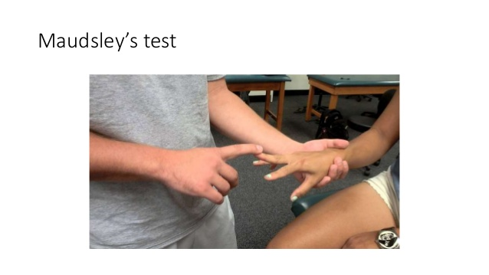
Discussion
Pathophysiology:
Extensor carpi radialis brevis is the most commonly affected muscle with supinator and other wrist extensors less frequently involved.
Overuse of these muscles (tennis, playing an instrument, manual labor, etc.) may cause multiple microtears that lead to degenerative changes within the tendon, resulting in tendinosis.
Exam/Features:
The majority of the patients with lateral epicondylitis complain of pain localized anterior to, or directly on, the bony surface of the lateral epicondyle.
Reproduced by wrist and finger extension and supination against resistance.
Some common physical examination maneuvers involved in the diagnosis of lateral epicondylitis include Maudsley’s test and diminished grip strength.
Risk Factors:
Known risk factors include smoking and obesity.
Maudsley’s test: axial downward force on third digit while asking patient to resist. Positive test is pain at the common extensor origin.

Slide 10
Discussion (cont.)
Treatment:
Lateral epicondylitis has a self-limiting course of usually 12 to 18 months, but in some patients, symptoms can persist and are refractory to treatment.
When activity modification does not provide symptomatic relief, patients can undergo different non-operative therapies, including physiotherapy, NSAIDs, corticosteroid injections, and epicondylar counterforce braces.
Operative treatment is reserved for patients with persistent symptoms who have failed non-operative therapies. Open, percutaneous and arthroscopic approaches have all been used with no consensus on which is the superior surgical technique to manage lateral epicondylitis.

Slide 11
ACR Appropriateness Criteria
Imaging is not always necessary to diagnose lateral epicondylitis, as it is usually a clinical diagnosis. However, if imaging is obtained both MRI without contrast and U/S are appropriate. Overall, the imaging obtained for this patient was appropriate.
https://acsearch.acr.org/docs/69423/Narrative/

Slide 12
Cost Calculations
Estimated range for MRI Upper Extremity Joint (shoulder, elbow, wrist) without Contrast is $1,473.19 - $2,209.79
https://www.memorialhermann.org/patients-visitors/patient-services/financial-care/financial-resources/pricing-estimate

Slide 13
Teaching points
Overuse of the extensor muscles of the arm (tennis, playing an instrument, manual labor, etc.) may cause tendinosis due to microtears on the common extensor tendon.
On MRI, increased T2 signal intensity in the common extensor origin on the lateral epicondyle is commonly seen.
Treatment involves rest, non-operative therapy (NSAID, steroids, braces), or operative therapy.

Slide 14
References
Cha, Y. K., Kim, S., Park, N. H., Kim, J. Y., Kim, J. H., & Park, J. Y. (2019). Magnetic resonance imaging of patients with lateral epicondylitis: Relationship between pain and severity of imaging features in elbow joints. Acta Orthopaedica Et Traumatologica Turcica, 53(5), 366-371.
Mackay D, Rangan A, Hide G, Hughes T, Latimer J. The objective diagnosis of early tennis elbow by magnetic resonance imaging. Occup Med (Lond). 2003 Aug;53(5):309-12.
Taylor SA, Hannafin JA. Evaluation and management of elbow tendinopathy. Sports Health. 2012;4(5):384-393.
Blankenbaker D, De Smet A, Vanderby R, McCabe R, Koplin S. MRI of Acute Bone Bruises: Timing of the Appearance of Findings in a Swine Model. American Journal of Roentgenology. 2008;190(1):W1-W7
Bucknor, M. D., Stevens, K. J., & Steinbach, L. S. (2016). Elbow Imaging in Sport: Sports Imaging Series. Radiology, 279(1), 12-28.
Merolla G, Singh S, Paladini P, Porcellini G. Calcific tendinitis of the rotator cuff: state of the art in diagnosis and treatment. J Orthop Traumatol. 2016;17(1):7-14.
Vaquero-Picado A, Barco R, Antuña SA. Lateral epicondylitis of the elbow. EFORT Open Rev. 2017;1(11):391-397. Published 2017 Mar 13.
https://onlinelibrary.wiley.com/doi/pdf/10.1002/jmri.22154

Slide 15

Questions?

