Slide 1
Mature Cystic Ovarian Teratoma
Olivia Ortiz
February 5, 2021
RAD4001
Dr. Wylie Foss, M.D. PGY-3

Slide 2
Clinical History
21yF with no significant PMHx who presented with sharp, cramping LLQ abdominal pain for 24hrs, referred by an outside urgent care due to abnormal imaging.
Associated Sx: nausea, early satiety for several weeks, abdominal fullness x 2 days
Denied: vaginal bleeding, abnormal menstrual periods, fever, headache, vision changes, SOB, cough, diarrhea, no prior episodes
Denies pertinent surgical, family, social hx, NKDA, no current medications
Notes:
Quick summary of the history and physical exam with notable findings
Include items such as age, gender, chief complaint
Initial workup if any
Associated symptoms and abnormal vitals or physical findings
Previous workup or significant PMH

Slide 3
Clinical History
In ED: T: 97.9 P: 73 RR: 20 O2sat: 98%
PE:
  AOx3, Lungs clear to auscultation, RRR
  Abd soft with midline suprapubic fullness on palpation, mild TTP in LLQ, no guarding/rebound
  Pelvic exam showed no blood in vault, cervix closed, no cervical motion tenderness, scant physiologic discharge
Pertinent Labs:
  Beta HCG <1, LDH 329 (h), WBC 13.7 (h), Hg 12.5, Plt 271, Seg Neut 90.2% (h)
  UA with ketones (80), RBC 5/HPF
  COVID Neg
  CEA 0.7 (n), CA125 19.9 (n)
Notes:
Quick summary of the history and physical exam with notable findings
Include items such as age, gender, chief complaint
Initial workup if any
Associated symptoms and abnormal vitals or physical findings
Previous workup or significant PMH

Slide 4
Differential Dx
LLQ pain in young adult female
  Ovarian cyst/cyst rupture, abscess, torsion
  Ectopic pregnancy
  Kidney stone
  Bowel obstruction

Slide 5
Relevant Imaging
Pt received pelvis transvaginal US and subsequent CT w/o contrast at outside facility
At MH patient underwent an additional US in ED
Notes:
Include relevant imaging with description of the modality, date acquired, labeled arrows of normal and abnormal anatomy
Optional: Side by side comparison of multiple images
Showing progression or imaging changes over time
Comparison with normal anatomy
(please include copy URL for each image obtain through online sources)

Slide 6
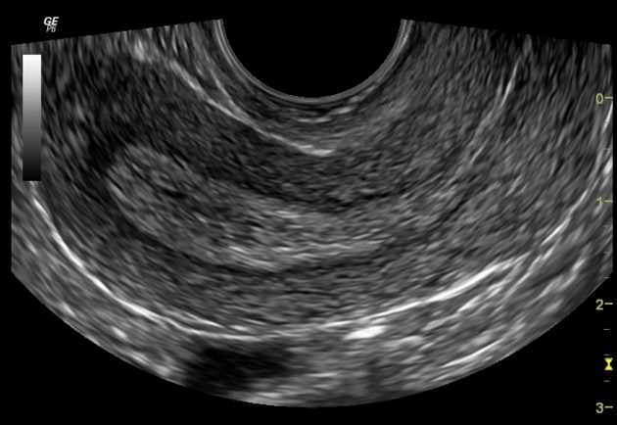
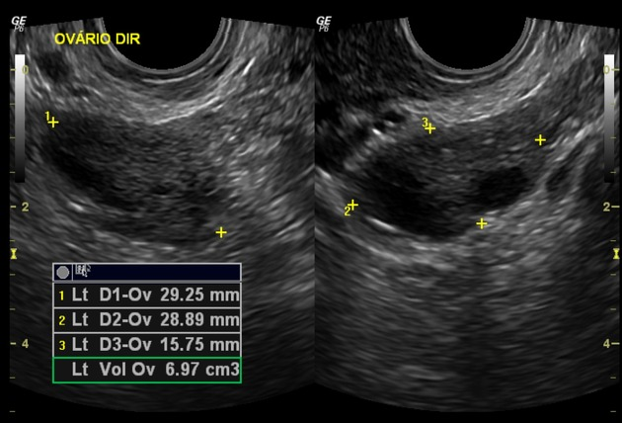
Normal imaging: Transvaginal US
Ovary
Endometrium
Myometrium
Serosa
https://radiopaedia.org/cases/normal-pelvic-ultrasound-transvaginal?lang=us, images 2 and 7
Notes:
Normal, anteverted uterus

Slide 7
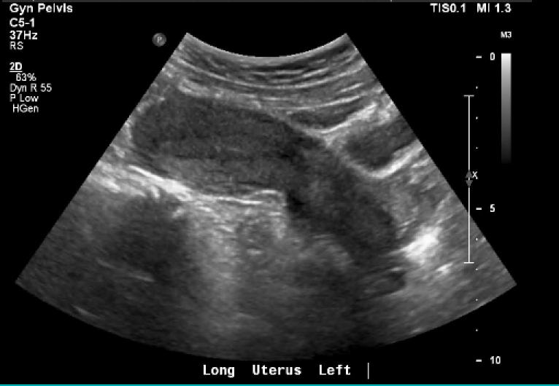
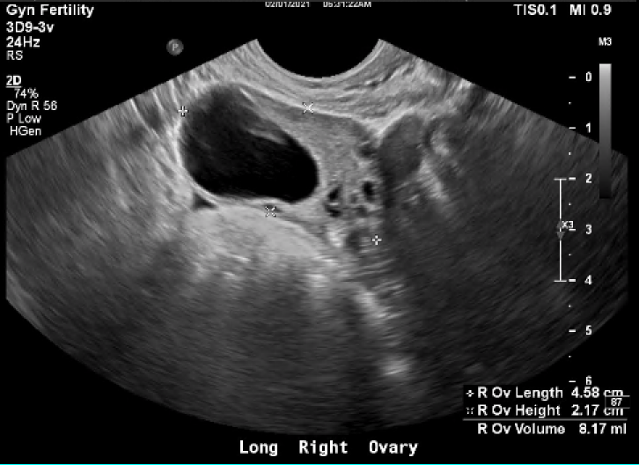
Transvaginal Ultrasound
R simple ovarian cyst
2/01/2021
Endometrium
Myometrium
2/01/2021

Slide 8
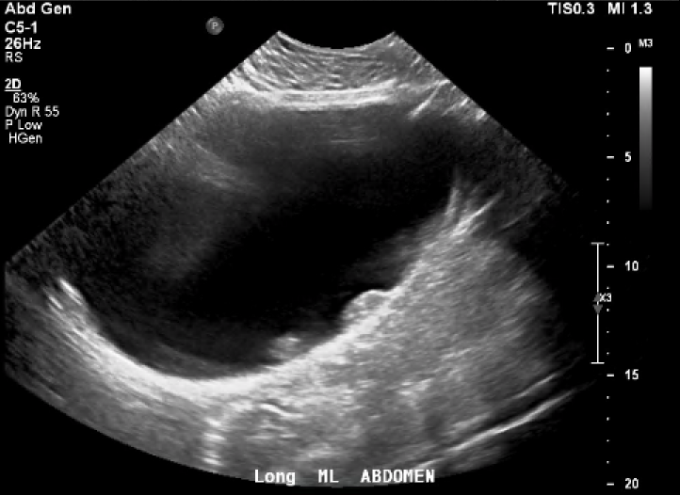
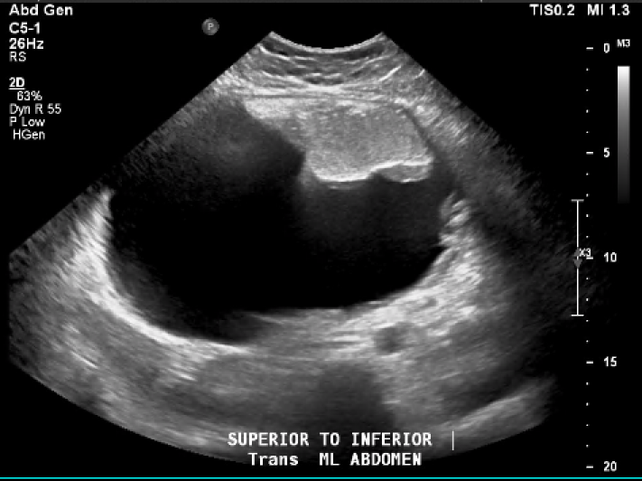
Abdominal Ultrasound
Possible soft tissue density
2/01/2021
2/01/2021
Notes:
Somewhat heterogeneous appearing mass, hyperechoic areas against the wall which may represent soft tissue dnesity

Slide 9
Ultrasound Impressions
US 2/1/2021 12:45am (Outside ED):
Anechoic cyst within the right ovary measuring 3.1 x 2.9 x 2.6 cm. Vascular flow within the right ovary.
Visualization of the left ovary is limited due to overlying bowel gas
US 2/1/2021 5:30am (MH):
Large, midline 18.8 x 17.4 x 11.3 cm cystic lesion with internal nodularity, and could be source of patient’s abdominal pain. Findings may represent complex cystic ovarian/adnexal cyst or neoplasm or other intraperitoneal lesion. Recommend CT abdomen and pelvis with contrast can be helpful for a more global assessment and for further evaluation. Ultimately, MR of the abdomen and pelvis may be necessary.
Left ovary not visualized, and could be related with the complex lesion.
No focal endometrial lesions.
3.1 cm cyst in the right ovary. Low suspicion for right ovarian torsion

Slide 10
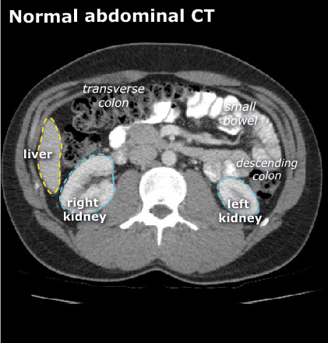
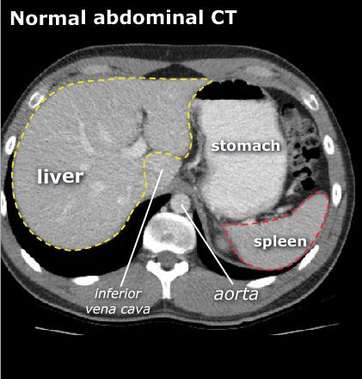
Normal Imaging- CT
https://www.startradiology.com/internships/general-surgery/abdomen/ct-abdomen-general/

Slide 11
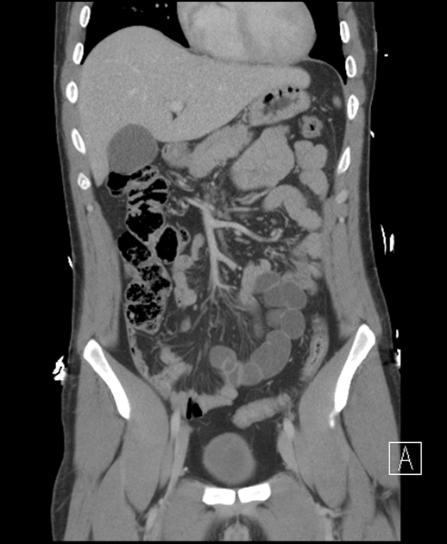
Normal Imaging-CT
Stomach
Head of pancreas
Liver
Gallbladder
Main pancreatic duct
Small bowel
Ascending colon
Bladder
https://radiopaedia.org/cases/ct-abdomenpelvis-coronal-labelling-questions?lang=us

Slide 12
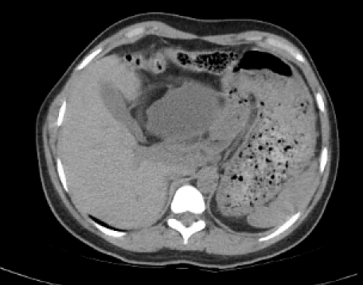
CT A/P Noncontrast- Transverse View
2/01/2021

Slide 13
CT A/P Noncontrast- Transverse View
2/01/2021
Intra-abdominal mass
Stomach
Gallbladder
Liver
Spleen

Slide 14
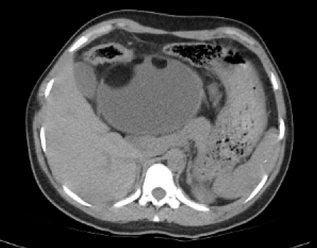
CT A/P Noncontrast- Transverse View
2/01/2021

Slide 15
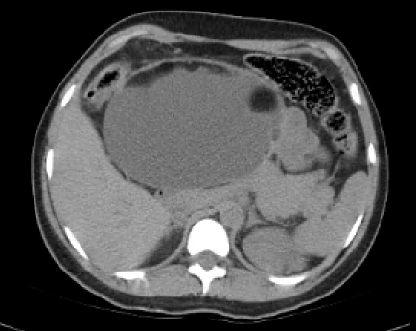
CT A/P Noncontrast- Transverse View
2/01/2021

Slide 16
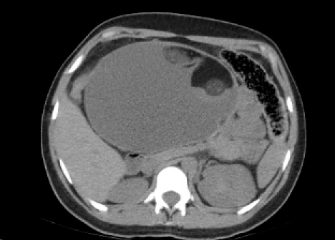
CT A/P Noncontrast- Transverse View
2/01/2021
Macroscopic fat
Mixed fat and soft tissue density
Mixed fluid density

Slide 17
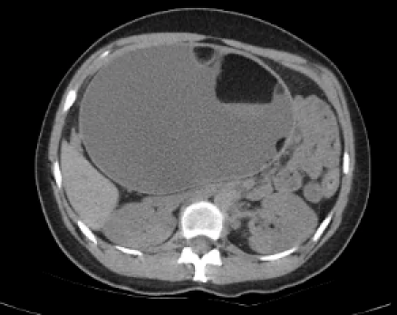
CT A/P Noncontrast- Transverse View
2/01/2021
Macroscopic fat
Small bowel
Liver
Left Kidney

Slide 18
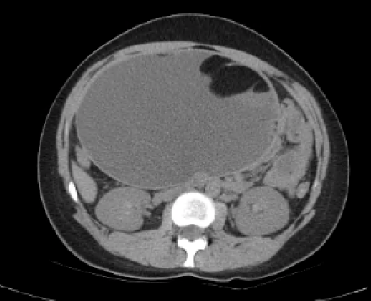
CT A/P Noncontrast- Transverse View
2/01/2021

Slide 19
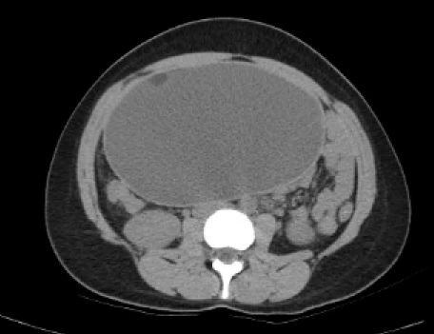
CT A/P Noncontrast- Transverse View
2/01/2021

Slide 20
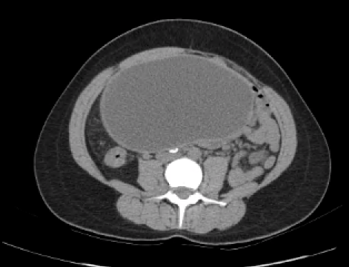
CT A/P Noncontrast- Transverse View
2/01/2021
Calcifications

Slide 21
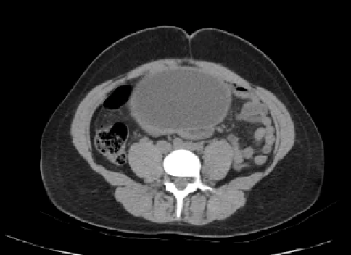
CT A/P Noncontrast- Transverse View
2/01/2021
Notes:
Macroscopic fat

Slide 22
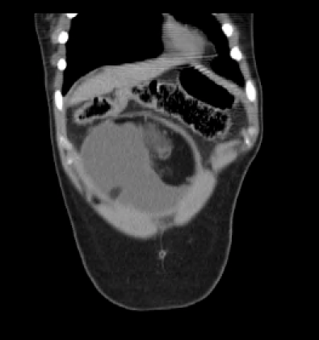
CT A/P Noncontrast- Coronal View
2/01/2021

Slide 23
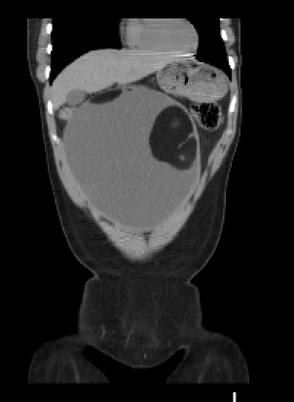
CT A/P Noncontrast- Coronal View
2/01/2021

Slide 24
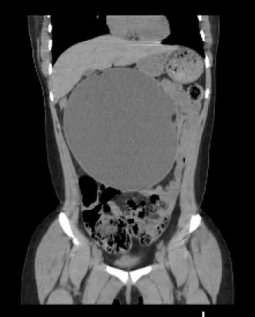
CT A/P Noncontrast- Coronal View
2/01/2021

Slide 25
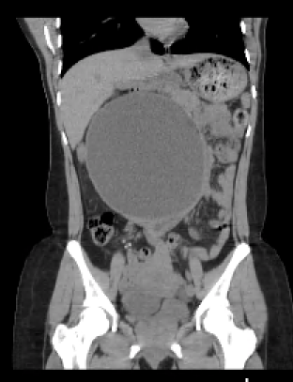
CT A/P Noncontrast- Coronal View
2/01/2021
Stomach
Intra-abdominal mass
Small bowel
Uterus
R ovarian cyst
Bladder

Slide 26
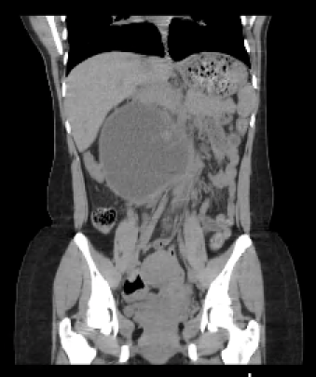
CT A/P Noncontrast- Coronal View
2/01/2021

Slide 27
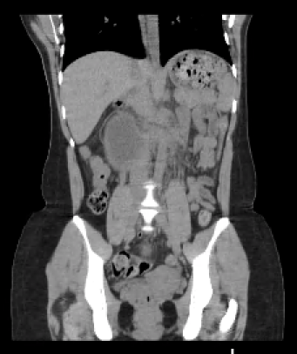
CT A/P Noncontrast- Coronal View
2/01/2021

Slide 28
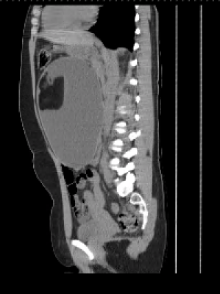
CT A/P Noncontrast- Sagittal View
2/01/2021
Intra-abdominal mass
Uterus
Bladder
Rectum
Notes:
43990 48205

Slide 29
Key Imaging Findings
U/S:
Anechoic cyst within the right ovary measuring 3.1 x 2.9 x 2.6 cm, vascular flow within the right ovary. Low suspicion for right ovarian torsion
Left ovary not visualized, could be related to the complex lesion
Large, midline 18.8 x 17.4 x 11.3 cm cystic lesion with internal nodularity, may represent complex cystic ovarian/adnexal cyst or neoplasm or other intraperitoneal lesion
CT A/P w/o contrast:
Large teratoma containing macroscopic fat, fluid, soft tissue and bone densities, measuring up to 18.4 cm in maximal dimension that appears to arise from left ovary with suggestion of twisting of the left gonadal vein and mesentery. Likely represents an ovarian teratoma arising from the left ovary which may be twisted or torsed
Right adnexal cyst
Marked distension of the stomach likely representing functional gastric outlet obstruction secondary to mass effect from large teratoma.
Notes:
Previous exam called it concerning for large dermoid cyst, and to recommend surgical consultation but no mention of possible torsion; said could further evaluate with contrast-enhanced MRI imaging
Summary of imaging findings with associated physical exam or clinical history
Can include/introduce classification or grading system if applicable
Please site your sources within the presentation

Slide 30
Differential Diagnosis
Mature vs immature cystic ovarian teratoma
  Pathology needed to differentiate the two
Ovarian cystadenoma/cancer
  Usually not the case if the cyst contains fat elements
Endometrioma
  Can have cystic-solid component

Slide 31
Mature Cystic Ovarian Teratoma
The most common ovarian germ cell tumor
Also sometimes called dermoid cysts, but have a fundamental histological difference
  A dermoid cyst is composed of only dermal and epidermal elements (which are both ectodermal in origin), whereas teratomas also comprise mesodermal and endodermal elements
Typically arise in young women ages 10-30
Notes:
Summary of the pathophysiology of the most likely diagnosis
How the diagnosis matches and fits this particular case
Further work up or management done/needed

Slide 32
Mature Cystic Ovarian Teratoma
Histologically they contain mature tissue of the ectoderm (skin, hair follicles, sebaceous glands), mesodermal (muscle, urinary tissue), and ectodermal origin (such as lung, GI, etc.)
Macroscopically can appear as a multicystic mass that contains teeth, hair, and/or skin that is within a sebaceous, thick material
https://www.uptodate.com/contents/ovarian-germ-cell-tumors-pathology-epidemiology-clinical-manifestations-and-diagnosis
Notes:
Summary of the pathophysiology of the most likely diagnosis
How the diagnosis matches and fits this particular case
Further work up or management done/needed

Slide 33
Mature Cystic Ovarian Teratoma- Pelvic US Imaging
Preferred imaging modality
Usually seen as a cystic adnexal mass with some mural components
Sonographic features include:
  Diffusely or partially echogenic mass with posterior sound attenuation from sebaceous material and hair in cyst cavity, tip-of-the-iceberg sign
  Mural hyperechoic Rokitansky nodule (dermoid plug)
  Presence of fluid-levels, echogenic calcific components
  Multiple thin, echogenic bands called dot-dash pattern
  No internal vascularity on color doppler
  Intracystic floating ball sign

Slide 34
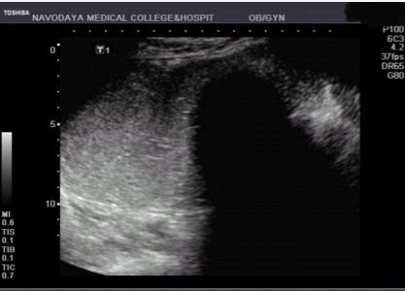
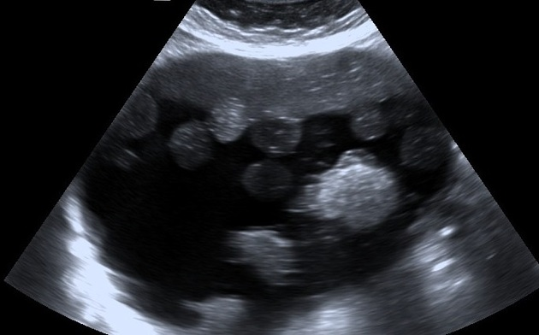
Mature Cystic Ovarian Teratoma- Pelvic US Imaging
https://radiopaedia.org/articles/floating-balls-sign?lang=us
Tip-of-the-iceberg sign: Acoustic shadowing from the hyperechoic part of the dermoid cyst
Floating ball sign: Represents spherules of sebaceous or keratinoid debris
Ravi G, B Swetha. Categorization of Ovarian Dermoids Depending Upon Their Sonographic Appearances. IOSR-JDMS.
Notes:
Floating ball sign= pathognomonic for ovarian mature cystic teratoma

Slide 35
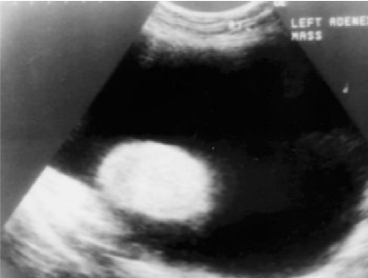
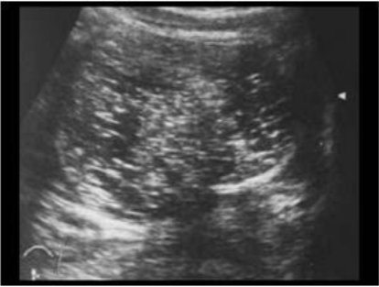
Mature Cystic Ovarian Teratoma- Pelvic US Imaging
Dermoid plug/Rokitansky nodule: Densely echogenic nodule with posterior acoustic shadowing projecting into the lumen of the mature cystic teratoma
Dot-dash pattern/Dermoid mesh: Short and long echogenic lines seen within a dermoid cyst due to the presence of hair
Ravi G, B Swetha. Categorization of Ovarian Dermoids Depending Upon Their Sonographic Appearances. IOSR-JDMS.
Notes:
Floating ball sign= pathognomonic for ovarian mature cystic teratoma

Slide 36
Mature Cystic Ovarian Teratoma- Imaging CT/MRI
CT with contrast
  High sensitivity in the diagnosis of cystic teratomas
  Not routinely recommended as initial modality due to ionizing radiation
  Demonstrate areas of fat, fat-fluid levels, calcification, Rokitansky protuberance, and tufts of hair
  Suspect transformation when size exceeds 10 cm, or if cyst has soft tissue plugs and irregular borders (cauliflower appearance)
  When ruptured, can see characteristic hypoattenuating fatty fluid as anti-dependent pockets, can also see stranded mesentery and thickened peritoneum if there is/was chemical peritonitis
MRI
  Usually reserved for difficult cases but is very good at seeing fat components
  Can use enhancement to identify solid invasive components which can help locally stage malignant variants
https://radiopaedia.org/articles/mature-cystic-ovarian-teratoma-1?lang=us
Notes:
Floating ball sign= pathognomonic for ovarian mature cystic teratoma

Slide 37
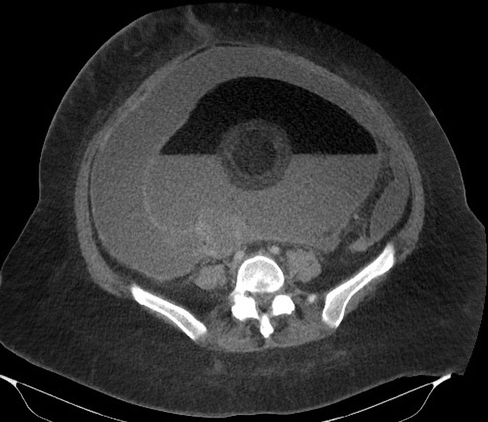
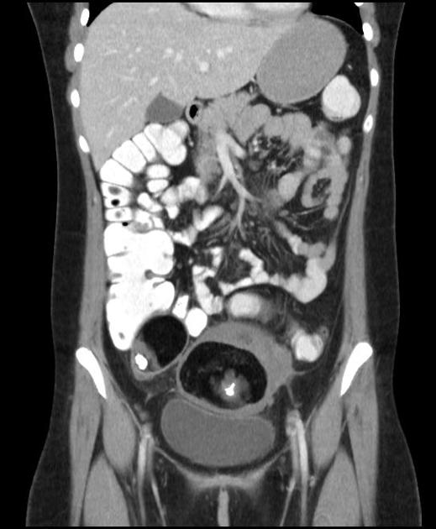
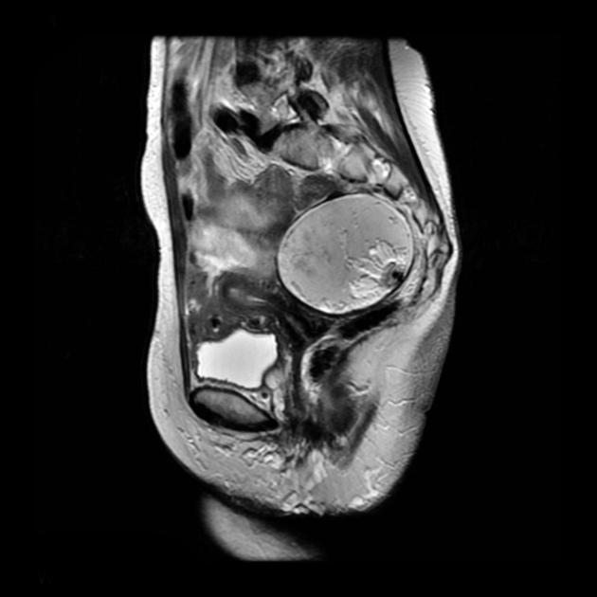
Mature Cystic Ovarian Teratoma- CT/MRI
CT. Floating ball sign, also has been called Pokemon sign when there is a single large ball floating at a fat-fluid interface
Sagittal T2
CT bilateral lesions, coronal view
https://radiopaedia.org/articles/mature-cystic-ovarian-teratoma-1?lang=us Case 46, Case 17, Case 6
Notes:
Floating ball sign= pathognomonic for ovarian mature cystic teratoma
Fat saturation= fat would be dark

Slide 38
Mature Cystic Ovarian Teratoma
Clinical Manifestations
  Most women are asymptomatic, but can be symptomatic especially with larger cysts
  Torsion is not uncommon, but rupture is uncommon but can result in shock, hemorrhage, or/and a marked granulomatous reaction that can cause adhesions (chemical peritonitis)
  Anti-N-methyl-D-aspartate (NMDA) receptor encephalitis is a rare condition that can be associated
Can be diagnosed noninvasively by imaging like ultrasound, but definitive diagnosis is made during surgical excision
https://www.uptodate.com/contents/ovarian-germ-cell-tumors-pathology-epidemiology-clinical-manifestations-and-diagnosis
Notes:
Summary of the pathophysiology of the most likely diagnosis
How the diagnosis matches and fits this particular case
Further work up or management done/needed

Slide 39
Mature Cystic Ovarian Teratoma
Malignant transformation:
  Occurs in 0.2-2% of mature cystic teratomas, with squamous cell carcinoma being the most common secondary neoplasm
  Can also have thyroid carcinoma, sarcoma, adenocarcinoma, basal cell carcinoma, melanoma, etc.
Treatment:
  Since many mature cystic ovarian teratomas are slow growing (1-2mm a year), usually annual follow-up is recommended to monitor growth of <7cm lesion
  After 7cm, resection via ovarian cystectomy either via laparoscopy or laparotomy is typically advised to preserve ovarian tissue and avoid potential complications such as torsion, rupture, or malignant transformation
  If there is malignant transformation, treatment must be tailored to the transformed histology
https://www.uptodate.com/contents/ovarian-germ-cell-tumors-pathology-epidemiology-clinical-manifestations-and-diagnosis
Notes:
Discuss the treatment done for this particular case
Discuss outcomes typically seen and compared to outcomes of this case
Any post-op or intervention imaging

Slide 40
Working Diagnosis
Likely Mature Cystic Ovarian Teratoma, final path is pending
Patient underwent diagnostic laparoscopy and left salpingoophorectomy for suspected left ovarian torsion
Notes:
List final diagnosis with associated grade/classification

Slide 41
ACR appropriateness Criteria
For this patient, US was the initial diagnostic imaging done, followed by a CT A/P without contrast
US was an appropriate first step, however CT A/P with contrast preferred to CT A/P without contrast which was received at outside ED
Imaging | Min Estimated Cost Range for uninsured ($) | Max Estimate Cost Range for uninsured ($)
Transvaginal US Pelvis | 350 | 525
CT A/P w/o Contrast | 1,854 | 2,782
CT A/P with Contrast | 2,492 | 3,738
MRI Abd with Contrast | 1,739 | 2,609
MRI Pelvis with Contrast | 1,543 | 2,314
Approximate patient cost for this work
up is $2,204 - $3,307
Estimates based on 21y uninsured
female at MH TMC via estimate calculator
Prices do not include physician or other
professional cost
https://onlinepatientestimation.com/PatientPortal/patient/estimate

Slide 42
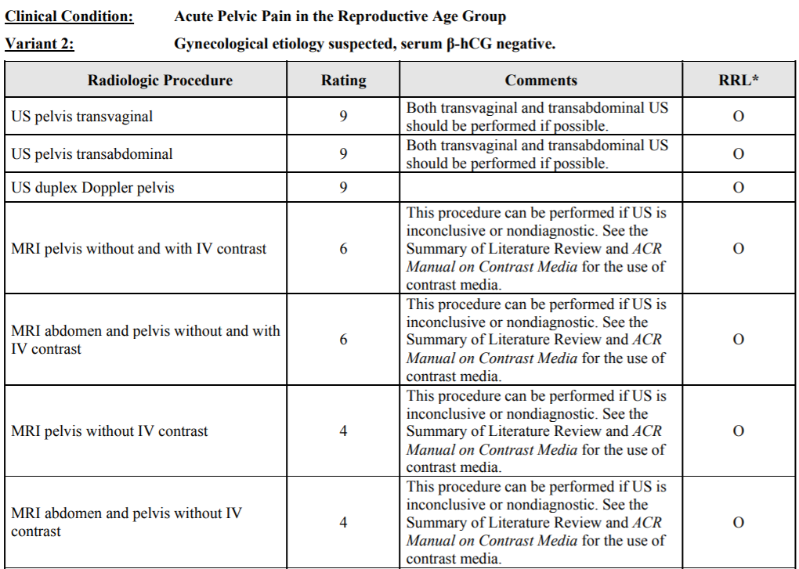
https://acsearch.acr.org/docs/69503/Narrative/

Slide 43
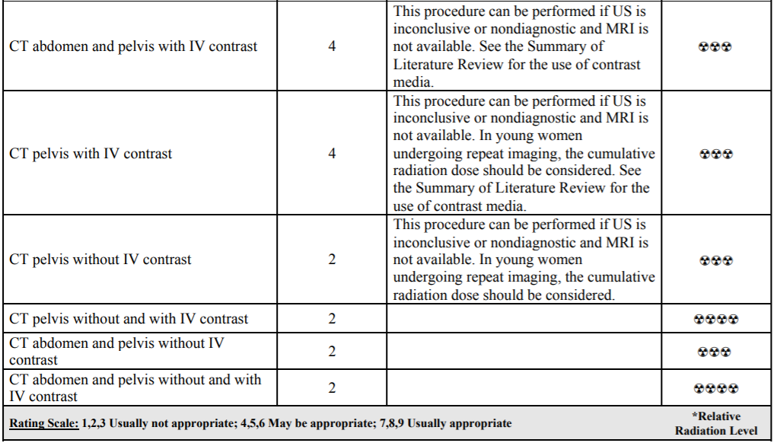
https://acsearch.acr.org/docs/69503/Narrative/

Slide 44
Take Home Points / Teaching points
Mature Cystic Ovarian Teratomas are the most common ovarian germ cell tumors in young women and can result in possible torsion or rupture
U/S is the preferred initial modality followed by a contrasted MRI or CT if inconclusive or nondiagnostic
There are many radiologic signs that can help diagnose mature cystic ovarian teratomas
Notes:
Bulleted list on the highlights and take home points of this case
What should the listener or reader walk away with from this presentation?
At least 3 points should be listed

Slide 45
References
https://radiopaedia.org/articles/mature-cystic-ovarian-teratoma-1?lang=us
https://www.uptodate.com/contents/ovarian-germ-cell-tumors-pathology-epidemiology-clinical-manifestations-and-diagnosis
https://radiopaedia.org/articles/rokitansky-nodule?lang=us
https://acsearch.acr.org/docs/69503/Narrative/
https://onlinepatientestimation.com/PatientPortal/patient/estimate
Katz DS, Khalid M, Coronel EE, Mazzie JP. Computed Tomography Imaging of the Acute Pelvis in Females. Canadian Association of Radiologists Journal. 2013;64(2):108-118. doi:10.1016/j.carj.2012.11.006
Ravi G, B. Swetha. Categorization of Ovarian Dermoids Depending Upon Their Sonographic Appearances. IOSR-JDMS. 2015;14(12):34-42.

Slide 46

Questions?
Thank you!

