Slide 1
Mesenteric Ischemia
Will Morris
3/3/21
RAD 4001 – General Radiology
Made in collaboration with Angel Su, MD

Slide 2
Clinical History
Patient is a male in his late 50s presenting to the ED with abdominal pain
  Pain is diffuse, severe, constant
  History of severe heart failure s/p Left Ventricular Assist Device (LVAD)
  Also has severe atherosclerotic disease and AAA that has required graft placement in the distal aorta
  Exam: generalized abdominal tenderness
  Patient presented to the ED 1 month prior with similar (but less severe) pain
    CTA abdomen/pelvis was performed but patient left AMA before any further workup could be done

Slide 3
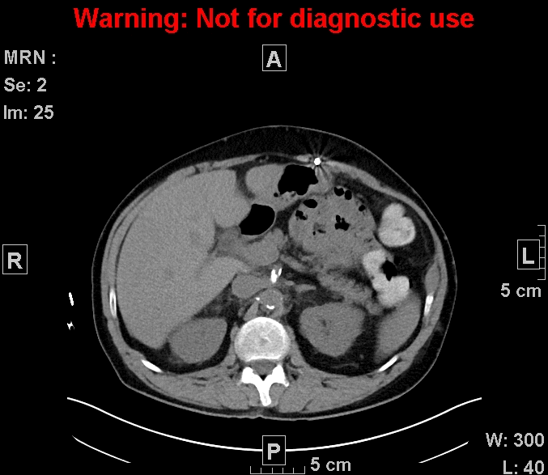
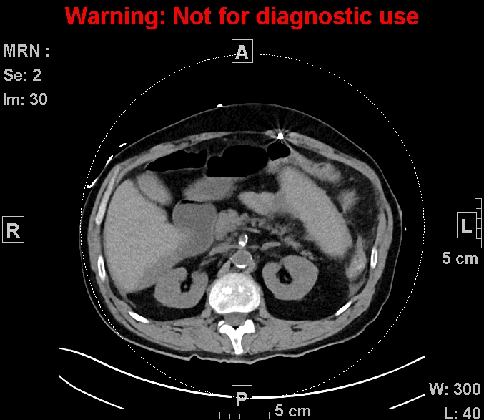
January 16th, 2021
February 19th, 2021

Slide 4
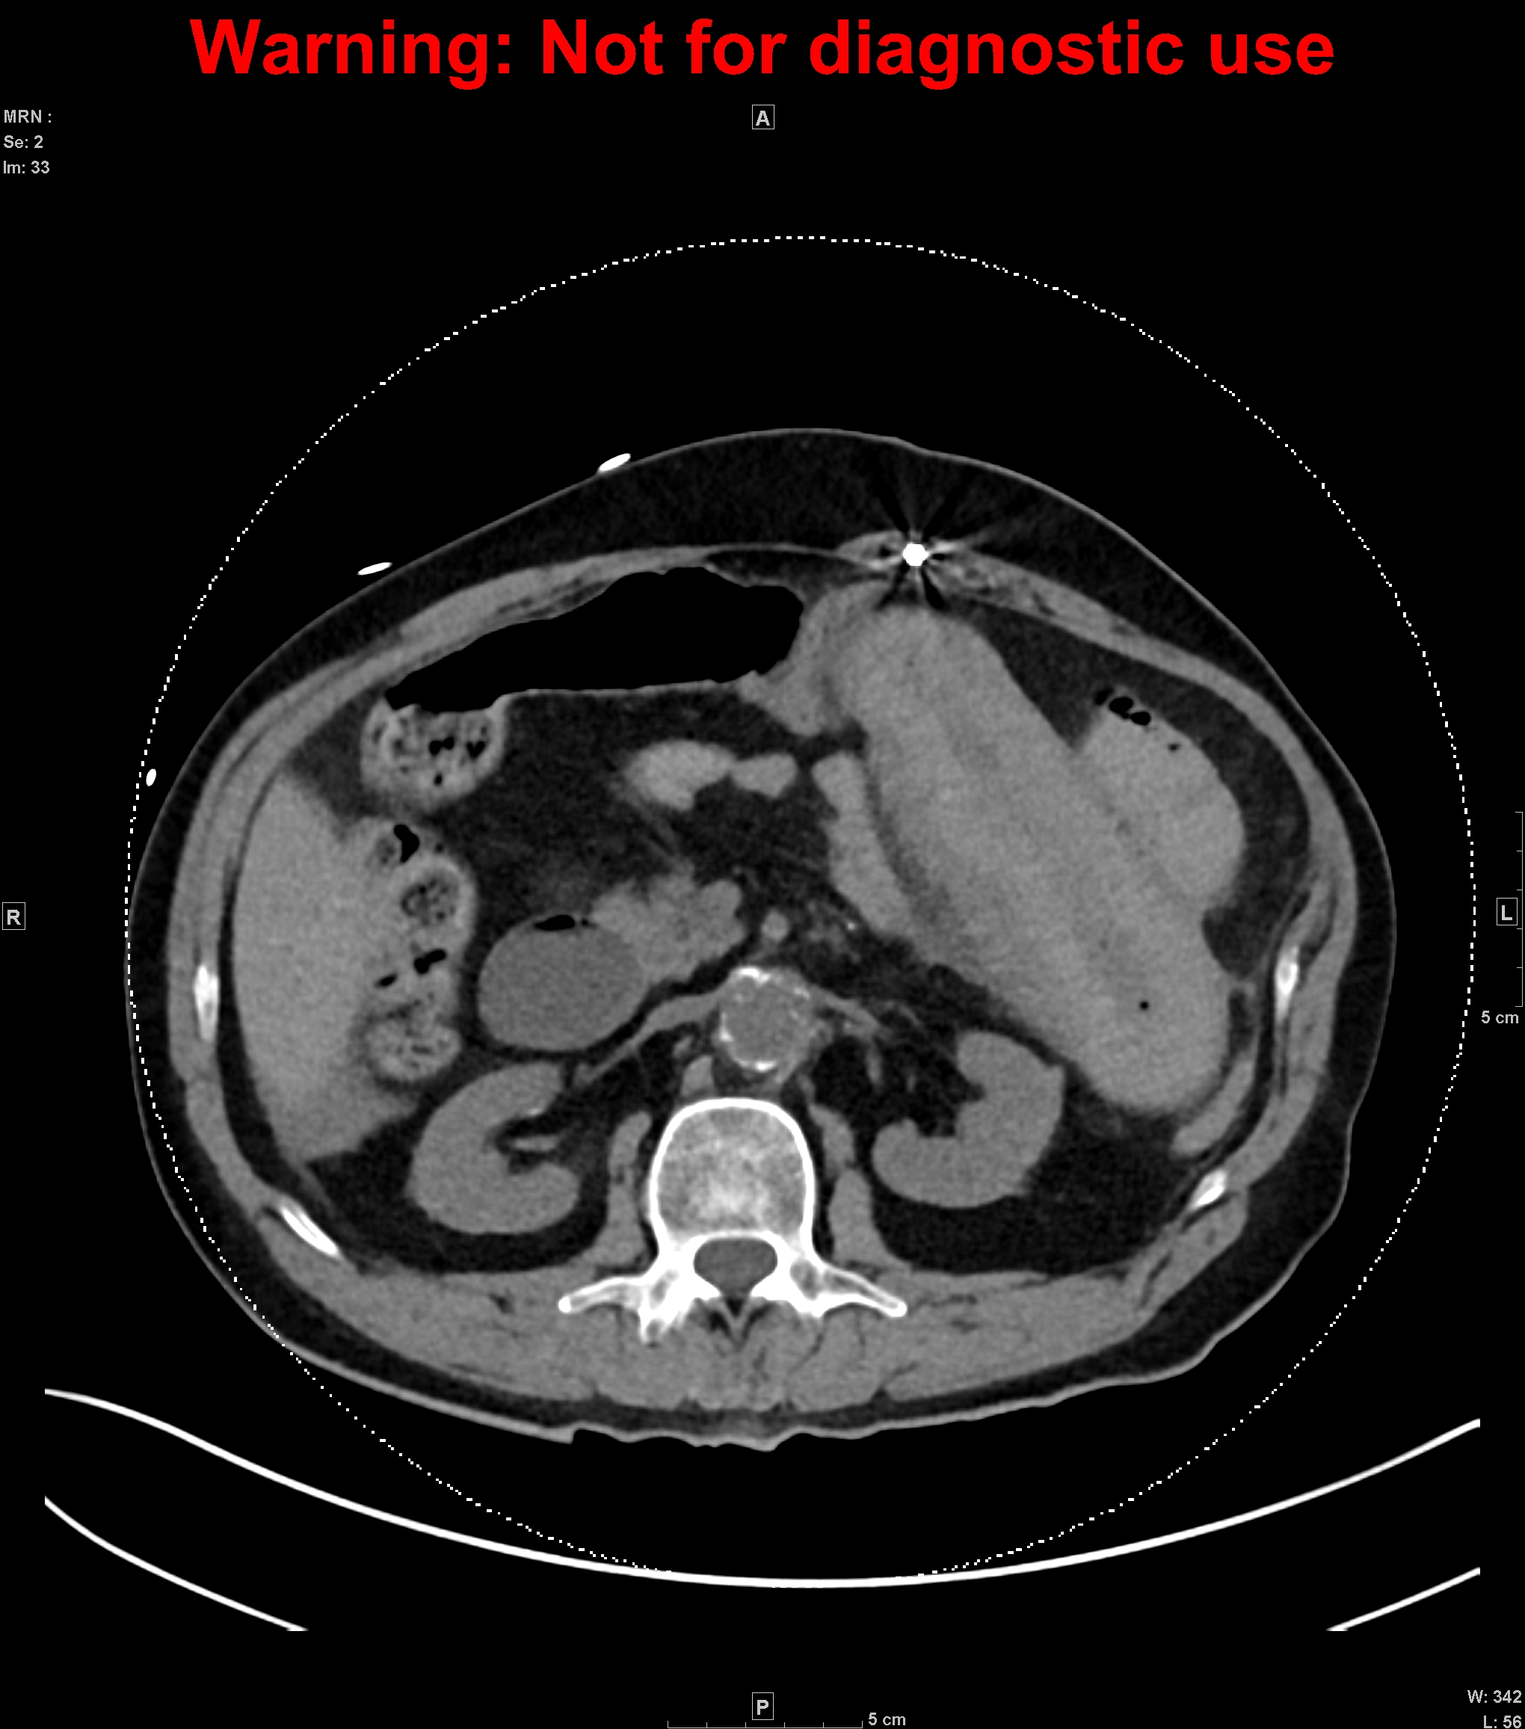
Bowel Wall Gas

Slide 5
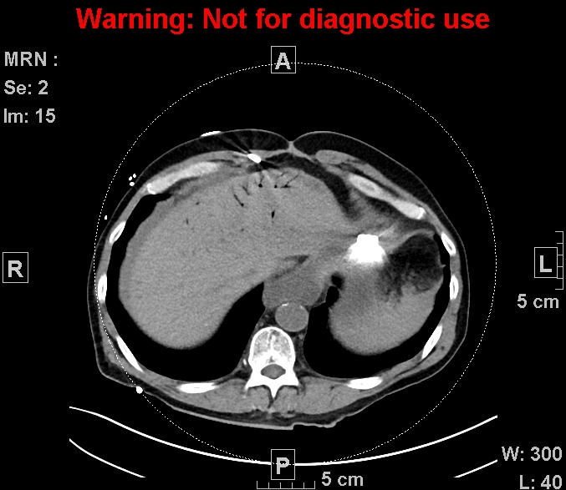
Portal Venous Gas

Slide 6
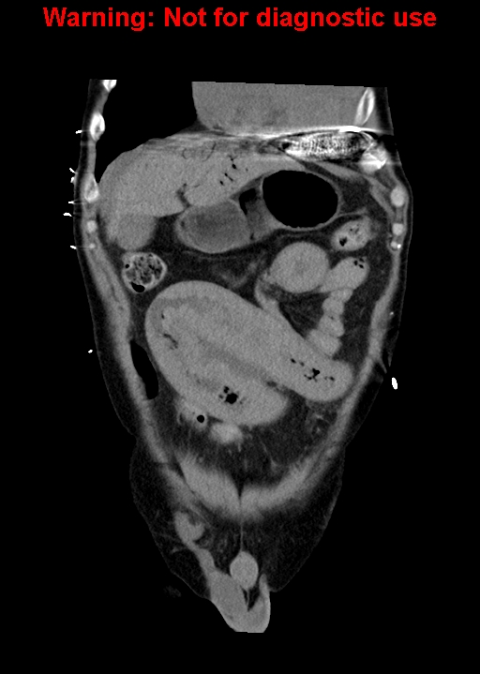
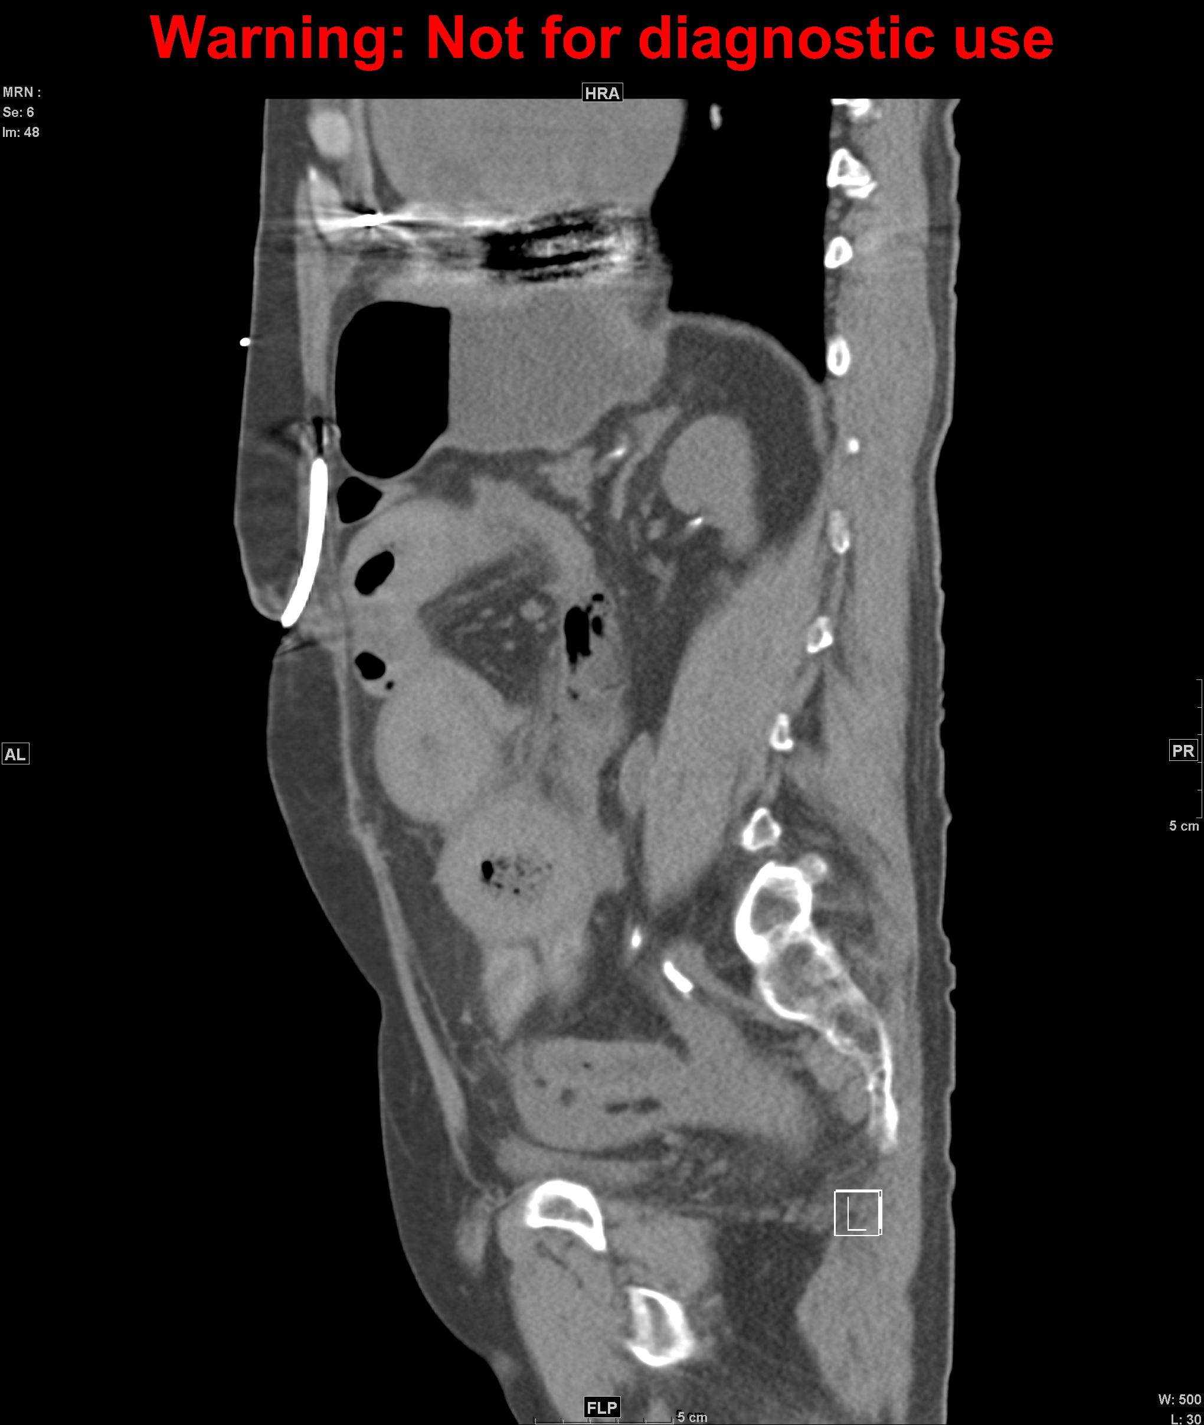
Bowel Wall Thickening/Dilation/Enhancement, Fat Stranding, and Free Fluid

Slide 7
Summary
History
Heart failure s/p LVAD
Severe atherosclerotic disease
Diffuse abdominal pain
CT Findings
Bowel wall gas (pneumatosis intestinalis)
Intrahepatic portal venous gas (pneumatosis portalis)
Bowel wall dilation/thickening/enhancement
Fat stranding
Free fluid

Slide 8
Differential Diagnoses
Diverticulosis/itis
IBD (Crohn’s vs. UC)
Mesenteric ischemia
Obstruction
Perforation of GI tract

Slide 9
Mesenteric Ischemia
Acute (95%) vs. Chronic (5%)
Within acute category:
  Arterial Occlusive (60-85%): typically an embolic event
  Non-Occlusive (15-30%): hypoperfusion
  Venous Occlusive (5-15%)
If untreated: ischemia → necrosis → sepsis and/or perforation → death
Treatment: urgent surgical exploration and mgmt. of underlying cause

Slide 10
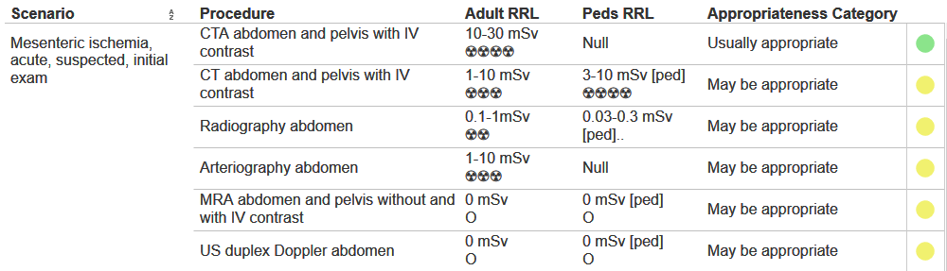
ACR Appropriateness Criteria
CTA abdomen/pelvis is the preferred imaging modality in this scenario
Average cost in Houston, TX: $700+

Slide 11
Take Home Points
History is vital!
  Identify risk factors (causes of hypoperfusion, atherosclerosis, etc)
Physical exam is highly variable and non-specific, but it is still important to assess for perotinitis
CTA is the preferred imaging modality
Imaging may not identify occlusion (remember: not always occlusive!)
Important to identify other features:
  Bowel wall gas
  Portal venous gas
    Note: differentiate from pneumobilia based on location of visible gas
  Pneumoperitoneum (not present in this particular case because there was no perforation)
  Variable amount of free fluid

Slide 12
Why is there air in the portal vein?
Bowel wall necrosis
Bacterial proliferation in necrotic bowel
Bacteria release gas into the wall
Gas enters mesenteric vessels
Gas travels into portal vein

Slide 13
References
https://radiopaedia.org/articles/mesenteric-ischaemia?lang=us
https://radiopaedia.org/articles/non-occlusive-mesenteric-ischaemia?lang=us
https://www.uptodate.com/contents/overview-of-intestinal-ischemia-in-adults
https://www.acr.org/Clinical-Resources/ACR-Appropriateness-Criteria
https://www.mdsave.com/procedures/ct-scan-of-abdomen-and-pelvis-with-contrast/d781f5c4/texas/houston-tx

Slide 14

Questions?

