Slide 1
Necrotizing Pancreatitis
Grace Howard
3/3/2021
RAD 4001
Dr. Mindy Wang (PGY3/R2)
Notes:
https://radiologyassistant.nl/abdomen/pancreas/acute-pancreatitis#imaging-necrotizing-pancreatitis

Slide 2
Clinical History
HPI
53 yo man with HTN, HLD, EtOH abuse and hernia repairs presents to the LBJ ED on Jan 2, 2021 with severe, epigastric abdominal pain lasting 4 hours. Pain is cramping and radiates to his back. The day prior, patient states he ate pizza and consumed six beers.
ROS
(+) Nausea, Vomiting x 3
(-) change in bowel movements, urine output
Notes:
Look through labs for epic
Maybe a picture of an abdominal PE
Labs: maybe have a lab slide separately

Slide 3
Epigastric Pain Differential Diagnosis
AAA
MI
Pancreatitis (Acute, Chronic)
Gastritis
Cholecystitis
Peptic Ulcer Disease
Acute Mesenteric Ischemia
GI Tract Perforation
Bowel Obstruction
Early Appendicitis
Hepatobiliary disease
Notes:
Add cardiogenic causes

Slide 4
History
Medical History
EtOH abuse
HTN
HLD
Surgical History
b/l inguinal hernia repair
Social History
Occupation: mechanic
Denies alcohol use for previous 10 years

Slide 5
Home Medications
Atorvastatin 40 mg
Fenofibrate 145 mg
Amlodipine 10 mg
Lisinopril-HCTZ 10-12.5 mg

Slide 6
Physical Exam
Vital Signs
BP: 192/116 → 226/116
Pulse: 67 → 62
RR: 28 → 25
Temp: 98 F → 98 F
O2: 98% → 98%
Notes:
Values from 9 AM to 10 AM on Saturday morning, highlighting blood pressure
BP went to 244/120 while in ED

Slide 7
Physical Exam
General: moderate distress, AAOx3
CV: bradycardic, distal pulses intact
Resp: tachypneic, lung sounds clear to auscultation
Abd:
Normal bowel sounds
Soft abdomen
Tender to palpation in RUQ, epigastric region, LUQ
(-) guarding, rebound tenderness
Notes:
Of note, patient was admitted to ICU. Intensivists note on physical exam reports the following changes: decreased breath sounds, basilar crackles, distended and diffusely tender abdomen, absent bowel sounds

Slide 8
Labs
17.4
141
101
14
30.8
255
265
3.8
25
1.2
Lactate: 3.6
COVID: POSITVE
AST 302 T Bili: 1.2
ALT 211 D Bili: 0.7
Alk Phos 210
Chol: 252
Lipase: 7,556 HDL: 45
LDL: 159
TG: 240
Notes:
CBC, CMP, AST, ALT, Tbili, ALP, Lipase, lactic acid
Anion gap, Lactate (can show that
Incidentally covid +
EKG

Slide 9
Labs
17.4
141
101
14
30.8
255
265
3.8
25
1.2
Lactate: 3.6 ➔ 7.4 ➔ 8.2
COVID: POSITVE
AST 302 T Bili: 1.2
ALT 211 D Bili: 0.7
Alk Phos 210
Chol: 252
Lipase: 7,556 HDL: 45
LDL: 159
TG: 240
Notes:
CBC, CMP, AST, ALT, Tbili, ALP, Lipase, lactic acid
Anion gap, Lactate (can show that
Incidentally covid +
EKG

Slide 10
Healthy Pancreas on CT Abd with Contrast
Remember this

Slide 11
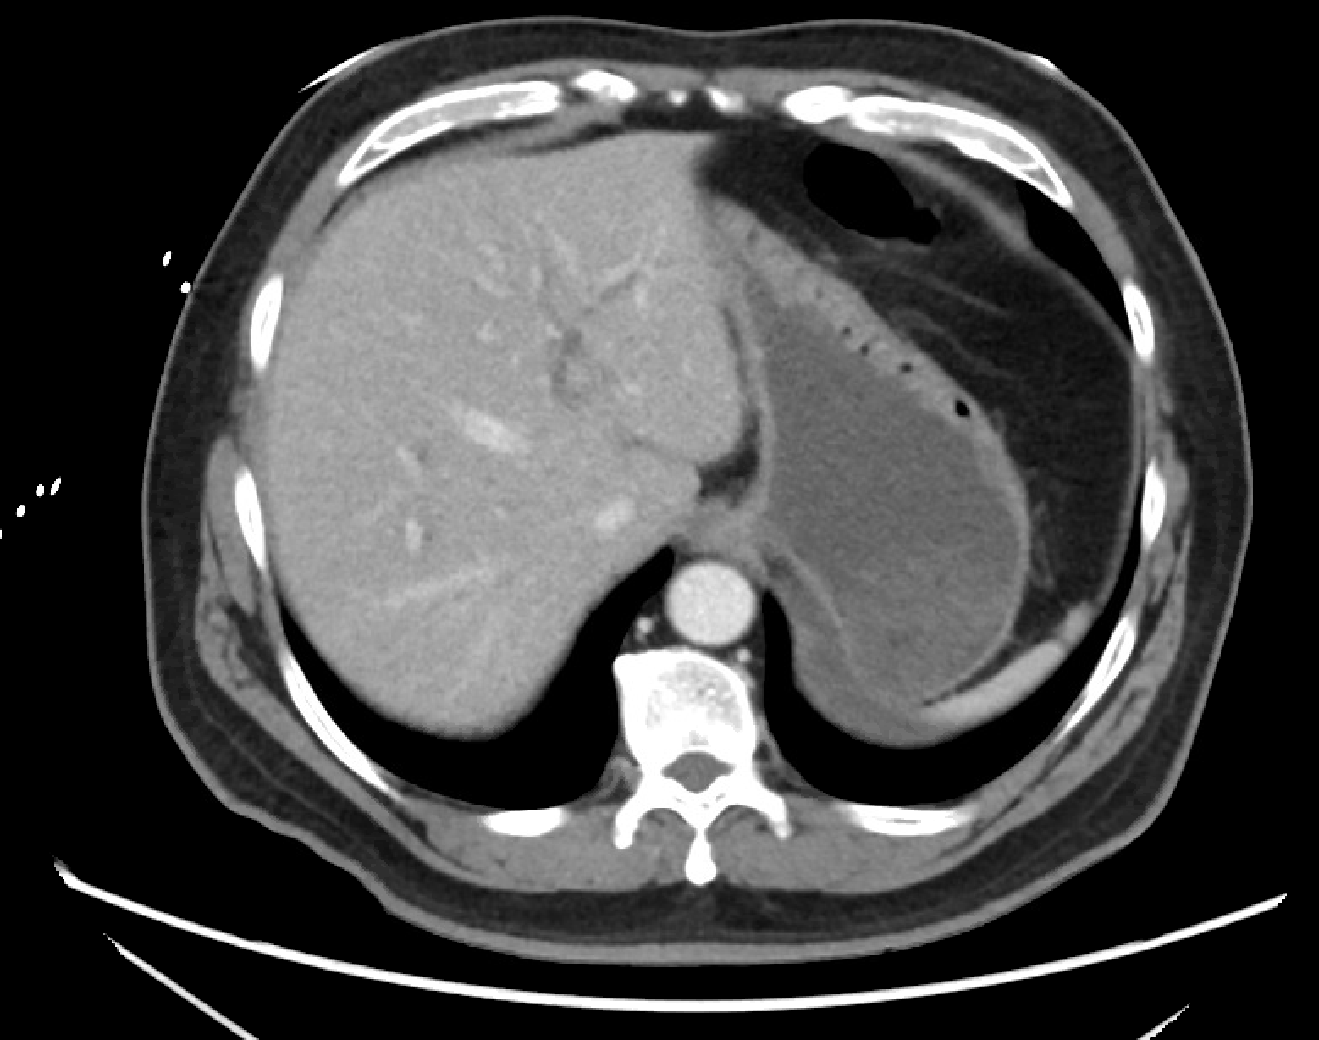
Imaging: CT A/P with Contrast (1/2/21)
Liver
Fat
Stomach
Ao
Notes:
CT Abdomen and pelvis: 1/2/2021 read by Dr. Mindy Wang, compared to 6/9/2015 previous imaging
Findings:
Impression: acute necrotizing pancreatitis, non-encapsulated peripancreatic fluid, gallstones present in gall bladder, CBD dilated (1.4 cm)
How did this imaging change our understanding?

Slide 12
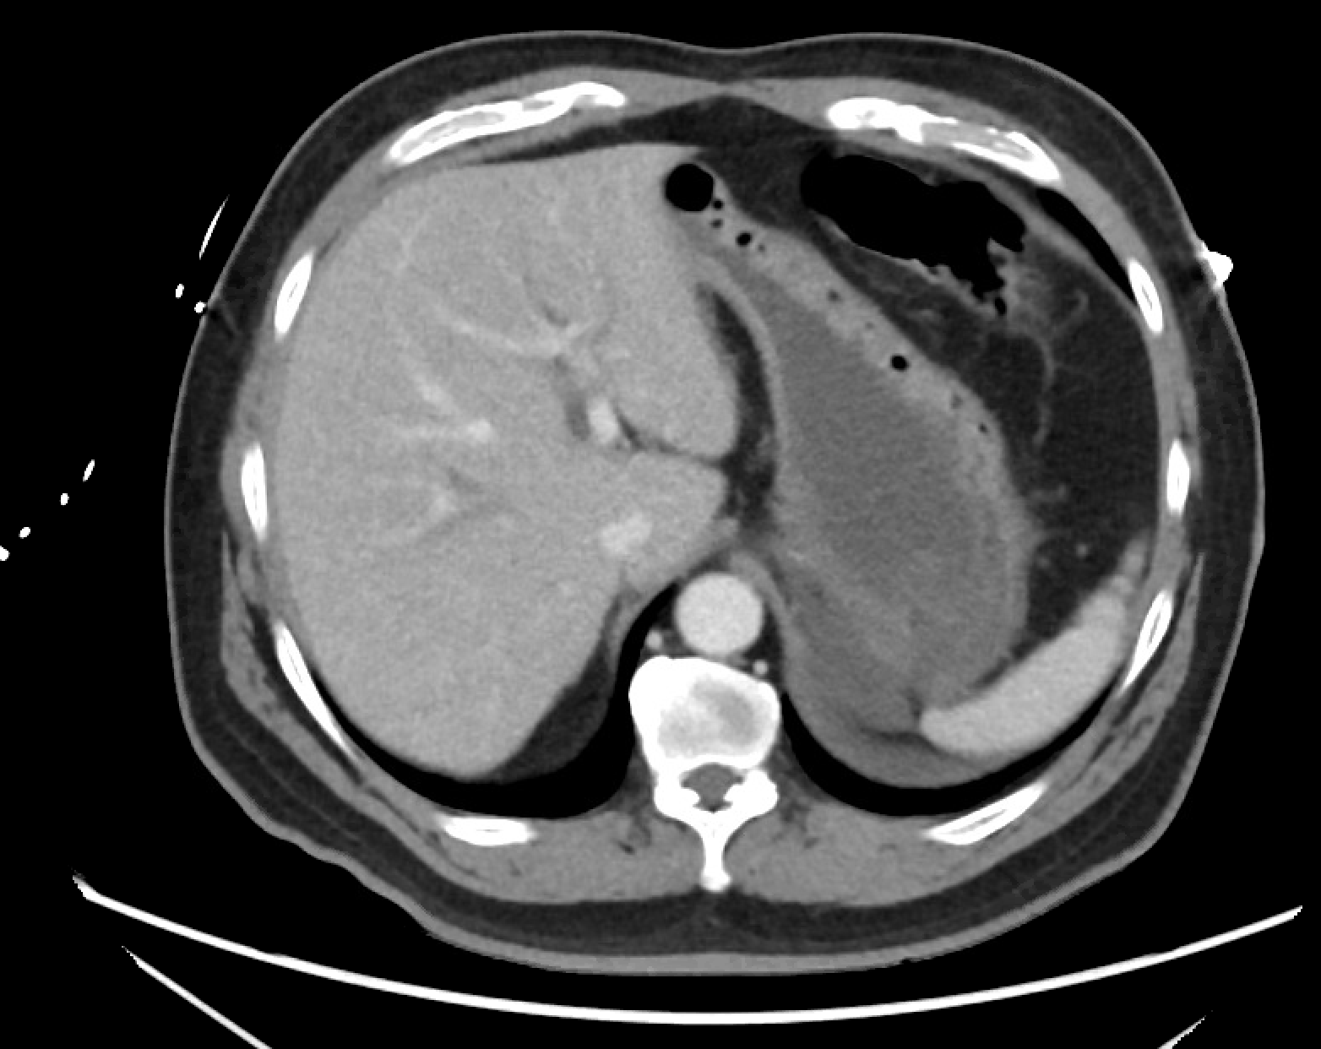
Imaging: CT A/P with Contrast (1/2/21)
Liver
Stomach
Spleen
Notes:
CT Abdomen and pelvis: 1/2/2021 read by Dr. Mindy Wang, compared to 6/9/2015 previous imaging
Findings:
Impression: acute necrotizing pancreatitis, non-encapsulated peripancreatic fluid, gallstones present in gall bladder, CBD dilated (1.4 cm)
How did this imaging change our understanding?

Slide 13
Imaging: CT A/P with Contrast (1/2/21)
Fat Stranding
Liver
IVC
Ao
Spleen
Notes:
CT Abdomen and pelvis: 1/2/2021 read by Dr. Mindy Wang, compared to 6/9/2015 previous imaging
Findings:
Impression: acute necrotizing pancreatitis, non-encapsulated peripancreatic fluid, gallstones present in gall bladder, CBD dilated (1.4 cm)
How did this imaging change our understanding?

Slide 14
Imaging: CT A/P with Contrast
Notes:
CT Abdomen and pelvis: 1/2/2021 read by Dr. Mindy Wang, compared to 6/9/2015 previous imaging
Findings:
Impression: acute necrotizing pancreatitis, non-encapsulated peripancreatic fluid, gallstones present in gall bladder, CBD dilated (1.4 cm)
How did this imaging change our understanding?

Slide 15
Imaging: CT A/P with Contrast (1/2/21)
Fat stranding
Gb
PV
Pancreas
Peripancreatic Fluid
IVC
Ao
Spleen
R K
Notes:
//focus on this slide//
CT Abdomen and pelvis: 1/2/2021 read by Dr. Mindy Wang, compared to 6/9/2015 previous imaging
Findings:
Impression: acute necrotizing pancreatitis, non-encapsulated peripancreatic fluid, gallstones present in gall bladder, CBD dilated (1.4 cm)
How did this imaging change our understanding?

Slide 16
Imaging: CT A/P with Contrast (1/2/21)
Fat Stranding
Peripancreatic Fluid
Gb
Gallstone
Pancreas
IVC
Ao
Spleen
RK
LK
Notes:
CT Abdomen and pelvis: 1/2/2021 read by Dr. Mindy Wang, compared to 6/9/2015 previous imaging
-gallstones present (verify)
Findings:
Impression: acute necrotizing pancreatitis, non-encapsulated peripancreatic fluid, gallstones present in gall bladder, CBD dilated (1.4 cm)
How did this imaging change our understanding?

Slide 17
Imaging: CT A/P with Contrast (1/2/21)
Fat Stranding
CBD
Peripancreatic Fluid
Notes:
CT Abdomen and pelvis: 1/2/2021 read by Dr. Mindy Wang, compared to 6/9/2015 previous imaging
Findings:
Impression: acute necrotizing pancreatitis, non-encapsulated peripancreatic fluid, gallstones present in gall bladder, CBD dilated (1.4 cm)
How did this imaging change our understanding?

Slide 18
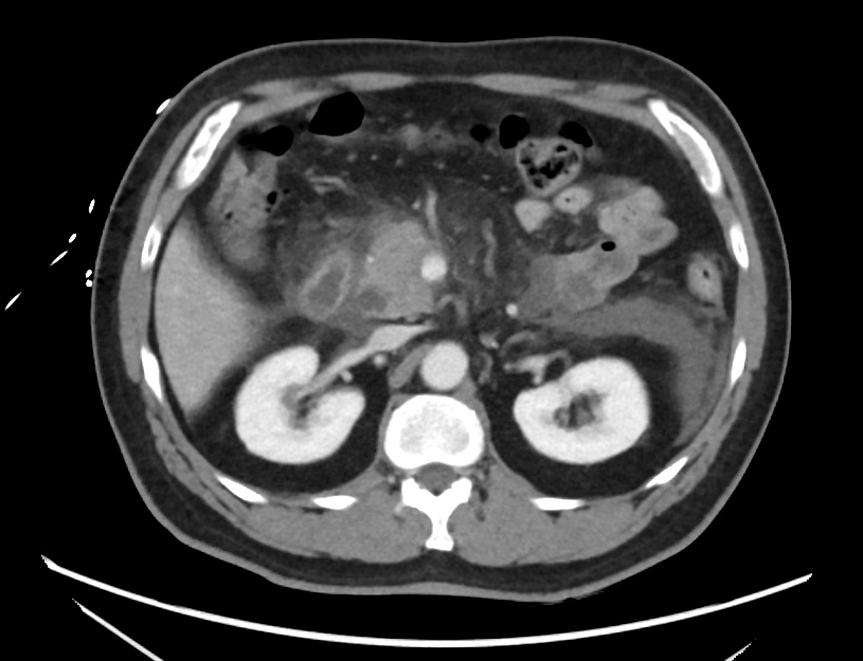
Imaging: CT A/P with Contrast
Notes:
CT Abdomen and pelvis: 1/2/2021 read by Dr. Mindy Wang, compared to 6/9/2015 previous imaging
Findings:
Impression: acute necrotizing pancreatitis, non-encapsulated peripancreatic fluid, gallstones present in gall bladder, CBD dilated (1.4 cm)
How did this imaging change our understanding?

Slide 19
Imaging: CT A/P with Contrast
Notes:
CT Abdomen and pelvis: 1/2/2021 read by Dr. Mindy Wang, compared to 6/9/2015 previous imaging
Findings:
Impression: acute necrotizing pancreatitis, non-encapsulated peripancreatic fluid, gallstones present in gall bladder, CBD dilated (1.4 cm)
How did this imaging change our understanding?

Slide 20
Imaging: CT A/P with Contrast (1/2/21)
Key Findings:
Pancreas: diffusely edematous with areas of decreased enhancement in the pancreatic body and tail more than the head/uncinate process
Peripancreatic fluid/fat stranding present
No organized or encapsulated fluid collection
CBD dilated to 1.4 cm
Stones present in gall bladder
Impression:
Acute necrotizing pancreatitis with nonencapsulated peripancreatic fluid
Cost: $474.00 cost from medicare.gov
Notes:
CT Abdomen and pelvis: 1/2/2021 read by Dr. Mindy Wang, compared to 6/9/2015 previous imaging
Findings:
Estimated Results - American Health Imaging
Impression: acute necrotizing pancreatitis, non-encapsulated peripancreatic fluid, gallstones present in gall bladder, CBD dilated (1.4 cm)
How did this imaging change our understanding?

Slide 21
U/S Abdomen (1/2/21)
Sludge
Gallstone
Notes:
(check this with residents…not sure where to find U/S imaging, just have the report)
U/S ordered for concern for gallstone pancreatitis
Technique: multiplanar grayscale and color doppler U/S of RUQ
Findings: liver: CC: 15.5 cm
Echogen: diffusely hyperechoic
Surface: normal
Mass: non
PV: caliber: 1 cm, flow: hepatopetal
Bile ducts: CBD diameter: 1.1 cm, intrahepatic duct: normal
Gallbladder:
* multiple mobile gallstones
* sludge present
* wall: 0.2 cm
* no polyps/masses
Impression: cholelithiasis and sludge without evidence of acute choleycystitis, dilated CBD up to 1. cm, could be concerning for choledocholithiasis, diffuse hepatic steatosis,
Compared to CT abd/pelvis of 1/2/2021

Slide 22
U/S Abdomen (1/2/21)
Key Findings
Gallbladder
multiple mobile gallstones
sludge present
GB wall: 0.2 cm
no polyps/masses
Impression
cholelithiasis and sludge without evidence of acute cholecystitis, dilated CBD up to 1.1 cm, could be concerning for choledocholithiasis
diffuse hepatic steatosis
Cost: $153.00 cost estimate from medicare.gov
Notes:
Findings:
Impression: acute necrotizing pancreatitis, non-encapsulated peripancreatic fluid, gallstones present in gall bladder, CBD dilated (1.4 cm)
How did this imaging change our understanding?
Look at classifications and grading system: https://www.jacr.org/article/S1546-1440(19)30604-0/fulltext (citation on Zotero)

Slide 23
Differential Diagnosis
Acute Pancreatitis
Autoimmune Pancreatitis
Malignancy

Slide 24
Diagnosis of Acute Pancreatitis (2/3)
Lipase or Amylase > 3x normal limit
Severe, acute epigastric pain
Imaging Findings
Notes:
https://radiologyresidentcorelectures.com/1121-dane/
Imaging helps us establish diagnosis, identify the cause (choledocholithiasis, biliary dilation), assess severity, detect complicatitons
Optimal time is usually 48-72 hours
Usually single-phase portal venous phase A/P
Balthazar CT Severity Index:
Grading of Pancreatitis, Pancreatic Necrosis (an important prognostic indicator)
Pancreatic necrosis: defined as non-enhancing portion of the pancreas
Grading:
A: normal (0)
B: enlarged (1)
C: peripancreatic fat stranding (2)
D: single fluid collection (3)
E: Two fluid collection (4)
Pancreatic Necrosis: None (0)
<= 30% (2)
30-50% (4)
>50 % (6)
0-3: mild acute pancreatitis
4-6: moderate, acute pancreatitis
7-10: severe acute pancreatitis
Morbidity of 90%
Mortality 17%
Peripancreatic necrosis: fat around can necrose
Revised Atlanta Classification of Acute Pancreatitis:
<4 weeks: acute peripancreatic

Slide 25
Discussion: Pathophysiology
Notes:
Reference: https://www.intechopen.com/books/intensive-care/severe-acute-pancreatitis-and-its-management
Inciting event ➔ damage to pancreatic acinar cells➔ pancreatic inflammation and release of enzymes➔ chain reaction causing more damage, leaking of enzymes, autodigestion
A case where positive feedback is not a good thing

Slide 26
Discussion: Etiology
Idiopathic
Gallstones**
EtOH**
Trauma
Steroids
Mumps/Malignancy
Autoimmune (IgG4 antibody)
Scorpion
Hypertriglyceridemia, Hypercalcemia
ERCP
Drugs
HCTZ, Sulfa drugs, Azathioprine

Slide 27
Discussion: Revised Atlanta Classification
Two Phases | Early <= 1st Week | Late > 1st Week
Severity | Mild no organ failure | Moderate organ failure <48 hr | Severe Organ failure >48 hr
Two Types (Complications) | Edematous <4 wk: acute peripancreatic collection >4 wk: pseudocyst | Necrotizing <4 wk: acute necrotic collection >4 wk: walled-off necrosis
Notes:
Table Based on https://radiologyassistant.nl/abdomen/pancreas/acute-pancreatitis#introduction

Slide 28
CT Severity Imaging
Grading of Pancreatitis
Grade | Description | Points
A | Normal | 0
B | Enlarged | 1
C | Peripancreatic Fat Stranding | 2
D | Single Fluid Collection | 3
E | Two Fluid Collection | 4
Pancreatic Necrosis Score
Percent of Pancreatic Necrosis | Points
None | 0
<= 30 % | 2
30-50% | 4
>50 % | 6
CT Severity Index
Total Score | CT Severity
0-3 | Mild Acute Pancreatitis
4-6 | Moderate Acute Pancreatitis
7-10 | Severe Acute Pancreatitis
Notes:
Balthazar CT Severity Index:
Grading of Pancreatitis, Pancreatic Necrosis (an important prognostic indicator)
Pancreatic necrosis: defined as non-enhancing portion of the pancreas
Grading:
A: normal (0)
B: enlarged (1)
C: peripancreatic fat stranding (2)
D: single fluid collection (3)
E: Two fluid collection (4)
Pancreatic Necrosis: None (0)
<= 30% (2)
30-50% (4)
>50 % (6)
0-3: mild acute pancreatitis
4-6: moderate, acute pancreatitis
7-10: severe acute pancreatitis
Morbidity of 90%
Mortality 17%

Slide 29
Complications
Fluid Collections
Necrosis Absent
Acute peripancreatic fluid collection
Pseudocysts
Necrosis Present
Acute necrotic collections
Walled-off necrosis
Necrotizing Pancreatitis
Can become infected**
Vascular Complications
Vascular
Hemorrhage (gastroduodenal, splenic)
Pseudoaneurysm
Thrombosis
Splenic and Portal Veins
Fistula Formations
Abdominal Compartment Syndrome
Notes:
Over the course of this patient’s hospitalization, has experienced splenic vein thrombus, necrosis of the pancreas, emphysematous pancreatitis, and abdominal compartment syndrome
ACS: defined as intra-abdominal pressure elevated >20 mmHg with concommittant organ dysfunction and failure

Slide 30
Initial Management
Patient admitted to SICU
Fluid Resuscitation
5 L Bolus
Pain Control
Tylenol, Gabapentin, Dilaudid
Nutritional Support
NPO then placed on TPN

Slide 31
The Rest of the Story…
1/3: ex-lap abdominal compartment syndrome, bloody ascites
1/5: ex-lap, cholecystectomy, abdomen left open
1/8-1/21: multiple washouts, NJ tubes, GI complications
2/10: CT A/P shows multiloculated retroperitoneal/pelvic collection, splenic vein thrombosis
2/19-2/26: multiple necrosectomies with GI
58 Day Hospitalization
Notes:
Try to insert 2/25 image

Slide 32
Final Diagnosis
CTSI= 7- 10
Severe Necrotizing Acute Pancreatitis
Outcome: multiple complications, morbidity, at LBJ preparing to discharge to LTAC

Slide 33
ACR appropriateness Criteria
Notes:
In majority of patients diagnosis can be made based on clinical findings of abd pain, elevated serum lipase, amylase
CT may not provide additional information,
however, in this case given patient’s presentation, rising
ACR:
Cost Calculator: https://www.americanhealthimaging.com/cost-calculator/

Slide 34
Teaching points
Imaging not always required for diagnosing pancreatitis, but can help with etiology
Diagnose with the Revised Atlanta Classification
Watch out for complications! Imaging can’t reliably identify infection
Notes:
Take home points????

Slide 35
References
ACR Appropriateness Criteria® Acute Pancreatitis—PubMed. (n.d.). Retrieved March 2, 2021, from https://pubmed.ncbi.nlm.nih.gov/31685100/
Acute pancreatitis | Radiology Reference Article | Radiopaedia.org. (n.d.). Retrieved March 2, 2021, from https://radiopaedia.org/articles/acute-pancreatitis?lang=us
Pfleger, R. (n.d.). Revised Atlanta classification of acute pancreatitis | Radiology Reference Article | Radiopaedia.org. Radiopaedia. Retrieved March 2, 2021, from https://radiopaedia.org/articles/revised-atlanta-classification-of-acute-pancreatitis-2?lang=us
Thoeni, R. F. (2012). The Revised Atlanta Classification of Acute Pancreatitis: Its Importance for the Radiologist and Its Effect on Treatment. Radiology, 262(3), 751–764. https://doi.org/10.1148/radiol.11110947

Slide 36
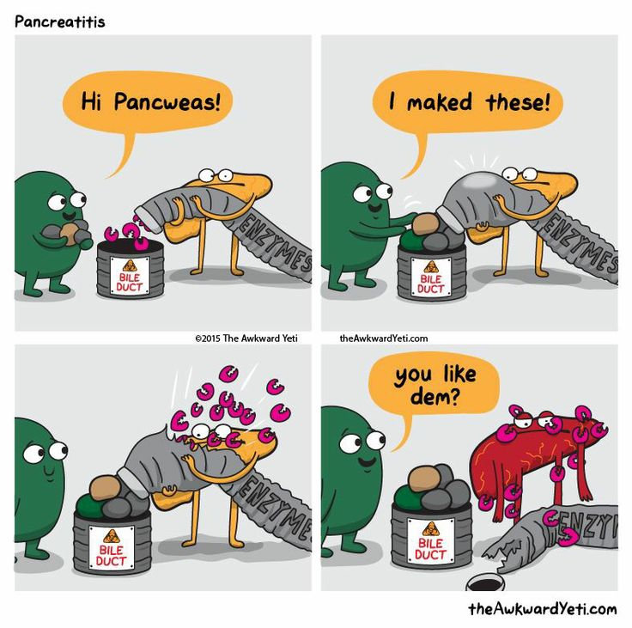
Questions?

Slide 37
Ranson’s vs BISAP

