Slide 1
Pneumoperitoneum
Chad Zhao
March 5, 2021
RAD 4001

Slide 2
Clinical History
84 y/o M w/ PMH stroke in 2009, hypertension, hypothyroidism who presented to OSH on 1/26 for increasing confusion and lethargy for past 3 weeks with multiple falls from standing height, found to have an acute on chronic SDH with 9mm midline shift. Patient transferred to MHH for neurosurgical evaluation.
Underwent burr hole for clot evacuation and drain placement on 1/26 and MMA embolization on 1/28. Hospital course was complicated by altered mental status, poor respiratory effort, and dysphagia. Underwent PEG tube placement on 2/10.
On 2/11, patient was noted to be persistently hypotensive despite fluids, uptrending creatinine, worsening of encephalopathy. Transferred to ICU and started on pressors.

Slide 3
Imaging
Notes:
Image taken for placement of R IJ on 2/11

Slide 4
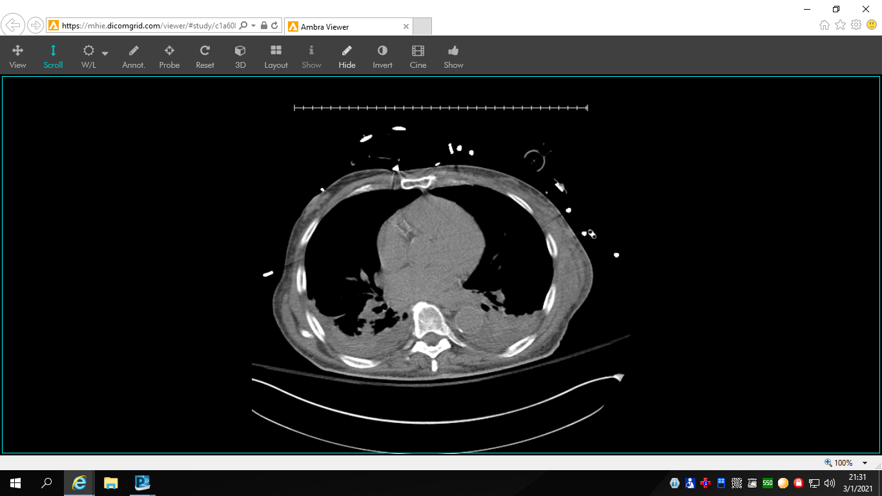
Notes:
CT AP taken on 2/12

Slide 5
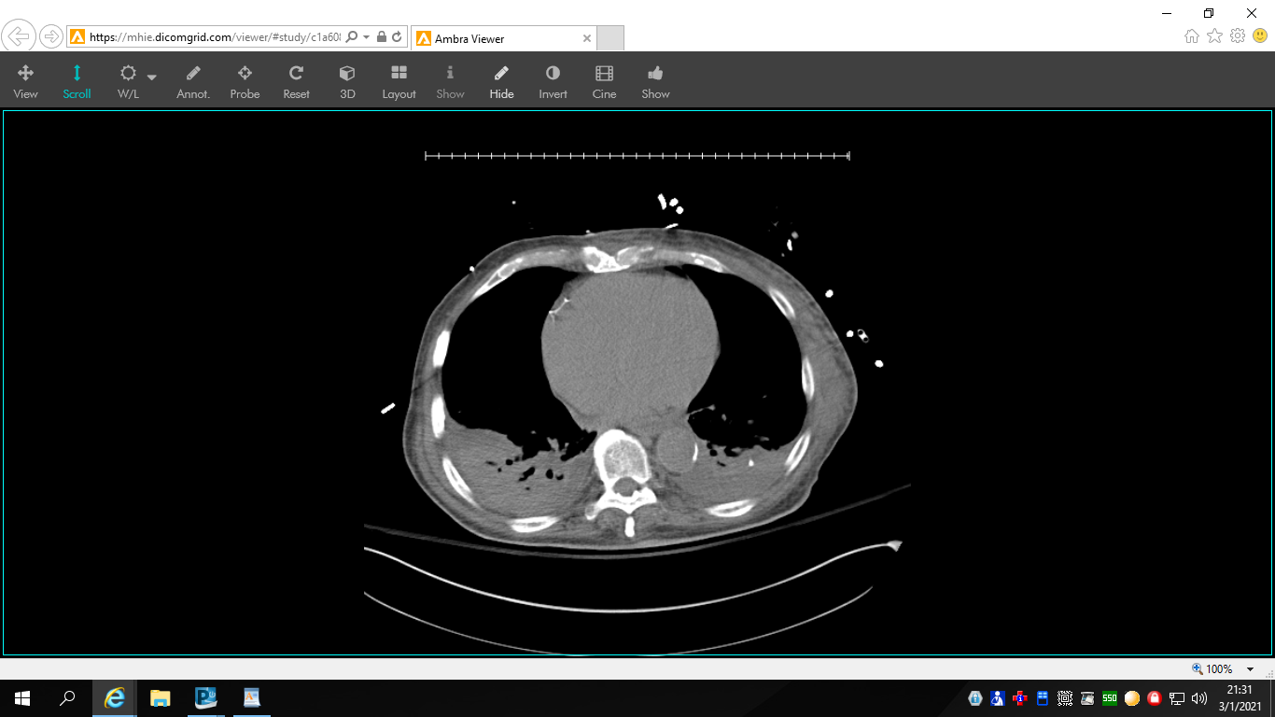

Slide 6
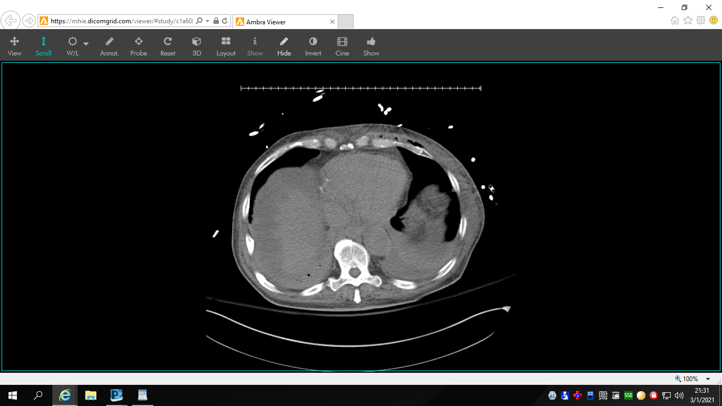

Slide 7
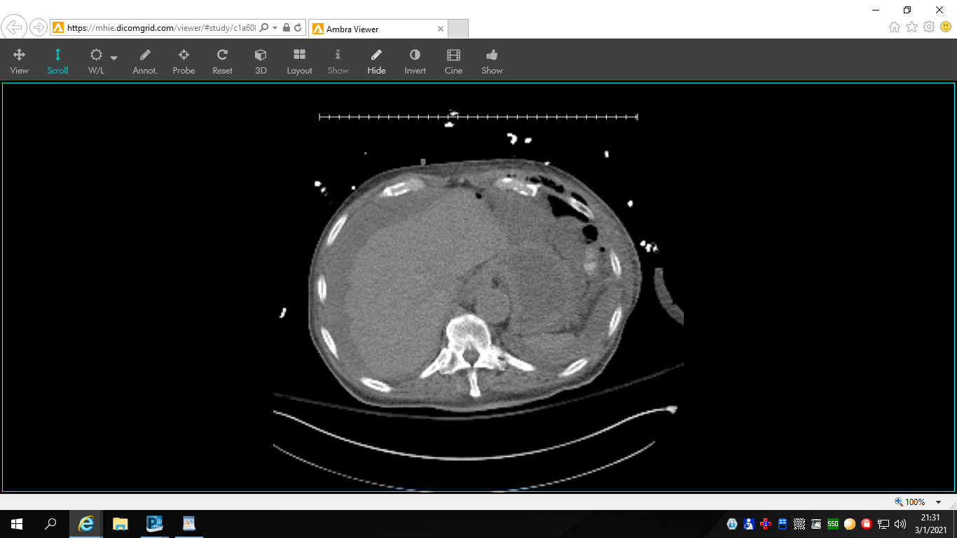

Slide 8
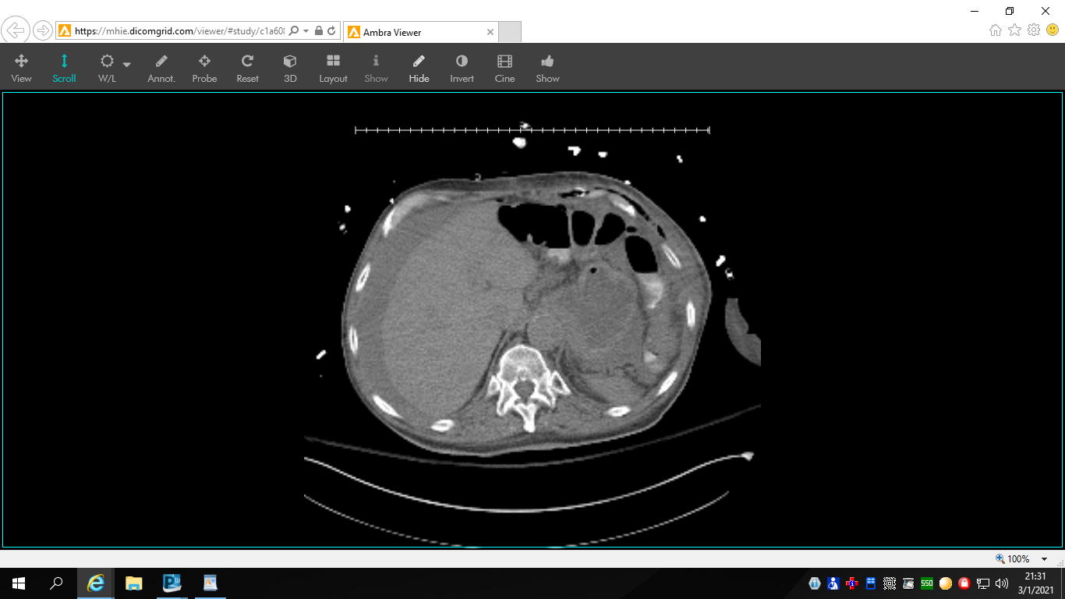

Slide 11
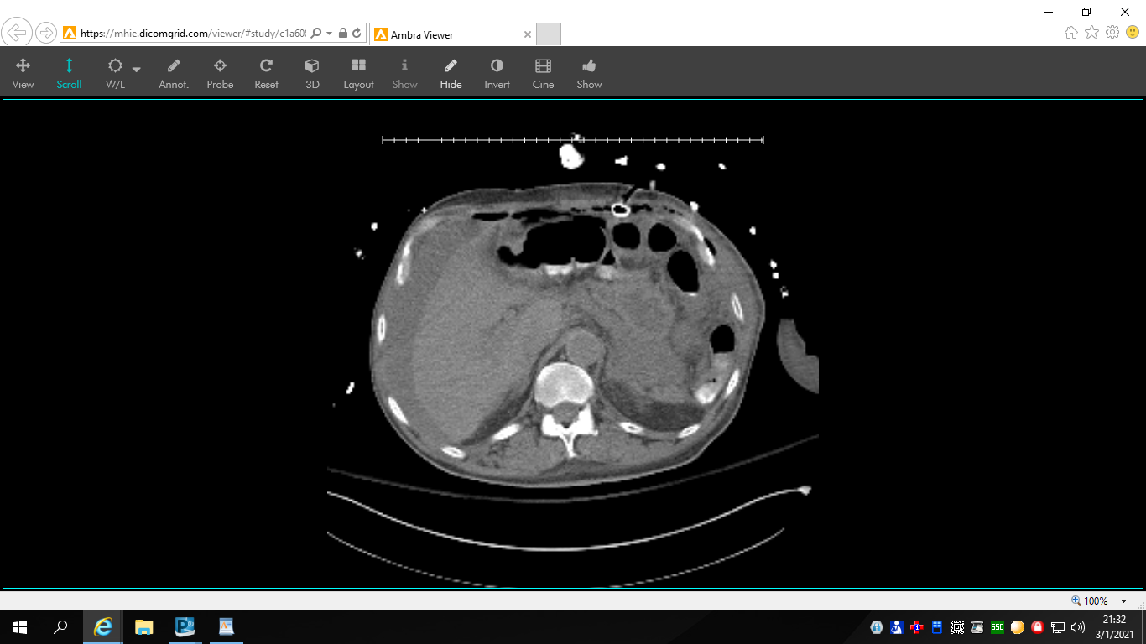

Slide 14
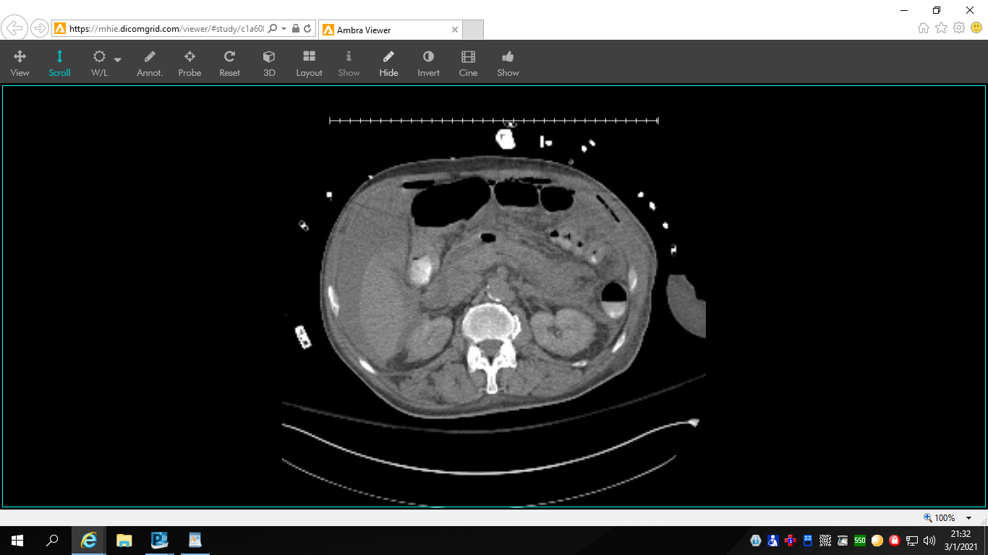

Slide 15
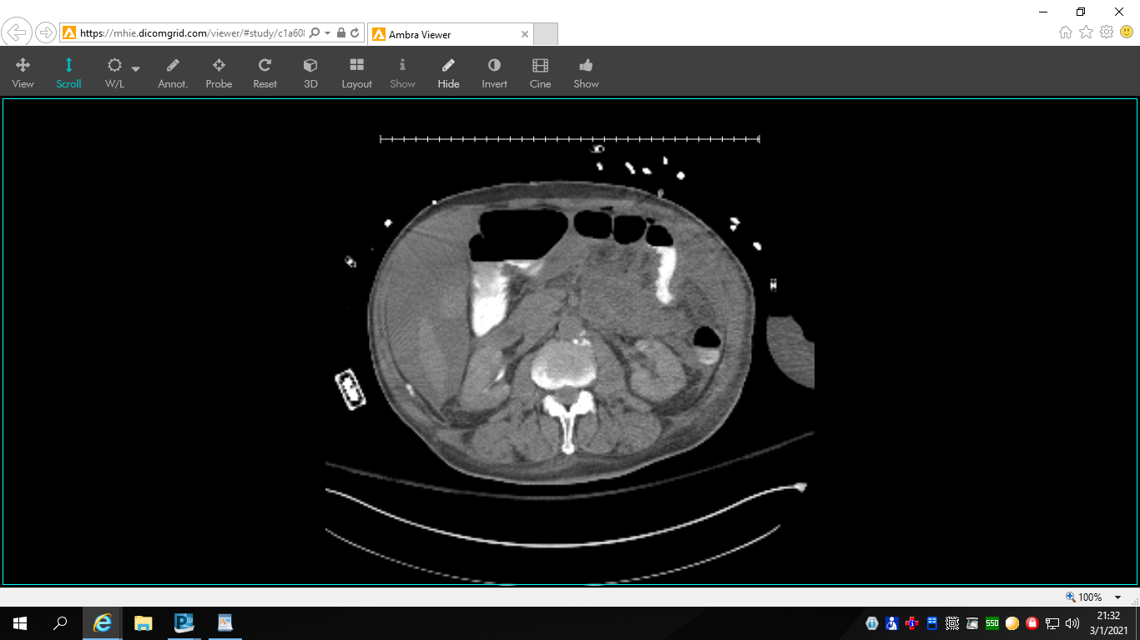

Slide 16
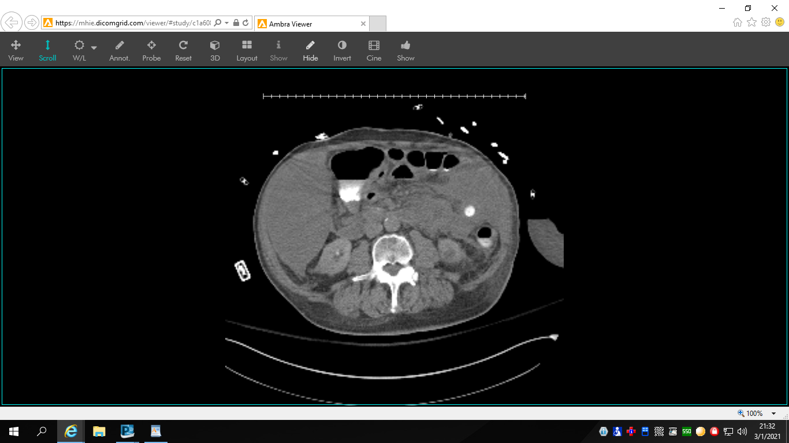

Slide 17
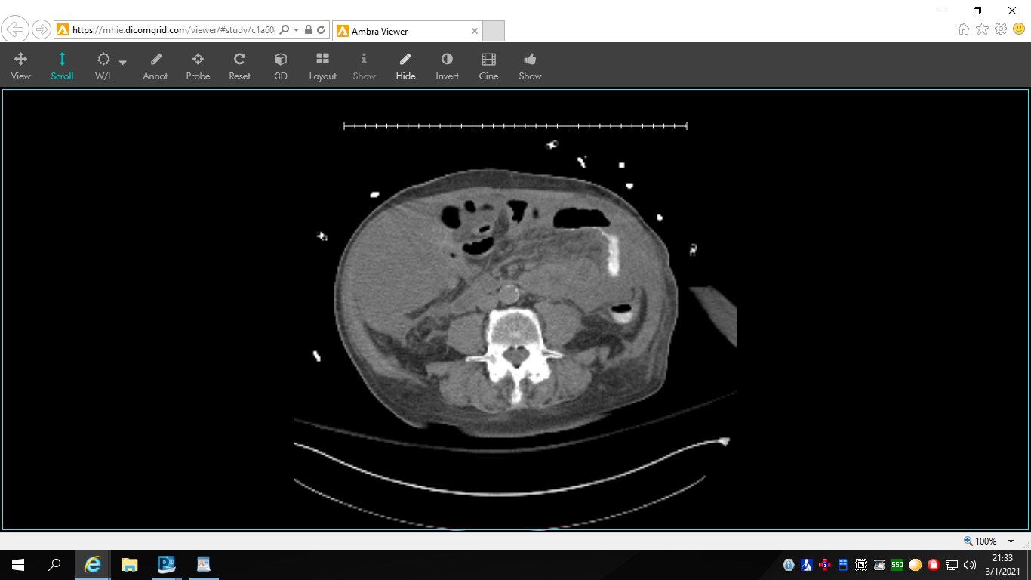

Slide 18
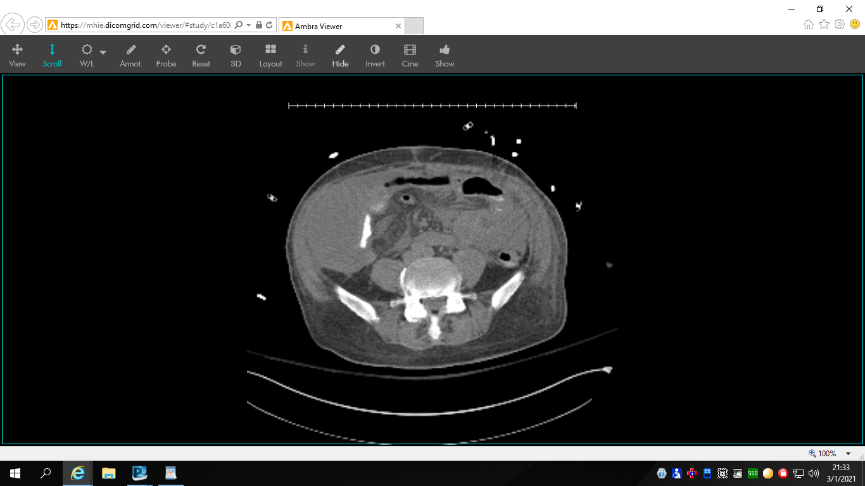

Slide 19
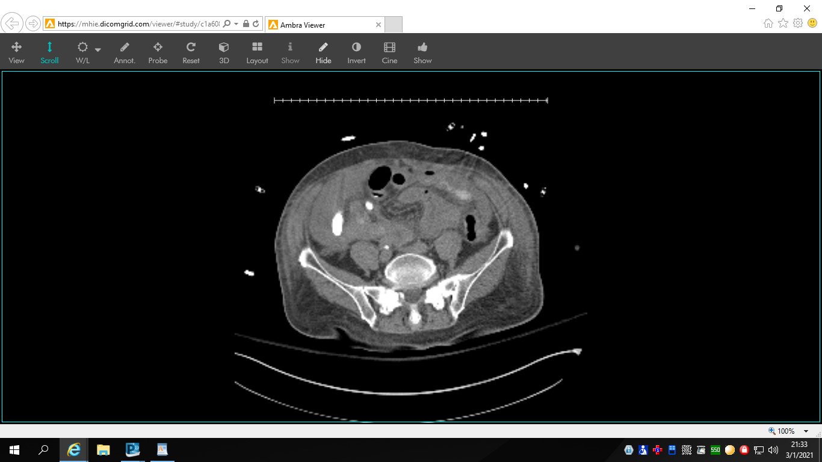

Slide 20
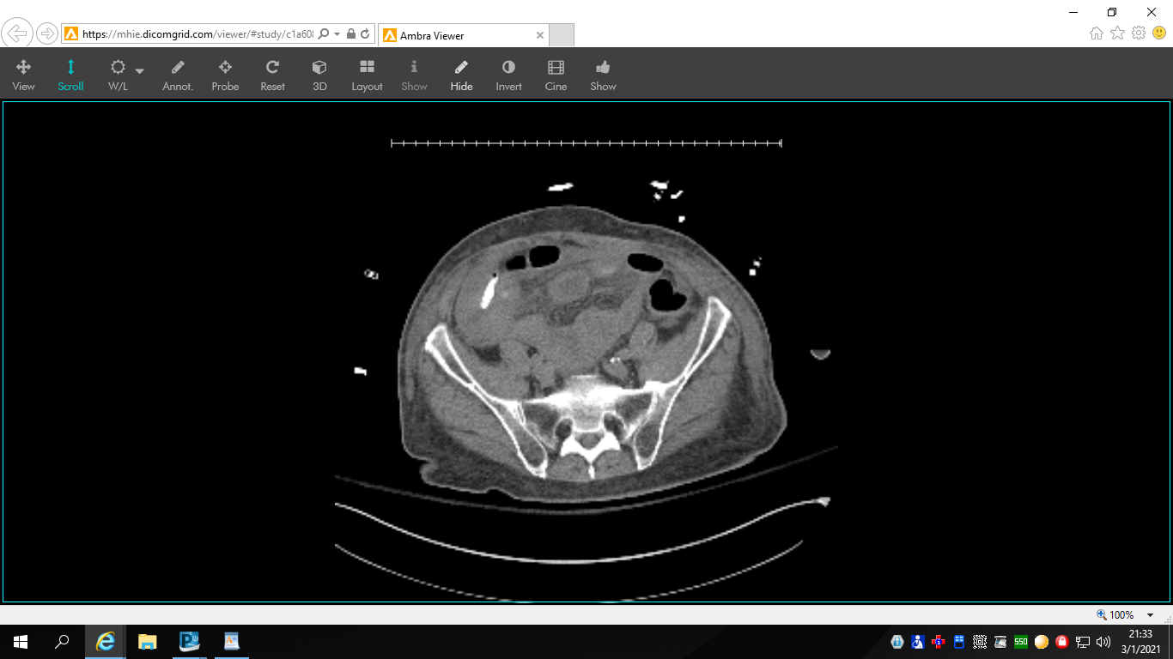

Slide 21
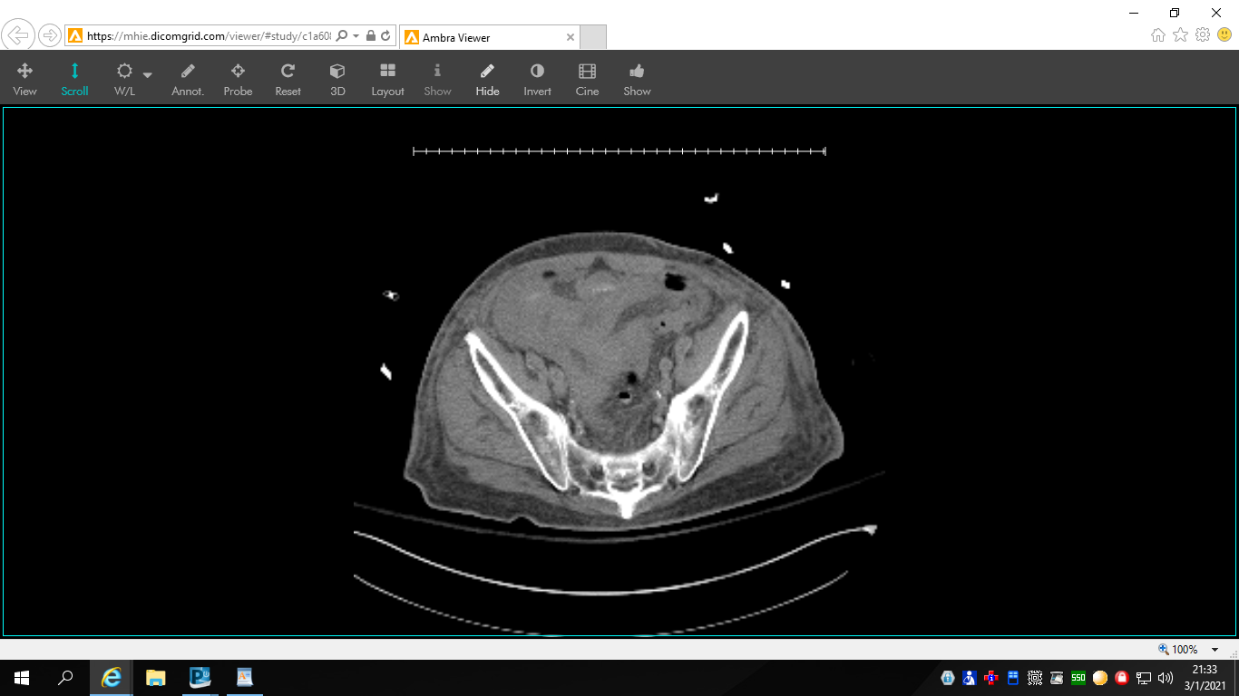
Notes:
Bibasilar opacities in the lung, effusion vs. pneumonia
Moderate ascites

Slide 22
Key Images

Slide 23
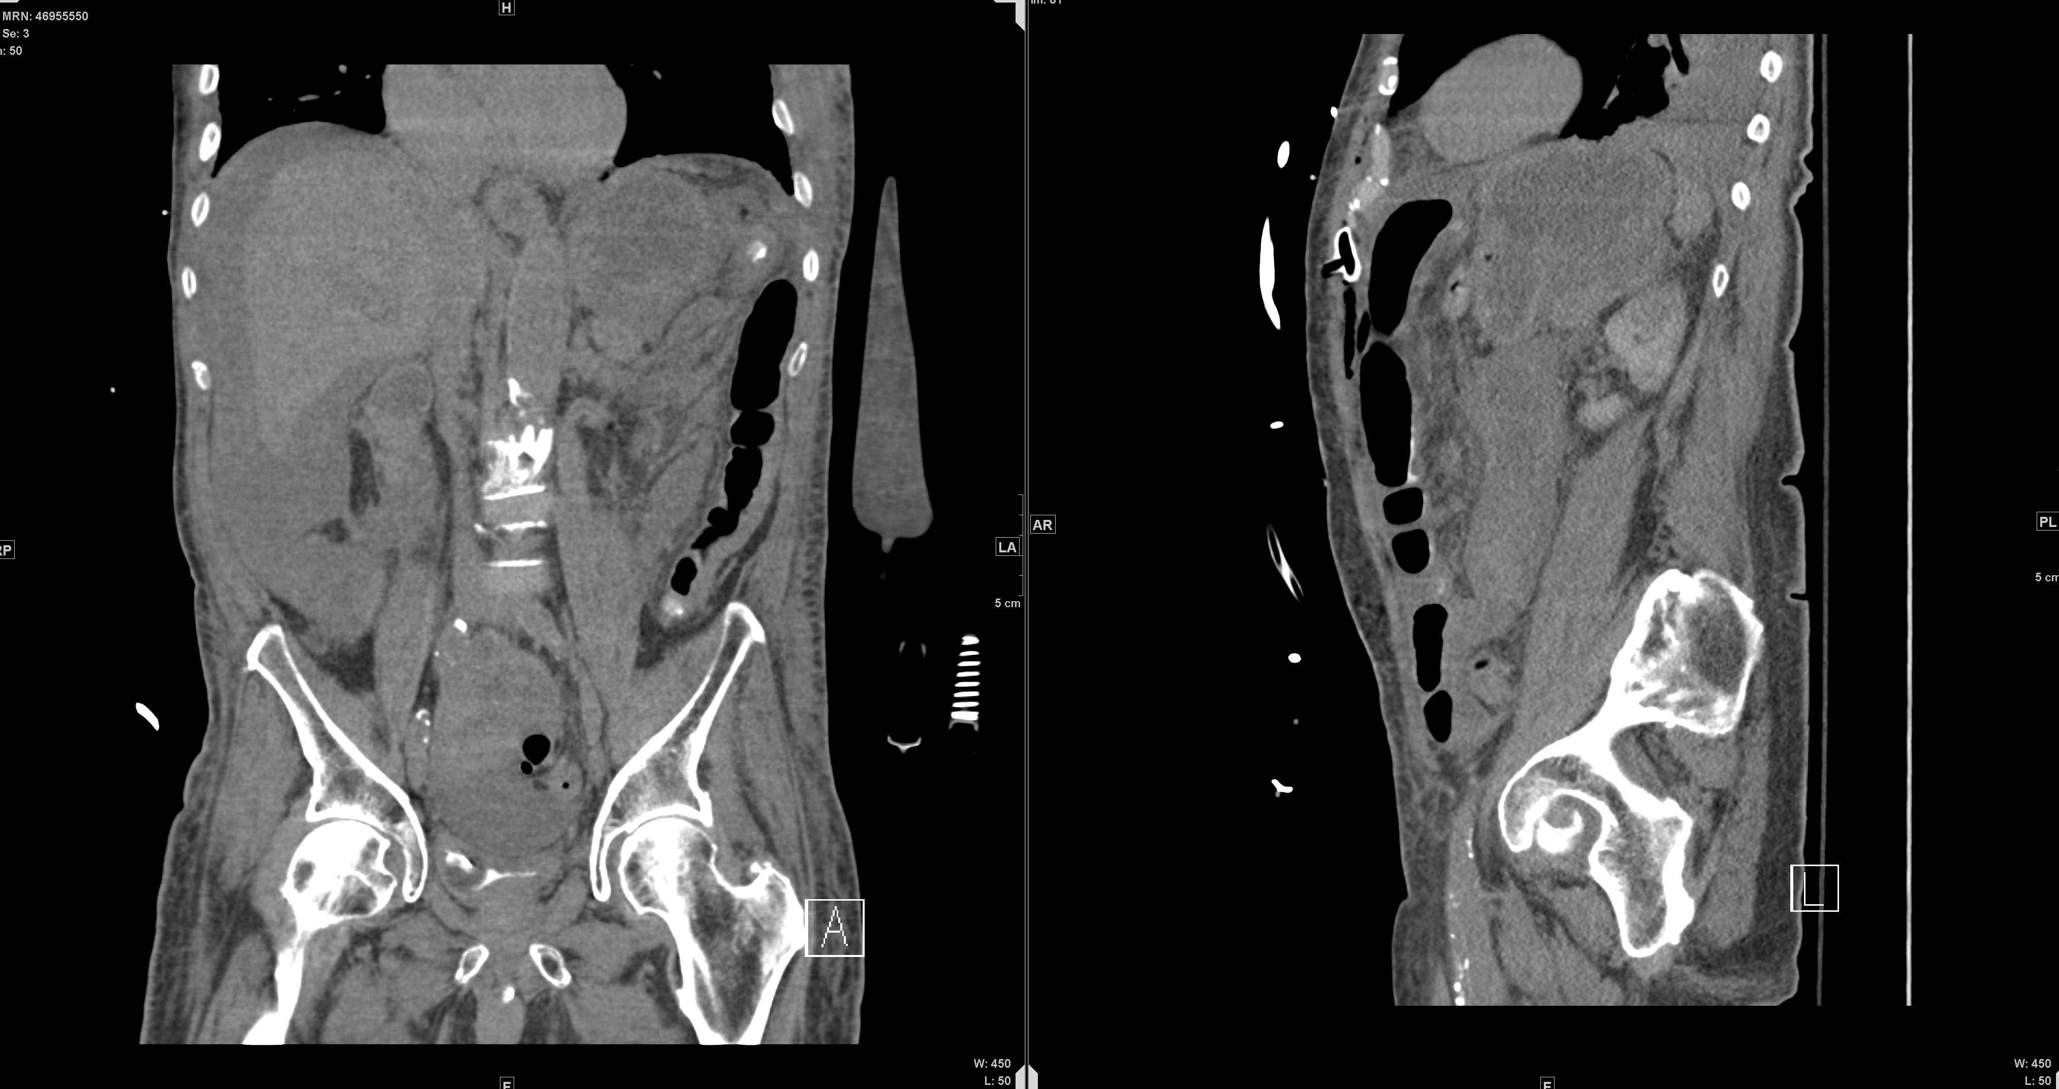
Key Images

Slide 24
Summary of Key Findings
Gastronomy tube appears to be along the anterior abdominal wall and is not in the lumen of the stomach. Bumper does not appear to be within the small bowel loop. Pneumoperitoneum and subcutaneous emphysema is noted likely due to recent percutaneous gastrostomy tube placement. No loculated fluid collected noted.
Pt had diffuse abdominal pain w/ hypotension
Cr 1.18 -> 2.37, lactic acid 9.8, WBC 9.8 -> 4.6
K 8.1, pH 7.18
BP 88/53
Notes:
Cr 1.18 -> 2.37, lactic acid 9.8, WBC 9.8 -> 4.6
K 8.1, pH 7.18
BP 88/53

Slide 25
Differential Diagnosis for Diffuse Abdominal Pain
Bowel Obstruction
Bowel Perforation
Intestinal Volvulus
Ischemic bowel
Intra-abdominal abscess
Radiographic differential diagnosis for pneumoperitoneum
Chilaiditi syndrome (pseudopneumonperitoneum)
Notes:
https://radiopaedia.org/articles/pseudopneumoperitoneum?lang=us
Pseudo – any gas within abdominal cavity that looks like free air when it is contained within an organ.

Slide 26
Pneumoperitoneum
Presence of air in the abdomen outside of the gastrointestinal tract usually as a result of intestinal perforation
Can be seen as normal post-surgical changes in abdominal surgery or laparoscopic surgery
Causes
Iatrogenic
Trauma
Ischemia
Ulceration
Infection
Mechanical Ventilation
Notes:
https://www.visualdx.com/visualdx/diagnosis/pneumoperitoneum?diagnosisId=55408&moduleId=101
https://www.ncbi.nlm.nih.gov/pmc/articles/PMC4535122/#:~:text=Pneumoperitoneum%20is%20the%20presence%20of,on%20computerized%20tomography%20(CT).
Sometimes pneumothorax can extend into pneumoperitoneum

Slide 27
Pneumoperitoneum
Erect chest x-ray is most sensitive plain radiograph
Many patients go to CT but is not required
Notes:
https://www.ncbi.nlm.nih.gov/pmc/articles/PMC3912647/
Solis et al. 2014.
Retrospective 4 year study at tertiary care academic medical center, 25 patients in non-CT group and 18 in CT group. CT delays surgery without providing measurable benefit.

Slide 28
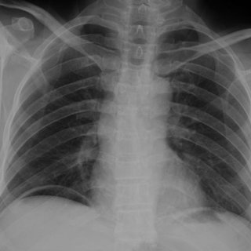
Pneumoperitoneum
Radiographic features
Chest radiograph
Subdiaphragmatic free gas
Continuous diaphragm sign
Cupola sign (supine)
Leaping Dolphin Sign
Subdiaphragmatic free gas
https://www.researchgate.net/figure/Plain-abdominal-radiograph-revealed-a-subdiaphragmatic-free-air-Abdomen-CT-scan-showing_fig1_289547951
Notes:
https://radiopaedia.org/articles/pneumoperitoneum?lang=us
https://radiopaedia.org/articles/continuous-diaphragm-sign?lang=us
https://radiopaedia.org/articles/cupola-sign-pneumoperitoneum?lang=us
https://radiopaedia.org/articles/leaping-dolphin-sign?lang=us
Subdiaphragmatic free gas – little as 1mL of free gas can be detected.
Continuous diaphragm sign – diaphragm can be seen continuously across the midline.
Leaping dolphin sign – collection of moderate to large volume of free air beneath the arcuate slips of diaphragm which mimics the parallel arcs of dolphins leaping in tandem
Cupola sign – seen on supine film when gas accumulates underneath the central tendon of the diaphragm in the midline. Seen as a lucency overlying the lower thoracic vertebral bodies.

Slide 29
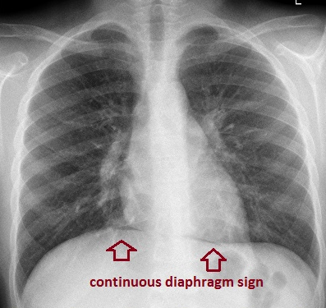
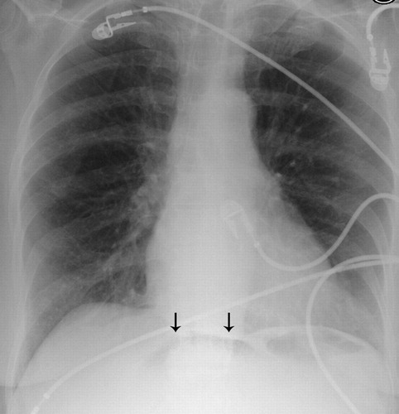
Cupola SIgn
https://pubs.rsna.org/doi/abs/10.1148/radiol.2412040700?journalCode=radiology
http://www.emergucate.com/pneumomediastinum-continuous-diaphragm-sign/
Notes:
http://www.emergucate.com/pneumomediastinum-continuous-diaphragm-sign/
Cupola sign - https://pubs.rsna.org/doi/abs/10.1148/radiol.2412040700?journalCode=radiology

Slide 30
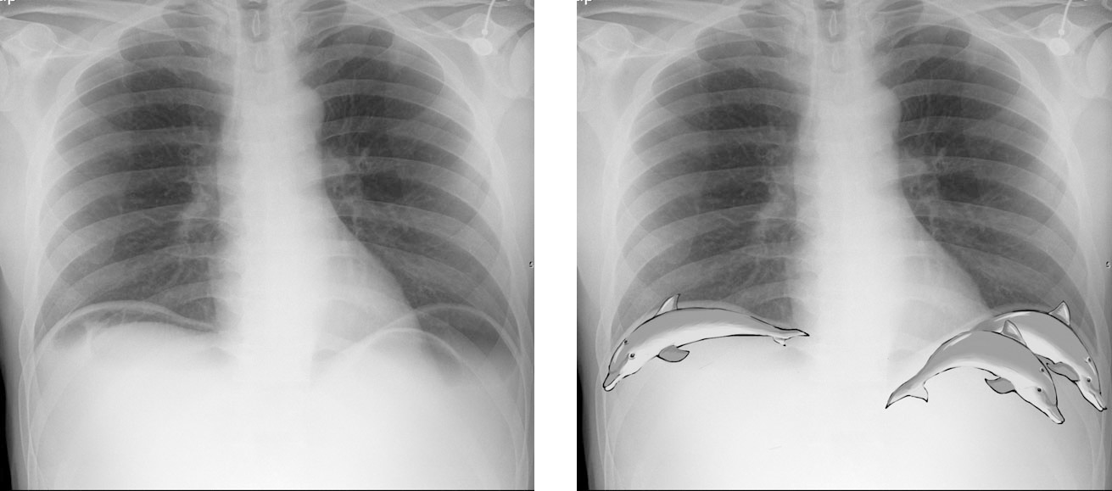
https://onlinelibrary.wiley.com/doi/full/10.1111/1754-9485.34_12784
Notes:
https://onlinelibrary.wiley.com/doi/full/10.1111/1754-9485.34_12784

Slide 31
Pneumoperitoneum
Radiographic features
Abdominal Radiograph
Rigler sign
Telltale triangle sign
Falciform ligament sign
Lateral umbilical ligament sign (Inverted “V” sign)
Cupola sign
Hepatic edge sign
Lucent liver sign
Morison pouch sign
Periportal free gas sign
Notes:
Only a portion of the radiographic signs for time-sake
Rigler sign – double wall sign. Gas is outlining both sides of the bowel wall. Seen in large pneumo (>1000 mL)
https://radiopaedia.org/articles/pneumoperitoneum?lang=us

Slide 32
Treatment
Pt went for emergency ex-lap with EGS and replacement of gastronomy tube on 2/12
Started on broad spectrum antibiotics
Pt became hypotensive and acidotic requiring multiple bicarb pushes and CRRT
On 2/14, pt had multiple episodes of cardiac arrest including PEA. Was unable to obtain ROSC.

Slide 33
Discussion
Pt likely became septic due to the mispositioned G-tube resulting in feeding into the abdominal cavity. In combination with patient’s complicated medical history and history of recent surgery, made him more susceptible to rapidly developing sepsis and septic shock
There may have been a component of a developing aspiration pneumonia or hospital acquired pneumonia due to patient’s prior history of stroke, dysphagia, and altered mental status. Right infrahilar airspace opacities were noted previously on CXR on 2/3 which were noted to be stable until 2/13.
Question for Dr. Awdeh: in the setting of procedure such as PEG tube placement, would you be likely to see a substantial degree of pneumoperitoneum on imaging?

Slide 34
Final Diagnosis
Pneumoperitoneum from misplaced gastronomy tube

Slide 35
ACR Appropriateness Criteria
Notes:
https://www.acr.org/Clinical-Resources/ACR-Appropriateness-Criteria
Obtaining CT of abdomen was appropriate due to patients acute abdomen with fever.

Slide 36
ACR Appropriateness Criteria
Notes:
https://www.acr.org/Clinical-Resources/ACR-Appropriateness-Criteria
Initial CXR imaging appropriate due to line placement and repeat imaging appropriate due to poor clinical status.

Slide 37
ACR Appropriateness Criteria
Cost of Imaging
CXR x 11 - $36
CTA PE - ~$1650
CT AP - $524
CT Head w/o Contrast x 2 - $500
Abdomen XR x 9 - ~$50
Total = $4020

Slide 38
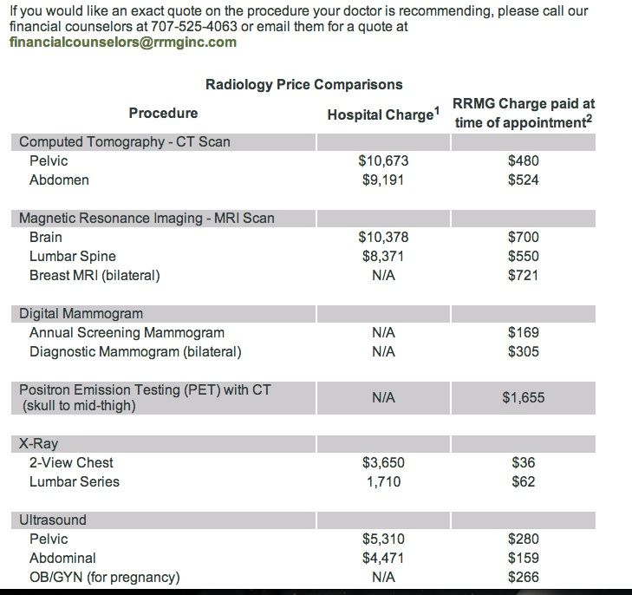
Notes:
https://www.mdsave.com/procedures/ct-scan-without-contrast/d781f5cd
https://www.newchoicehealth.com/procedures/ct-angiography-chest

Slide 39
Notes:
https://www.mdsave.com/procedures/ct-scan-without-contrast/d781f5cd
https://www.newchoicehealth.com/procedures/ct-angiography-chest

Slide 40
Take Home Points
Be methodic when reading a chest x-ray to ensure that you don’t miss any significant pathology
Discussed clinical presentation and causes of pneumoperitoneum
Discussed the radiographic signs for diagnosing pneumoperitoneum on plain film radiography

Slide 41
References
https://radiopaedia.org/articles/pseudopneumoperitoneum?lang=us
https://www.visualdx.com/visualdx/diagnosis/pneumoperitoneum?diagnosisId=55408&moduleId=101
https://www.ncbi.nlm.nih.gov/pmc/articles/PMC4535122/#:~:text=Pneumoperitoneum%20is%20the%20presence%20of,on%20computerized%20tomography%20(CT)
https://www.ncbi.nlm.nih.gov/pmc/articles/PMC3912647/
https://radiopaedia.org/articles/pneumoperitoneum?lang=us
https://radiopaedia.org/articles/continuous-diaphragm-sign?lang=us
https://radiopaedia.org/articles/cupola-sign-pneumoperitoneum?lang=us
https://radiopaedia.org/articles/leaping-dolphin-sign?lang=us

Slide 42
References
http://www.emergucate.com/pneumomediastinum-continuous-diaphragm-sign/
https://pubs.rsna.org/doi/abs/10.1148/radiol.2412040700?journalCode=radiology
https://onlinelibrary.wiley.com/doi/full/10.1111/1754-9485.34_12784
https://www.acr.org/Clinical-Resources/ACR-Appropriateness-Criteria
https://www.mdsave.com/procedures/ct-scan-without-contrast/d781f5cd
https://www.newchoicehealth.com/procedures/ct-angiography-chest

