Slide 1
Pulmonary Embolism
Kyle Meissner
02/01/2021
RAD 4001

Slide 2
Clinical History
83 yo male
PMHx CAD s/p PCI x3 (8-10 yr ago) and CVA w/ residual blindness
Presented after LOC and complaining of a five day hx of chest pain
  Bilateral painful leg swelling 3 days ago that resolved after 24 hours
Vitals:
  BP 118/69
  P 104
  T 96.6 F
  R 28
  O2 Saturation 94%
Work-up
  Troponin 0.53
  CXR
  CT Chest PE Protocol

Slide 3
Differential Diagnosis
Pulmonary Embolism
Myocardial Infarction
Pneumonia
Aortic Dissection
Pericarditis
Cardiac Tamponade
Pleuritic Chest Pain

Slide 4
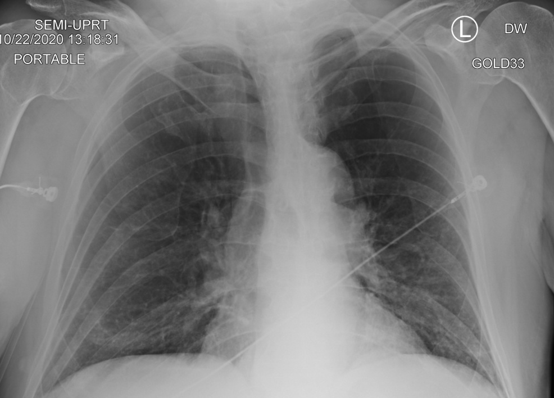
Chest X-Ray
Impression:
  Bibasilar hazy opacities representing atelectasis or possible early infection

Slide 5
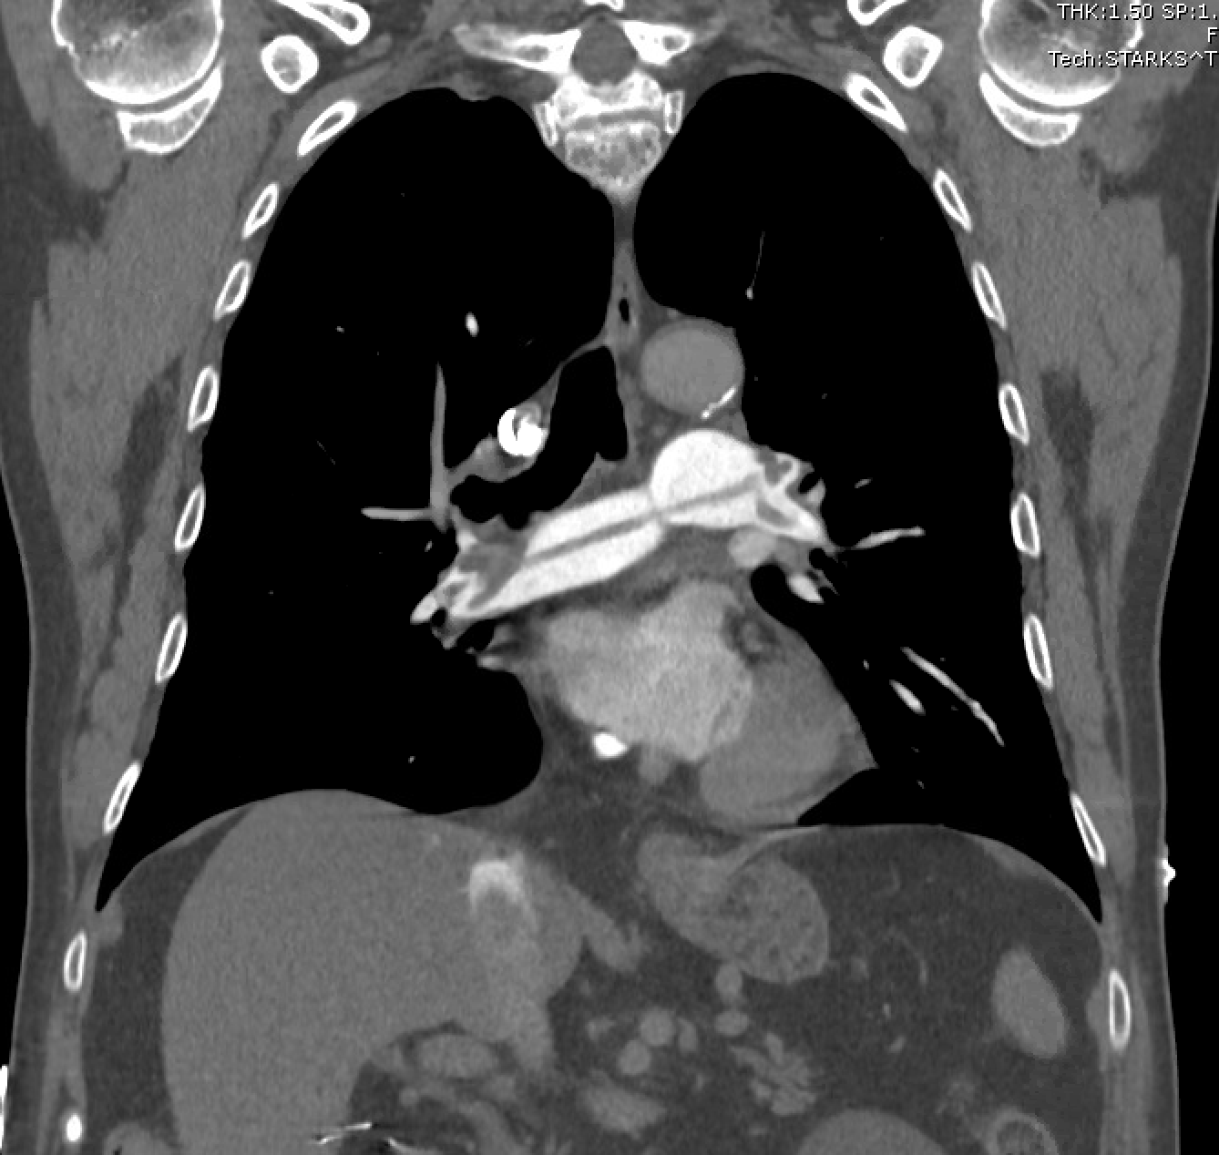
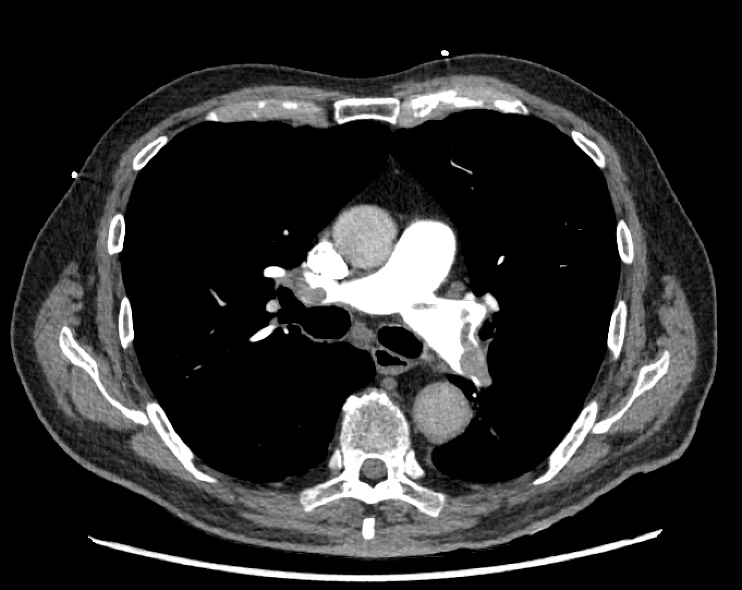
CT Chest PE Protocol
R/L Mainstem Bronchus
Ascending Aorta
Thrombus
Pulmonary Vasculature
Descending Aorta

Slide 6
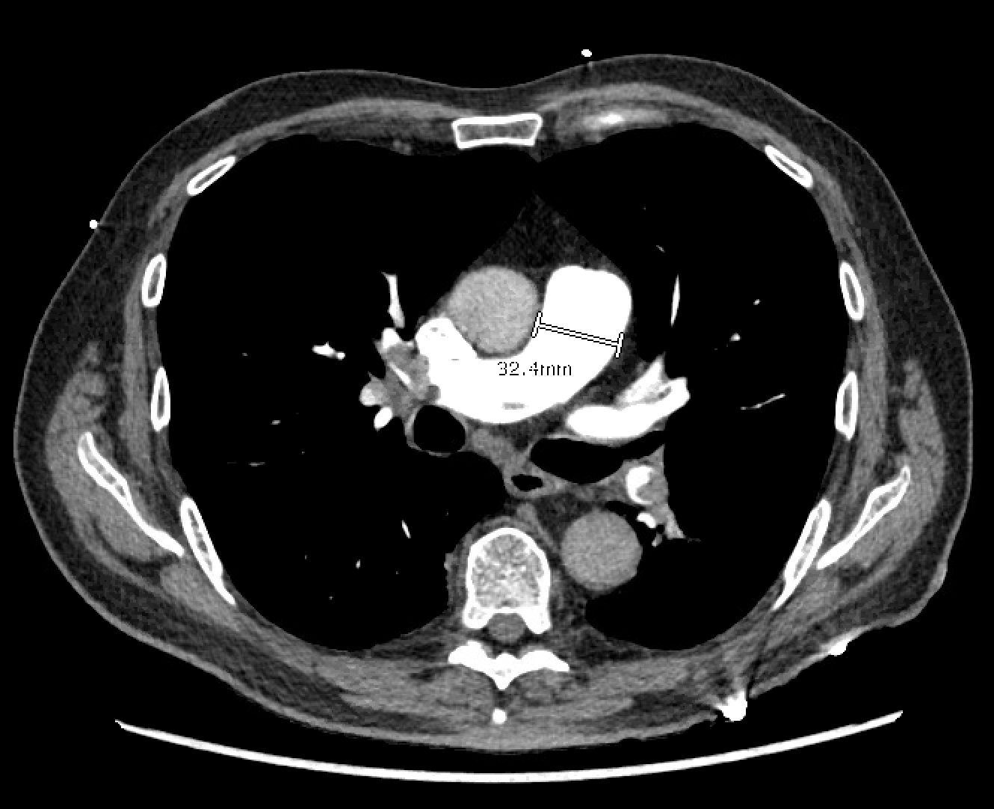
Key Imaging Findings
Saddle Embolism with bilateral emboli involving the right and left pulmonary arteries (lobar and segmental branches)
Right Heart Strain
Abnormal position of the interventricular septum - Flattening of the interventricular septum - Paradoxical interventricular septal bowing, i.e., towards the left ventricle right ventricular enlargement (right ventricle bigger than the left ventricle)
Pulmonary trunk enlargement (bigger than the aorta)
Features of right heart failure - Inferior vena cava contrast reflux - Dilated azygous venous system - Dilated hepatic veins +/- with contrast reflux
*https://radiopaedia.org/articles/right-heart-strain?lang=us

Slide 7
Differential Diagnosis
Pulmonary Embolism
  Acute v. Chronic
  Massive v. Submassive
Myocardial Infarction
Pneumonia
Malignancy

Slide 8
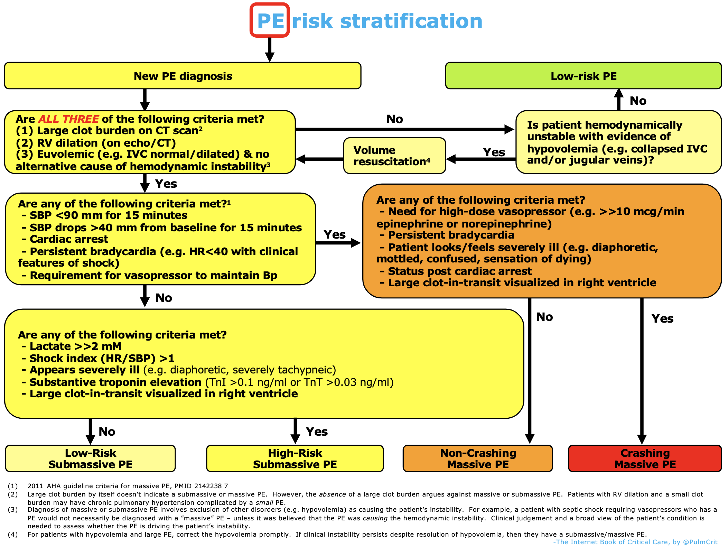
Discussion
Types of PE:
  Massive
    Hemodynamically unstable (SBP<90, Cardiac arrest, persistent bradycardia, vasopressor requirement
  Submassive
    Stable, etc.
Notes:
https://emcrit.org/wp-content/uploads/2019/09/stratalgo.svg

Slide 9
Final Diagnosis
Submassive Pulmonary Embolism with Right Heart Strain

Slide 10
Hospital Course
Transferred to BT CCU, started on Heparin
Transthoracic Echo
  Grossly right ventricular appears
  moderately dilated, visually mild to moderately reduced function
  Estimated pulmonary artery systolic pressure to be at least 32-37mmHg assuming a RA pressure of 5-10 mmHg
IR Pulmonary Angiogram
  For possible catheter directed thrombolysis
  No filling defects, PA pressure 25 mmHg
Lower Extremity Venous Doppler
  Deep venous thrombosis of the left popliteal vein
Notes:
https://www.nejm.org/doi/pdf/10.1056/NEJMra0907731?articleTools=true

Slide 11
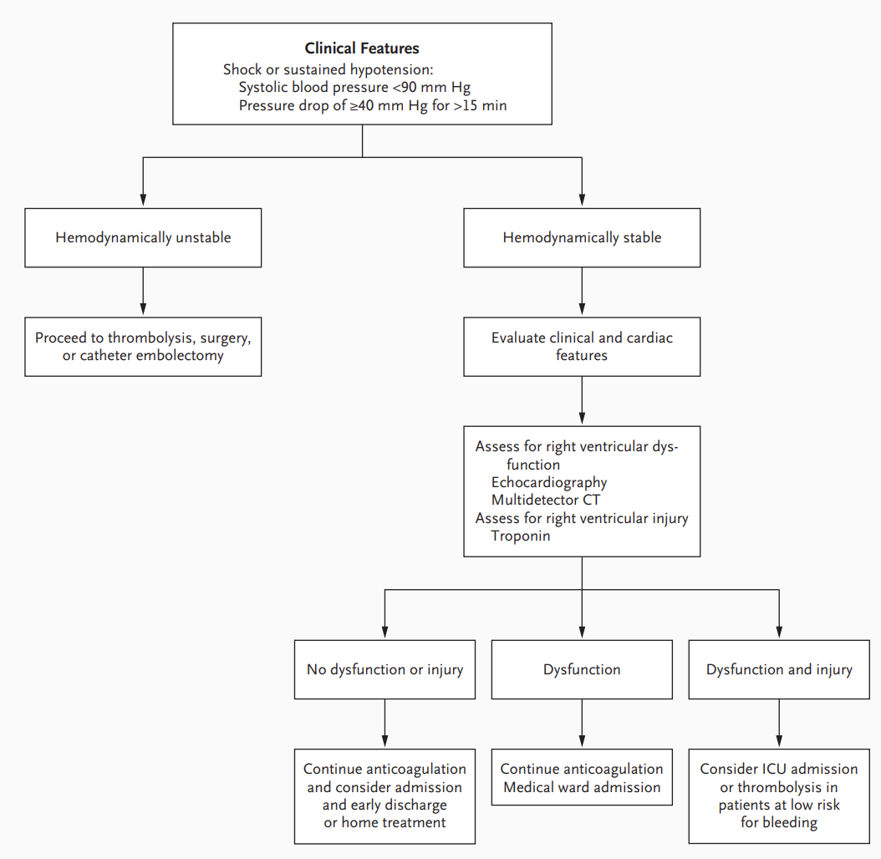
Treatment
Transitioned from Heparin to Lovenox
  No thrombolysis
Continued ASA and Statin for CVA/MI history
Discharged
Notes:
https://www.nejm.org/doi/pdf/10.1056/NEJMra0907731?articleTools=true

Slide 12
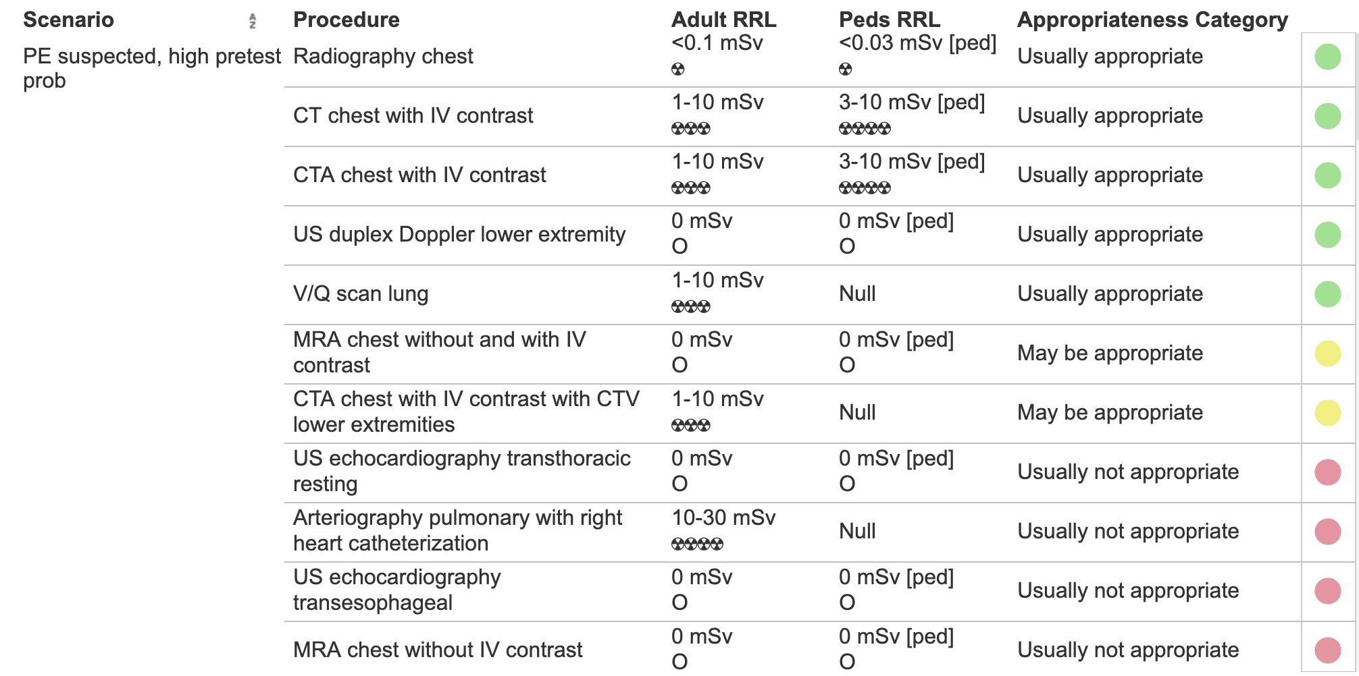
ACR Appropriateness Criteria
Notes:
https://www.acr.org/Clinical-Resources/ACR-Appropriateness-Criteria

Slide 13
Associated Costs
Chest Xray - $300
CT Angiogram Chest - $6,200
Transthoracic Echo - $2,000
IR Cardiac Catheterization - $9,268
DVT Doppler - $766
Total Cost – $18,534
Notes:
https://www.newchoicehealth.com/procedures/ct-angiography-chest
https://www.choosingwisely.org/patient-resources/echocardiograms-for-heart-valve-disease/#:~:text=A%20standard%20echocardiogram%20and%20TEE,the%20cost%20of%20the%20test.
https://health.costhelper.com/chest-x-rays.html#:~:text=For%20patients%20not%20covered%20by,NewChoiceHealth.com%5B1%5D%20.
https://www.mdsave.com/procedures/venous-doppler-study-bilateral/d786fdce
https://www.mdsave.com/procedures/cardiac-catheterization-with-and-without-coronary-angiogram/d785fec8/texas

Slide 14
Take Home Points / Teaching points
Pulmonary embolisms are best diagnosed through CT PE Protocol
An additional transthoracic echo is not required to assess right heart strain already confirmed on CT
Both massive and submassive PEs can produce right heart strain. The main differentiating factor is hemodynamic stability

Slide 15
References
https://emcrit.org/wp-content/uploads/2019/09/stratalgo.svg
https://www.nejm.org/doi/pdf/10.1056/NEJMra0907731?articleTools=true
https://www.acr.org/Clinical-Resources/ACR-Appropriateness-Criteria
https://www.newchoicehealth.com/procedures/ct-angiography-chest
https://www.choosingwisely.org/patient-resources/echocardiograms-for-heart-valve-disease/#:~:text=A%20standard%20echocardiogram%20and%20TEE,the%20cost%20of%20the%20test.
https://health.costhelper.com/chest-x-rays.html#:~:text=For%20patients%20not%20covered%20by,NewChoiceHealth.com%5B1%5D%20.
https://www.mdsave.com/procedures/venous-doppler-study-bilateral/d786fdce
https://www.mdsave.com/procedures/cardiac-catheterization-with-and-without-coronary-angiogram/d785fec8/texas

Slide 16

Questions?

